Slide 1
Cardio Good Fitness Project
Preliminary Data Analysis
Submitted by:
Naveen Pusuluri

Slide 2
Objective
To conduct preliminary Data Analysis by exploring and extracting basic observations from the given set of data, and create a customer profile of the different products offered by Cardio Good Fitness retail store.
This will be done by:
Performing univariate, bivariate, and multivariate analyses
Analyzing variables that influence characteristics of a customer for different products
Generating a set of insights and recommendations which will help the company in targeting new customers

Slide 3
Data Information
Following are the data variables for customers of the treadmill product(s) of a retail store called Cardio Good Fitness
Variable | Description
Product | model no. of the treadmill
Age | In no of years, of the customer
Gender | of the customer
Education | In no. of years, of the customer
Marital status | of the customer
Usage | Avg. # times the customer wants to use the treadmill every week
Fitness | Self rated fitness score of the customer (5 - very fit, 1 - very unfit)
Income | of the customer
Miles | expected to run
Observations | Variables
180 | 9

Slide 4
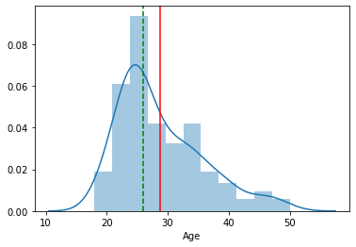
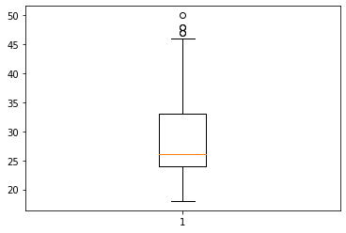
Exploratory Data Analysis – Age Variable
Age
Observations:
The distribution of Age is moderately right skewed.
Most of the customers fall in the 20 to 40 age group.
Majority of the customers are in the 23 to 28 age group.
There are some outliers in the Age variable.
Median is close to 25th percentile.

Slide 5
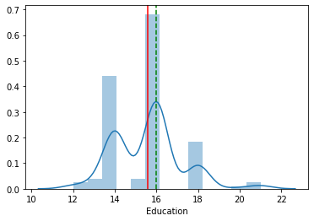
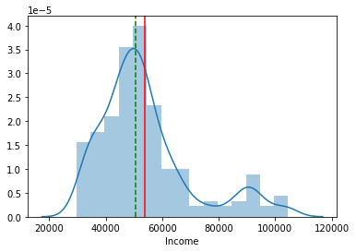
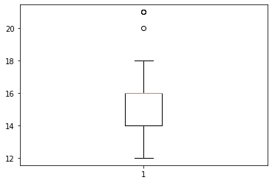
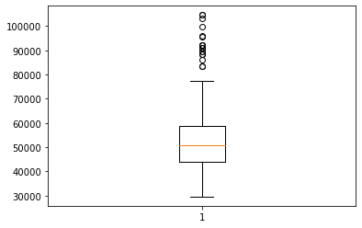
Exploratory Data Analysis – Education & Income
Education
Income
Observations
Education Variable has some skewness on right side.
Majority of the customers have 16 years of education.
Very few outliers in Education variable.
Median is at 75th percentile.
Observations:
Income variable has right skewness.
Most of the customer income is in the range of 30000 to 60000 Income.
There are many outliers in Income variable.
Median is around 50th percentile.

Slide 6
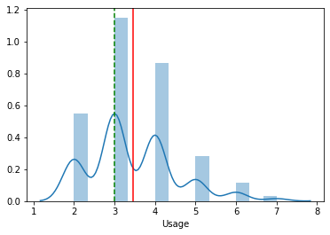
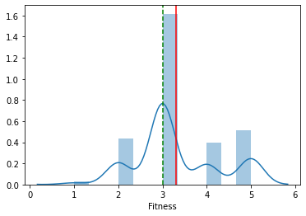
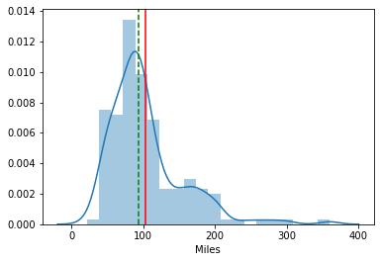
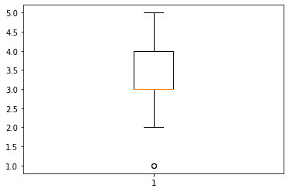
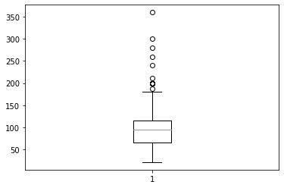
Exploratory Data Analysis – Usage, Fitness & Miles
Usage
Fitness
Miles
Observations:
Distribution has right skewness.
Average expected usage of the product is between 3 and 4 times per week.
Very few outliers in Usage variable.
Median is at 25th percentile.
Observations:
Majority of the customers are at medium fitness level.
Very few outliers towards bottom for the fitness variable.
Median is at 25th percentile.
Observations
Miles variable has right skewness.
Mean is 103 and median is 94 indicating that majority customers expect to run around 100 miles in week.
There are many outliers in Miles variable.
Median is slightly close to the 75th percentile

Slide 7
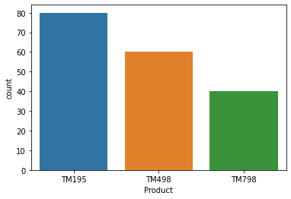
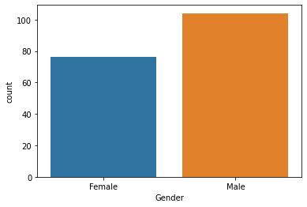
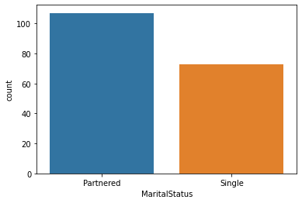
Exploratory Data Analysis – Product, Gender & Marital Status
Product
Gender
Marital Status
Observations:
Majority of the customers have TM195, followed by TM498 and TM798.
Observations:
Of the total 180 customers, 104 are male and 76 are female.
Observations:
107 customers are partnered and 73 customers are single.

Slide 8
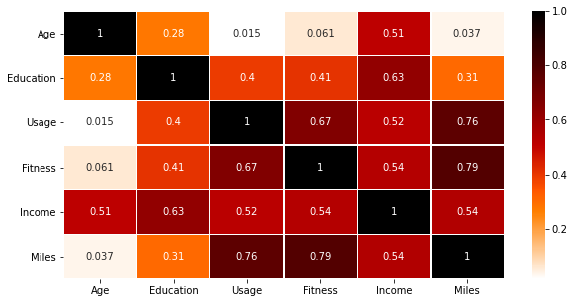
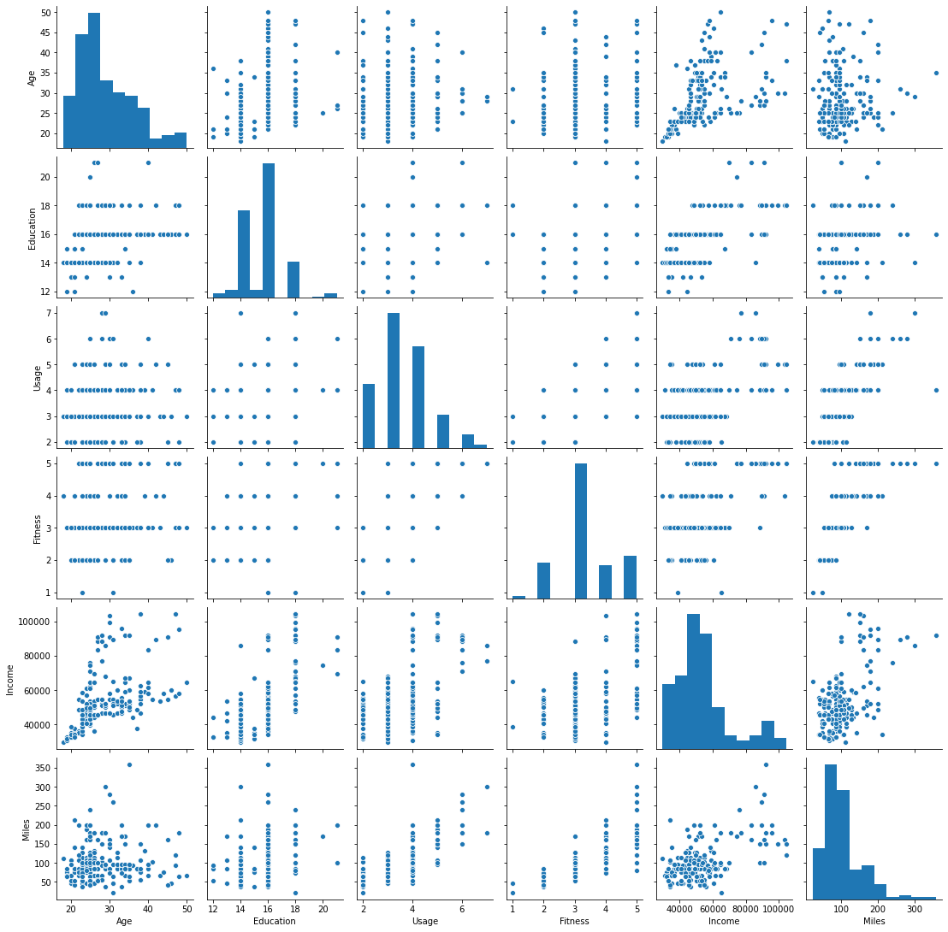
Exploratory Data Analysis – Correlation Matrix
Observations:
As expected, Usage and Miles have good correlation.
Fitness has strong correlation with Miles and Usage.
While education and Income correlate well with each other, Education doesn't have much correlation with other variables.
Income shows a decent correlation with all variables.
Age has decent correlation with income and some correlation with Education. Age has no influence on Usage, Fitness, and Miles.

Slide 9
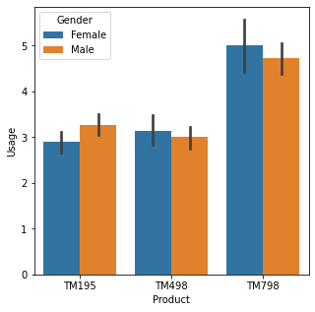
Exploratory Data Analysis – Usage across Product by Gender
Product Usage Vs. Gender
Observations:
Comparing weekly usage with the product categories:
TM798 is used more often than TM498 and TM195.
Female customers use TM798 and TM498 slightly more than male customers.
Male customers use TM195 slightly more than Female customers.

Slide 10
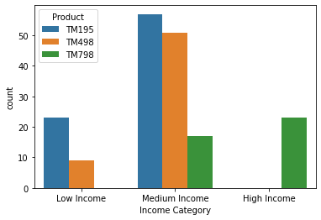
Exploratory Data Analysis – Product Preference based on Customer Income Category
Product Vs. Income Level
Note: Created a new column in dataset as “Income Category” by creating bins with labels on Income variable.
Observations:
Majority of the customers are in the medium income range.
Among the medium income customers, most of them use TM195 followed by TM498, and only a few customers use TM798.
High income customers use only TM798 indicating that it is a premium product.
Low income customers use only TM195 or TM498, with majority of them using TM195.

Slide 11
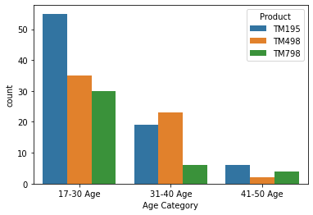
Exploratory Data Analysis – Product preference by Customer Age
Product Vs. Customer Age
Note: Created a new column in dataset as “Age Category” by creating bins with labels on Age variable.
Observations:
Majority of customers are under 30 years of age and most of them preferred TM195 followed by TM498 and T798.
Among 31-40 age group, TM498 is the most preferred product followed by TM195 and TM798.
There are very few customers in between 41-50 age group, and they preferred TM195 the most followed by TM798 and T498.

Slide 12
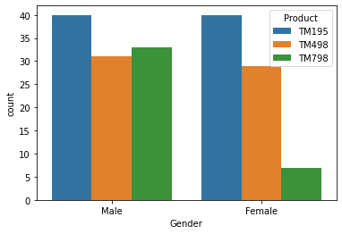
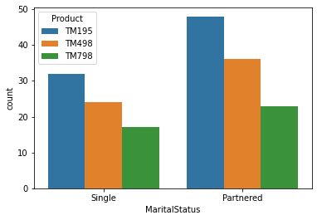
Exploratory Data Analysis – Product Preference based on Customer Gender & Marital Status
Product Vs. Customer Gender
Product Vs. Customer Marital Status
Observations:
TM798 is largely preferred by Male customers, while TM195 and TM498 are preferred by both male & female customers equally.
Observations:
There are more partnered customers than single customers.
Both partnered and single customers preferred TM195 the most followed by TM498 and TM798.

Slide 13
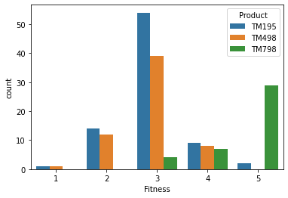
Exploratory Data Analysis – Fitness Level of Customer based on Product choice
Product Vs. Customer Fitness Level
Observations:
Majority of customers who owned TM195 and TM498 are at fitness level 3.
Majority of customers who owned TM798 are at above fitness level 4 and above.

Slide 14
Conclusion
Based on the analysis, we can conclude the following customer characteristics for the different Cardio Good Fitness products:
TM195:
Used by ~44% of the customers
Mainly low-medium income level
Product usage/week is low & customer fitness level is average
TM498:
Used by ~33% of the customers
Low-medium income level
Product usage/week is low & their customer fitness level is average
TM798:
Used by ~23% of the customers
High-income customers preferred only TM198, not other two products
Product usage/week is high & customer fitness level is very good
Majority of Good Cardio Fitness’s customers are under 30 years of age and most of them preferred TM195 followed by TM498 and TM798.
Among 31-40 age group, TM498 is the most preferred product followed by TM195 and TM798.
There are very few customers in between 41-50 age group, and they preferred TM195 the most followed by TM798 and TM498
TM798 is largely preferred by Male customers, while TM195 and TM498 are preferred by both male & female customers equally.
There are more partnered customers than single customers.
Both partnered and single customers preferred TM195 the most followed by TM498 and TM798.
It is observed that customers who have TM195 & TM498 do not use the product more number of times per week compared to the customer who have TM798, because of which fitness level of TM195 & TM498 customers is average.

Slide 15
Recommendations
TM195 has the highest demand among the three products sold by Cardio Good Fitness followed by TM498. While TM195 & TM498 share almost similar customer profiles, TM798 is preferred only by high-income customers & a few medium-income customers.
Cardio Good Fitness must promote TM195 & TM498 products to the low-medium income level customers.
Cardio Good Fitness must promote TM798 to male high-income level customers.

