Slide 1
Computação Paralela e Distribuída
Parallel and Distributed Computing
Practical session 5
  MPI - Message-passing interface

Slide 2
MPI Message-passing Interface
Standard
Vendor and public-domain implementations – we will use openmpi
Library used from C, C++ and Fortran
Several Java implementations

Slide 3
Identifying MPI processes
Common practice to identify processes by nonnegative integer ranks.
p processes are numbered 0, 1, 2, .. p-1

Slide 4
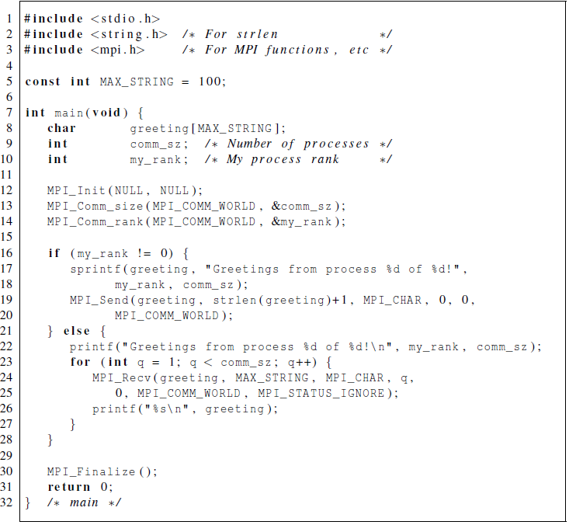
Our first MPI program

Slide 5
Compilation
wrapper script to compile
source file
mpicc -g -Wall -o mpi_hello mpi_hello.c
produce
debugging
information
create this executable file name
(as opposed to default a.out)
turns on all warnings

Slide 6
Execution
mpiexec -n <number of processes> <executable>
mpiexec -n 1 ./mpi_hello
run with 1 process
mpiexec -n 4 ./mpi_hello
run with 4 processes

Slide 7
Execution
mpiexec -n 1 ./mpi_hello
Greetings from process 0 of 1 !
mpiexec -n 4 ./mpi_hello
Greetings from process 0 of 4 !
Greetings from process 1 of 4 !
Greetings from process 2 of 4 !
Greetings from process 3 of 4 !

Slide 8
MPI Programs
Written in C.
  Has main.
  Uses stdio.h, string.h, etc.
Need to add mpi.h header file.
Identifiers defined by MPI start with “MPI_”.
First letter following underscore is uppercase.
  For function names and MPI-defined types.
  Helps to avoid confusion.

Slide 9


MPI Components
MPI_Init
  Tells MPI to do all the necessary setup.
MPI_Finalize
  Tells MPI we’re done, so clean up anything allocated for this program.

Slide 10
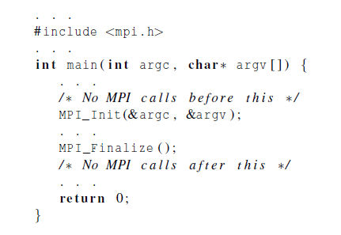
Basic Outline

Slide 11
Communicators
A collection of processes that can send messages to each other.
MPI_Init defines a communicator that consists of all the processes created when the program is started.
Called MPI_COMM_WORLD.

Slide 12


Communicators
number of processes in the communicator
my rank
(the process making this call)

Slide 13
SPMD
Single-Program Multiple-Data
We compile one program.
Process 0 does something different.
  Receives messages and prints them while the other processes do the work.
The if-else construct makes our program SPMD.

Slide 14
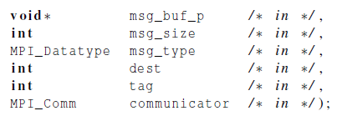

Communication

Slide 15
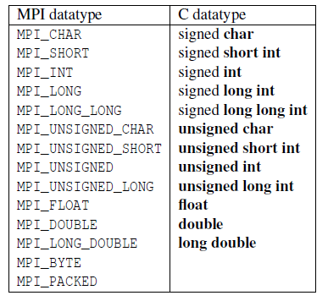
Data types

Slide 16
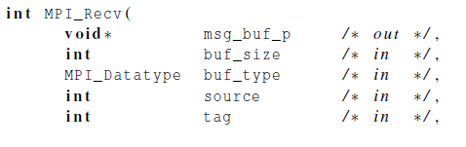

Communication

Slide 17

Message matching
r
MPI_Send
src = q
MPI_Recv
dest = r
q

Slide 18

Receiving messages
A receiver can get a message without knowing:
  the amount of data in the message,
  the sender of the message,
  or the tag of the message.

Slide 19
status_p argument
MPI_Status*
MPI_Status* status;
status.MPI_SOURCE
status.MPI_TAG
MPI_SOURCE
MPI_TAG
MPI_ERROR

Slide 20


How much data am I receiving?

Slide 21

Issues with send and receive
Exact behavior is determined by the MPI implementation.
MPI_Send may behave differently with regard to buffer size, cutoffs and blocking.
MPI_Recv always blocks until a matching message is received.
Know your implementation;
don’t make assumptions!

Slide 22
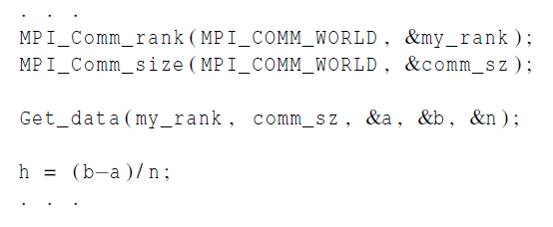
Input
Most MPI implementations only allow process 0 in MPI_COMM_WORLD access to stdin.
Process 0 must read the data (scanf) and send to the other processes.

Slide 23
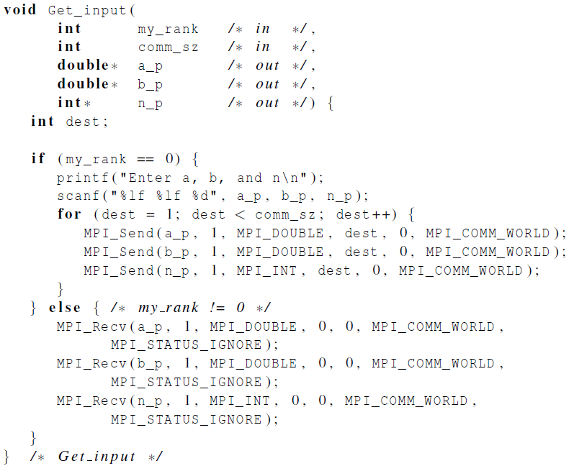
Function for reading user input

Slide 24

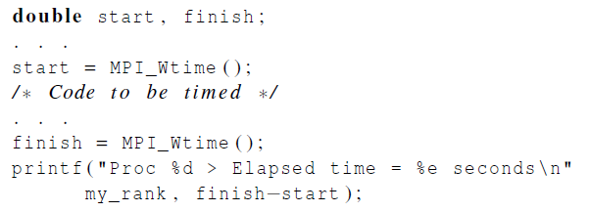
Elapsed parallel time
Returns the number of seconds that have elapsed since some time in the past.

Slide 25

Alternative to gettimeofday()
Standard library call
Returns time in microseconds elapsed from some point in the past.
#include <stdlib.h>
#include <sys/time.h>
…
struct timeval s,t;
…
gettimeofday(&s, NULL);
/* Code to be timed */
gettimeofday(&t, NULL);
printf("Elapsed time (us) = %ld\n", (t.tv_sec - s.tv_sec)*1000000 + (t.tv_usec - s.tv_usec));

Slide 26

MPI_Barrier
Ensures that no process will return from calling it until every process in the communicator has started calling it.

Slide 27
MPI_Barrier: example of use
double start, finish;
…
MPI_Barrier(MPI_COMM_WORLD);
if(my_rank == 0) start = MPI_Wtime();
/* Code to be timed */
MPI_Barrier(MPI_COMM_WORLD);
if(my_rank == 0) {
finish = MPI_Wtime();
printf("Elapsed time (us) = %e\n", finish -start);
}

Slide 28
MPI Overview
MPI or the Message-Passing Interface is a library of functions that can be called from C, C++, or Fortran programs.
A communicator is a collection of processes that can send messages to each other.
Many parallel programs use the single-program multiple data or SPMD approach.
Collective communications involve all the processes in a communicator (next class)
An MPI program is unsafe if its correct behavior depends on the fact that MPI_Send is buffering its input. (next class)

