Slide 1
Computação Paralela e Distribuída
Parallel and Distributed Computing
Practical session 09
  MPI I-0

Slide 2
MPI-IO Introduction
Goals of this session
  introduce the important features of MPI-IO in the form of example programs, following the outline of the Parallel I/O chapter in Using MPI-2
  focus on how to achieve high performance
What can you expect from this session?
  learn how to use MPI-IO and, hopefully, like it
  be able to go back home and immediately use MPI-IO in your applications
  get much higher I/O performance than what you have been getting so far using other techniques

Slide 3
Common Ways of Doing I/O in Parallel Programs
Sequential I/O:
  All processes send data to rank 0, and 0 writes it to the file

Slide 4
Pros and Cons of Sequential I/O
Pros:
  parallel machine may support I/O from only one process (e.g., no common file system)
  Some I/O libraries (e.g. HDF-4, NetCDF) not parallel
  resulting single file is handy for ftp, mv
  big blocks improve performance
  short distance from original, serial code
Cons:
  lack of parallelism limits scalability, performance (single node bottleneck)

Slide 5
Another Way
Each process writes to a separate file
Pros:
  parallelism, high performance
Cons:
  lots of small files to manage
  difficult to read back data from different number of processes

Slide 6
What is Parallel I/O?
Multiple processes of a parallel program accessing data (reading or writing) from a common file
FILE
P0
P1
P2
P(n-1)

Slide 7
Why Parallel I/O?
Non-parallel I/O is simple but
  Poor performance (single process writes to one file) or
  Awkward and not interoperable with other tools (each process writes a separate file)
Parallel I/O
  Provides high performance
  Can provide a single file that can be used with other tools (such as visualization programs)

Slide 8
Why is MPI a Good Setting for Parallel I/O?
Writing is like sending a message and reading is like receiving
Any parallel I/O system will need a mechanism to
  define collective operations (MPI communicators)
  define noncontiguous data layout in memory and file (MPI datatypes)
  Test completion of nonblocking operations (MPI request objects)
I.e., lots of MPI-like machinery

Slide 9
Using MPI for Simple I/O
FILE
P0
P1
P2
P(n-1)
Each process needs to read a chunk of data from a common file

Slide 10
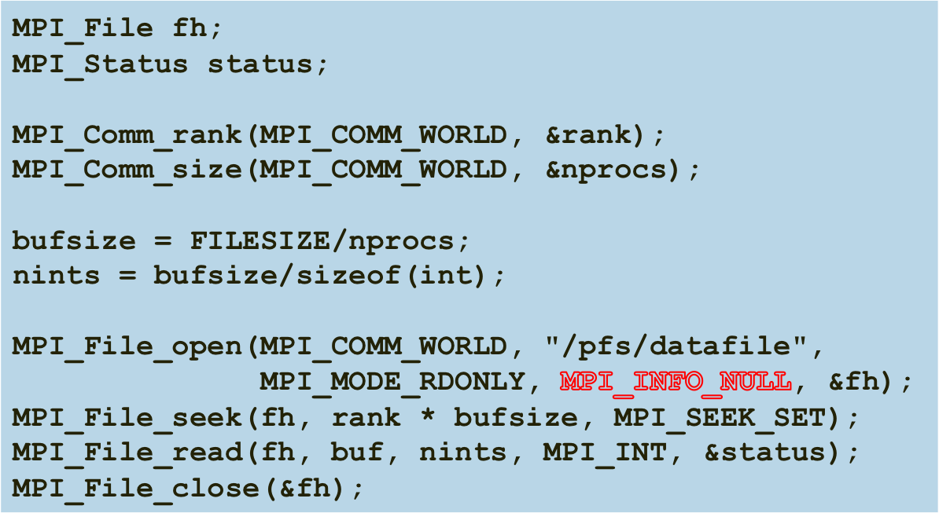
Using Individual File Pointers

Slide 11
Using Explicit Offsets
include 'mpif.h'
integer status(MPI_STATUS_SIZE)
integer (kind=MPI_OFFSET_KIND) offset
C in F77, see implementation notes (might be integer*8)
call MPI_FILE_OPEN(MPI_COMM_WORLD, '/pfs/datafile', &
MPI_MODE_RDONLY, MPI_INFO_NULL, fh, ierr)
nints = FILESIZE / (nprocs*INTSIZE)
offset = rank * nints * INTSIZE
call MPI_FILE_READ_AT(fh, offset, buf, nints,
MPI_INTEGER, status, ierr)
call MPI_GET_COUNT(status, MPI_INTEGER, count, ierr)
print *, 'process ', rank, 'read ', count, 'integers'
call MPI_FILE_CLOSE(fh, ierr)

Slide 12
Writing to a File
Use MPI_File_write or MPI_File_write_at
Use MPI_MODE_WRONLY or MPI_MODE_RDWR as the flags to MPI_File_open
If the file doesn’t exist previously, the flag MPI_MODE_CREATE must also be passed to MPI_File_open
We can pass multiple flags by using bitwise-or ‘|’ in C, or addition ‘+” in Fortran

Slide 13
Using File Views
Processes write to shared file
MPI_File_set_view assigns regions of the file to separate processes

Slide 14
File Views
Specified by a triplet (displacement, etype, and filetype) passed to MPI_File_set_view
displacement = number of bytes to be skipped from the start of the file
etype = basic unit of data access (can be any basic or derived datatype)
filetype = specifies which portion of the file is visible to the process

Slide 15
File View Example
MPI_File thefile;
for (i=0; i<BUFSIZE; i++)
buf[i] = myrank * BUFSIZE + i;
MPI_File_open(MPI_COMM_WORLD, "testfile",
MPI_MODE_CREATE | MPI_MODE_WRONLY,
MPI_INFO_NULL, &thefile);
MPI_File_set_view(thefile, myrank * BUFSIZE * sizeof(int),
MPI_INT, MPI_INT, "native",
MPI_INFO_NULL);
MPI_File_write(thefile, buf, BUFSIZE, MPI_INT,
MPI_STATUS_IGNORE);
MPI_File_close(&thefile);

Slide 16
MPI_File_set_view
Describes that part of the file accessed by a single MPI process.
Arguments to MPI_File_set_view:
  MPI_File file
  MPI_Offset disp
  MPI_Datatype etype
  MPI_Datatype filetype
  char *datarep
  MPI_Info info

Slide 17
Other Ways to Write to a Shared File
MPI_File_seek
MPI_File_read_at
MPI_File_write_at
MPI_File_read_shared
MPI_File_write_shared
Collective operations
like Unix seek
combine seek and I/O
for thread safety
use shared file pointer

Slide 18
Collective I/O
MPI_File_read_all, MPI_File_read_at_all, etc
_all indicates that all processes in the group specified by the communicator passed to MPI_File_open will call this function
Each process specifies only its own access information -- the argument list is the same as for the non-collective functions

Slide 19
Under the Covers of MPI-IO
MPI-IO implementation is given a lot of information in this case:
  Collection of processes reading data
  Structured description of the regions
Implementation has some options for how to obtain this data
  Noncontiguous data access optimizations
  Collective I/O optimizations

Slide 20
Trabalho a realizar
Modificar o simulador de fogos florestais de forma a usar o MPI-IO
  O ficheiro que representa os dados produzidos num dado passo é escrito em conjunto por todos os processos usando o MPI-IO
  Escrever apenas de 10 em 10 passos

