Slide 1
RAMACHANDRA COLLEGE OF ENGINEERING
(Autonomous)
COURSE:OBJECT-ORIENTED PROGRAMMING THROUGH JAVA
Unit-04: Interfaces, Packages and Java Library and Exception Handling

Slide 2
The complete Reference Java, 11th Edition, Herbert Schildt, TMH
Joy with JAVA, Fundamentals of Object-Oriented Programming, Debasis Samanta, Monalisa
Sarma, Cambridge, 2023.

Slide 3
Interfaces: Introduction, Declaration and Implementation of Interface, Multiple Interfaces, Nested
Interfaces, Inheritance of Interfaces, Default Methods in Interfaces, Static Methods in Interface.
Packages and Java Library: Introduction, Defining Package, Importing Packages and Classes into Programs, Path and Class Path, Access Control, Packages in Java SE, Java.lang Package and its Classes, Universal super Class Object Class, Enumeration, class Math, Wrapper Classes, Auto boxing and Auto- un boxing, Java util Classes and Interfaces, Scanner class.
Exception Handling: Introduction, Hierarchy of Standard Exception Classes, Keywords throws and throw, try, catch, and finally Blocks, Multiple Catch Clauses, Class Throwable, Unchecked Exceptions, Checked Exceptions.

Slide 4
LEARNING OBJECTIVE
Make the student able to Understanding to the concepts of interfaces, packages, Java library, and exception handling.
LEARNING OUTCOMES
After attending this session, a student will be able to Apply the concepts of interfaces, packages, Java library, and exception handling

Slide 5
UNIT-IV PART-A :
Interfaces: Introduction, Declaration and Implementation of Interface, Multiple Interfaces, Nested Interfaces, Inheritance of Interfaces, Default Methods in Interfaces, Static Methods in Interface.

Slide 6
PART- A: Interfaces:
Concept-1:Introduction, Declaration and Implementation of Interface

Slide 7
Why use Java interface?
There are mainly two reasons to use interface. They are given below.
It is used to achieve multiple inheritances.
It is used to achieve abstraction.
Interface in Java having only abstract methods
abstract methods means writing only method declaration but not method definition
Interface says I will tell you what are the methods you need but I will not implement.
We want to create Concrete class to define methods and concrete class implements interface
Two keywords we are using a.interface b.implements
Syntax:
interface interfacename
{
//by using the interface keyword.
void method();
//declare method
}

Slide 8
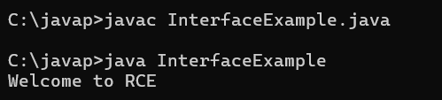
interface Parent // Interface declaration
{
void display(); // Abstract method
}
class Child implements Parent // Class implementing the interface
{
public void display()
// Implementing the method from the interface (must be public)
{
System.out.println("Welcome to RCE");
}
}
class InterfaceExample
{
public static void main(String args[])
{
Child obj = new Child(); // Creating an object of the Child class
obj.display(); // Calling the display method
}
}

Slide 9
PART-A: Interfaces:
Concept-2:Multiple Interfaces & Inheritance of Interfaces

Slide 10
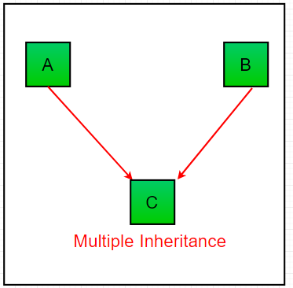
Multiple Inheritance
In multiple inheritance, a single subclass extends from multiple superclasses. For example
Note: Java doesn't support multiple inheritance. However, we can achieve multiple inheritance using
interfaces.

Slide 11
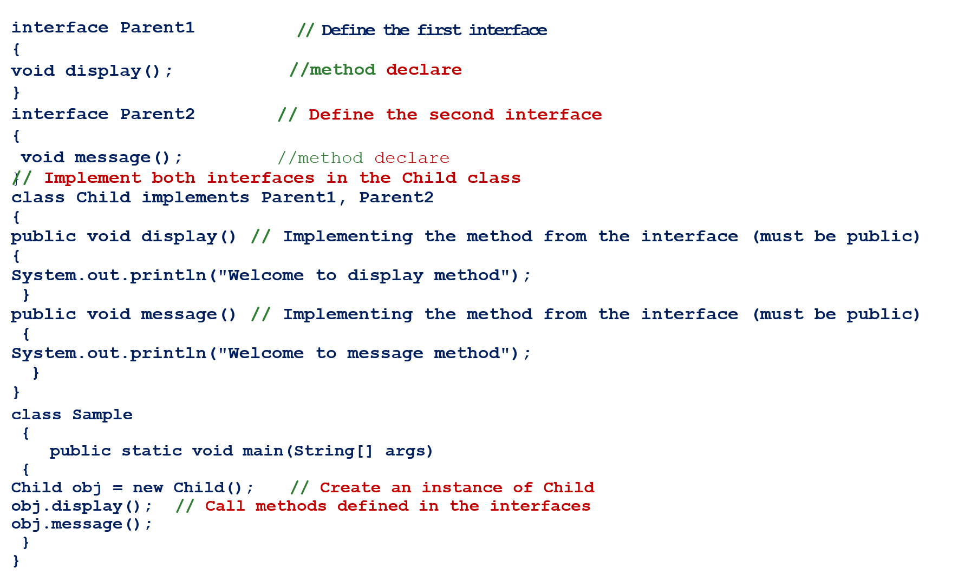

Slide 12
// Implement both interfaces in the Child class
class Child implements Parent1, Parent2
{
public void display() // Implementing the method from the interface (must be public)
{
System.out.println("Welcome to display method");
}
public void message() // Implementing the method from the interface (must be public)
{
System.out.println("Welcome to message method");
}
}
class Sample
{
public static void main(String[] args)
{
Child obj = new Child(); // Create an instance of Child
obj.display(); // Call methods defined in the interfaces
obj.message();
}
}

Slide 13
Abstract class and Methods
Abstract class contains atleast one abstract method.i.e., abstract methods and non abstract methods
Abstract method only declaration but no definition
Implementation of abstract method will be written in derived class
Concreate class(contains complete definition or implementation of all the methods)
Object can not be created for Abstract class
Object can be created for concreate class

Slide 14
Write a JAVA program for abstract class to find areas of different shapes
class Shape
{
// Abstract base class
Abstract class
void display();
// Abstract method
}
class Circle extends Shape
{
double radius=2.25;
// Derived class for Circle
void display() // Implementing the abstract method
{
double area = 3.14* radius * radius;
System.out.println("The area of the circle is: " + area);
}
}
concrete class

Slide 15
Write a JAVA program for abstract class to find areas of different shapes
class Shape
{
// Abstract base class
Abstract class
void display();
// Abstract method
}
class Circle extends Shape
{
double radius=2.25;
// Derived class for Circle
void display() // Implementing the abstract method
{
double area = 3.14* radius * radius;
System.out.println("The area of the circle is: " + area);
}
}
concrete class

Slide 16
class Rectangle extends Shape
// Derived class for
Rectangle
{
double length=4.0;
double breadth=6.0;
concrete class
void display() // Implementing the abstract method
{
double area = length * breadth;
System.out.println("The area of the rectangle is: "
+ area);
}
}

Slide 17
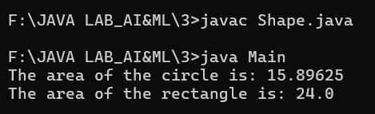
class Main // Main class to test the shapes
{
public static void main(String[] args)
{
Circle obj = new Circle(); // Creating object
Rectangle obj1= new Rectangle(); // Creating object
obj.display();
obj1.display();
}
}

Slide 18
DIFFERENCE BETWEEN INTERFACE & ABSTRACT
Interface | Abstract class
Interface should contain declaration of methods | Abstract should contain Both declaration and definition of methods
Interface having Interface keyword only for class | Abstract class having Abstract keyword for class and method
Interface is used to achieve multiple inheritance | Abstract class Not Supports multiple inheritance
Interface is used to achieve abstraction | Abstract class is used to achieve abstraction
Interface having only abstract methods | Abstract class having atleast one abstract method and non abstract methods
Interface having impelements keyword | Abstract class having extends keyword
In Interface ,implement keyword is used to import multiples base class properties into single derived class | In Abstract class,extends keyword is used to import single base class properties into single derived class
Syntax: interface classname { abstract method(); } | Syntax: abstract class classname { abstract method(); Non-abstract method(); ₂₀ }

Slide 19
PART-A:Interfaces:
Concept-3:Default Methods in Interfaces

Slide 20
Before Java 8, interfaces could have only abstract methods. The implementation of these methods has to be provided in a separate class.
So, if a new method is to be added in an interface, then its implementation code has to be provided in the class implementing the same interface.
To overcome this issue, Java 8 has introduced the concept of default methods which allow the interfaces to have methods with implementation without affecting the classes that implement the interface. A default method should not override.

Slide 21
interface Parent
{
Default void display()
{
System.out.println("Welcome to RCE from Parent class");
}
}
class Child implements Parent
{
// can override defaultMethod, but not mandatory
}
class DefaultMethodExample
{
public static void main(String args[])
{
Child obj=new Child(); obj.display();
}
}

Slide 22
PART-A:Interfaces:
Concept-4:Static Methods in Interface.

Slide 23
Static Methods in Interface.
Similar to Default Method in Interface, the static method in an interface can be defined
in the interface, but cannot be overridden in Implementation Classes.
To use a static method, Interface name should be instantiated with it, as it is a part of the Interface only.

Slide 24
interface Parent
{
Static void display()
{
System.out.println("Welcome to RCE from Parent class");
}
}
class StaticMethodExample
{
public static void main(String args[])
{
Parent.display();
}
}

Slide 25
PART-A:Interfaces:
Concept-5: Nested Interfaces

Slide 26
An interface, i.e., declared within another interface or class, is known as a nested interface.
The nested interfaces are used to group related interfaces so that they can be easy to maintain.
The nested interface must be referred to by the outer interface or class. It can't be accessed directly.

Slide 27
class OuterClass
{
interface Parent
{
void display();
}
}
class innerClass implements OuterClass
{
interface child
{
public void display()
{
System.out.println("Welcome to RCE");
}
class NestedInterfaceExample
{
public static void main(String args[ ])
{
innerclass obj = new innerclass();
obj.display();
}
}

Slide 28
Unit-IV: PART-B
Exception Handling: Introduction, Hierarchy of Standard Exception Classes, Keywords throws and throw, try, catch, and finally Blocks, Multiple Catch Clauses, Class Throwable, Unchecked Exceptions, Checked Exceptions.

Slide 29
Unit-IV: PART-B:Exception Handling
Concept-1:Introduction, Hierarchy of Standard Exception Classes

Slide 30
The Exception Handling in Java is one of the powerful mechanism to handle the runtime errors so that the normal flow of the application can be maintained.
If there is any error occurs in a program automatically rest of the code will not be executed & the program will be terminated abnormally. i.e., Avoiding abnormal termination of program.
Actually we are use five keywords
Try
Catch
Throw
Throws
Finally

Slide 31
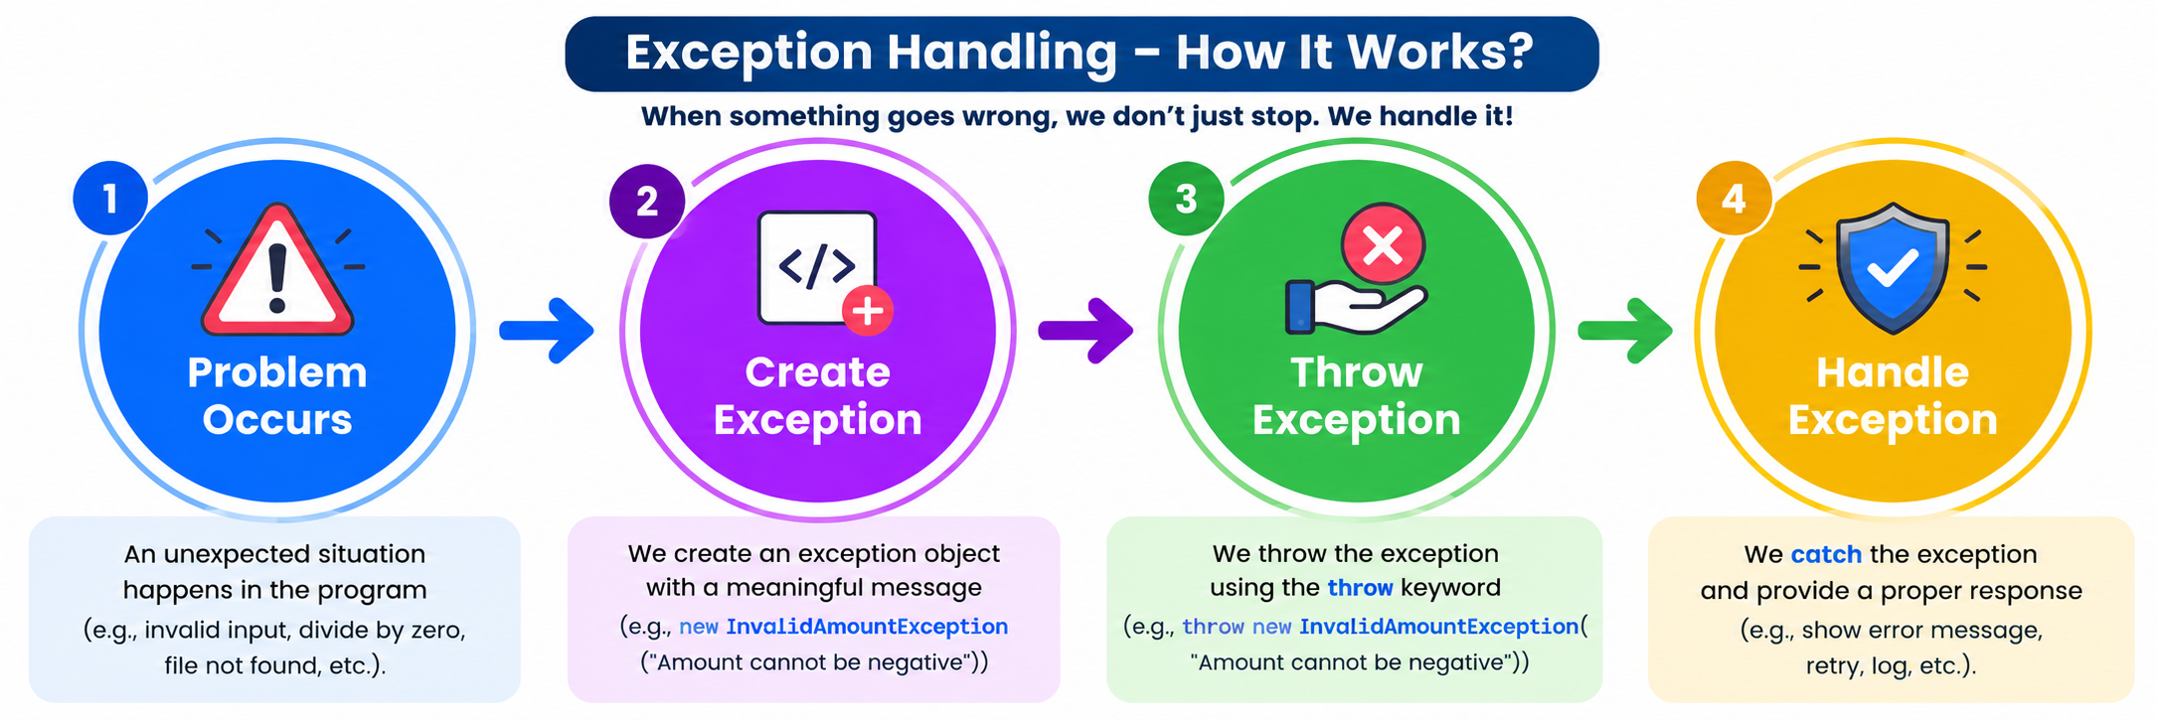

Slide 32
What is Exception in Java?
Dictionary Meaning: Exception is an abnormal condition.
In Java, an exception is an event that disrupts the normal flow of the program. It is an object which is thrown at runtime.
What is Exception Handling?
Exception Handling is a mechanism to handle runtime errors such as ClassNotFoundException,
IOException, SQLException, RemoteException, etc.

Slide 33
ADVANTAGE OF EXCEPTION HANDLING
The core advantage of exception handling is to maintain the normal flow of the application. An exception normally disrupts the normal flow of the application; that is why we need to handle exceptions. Let's consider a scenario:
statement 1;
statement 2;
statement 3;
statement 4;
statement 5;//exception occurs
statement 6;
statement 7;
statement 8;
statement 9;
statement 10;
Suppose there are 10 statements in a Java program and an exception occurs at statement 5; the rest of
the code will not be executed, i.e., statements 6 to 10 will not be executed. However, when we perform
exception handling, the rest of the statements will be executed. That is why we use exception handling in Java.

Slide 34
Unit-IV: PART-B:Exception Handling
Concept-2:TYPES OF JAVA EXCEPTIONS

Slide 35
Exception handling is a mechanism in Java that allows developers to manage
runtime errors and maintain normal application flow.
When an error occurs during the execution of a program, an exception object
is created, and Java's runtime environment attempts to handle it.
If the exception is not handled properly, it can lead to program termination.

Slide 36
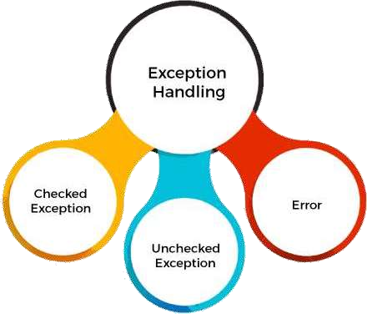
TYPES OF JAVA EXCEPTIONS
  There are mainly two types of exceptions: checked and unchecked. An error is considered as
  the unchecked exception. However, according to Oracle, there are three types of exceptions
  namely:
  CHECKED EXCEPTION
  UNCHECKED EXCEPTION
  ERROR

Slide 37
Checked Exception
    The Exceptions which are checked by compiler at the time and It is a compile time Exception
    They will checked at compile time then whatever the errors are occurred those errors are known as checked exceptions.
    For example, IOException, SQLException, etc. Checked
  exceptions are checked at compile-time.
2) Unchecked Exception
  The Exceptions which are not checked by compiler at the time
  Unchecked exceptions are not checked at compile-time, but they are checked at runtime.
  It is a Run time Exception
  For example, ArithmeticException, NullPointerException,
  ArrayIndexOutOfBoundsException, NullFormatException etc.
3) Error
  Error is irrecoverable.
  Some example of errors are SyntaxError,OutOfMemoryError, VirtualMachineError, AssertionError etc

Slide 38
Unit-IV: PART-B:Exception Handling
Concept-3:COMMON SCENARIOS OF JAVA EXCEPTIONS

Slide 39
COMMON SCENARIOS OF JAVA EXCEPTIONS
There are given some scenarios where unchecked exceptions may occur. They are as follows:
1) where ArithmeticException occurs
If we divide any number by zero , there occurs an
ArithmeticException.
int a=50/0;
System.out.println(a);//ArithmeticException
2) where NullPointerException occurs
We don’t have any initialization but we are accessing the length of the
string
String name=null; System.out.println(name.length());//NullPointerException

Slide 40
3) where NumberFormatException occurs
Suppose we have a string variable that has characters; it converting this
variable into number or digit will cause NumberFormatException.
String s="abc";
int i=Integer.parseInt(s);//NumberFormatException
4) where ArrayIndexOutOfBoundsException occurs
When an array exceeds to it's size, the ArrayIndexOutOfBoundsException occurs , There may be other reason to occur ArrayIndexOutOf BoundsException
the following statements.
int a[]=new int[5]; a[10]=50;
System.out.println(a[10]);//ArrayIndexOutOfBoundsException

Slide 41
Unit-IV: PART-B:Exception Handling
Concept-3: Keywords throws and throw, try, catch, and finally Blocks

Slide 42
Keyword | Description
try | The "try" keyword is used to specify a block where we should place an exception code. It means we can't use try block alone. The try block must be followed by either catch or finally.
catch | The "catch" block is used to handle the exception. It must be preceded by try block which means we can't use catch block alone. It can be followed by finally block later.
finally | The "finally" block is used to execute the necessary code of the program. It is executed whether an exception is handled or not.
throw | The "throw" keyword is used to throw an exception.
throws | The "throws" keyword is used to declare exceptions. It specifies that there may occur an exception in the method. It doesn't throw an exception. It is always used with method signature.

Slide 43
TRY BLOCK
If an exception occurs at the particular statement in the try block, the rest of the block code will
not execute.
Java try block must be followed by either catch or finally block.
We have to write code in which we are excepting exception Syntax of try block:
Syntax:
try
{
Statements;
}
catch(Exceptionname
{
Statements;
}
}

Slide 44
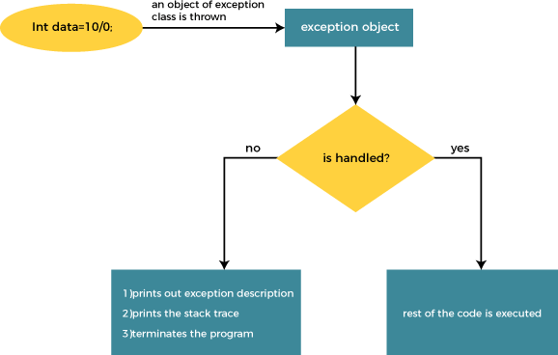
CATCH BLOCK
What ever the exceptions raised in try block those exceptions will be handle in catch block
Without try block we should not write the catch block
Without catch block we should not write try block
The JVM firstly checks whether the exception is handled or not. If exception is not handled, JVM provides a default exception handler that performs the following tasks:
Fig:Internal Working of Java try-catch block

Slide 45
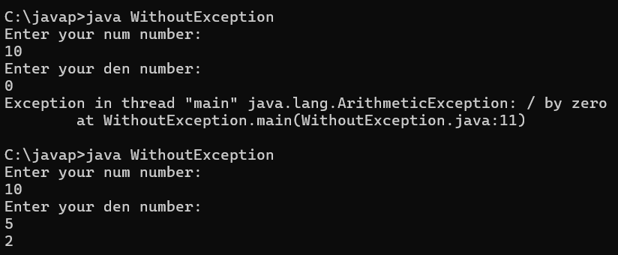
PROBLEM WITHOUT EXCEPTION HANDLING
public class WithoutException{
public static void main(String args[])
{
Scanner sc=new Scanner(System.in);
System.out.println("Enter your num number:");
int num=sc.nextInt();
System.out.println("Enter your den number:");
int den=sc.nextInt();
int a=num/den;
System.out.println(a);
}
}

Slide 46
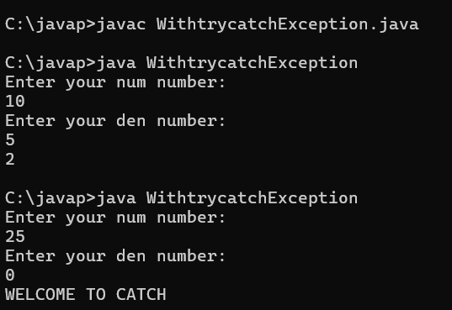
PROBLEM WITH EXCEPTION HANDLING
import java.util.*;
class WithtrycatchException
{
public static void main(String args[])
{
Scanner sc=new Scanner(System.in);
System.out.println("Enter your num number:"); }
}
int num=sc.nextInt();
System.out.println("Enter your den number:");
int den=sc.nextInt();
try
{
int a=num/den;
System.out.println(a);
}
catch(ArithmeticException e)
{
System.out.println("WELCOME TO CATCH");
}
}
}

Slide 47
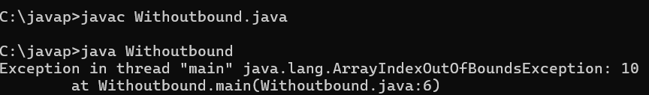
class WithoutboundException
PROBLEM WITHOUT EXCEPTION HANDLING
{
public static void main(String args[])
{
int a[]=new int[10];
a[10]=100;
System.out.println(a);
}
}
}

Slide 48
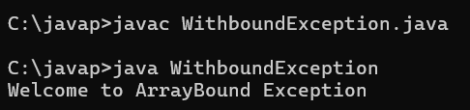
class WithboundException
{
PROBLEM WITH EXCEPTION HANDLING
public static void main(String args[])
{
try
{
int a[]=new int[10]; a[10]=100;
System.out.println(a);
}
catch(ArrayIndexOutOfBoundsException x)
{
System.out.println("Welcome to ArrayBound Exception");
}
}
}

Slide 49
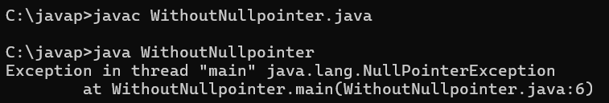
class WithoutNullpointer
PROBLEM WITHOUT EXCEPTION HANDLING
{
public static void main(String args[])
{
String name=null;
System.out.println(name.length());
}
}

Slide 50
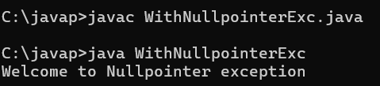
class WithNullpointerExc
PROBLEM WITH EXCEPTION HANDLING
{
public static void main(String args[])
{
try
{
String name=null; System.out.println(name.length());
}
catch(NullPointerException e)
{
System.out.println("Welcome to Nullpointer exception");
}
}

Slide 51
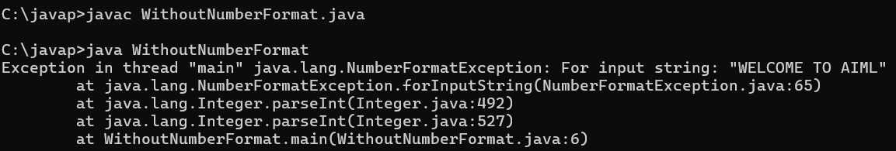
class WithoutNumberFormat
PROBLEM WITHOUT EXCEPTION HANDLING
{
public static void main(String args[])
{
String name="WELCOME TO AIML";
int number=Integer.parseInt(name);
System.out.println(number);
}
}

Slide 52
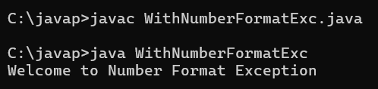
Problem with Exception Handling
class WithNumberFormatExc
{
public static void main(String args[])
{
try
{
String name="WELCOME TO RCE";
int ans=Integer.parseInt(name);
System.out.println(ans);
}
catch(NumberFormatException z)
{
System.out.println("Welcome to Number Format Exception");
}
}
}

Slide 53
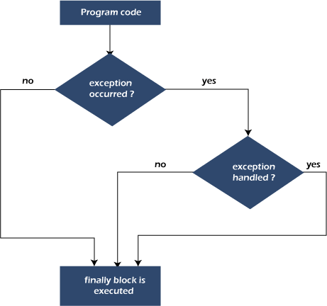
Finally Block
Java finally block is always executed whether an exception is handled or not. Therefore, it contains all the necessary statements that need to be printed regardless of the exception occurs or not.
The finally block follows the try-catch block.
Java finally block is always executed whether exception is handled or not.
Java finally block must be followed by try or catch block.
Syntax
try
{
Statements;
}
catch(Exceptionname
{
Statements;
}
finally
{
Statements;
}

Slide 54
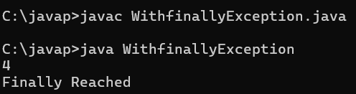
Case 1: When an exception does not occur
class WithfinallyException
{
public static void main(String args[])
{
try
{
int a=100/4; System.out.println(a);
}
catch(ArithmeticException e)
{
System.out.println("Exception Handled by catch block");
}
finally
{
System.out.println("Finally Reached");
}
}
}

Slide 55
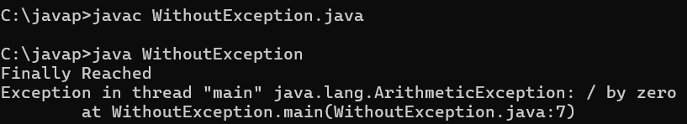
Case 2: When an exception occurr but not handled by the catch block
class WithoutException
{
public static void main(String args[])
{
try
{
int a=100/0;
System.out.println(a);
}
catch(NullPointerException e)
{
System.out.println("Exception Handled by catch block");
}
finally
{
System.out.println("Finally Reached");
}
}
}

Slide 56
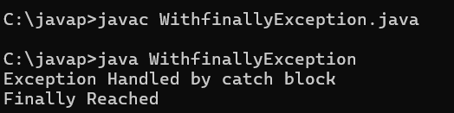
Case 3: When an exception occurs and is handled by the catch block
class WithfinallyException
{
public static void main(String args[])
{
try
{
int a=100/0;
System.out.println(a);
}
catch(ArithmeticException e)
{
System.out.println("Exception Handled by catch block");
}
finally
{
System.out.println("Finally Reached");
}
}
}

Slide 57
Throw block
It is used to Throwing our own Exceptions
It is a keyword Used to create an our exception and through it explicitly to catch block
Throw our own exception using throw keyword
The flow of execution stops immediately
subsequence statements are not executed
Syntax
throw new exceptiontype();
after the throw statements and any

Slide 58
The throw statement
Use throw to raise an exception at a specific point in your code.
SYNTAX
EXAMPLE: VALIDATE AGE
throw new IllegalArgumentException("Invalid age");
if (age < 18) {
throw new IllegalArgumentException(
"Age must be 18 or older");
}
Read the statement
throw
starts the throw operation
The condition is true → Java raises the exception.
new IllegalArgumentException(...)
Creates the object; its message adds context.
WHAT HAPPENS NEXT?
1
Execution stops here
2
Java looks for catch
3
Otherwise, it propagates
Statements after throw are skipped.
The nearest matching catch can handle it.
The caller gets the exception.
Remember: throw raises an exception; throws declares possible exceptions in a method header.

Slide 59
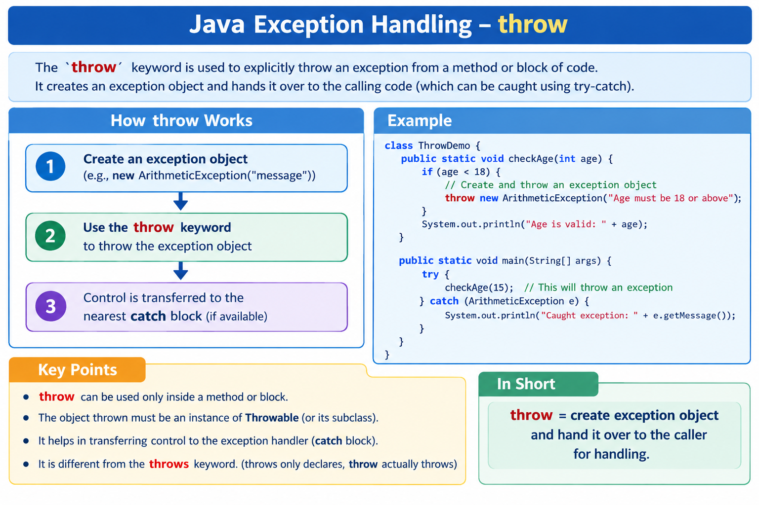

Slide 60
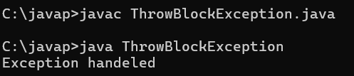
class ThrowBlockException
{
public static void main(String args[])
{
try
{
throw new ArithmeticException();
}
catch(ArithmeticException e)
{
System.out.println("Exception handeled");
}
}
}
Note:It is a keyword Used to create an our exception and throw it explicitly to catch block

Slide 61
The throws clause
Declare exceptions a method may pass to its caller.
METHOD DECLARATION
EXAMPLE: A METHOD THAT MAY FAIL
returnType methodName()
throws ExceptionType { ... }
static String readFile() throws IOException {
return Files.readString(
Path.of("notes.txt"));
}
What does throws tell us?
throws
lists exception types in the method header
IOException is checked: the caller must catch it or declare it too.
It declares a possibility
It does not throw by itself.
FOLLOW THE EXCEPTION
1
Method declares it
2
Exception reaches caller
3
Caller handles or declares
The method may pass this type out.
If not caught inside the method.
Catch it, or add its own throws.
Remember: throws declares exceptions in a method header; throw raises one in the method body.

Slide 62
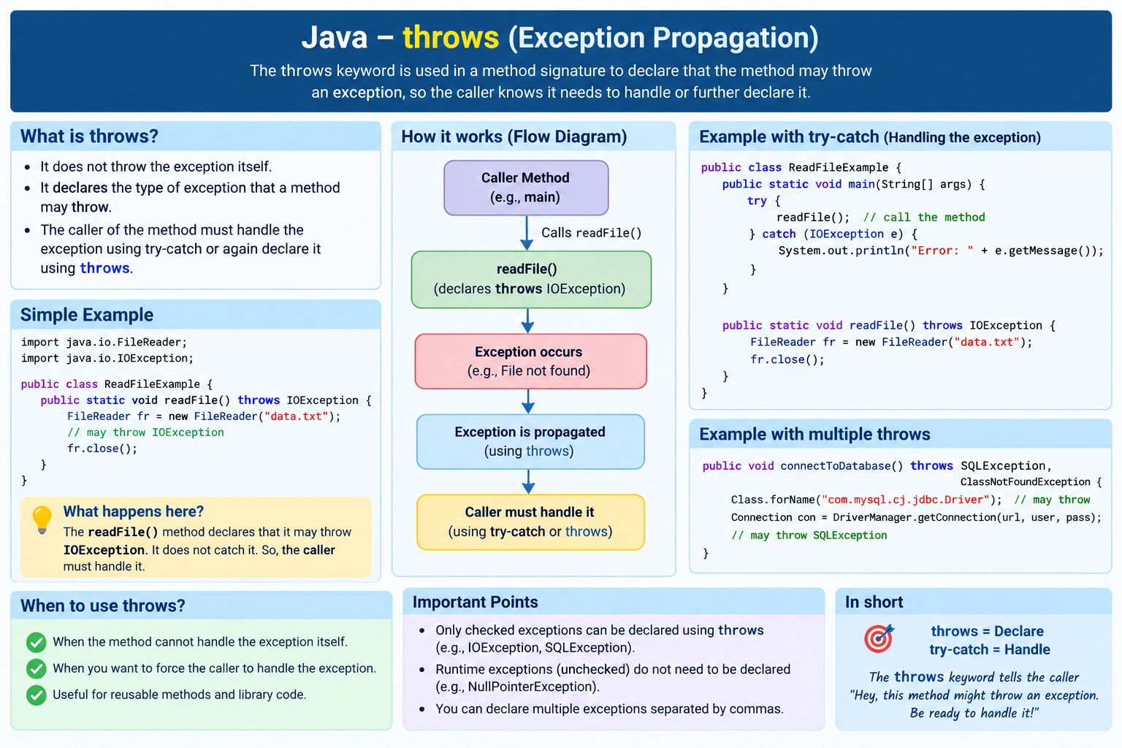

Slide 63
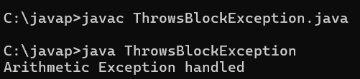
class ThrowsBlockException
{
static void rce() throws ArithmeticException
{
int a=10/0;
System.out.println(a);
}
public static void main(String args[])
{
try
{
rce();
}
catch(ArithmeticException e)
{
System.out.println("Arithmetic Exception handled");
}
}
}

Slide 64
Unit-IV: PART-B:Exception Handling
Concept-5: Multiple Catch Clauses
,

Slide 65
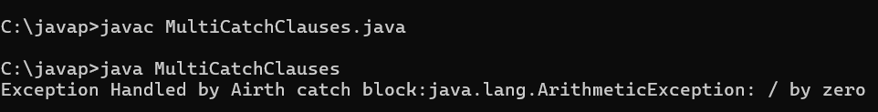
class MultiCatchClauses
{
public static void main(String args[])
{
try
{
int a=100/0;
System.out.println(a);
}
catch(ArithmeticException e)
{
System.out.println("Exception Handled by Airth catch block:"+ e);
}
catch(NullPointerException e)
{
System.out.println("Exception Handled by Null catch block:"+ e);
}
catch(ArrayIndexOutOfBoundsException e)
{
System.out.println("Exception Handled by Outof catch block:"+ e);
}
}
}

Slide 66
UNIT-IV PART-C :
Packages and Java Library : Introduction, Defining Package, Importing Packages and Classes into Programs, Path and Class Path, Access Control, Packages in Java SE, Java.lang Package and its Classes, Universal super Class Object Class, Enumeration, class Math, Wrapper Classes, Auto boxing and Auto-un boxing, Java util Classes and Interfaces, Scanner class.

Slide 67
UNIT-04 PART-C
Concept-01 Packages and Java Library &
Advantages

Slide 68
Introduction
It is necessary in software development to create several classes and interfaces.
After creating these classes and interfaces, it is better if they are divided into some groups depending on their relationship.
So these classes and interfaces are stored in some directory.
This directory or folder is also known as package.

Slide 69
Package names show a hierarchy
Each dot marks a deeper level in the package structure.
READ THE PACKAGE TREE
DOTS BECOME PATH LEVELS
java
Package name
Path form
java.io
→
java / io
io
java.lang
→
java / lang
lang
java.awt.event
→
java / awt / event
awt
event
A dot separates package levels; it is not part of a folder name.
Example: java.awt.event is nested as java → awt → event.

Slide 70
Advantages of packages
Packages hide the classes and interfaces in a separate sub directory, so accidental deletion of classes and interfaces will not take place
Two classes in two different packages can have the same name.
A group of packages is called a library.
The reusability nature of packages makes programming easy.

Slide 71
UNIT-04 PART-C
Concept-02 Types of Packages

Slide 72
TYPES OF PACKAGES
There are two types of packages.
Built-in packages.
User Defined Packages.

Slide 73
I.Built-in Packages:
These packages consist of a large number of classes. Some of the commonly used built-in packages are:
java.lang: Contains language support classes (e.g classes which defines primitive data types, math operations).
This package is automatically imported.
java.io: Contains classes for supporting input / output operations.
java.util: Contains utility classes which implement data structures like Linked List, classes related to date and time
java.net - Contain classes for supporting networking operations.
applet − This package provides classes and methods to create and communicate with the applets.
awt − This package provides classes and methods to create user interfaces.

Slide 74

II.User-defined packages
These are the packages that are defined by the user.
A package declaration resides at the top of a java source file. All class are to be placed in a package have common package name.
The name of the package should be followed by the keyword package, declared at the top of the program. Thus, we can define a class belonging to a package.
Example for User defined package

Slide 75
Declaring a package
Use the package statement to place a class in a named package.
SYNTAX
package <package_name>;
HOW TO READ IT
JAVA SOURCE EXAMPLE
package com.rce.oops.unit1;
Names the package that contains Student.
package com.rce.oops.unit1;
public class Student {
// class code goes here
}
Where it goes
Put the package declaration before imports and class declarations. Comments may come first.
Naming style
Package names are conventionally written in lowercase.
Typical source path
src / com /rce /oops /unit1 / Student.java
The folder path mirrors the package name.

Slide 76
UNIT-04 PART-C
Concept-03 Importing Packages and Classes into
Programs

Slide 77
Importing Packages and Classes into Programs
How to access package from another package?
There are three ways to access the package from outside the package.
import package.*;
import package.classname;
fully qualified name.

Slide 78
Using a class from another package
Choose an import style—or write the class’s full package name.
EXAMPLE CLASS
Assume Student is public and declared in package school.people.
1
Import all types
import com.rce.oops.*;
Student s = new Student();
2
Import one class
import com.rce.oops.Student;
Student s = new Student();
3
Use the full name
com.rce.oops.Student s =
com.rce.oops.Student.Student();
Access note
Student must be public. The * import covers this package only; it does not include subpackages.

Slide 79
import package.*;
  If you use package.* then all the classes and interfaces of this package will be accessible.
  The import keyword is used to make the classes and interface of another package accessible to the current package.
package com.rce.oops;
public class Sample
{
public void display()
{
System.out.println("Welcome to RCE");
}
}

Slide 80
Program to use Addition.class from mypack import com.*;
Instead of referring the package name every time, we can import the package like this
import com.rce.oops.unti1;
class PackEx
{
public static void main(String args[])
{
System.out.println("WELCOME TO RCE");
Sample obj=new Sample();
obj.display();
}
}

Slide 81
2) import package.classname;
If you import package.classname then only declared class of this package will be accessible.
package com.rce;
public class Sample
{
public void display()
{
System.out.println("IOT");
}
}
import com.rce.oops.unit1.Sample;
class PackEx
{
public static void main(String args[])
{
System.out.println("RCE");
Sample obj=new Sample(); obj.display();
}
}

Slide 82
3) fully qualified name.
If you use fully qualified name then only declared class of this package will be accessible.
Now there is no need to import. But you need to use fully qualified name every time when you are accessing the class or interface.
It is generally used when two packages have same class name e.g. java.util and java.sql packages contain Date class.

Slide 83
Package IOT; class PackEx
{
public static void main(String args[])
{
System.out.println("RCE");
IOT.Sample obj=new IOT.Sample();
obj.display();
}
}
package IOT;
public class Sample
{
public void display()
{
System.out.println("IOT");
}
}

Slide 84
UNIT-03 PART-C
Concept-04:Access Control & Packages in Java SE

Slide 85
Who can access a member?
Access depends on the modifier and where the accessing code is located.
VISIBILITY MATRIX
QUICK EXAMPLES
Access location
private
package-private
(no keyword)
protected
public
private int pin;
Only code inside the declaring class can access pin.
Inside declaring class
YES
YES
YES
YES
Other class, same package
NO
YES
YES
YES
int score;
No modifier means package-private: same-package code can access score.
Subclass, different package
NO
NO
YES
YES
protected void show() { }
Unrelated class, different package
NO
NO
NO
YES
A subclass in another package can use an inherited protected member.
Remember
Cross-package protected access follows a subclass rule. Public access also requires the declaring class to be accessible.

Slide 86
Packages in Java SE
Java Standard Edition provides 14 packages namely
applet − This package provides classes and methods to create and communicate with the applets.
awt − This package provides classes and methods to create userinterfaces.
io − This package contains classes and methods to read and write data standard input and output devices, streams and files.
lang − This package contains the fundamental classes, methods and interfaces of Java language.
math − This package contains classes and methods which helps you to perform arithmetic operations using the Java language.
net − This package provides classes to implement networking applications.
rmi − This package provides classes, methods, and interfaces for Remote Method Invocation.

Slide 87
security
– This package provides classes and interfaces for security framework
sql − This package provides classes and methods to access and process the data stored in a data source.
text − This package provides classes and interfaces to handle text.
util − This package contains collection framework, collection classes, classes related to date and time, event model, internationalization, and miscellaneous utility classes.

Slide 88
UNIT-04 PART-C
Concept-05 HOW TO CREATE SET PATH & CLASS PATH

Slide 89
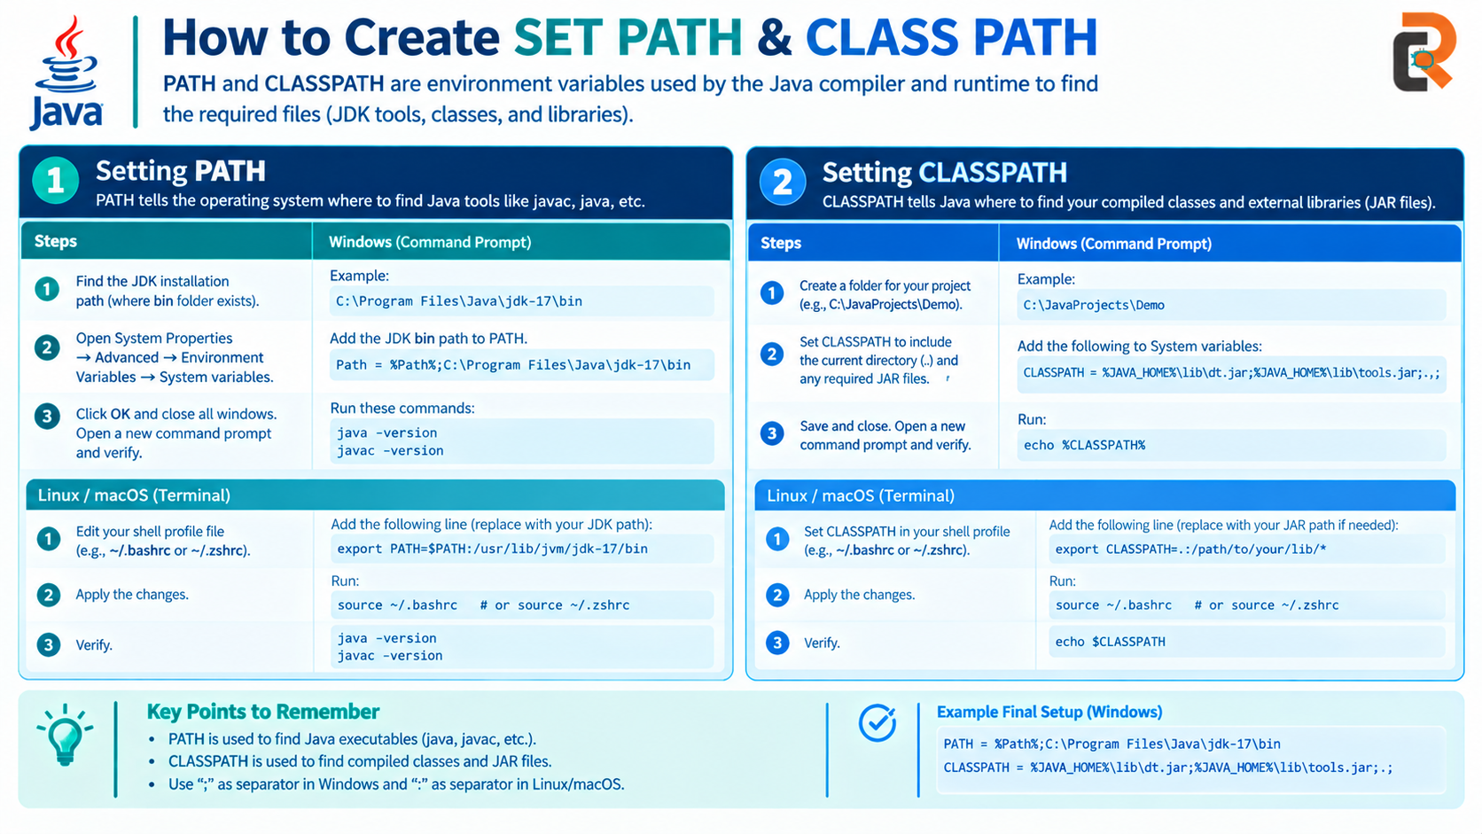

Slide 90
UNIT-04 PART-C
Concept-06 Wrapper Classes and Auto-boxing and Auto-unboxing

Slide 91
The wrapper class in Java provides the mechanism to convert primitive
into object and object into primitive.
The wrapper classes in Java are used to convert primitive types (int, char, float, etc) into corresponding objects.
Autoboxing and Unboxing are the features included in Java 1.5
Autoboxing and Unboxing feature convert primitives into objects and
objects into primitives automatically.
The automatic conversion of primitive into object is known as Autoboxing and vice-versa Unboxing.

Slide 92
Auto Boxing or Boxing:
Autoboxing is the process of converting a primitive type data into its corresponding wrapper class object instance
Unboxing:
Unboxing is the process of converting a Objective instance into a primitive type
Java performs these conversions automatically, which is called autoboxing and auto-unboxing

Slide 93
Primitive types and wrapper classes
Each Java primitive has a corresponding wrapper class.
Primitive type
Size
Wrapper class
Example
boolean
Not fixed by Java
Boolean
boolean ready = true;
char
16 bits
Character
char grade = 'A';
byte
8 bits
Byte
byte age = 18;
short
16 bits
Short
short year = 2026;
int
32 bits
Integer
int count = 42;
long
64 bits
Long
long distance = 9_000_000_000L;
float
32 bits
Float
float price = 19.99F;
double
64 bits
Double
double rate = 3.14159;
Autoboxing
primitive → wrapper
Unboxing
wrapper → primitive
Wrappers are useful where Java APIs require objects, such as ArrayList<Integer>.

Slide 94
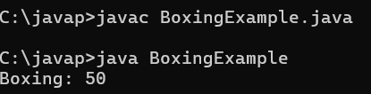
//AutoBoxing Example
class BoxingExample
{
public static void main(String args[])
{
int a=50;
Integer obj=new Integer(a);//Boxing
System.out.println("Boxing: "+obj);
}

Slide 95
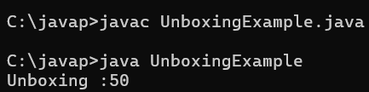
//UnBoxing Example
class UnboxingExample
{
public static void main(String args[])
{
Integer obj=new Integer(50);
int a=obj;
System.out.println("Unboxing :" +a);
}
}

Slide 96
UNIT-04 PART-C
Concept-07 Math Class

Slide 97
Java Math Class in Java contains certain methods to perform different numeric operations, is exponential, square root, logarithmic, trigonometric functions.
Java Math class provides several methods to work on math calculations like sqrt(),min(), max(),avg(), sin(), cos(), tan(), round(),floor(), abs() etc.
Arithmetic operations like increment, decrement, divide, absolute value, It should be checked against the maximum and minimum value as appropriate.

Slide 98
Common methods in java.lang.Math
Call each static method as Math.method(...).
Method
What it does
Example → result
Math.abs(x)
Returns the absolute value
Math.abs(-7) → 7
Math.max(a, b)
Returns the larger value
Math.max(12, 20) → 20
Math.min(a, b)
Returns the smaller value
Math.min(12, 20) → 12
Math.round(x)
Rounds to the nearest integer
Math.round(4.6) → 5L
Math.sqrt(x)
Returns the square root
Math.sqrt(81) → 9.0
Math.cbrt(x)
Returns the cube root
Math.cbrt(27) → 3.0
Math.pow(a, b)
Raises a to the power b
Math.pow(2, 3) → 8.0
Math.sin(x)
Returns the sine of x
Math.sin(Math.toRadians(30)) ≈ 0.5
Math.cos(x)
Returns the cosine of x
Math.cos(Math.toRadians(60)) ≈ 0.5
Math.tan(x)
Returns the tangent of x
Math.tan(Math.toRadians(45)) ≈ 1.0
Radians
sin, cos, and tan expect radians. Use Math.toRadians(degrees) to convert degrees.

Slide 99
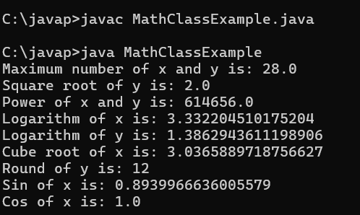
class MathClassExample
{
public static void main(String args[])
{
double x = 28;
double y = 4;
System.out.println("Maximum number of x and y is: " + Math.max(x, y));
System.out.println("Square root of y is: " + Math.sqrt(y));
System.out.println("Power of x and y is: " + Math.pow(x, y));
System.out.println("Logarithm of x is: " + Math.log(x));
System.out.println("Logarithm of y is: " + Math.log(y));
System.out.println("Cube root of x is: " + Math.cbrt(x));
System.out.println("Round of y is: " + Math.round(11.78));
System.out.println("Sin of x is: " + Math.sin(90));
System.out.println("Cos of x is: " + Math.cos(0));
}
}

Slide 100
UNIT-04 PART-C
Concept-08 Enumeration in java

Slide 101
Enumeration in java
The Enum in Java is a data type which contains a fixed set of constants.
It can be used for days of the week, directions, season, colors etc.
enum constants in capital letters.
The enum can be defined within or outside the class because it is similar to a class.
The semicolon (;) at the end of the enum constants are optional.
For example:
enum Colors { RED,GREEN,BLUE,BLACK,YELLOW,PURPLE }
enum Day {
MONDAY, TUESDAY, WEDNESDAY, THURSDAY,
FRIDAY, SATURDAY, SUNDAY
}

Slide 102
Few More Examples
Day: MONDAY, TUESDAY, WEDNESDAY, THURSDAY, FRIDAY, SATURDAY, SUNDAY
Month: JANUARY, FEBRUARY, MARCH, APRIL, MAY, JUNE, JULY, AUGUST, SEPTEMBER, OCTOBER, NOVEMBER, DECEMBER
Direction: NORTH, SOUTH, EAST, WEST
TrafficLight: RED, YELLOW, GREEN
Season: SPRING, SUMMER, AUTUMN, WINTER
OrderStatus: NEW, CONFIRMED, PROCESSING, SHIPPED, DELIVERED, CANCELLED
PaymentStatus: PENDING, COMPLETED, FAILED, REFUNDED
TicketStatus: OPEN, IN_PROGRESS, RESOLVED, CLOSED
Priority: LOW, MEDIUM, HIGH, CRITICAL
UserRole: ADMIN, MANAGER, TEACHER, STUDENT, GUEST
FileType: TXT, PDF, DOCX, JPG, PNG
Grade: A, B, C, D, F
Size: SMALL, MEDIUM, LARGE, EXTRA_LARGE
Operation: ADD, SUBTRACT, MULTIPLY, DIVIDE
CardSuit: HEARTS, DIAMONDS, CLUBS, SPADES
Planet: MERCURY, VENUS, EARTH, MARS, JUPITER, SATURN, URANUS, NEPTUNE
ConnectionState: CONNECTED, DISCONNECTED, CONNECTING, FAILED
HttpMethod: GET, POST, PUT, PATCH, DELETE

Slide 103
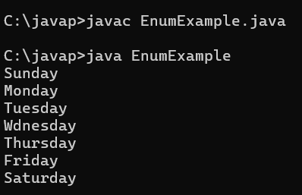
Java Enum Example:
enum Days{ Sunday,Monday,Tuesday,Wdnesday,Thursday,Friday,Saturday}
class EnumExample
{
public static void main(String args[])
{
Days a[] = Days.values(); // get all enum constants
for (int i = 0; i <a.length; i++)
{
System.out.println(a[i]);
}
}
}

Slide 104
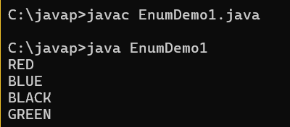
Java Enum Example:
class EnumDemo1
{
enum Colors{ RED, BLUE, BLACK, GREEN }
public static void main(String args[])
{
Colors a[] = Colors.values(); // get all enum constants
for (int i = 0; i <a.length; i++)
{
System.out.println(a[i])
}
}
;
}

Slide 105
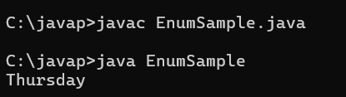
Java Enum Example: Defined inside class
enum Days{ Sunday,Monday,Tuesday,Wdnesday,Thursday,Friday,Saturday;}
class EnumSample
{
public static void main(String args[])
{
Days a= Days.Thursday; // get all enum constants
System.out.println(a);
}
}

Slide 106
Java Enum Example: main method inside Enum
enum Colors{
RED,BLUE,BLACK,GREEN;
}
public static void main(String[] args)
{
Colors c=Colors.RED;
System.out.println(c);
}
}
Output:
RED

Slide 107
UNIT-04 PART-C
Concept-09 Java. lang Package and its Classes

Slide 108
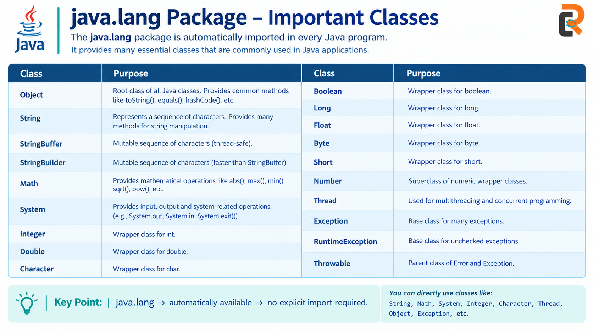
Commonly used classes of java.lang package
Object Class
Wrapper Classes(Byte, Short, Integer, Long, Float, Double, Boolean, Character)
Math Class
Thread
String
StringBuffer
StringBuilder
Enum

Slide 109
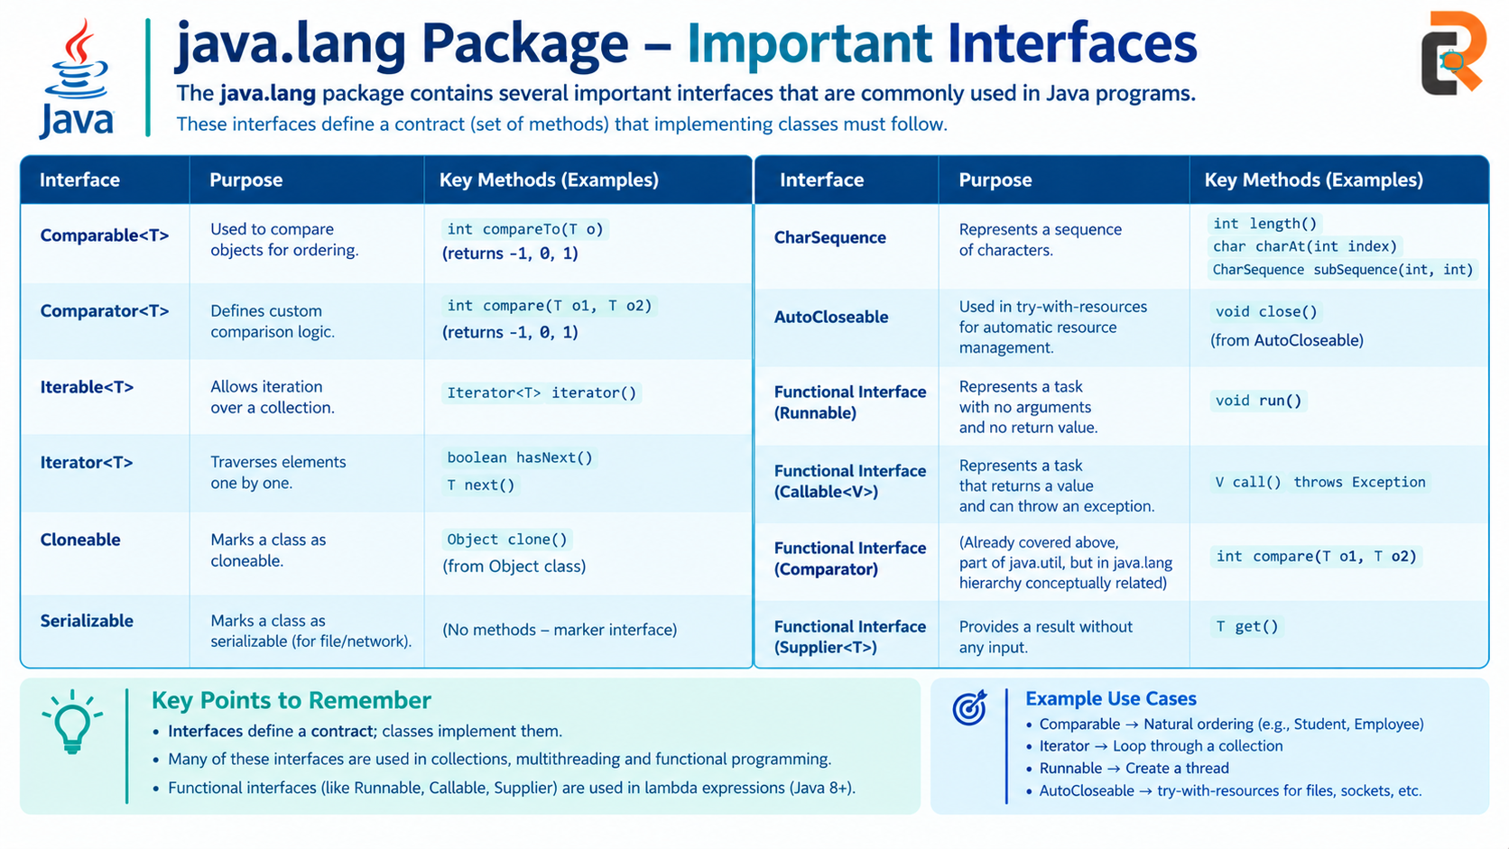
Interfaces defined in java.lang package
Throwable
Runnable
Comparable
Iterable
CharSequence
Appendable
Readable
Void
InheritableThreadLocal

Slide 110
UNIT-04 PART-C
Concept-10:Java util Classes and Interfaces

Slide 111
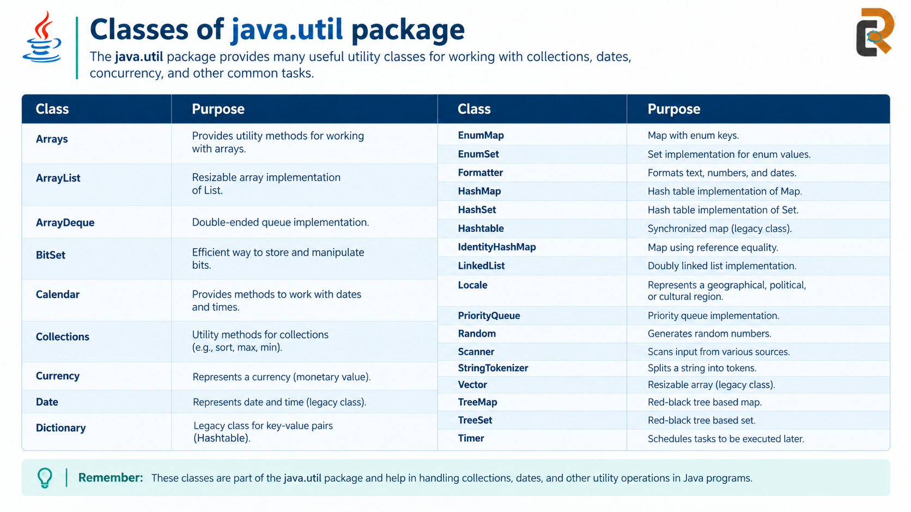

Slide 112
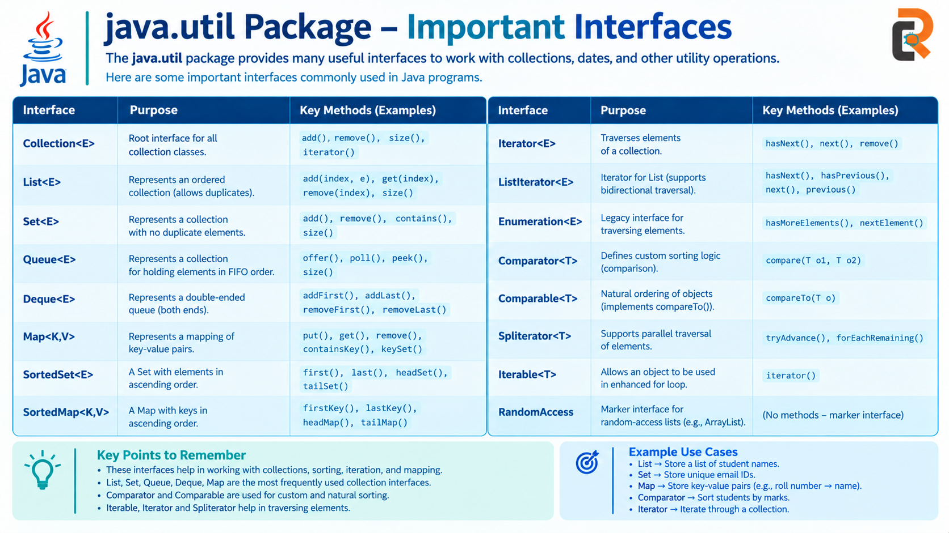

Interfaces of util package
Collection | List | Queue
Comparator | ListIterator | RandomAccess
Deque | Map | Set
Enumeration | Map.Entry | SortedMap
EventListener | NavigableMap | SortedSet
Formattable | NavigableSet
Iterator | Observer

Slide 113
Thank You..!

