Slide 1

RAMACHANDRA COLLEGE OF ENGINEERING (AUTONOMOUS)
Department of Cyber Security | Eluru, Andhra Pradesh
OBJECT-ORIENTED PROGRAMMING THROUGH JAVA
UNIT V: MULTITHREADED PROGRAMMING, AWT COMPONENTS, EVENT HANDLING AND APPLETS
Faculty: N V Narasimha Raju

Slide 2
UNIT V · MULTITHREADING, AWT, EVENTS & APPLETS
Reference Text Books
The complete Reference Java, 11th Edition, Herbert Schildt, TMH
Joy with JAVA, Fundamentals of Object-Oriented Programming, Debasis Samanta, Monalisa Sarma, Cambridge, 2023.
Object Oriented Programming Through Java | Unit V: Multithreading, AWT, Event Handling & Applets | Ramachandra College of Engineering (Autonomous) | Faculty: N V Narasimha Raju
2

Slide 3
UNIT V · MULTITHREADING, AWT, EVENTS & APPLETS
Unit V: Multithreading, AWT, Events and Applets
Multithreaded Programming: Introduction, Need for Multiple Threads Multithreaded Programming for Multi-core Processor, Thread Class, Main Thread-Creation of NewThreads, Thread States, Thread Priority-Synchronization, Deadlock and Race Situations, Inter-thread Communication-Suspending, Resuming, and Stopping of Threads.
AWT Components: Introduction, components and containers, Layouts Manager, Button, Label, Checkbox, Radio Buttons, List Boxes, Choice Boxes, Menu and Scrollbar.
Event Handling: Event delegation model, sources of event, Event Listeners & Adapter classes.
Applets: Introduction to Applet, Lifecycle of an Applet, sample Applet programs
Object Oriented Programming Through Java | Unit V: Multithreading, AWT, Event Handling & Applets | Ramachandra College of Engineering (Autonomous) | Faculty: N V Narasimha Raju
3

Slide 4
UNIT V · MULTITHREADING, AWT, EVENTS & APPLETS
Learning Objective and Outcomes
Learning Objective:
Make the student able to Understanding to the concepts of concepts of GUI programming using Abstract Window Toolkit, Applets and multi-threading.
Learning Outcomes:
After attending this session, a student will be able to Demonstrate the concepts of GUI programming using Abstract Window Toolkit, Applets and multi-threading.
Object Oriented Programming Through Java | Unit V: Multithreading, AWT, Event Handling & Applets | Ramachandra College of Engineering (Autonomous) | Faculty: N V Narasimha Raju
4

Slide 5
PART A · MULTITHREADED PROGRAMMING
Part A: Multithreaded Programming
Multithreaded Programming: Introduction, Need for Multiple Threads Multithreaded Programming for Multi-core Processor, Thread Class, Main Thread-Creation of NewThreads, Thread States, Thread Priority-Synchronization, Deadlock and Race Situations, Inter-thread Communication-Suspending, Resuming, and Stopping of Threads.
Object Oriented Programming Through Java | Unit V: Multithreading, AWT, Event Handling & Applets | Ramachandra College of Engineering (Autonomous) | Faculty: N V Narasimha Raju
5

Slide 6
PART A · MULTITHREADED PROGRAMMING
CONCEPT 1
Introduction, Need for Multiple Threads Multithreaded Programming for Multi-core Processor
Object Oriented Programming Through Java | Unit V: Multithreading, AWT, Event Handling & Applets | Ramachandra College of Engineering (Autonomous) | Faculty: N V Narasimha Raju
6

Slide 7
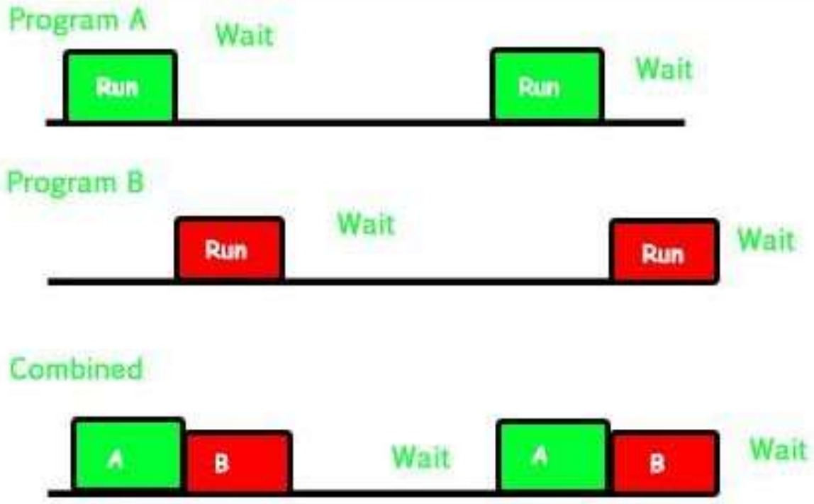
PART A · MULTITHREADED PROGRAMMING
Introduction: Multiprogramming
Multiprogramming – Multiprogramming is known as keeping multiple programs in the main memory at the same time ready for execution.
In the image below, program A runs for some time and then goes to waiting state. In the mean time program B begins its execution. So the CPU does not waste its resources and gives program B an opportunity to run.
Object Oriented Programming Through Java | Unit V: Multithreading, AWT, Event Handling & Applets | Ramachandra College of Engineering (Autonomous) | Faculty: N V Narasimha Raju
7

Slide 8
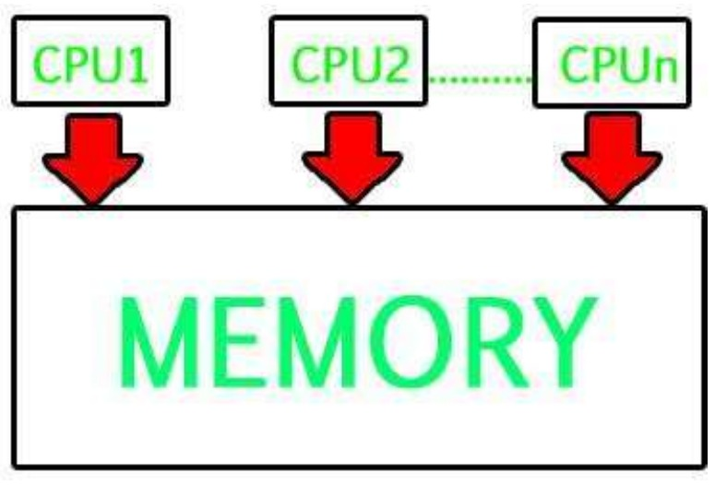
PART A · MULTITHREADED PROGRAMMING
Multiprocessing
Multiprocessing – A computer using more than one CPU at a time.
It also provides increased reliability in the sense that if one processor fails, the work does not halt, it only slows down. e.g. if we have 10 processors and 1 fails, then the work does not halt, rather the remaining 9 processors can share the work of the 10th processor. Thus the whole system runs only 10 percent slower, rather than failing altogether.
Object Oriented Programming Through Java | Unit V: Multithreading, AWT, Event Handling & Applets | Ramachandra College of Engineering (Autonomous) | Faculty: N V Narasimha Raju
8

Slide 9
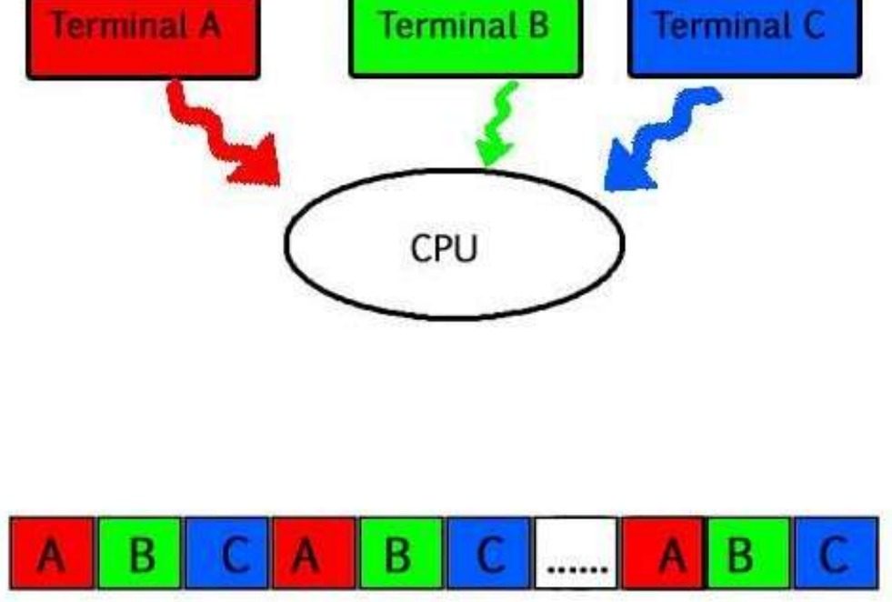
PART A · MULTITHREADED PROGRAMMING
Multitasking
Multitasking – Multitasking is nothing but multiprogramming with a Round-robin scheduling algorithm.
At any time the CPU is executing only one task while other tasks are waiting for their turn. The illusion of parallelism is achieved when the CPU is reassigned to another task. i.e all the three tasks A, B and C are appearing to occur simultaneously because of time sharing.
So for multitasking to take place, firstly there should be multiprogramming i.e. presence of multiple programs ready for execution. And secondly the concept of time sharing.
Object Oriented Programming Through Java | Unit V: Multithreading, AWT, Event Handling & Applets | Ramachandra College of Engineering (Autonomous) | Faculty: N V Narasimha Raju
9

Slide 10
PART A · MULTITHREADED PROGRAMMING
Multitasking in Java
Multitasking is a process of executing multiple tasks simultaneously. We use multitasking to utilize the CPU.
Multitasking can be achieved in two ways:
Process-based Multitasking (Multiprocessing)
Thread-based Multitasking (Multithreading)
1) Process-based Multitasking (Multiprocessing)
Each process has an address in memory. In other words, each process allocates a separate memory area.
A process is heavyweight.
Cost of communication between the process is high.
Switching from one process to another requires some time for saving and loading registers, memory maps, updating lists, etc.
2) Thread-based Multitasking (Multithreading)
Threads share the same address space.
A thread is lightweight.
Cost of communication between the thread is low.
Object Oriented Programming Through Java | Unit V: Multithreading, AWT, Event Handling & Applets | Ramachandra College of Engineering (Autonomous) | Faculty: N V Narasimha Raju
10

Slide 11
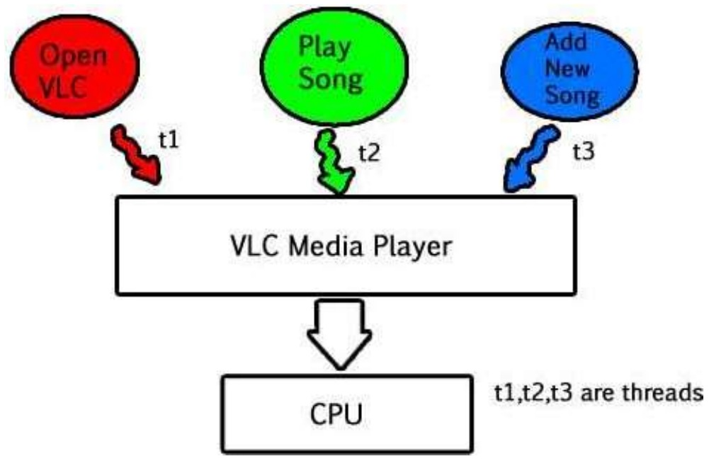
PART A · MULTITHREADED PROGRAMMING
Multithreading
Multithreading is an extension of multitasking.
Object Oriented Programming Through Java | Unit V: Multithreading, AWT, Event Handling & Applets | Ramachandra College of Engineering (Autonomous) | Faculty: N V Narasimha Raju
11

Slide 12
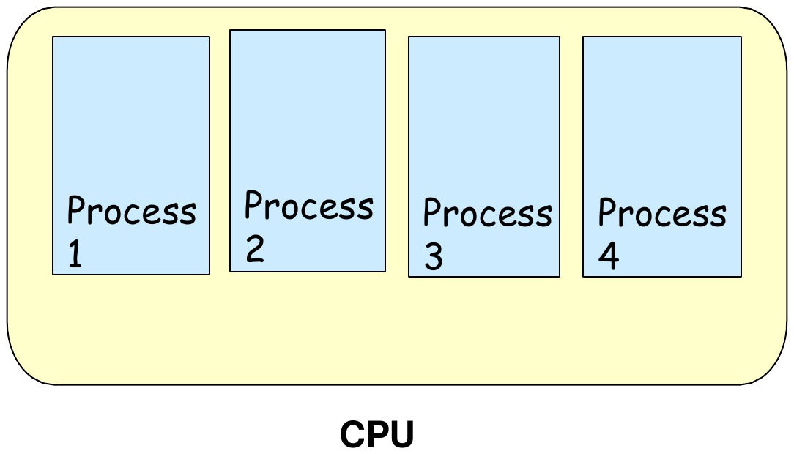
PART A · MULTITHREADED PROGRAMMING
Process
An executing instance of a program is called process.
Also known as “Heavyweight process”.
It has own address space.
For example while writing java program in editor we can run MP3 player. At the same time we can download file from net. All these task are executing simultaneously and independent of eachother.
Object Oriented Programming Through Java | Unit V: Multithreading, AWT, Event Handling & Applets | Ramachandra College of Engineering (Autonomous) | Faculty: N V Narasimha Raju
12

Slide 13
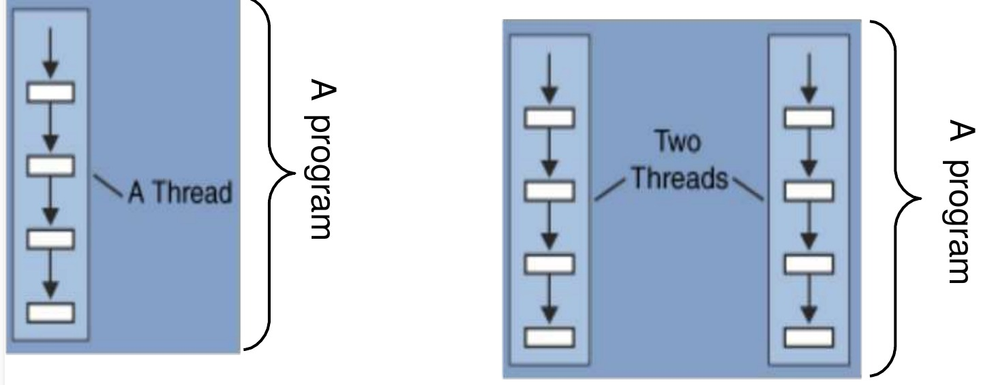
PART A · MULTITHREADED PROGRAMMING
What is a Thread?
A thread is a single sequential flow of execution within a program.
A thread is a subset of process.
Thread is considered as “Light Weight Process” because it use less resource than process.
They share the address space of the process but process have their own address space.
JVM create the thread whose task is to define the main thread.
Object Oriented Programming Through Java | Unit V: Multithreading, AWT, Event Handling & Applets | Ramachandra College of Engineering (Autonomous) | Faculty: N V Narasimha Raju
13

Slide 14
PART A · MULTITHREADED PROGRAMMING
Process vs. Thread
Process | Thread
It is a program with multiple threads | It is a individual unit of a program
Execution of running program | Individual parts of a program
Each program has its own address space | Multiple threads may share common address space
Heavy weight process | Light weight process
Context switching is high cost i.e., switching from one process to another process | Switching between threads will be very easy so context switching is low
Inter process communication is expensive because each program has its own address space | Inter process communication is inexpensive
Not under control of Java | Under control of Java
Object Oriented Programming Through Java | Unit V: Multithreading, AWT, Event Handling & Applets | Ramachandra College of Engineering (Autonomous) | Faculty: N V Narasimha Raju
14

Slide 15
PART A · MULTITHREADED PROGRAMMING
Multithreading in Java
The process of executing multiple threads simultaneously is known as multithreading.
Example
Games are very good examples of threading. You can use multiple objects in games like cars, motor bikes, animals, people etc. All these objects are nothing but just threads that run your game application.
In word processor one thread take the input from keyboard and another thread check the spelling mistakes and third thread count the words.
Railway ticket reservation system where multiple customers accessing the server.
Multiple account holders accessing their accounts simultaneously on the server. When you insert a ATM card, it starts a thread for perform your operations.
Object Oriented Programming Through Java | Unit V: Multithreading, AWT, Event Handling & Applets | Ramachandra College of Engineering (Autonomous) | Faculty: N V Narasimha Raju
15

Slide 16
PART A · MULTITHREADED PROGRAMMING
Advantages and Disadvantages of Multithreading
Advantages of Java Multithreading
The main advantage is proper utilization or max utilization is possible.
Decreased cost of maintenance.
Time saving.
Improves the performance of complex applications.
Parallelize tasks.
Disadvantage of Multithreading
Complex debugging and testing processes.
Increased difficulty level in writing a program.
Unpredictable results.
Object Oriented Programming Through Java | Unit V: Multithreading, AWT, Event Handling & Applets | Ramachandra College of Engineering (Autonomous) | Faculty: N V Narasimha Raju
16

Slide 17
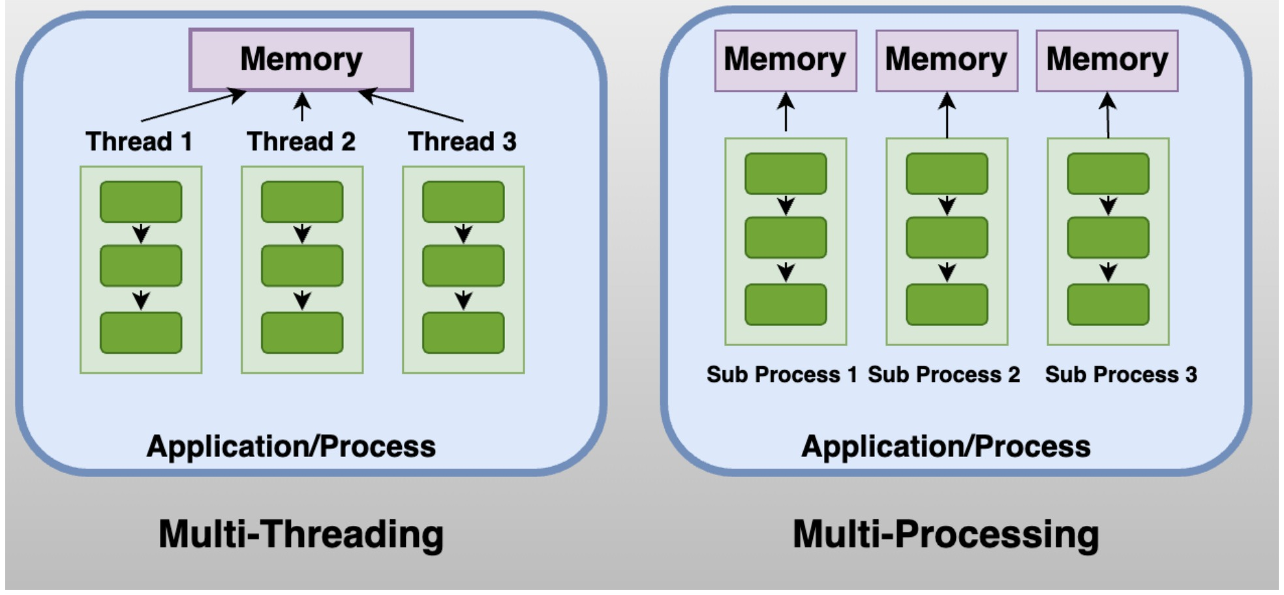
PART A · MULTITHREADED PROGRAMMING
Multi-Threading vs. Multi-Processing
Object Oriented Programming Through Java | Unit V: Multithreading, AWT, Event Handling & Applets | Ramachandra College of Engineering (Autonomous) | Faculty: N V Narasimha Raju
17

Slide 18
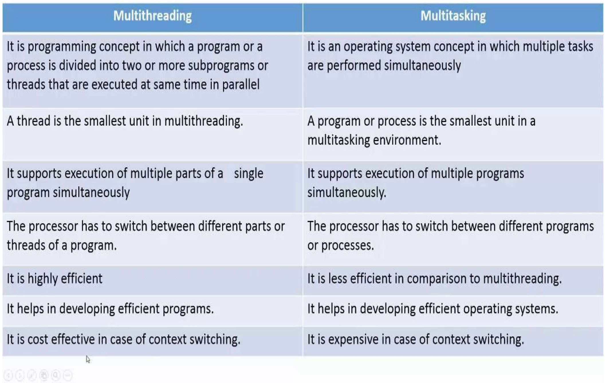
PART A · MULTITHREADED PROGRAMMING
Multithreading vs. Multitasking
Object Oriented Programming Through Java | Unit V: Multithreading, AWT, Event Handling & Applets | Ramachandra College of Engineering (Autonomous) | Faculty: N V Narasimha Raju
18

Slide 19
PART A · MULTITHREADED PROGRAMMING
CONCEPT 2
Thread Lifecycle or Thread States
Object Oriented Programming Through Java | Unit V: Multithreading, AWT, Event Handling & Applets | Ramachandra College of Engineering (Autonomous) | Faculty: N V Narasimha Raju
19

Slide 20
PART A · MULTITHREADED PROGRAMMING
Thread Lifecycle or Thread States
How to thread will be created
How it will be process
How it will be terminated
Everything will done in number of states. We called as lifecycle states
Object Oriented Programming Through Java | Unit V: Multithreading, AWT, Event Handling & Applets | Ramachandra College of Engineering (Autonomous) | Faculty: N V Narasimha Raju
20

Slide 21
PART A · MULTITHREADED PROGRAMMING
Thread Lifecycle: New, Runnable and Running
In Java thread is a class
We know that class consists of number of methods, variables, constructors etc., Here thread class consists of number of methods. In order to access those methods of thread first we have to create an object for a thread. Creation of that object then thread will be in new state or new born state.
Immediately after the new born state there is an another state is called as runnable state. Ready to execute its task then it will be in runnable state.
Thread is allocated to process - Processor is available then it will be moving to Running state.
Object Oriented Programming Through Java | Unit V: Multithreading, AWT, Event Handling & Applets | Ramachandra College of Engineering (Autonomous) | Faculty: N V Narasimha Raju
21

Slide 22
PART A · MULTITHREADED PROGRAMMING
Thread Lifecycle: Blocked and Terminated
Process will starts execution (under execution). If any other interruption are occur during running state then the thread will moved to waiting or blocking state.
Thread is under control processor if there is any interruption may occur such conditions the thread will be moved to blocking or waiting state. Process will execute another thread.
After completion of interruption it will be moved to either running state if processor is available or runnable state if processor is busy.
If there is no interruptions are occur after completion of execution process it will move to stop or termination.
Object Oriented Programming Through Java | Unit V: Multithreading, AWT, Event Handling & Applets | Ramachandra College of Engineering (Autonomous) | Faculty: N V Narasimha Raju
22

Slide 23
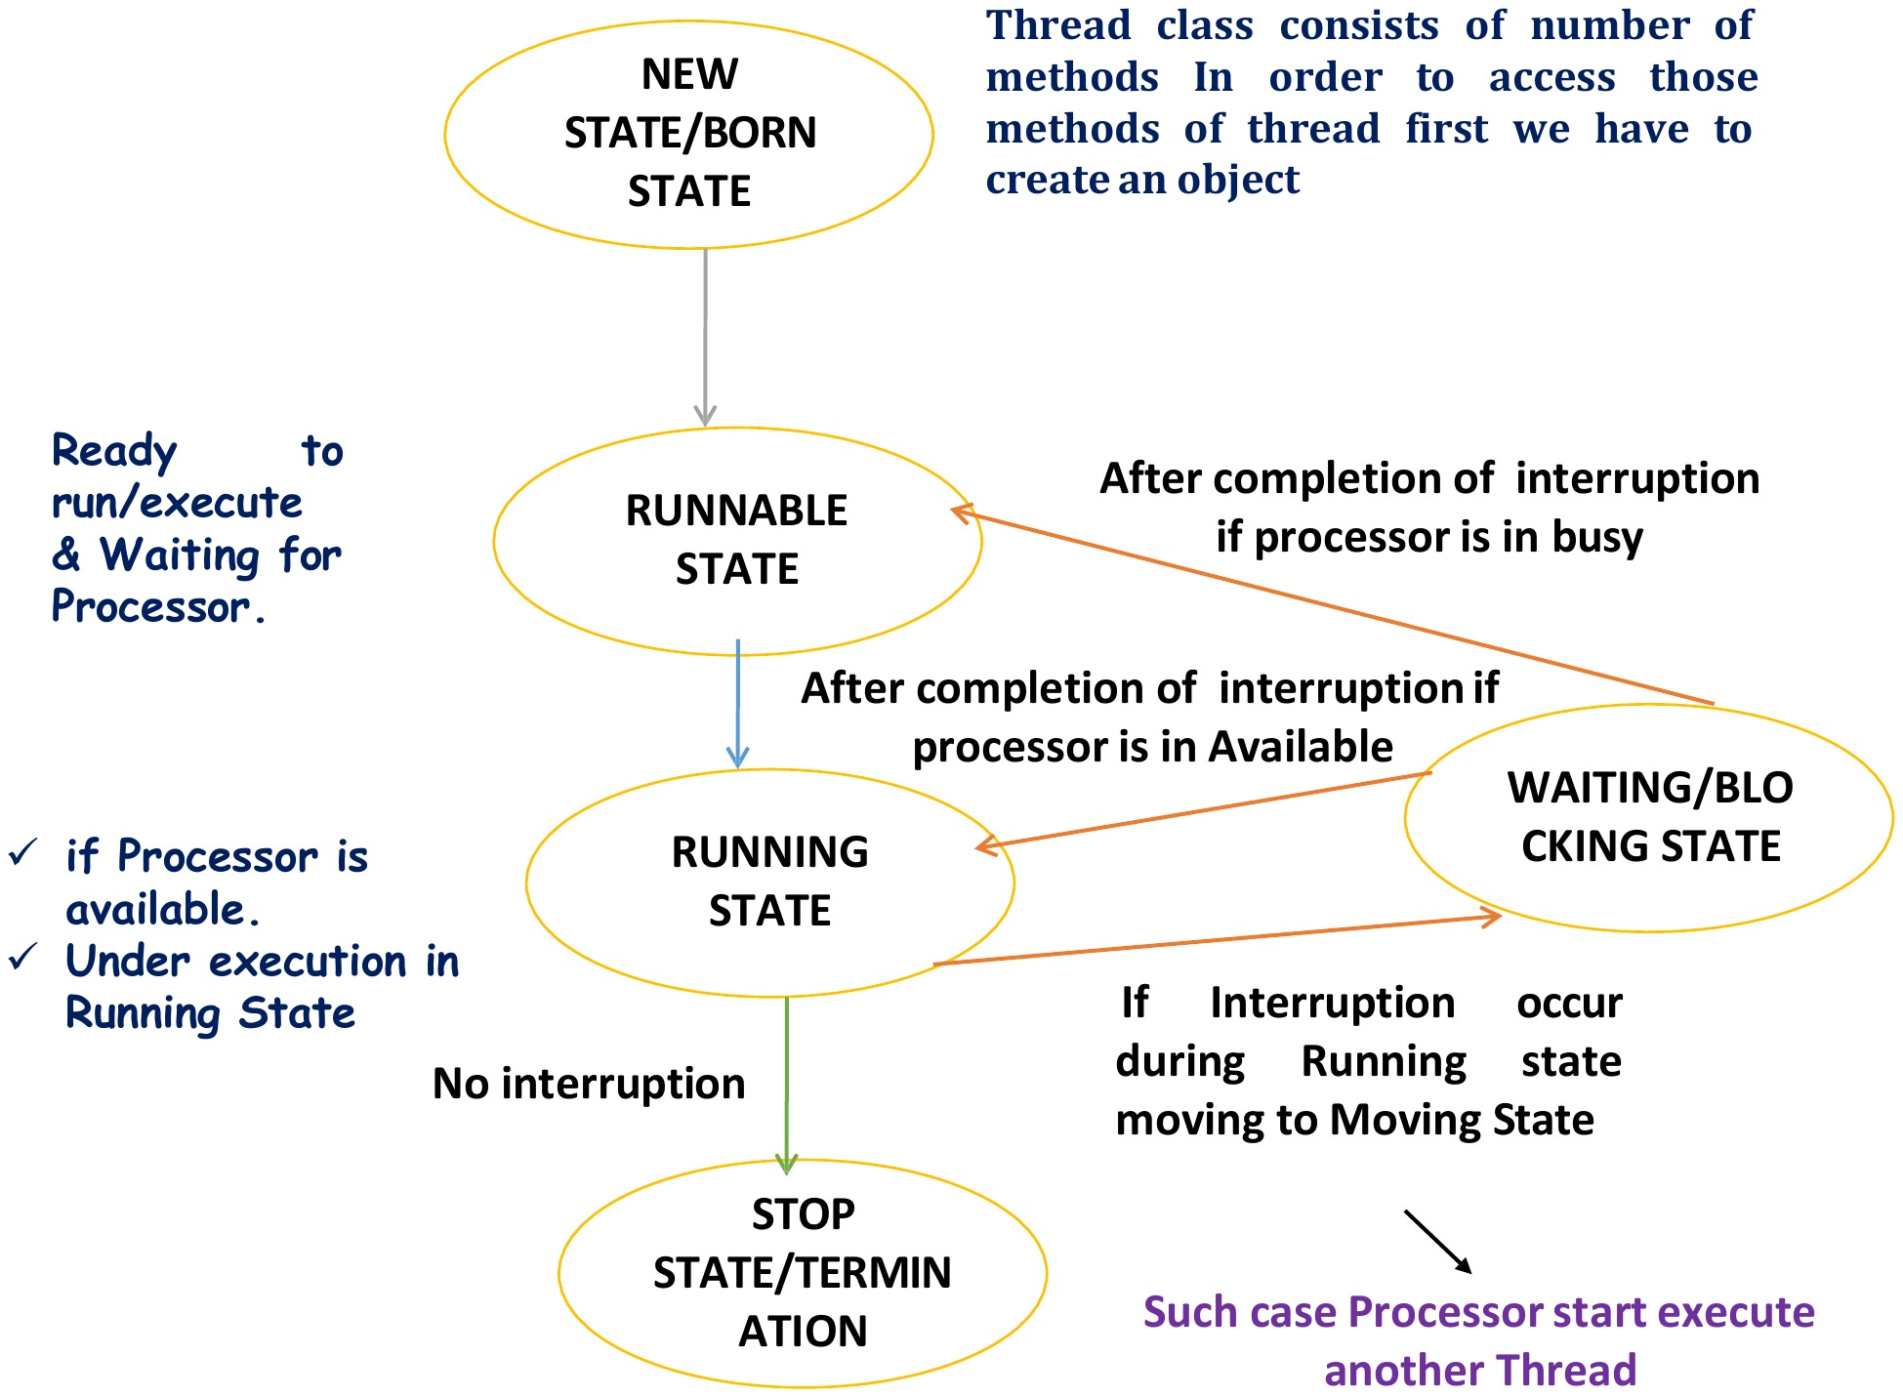
PART A · MULTITHREADED PROGRAMMING
Thread Lifecycle (States)
Object Oriented Programming Through Java | Unit V: Multithreading, AWT, Event Handling & Applets | Ramachandra College of Engineering (Autonomous) | Faculty: N V Narasimha Raju
23

Slide 24
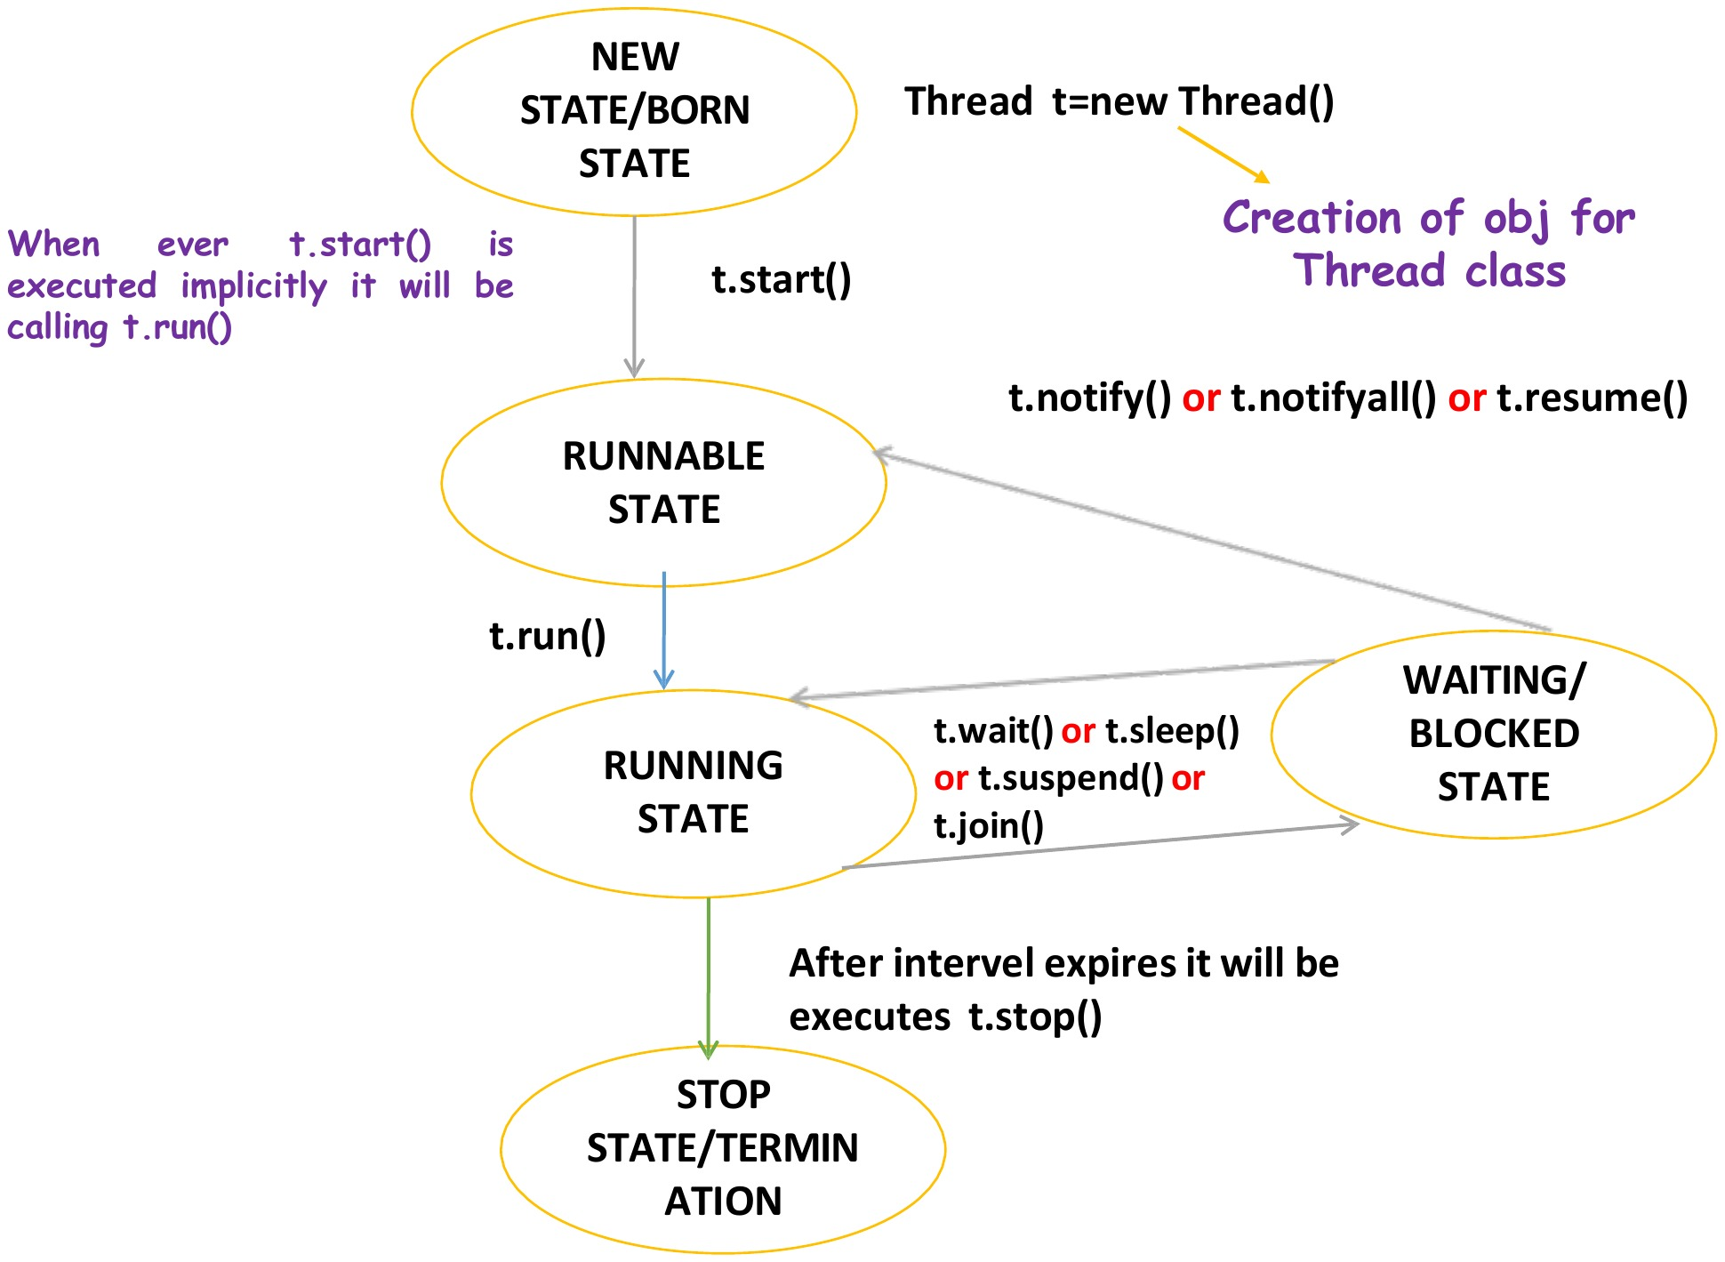
PART A · MULTITHREADED PROGRAMMING
Thread Lifecycle: Methods in Each State
Object Oriented Programming Through Java | Unit V: Multithreading, AWT, Event Handling & Applets | Ramachandra College of Engineering (Autonomous) | Faculty: N V Narasimha Raju
24

Slide 25
PART A · MULTITHREADED PROGRAMMING
CONCEPT 3
Creating a Thread or How to Create a Thread in Java
Object Oriented Programming Through Java | Unit V: Multithreading, AWT, Event Handling & Applets | Ramachandra College of Engineering (Autonomous) | Faculty: N V Narasimha Raju
25

Slide 26
PART A · MULTITHREADED PROGRAMMING
Creating a Thread in Java
There are two ways to create a thread:
By using inheritance or By extends Thread class
By using interface or By implements Runnable interface.
Object Oriented Programming Through Java | Unit V: Multithreading, AWT, Event Handling & Applets | Ramachandra College of Engineering (Autonomous) | Faculty: N V Narasimha Raju
26

Slide 27
PART A · MULTITHREADED PROGRAMMING
1. By extending the Thread class
Declaring a class: Any new class can be declared to extends the thread class, thus inheriting all the functionalities of the Thread class.
class NewThread extends Thread
{
}
This is one of the way to create a thread by a new class that extends Thread class and create an instance of that class.
Create the thread object and use the start() method to initiate the thread execution. Then it implicitly calls run() method.
Object Oriented Programming Through Java | Unit V: Multithreading, AWT, Event Handling & Applets | Ramachandra College of Engineering (Autonomous) | Faculty: N V Narasimha Raju
27

Slide 28
PART A · MULTITHREADED PROGRAMMING
Thread Example: Extending Thread Class
class Multi extends Thread
{
public void run()
{
System.out.println("thread is running...");
}
public static void main(String args[])
{
Multi t1=new Multi();
t1.start();
}
}
thread is running...
Object Oriented Programming Through Java | Unit V: Multithreading, AWT, Event Handling & Applets | Ramachandra College of Engineering (Autonomous) | Faculty: N V Narasimha Raju
28

Slide 29
PART A · MULTITHREADED PROGRAMMING
Extending Thread: Example 2
class Example extends Thread
{
public void run()
{
for(int i=0;i<=5;i++)
{
System.out.println("welcome to EEE");
}
}
public static void main(String args[])
{
for(int j=5;j<=10;j++)
{
System.out.println("RCE");
}
Example obj=new Example();
obj.start();
}
}
E:\>javac Exam.java
E:\>java Example
RCE
RCE
RCE
RCE
RCE
RCE
welcome to EEE
welcome to EEE
welcome to EEE
welcome to EEE
welcome to EEE
welcome to EEE
Object Oriented Programming Through Java | Unit V: Multithreading, AWT, Event Handling & Applets | Ramachandra College of Engineering (Autonomous) | Faculty: N V Narasimha Raju
29

Slide 30
PART A · MULTITHREADED PROGRAMMING
Extending Thread: Example with sleep()
class Example extends Thread
{
public void run()
{
for(int i=0;i<=5;i++)
{
System.out.println("welcome to IV-EEE-A");
try
{
Thread.sleep(1000);
}
catch(Exception e)
{
}
System.out.println("welcome to IV-EEE-B");
}
}
public static void main(String args[])
{
Example obj=new Example();
obj.start();
}
}
D:\>JAVAC Example.java
D:\>java Example
welcome to IV-EEE-A
welcome to IV-EEE-B
welcome to IV-EEE-A
welcome to IV-EEE-B
welcome to IV-EEE-A
welcome to IV-EEE-B
welcome to IV-EEE-A
welcome to IV-EEE-B
welcome to IV-EEE-A
welcome to IV-EEE-B
welcome to IV-EEE-A
welcome to IV-EEE-B
Object Oriented Programming Through Java | Unit V: Multithreading, AWT, Event Handling & Applets | Ramachandra College of Engineering (Autonomous) | Faculty: N V Narasimha Raju
30

Slide 31
PART A · MULTITHREADED PROGRAMMING
2. By implementing the Runnable interface
The runnable interface has an undefined method run() with void as return type, and it takes in no arguments. The method summary of the run() method is given below-
Method syntax:
public void run()
Description:
In this method, we can use variables, instantiate classes, and perform an action like the same way the main thread does.
Object Oriented Programming Through Java | Unit V: Multithreading, AWT, Event Handling & Applets | Ramachandra College of Engineering (Autonomous) | Faculty: N V Narasimha Raju
31

Slide 32
PART A · MULTITHREADED PROGRAMMING
Thread Example: Implementing Runnable
class Multi implements Runnable
{
public void run()
{
System.out.println("thread is running...");
}
public static void main(String args[])
{
Multi m1=new Multi(); //object creation
Thread t1 =new Thread(m1); //passing the parameter to Thread class
t1.start();
}
}
thread is running...
Object Oriented Programming Through Java | Unit V: Multithreading, AWT, Event Handling & Applets | Ramachandra College of Engineering (Autonomous) | Faculty: N V Narasimha Raju
32

Slide 33
PART A · MULTITHREADED PROGRAMMING
A Simple Thread Example Using Runnable
class Example implements Runnable
{
public void run()
{
for(int i=0;i<=5;i++)
{
System.out.println("HELLO WORLD");
}
}
public static void main(String args[])
{
for(int j=5;j<=10;j++)
{
System.out.println("WELCOME TO RCE");
}
Example obj=new Example();
Thread t=new Thread(obj);
t.start();
}
}
E:\>javac Exam.java
E:\>java Example
WELCOME TO RCE
WELCOME TO RCE
WELCOME TO RCE
WELCOME TO RCE
WELCOME TO RCE
WELCOME TO RCE
HELLO WORLD
HELLO WORLD
HELLO WORLD
HELLO WORLD
HELLO WORLD
HELLO WORLD
Object Oriented Programming Through Java | Unit V: Multithreading, AWT, Event Handling & Applets | Ramachandra College of Engineering (Autonomous) | Faculty: N V Narasimha Raju
33

Slide 34
PART A · MULTITHREADED PROGRAMMING
Runnable Example with sleep()
class Example implements Runnable
{
public void run()
{
for(int i=0;i<=5;i++)
{
System.out.println("welcome to IV-EEE-A");
try
{
Thread.sleep(1000);
}
catch(Exception e)
{
}
System.out.println("welcome to IV-EEE-B");
}
}
public static void main(String args[])
{
Example obj=new Example();
Thread obj1=new Thread(obj);
obj1.start();
}
}
D:\>javac Example.java
D:\>java Example
welcome to IV-EEE-A
welcome to IV-EEE-B
welcome to IV-EEE-A
welcome to IV-EEE-B
welcome to IV-EEE-A
welcome to IV-EEE-B
welcome to IV-EEE-A
welcome to IV-EEE-B
welcome to IV-EEE-A
welcome to IV-EEE-B
welcome to IV-EEE-A
welcome to IV-EEE-B
Object Oriented Programming Through Java | Unit V: Multithreading, AWT, Event Handling & Applets | Ramachandra College of Engineering (Autonomous) | Faculty: N V Narasimha Raju
34

Slide 35
PART A · MULTITHREADED PROGRAMMING
CONCEPT 4
Thread Priorities
Object Oriented Programming Through Java | Unit V: Multithreading, AWT, Event Handling & Applets | Ramachandra College of Engineering (Autonomous) | Faculty: N V Narasimha Raju
35

Slide 36
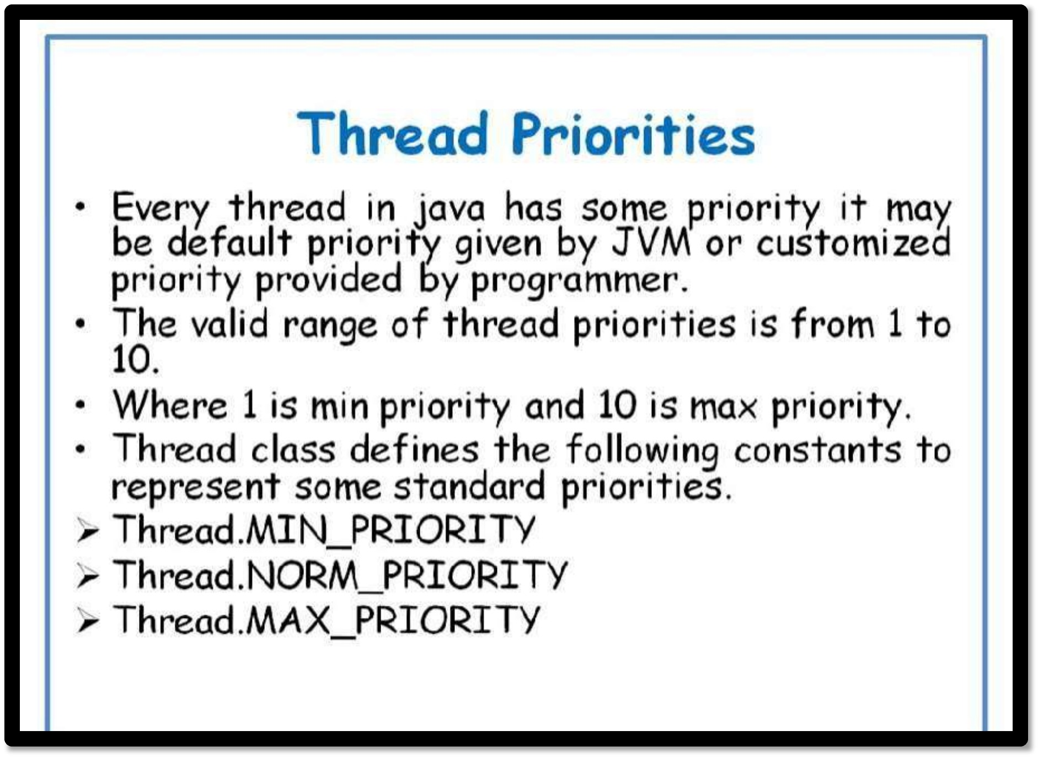
PART A · MULTITHREADED PROGRAMMING
Thread Priorities
Object Oriented Programming Through Java | Unit V: Multithreading, AWT, Event Handling & Applets | Ramachandra College of Engineering (Autonomous) | Faculty: N V Narasimha Raju
36

Slide 37
PART A · MULTITHREADED PROGRAMMING
Thread Priority Constants
Constant | Description
Thread.MAX_PRIORITY | The maximum priority of any thread (an int value of 10)
Thread.MIN_PRIORITY | The minimum priority of any thread (an int value of 1)
Thread.NORM_PRIORITY | The normal priority of any thread (an int value of 5)
Object Oriented Programming Through Java | Unit V: Multithreading, AWT, Event Handling & Applets | Ramachandra College of Engineering (Autonomous) | Faculty: N V Narasimha Raju
37

Slide 38
PART A · MULTITHREADED PROGRAMMING
Methods to Set the Priority
Method | Description
setPriority() | This is method is used to set the priority of thread.
getPriority() | This method is used to get the priority of thread.
Object Oriented Programming Through Java | Unit V: Multithreading, AWT, Event Handling & Applets | Ramachandra College of Engineering (Autonomous) | Faculty: N V Narasimha Raju
38

Slide 39
PART A · MULTITHREADED PROGRAMMING
Example Program: Thread Priority
class Priority extends Thread
{
public void run()
{
System.out.println("WELCOME TO RCE");
System.out.println("WELCOME TO AIML");
}
public static void main(String args[])
{
Priority p1=new Priority();
Priority p2=new Priority();
p1.start();
P2.start();
Object Oriented Programming Through Java | Unit V: Multithreading, AWT, Event Handling & Applets | Ramachandra College of Engineering (Autonomous) | Faculty: N V Narasimha Raju
39

Slide 40
PART A · MULTITHREADED PROGRAMMING
Example Program: Thread Priority (contd.)
System.out.println("Name is:"+p1.getName());
System.out.println("Name is:"+p2.getName());
System.out.println("Id is:"+p1.getId());
System.out.println("Id is:"+p2.getId());
System.out.println("before change:"+p1.getPriority());
System.out.println("before change:"+p2.getPriority());
p1.setPriority(Thread.MIN_PRIORITY);
p2.setPriority(Thread.MAX_PRIORITY);
System.out.println("after change:"+p1.getPriority());
System.out.println("after change:"+p2.getPriority());
}
}
Object Oriented Programming Through Java | Unit V: Multithreading, AWT, Event Handling & Applets | Ramachandra College of Engineering (Autonomous) | Faculty: N V Narasimha Raju
40

Slide 41
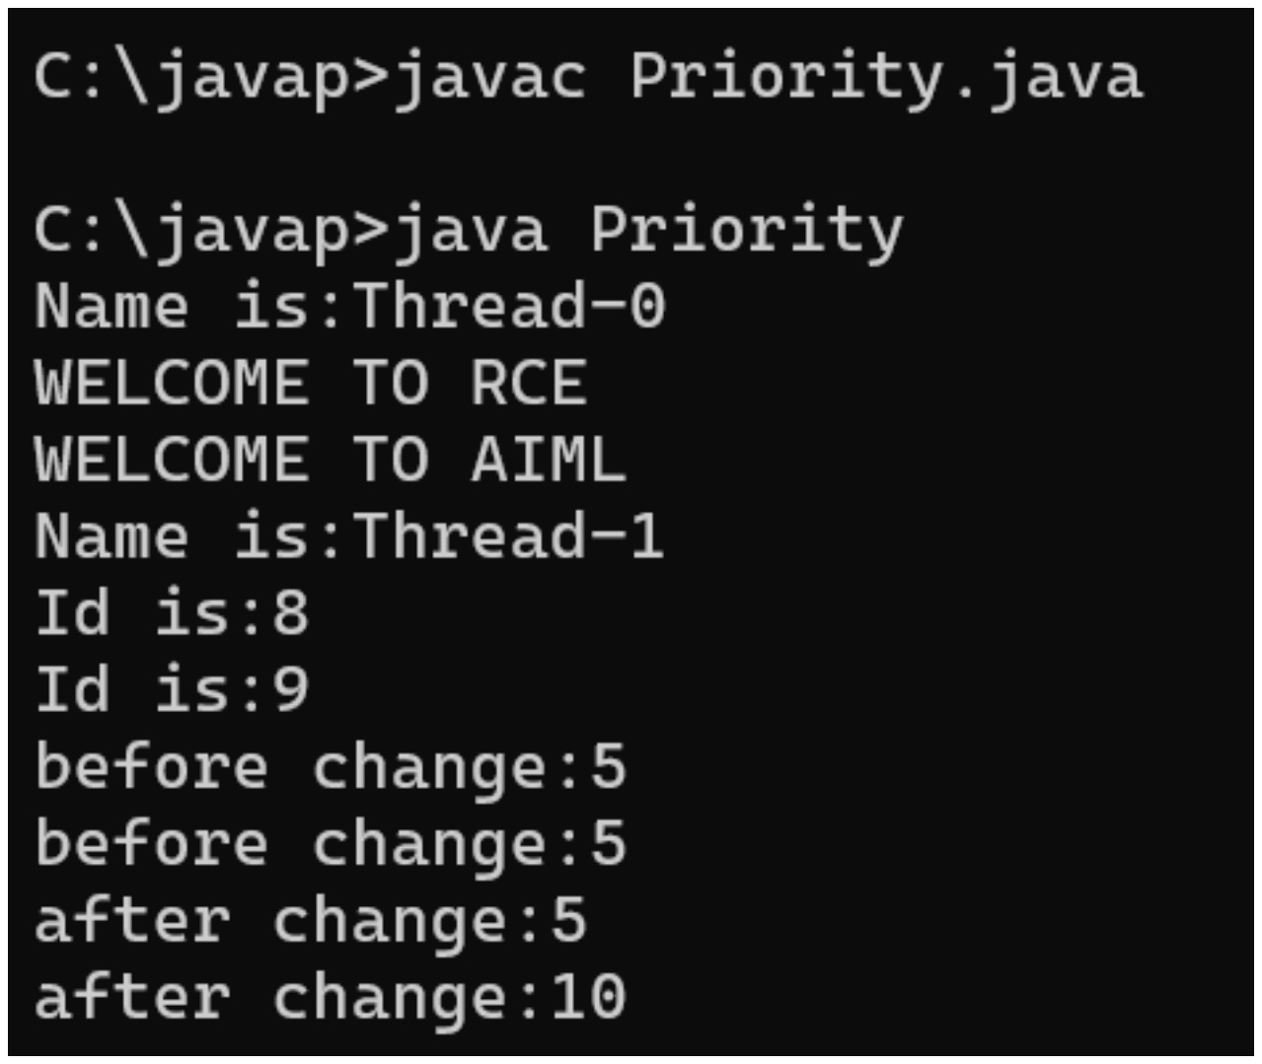
PART A · MULTITHREADED PROGRAMMING
Thread Priority: Output
Object Oriented Programming Through Java | Unit V: Multithreading, AWT, Event Handling & Applets | Ramachandra College of Engineering (Autonomous) | Faculty: N V Narasimha Raju
41

Slide 42
PART A · MULTITHREADED PROGRAMMING
CONCEPT 5
Synchronization in Java
Object Oriented Programming Through Java | Unit V: Multithreading, AWT, Event Handling & Applets | Ramachandra College of Engineering (Autonomous) | Faculty: N V Narasimha Raju
42

Slide 43
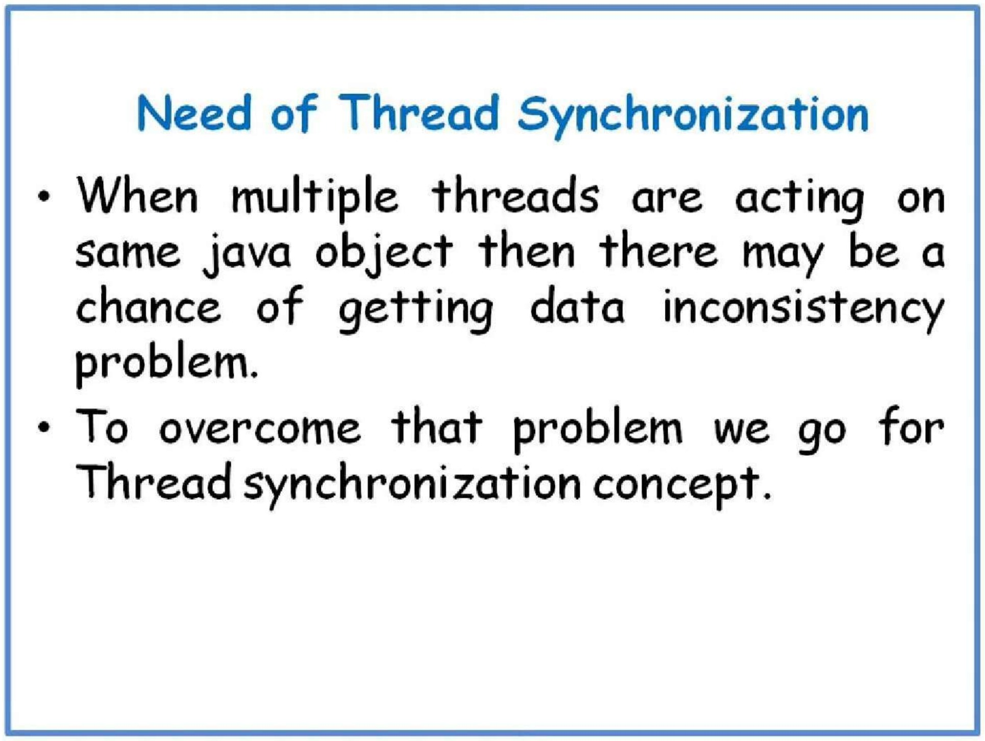
PART A · MULTITHREADED PROGRAMMING
Need of Thread Synchronization
Object Oriented Programming Through Java | Unit V: Multithreading, AWT, Event Handling & Applets | Ramachandra College of Engineering (Autonomous) | Faculty: N V Narasimha Raju
43

Slide 44
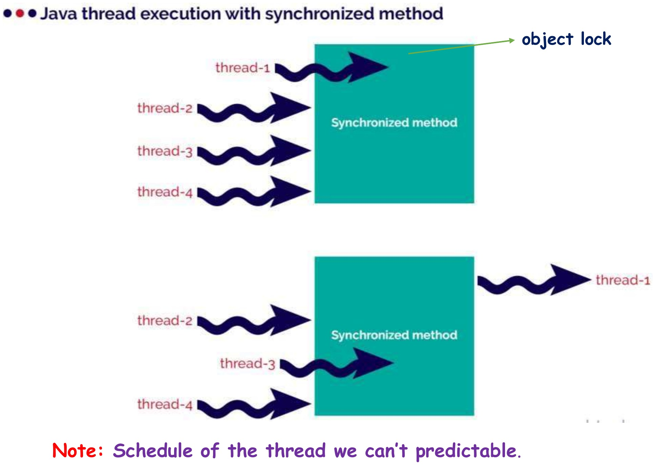
PART A · MULTITHREADED PROGRAMMING
Thread Execution with a Synchronized Method
Object Oriented Programming Through Java | Unit V: Multithreading, AWT, Event Handling & Applets | Ramachandra College of Engineering (Autonomous) | Faculty: N V Narasimha Raju
44

Slide 45
PART A · MULTITHREADED PROGRAMMING
How Synchronization Works
Synchronization mechanism is depending object lock. the object which is created in the object pool is combining lock.
The lock can’t duplicated
Depending on FIFO
After the lock, the thread only entering synchronization process.
If the lock is not available, such threads are not enter in synchronization process. hence this Synchronization also be called as Thread Controlling Mechanism
Object Oriented Programming Through Java | Unit V: Multithreading, AWT, Event Handling & Applets | Ramachandra College of Engineering (Autonomous) | Faculty: N V Narasimha Raju
45

Slide 46
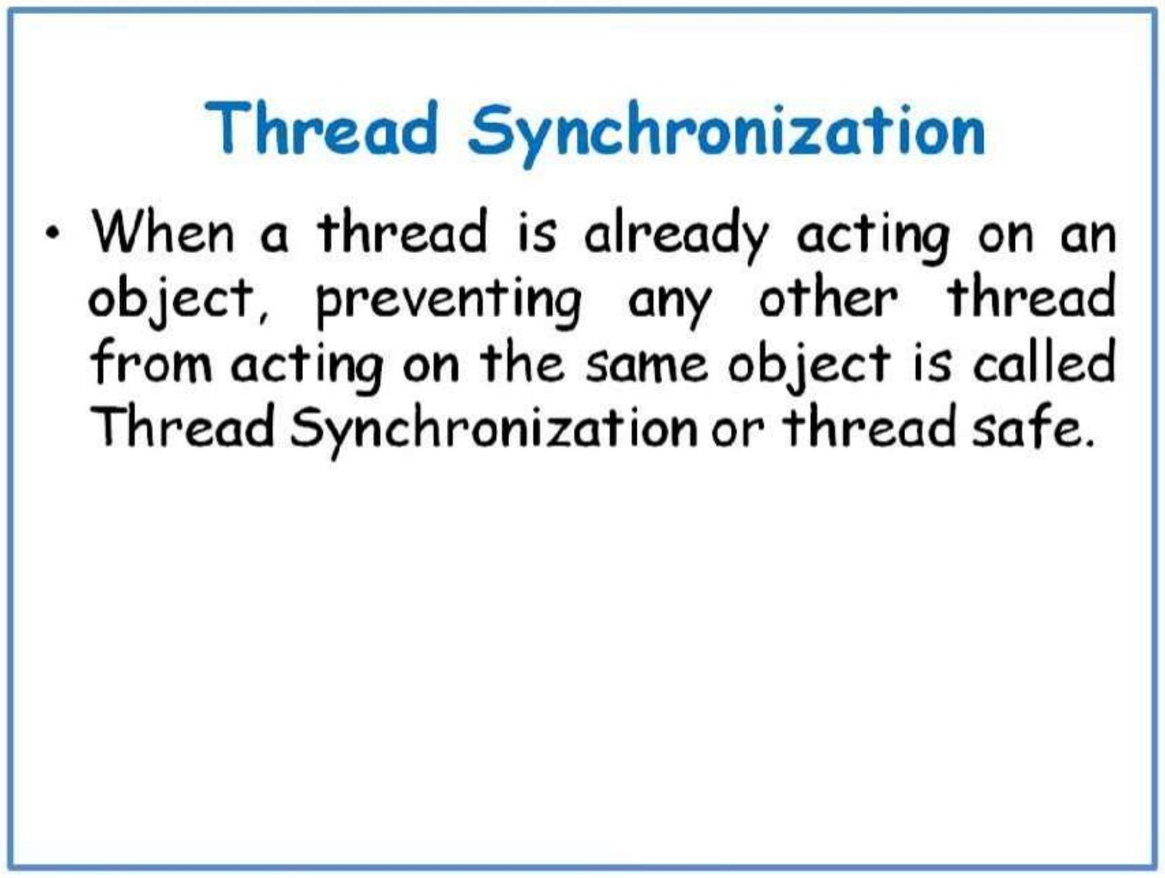
PART A · MULTITHREADED PROGRAMMING
Thread Synchronization
Object Oriented Programming Through Java | Unit V: Multithreading, AWT, Event Handling & Applets | Ramachandra College of Engineering (Autonomous) | Faculty: N V Narasimha Raju
46

Slide 47
PART A · MULTITHREADED PROGRAMMING
Synchronization in Java
Multithreading execution is not good in all cases some times when the data is “sensitive” or “critical”. then the simultaneous execution can able to give bad results.
To overcome these problem java introduce a new concept called as synchronization.
In synchronization the synchronized keyword is used. it can be accessing only one thread at one time.
Synchronization mechanism also be called as Thread Controlling Mechanism
This can be done in two ways
Synchronized method.
Synchronized block.
Object Oriented Programming Through Java | Unit V: Multithreading, AWT, Event Handling & Applets | Ramachandra College of Engineering (Autonomous) | Faculty: N V Narasimha Raju
47

Slide 48
PART A · MULTITHREADED PROGRAMMING
Thread Safety
When ever the synchronization is possible then Thread safety also possible
In synchronization process, the Thread is not distributed by any other Threads. hence it is said to be Thread safety
At which situation Synchronization is better?
whenever the data is critical or sensitive in all these cases Synchronization is better.
whenever the data is static that condition simultaneous Execution is better.
Object Oriented Programming Through Java | Unit V: Multithreading, AWT, Event Handling & Applets | Ramachandra College of Engineering (Autonomous) | Faculty: N V Narasimha Raju
48

Slide 49
PART A · MULTITHREADED PROGRAMMING
Why Use Synchronization?
Synchronization in Java is the capability to control the access of multiple threads to any shared resource.
Synchronization supporting simultaneous based sequential execution
Java Synchronization is better option where we want to allow only one thread to access the shared resource.
Why use Synchronization?
The synchronization is mainly used to
To prevent thread interference.
To prevent consistency problem.
Object Oriented Programming Through Java | Unit V: Multithreading, AWT, Event Handling & Applets | Ramachandra College of Engineering (Autonomous) | Faculty: N V Narasimha Raju
49

Slide 50
PART A · MULTITHREADED PROGRAMMING
Example Without Using Synchronized
class B extends Thread
{
public void run()
{
for(int i=0;i<5;i++)
{
System.out.println(Thread.currentThread().getName()+(i));
}
}
}
class Demo
{
public static void main(String args[])
{
B b=new B();
Thread t1=new Thread(b);
Thread t2=new Thread(b);
t1.setName("t1:");
t2.setName("t2:");
t1.start();
t2.start();
}
}
Object Oriented Programming Through Java | Unit V: Multithreading, AWT, Event Handling & Applets | Ramachandra College of Engineering (Autonomous) | Faculty: N V Narasimha Raju
50

Slide 51
PART A · MULTITHREADED PROGRAMMING
Without Synchronized: Output
E:\>javac B.java
E:\>java Demo
t2:0
t2:1
t2:2
t2:3
t1:0
t2:4
t1:1
t1:2
t1:3
t1:4
Object Oriented Programming Through Java | Unit V: Multithreading, AWT, Event Handling & Applets | Ramachandra College of Engineering (Autonomous) | Faculty: N V Narasimha Raju
51

Slide 52
PART A · MULTITHREADED PROGRAMMING
Example Using Synchronized
class B extends Thread
{
public void run()
{
synchronized(this)
{
for(int i=0;i<5;i++)
{
System.out.println(Thread.currentThread().getName()+(i));
}
}
}
}
class Demo
{
public static void main(String args[])
{
B b=new B();
Thread t1=new Thread(b);
Thread t2=new Thread(b);
t1.setName("t1:");
t2.setName("t2:");
t1.start();
t2.start();
}
}
Object Oriented Programming Through Java | Unit V: Multithreading, AWT, Event Handling & Applets | Ramachandra College of Engineering (Autonomous) | Faculty: N V Narasimha Raju
52

Slide 53
PART A · MULTITHREADED PROGRAMMING
Using Synchronized: Output
E:\>javac B1.java
E:\>java Demo
t2:0
t2:1
t2:2
t2:3
t2:4
t1:0
t1:1
t1:2
t1:3
t1:4
Object Oriented Programming Through Java | Unit V: Multithreading, AWT, Event Handling & Applets | Ramachandra College of Engineering (Autonomous) | Faculty: N V Narasimha Raju
53

Slide 54
PART A · MULTITHREADED PROGRAMMING
Concept 6: Inter-Thread Communication or Co-operation
By using one Thread communication with another thread
It allows one synchronized thread can communicate with another synchronized thread.
It is a mechanism in which a thread is going into wait state until another thread sends a notification.
wait(): corresponding thread goes into sleeping state or waiting state until to get notification from some other thread calls notify()
notify(): wakes up a thread that called wait() on same object
Object Oriented Programming Through Java | Unit V: Multithreading, AWT, Event Handling & Applets | Ramachandra College of Engineering (Autonomous) | Faculty: N V Narasimha Raju
54

Slide 55
PART A · MULTITHREADED PROGRAMMING
Inter-Thread Communication or Co-operation
It is all about allowing synchronized threads to communicate with each other.
Cooperation (Inter-thread communication) is a mechanism in which a thread is paused running in its critical section and another thread is allowed to enter (or lock) in the same critical section to be executed. It is implemented by following methods of Object class:
wait()
notify()
notifyAll()
Object Oriented Programming Through Java | Unit V: Multithreading, AWT, Event Handling & Applets | Ramachandra College of Engineering (Autonomous) | Faculty: N V Narasimha Raju
55

Slide 56
PART A · MULTITHREADED PROGRAMMING
wait() Method
1) wait() method
The wait() method causes current thread to release the lock and wait until either another thread invokes the notify() method or the notifyAll() method for this object, or a specified amount of time has elapsed.
The current thread must own this object's monitor, so it must be called from the synchronized method only otherwise it will throw exception.
Method | Description
public final void wait() throws InterruptedException | It waits until object is notified.
public final void wait(long timeout) throws InterruptedException | It waits for the specified amount of time.
Object Oriented Programming Through Java | Unit V: Multithreading, AWT, Event Handling & Applets | Ramachandra College of Engineering (Autonomous) | Faculty: N V Narasimha Raju
56

Slide 57
PART A · MULTITHREADED PROGRAMMING
notify() and notifyAll() Methods
2) notify() method
The notify() method wakes up a single thread that is waiting on this object's monitor. If any threads are waiting on this object, one of them is chosen to be awakened. The choice is arbitrary and occurs at the discretion of the implementation.
Syntax:
3) notifyAll() method
Wakes up all threads that are waiting on this object's monitor.
Syntax:
public final void notify()
public final void notifyAll()
Object Oriented Programming Through Java | Unit V: Multithreading, AWT, Event Handling & Applets | Ramachandra College of Engineering (Autonomous) | Faculty: N V Narasimha Raju
57

Slide 58
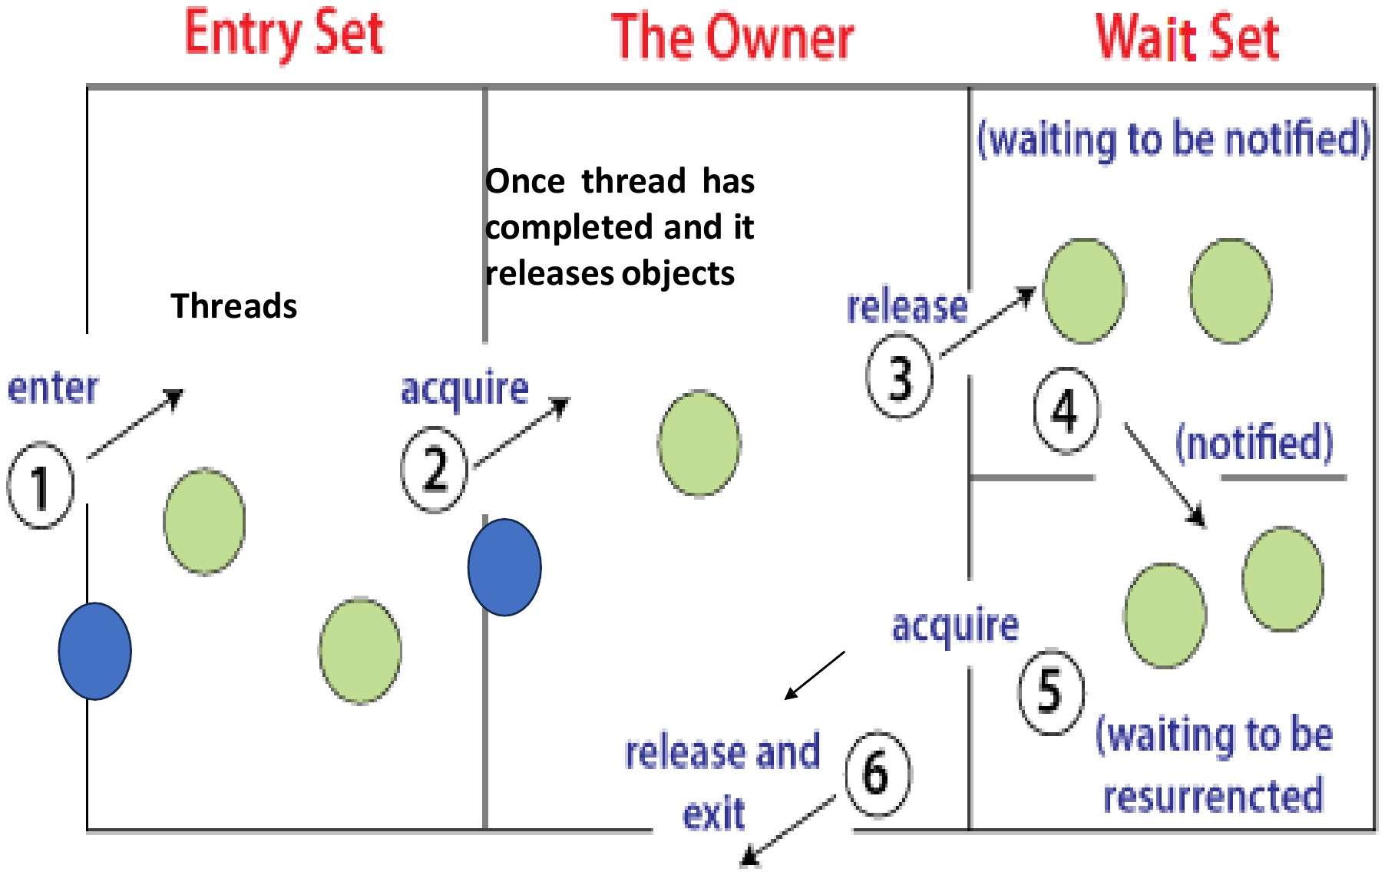
PART A · MULTITHREADED PROGRAMMING
Inter-Thread Communication: Monitor Diagram
Object Oriented Programming Through Java | Unit V: Multithreading, AWT, Event Handling & Applets | Ramachandra College of Engineering (Autonomous) | Faculty: N V Narasimha Raju
58

Slide 59
PART A · MULTITHREADED PROGRAMMING
Explanation of the Monitor Diagram
Threads enter to acquire lock.
Lock is acquired by on thread.
Now thread goes to waiting state if you call wait() method on the object. otherwise it releases the lock and exits.
If you call notify() or notifyall() method, thread moves to the notified state (runnable state).
Now thread is available to acquire lock.
After completion of the task, thread releases the lock and exits the monitor state of the object.
Object Oriented Programming Through Java | Unit V: Multithreading, AWT, Event Handling & Applets | Ramachandra College of Engineering (Autonomous) | Faculty: N V Narasimha Raju
59

Slide 60
PART A · MULTITHREADED PROGRAMMING
Difference Between wait() and sleep()
wait() | sleep()
The wait() method releases the lock. | The sleep() method doesn't release the lock.
It is a method of Object class | It is a method of Thread class
It is the non-static method | It is the static method
It should be notified by notify() or notifyAll() methods | After the specified amount of time, sleep is completed.
Object Oriented Programming Through Java | Unit V: Multithreading, AWT, Event Handling & Applets | Ramachandra College of Engineering (Autonomous) | Faculty: N V Narasimha Raju
60

Slide 61
PART A · MULTITHREADED PROGRAMMING
CONCEPT 7
Deadlock and Race Situations
https://drive.google.com/file/d/15e7_R5C7z-LcPvw82mYvzpmaRB8jIHbD/view?usp=sharing
Object Oriented Programming Through Java | Unit V: Multithreading, AWT, Event Handling & Applets | Ramachandra College of Engineering (Autonomous) | Faculty: N V Narasimha Raju
61

Slide 62
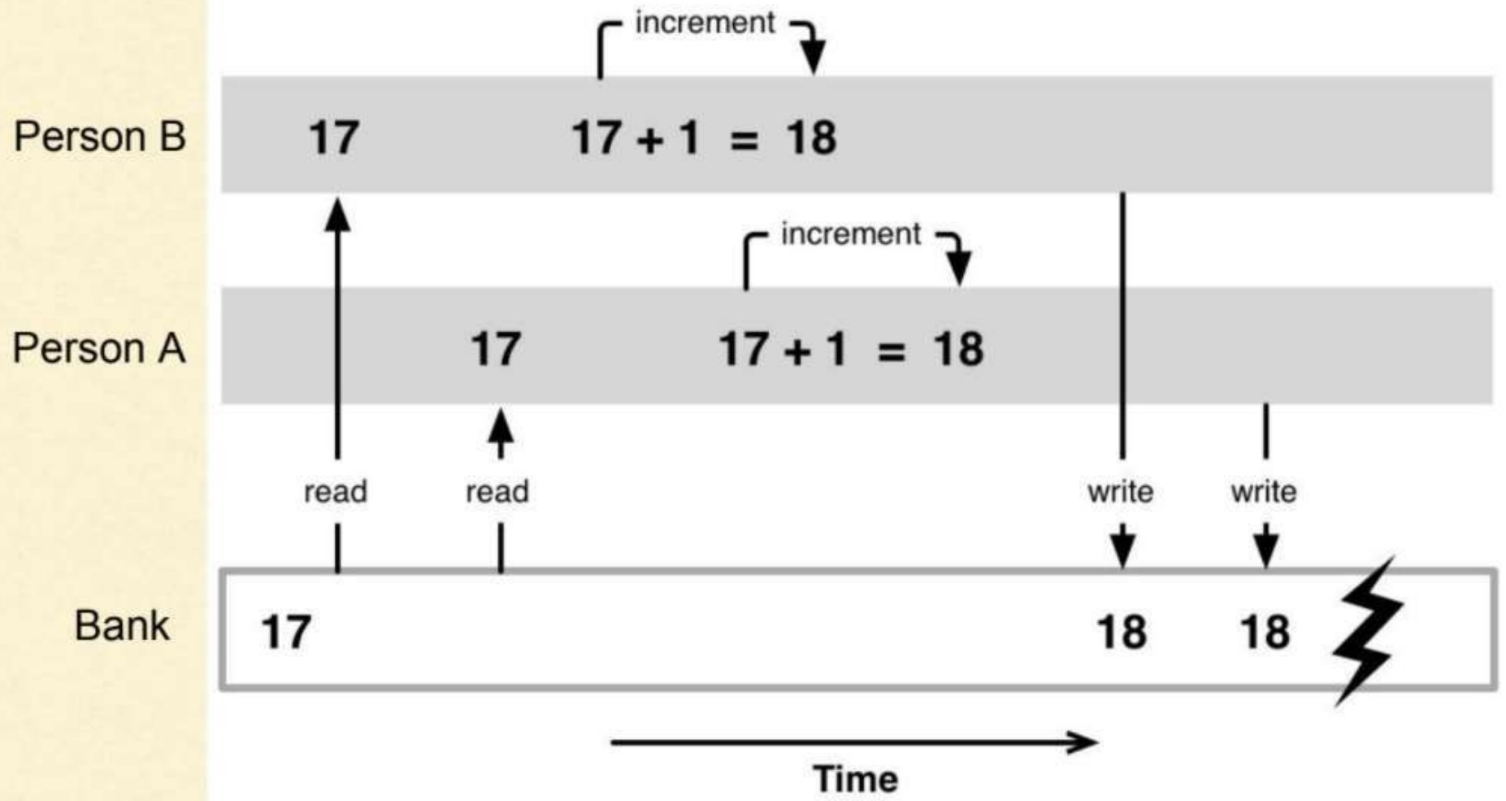
PART A · MULTITHREADED PROGRAMMING
What is a Race Condition?
When two processes are competing with each other causing data corruption.
Object Oriented Programming Through Java | Unit V: Multithreading, AWT, Event Handling & Applets | Ramachandra College of Engineering (Autonomous) | Faculty: N V Narasimha Raju
62

Slide 63
PART A · MULTITHREADED PROGRAMMING
Race Condition: Bank Account Example
As shown in the diagram, two persons are trying to deposit 1 dollar online into the same bank account. The initial amount is 17 dollar. Both the persons would be able to see $17 initially. Each of them tries to deposit $1, and the final amount is expected to be $19. But due to race conditions, the final amount in the bank is $18 instead of $19. This is also known as dirty read.
For example, if two processes/threads are trying to execute the following conditions simultaneously, they cause data corruption:
Thread 1:
Thread 2:
total = num1 + num2
total = num1 - num2
It is very common for the race conditions to go unnoticed during testing even after multiple tests and code reviews. But in production, there would be a lot of processes and threads working parallelly and compete for the same resources, and this problem would occur.
Object Oriented Programming Through Java | Unit V: Multithreading, AWT, Event Handling & Applets | Ramachandra College of Engineering (Autonomous) | Faculty: N V Narasimha Raju
63

Slide 64
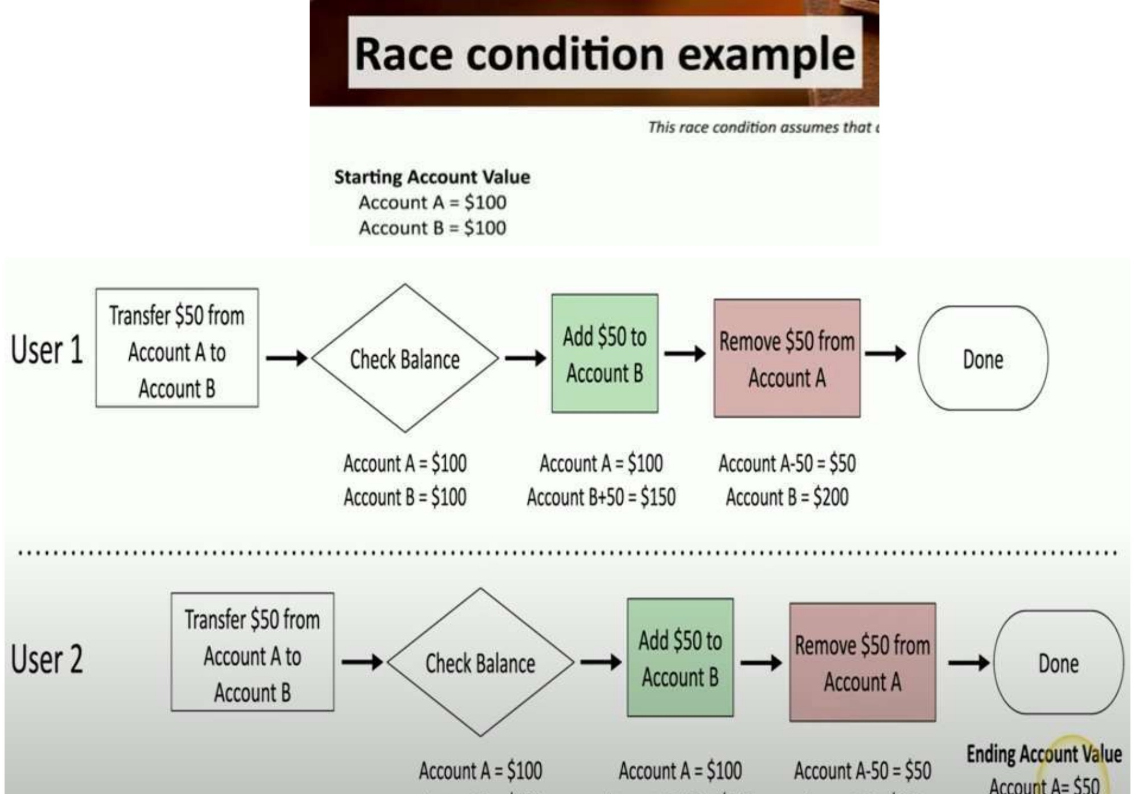
PART A · MULTITHREADED PROGRAMMING
Race Condition: Example
Object Oriented Programming Through Java | Unit V: Multithreading, AWT, Event Handling & Applets | Ramachandra College of Engineering (Autonomous) | Faculty: N V Narasimha Raju
64

Slide 65
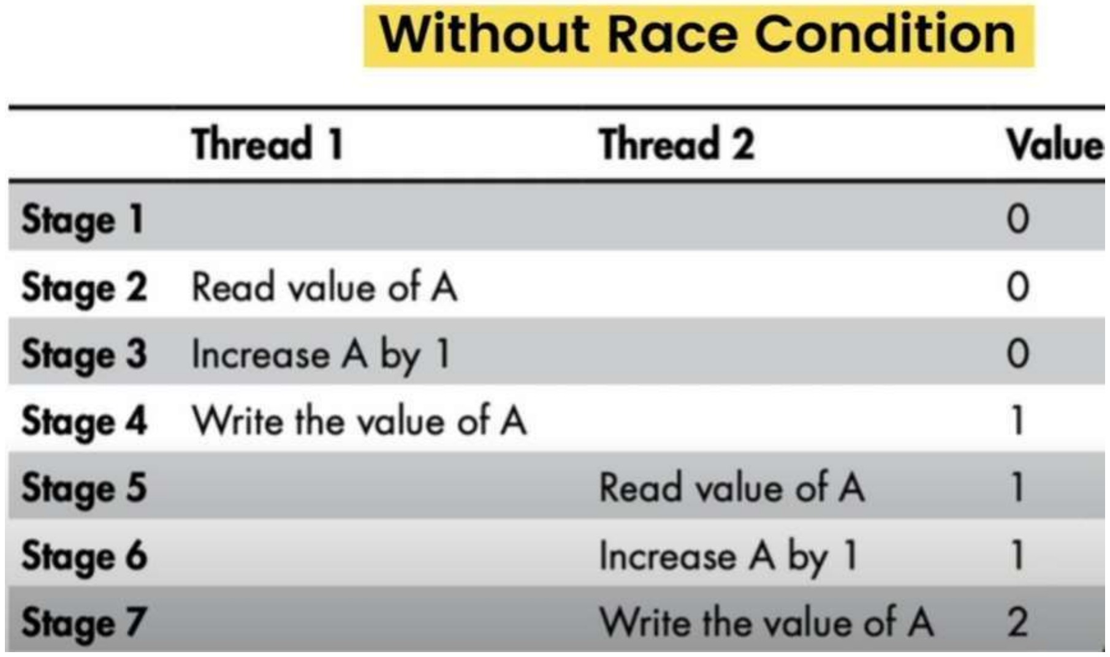
PART A · MULTITHREADED PROGRAMMING
Race Condition: Without Race Condition
Object Oriented Programming Through Java | Unit V: Multithreading, AWT, Event Handling & Applets | Ramachandra College of Engineering (Autonomous) | Faculty: N V Narasimha Raju
65

Slide 66
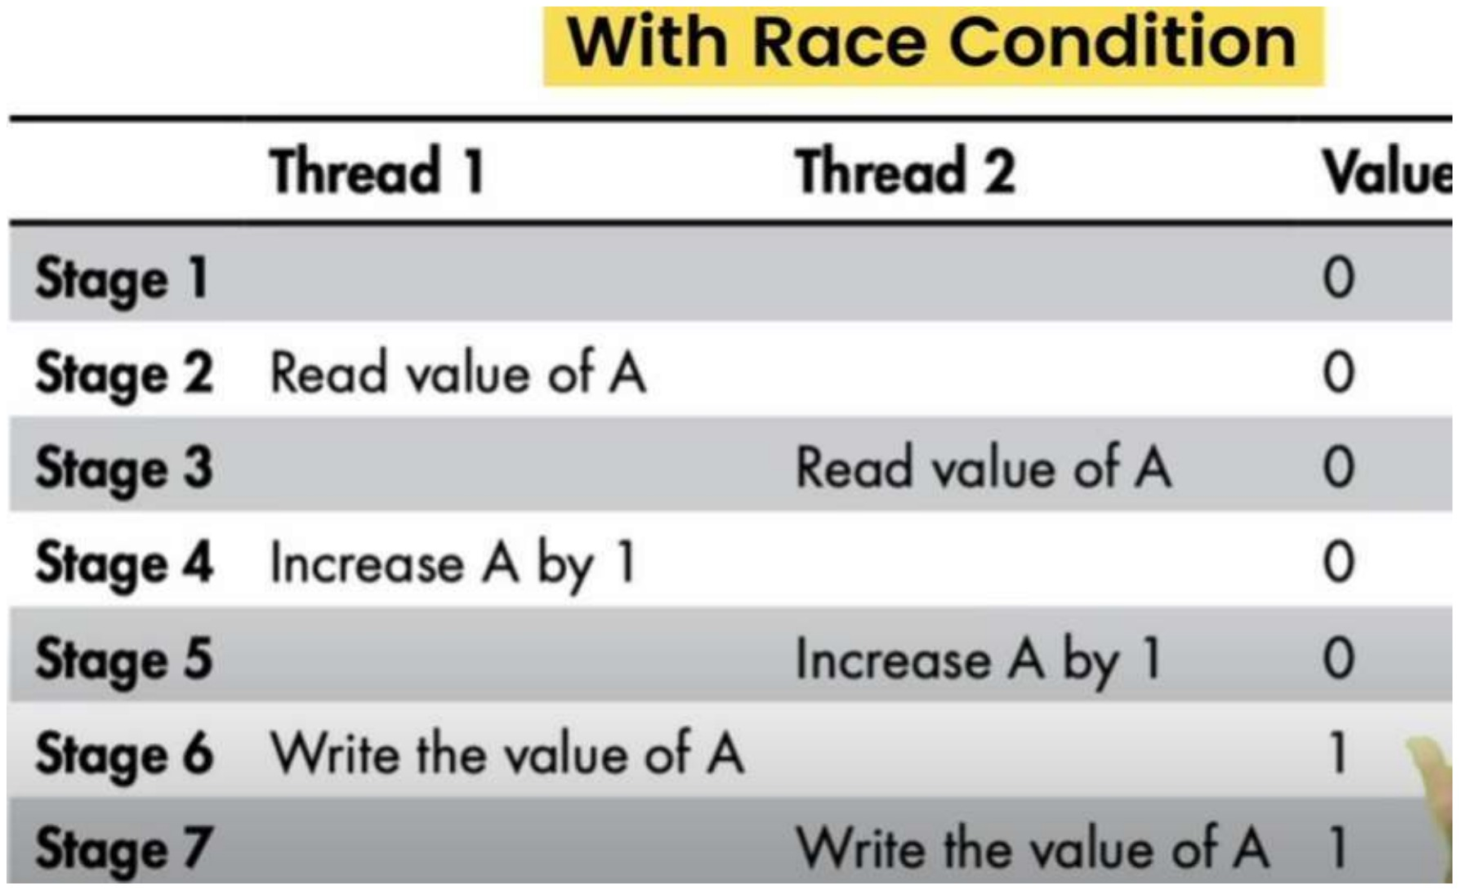
PART A · MULTITHREADED PROGRAMMING
Race Condition: With Race Condition
Object Oriented Programming Through Java | Unit V: Multithreading, AWT, Event Handling & Applets | Ramachandra College of Engineering (Autonomous) | Faculty: N V Narasimha Raju
66

Slide 67
PART A · MULTITHREADED PROGRAMMING
What is a Deadlock?
When two processes are waiting for each other directly or indirectly, it is called deadlock.
This usually occurs when two processes are waiting for shared resources acquired by others. For example, If thread T1 acquired resource R1 and it also needs resource R2 for it to accomplish its task. But the resource R2 is acquired by thread T2 which is waiting for resource R1 (which is acquired by T1). Neither of them will be able to accomplish its task, as they keep waiting for the other resources they need.
Object Oriented Programming Through Java | Unit V: Multithreading, AWT, Event Handling & Applets | Ramachandra College of Engineering (Autonomous) | Faculty: N V Narasimha Raju
67

Slide 68
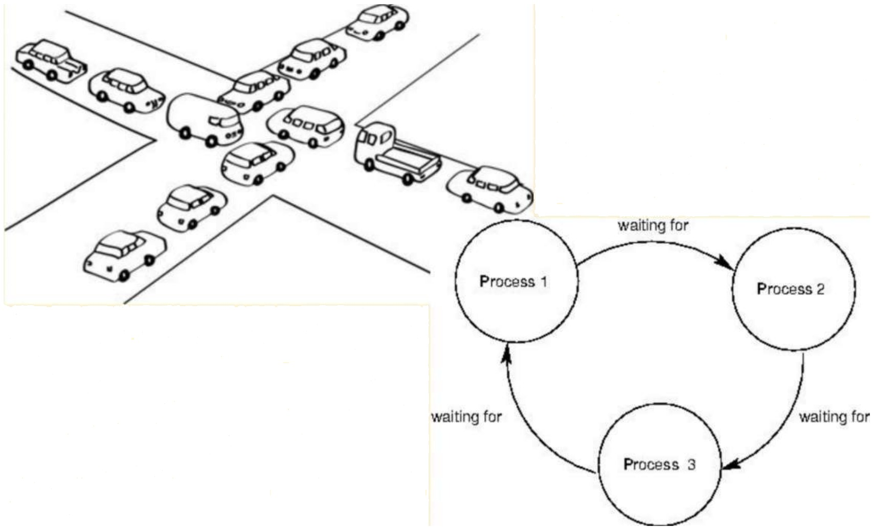
PART A · MULTITHREADED PROGRAMMING
Deadlock: Illustration
As you can see in the second diagram, process 1 is waiting for process 2 and process 2 is waiting for process 3 to finish and process 3 is waiting for process 1 to finish. All these three processes would keep waiting and will never end. This is called deadlock.
Object Oriented Programming Through Java | Unit V: Multithreading, AWT, Event Handling & Applets | Ramachandra College of Engineering (Autonomous) | Faculty: N V Narasimha Raju
68

Slide 69
PART B · AWT COMPONENTS
Part B: AWT Components
AWT Components: Introduction, components and containers, Layouts Manager, Button, Label, Checkbox, Radio Buttons, List Boxes, Choice Boxes, Menu and Scrollbar.
Object Oriented Programming Through Java | Unit V: Multithreading, AWT, Event Handling & Applets | Ramachandra College of Engineering (Autonomous) | Faculty: N V Narasimha Raju
69

Slide 70
PART B · AWT COMPONENTS
AWT (Abstract Window Toolkit)
Object Oriented Programming Through Java | Unit V: Multithreading, AWT, Event Handling & Applets | Ramachandra College of Engineering (Autonomous) | Faculty: N V Narasimha Raju
70

Slide 71
PART B · AWT COMPONENTS
Introduction to AWT (Abstract Window Toolkit)
Abstract Window Toolkit was java’s first GUI framework
The AWT classes are contained in the java.awt package
Java AWT (Abstract Window Toolkit) is an API to develop Graphical User Interface (GUI) or windows-based applications in Java.
The java.awt package provides classes for AWT API such as TextField, Label, RadioButton, CheckBox, Choice, List etc.
The AWT tutorial will help the user to understand Java GUI programming in simple and easy steps.
For example, an AWT GUI with components like TextField, label and button will have different look and feel for the different platforms like Windows, MAC OS, and Unix.
Object Oriented Programming Through Java | Unit V: Multithreading, AWT, Event Handling & Applets | Ramachandra College of Engineering (Autonomous) | Faculty: N V Narasimha Raju
71

Slide 72
PART B · AWT COMPONENTS
Java AWT Hierarchy
The hierarchy of Java AWT classes are given below.
Components
All the elements like the button, text fields, scroll bars, etc. are called components. In Java AWT, there are classes for each component as shown in above diagram. In order to place every component in a particular position on a screen, we need to add them to a container.
Container
The Container is a component in AWT that can contain another components like buttons, textfields, labels etc. The classes that extends Container class are known as container such as Frame, Dialog and Panel.
It is basically a screen where the components are placed at their specific locations. This it contains and controls the layout of components.
Object Oriented Programming Through Java | Unit V: Multithreading, AWT, Event Handling & Applets | Ramachandra College of Engineering (Autonomous) | Faculty: N V Narasimha Raju
72

Slide 73
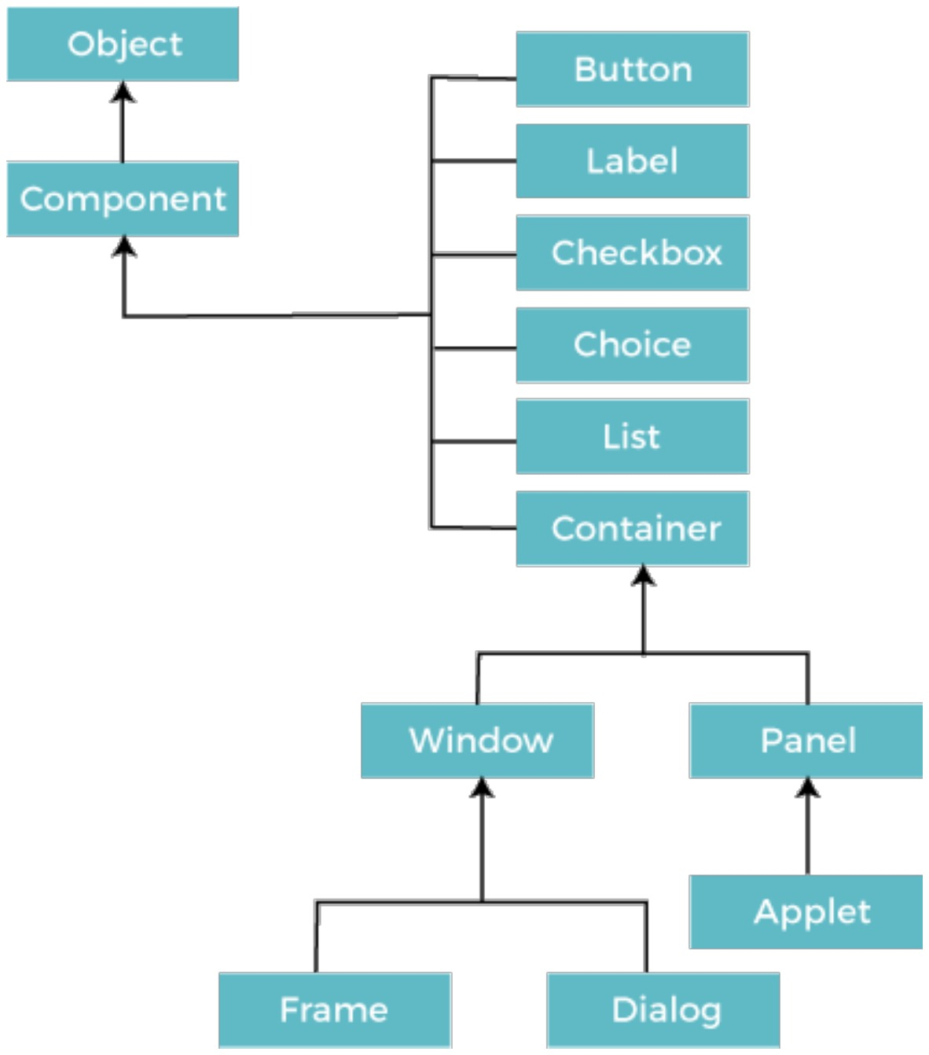
PART B · AWT COMPONENTS
Java AWT Hierarchy: Class Diagram
Object Oriented Programming Through Java | Unit V: Multithreading, AWT, Event Handling & Applets | Ramachandra College of Engineering (Autonomous) | Faculty: N V Narasimha Raju
73

Slide 74
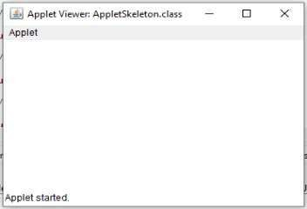
PART B · AWT COMPONENTS
Types of Containers
There are following types of containers in Java AWT:
1. Window
The window is the container that have no borders and menu bars. You must use frame, dialog or another window for creating a window. We need to create an instance of Window class to create this container.
Object Oriented Programming Through Java | Unit V: Multithreading, AWT, Event Handling & Applets | Ramachandra College of Engineering (Autonomous) | Faculty: N V Narasimha Raju
74

Slide 75
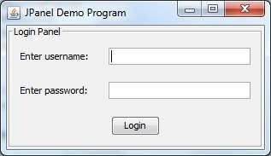
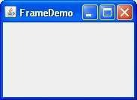
PART B · AWT COMPONENTS
Types of Containers: Panel and Frame
2. Panel
The Panel is the container that doesn't contain title bar, border or menu bar. It is generic container for holding the components. It can have other components like button, text field etc. An instance of Panel class creates a container, in which we can add components.
3. Frame
The Frame is the container that contain title bar and border and can have menu bars. It can have other components like button, text field, scrollbar etc. Frame is most widely used container while developing an AWT application.
Object Oriented Programming Through Java | Unit V: Multithreading, AWT, Event Handling & Applets | Ramachandra College of Engineering (Autonomous) | Faculty: N V Narasimha Raju
75

Slide 76
PART B · AWT COMPONENTS
Useful Methods of Component Class
Method | Description
public void add(Component c) | Inserts a component on this component.
public void setSize(int width,int height) | Sets the size (width and height) of the component.
public void setLayout(LayoutManager m) | Defines the layout manager for the component.
public void setVisible(boolean status) | Changes the visibility of the component, by default false.
Object Oriented Programming Through Java | Unit V: Multithreading, AWT, Event Handling & Applets | Ramachandra College of Engineering (Autonomous) | Faculty: N V Narasimha Raju
76

Slide 77
PART B · AWT COMPONENTS
The java.awt Package
The java.awt package provides classes for AWT API such as
Label
Button
Check Box
Check Box Group, etc.,
Object Oriented Programming Through Java | Unit V: Multithreading, AWT, Event Handling & Applets | Ramachandra College of Engineering (Autonomous) | Faculty: N V Narasimha Raju
77

Slide 78
PART B · AWT COMPONENTS
Program on Label
import java.awt.*;
class LabelExample extends Frame
{
LabelExample() // Constructor to set up the frame and labels
{
Label l1=new Label("STUDENT NAME"); // Create labels
Label l2=new Label("COLLEGE NAME"); // Create labels
add(l1); // Add labels to the frame
add(l2); // Add labels to the frame
l1.setBounds(0, 0, 175, 240); //setBounds(x, y, width, height)
l2.setBounds(100,100,200,350); //setBounds(x, y, width, height)
setSize (500, 500); //Sets the frame size to 500x500 pixels.
setLayout (null); //Disables the default layout manager
setVisible (true); //Makes the frame visible.
}
public static void main(String args[])
{
LabelExample obj=new LabelExample(); //which in turn calls the constructor
}
}
Object Oriented Programming Through Java | Unit V: Multithreading, AWT, Event Handling & Applets | Ramachandra College of Engineering (Autonomous) | Faculty: N V Narasimha Raju
78

Slide 79
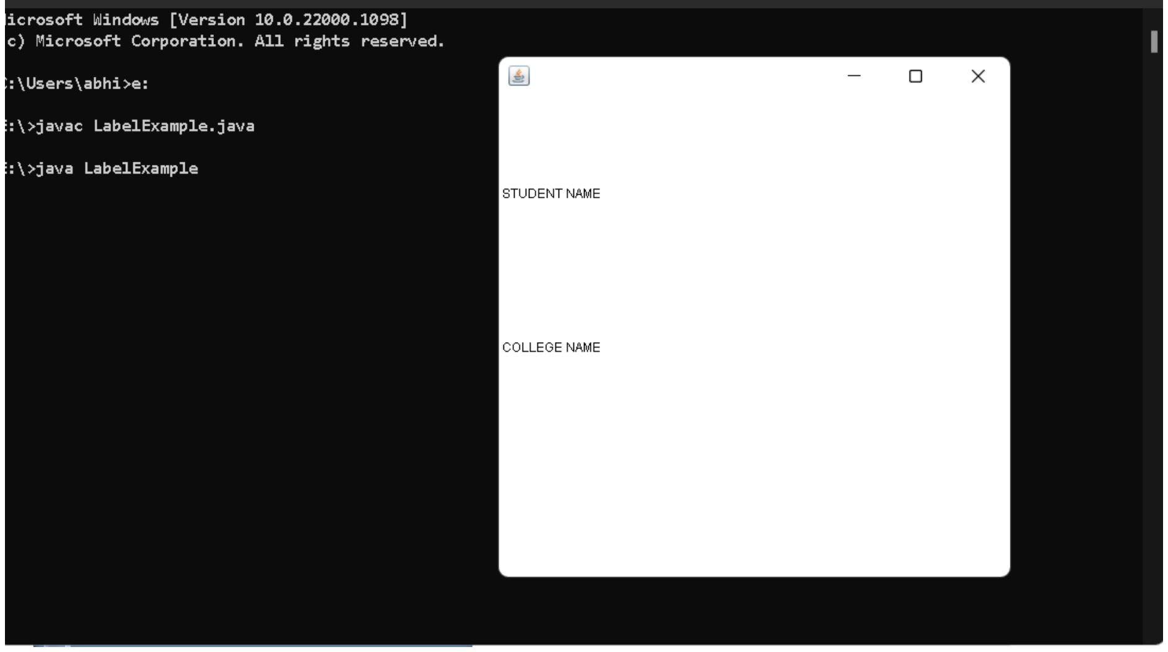
PART B · AWT COMPONENTS
Program on Label: Output
Object Oriented Programming Through Java | Unit V: Multithreading, AWT, Event Handling & Applets | Ramachandra College of Engineering (Autonomous) | Faculty: N V Narasimha Raju
79

Slide 80
PART B · AWT COMPONENTS
Program on Button
import java.awt.*;
class ButtonExample extends Frame
{
ButtonExample () //constructor
{
Button b = new Button ("click"); // Create button
b.setBounds (90, 140, 75, 40); //setBounds(x, y, width, height)
add (b); // Add labels to the frame
setSize (250, 250); //Sets the frame size to 250x250 pixels.
setLayout (null); //Sets the frame size to 500x500 pixels.
setVisible (true); //Makes the frame visible
}
public static void main (String args[])
{
ButtonExample obj= new ButtonExample (); //which in turn calls the constructor
}
}
Object Oriented Programming Through Java | Unit V: Multithreading, AWT, Event Handling & Applets | Ramachandra College of Engineering (Autonomous) | Faculty: N V Narasimha Raju
80

Slide 81
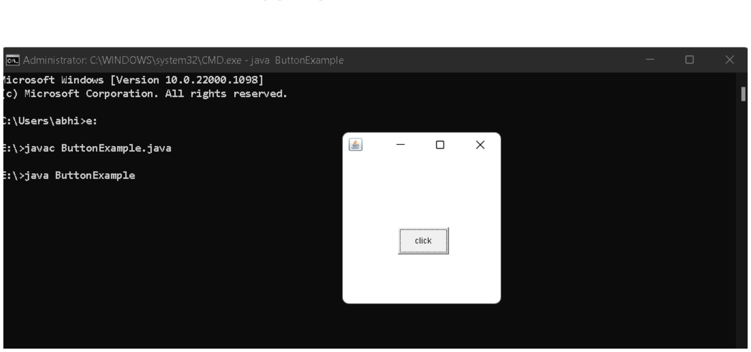
PART B · AWT COMPONENTS
Program on Button: Output
Object Oriented Programming Through Java | Unit V: Multithreading, AWT, Event Handling & Applets | Ramachandra College of Engineering (Autonomous) | Faculty: N V Narasimha Raju
81

Slide 82
PART B · AWT COMPONENTS
Program on Checkbox
import java.awt.*;
class CheckboxExample extends Frame
{
CheckboxExample () //constructor
{
Checkbox obj1=new Checkbox("AIML-A"); // Create Checkbox
Checkbox obj2=new Checkbox("AIML-B");
add(obj1); // Add labels to the frame
add(obj2); // Add labels to the frame
obj1.setBounds(100, 0, 175, 240); //setBounds(x, y, width, height)
obj2.setBounds(100,100,200,350); //setBounds(x, y, width, height)
setSize (500, 500); //Sets the frame size to 500x500 pixels.
setLayout (null); //Disables the default layout manager
setVisible (true); //Makes the frame visible
}
public static void main (String args[])
{
CheckboxExample obj=new CheckboxExample (); //which in turn calls the constructor
}
}
Object Oriented Programming Through Java | Unit V: Multithreading, AWT, Event Handling & Applets | Ramachandra College of Engineering (Autonomous) | Faculty: N V Narasimha Raju
82

Slide 83
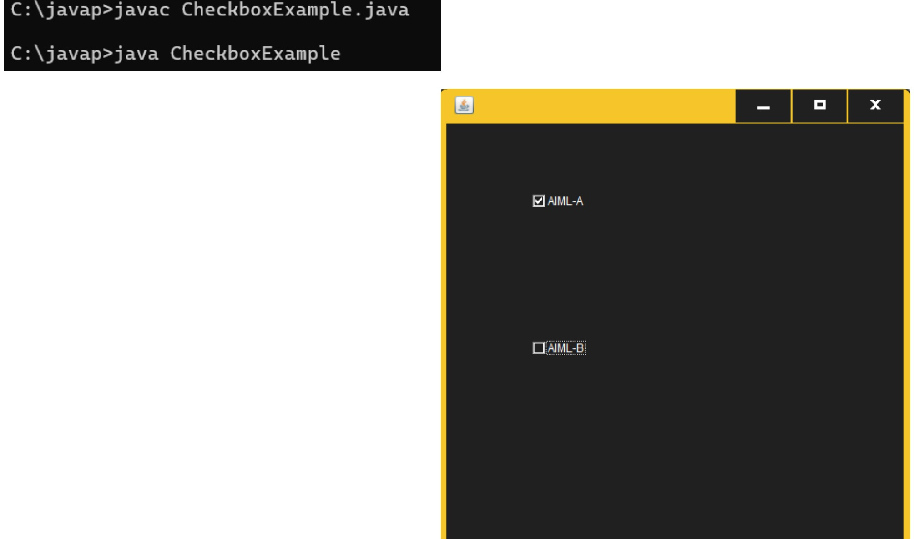
PART B · AWT COMPONENTS
Program on Checkbox: Output
Object Oriented Programming Through Java | Unit V: Multithreading, AWT, Event Handling & Applets | Ramachandra College of Engineering (Autonomous) | Faculty: N V Narasimha Raju
83

Slide 84
PART B · AWT COMPONENTS
Program on CheckboxGroup
import java.awt.*;
class CheckboxGroupExample extends Frame
{
CheckboxGroupExample () //constructor
{
CheckboxGroup group=new CheckboxGroup();
Checkbox obj1=new Checkbox("AIML-A",group,false); // Unselected checkbox
Checkbox obj2=new Checkbox("AIML-B",group,true); // selected checkbox
add(obj1); // Add labels to the frame
add(obj2); // Add labels to the frame
obj1.setBounds(100, 0, 175, 240); //setBounds(x, y, width, height)
obj2.setBounds(100,100,200,350); //setBounds(x, y, width, height)
setSize (500, 500); //Sets the frame size to 500x500 pixels.
setLayout (null); //Disables the default layout manager
setVisible (true); //Makes the frame visible
}
public static void main (String args[])
{
CheckboxGroupExample obj=new CheckboxGrooupExample (); //which in turn calls the constructor
}
}
Object Oriented Programming Through Java | Unit V: Multithreading, AWT, Event Handling & Applets | Ramachandra College of Engineering (Autonomous) | Faculty: N V Narasimha Raju
84

Slide 85
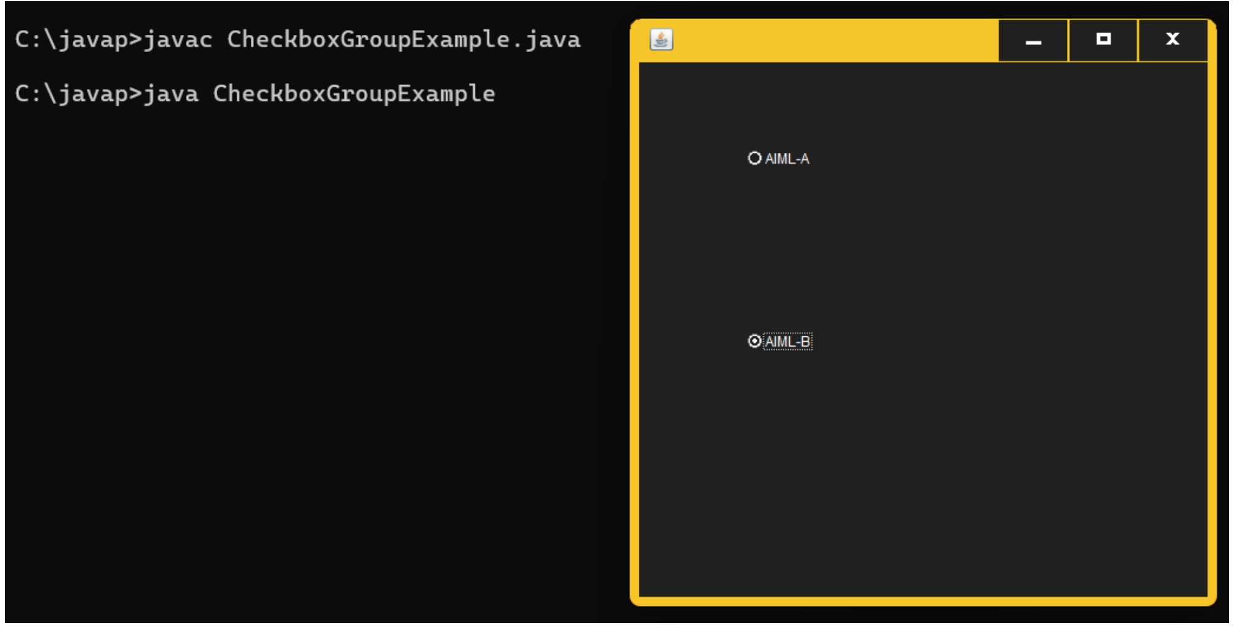
PART B · AWT COMPONENTS
Program on CheckboxGroup: Output
Object Oriented Programming Through Java | Unit V: Multithreading, AWT, Event Handling & Applets | Ramachandra College of Engineering (Autonomous) | Faculty: N V Narasimha Raju
85

Slide 86
PART C · EVENT HANDLING
Part C: Event Handling
Event Handling: Event delegation model, sources of event, Event Listeners & Adapter classes.
Object Oriented Programming Through Java | Unit V: Multithreading, AWT, Event Handling & Applets | Ramachandra College of Engineering (Autonomous) | Faculty: N V Narasimha Raju
86

Slide 87
PART C · EVENT HANDLING
Event Handling in Java
An event can be defined as changing the state of an object or behavior by performing actions.
Actions can be a button click, cursor movement, keypress through keyboard, page scrolling, etc.
The java.awt.event package can be used to provide various event classes.
Classification of Events
Foreground Events
Background Events
Object Oriented Programming Through Java | Unit V: Multithreading, AWT, Event Handling & Applets | Ramachandra College of Engineering (Autonomous) | Faculty: N V Narasimha Raju
87

Slide 88
PART C · EVENT HANDLING
Foreground and Background Events
1. Foreground Events
Foreground events are that require user interaction to generate events, i.e., foreground events are generated due to interaction by the user on components in Graphic User Interface (GUI).
Interactions are nothing but clicking on a button, scrolling the scroll bar, cursor moments, etc.
2. Background Events
Events that don’t require interactions of users to generate are known as background events.
Examples of these events are operating system(OS) failures/interrupts, operation completion, etc.
Object Oriented Programming Through Java | Unit V: Multithreading, AWT, Event Handling & Applets | Ramachandra College of Engineering (Autonomous) | Faculty: N V Narasimha Raju
88

Slide 89
PART C · EVENT HANDLING
Event Handling
It is a mechanism to control the events and to decide what should happen after an event occur.
To handle the events, Java follows the Delegation Event model.
Delegation Event Model
It has Sources and Listeners.
Object Oriented Programming Through Java | Unit V: Multithreading, AWT, Event Handling & Applets | Ramachandra College of Engineering (Autonomous) | Faculty: N V Narasimha Raju
89

Slide 90
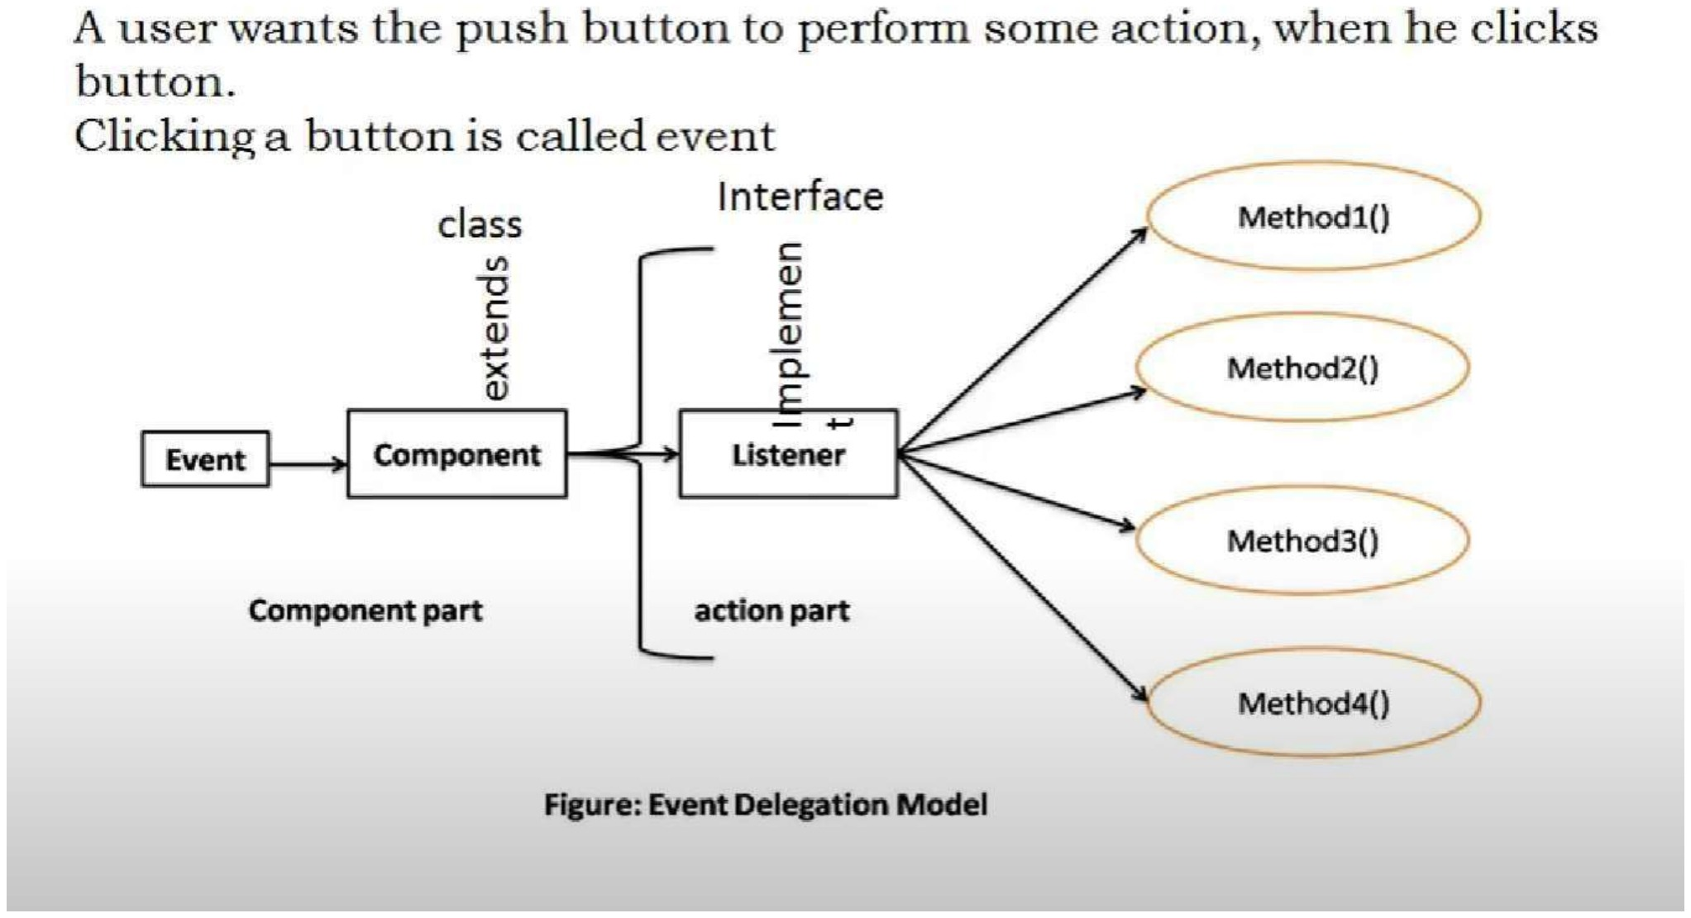
PART C · EVENT HANDLING
Delegation Event Model
Object Oriented Programming Through Java | Unit V: Multithreading, AWT, Event Handling & Applets | Ramachandra College of Engineering (Autonomous) | Faculty: N V Narasimha Raju
90

Slide 91
PART C · EVENT HANDLING
Event Source and Listeners
Source:
Events are generated from the source.
There are various sources like buttons, checkboxes, list, menu-item, choice, scrollbar, text components, windows, etc., to generate events.
Listeners:
Listeners are used for handling the events generated from the source.
Each of these listeners represents interfaces that are responsible for handling events.
Object Oriented Programming Through Java | Unit V: Multithreading, AWT, Event Handling & Applets | Ramachandra College of Engineering (Autonomous) | Faculty: N V Narasimha Raju
91

Slide 92
PART C · EVENT HANDLING
Registering the Source with Listener
To perform Event Handling, we need to register the source with the listener.
Registering the Source With Listener
Different Classes provide different registration methods.
Syntax:
addTypeListener()
where Type represents the type of event.
Example 1: For KeyEvent we use addKeyListener() to register.
Example 2: For ActionEvent we use addActionListener() to register.
Object Oriented Programming Through Java | Unit V: Multithreading, AWT, Event Handling & Applets | Ramachandra College of Engineering (Autonomous) | Faculty: N V Narasimha Raju
92

Slide 93
PART C · EVENT HANDLING
Event Classes in Java
Event Class | Listener Interface | Description
ActionEvent | ActionListener | An event that indicates that a component-defined action occurred like a button click or selecting an item from the menu-item list.
AdjustmentEvent | AdjustmentListener | The adjustment event is emitted by an Adjustable object like Scrollbar.
ComponentEvent | ComponentListener | An event that indicates that a component moved, the size changed or changed its visibility.
FocusEvent | FocusListener | These are focus-related events, which include focus, focusin, focusout, and blur.
KeyEvent | KeyListener | An event that occurs due to a sequence of keypresses on the keyboard.
WindowEvent | WindowListener | An event which indicates whether a window has changed its status or not.
Object Oriented Programming Through Java | Unit V: Multithreading, AWT, Event Handling & Applets | Ramachandra College of Engineering (Autonomous) | Faculty: N V Narasimha Raju
93

Slide 94
PART C · EVENT HANDLING
Flow of Event Handling
User Interaction with a component is required to generate an event.
The object of the respective event class is created automatically after event generation, and it holds all information of the event source.
The newly created object is passed to the methods of the registered listener.
The method executes and returns the result.
Code-Approaches
The three approaches for performing event handling are by placing the event handling code in one of the below-specified places.
Object Oriented Programming Through Java | Unit V: Multithreading, AWT, Event Handling & Applets | Ramachandra College of Engineering (Autonomous) | Faculty: N V Narasimha Raju
94

Slide 95
PART C · EVENT HANDLING
Event Sources
A source is an object that generates an event.
This occurs when the internal state of that object changes in some way.
Sources may generate more than one type of event.
source must register listeners in order for the listeners to receive notifications about a specific type of event.
Object Oriented Programming Through Java | Unit V: Multithreading, AWT, Event Handling & Applets | Ramachandra College of Engineering (Autonomous) | Faculty: N V Narasimha Raju
95

Slide 96
PART C · EVENT HANDLING
Event Sources: Registration Methods
Each type of event has its own registration method.
General form is:
public void addTypeListener(TypeListener refvariable)
Here, Type is the name of the event and refvariable is a reference to the event listener.
For example,
The method that registers a keyboard event listener is called addKeyListener ().
The method that registers a mouse motion listener is called addMouseMotionListener ( ).
Object Oriented Programming Through Java | Unit V: Multithreading, AWT, Event Handling & Applets | Ramachandra College of Engineering (Autonomous) | Faculty: N V Narasimha Raju
96

Slide 97
PART C · EVENT HANDLING
Event Sources: Removing Listeners
Here, Type is the name of the event and refvariable is a reference to the event listener.
For example, to remove a keyboard listener, you would call removeKeyListener( ).
The methods that add or remove listeners are provided by the source that generates events.
For example, the Component class provides methods to add and remove keyboard and mouse event listeners.
A source must also provide a method that allows a listener to unregister an interest in a specific type of event.
The general form is:
public void removeTypeListener(TypeListener refvaiable)
Object Oriented Programming Through Java | Unit V: Multithreading, AWT, Event Handling & Applets | Ramachandra College of Engineering (Autonomous) | Faculty: N V Narasimha Raju
97

Slide 98
PART C · EVENT HANDLING
Event Listeners
A listener is an object that is notified when an event occurs.
Event has two major requirements.
It must have been registered with one or more sources to receive notifications about specific types of events.
It must implement methods to receive and process these notifications.
The methods that receive and process events are defined in a set of interfaces found in java.awt.event.
For example, the MouseMotionListener interface defines two methods to receive notifications when the mouse is dragged or moved.
Any object may receive and process one or both of these events if it provides an implementation of this interface.
Object Oriented Programming Through Java | Unit V: Multithreading, AWT, Event Handling & Applets | Ramachandra College of Engineering (Autonomous) | Faculty: N V Narasimha Raju
98

Slide 99
PART C · EVENT HANDLING
Adapter Classes
The absrtract clases can be called as Event Adapter for receiving various events.
An Adapter Class gives a default implementation of all the methods in an EventListener interface
Java provides a special feature, called an adapter class that can simplify the creation of event handlers.
An adapter class provides an empty implementation of all methods in an event listener interface.
Adapter classes are useful when you want to receive and process only some of the events that are handled by a particular event listener interface.
You can define a new class to act as an event listener by extending one of the adapter classes and implementing only those events in which you are interested. Adapter classes in java.awt.event are.
Object Oriented Programming Through Java | Unit V: Multithreading, AWT, Event Handling & Applets | Ramachandra College of Engineering (Autonomous) | Faculty: N V Narasimha Raju
99

Slide 100
PART C · EVENT HANDLING
Adapter Classes in java.awt.event
Adapter Class | Listener Interface
ComponentAdapter | ComponentListener
ContainerAdapter | ContainerListener
FocusAdapter | FocusListener
KeyAdapter | KeyListener
MouseAdapter | MouseListener
MouseMotionAdapter | MouseMotionListener
WindowAdapter | WindowListener
Object Oriented Programming Through Java | Unit V: Multithreading, AWT, Event Handling & Applets | Ramachandra College of Engineering (Autonomous) | Faculty: N V Narasimha Raju
100

Slide 101
PART C · EVENT HANDLING
Event Handling Example: Components and Constructor
import java.awt.*;
import java.awt.event.*; // Components import
class EventHandling extends Frame implements ActionListener // Listeners interface
{
TextField tf; //TextField is a GUI component that allows users to view or edit a single line of text
EventHandling () // Constructor
{
tf = new TextField (); // Create components
tf.setBounds (60, 50, 170, 20);
Button b = new Button ("click");
b.setBounds (90, 140, 75, 40);
Object Oriented Programming Through Java | Unit V: Multithreading, AWT, Event Handling & Applets | Ramachandra College of Engineering (Autonomous) | Faculty: N V Narasimha Raju
101

Slide 102
PART C · EVENT HANDLING
Event Handling Example: Registering the Listener
b.addActionListener (this); // Register listener & passing current instance
add (b);
add (tf);
setSize (250, 250); // Adding component size
setLayout (null);
setVisible (true);
}
public void actionPerformed (ActionEvent e) // Call method
{
tf.setText ("Hello World");
}
public static void main (String args[])
{
new EventHandling ();
}
}
Object Oriented Programming Through Java | Unit V: Multithreading, AWT, Event Handling & Applets | Ramachandra College of Engineering (Autonomous) | Faculty: N V Narasimha Raju
102

Slide 103
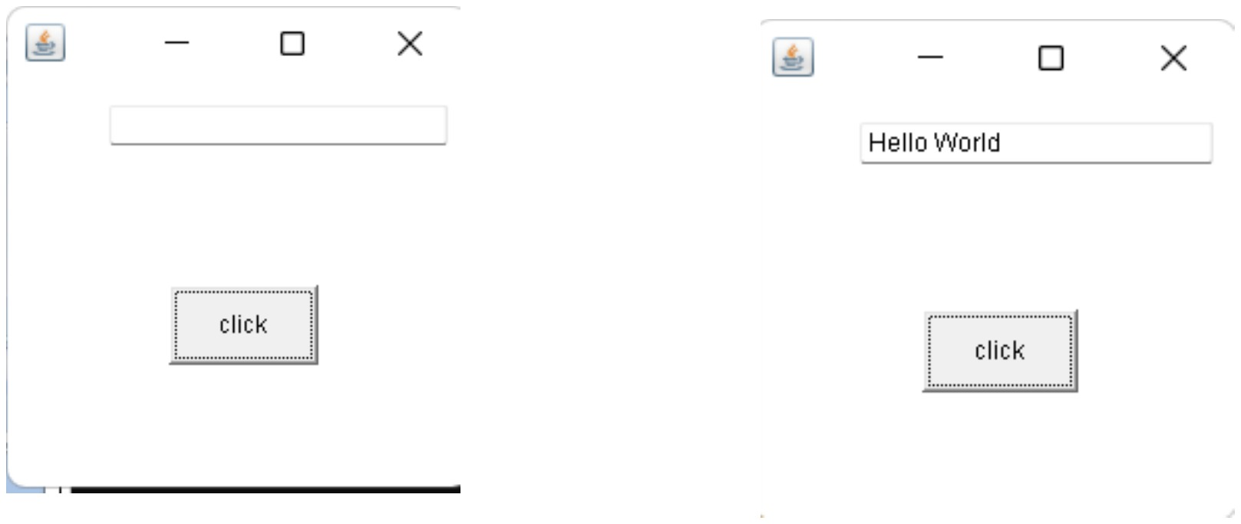
PART C · EVENT HANDLING
Event Handling Example: Output
Object Oriented Programming Through Java | Unit V: Multithreading, AWT, Event Handling & Applets | Ramachandra College of Engineering (Autonomous) | Faculty: N V Narasimha Raju
103

Slide 104
PART C · EVENT HANDLING
Explanation
Firstly extend the class with the applet and implement the respective listener.
Create Text-Field and Button components.
Registered the button component with respective event. i.e. ActionEvent by addActionListener().
In the end, implement the abstract method.
Object Oriented Programming Through Java | Unit V: Multithreading, AWT, Event Handling & Applets | Ramachandra College of Engineering (Autonomous) | Faculty: N V Narasimha Raju
104

Slide 105
PART D · APPLETS
Part D: Applets
Applets: Introduction to Applet, Lifecycle of an Applet, sample Applet programs
Object Oriented Programming Through Java | Unit V: Multithreading, AWT, Event Handling & Applets | Ramachandra College of Engineering (Autonomous) | Faculty: N V Narasimha Raju
105

Slide 106
PART D · APPLETS
Introduction to Applet
Applet is a special type of program that is embedded in the webpage to generate the dynamic content. It runs inside the browser and works at client side.
Advantage of Applet
There are many advantages of applet. They are as follows:
It works at client side so less response time or fast response time.
Secured
It can be executed by browsers running under many platforms, including Linux, Windows, Mac Os etc.
Drawback of Applet
Plugin is required at client browser to execute applet otherwise applet will not visible.
Object Oriented Programming Through Java | Unit V: Multithreading, AWT, Event Handling & Applets | Ramachandra College of Engineering (Autonomous) | Faculty: N V Narasimha Raju
106

Slide 107
PART D · APPLETS
Managing and Running an Applet
Who is responsible to manage the life cycle of an applet?
Java Plug-in software.
Simple example of Applet by appletviewer tool:
To execute the applet by appletviewer tool, create an applet that contains applet tag in comment and compile it. After that run it by: appletviewer First.java.
How to run an Applet?
There are two ways to run an applet
By html file.
By appletviewer tool (for testing purpose).
Object Oriented Programming Through Java | Unit V: Multithreading, AWT, Event Handling & Applets | Ramachandra College of Engineering (Autonomous) | Faculty: N V Narasimha Raju
107

Slide 108
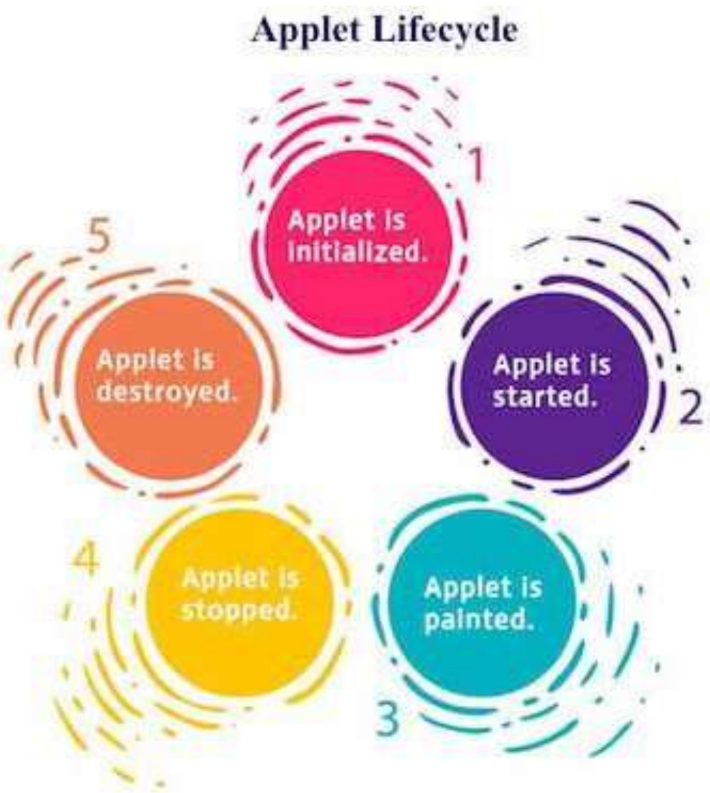
PART D · APPLETS
Lifecycle of Java Applet
Applet is initialized.
Applet is started.
Applet is painted.
Applet is stopped.
Applet is destroyed.
Object Oriented Programming Through Java | Unit V: Multithreading, AWT, Event Handling & Applets | Ramachandra College of Engineering (Autonomous) | Faculty: N V Narasimha Raju
108

Slide 109
PART D · APPLETS
Applet Life Cycle Methods
Applets life cycle includes the following methods
1. init( )
2. start( )
3. paint( )
4. stop( )
5. destroy( )
When an applet begins, the AWT calls the following methods, in this sequence:
1. init( )
2. start( )
3. paint( )
When an applet is terminated, the following sequence of method calls takes place:
1. stop( )
2. destroy( )
Object Oriented Programming Through Java | Unit V: Multithreading, AWT, Event Handling & Applets | Ramachandra College of Engineering (Autonomous) | Faculty: N V Narasimha Raju
109

Slide 110
PART D · APPLETS
Lifecycle Methods for Applet
The java.applet.Applet class 4 life cycle methods and java.awt.Component class provides 1 life cycle methods for an applet.
import java.applet.Applet;
It provides 4 life cycle methods of applet.
public void init(): It is used to initialized the Applet. It is executed only once. It is executed when the browser is opened/enters the page
public void start(): It is used to start the Applet. It will execute when the browser is maximized.
public void stop(): It is used to stop the Applet. It will execute when the browser is minimized.
public void destroy(): It is used to destroy the Applet. It is executed when the browser is closed/ leaves the page.
Object Oriented Programming Through Java | Unit V: Multithreading, AWT, Event Handling & Applets | Ramachandra College of Engineering (Autonomous) | Faculty: N V Narasimha Raju
110

Slide 111
PART D · APPLETS
Lifecycle Method: paint()
import java.awt.*;
provides 1 life cycle method of applet.
public void paint(Graphics g): is used to paint the Applet. It is Used to display the content of Applet
Object Oriented Programming Through Java | Unit V: Multithreading, AWT, Event Handling & Applets | Ramachandra College of Engineering (Autonomous) | Faculty: N V Narasimha Raju
111

Slide 112
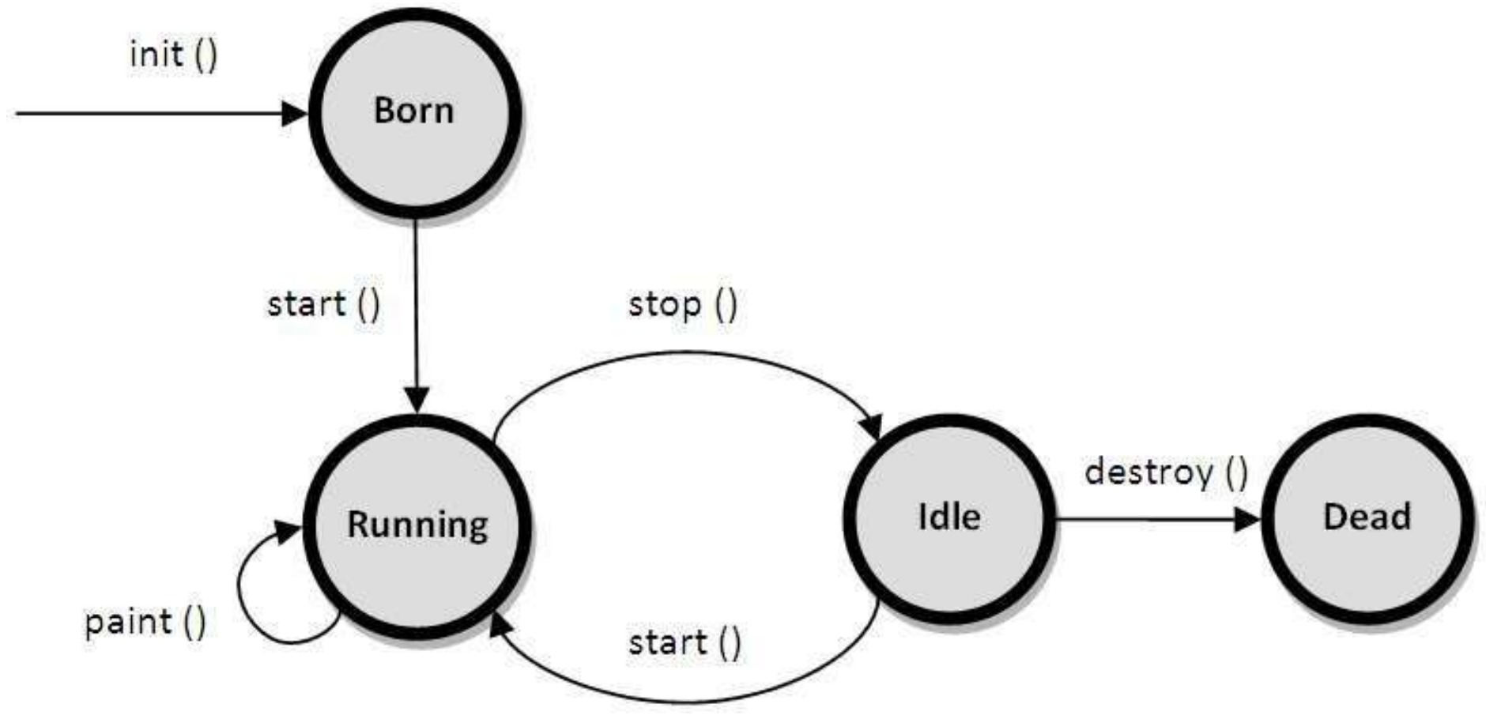
PART D · APPLETS
Applet Lifecycle: State Diagram
Object Oriented Programming Through Java | Unit V: Multithreading, AWT, Event Handling & Applets | Ramachandra College of Engineering (Autonomous) | Faculty: N V Narasimha Raju
112

Slide 113
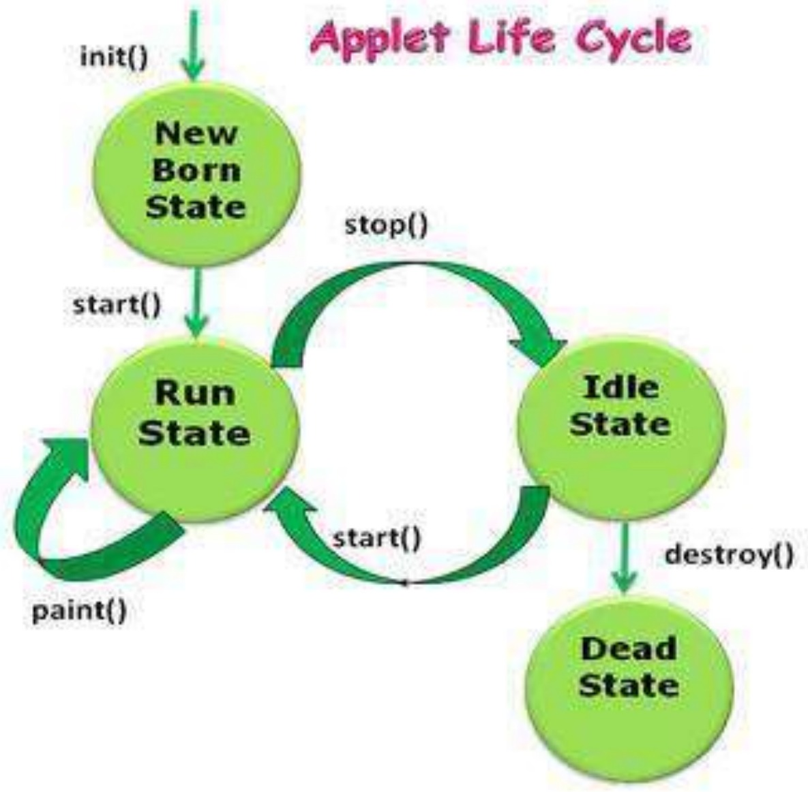
PART D · APPLETS
Applet Life Cycle
Object Oriented Programming Through Java | Unit V: Multithreading, AWT, Event Handling & Applets | Ramachandra College of Engineering (Autonomous) | Faculty: N V Narasimha Raju
113

Slide 114
PART D · APPLETS
Creating the Web Page
In order to run an applet you have to embed it in a web page using a special <applet> tag e.g:
<applet code="name.class" width=www height=hhh></applet>
www and hhh give the size of the applet in pixels
"Greetings.html"
<applet code="Greetings.class" width=300 height=200 ></applet>
Object Oriented Programming Through Java | Unit V: Multithreading, AWT, Event Handling & Applets | Ramachandra College of Engineering (Autonomous) | Faculty: N V Narasimha Raju
114

Slide 115
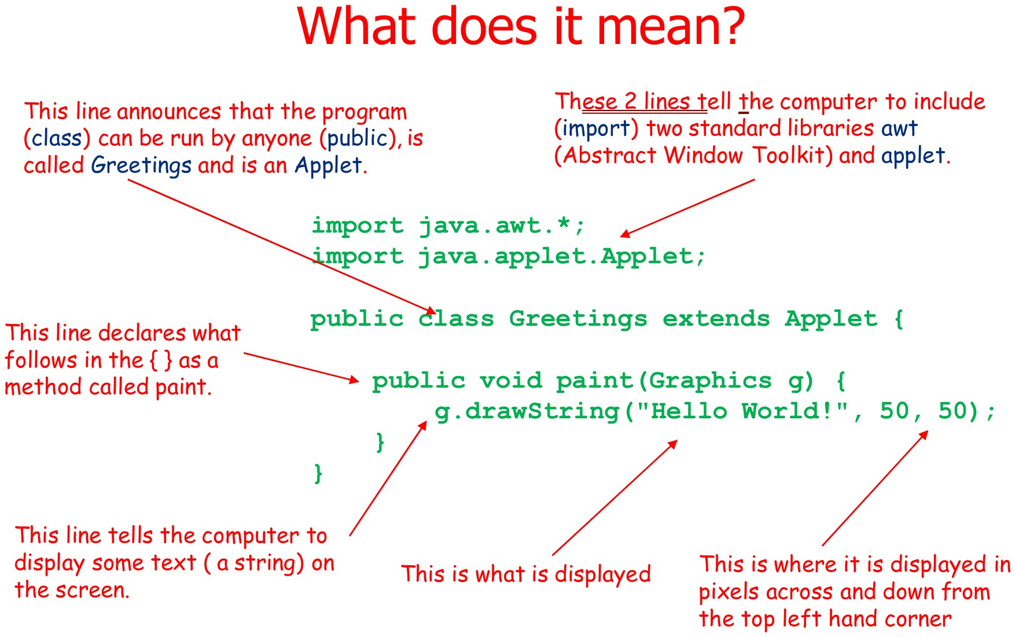
PART D · APPLETS
Applet Program: What Does It Mean?
Object Oriented Programming Through Java | Unit V: Multithreading, AWT, Event Handling & Applets | Ramachandra College of Engineering (Autonomous) | Faculty: N V Narasimha Raju
115

Slide 116
PART D · APPLETS
Applet Program: Welcome Message
Write an Applet program that displays “Welcome to Ramachandra College of Engineering”?
Object Oriented Programming Through Java | Unit V: Multithreading, AWT, Event Handling & Applets | Ramachandra College of Engineering (Autonomous) | Faculty: N V Narasimha Raju
116

Slide 117
PART D · APPLETS
Applet Program: Welcome Message (code)
import java.applet.*;
Import java.awt.*;
/*<applet code="First" width="400" height="600"></applet>*/
public class First extends Applet
{
public void init()
{
setBackground(Color.yellow);
setForeground(Color.green);
}
public void paint(Graphics g)
{
g.drawString("Welcome to Ramachandra College of Engineering",40,40);
}
}
Object Oriented Programming Through Java | Unit V: Multithreading, AWT, Event Handling & Applets | Ramachandra College of Engineering (Autonomous) | Faculty: N V Narasimha Raju
117

Slide 118
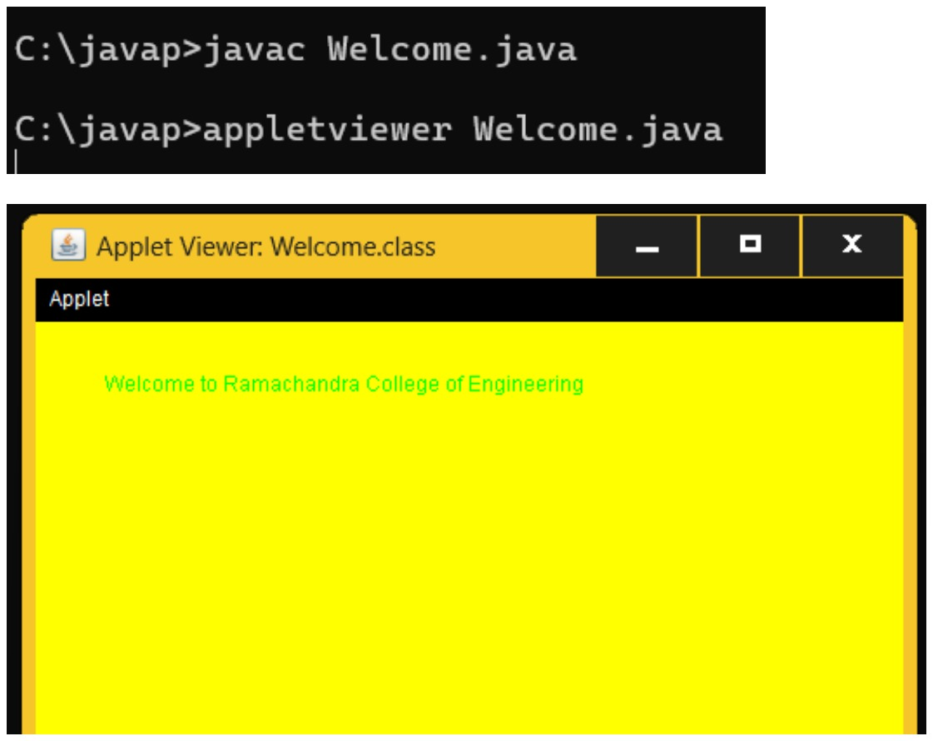
PART D · APPLETS
Applet Program: Output
Object Oriented Programming Through Java | Unit V: Multithreading, AWT, Event Handling & Applets | Ramachandra College of Engineering (Autonomous) | Faculty: N V Narasimha Raju
118

Slide 119
PART D · APPLETS
Displaying Graphics in Applet
import java.applet.Applet;
import java.awt.*;
/*<applet code="GraphicsDemo.class" width="300" height="300">
</applet>*/
public class GraphicsDemo extends Applet
{
public void init()
{
setBackground(Color.black);
setForeground(Color.white);
}
Object Oriented Programming Through Java | Unit V: Multithreading, AWT, Event Handling & Applets | Ramachandra College of Engineering (Autonomous) | Faculty: N V Narasimha Raju
119

Slide 120
PART D · APPLETS
Displaying Graphics in Applet (contd.)
public void paint(Graphics g)
{
g.setColor(Color.red);
g.drawString("WELCOME TO IV-EEE",111, 111);
g.drawLine(20,30,20,300);
g.drawRect(70,100,30,30);
g.fillRect(70,100,70,30);
g.drawOval(70,200,30,30);
g.setColor(Color.pink);
g.drawArc(90,150,30,30,30,270);
}
}
drawString(String str, int x, int y):
drawLine(int x1, int y1, int x2, int y2):
drawRect(int x, int y, int width, int height)
drawOval(int x, int y, int width, int height):
drawArc(int x, int y, int width, int height,
int startAngle, int arcAngle)
Object Oriented Programming Through Java | Unit V: Multithreading, AWT, Event Handling & Applets | Ramachandra College of Engineering (Autonomous) | Faculty: N V Narasimha Raju
120

Slide 121
PART D · APPLETS
Unit V: Short Answer Questions
No. | Question | Marks
1 | What is multithreading? What are the advantages of multithreading? | 2M
2 | Differentiate between process and thread? | 2M
3 | What is the difference between wait() and sleep() method? | 2M
4 | Write about the daemon threads? | 2M
5 | What is the synchronization? What is the difference between notify() and notifyAll()? | 2M
6 | Distinguish between deadlock and race-condition. | 2M
7 | What is the difference between the paint() and repaint() method? | 2M
8 | What is the difference between choice and list? | 2M
9 | What is an adapter class? | 2M
10 | What is an event and what are the models available for event handling? | 2M
Object Oriented Programming Through Java | Unit V: Multithreading, AWT, Event Handling & Applets | Ramachandra College of Engineering (Autonomous) | Faculty: N V Narasimha Raju
121

Slide 122
PART D · APPLETS
Unit V: Essay Questions
No. | Question | Marks
1.a | What are the states in the lifecycle of a thread? Explain with a neat diagram. | 05M
b. | Write a JAVA Program that creates threads by extending Thread class. Create a Two Threads, First Thread to display all even number given range and the Second Thread to display all odd number given range. | 05M
2.a | How many ways are possible in Java to create multiple threaded programs? Discuss the differences between them. | 05M
b. | Write a JAVA Program illustrating Daemon Threads | 05M
3.a | What is the purpose of the wait(), notify(), and notifyAll() methods? Explain in detail. | 05M
b. | With a Java program, explain the various ways to create Threads. | 05M
4.a | Write a java program to implement thread priorities. | 05M
b. | Explain Inter-thread Communication with an example | 05M
5.a | Explain thread synchronization with sample program | 05M
b. | Write a JAVA Program to observe the thread Completion status | 05M
6.a | Discuss the issues of Race condition and Deadlock | 05M
b. | Write a Java program to create a check box using the CheckBox class. | 05M
7.a | Describe the sources of events and event listeners.? | 05M
b. | Write a Java program to create a Label using AWT. | 05M
8.a | Explain the Event delegation model and also list out various sources of Events? | 05M
b. | Write an Applet program that displays “Welcome to Ramachandra College of Engineering”? | 05M
9.a | Write a Java program to create multiple CheckBox components using AWT. | 05M
b. | Write a Java program to create a Button using AWT. | 05M
10.a | Describe the lifecycle of an applet? | 05M
b. | Explain the structure of an applet | 05M
Object Oriented Programming Through Java | Unit V: Multithreading, AWT, Event Handling & Applets | Ramachandra College of Engineering (Autonomous) | Faculty: N V Narasimha Raju
122

Slide 123
RAMACHANDRA COLLEGE OF ENGINEERING (AUTONOMOUS)
Thank You
Object Oriented Programming Through Java | Unit V: Multithreading, AWT, Event Handling & Applets | Ramachandra College of Engineering (Autonomous) | Faculty: N V Narasimha Raju
123

