Slide 1


TRAIN TICKET RESERVATION SYSTEM
UNDER THE SUPERVISION OF
SYED SADHAKATH

Slide 2



TEAM MEMBERS:
NAVEEN SHARMA (6137)
ARCHIT DASH (6135)
OMPRAKASH HIVRE (6138)
ARUNKUMAR CHOWDAPPA (6134)
NITHIN DORNALA (6139)

Slide 3
OVERVIEW :-
Information about arrival time, departure time and number of trains available.
Stores and retrieves information about the various journeys regarding the train travels.
Keep traces of the passengers and thus schedule their journey accordingly.
Maintains records of passengers travelling in different trains on different dates reaching different destination in the system.
User friendly interface to administrator and customer.

Slide 4



Technologies Used :-
Front End -
HTML CSS JavaScript
Back End -
STS ( Spring Tool Suite)
MySQL
Java

Slide 5
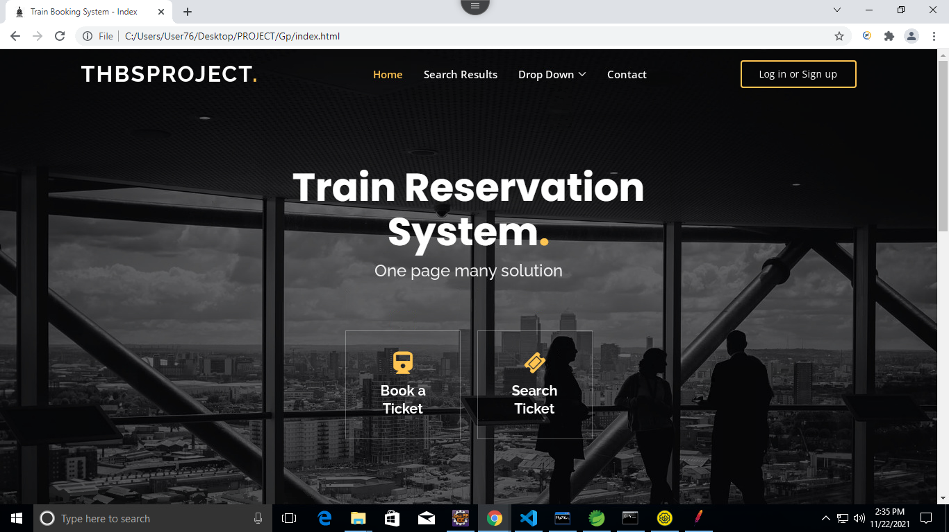
User Interface Page :-

Slide 6
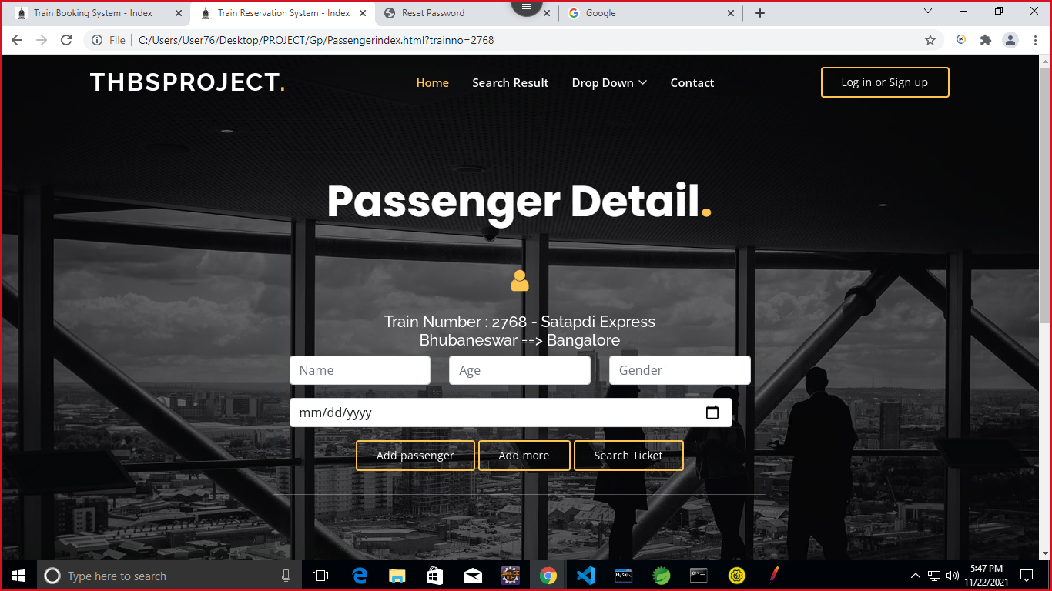
Passenger Details Page :-

Slide 7
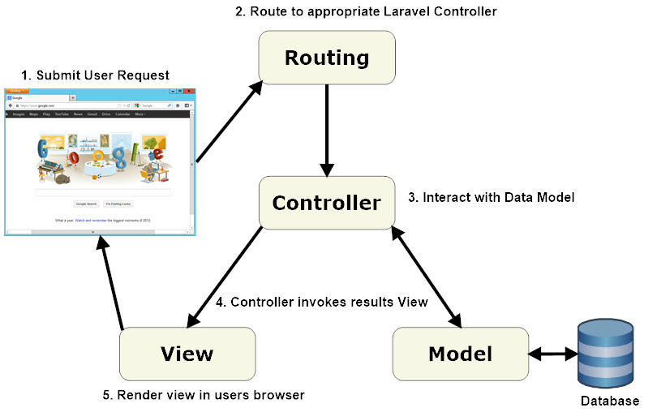
MVC Architecture

Slide 8
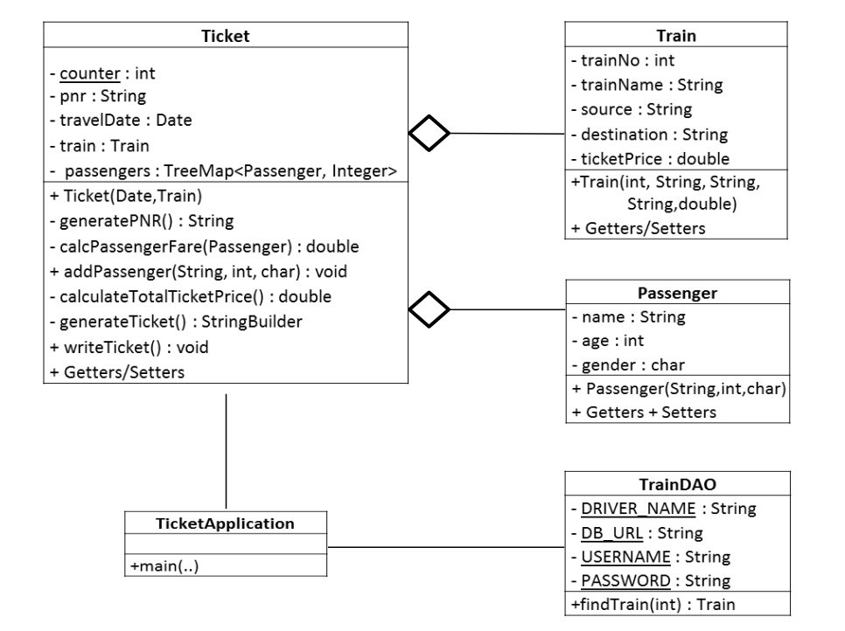
Class Diagram

Slide 9

FUTURE SCOPE
Enhancing the security of the application.
Integrating payment gateway.
Live Tracking.

Slide 10

Thank you

