Slide 1
Price Searchers
Monopoly and Monopolistic Competition
Management 405
Prof. Nico Voigtländer · UCLA Anderson

Slide 2
Module 5 · Course Roadmap
Agenda for the Class
1. Basic Principles and Economic Way of Thinking
2. Value and Demand
3. Supply and Cost
4. Markets, Pricing, and Strategy
we are here
Management 405 · Module 5 · Monopoly and Monopolistic Competition
2
Notes:
This is where we are in the course. After value and demand, and supply and cost, we are now in the last part: markets, pricing and strategy. In this module we look at firms that have market power.

Slide 3
Module 5 · Agenda
Outline of Module 5
1
Profit Maximization for Price Searchers
How a firm with market power picks its price and quantity
In class
1b
Markup and Lerner Index
How far price sits above marginal cost
In class
2
Monopoly and Welfare Impact
Monopoly profits come at consumers' expense
In class
3
Rising Market Power and Regulations
Rising market concentration and government responses
In class
4
Monopolistic Competition
Many firms, differentiated products: entry erodes profits
In class
Management 405 · Module 5 · Monopoly and Monopolistic Competition
3
Notes:
Here is the plan for Module 5. We start with how a firm with market power picks its price and quantity, and how far its price sits above marginal cost. Then we look at what monopoly does to consumers and to total welfare, at rising market concentration and how governments respond, and finally at monopolistic competition, where entry erodes profits.

Slide 4
Module 5 · Market Structures
The Four Basic Market Structures
Use the same analytics to find optimal price/quantity
 | Perfect Competition | Monopolistic Competition | Oligopoly | Monopoly
Number of firms | Many | Many | Few | One
Type of products sold | Identical | Differentiated | Identical or Differentiated | “Unique”
Barriers to entry | None | None | Some | Many
More firms, more similar products, easier entry, more competition
Management 405 · Module 5 · Monopoly and Monopolistic Competition
4
Notes:
These are the four market structures we use in the course. They differ in the number of firms, in how different the products are, and in how hard it is to enter. Moving to the left, there is more competition.
In this module we look at the two red circles: monopoly and monopolistic competition. Both are price searchers, and we use the same analytics for both to find the optimal price and quantity. Oligopoly follows in Module 7.

Slide 5
Module 5 · Agenda
Outline of Module 5
1
Profit Maximization for Price Searchers
How a firm with market power picks its price and quantity
In class
1b
Markup and Lerner Index
In class
2
In class
Monopoly and Welfare Impact
3
In class
Rising Market Power and Regulations
4
In class
Monopolistic Competition
Management 405 · Module 5 · Monopoly and Monopolistic Competition
5
Notes:
We begin with the basic question: how does a firm that faces a downward-sloping demand curve choose its price and quantity?

Slide 6
Module 5 · Profit Maximization for Price Searchers
Firm Demand: Price Takers vs. Price Searchers
Price taker
Price searcher
P
P
D = P_{M} = MR
P_{M}
D
MR
Output
Output
The demand curve faced by a price taker is the market price (which in turn equals MR for a price taker)
The demand curve faced by a price searcher is downward-sloping
Marginal revenue (MR) is different from the demand curve (D)
Management 405 · Module 5 · Monopoly and Monopolistic Competition
6
Notes:
On the left is the price taker from Module 4. It can sell as much as it wants at the market price, so its demand curve is flat at that price, and each extra unit adds exactly the price to revenue: demand equals marginal revenue.
On the right is a price searcher. Its demand curve slopes down: to sell one more unit, it has to lower the price on all units. That is why marginal revenue lies below demand, and this one difference drives everything in this module.

Slide 7
Module 5 · Profit Maximization for Price Searchers
Test of Market Power
If we raise our price, will we lose all our customers?
  “yes” → Price taker
    We have no market power
  “no” → Price searcher
    We have market power!
    We face a downward-sloping demand curve
Management 405 · Module 5 · Monopoly and Monopolistic Competition
7
Notes:
Here is a simple test for market power. Ask what happens if we raise our price a little. If we would lose all our customers, we are a price taker and have no market power, like a wheat farmer.
If we keep some customers, we are a price searcher. We have market power, which is the same as saying that we face a downward-sloping demand curve. Most firms you will manage are in this second group.

Slide 8

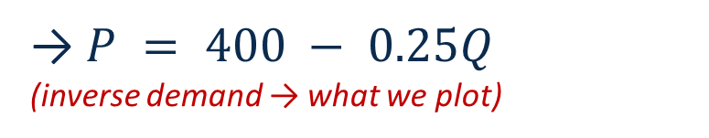
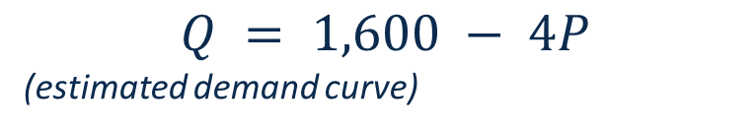
Module 5 · Profit Maximization for Price Searchers
Profit Maximization for Price Searcher
Profit maximization for price searchers:
P
$$MR = MC$$
P* = $300
$$Q = 1,600 − 4P$$
(estimated demand curve)
MC = $200
MC
→ $P = 400 − 0.25Q$
(inverse demand → what we plot)
MR = MC
MR is derived from the (inverse) demand curve
MR
D
Q* = 400
Q
▤ Teaching Note: MR = MC
Management 405 · Module 5 · Monopoly and Monopolistic Competition
8
Notes:
The rule for a price searcher is the same marginal rule as always: produce where marginal revenue equals marginal cost.
In the example, the firm estimates its demand as Q = 1,600 minus 4P. To plot it we solve for price: P = 400 minus a quarter of Q. Marginal revenue starts at the same intercept of 400 but falls twice as fast. With a marginal cost of $200, MR equals MC at 400 units. We then go up to the demand curve to read off the price customers will pay for 400 units: $300.
The teaching note on MR = MC has the full derivation.

Slide 9
Module 5 · Profit Maximization for Price Searchers
MR = MC: Computation Example
1
Demand and inverse demand
$$Q = 1,600 − 4P ⇒ P = 400 − 0.25Q$$
2
Total and marginal revenue
$$TR = P·Q = 400Q − 0.25Q^{2} ⇒ MR = 400 − 0.5Q$$
3
Set MR = MC (MC = 200)
$$400 − 0.5Q = 200 ⇒ Q^{∗} = 400$$
4
Optimal price: go up to the demand curve
$$P^{∗} = 400 − 0.25 · 400 = \$300$$
Management 405 · Module 5 · Monopoly and Monopolistic Competition
9
Notes:
Here is the same example as algebra, in four steps. First, we turn the estimated demand around so that price is on the left: P = 400 minus 0.25 Q.
Second, total revenue is price times quantity, 400Q minus 0.25 Q squared, so marginal revenue is 400 minus 0.5 Q. Notice that the slope doubles.
Third, we set MR equal to the marginal cost of 200 and get Q* = 400. Fourth, we go back to the demand curve to find the price at which customers buy 400 units: $300.

Slide 10
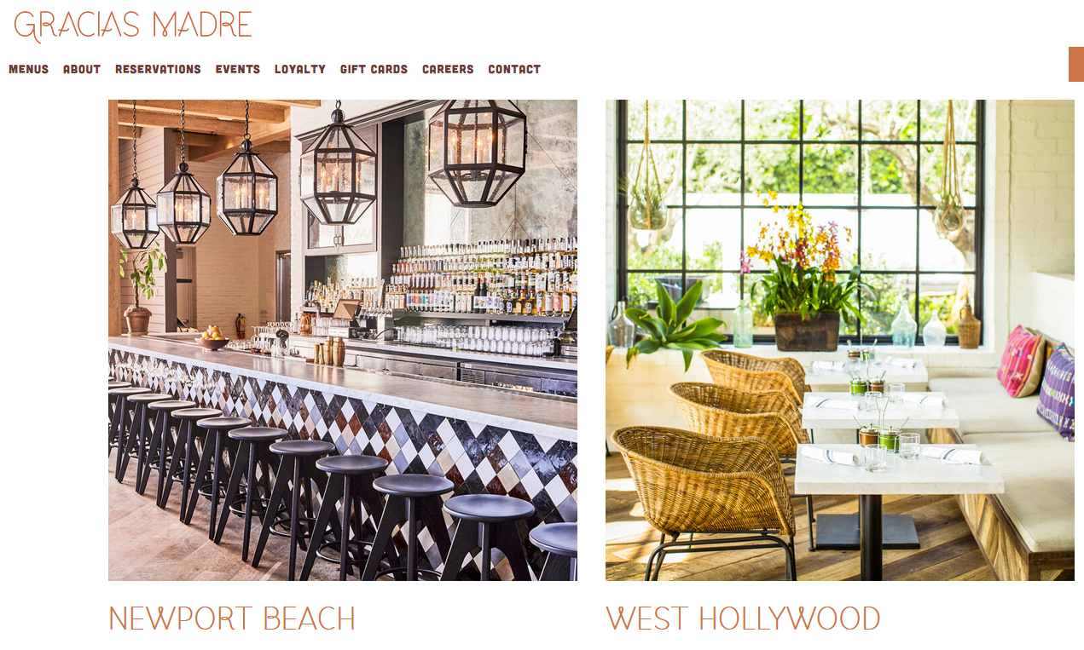
Module 5 · Profit Maximization for Price Searchers
Profit Maximization of a Restaurant
Practice Video: Optimization of a Price Searcher
Management 405 · Module 5 · Monopoly and Monopolistic Competition
10
Notes:
Our running example is Gracias Madre, a plant-based Mexican restaurant with locations in West Hollywood and Newport Beach. The practice video works through its profit maximization step by step, and the next slides use the same numbers to build the graphs and the intuition.

Slide 11

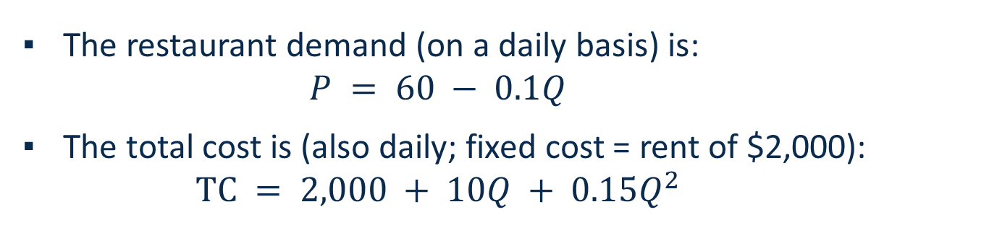
Module 5 · Profit Maximization for Price Searchers
This Is from the Practice Video: Profit Maximization for a Restaurant
The restaurant demand (on a daily basis) is:
  $$P = 60 − 0.1Q$$
The total cost is (also daily; fixed cost = rent of $2,000):
  $$TC = 2,000 + 10Q + 0.15Q^{2}$$
TC
What are P* and Q*? What are profits?
In class, we will focus on the graphics/intuition. Watch the Practice Video for exam prep!
Q
Practice Video: Optimization of a Price Searcher
Management 405 · Module 5 · Monopoly and Monopolistic Competition
11
Notes:
This is the problem from the practice video. Demand per day is P = 60 minus 0.1 Q, and daily total cost is 2,000 plus 10Q plus 0.15 Q squared, where the 2,000 is the fixed cost, the rent. The steps are always the same: compute MR, compute MC, set them equal to get Q*, read P* off demand, and then compute the profit at that point.
In class we focus on the graphs and the intuition. The practice video does the algebra, and it is the best preparation for the exam.

Slide 12
Module 5 · Profit Maximization for Price Searchers
Illustration of the Practice Video Example: Profit Maximization
Total Revenue and Total Cost
Profit
$
π
Q*
$12,000
Q*
$500
TC
$10,000
$0
Q
$8,000
TR
−$500
$6,000
−$1,000
$4,000
−$1,500
$2,000
−$2,000
$0
0
50
100
150
200
Q
0
50
100
150
200
To find the profit-maximizing quantity, use marginal analysis (MR = MC)
Management 405 · Module 5 · Monopoly and Monopolistic Competition
12
Notes:
On the left are total revenue and total cost for the restaurant. Profit is the vertical gap between them, and it is largest at 100 meals a day.
The right panel plots that gap directly. Profit peaks at $500 a day at Q* = 100. At the peak, the slope of the profit curve is zero, which is the same as saying that the slopes of TR and TC are equal: marginal revenue equals marginal cost. Marginal analysis finds this point without plotting anything.

Slide 13
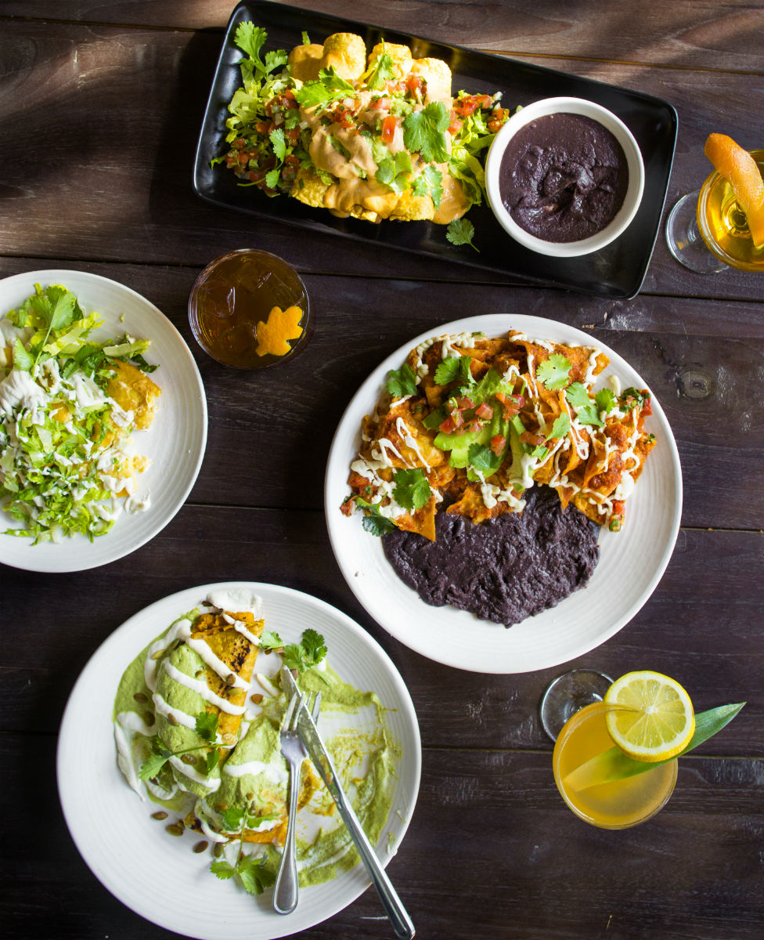
Module 5 · Profit Maximization for Price Searchers
Price Searcher: Maximizing Profit Using MR=MC
P
MC
ATC
P*
Profit
π > 0
D
ATC
MR
Now suppose: rent increases → ATC moves up (next slide)
Q*
Output
Management 405 · Module 5 · Monopoly and Monopolistic Competition
13
Notes:
Here is the restaurant's problem in a graph. The restaurant picks the output where marginal revenue meets marginal cost, Q*, and then charges the price on the demand curve at that output, P*.
At Q*, average total cost is well below the price, so the restaurant earns a profit: the red rectangle. Notice that Q* is not where average total cost is lowest. In this graph, the minimum of ATC is where MC cuts it, at a lower output. The firm does not care about minimizing average cost; it cares about maximizing profit. The only difference from perfect competition is that MR is no longer equal to the price.
Gracias Madre is a plant-based Mexican restaurant in West Hollywood.
https://www.graciasmadre.co/
To maximize profit, monopolist sets MC=MR — only difference with respect to perfect competition is that under perfect competition MR=P, but that is no longer the case for a monopolist.

Slide 14
Module 5 · Profit Maximization for Price Searchers
Price Searcher: Minimizing Loss
P
MC
ATC (with higher rent)
ATC
AVC
P*
Loss
(this curve is needed to check whether to continue producing in the short run)
Contribution
to TFC
D
Losses, because P* < ATC
But P* > AVC → the restaurant should continue to produce, to cover part of its TFC
AVC
MR
TFC = (ATC − AVC) · Q
Q*
Output
Management 405 · Module 5 · Monopoly and Monopolistic Competition
14
Notes:
Now the rent rises. Nothing about MR or MC changes, so the best output and price stay where they were, at Q* and P*. But average total cost now lies above the price at Q*, so the restaurant makes a loss on every meal: the gray rectangle.
Should it keep producing? Compare the price with average variable cost. Every meal brings in more than it costs to make, and that margin is a contribution to the rent it owes anyway: the gold rectangle, which is much larger than the loss. So in the short run it continues to produce, as long as P is at least AVC.
The last line of the legend puts the two rectangles together. Stacked on top of each other, the loss and the contribution make up the whole fixed cost: TFC = (ATC − AVC) × Q. That is the rectangle on the next slide.

Slide 15
Module 5 · Profit Maximization for Price Searchers
Loss When Stopping to Produce in the Short Run
P
MC
ATC (with higher rent)
ATC
AVC
P*
Loss
(= TFC)
D
If the restaurant stops serving customers but still has to pay the rent, it loses the whole fixed cost (TFC), which is equal to the rent
AVC
MR
Q*
Output
Management 405 · Module 5 · Monopoly and Monopolistic Competition
15
Notes:
What if the restaurant stopped serving customers instead? It would still owe the rent, so its loss would be the whole fixed cost: the dark rectangle, which is the loss rectangle plus the contribution rectangle from the previous slide.
Producing loses only the small gray rectangle, stopping loses the whole rent. So the restaurant continues to produce in the short run. In the long run, when the lease can be ended, a loss like this is a reason to shut down.

Slide 16
Module 5 · Profit Maximization for Price Searchers
Price Searcher: Fixed Cost Does Not Impact Price
P
MC
ATC (with higher rent)
ATC (with lower rent)
P*
P* does not change if fixed costs go up
D
When fixed costs (and thus ATC) increase, P* does not change. But profits fall
MR
Q*
Output
Management 405 · Module 5 · Monopoly and Monopolistic Competition
16
Notes:
Put the two cases side by side. A higher rent pushes average total cost up, but it does not change marginal cost or marginal revenue. So the best output and the best price stay exactly where they were.
This is a common mistake in practice: raising prices to cover a rent increase. The fixed cost changes how much profit the restaurant makes, and whether it should stay in the location in the long run, but not the price it should charge.

Slide 17
Module 5 · Profit Maximization for Price Searchers
Illustration Based on the Practice Video Example
Case 1: Low Fixed Cost (Rent $1,000)
Total revenue and total cost
Profit
$
π
Q*
$12,000
Q*
$1,500
$10,000
TC
$1,000
$8,000
TR
$500
$6,000
$0
$4,000
Q
−$500
$2,000
−$1,000
$0
0
50
100
150
200
Q
0
50
100
150
200
Management 405 · Module 5 · Monopoly and Monopolistic Competition
17
Notes:
Here are the same two panels with a low rent of $1,000 a day. Total cost sits low, the gap between revenue and cost is wide, and profit peaks at $1,500 a day at 100 meals.

Slide 18
Module 5 · Profit Maximization for Price Searchers
Illustration Based on the Practice Video Example
Case 2: Medium Fixed Cost (Rent $2,000)
Total revenue and total cost
Profit
$
π
Q*
$12,000
Q*
$500
TC
$10,000
$0
Q
$8,000
TR
−$500
$6,000
−$1,000
$4,000
−$1,500
$2,000
−$2,000
$0
0
50
100
150
200
Q
0
50
100
150
200
Management 405 · Module 5 · Monopoly and Monopolistic Competition
18
Notes:
With a rent of $2,000, the total cost curve shifts up by $1,000 at every output. The profit curve shifts down by the same amount, to a peak of $500, but the peak is still at 100 meals.

Slide 19
Module 5 · Profit Maximization for Price Searchers
Illustration Based on the Practice Video Example
Case 3: High Fixed Cost (Rent $3,000)
Total revenue and total cost
Profit
$
Q*
π
Q*
$12,000
TC
$0
$10,000
Q
−$500
$8,000
TR
−$1,000
$6,000
−$1,500
$4,000
−$2,000
−$2,500
$2,000
−$3,000
$0
0
50
100
150
200
Q
0
50
100
150
200
In all three fixed-cost cases, the profit-maximizing quantity remains the same
Management 405 · Module 5 · Monopoly and Monopolistic Competition
19
Notes:
With a rent of $3,000, the restaurant cannot make a profit at any output. The best it can do is lose $500 a day, and that best output is again 100 meals. A fixed cost moves the profit curve up or down, never sideways, so it never changes the profit-maximizing quantity, and so never the price.

Slide 20
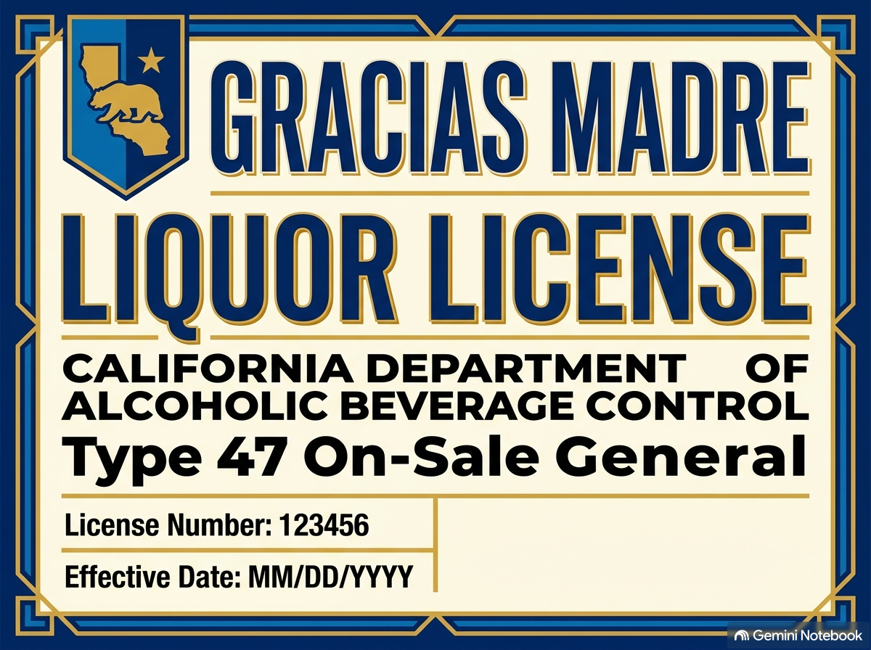
Module 5 · Profit Maximization for Price Searchers
Additional Exercise in the Practice Video
Should Gracias Madre buy a liquor license?
Practice Video: Optimization of a Price Searcher
Management 405 · Module 5 · Monopoly and Monopolistic Competition
20
Notes:
The practice video has one more exercise for this part of the module. It asks whether Gracias Madre should buy a liquor license: serving drinks raises demand, but also variable cost, so what is the most the restaurant would pay for the license each day? The video works through it with the same MR = MC steps we just used.

Slide 21
Module 5 · Agenda
Outline of Module 5
1
In class
Profit Maximization for Price Searchers
1b
Markup and Lerner Index
How far price sits above marginal cost
In class
2
In class
Monopoly and Welfare Impact
3
In class
Rising Market Power and Regulations
4
In class
Monopolistic Competition
Management 405 · Module 5 · Monopoly and Monopolistic Competition
21
Notes:
Next, how far above marginal cost does such a firm set its price? The Lerner index measures this, and it links the markup to the elasticity of demand.

Slide 22
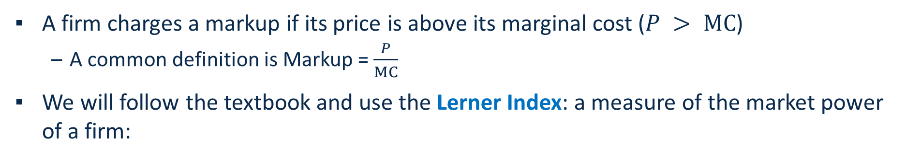
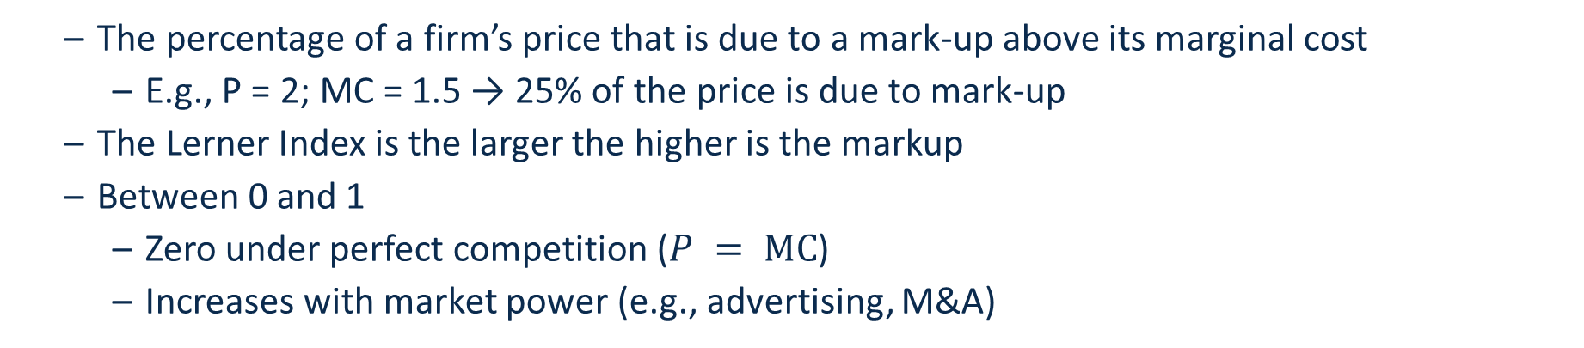

Module 5 · Markup and Lerner Index
Markup and the Lerner Index
A firm charges a markup if its price is above its marginal cost ($P > MC$)
  A common definition is Markup = $\frac{P}{MC}$
We will follow the textbook and use the Lerner Index: a measure of the market power of a firm:
$$Lerner Index = \frac{P − MC}{P}$$
  The percentage of a firm’s price that is due to a mark-up above its marginal cost
    E.g., P = 2; MC = 1.5 → 25% of the price is due to mark-up
  The Lerner Index is the larger the higher is the markup
  Between 0 and 1
    Zero under perfect competition ($P = MC$)
    Increases with market power (e.g., advertising, M&A)
Management 405 · Module 5 · Monopoly and Monopolistic Competition
22
Notes:
A firm charges a markup when its price is above its marginal cost. One way to measure it is the ratio of price to marginal cost. We follow the textbook and use the Lerner index instead: price minus marginal cost, divided by price.
The Lerner index is the share of the price that is markup. If the price is $2 and marginal cost is $1.50, 50 cents of every $2, or 25%, is markup. It is zero under perfect competition, where price equals marginal cost, and it rises with market power.

Slide 23

Module 5 · Markup and Lerner Index
Lerner Index for Major US Companies
Company | Lerner Index (P − MC) / P
Alphabet | 0.55
Amazon.com | 0.33
American Airlines | 0.24
Apple | 0.33
AT&T | 0.35
Johnson & Johnson | 0.72
Microsoft | 0.56
Pfizer | 0.78
Tesla | 0.25
United Airlines | 0.21
Whole Foods Market | 0.19
Percentage of Price that is due to Markup
$$Lerner Index = \frac{P − MC}{P}$$
Source: De Loecker et al. (2019)
Management 405 · Module 5 · Monopoly and Monopolistic Competition
23
Notes:
Here are Lerner indexes for well-known US companies. For Pfizer, 78% of the price is markup over marginal cost; for Whole Foods, 19%. Drug patents and strong brands show up as high markups. Grocery retail and airlines, where customers compare prices easily, show up low.
Reference: https://www.janeeckhout.com/wp-content/uploads/RMP.pdf Table 5.1.
Note that markup refers to MC and not AVC

Slide 24
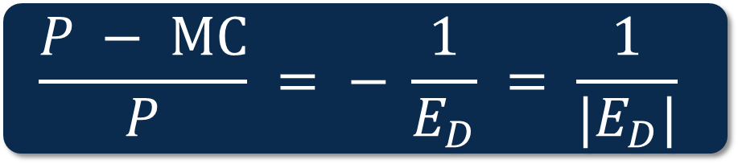
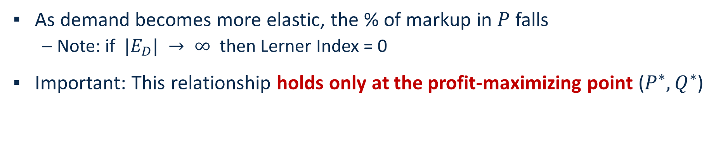
Module 5 · Markup and Lerner Index
Lerner Index
The elasticity of demand has a negative value
The Lerner index is related to the firm’s elasticity:
$$\frac{P − MC}{P} = − \frac{1}{E_{D}} = \frac{1}{|E_{D}|}$$
As demand becomes more elastic, the % of markup in $P$ falls
  Note: if $|E_{D}| → ∞$ then Lerner Index = 0
Important: This relationship holds only at the profit-maximizing point ($P^{∗}, Q^{∗}$)
Management 405 · Module 5 · Monopoly and Monopolistic Competition
24
Notes:
Here is a formula that links the markup to the elasticity of demand. At the profit-maximizing point, the Lerner index equals one over the absolute value of the firm's demand elasticity. The minus sign is there because the elasticity is negative.
The more elastic demand is, the smaller the markup. When demand becomes perfectly elastic, as for a price taker, the markup goes to zero. And the relationship only holds at the optimum, where MR equals MC.

Slide 25

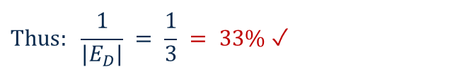
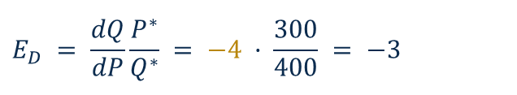

Module 5 · Markup and Lerner Index
Illustrating the Lerner Index
Using the example from above: $Q = 1,600 − 4P; MC = 200$
P
$$\frac{P − MC}{P} = \frac{1}{|E_{D}|}$$
$300
Lerner relationship holds only at the profit-max point!
P − MC
$200
MC
At the profit-max point:
$$E_{D} = \frac{dQ}{dP}\frac{P^{∗}}{Q^{∗}} = −4 · \frac{300}{400} = −3$$
MC
D
$$Thus: \frac{1}{|E_{D}|} = \frac{1}{3} = 33\% ✓$$
MR
Q* = 400
Q
$$\frac{P − MC}{P} = \frac{300 − 200}{300} = 33\%$$
Check: The two formulas give the same result ✓
→ 33% of the price is due to markup
Management 405 · Module 5 · Monopoly and Monopolistic Competition
25
Notes:
Back to our example. At the optimum the price is $300 and marginal cost is $200, so $100 of the $300 price is markup. The Lerner index is 100 over 300, or 33%.
Now compute the elasticity at the same point. The slope dQ/dP is minus 4 from the demand equation, and P over Q is 300 over 400, so the elasticity is minus 3. One over 3 is 33%, the same number. The formula works, but only at the profit-maximizing point.
The dashed arrow on the slide marks this check: the markup computed from price and marginal cost, and the markup computed from the elasticity, give the same result.

Slide 26
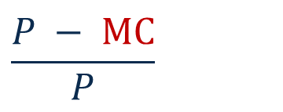
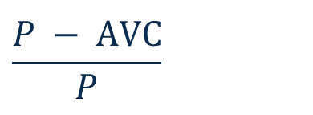
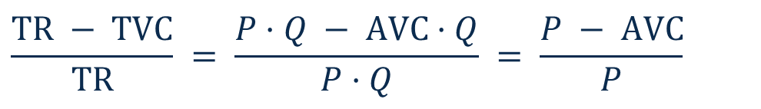
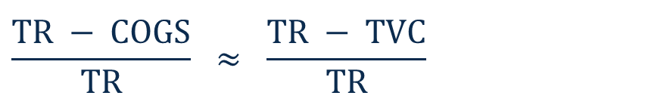
Module 5 · Markup and Lerner Index
Lerner Index – Relationship to Accounting
(For Your Notes Later, When You Take Accounting)
In accounting, you’ll see:
“Cost of Goods Sold” ≈ TVC
Gross Margin =
$$\frac{TR − COGS}{TR}$$
$$\frac{TR − COGS}{TR} ≈ \frac{TR − TVC}{TR}$$
Average variable cost
Divide by quantity:
$$\frac{TR − TVC}{TR} = \frac{P·Q − AVC·Q}{P·Q}$$
$$\frac{TR − TVC}{TR} = \frac{P·Q − AVC·Q}{P·Q} = \frac{P − AVC}{P}$$
$$\frac{P − AVC}{P}$$
Lerner Index:
$$\frac{P − MC}{P}$$
→ Gross Margin ≈
Thus: The Gross Margin is similar to the Lerner Index, but it is measured at average instead of marginal cost
  → Economists think at the margin
Management 405 · Module 5 · Monopoly and Monopolistic Competition
26
Notes:
This slide is for later, when you take accounting. Accountants report the gross margin: revenue minus cost of goods sold, divided by revenue. Cost of goods sold is close to total variable cost.
Divide top and bottom by quantity and the gross margin becomes price minus AVERAGE variable cost, over price. That looks like the Lerner index, except that the Lerner index uses MARGINAL cost. The two are close when marginal cost is roughly flat, but for decisions about one more unit, the marginal number is the one that matters.
From Henry Friedman (Accounting Prof):
COGS is cost of goods sold. It’s about as close to a pure variable cost as you’re going to get. It’s basically what it cost the firm to get the stuff that it sells. For a merchandising or wholesaling firm, it’s basically the purchase price of inventory, though some shipping and warehousing costs might be included. For a manufacturing firm, you’d also have some fixed costs (e.g., assembly facility rent, production line manager and insurance) included, as these are allocated to inventory.
For a service company, you might have a similar Cost of Services Sold (or cost of revenue) line, which for instance, would be the cost of consultants on a consulting team, but not the cost of the consulting firm’s management.
Linking back to markups, Gross margins, or (Revenue – COGS)/Revenue are close to the Lerner index, as dividing the numerator and denominator by Q gets you to (P – AVC)/P, though the AVC here is average variable cost related to inventory specifically. There could be other variable costs, like sales commissions, that come into play. Still though, Gross margins are really close to the Lerner Index.

Slide 27
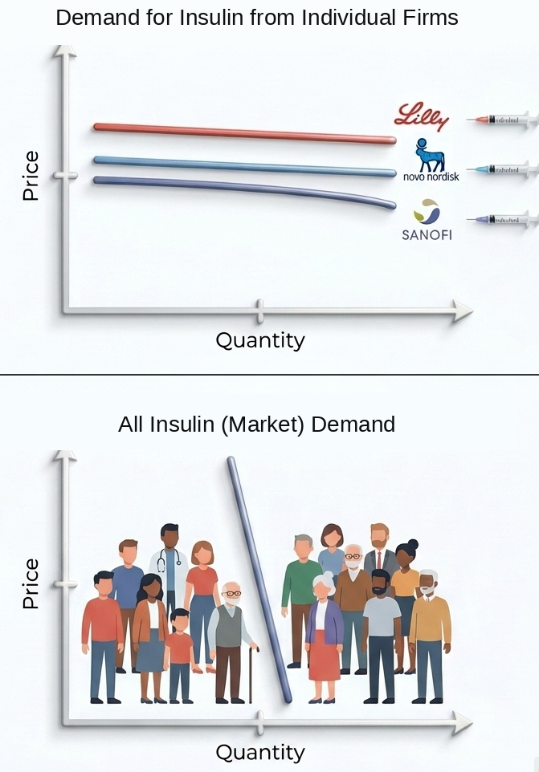
Module 5 · Markup and Lerner Index
Firm and Market Elasticity
Note that the Lerner index is calculated based on the firm elasticity
Important:
  Firm and market elasticity are generally different
  Firm elasticity tends to be larger than market elasticity, especially if there are many firms competing in an industry
  Across firms, those with more differentiated products tend to face lower elasticities
Management 405 · Module 5 · Monopoly and Monopolistic Competition
27
Notes:
One caution: the elasticity in the Lerner formula is the elasticity of demand for the FIRM's product, not for the whole market. Demand for soft drinks as a category is fairly inelastic, but demand for one brand is much more elastic, because customers can switch to another brand.
The more firms compete in an industry, the bigger that gap. And firms whose products are more differentiated face less elastic demand, so they can charge higher markups. The next example makes this concrete.

Slide 28
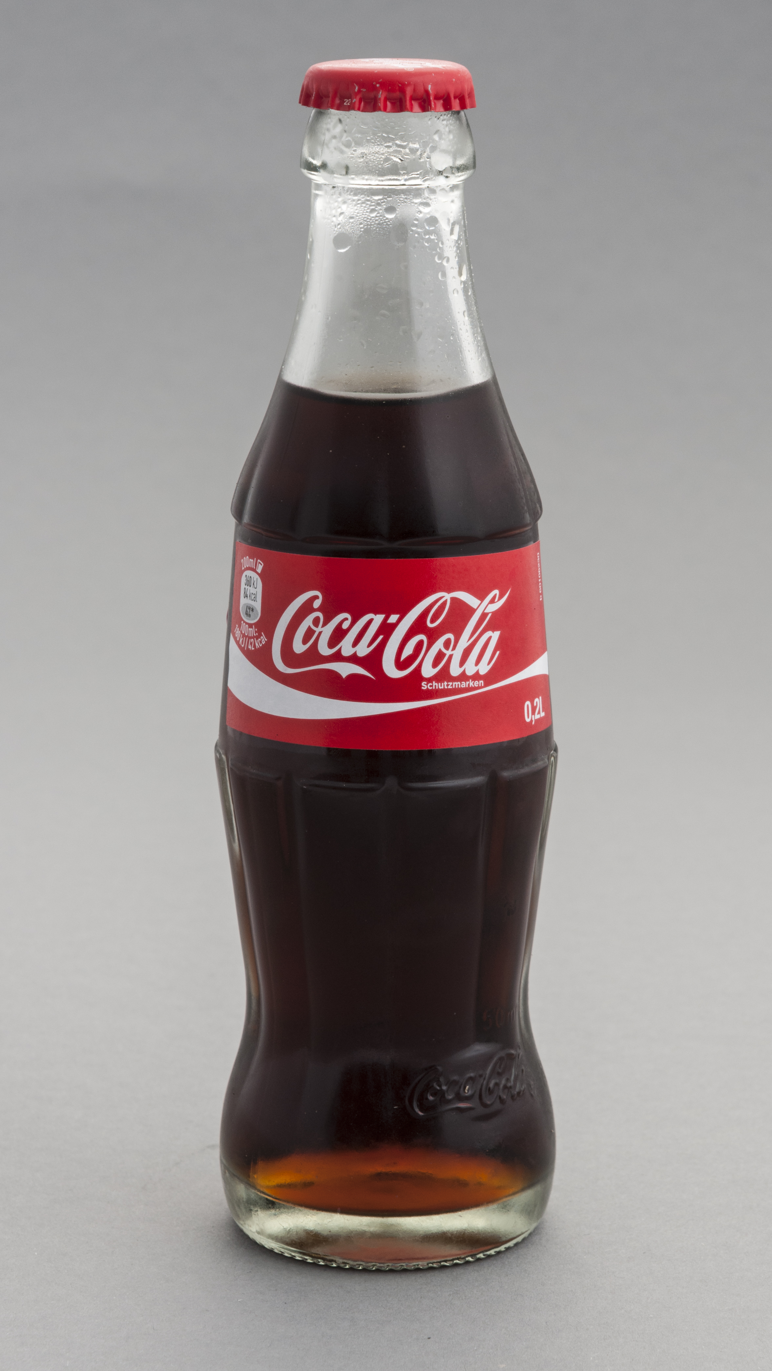
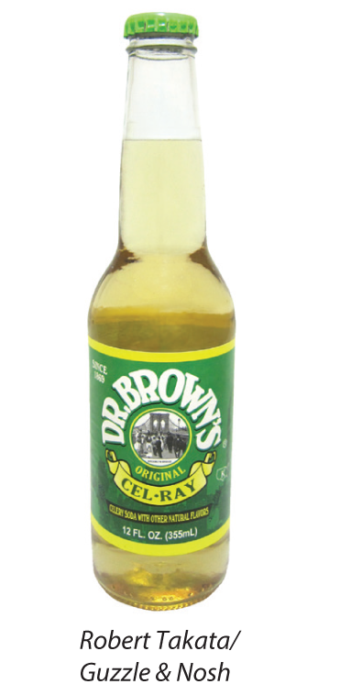
Module 5 · Markup and Lerner Index
Mark-Up and Elasticity
Coca-Cola’s demand elasticity is −4.1
Dr. Brown’s Cel-Ray has a demand elasticity of −2.0
What is the % of the price that is due to markup for the two products?
  Note: You may assume that elasticities are for the profit-maximizing P and Q
Poll Break
Management 405 · Module 5 · Monopoly and Monopolistic Competition
28
Notes:
Two soft drinks. Coca-Cola faces a demand elasticity of minus 4.1, and Dr. Brown's Cel-Ray, a celery soda you find in New York delis, minus 2. Use the Lerner index to find what share of each price is markup, and answer in the poll.
Prepare poll-ev Consider Coca-Cola and Dr Brown, which has the higher mark-up?
Elasticity is lower because of niche product

Slide 29
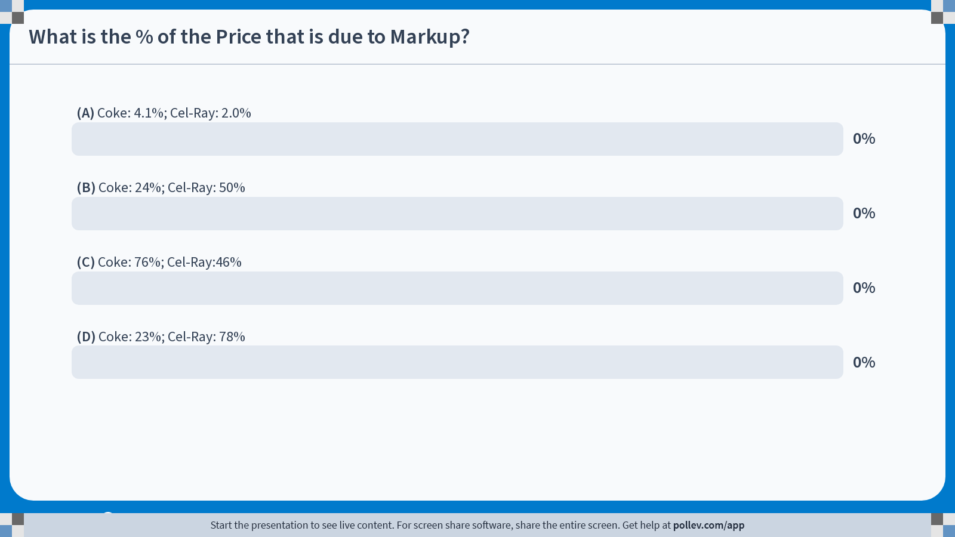
Notes:
Poll Title: Do not modify the notes in this section to avoid tampering with the Poll Everywhere activity.
More info at polleverywhere.com/support
What is the % of the Price that is due to Markup?
https://www.polleverywhere.com/multiple_choice_polls/N7b4Z8mD8cUApKIyTWkWe?state=opened&flow=Default&onscreen=persist

Slide 30
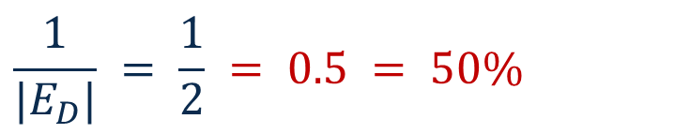
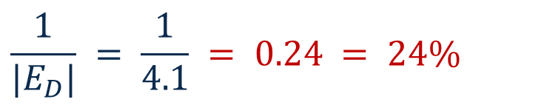
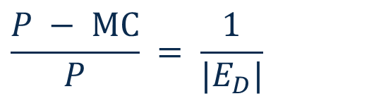
Module 5 · Markup and Lerner Index
Solution
Poll Break
Management 405 · Module 5 · Monopoly and Monopolistic Competition
30

Slide 31
Module 5 · Markup and Lerner Index
Price Searcher Take-Aways
Basic rule for profit maximization:
  Set MR = MC to find Q*
  Continue to produce in the short run if P ≥ AVC
Key difference to price taker:
  The price searcher sets P* > MC
Mark-up depends on elasticity
Management 405 · Module 5 · Monopoly and Monopolistic Competition
31
Notes:
To sum up the first part. A price searcher uses the same rule as every firm: produce where MR equals MC, and in the short run continue to produce as long as the price covers average variable cost.
What is different from a price taker is that the price ends up above marginal cost. How far above depends on the elasticity of the firm's demand.

Slide 32
Module 5 · Agenda
Outline of Module 5
1
In class
Profit Maximization for Price Searchers
1b
Markup and Lerner Index
In class
2
Monopoly and Welfare Impact
Monopoly profits come at consumers' expense
In class
3
In class
Rising Market Power and Regulations
4
In class
Monopolistic Competition
Management 405 · Module 5 · Monopoly and Monopolistic Competition
32
Notes:
Now we look at monopoly: what it does to profits, to consumers and to total welfare.

Slide 33
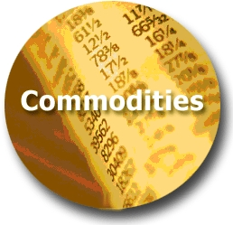
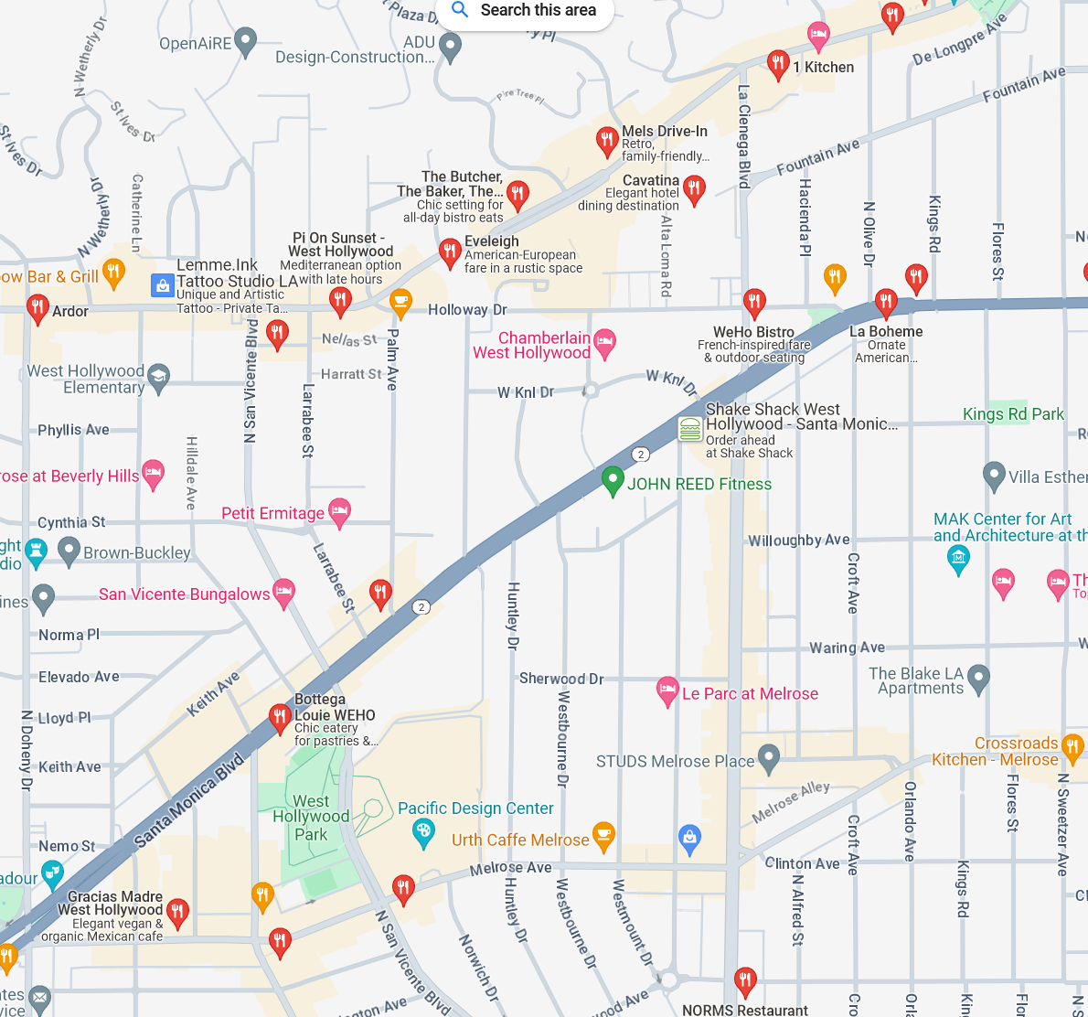
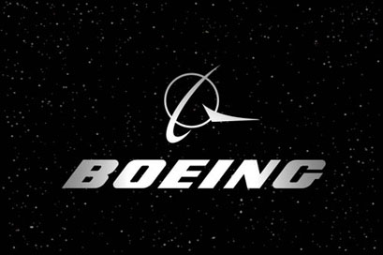


Module 5 · Monopoly and Welfare Impact
Where We Are and Where We Are Going
Least Market Power
Most Market Power
Perfect
Competition
Monopolistic
Competition
Oligopoly
Monopoly
(Price Takers)
(Price Searchers)
Commodity markets
Restaurants in WeHo
Wide-body aircraft
Municipal utilities
TODAY
Management 405 · Module 5 · Monopoly and Monopolistic Competition
33
Notes:
Here is the spectrum of market power. On the left, perfect competition: commodity markets, where every firm is a price taker. On the right, monopoly: a single seller, like the city's water and power utility.
Everything to the right of perfect competition is a price searcher. We start at the far right with monopoly, and later in this module we come back to monopolistic competition.

Slide 34

Module 5 · Monopoly and Welfare Impact
Market Structure Characteristics
 | Monopoly
Number of actual or potential competitors | Single seller
Product differentiation | Very high – no close substitutes
Entry conditions | Restricted access (barriers)
Profit potential | Profit potential in short and long run
Examples | Microsoft (before the rise of Apple); gas, water and electric utilities
Management 405 · Module 5 · Monopoly and Monopolistic Competition
34
Notes:
A monopoly is a single seller of a product with no close substitutes, protected by barriers to entry. Because nobody can come in, it can earn profits in the short run and in the long run. Think of Microsoft's operating system before Apple's rise, or a local water utility.
Article on att-time-warner merger
https://www.cnn.com/2019/02/26/media/att-time-warner-merger-ruling/index.html
Live Nation / Ticketmaster merger
https://www.nytimes.com/2010/04/25/business/25ticket.html

Slide 35

Module 5 · Monopoly and Welfare Impact
Poll: Was the Amazon–MGM Merger Bad for Consumers?
In March 2022, Amazon completed its acquisition of MGM Studios for $8.45 billion
Was this merger bad for consumers, or did it not harm them?
Poll Break
Management 405 · Module 5 · Monopoly and Monopolistic Competition
35
Notes:
In March 2022 Amazon closed its purchase of the MGM film studio, with its James Bond and Rocky libraries, for $8.45 billion. Before we look at the economics of monopoly, what is your instinct: was this deal bad for consumers?
Do not modify the notes in this section to avoid tampering with the Poll Everywhere activity.
More info at polleverywhere.com/support
In March 2022, Amazon completed its acquisition of MGM Studios for $8.45 billion. This merger:
https://www.polleverywhere.com/multiple_choice_polls/IJ8aUfND9oCGPDbgSvELK?display_state=instructions&activity_state=opened&state=opened&flow=Engagement&onscreen=persist

Slide 36
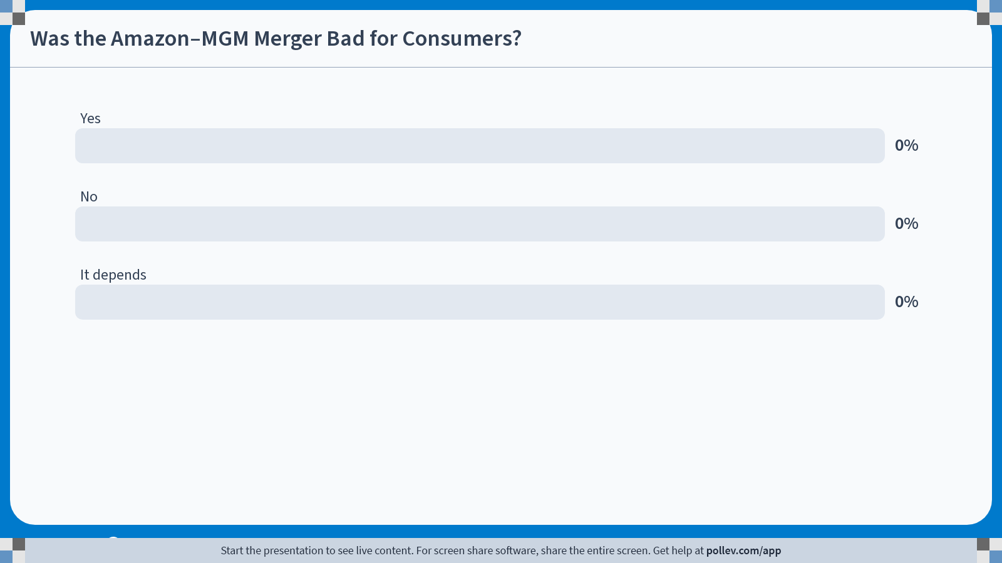
Notes:
Poll Title: Do not modify the notes in this section to avoid tampering with the Poll Everywhere activity.
More info at polleverywhere.com/support
Was the Amazon–MGM Merger Bad for Consumers?
https://www.polleverywhere.com/multiple_choice_polls/YTzPU9mXqUgAiCqRAfrFw?state=opened&flow=Default&onscreen=persist

Slide 37
Module 5 · Monopoly and Welfare Impact
Recall: Consumer and Producer Surplus Under Competition
P
MC
Consumer surplus (CS) under competition
CS
Producer surplus (PS) under competition
P_{Comp}
PS
D
Q_{Comp}
Q
Management 405 · Module 5 · Monopoly and Monopolistic Competition
37
Notes:
Before we look at monopoly, recall the competitive benchmark from Module 4. Under competition the market produces where demand meets marginal cost. Consumer surplus is the area under the demand curve and above the price: what buyers would have paid minus what they do pay. Producer surplus is the area above marginal cost and below the price. Under competition, the sum of the two is as large as it can be. The next slide shows what a monopolist does to it.

Slide 38
Module 5 · Monopoly and Welfare Impact
Monopoly: Good for Business, Bad for Consumers and Welfare
P
Consumer surplus (CS) under monopoly
MC
CS
P_{M}
Producer surplus (PS) under monopoly
P_{Comp}
DWL
PS
Deadweight loss (DWL) under monopoly
D
MR
Q_{M}
Q_{Comp}
Q
Management 405 · Module 5 · Monopoly and Monopolistic Competition
38
Notes:
Since a monopolist charges a price above the MC, you might suspect that having market power is beneficial for firms. It is! We can characterize the welfare consequences of market power and specify how it affects consumers and the firm.
We compute consumer and producer surplus similar to the competitive market setting.
Consumer surplus: the area under the demand curve and above the price
Producer surplus: the area above the MC curve and below the price. (Recall that a firm’s short run supply curve in a perfectly competitive market is where the MC curve is above AVC.)
Under monopoly (relative to perfect competition):
--consumer surplus declines.
--producer surplus rises.
--total welfare is reduced (deadweight loss of market power).

Slide 39
Module 5 · Monopoly and Welfare Impact
What If Costs Are Lower for One Large Producer?
P
CS and PS under competition (original MC)
MC₁
Consumer surplus (CS) under monopoly with lower MC
CS
P_{M}
Producer surplus (PS) under monopoly with lower MC
P_{Comp}
PS
DWL
MC₂
Deadweight loss (DWL) under monopoly with lower MC
D
Lower costs after mergers can benefit consumers, but only if higher market power does not reverse these gains
MR
Q_{M}
Q
Management 405 · Module 5 · Monopoly and Monopolistic Competition
39
Notes:
Here is the other side of the merger question. Demand is the same as on the previous slide. The pale areas are consumer and producer surplus under competition, with the original marginal cost MC1.
Now suppose that one large producer, for example the firm created by a merger, can produce at a lower and flatter marginal cost, MC2. It is still a monopolist, so it sets MR equal to its own marginal cost and charges a price above it. But because its costs are lower, its price is lower and its quantity higher than those of the high-cost monopolist on the previous slide, so consumer surplus is larger than there. In this example it is still smaller than the pale consumer surplus under competition.
If mergers reduce costs, then consumers can also benefit, and the net effect depends on the tradeoff between market power (higher prices) and cost efficiencies due to scale (lower prices).

Slide 40

Module 5 · Monopoly and Welfare Impact
The Case of Luxottica (Now EssilorLuxottica)
60 Minutes on Luxottica – watch on YouTube (from 9:49)
Class Discussion
Management 405 · Module 5 · Monopoly and Monopolistic Competition
40
Notes:
This 60 Minutes segment asks who actually makes your glasses. The link starts at 9:49. Watch it with the question in mind: where does Luxottica's market power come from?
https://www.youtube.com/watch?v=gDdq2rIqAlM&t=589s
Watch 0:55 (if time)
Watch from 5:00 – (if less time)
Watch from 6:45 if previously assigned video
Note: Merger with Essilor in 2018: EssilorLuxottica
New entrant: Warby Parker

Slide 41
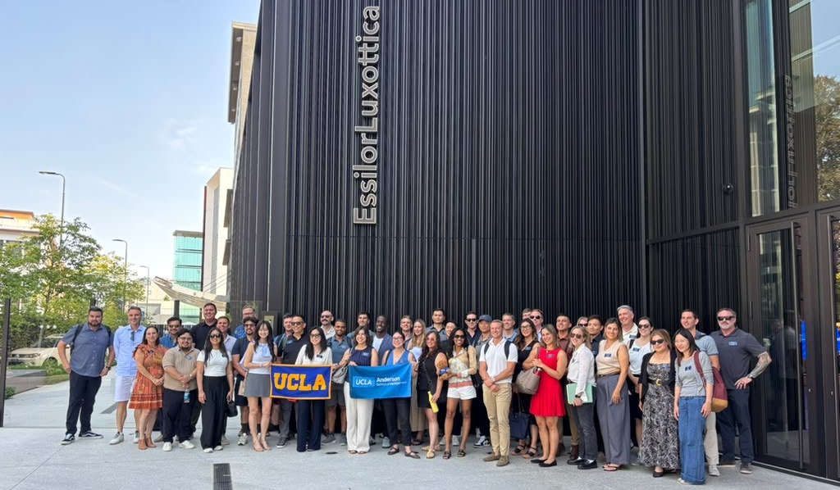
Module 5 · Monopoly and Welfare Impact
So I Visited EssilorLuxottica with an EMBA IBR Class…
Management 405 · Module 5 · Monopoly and Monopolistic Competition
41
Notes:
I visited EssilorLuxottica with an Executive MBA class on its International Business Residency (IBR). This is our group in front of the company's building.
The visit is a good way into the questions on Luxottica: the company you just saw in the clip is now one firm with the lens maker Essilor.

Slide 42
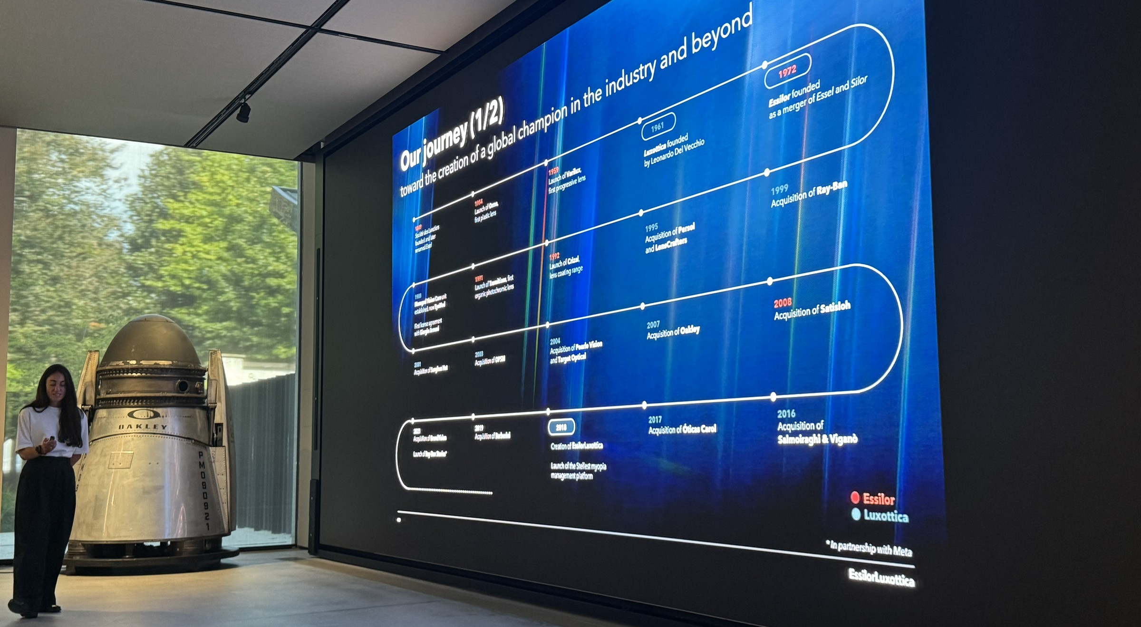
Module 5 · Monopoly and Welfare Impact
…and This Was Their Chart on Company History
Management 405 · Module 5 · Monopoly and Monopolistic Competition
42
Notes:
During the visit, the company showed us this chart of its history. Look at how many entries are acquisitions: Persol and LensCrafters in 1995, Ray-Ban in 1999, Sunglass Hut in 2001, OPSM in 2003, Pearle Vision and Target Optical in 2004, Oakley in 2007, Satisloh in 2008, Salmoiraghi & Viganò in 2016, Óticas Carol in 2017, Barberini in 2019 and GrandVision in 2021. In 2018 Essilor and Luxottica merged into EssilorLuxottica.
Much of the company's market power was built by buying brands, retailers and suppliers. Keep this in mind for the antitrust question on the next slide.

Slide 43
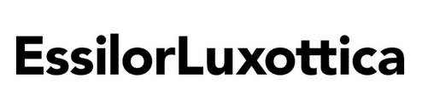

Module 5 · Monopoly and Welfare Impact
The Case of Luxottica
Which type of market is Luxottica operating in?
How do they achieve market power?
Do they have a high markup?
How does the following statement by Luxottica’s former CEO relate to what we learned about the demand curve?
  « Everything is worth what people are ready to pay »
Management 405 · Module 5 · Monopoly and Monopolistic Competition
43
Notes:
Some questions to discuss after the clip. Luxottica owns Ray-Ban and Oakley, makes glasses for most luxury brands, and owns retail chains like LensCrafters and Sunglass Hut, and since the 2018 merger with Essilor also the lens maker. How does that structure give it market power, and does it show up in markups?
The CEO's line, everything is worth what people are ready to pay, is a description of a price searcher reading its demand curve.

Slide 44

Module 5 · Monopoly and Welfare Impact
Monopoly Take-Aways
Monopolist: Large degree of market power
  Enables high profits
  Reduces consumer surplus
  Reduces overall (society) welfare
Silver lining: Patents, licenses and copyrights
  The prospect of monopoly power provides incentives for innovation (e.g., new drugs)
  Consumer surplus from new product creation can outweigh deadweight loss due to high prices
Management 405 · Module 5 · Monopoly and Monopolistic Competition
44
Notes:
A monopolist has a lot of market power. That is good for its profits, bad for consumers, and bad for society as a whole, because of the deadweight loss.
There is a silver lining. Patents, licenses and copyrights create monopolies on purpose, because the prospect of that power is what pays for innovation, new drugs being the standard example. A new drug sold at a high price can still create more consumer surplus than the deadweight loss it causes.
Visual Elements:
Market Monopolist (Left/Center): A massive, dominant corporate tower anchored by a four-panel grid emblem, representing Microsoft's entrenched OS platform and market control.
Competitive Entry (Right): A sleek silver Apple silhouette entering from the right, dynamically cutting into the market space to illustrate how innovative competitors challenge an incumbent monopolist.

Slide 45
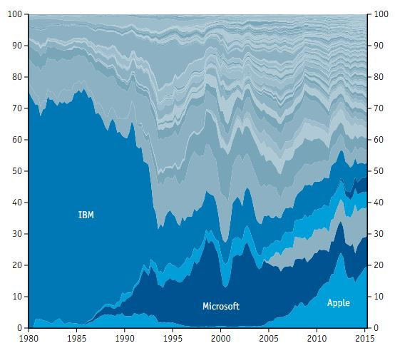
Module 5 · Monopoly and Welfare Impact
All Firms Face Potential (Future) Competitors
Source: The Economist, economist.com/techfirms
Management 405 · Module 5 · Monopoly and Monopolistic Competition
45
Notes:
Market power does not last forever. The chart shows the share of the computing industry held by its leaders over time: IBM dominated, then Microsoft, then Apple. Each looked unbeatable in its time.
Even if you are the only player on a market, you have to worry about potential entry: contestable markets.

Slide 46
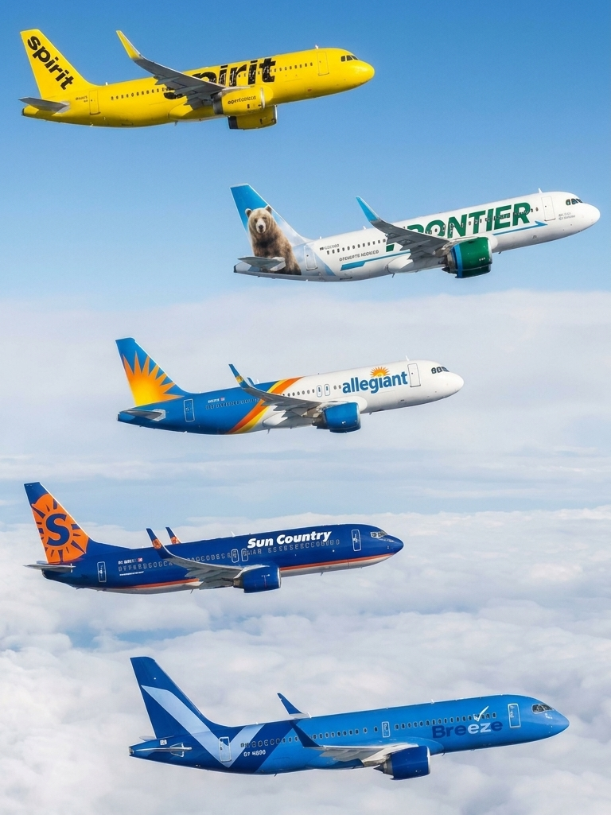
Module 5 · Monopoly and Welfare Impact
Ultra-Low-Cost Carrier Airlines: Entry Drives Down Prices
Ultra-low-cost carriers (ULCC)
On routes that ULCC start to fly:
  Fares about 21% lower than average¹
  Number of passengers goes up
Even the threat of entry lowers fares:
  Once Southwest served both endpoints of a route, incumbents cut fares; over half of the drop came before Southwest entered²
¹ Bachwich, A. R., and M. D. Wittman (2017): “The Emergence and Effects of the Ultra-Low Cost Carrier (ULCC) Business Model in the U.S. Airline Industry,” Journal of Air Transport Management 62: 155–164.
² Goolsbee, A., and C. Syverson (2008): “How Do Incumbents Respond to the Threat of Entry? Evidence from the Major Airlines,” Quarterly Journal of Economics 123(4): 1611–1633.
Management 405 · Module 5 · Monopoly and Monopolistic Competition
46
Notes:
Ultra-low-cost carriers such as Allegiant, Frontier and Spirit undercut the fares of the incumbent airlines. A study of US markets found that in 2015 fares were about 21% lower than average in markets where an ultra-low-cost carrier flew, against 8% lower where another low-cost carrier was present. Even the threat of entry matters. When Southwest began serving both ends of a route, the airlines already flying it cut their fares, and more than half of the total fare drop came before Southwest started flying the route. Entry, and even the prospect of it, disciplines the prices of firms that look powerful.
Sources. Earlier versions of this slide listed airport figures from the textbook discussion (p. 321: O'Hare 23%, Newark 22%, IAH 21%, DFW 20%, Las Vegas 20%); their original source could not be traced, so the slide now uses the published study: Bachwich, A. R. and Wittman, M. D. (2017), "The emergence and effects of the ultra-low cost carrier (ULCC) business model in the U.S. airline industry", Journal of Air Transport Management 62: 155-164, https://doi.org/10.1016/j.jairtraman.2017.03.012. In 2015, ULCC presence in a market was associated with base fares 21% lower than average, against 8% for low-cost carriers.
The threat of entry: Goolsbee, A. and Syverson, C. (2008), "How Do Incumbents Respond to the Threat of Entry? Evidence from the Major Airlines", Quarterly Journal of Economics 123(4): 1611-1633, https://doi.org/10.1162/qjec.2008.123.4.1611. Abstract: "incumbents cut fares significantly when threatened by Southwest's entry. Over half of Southwest's total impact on incumbent fares occurs before Southwest starts flying." A route counts as threatened once Southwest operates at both endpoint airports. The entrant in the paper is Southwest, a low-cost carrier, not an ultra-low-cost one; a search found no published ULCC version of this result.
My original notes, kept for reference (the airport figures in them could not be traced): ULCC: discussion on page 321 of the textbook
Allegiant, Frontier and Spirit, undercut fares offered by incumbent carriers.
Prices can fall by double digit, number of passengers goes up.
Drop in prices: Chicago O’Hare (23%), Newark (22%), Houston George Bush Intercontinental (21%), Dallas/Fort Worth (20%), Las Vegas McCarran (20%)
The airline sector is very concentrated: Delta (22%), American (21%), United (18%), Southwest (15%)

Slide 47
Module 5 · Agenda
Outline of Module 5
1
In class
Profit Maximization for Price Searchers
1b
Markup and Lerner Index
In class
2
In class
Monopoly and Welfare Impact
3
Rising Market Power and Regulations
Rising market concentration and government responses
In class
4
In class
Monopolistic Competition
Management 405 · Module 5 · Monopoly and Monopolistic Competition
47
Notes:
Next, the evidence that market power has been rising in the US, and what governments do about it.

Slide 48
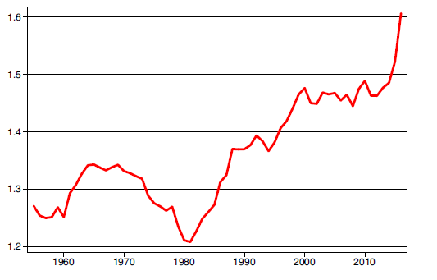
Module 5 · Rising Market Power and Regulations
Rising Markups in the US
Average markup (P/MC) in the US economy*
Note: If markup = 1.5 → Lerner index = 0.33
Source: De Loecker et al., QJE 2020: The Rise of Market Power and the Macroeconomic Implications
*The source uses the markup definition (P/MC) – this is different from the Lerner index (P − MC)/P
Management 405 · Module 5 · Monopoly and Monopolistic Competition
48
Notes:
This is the best-known estimate of how markups have changed. The average US firm charged prices about 20% above marginal cost in 1980 and about 60% above by the late 2010s, on this measure.
Source: DeLoecker et al, QJE 2020: The Rise of Market Power and the Macroeconomic Implications
Note: 𝐿=(𝑃/𝑀𝐶 − 1)/(𝑃/𝑀𝐶) . So if 𝑃/𝑀𝐶 = 1.5 → L=0.33 [Not needed for exam!]

Slide 49
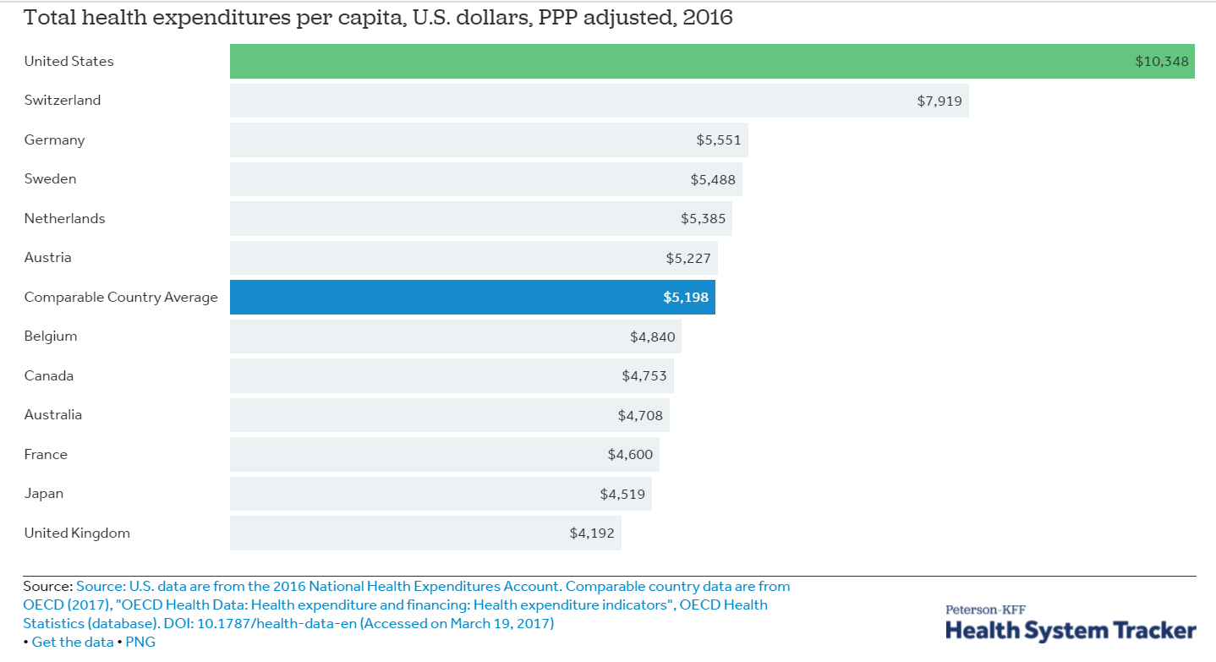
Module 5 · Rising Market Power and Regulations
Health Care Expenditures Across Countries
Management 405 · Module 5 · Monopoly and Monopolistic Competition
49
Notes:
The United States spends far more per person on health care than any other rich country. Part of the reason is concentration: in many local markets a few hospital systems and insurers dominate.
This website is really cool: https://concentrationcrisis.openmarketsinstitute.org/
You can click on the sector and see how concentrated each market is:

Slide 50
Module 5 · Rising Market Power and Regulations
Health Care Cost Comparison: Heart-Related Treatments
Angioplasty: a procedure used to open blocked coronary arteries
Bypass surgery: redirect blood around a blocked section of an artery in the heart
Median price of an angioplasty and of a coronary bypass, 2022 (USD)
Angioplasty
$89.1k
Bypass surgery
$34.5k
$25.8k
$17.7k
$16.9k
$11.1k
$10.2k
$3.3k
United Kingdom
Australia
Germany
United States
Source: iFHP and HCCI, International Healthcare Cost Comparison Report 2024 (2022 data); median private-insurer claims costs
Management 405 · Module 5 · Monopoly and Monopolistic Competition
50
Notes:
Here are prices for two common heart procedures in several countries. The same procedure costs several times as much in the United States as elsewhere, which is what you expect when sellers have market power.
More price comparisons for medical procedures: https://www.nytimes.com/2019/12/27/upshot/expensive-health-care-world-comparison.html
The chart uses the most recent data, from the International Federation of Health Plans and the Health Care Cost Institute (International Healthcare Cost Comparison Report 2024, 2022 data). These are median claims costs paid by private insurers, in US dollars; the US figures come from commercial claims. An angioplasty cost about 34,500 dollars in the US against about 10,000 to 11,000 in the UK and Australia and about 3,300 in Germany. A coronary bypass cost about 89,000 dollars in the US against roughly 17,000 to 26,000 in the other three countries.

Slide 51

Module 5 · Rising Market Power and Regulations
Concentration in US Industries
A market is “concentrated” if CR4 (the share of sales of the top-4 companies) is above 50%
concentrationcrisis.openmarketsinstitute.org
Management 405 · Module 5 · Monopoly and Monopolistic Competition
51
Notes:
The Open Markets Institute tracks concentration industry by industry. A common rule of thumb calls a market concentrated when the four largest firms have more than half of its sales.
This website is really cool: https://concentrationcrisis.openmarketsinstitute.org/
You can click on the sector and see how concentrated each market is:

Slide 52

Module 5 · Rising Market Power and Regulations
Government Regulations to Control Market Power
Price regulations
  Happens frequently with natural monopolies: electricity, natural gas, (historically: local telephone service)
Antitrust laws
  Scrutiny on mergers/acquisitions that would limit competition
  FTC successfully blocked Kroger’s acquisition of Albertsons in 2024 (~ $24.6 billion)
  Ban collusion on prices
Nevertheless: Very high and rising market concentration in the US
Killer acquisitions of startups
Management 405 · Module 5 · Monopoly and Monopolistic Competition
52
Notes:
Governments have two main tools against market power. Price regulation is used for natural monopolies, like the electricity or gas utility, where one network serves everyone and competition is not practical.
Antitrust law reviews mergers that would reduce competition and bans price collusion. In December 2024 the FTC won its case to block Kroger's $24.6 billion takeover of Albertsons, the largest supermarket merger ever proposed. Even so, concentration in many US industries is high and rising, as the previous slides showed.
The picture on the right refers to the paper “Killer Acquisitions” by Colleen Cunningham, Florian Ederer and Song Ma (Journal of Political Economy, 2021). They argue that an incumbent firm may buy an innovative startup not to develop its product, but to shut the project down so that it never becomes a competitor. Using data on more than 16,000 drug projects in the pharmaceutical industry, they show that projects bought by a firm with an overlapping drug (same therapeutic class and mechanism) are 23.4% less likely to continue in development than projects bought by firms without such an overlap. By their conservative estimate, 5.3% to 7.4% of the acquisitions in their sample are killer acquisitions, and these deals cluster just below the size thresholds that trigger antitrust review. The paper can be downloaded at https://florianederer.github.io/pdf/killer.pdf
Two rationales for regulating monopoly:
-- total welfare
-- allocation of surplus among consumers and producers
For more on the AT&T breakup: http://articles.latimes.com/1995-09-21/business/fi-48462_1_system-breakup
…but many mergers that limit competition still go through. CF Live Nation+Ticketmaster merger in 2010: https://www.vox.com/the-goods/23569504/ticketmaster-monopoly-live-nation-taylor-swift-antitrust-clyde-Lawrence
(About the picture): It uses a funnel composition showing dozens of small, scattered startup icons on the left consolidating and being absorbed into three massive dominant tech logos on the right that take up 90% of the market space, visually conveying market power without using words.
The three symbols stand for Anthropic (the A with the brain), ChatGPT/OpenAI (the green C) and Google with its Gemini models (the G with the ring). They are stylized, AI-generated letters, not the companies' actual logos.

Slide 53
Module 5 · Agenda
Outline of Module 5
1
In class
Profit Maximization for Price Searchers
1b
Markup and Lerner Index
In class
2
In class
Monopoly and Welfare Impact
3
In class
Rising Market Power and Regulations
4
Monopolistic Competition
Many firms, differentiated products: entry erodes profits
In class
Management 405 · Module 5 · Monopoly and Monopolistic Competition
53
Notes:
The last part is monopolistic competition: many firms with differentiated products, where entry erodes profits in the long run.

Slide 54
Module 5 · Monopolistic Competition
Where We Are
Least Market Power
Most Market Power
Perfect
Competition
Monopolistic
Competition
Oligopoly
Monopoly
(Price Takers)
(Price Searchers)
Commodity markets
Restaurants in WeHo
Wide-body aircraft
Municipal utilities
TODAY
Management 405 · Module 5 · Monopoly and Monopolistic Competition
54
Notes:
Back to the spectrum. We now move to monopolistic competition: many firms selling products that are similar but not identical, like the restaurants in West Hollywood. Each restaurant is a price searcher, but entry is easy, and that changes what happens to profits in the long run.

Slide 55
Module 5 · Monopolistic Competition
Market Structure Characteristics
 | Monopolistic Competition
Number of actual or potential competitors | Many sellers
Product differentiation | Perceived differences but relatively close substitutes
Entry conditions | No (major) barriers to entry
Profit potential | Normal economic profit in long run; losses and profits in short run only
Examples | Professional services (plumbers, gardeners); restaurants, gas stations; clothing
(How to get market power: Palessi)
Management 405 · Module 5 · Monopoly and Monopolistic Competition
55
Notes:
Monopolistic competition combines many sellers with products that customers see as somewhat different, like restaurants, plumbers or clothing brands. Each firm has a little market power. The key feature is the red box: there are no major barriers to entry, so profits attract new firms and do not last.
The Palessi clip shows how much perceived differentiation can be worth: Payless sold its discount shoes as a fake luxury brand at many times the price.

Slide 56

Module 5 · Monopolistic Competition
Monopolistic Competition Example: Gas Stations
Product differentiation by location
Management 405 · Module 5 · Monopoly and Monopolistic Competition
56
Notes:
Take gas stations, for example. Even in small towns, there can be dozens of them. While their marketing departments try really hard to tell you otherwise, all the different stations sell the exact same product. However, there is a bit of product differentiation through their locations. The customers prefer to drive to the closest one. For a given customer, this makes some stations more attractive than others.

Slide 57
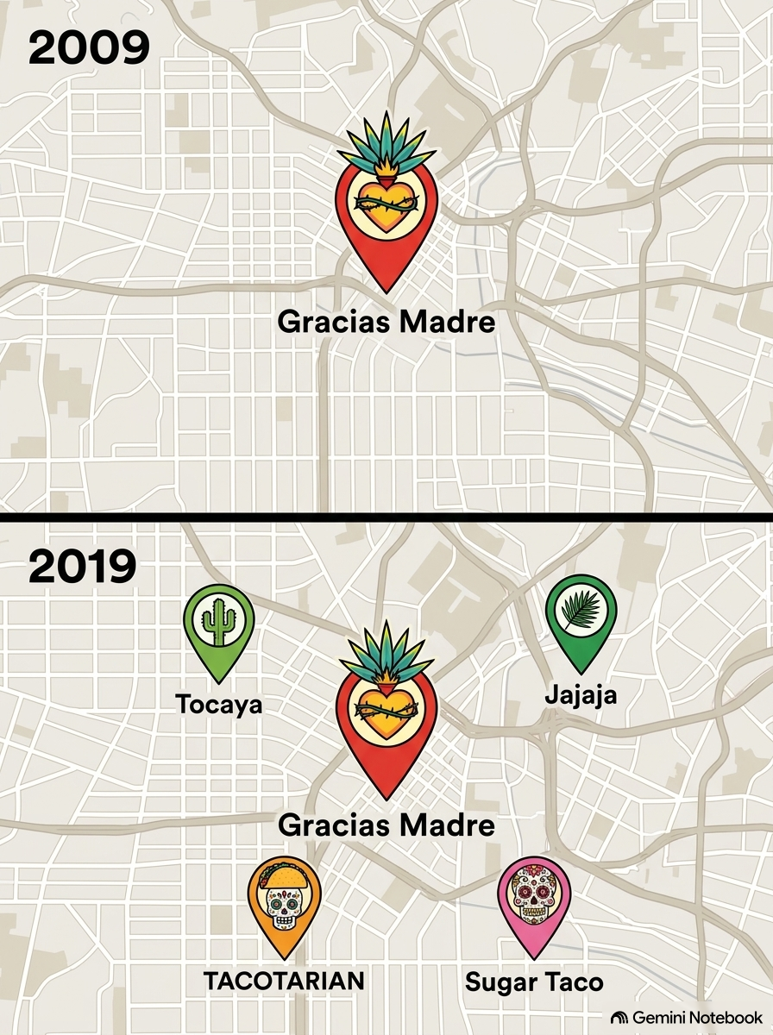
Module 5 · Monopolistic Competition
Monopolistic Competition: The Role of Entry
Monopolistic competition
  Large number of firms
  No (major) entry barriers
Short run: economic profits possible
Long run: entry erodes economic profits
Management 405 · Module 5 · Monopoly and Monopolistic Competition
57
Notes:
Under monopolistic competition there are many firms and no major barriers to entry. Each firm has some market power, so in the short run it can earn profits, exactly like a monopolist. In the long run, though, those profits attract new firms, and entry erodes them. The next three graphs show how.

Slide 58
Module 5 · Monopolistic Competition
Monopolistic Competition: Short Run
P
ATC
MC
P*
Profit
ATC
D
MR
Q*
Q
Management 405 · Module 5 · Monopoly and Monopolistic Competition
58
Notes:
In the short run a monopolistically competitive firm looks exactly like a monopolist. Gracias Madre faces a downward-sloping demand curve, sets MR equal to MC, charges the price on its demand curve, and earns a profit, the red rectangle. Notice where marginal cost cuts the average total cost curve: at its lowest point. Below that output, the extra meal costs less than the average, so it pulls the average down; above it, it pushes the average up.
Short run. Firms that differentiate are perpetually looking for those short term profits.

Slide 59
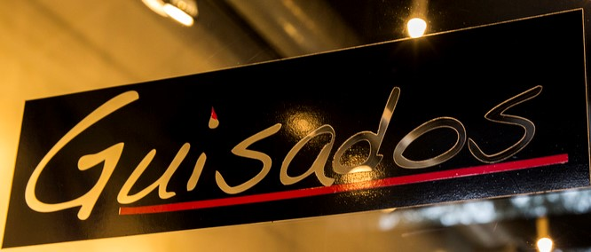


Module 5 · Monopolistic Competition
Monopolistic Competition: Entry of New Firms
P
ATC
MC
New entrants → the incumbent’s demand curve shifts down and becomes more elastic (D₂)
P₂
Profit
ATC
D₁
D₂
Profits of the incumbent firm decline as more competitors with similar (but differentiated) products enter
MR₂
Q₂
Q
Management 405 · Module 5 · Monopoly and Monopolistic Competition
59
Notes:
New restaurants open nearby, such as Guisados and Mercado. Gracias Madre's demand curve shifts down from D1 to D2 and becomes flatter, because its customers now have more alternatives. It still sets MR equal to MC and still makes a profit, but a smaller one than before.
Long run: Entry of new firms makes the incumbent firm’s demand more elastic (less steep) due to the availability of substitutes. Entry of new firms also shifts the incumbent firm’s demand curve down due to the fact that the firm is now splitting the market. The MR curve shifts accordingly.
As long as there are positive profits, more firms will enter. The demand curve will shift down to where it meets average total cost, so that profits are zero.
Note that the entry of firms does not lead to the perfectly competitive outcome. There is still a price mark up over the MC due to downward sloping demand.

Slide 60
Module 5 · Monopolistic Competition
Monopolistic Competition: Long-Run Equilibrium
P
ATC
MC
Entry shifts demand down and makes it more elastic (flatter)
P_{LR} = ATC
D₁
In the long run, each monopolistically competitive firm earns zero economic profit (P = ATC)
Note: This holds under the assumption that firms are symmetric in costs but produce differentiated products
D_{LR}
MR_{LR}
Q_{LR}
Q
Management 405 · Module 5 · Monopoly and Monopolistic Competition
60
Notes:
As long as there are profits, more restaurants open, and each new one takes customers from the incumbent. Its demand curve keeps shifting down and becoming flatter, until it just touches the average total cost curve. At that point the best the firm can do is charge a price equal to average total cost: zero economic profit, and no reason for anyone else to enter.
Notice that this is not perfect competition. The demand curve still slopes down, so the price is still above marginal cost: there is still a markup, it just no longer produces a profit.
The note in the box matters. Zero profit for every firm assumes that all firms have the same costs and differ only in their products. A restaurant with lower costs than its rivals can keep earning a profit even in the long run.

Slide 61
Module 5 · Monopolistic Competition
Barriers to Entry
Entry erodes profits in a monopolistically competitive market
Different from monopoly: A monopolist makes positive economic profits
Why the difference?
  Barriers to entry protect a monopolist
  Can firms create barriers to entry?
Management 405 · Module 5 · Monopoly and Monopolistic Competition
61
Notes:
So entry erodes profits under monopolistic competition, but not under monopoly. The difference is barriers to entry. Which raises the question every manager cares about: can a firm build its own barriers?

Slide 62




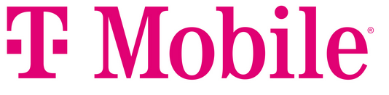
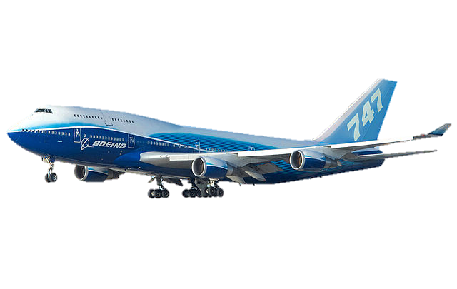
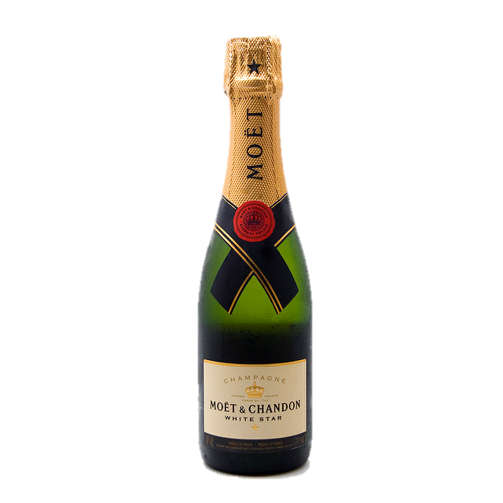
Module 5 · Monopolistic Competition
“Structural” Barriers to Entry
Legal barriers
Network effect
Economies of scale
Learning
Control of resources
Management 405 · Module 5 · Monopoly and Monopolistic Competition
62
Notes:
Here are five structural barriers. Legal barriers: drug approval by the FDA, patents, licenses. Network effects: a social network is worth more the more people are on it, so a newcomer starts at a disadvantage. Economies of scale: a national wireless network has enormous fixed costs. Learning: Boeing has built wide-body jets for decades, and that know-how is hard to copy. And control of resources: only grapes from the Champagne region can be sold as champagne.
Example of legal barriers include:
-- licensing requirements
-- taxi medallions
-- patents and copyrights

Slide 63



Module 5 · Monopolistic Competition
Switching Costs Can Also Raise Barriers to Entry
Loyalty programs
Compatibility
Learning
Management 405 · Module 5 · Monopoly and Monopolistic Competition
63
Notes:
Firms can also build barriers by making it costly for customers to leave. Loyalty programs: airline miles you lose if you switch carriers. Compatibility: once your phone, laptop and tablet all work together, a rival device is less attractive. And learning: once your staff is trained on Oracle's software, moving to a competitor means retraining everyone. Each makes demand less elastic, which supports a higher markup.

