Slide 1

Production and Costs
Module 3
Management 405 · EMBA
Prof. Nico Voigtländer · UCLA Anderson
Notes:
Welcome to Module 3 of Management 405, on Production and Costs. In the last module we looked at the demand side of the business, and we saw how customers respond to price and what that means for revenue. In this module we move to the supply side. We'll keep it to two questions. The first is how a firm turns its inputs into output. By inputs I just mean the things a firm uses: its people, its machines, and its materials. The second question is what that output costs to produce. Once we've answered both, we'll have everything we need for Module 4, where we combine demand and cost to find the choices that make the most profit. Let's get going.

Slide 2
Module 3 · Video 1 · Announcements
General Logistics
Coffee & Econ on Sunday Nov 8 at 9am
  In the class calendar
  Send me questions / suggestions
Management 405 · Module 3 · Production and Costs
2
Notes:
One logistics note before we get into the material. The next Coffee and Econ session is on Sunday, November 8, at 9 am, on Zoom. You find the Zoom link in the class calendar on the course website. Please send me your questions or suggestions for topics ahead of time, so that we can make the most of the hour.

Slide 3
Module 3 · Video 1 · Announcements
Midterm Logistics: Timing, Coverage, and Help
Open Fri 10/30, 12:01 am – Sat 10/31, 11:59 pm
  3 hours from first opening; the clock cannot be stopped
  Latest full-length start: Sat 10/31, 8:59 pm
TA on Zoom: Sat 10/31, 9 am – noon and 1 – 4 pm
  Join from your phone before starting; raise your hand for a breakout room
  Phone only for the TA call
Material: Modules 1 – 3 (incl. Problem Sets 1 + 2)
  Problem-solving exercises similar to the problem sets
Practice Exam on the class website (under Week 6)
Management 405 · Module 3 · Production and Costs
3
Notes:
Here are the key facts about the midterm. The exam is open from Friday, October 30, at 12:01 am until Saturday, October 31, at 11:59 pm, and you have 3 hours from the moment you first open it. The clock keeps running once you start, so the latest time to start a full-length exam is 8:59 pm on Saturday. On Saturday the TA is available on Zoom from 9 am to noon and from 1 to 4 pm. If you take the exam during one of those windows, join the call from your phone before you begin. If you have a question, pick up the phone, show its screen to the webcam, and raise your hand in Zoom. The TA then opens a breakout room for you. Stay visible on camera while you hold the phone, and put it out of reach again afterwards. The timer does not stop during the call. The exam covers Modules 1 to 3, and the problem-solving part looks like the exercises in Problem Sets 1 and 2. To prepare, take the practice exam on the class website, under Week 6.

Slide 4
Module 3 · Video 1 · Announcements
Midterm Rules: LockDown Browser, Paper Only, One PDF
Respondus LockDown Browser + webcam required
  Go over the “Lockdown Browser Practice” first
  Show your workspace at the start and after every break
Allowed: anything on paper. Not allowed: other devices, internet, AI
  Phone only for the TA call; the calculator is built into the browser
Part I (Multiple Choice): pick one answer. Part II: type final answers in the boxes
  Show your work on paper for partial credit; email the TA about extra assumptions
After the exam: webcam photos, then upload ONE PDF within 15 minutes
  Only pages shown on the webcam count
Management 405 · Module 3 · Production and Costs
4
Notes:
The exam runs in Respondus LockDown Browser with webcam proctoring, so install it and go through the Lockdown Browser Practice beforehand. Write down your BruinLearn login, because the browser has no auto-fill. When you start, you show your workspace by lifting the webcam or the laptop, and you repeat that whenever you come back after leaving the camera's view. Anything on paper is allowed: slides, notes, books and your own summary sheets. Phones, calculators, other devices, the internet and AI tools are not. The browser has a built-in calculator. In the multiple-choice part you only pick the answer, and there is no partial credit there. In Part II you type your final numbers and text answers into the boxes, and you do your calculations and drawings on paper so we can give partial credit. If you think a question needs an extra assumption, write it down and email the TA after the exam. Leave the last 5 to 15 minutes for webcam photos of all your pages. After you close the browser, you have 15 minutes to upload one combined PDF of your Part II work in the separate upload assignment. A scanning app such as TurboScan combines the pages for you. Only pages that also appear in the webcam photos are graded. If something goes wrong technically, email the TA and copy its@anderson.ucla.edu. If the upload fails, email your PDF to the TA before the window closes. After you submit, BruinLearn shows that the answers are hidden and that the quiz is muted until grades are released.

Slide 5
Module 3
Some Applications of the Material
Covered in the Videos
Management 405 · Module 3 · Production and Costs
5
Notes:
From here on we are in the classroom. The videos have covered markets, demand and supply, and equilibrium; the in-class part takes on opportunity costs, sunk costs, and cost-benefit and marginal analysis.

Slide 6
Module 3 · Video 1 · Course Roadmap
Agenda for the Class
1. Basic Principles and Economic Way of Thinking
2. Value and Demand
3. Supply and Cost
we are here
4. Markets, Pricing, and Strategy
Management 405 · Module 3 · Production and Costs
6
Notes:
Let me show you where this module sits in the course. We started with the basic principles, the economic way of thinking. Module 2 was value and demand, which is the customer's side. Module 3, which we're on now, is supply and cost, the firm's side. And Module 4 brings it all together into pricing and strategy. So on this map, we're filling in the supply box.

Slide 7
Module 3 · Video 1 · Big Picture
Big Picture of Module 3
Production Functions
Demand
Costs
Output Decisions
Management 405 · Module 3 · Production and Costs
7
Notes:
Let me set up the big picture before we get into any details. A lot of the decisions you make as an executive come down to production and cost, whether you're setting a price, hiring, adding capacity, or choosing a supplier. In this module we build the left side of the diagram on the slide. Production functions describe how inputs become output, and costs turn those inputs into dollars. Put those together with demand from Module 2, and you get the pricing and output decisions in Module 4. So the flow to keep in mind is simple: inputs give you output, output has a cost, and cost drives the decision.

Slide 8
Module 3 · Video 1 · Agenda
Outline of Module 3
1
Introduction to Module 3
A brief overview of what we cover in Module 3
Video 1
2
The Production Function
How inputs (capital and labor) are turned into output
Video 2
3
Short Run: Hiring Decisions
How many workers to hire when capital is fixed
Video 3
4
Wage Searchers
When hiring one more worker bids up the wage for everyone
Video 4
5
Long Run: The Optimal Input Mix
Choosing between capital and labor when both can be adjusted
Video 5
6
Cost Concepts
Fixed, variable, marginal, and sunk costs, and which ones matter
Video 6
7
Economies of Scale and Scope
When bigger or broader production lowers cost per unit
Video 7
Management 405 · Module 3 · Production and Costs
8
Notes:
Here is the plan for the whole module, and everything we do today sits somewhere on this list. Part 1 is production: what a production function is, then hiring in the short run when the plant is fixed, then the long run, where we choose the mix of capital and labor. Part 2 is costs: the cost concepts that should drive a decision and the ones that should not, and then what happens to cost per unit as a firm gets bigger or broader. We come back to this list at each transition.

Slide 9




Module 3 · Concept Map
How the Pieces of Module 3 Connect
PRODUCTION
COSTS
Production function
Cost types
$$Q = f(K, L)$$
$$TFC / TVC / AFC / AVC / ATC / MC$$
Short Run
(K fixed, L flexible)
Long Run
(Both K and L flexible)
Fixed costs
⇒ ignore if
they are sunk
Marginal Costs
crucial for optimal
output decisions:
MR = MC
(In Module 4)
Average Costs
mostly for
accounting purposes
Hire until
Bang-for-the-buck
$$MRPL = w$$
$$\frac{{MP}_{K}}{p_{K}} = \frac{{MP}_{L}}{w}$$
↑ short-run optimization
↑ long-run optimization
Optimized production leads to minimum Long-Run Average Costs (LAC)
Minimum cost
for any given Q
If long-run AC
falls with Q
⇒ Economies
of Scale
MB = MC
(of labor)
MB = MC
(of output)
Management 405 · Module 3 · Production and Costs
9
Notes:
This slide shows the whole module in one picture, and I'll come back to it each time we start a new section. There are two branches. On the left is production. The production function splits into two time frames. In the short run, capital is fixed and you adjust labor. In the long run, you can adjust both. Each case has its own rule for what to do, and both rules come down to the same idea: keep going as long as the benefit of one more is worth its cost. On the right is cost, where we'll cover fixed, marginal, and average cost. The box at the bottom connects the two sides: when you follow the production rules, you're producing any given amount at the lowest possible cost. So production and cost are two views of the same problem. You don't need to memorize this slide; just keep it in mind as the map for where we're going.

Slide 10
Module 3 · Video 3 · Short Run: Hiring Decisions
The Optimal Hiring Rule in the Short Run
Recall: MRPL: Marginal Revenue Product of Labor
  By how much revenues go up if we hire one more worker
If MRPL > wage: Hire more labor
Note:
  This holds in the short run, when K is fixed while labor is the flexible input
MB = MC
(of labor)
Optimal Number of Workers: L* where: MRPL = w
Management 405 · Module 3 · Production and Costs
10
Notes:
Now we can state the rule cleanly. Suppose the weekly wage, including benefits, is about 1,500 dollars per worker. Think about hiring one more person. Revenue goes up by that worker's marginal revenue product, and costs go up by the wage. So profit rises as long as the marginal revenue product is bigger than the wage. You keep hiring until the two are equal. That point, where MRPL equals the wage, is the optimal number of workers, which we call L-star. And once again, this is the marginal-benefit-equals-marginal-cost idea, now for the hiring decision. The benefit of one more worker is the revenue they bring in, the cost is their wage, and you push to the point where those two balance.

Slide 11
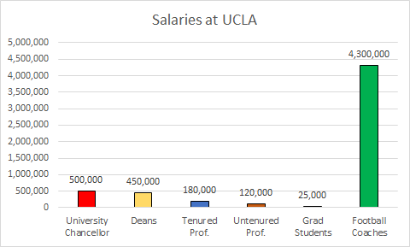
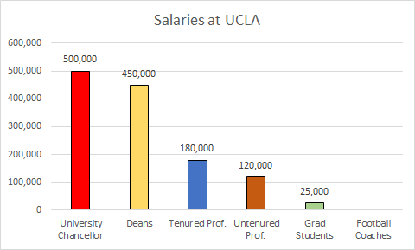
Module 3 · In Class · Examples · Wage Searchers
Are Real-World Wages = MRPL?
Search tool: https://ucannualwage.ucop.edu/wage/
Management 405 · Module 3 · Production and Costs
11
Notes:
Let's close this section with the obvious empirical question. In the real world, do wages actually line up with the marginal revenue product of labor? You can check for yourself. The University of California publishes every employee's salary, and the tool linked here lets you look people up. Broadly, the answer is yes. Better-paid roles tend to be the ones that add more revenue. But there are persistent gaps that economists still argue about, so treat the theory as a strong first approximation rather than the whole story.

Slide 12
Module 3 · Video 4 · Agenda
Outline of Module 3
1
Introduction to Module 3
Video 1
2
The Production Function
Video 2
3
Short Run: Hiring Decisions
Video 3
4
Wage Searchers
When hiring one more worker bids up the wage for everyone
Video 4
5
Long Run: The Optimal Input Mix
Video 5
6
Cost Concepts
Video 6
7
Economies of Scale and Scope
Video 7
Management 405 · Module 3 · Production and Costs
12
Notes:
One more wrinkle before we leave the short run. Everything so far assumed the firm can hire as many people as it wants at the going wage. That is fine for a small employer. It is not fine for a firm that is large in its local labor market, or that is bidding for very scarce talent. There the next hire raises the wage for everyone, and the true cost of that hire is well above the wage on the offer letter. That is what a wage searcher faces, and it is what the next few slides work out.

Slide 13

Module 3 · In Class · Examples · Wage Searchers
Example: The Full Cost of Poaching an AI Researcher
Anthropic is trying to poach a star researcher from Google DeepMind
  She would join Anthropic for a $5M annual salary
Anthropic already employs 2 star researchers, each earning $3.5M
  If the new researcher is hired, the existing two will demand the same salary
→ What is the marginal cost of the 3rd researcher?
Demis Hassabis (CC BY, C. Michel via Wikimedia)
Poll Break
Management 405 · Module 3 · Production and Costs
13
Notes:
Here is that idea in a very current setting, the AI talent wars. Suppose Anthropic wants to poach a star researcher from Google DeepMind. She will come for a salary of 5 million dollars a year. But Anthropic already employs two star researchers, each earning 3.5 million. The moment the new hire arrives on 5 million, the existing two are going to want the same. So the real question is, what is the full marginal cost of adding that third researcher? It is clearly more than her own salary, once you account for the raises the other two will demand. Take a moment to work out that full cost before we look at the answer.

Slide 14
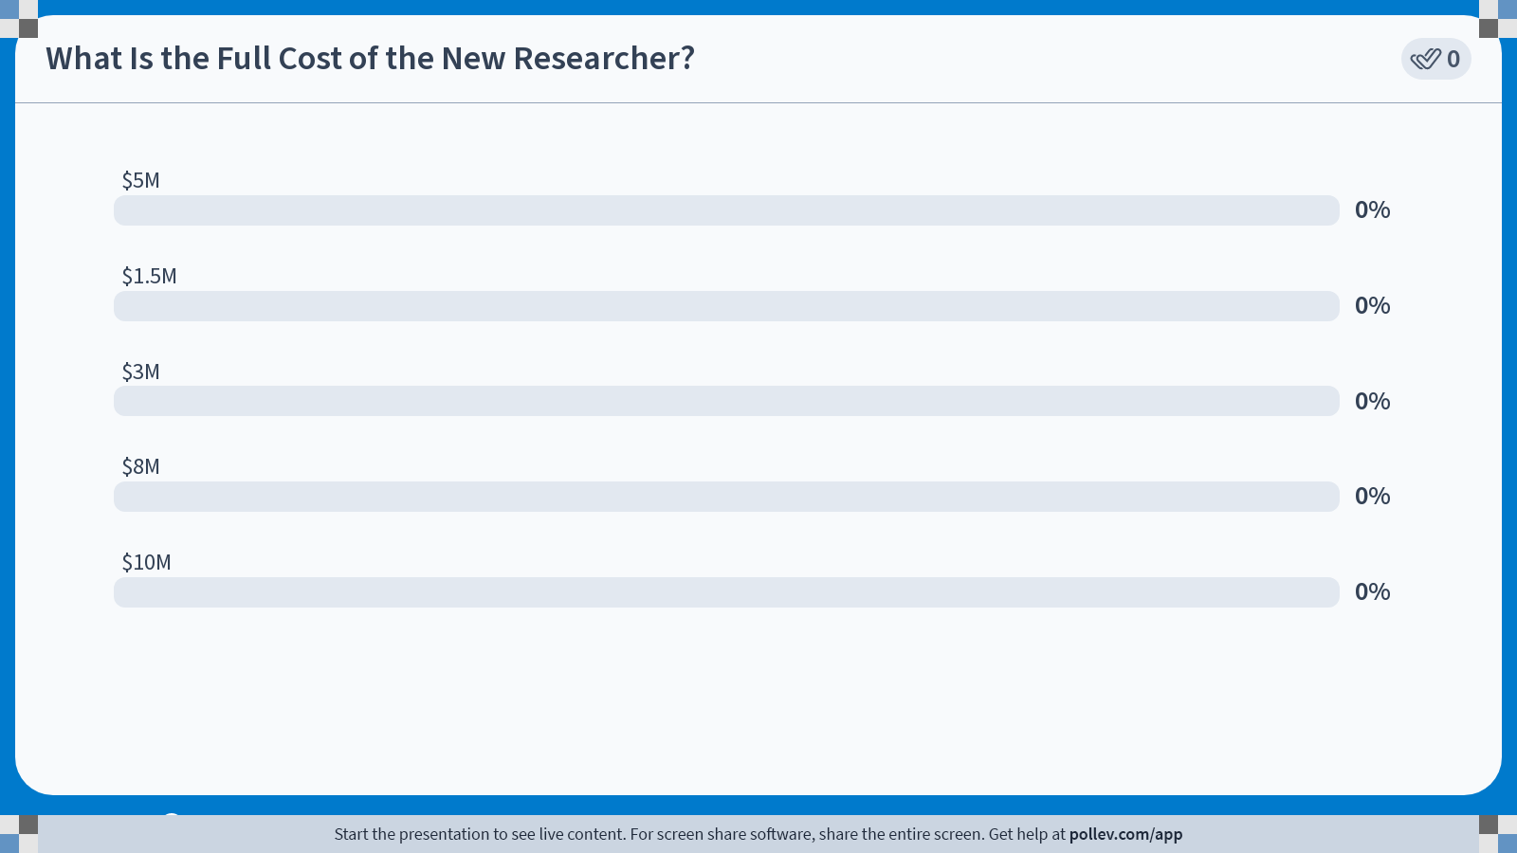
POLL
Notes:
Poll Title: Do not modify the notes in this section to avoid tampering with the Poll Everywhere activity.
More info at polleverywhere.com/support
What Is the Full Cost of the New Researcher?
https://www.polleverywhere.com/multiple_choice_polls/M4Af0onVPm5HB7kOEOIg0?state=opened&flow=Default&onscreen=persist

Slide 15
Module 3 · In Class · Examples · Wage Searchers
Solution: Marginal Cost of the 3rd Researcher = $8M
The star researcher herself is paid $5M
The two existing researchers each get a raise of ($5M − $3.5M) = $1.5M
Total extra wage bill: $5M + 2 × $1.5M
Full Marginal Cost of the 3rd researcher = $8M
Take-Away: Big buyers of scarce talent can affect wages — factor it in
Poll Break
Management 405 · Module 3 · Production and Costs
15
Notes:
Here is the full cost. The new researcher herself is paid 5 million dollars. But to keep things fair, each of the two existing researchers gets bumped from 3.5 million up to 5 million, a raise of 1.5 million each. So the total extra wage bill is her 5 million plus two times 1.5 million, which comes to 8 million dollars. So the full marginal cost of that third researcher is 8 million, not the 5 million on her contract. The lesson generalizes well beyond AI labs. When you are a big enough buyer of anything scarce, your own purchases move the market price, and you have to factor that in. Meta ran straight into this in 2024, when it paid up heavily to keep its AI researchers from leaving.

Slide 16
Module 3 · Video 5 · Agenda
Outline of Module 3
1
Introduction to Module 3
Video 1
2
The Production Function
Video 2
3
Short Run: Hiring Decisions
Video 3
4
Wage Searchers
Video 4
5
Long Run: The Optimal Input Mix
Choosing between capital and labor when both can be adjusted
Video 5
6
Cost Concepts
Video 6
7
Economies of Scale and Scope
Video 7
Management 405 · Module 3 · Production and Costs
16
Notes:
We now switch gears, from the short run to the long run. In the short run capital was stuck, and labor was our only lever. In the long run nothing is fixed. We get to choose both capital and labor from scratch. That opens a new question. What is the right mix of capital and labor to use? That is what the next several slides work out.

Slide 17

Module 3 · Video 5 · Long Run: The Optimal Input Mix
Optimal Combination of Inputs
Optimal Input Mix: How much K and how much L?
Decision rule for the long run:
$$\frac{{MP}_{K}}{p_{K}} = \frac{{MP}_{L}}{w}$$
MP_{K} : Marginal Product of Capital
MP_{L} : Marginal Product of Labor
pₖ : Price of Capital
w : Wage
Bang for the Buck Rule
  Holds when both L and K are flexible
  Refers to a given output quantity Q
  Assumes input prices w and pₖ are constant
▤ Teaching Note: Bang-for-the-Buck Rule
Management 405 · Module 3 · Production and Costs
17
Notes:
Here is the decision rule for the long run, and it has a name, the bang-for-the-buck rule. The idea is to spend each additional dollar on whichever input gives you the most extra output per dollar. Written out, it says the marginal product of capital divided by the price of capital should equal the marginal product of labor divided by the wage. In words, the extra output per dollar spent on robots should match the extra output per dollar spent on workers. The terms are on the slide. MPK and MPL are the marginal products of capital and labor, p-sub-k is the price of a robot, and w is the wage. Three conditions come with the rule. Both inputs have to be flexible, we hold the output quantity fixed, and we take the input prices as given. Notice that this is really the same marginal logic as the short-run hiring rule, just generalized to the choice between two inputs.

Slide 18
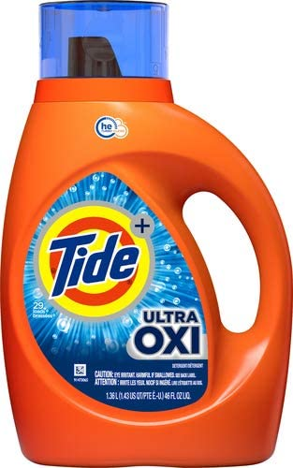
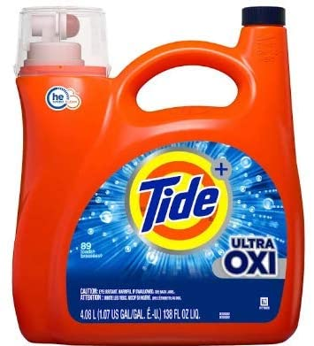
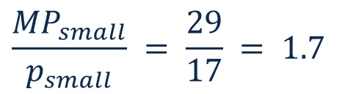
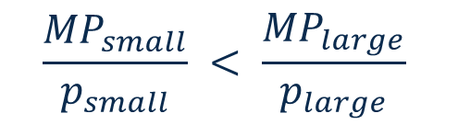
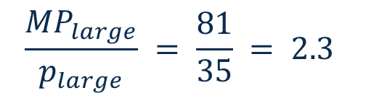
Module 3 · Video 5 · Long Run: The Optimal Input Mix
“Bang for the Buck” in Grocery Shopping
P&G offers two sizes for its flagship detergent
  Small Tide Ultra Oxi (29 loads) for $17
  Large Tide Ultra Oxi (81 loads) for $35
$$\frac{{MP}_{small}}{p_{small}} = \frac{29}{17} = 1.7$$
$$\frac{{MP}_{large}}{p_{large}} = \frac{81}{35} = 2.3$$
$$\frac{{MP}_{small}}{p_{small}} < \frac{{MP}_{large}}{p_{large}}$$
Bang-for-the-buck: a universal decision rule
Management 405 · Module 3 · Production and Costs
18
Notes:
This rule is not just for factories. You use it every week at the grocery store. Procter and Gamble sells Tide Ultra Oxi in two sizes. The small bottle does 29 loads for 17 dollars, and the large does 81 loads for 35 dollars. Work out the loads per dollar. The small bottle gives about 1.7 loads per dollar, and the large gives about 2.3. So the large bottle delivers more cleaning per dollar, and the bang-for-the-buck rule says buy the large one. It is exactly the same logic Rivian uses to choose between robots and workers, just a much smaller decision.

Slide 19
Module 3 · Long Run: The Optimal Input Mix
Applying the 'Bang for the Buck' Rule
('recipe' for exams)
How to adjust L and K in order to produce a given quantity at lower cost
If $\frac{{MP}_{L}}{w}$ > $\frac{{MP}_{K}}{p_{K}}$ → use more L and less K
  Decreasing marginal returns imply:
    Due to increased L, ${MP}_{L}$ will fall as L increases
    Due to reduced K, ${MP}_{K}$ will rise as K decreases
    Thus, the two fractions move closer to each other
If $\frac{{MP}_{L}}{w}$ < $\frac{{MP}_{K}}{p_{K}}$ → use less L and more K
…continue to adjust until $\frac{{MP}_{L}}{w} = \frac{{MP}_{K}}{p_{K}}$
Management 405 · Module 3 · Production and Costs
19
Notes:
Now the recipe for actually using the rule, the kind of thing worth having ready for an exam. Compare the two ratios, output per dollar on labor versus output per dollar on capital. If the labor ratio is higher, you are getting more output per dollar from workers, so shift toward labor, more workers and fewer robots. If the capital ratio is higher, shift the other way, toward more robots. Here is the nice part, the adjustment is self-correcting. As you add labor, diminishing returns pull the marginal product of labor down. As you pull back on capital, the marginal product of capital rises. So the two ratios move toward each other. You keep adjusting until they are equal, and that balance point is the optimal input mix.

Slide 20
Module 3 · Video 6 · Agenda
Outline of Module 3
1
Introduction to Module 3
Video 1
2
The Production Function
Video 2
3
Short Run: Hiring Decisions
Video 3
4
Wage Searchers
Video 4
5
Long Run: The Optimal Input Mix
Video 5
6
Cost Concepts
Fixed, variable, marginal, and sunk costs, and which ones matter
Video 6
7
Economies of Scale and Scope
Video 7
Management 405 · Module 3 · Production and Costs
20
Notes:
That wraps up production, the question of what to make and with which inputs. Now we turn to Part 2, costs. The question shifts to what it costs to produce, and just as importantly, which costs should actually drive a decision. That second part trips up a lot of smart people, so we spend real time on it.

Slide 21
Module 3 · Video 6 · Cost Concepts
Three Cost Types
Variable Costs
Fixed Costs
Sunk Costs
Depend on volume produced (Q)
→ Always consider!
Do not depend on quantity produced (Q)
→ Consider for long-run decisions
(entry, exit, capacity)
A fixed cost that
cannot be recovered
→ Ignore!
Examples
• Buy raw materials
• Hire workers
• Shipping & packaging
Examples
• Rent / lease payments
• Insurance & property tax
• R&D investments (for future innovation)
Examples
• Past R&D
• Past advertising
• Non-refundable deposits
Sunk costs should not affect managerial decisions
Management 405 · Module 3 · Production and Costs
21
Notes:
Let's sort costs into three buckets. First, variable costs. These rise and fall with how much you produce, things like raw materials, the workers you hire, and shipping. Because they change with output, you always weigh them in a decision. Second, fixed costs. These do not change with output, things like rent, insurance, and past R and D. They matter mainly for the big long-run choices, whether to enter, exit, or change capacity. Third, and the one to watch, sunk costs. A sunk cost is a fixed cost you have already spent and cannot get back. We give sunk costs their own slides next, because they are the ones people most often mishandle.

Slide 22

Module 3 · In Class · Examples · Cost Concepts
Cost Example: Dog Leashes
You produce dog leashes
  Already bought: lots of nylon yarn and a webbing loom (cannot be resold)
  You pay rent for the shop and employ sewing workers
Last month:
  Sold 1,000 leashes at P = $40
  TC = $35,000
Expected: you could sell 1,200 leashes at P = $35
Should you cut the price to $35?
Which cost information do you need to make a decision?
Group Discussion
Management 405 · Module 3 · Production and Costs
22
Notes:
Here is a short case to put the three cost types to work. You make dog leashes. You have already bought a large stock of nylon yarn and the webbing loom that weaves it into straps, you pay rent for the shop, and you employ sewing workers. Last month you sold 1,000 leashes at 40 dollars, and your total cost was 35,000 dollars. If you cut the price to 35 dollars, you expect to sell 1,200 leashes. Should you do it? Before you answer, ask yourself which cost information you actually need. Total cost alone cannot settle it, because it lumps together the yarn and the loom you have already paid for, the rent you owe either way, and the cost that rises with every extra leash you make. On the next slide we open up that total.

Slide 23
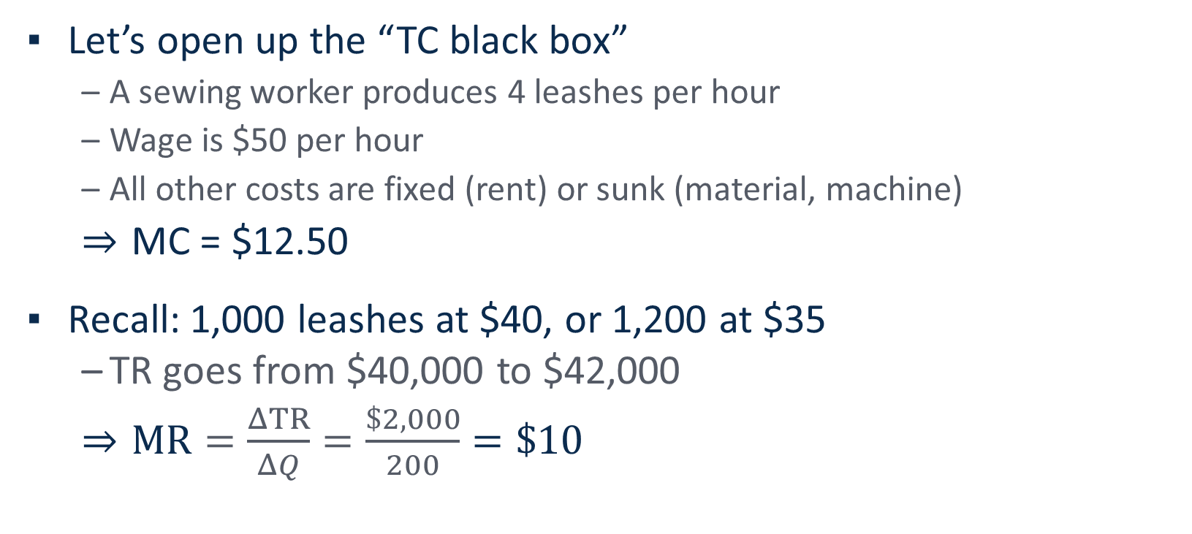
Module 3 · In Class · Examples · Cost Concepts
Solution: Compare MR and MC
Let’s open up the “TC black box”
  A sewing worker produces 4 leashes per hour
  Wage is $50 per hour
  All other costs are fixed (rent) or sunk (material, machine)
  MC = $12.50
Recall: 1,000 leashes at $40, or 1,200 at $35
  TR goes from $40,000 to $42,000
  $MR=\frac{ΔTR}{ΔQ}=\frac{\$2,000}{200}=\$10$
Thus, MR < MC, so we should not cut the price
Group Discussion
Management 405 · Module 3 · Production and Costs
23
Notes:
Now let's open up the total cost number. A sewing worker makes 4 leashes an hour and earns 50 dollars an hour, so the labor in one leash costs 50 divided by 4, which is 12 dollars and 50 cents. The yarn and the loom are already paid for, so they are sunk, and the rent is fixed: it is the same whether you make 1,000 leashes or 1,200. So the marginal cost of one more leash is the 12.50 dollars of labor. On the revenue side, 1,000 leashes at 40 dollars bring in 40,000 dollars, and 1,200 leashes at 35 dollars bring in 42,000 dollars. The extra 200 leashes add 2,000 dollars of revenue, so marginal revenue is 10 dollars per leash. Since marginal revenue of 10 dollars is below the marginal cost of 12.50 dollars, cutting the price would lower profit, by 500 dollars, so you should not do it. Notice that the 35,000 dollars of total cost never entered the calculation.

Slide 24
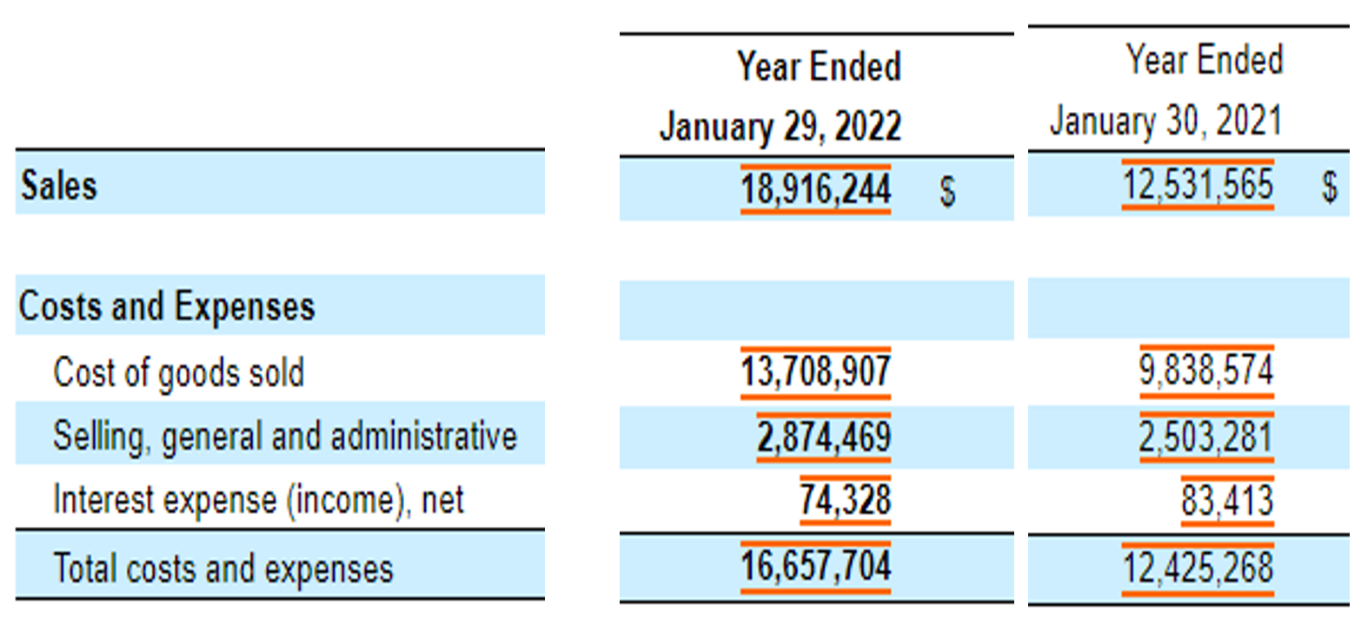
Module 3 · Video 6 · Cost Concepts
Relationship to Accounting: Ross Stores Annual Report
≈ TVC
Mix FC & VC
Part of FC
≈ TC
Management 405 · Module 3 · Production and Costs
24
Notes:
Let's connect these textbook terms to a real financial statement, using Ross Stores, the discount retailer. Pull up the costs and expenses section of their annual report and you will see three lines. The first is cost of goods sold, the merchandise they buy to sell. That rises and falls with sales, so it is essentially variable cost. The second is selling, general, and administrative expense, which is a mix. Sales commissions move with revenue, but the CEO's salary does not, so it is part fixed and part variable. The third is interest expense, the cost of servicing their debt, which does not move with sales, so it is fixed. Add them up and you get close to total cost. The point is that the fixed, variable, and marginal language we just defined maps directly onto the numbers a real company reports.

Slide 25
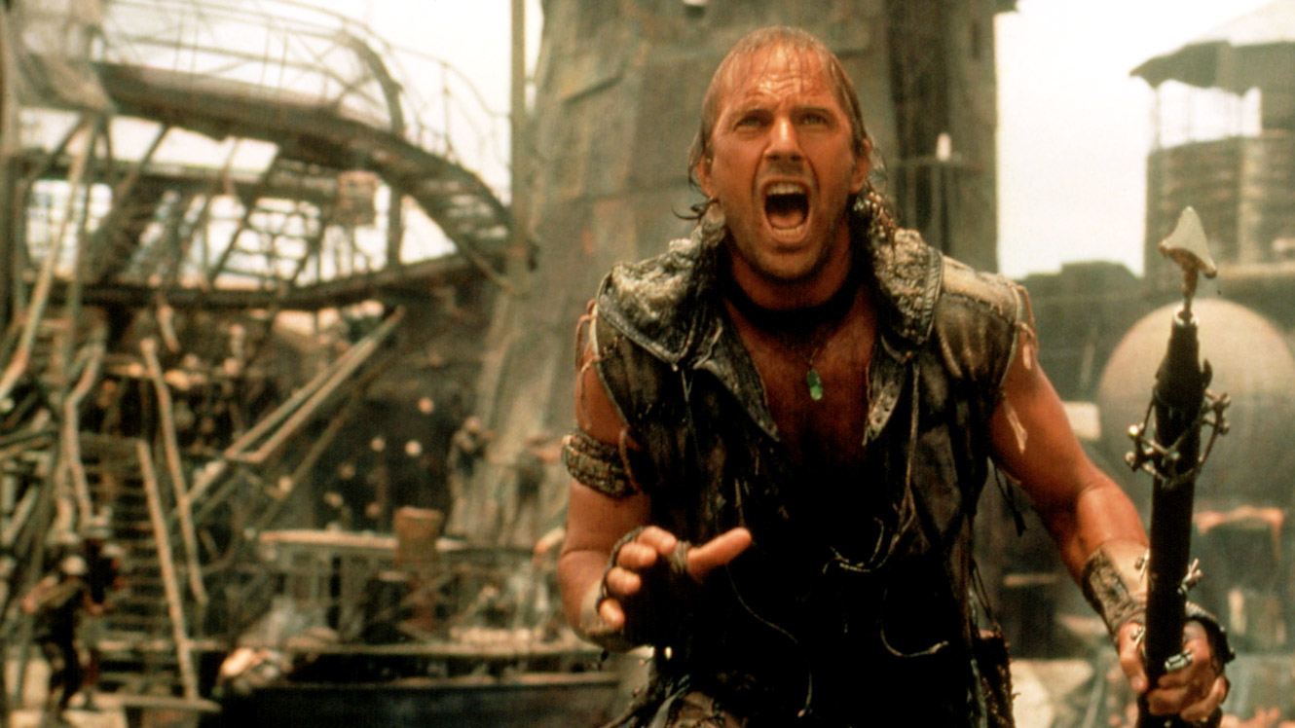
Module 3 · Video 6 · Cost Concepts
Why Studios Finish Movies They Know Lose Money
Waterworld (1995)
Management 405 · Module 3 · Production and Costs
25
Notes:
Let's make sunk costs concrete with a Hollywood story. In 1995 Universal released Waterworld, the Kevin Costner film. It ran famously over budget, and the studio had a strong sense it would flop. So why release it at all? The answer is all about sunk costs, and the next slide lays out the actual decision they faced.

Slide 26
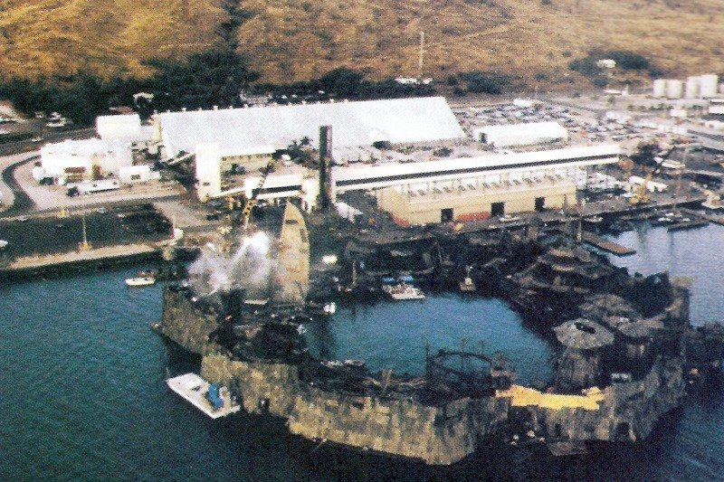
Module 3 · Video 6 · Cost Concepts
Waterworld: Sunk Costs and Decisions Over Time
June 1994
September 1994
December 1994
Expected Revenues ($M)
150
150
150
“slave colony”
Sunk Cost ($M)
16
100
140
Expected Additional Cost ($M)
84
40
35
Overall Cost (incl. sunk) ($M)
100
140
175
Expected Profit ($M)
+50
+10
−25
Decision
Make the film!
Make the film!
Make the film!
Ignore sunk costs — continue when Expected Revenue > Expected Additional Cost
Management 405 · Module 3 · Production and Costs
26
Notes:
Here is the decision the studio faced, tracked at three points in time as more money got spent. Look at June 1994 first. Expected revenue from releasing is 150 million dollars. At that point only 16 million had been sunk into production, and it would cost another 84 million to finish and release. Since 84 million to finish is well below the 150 million it brings in, you release, and you expect a 50 million dollar profit. Now move to September. More has been sunk, 100 million, but the cost still to come has dropped to 40 million. Forty million to finish against 150 million in revenue, so you still release. By December, 140 million is sunk and only 35 million remains to release. Now look at the overall column, which adds the sunk cost back in. On paper the total is 175 million against 150 million of revenue, so it looks like a 25 million dollar loss, and the instinct is to shelve it. But that is the sunk-cost trap. The 140 million is already gone whether you release or not. The only number that matters now is the 35 million it takes to release against the 150 million it earns. So you release every single time. The rule at the bottom says it cleanly, ignore sunk costs, and go ahead whenever the extra revenue beats the extra cost.

Slide 27

Module 3 · Video 6 · Cost Concepts
Marginal Cost in Action: What Is the MC of a Burn60 Workout?
Poll Break
Management 405 · Module 3 · Production and Costs
27
Notes:
Real-world setup for the marginal-cost concept. Burn60 (a boutique fitness studio) offers package pricing: 10 classes for $10 each ($100 total) or 20 classes for $8 each ($160 total). The question to put to the room: starting from the 10-pack, what's the marginal cost of the 11th class? Hint: it's not $8. Going from the 10-pack to the 20-pack costs an additional $60 for ten more classes — so the marginal cost of each of those next ten is $6, not the $8 sticker price. Average cost (per-unit price you see advertised) and marginal cost (what one more actually costs) diverge whenever there is volume-tier pricing. We poll the room on the next slide before walking through it.

Slide 28
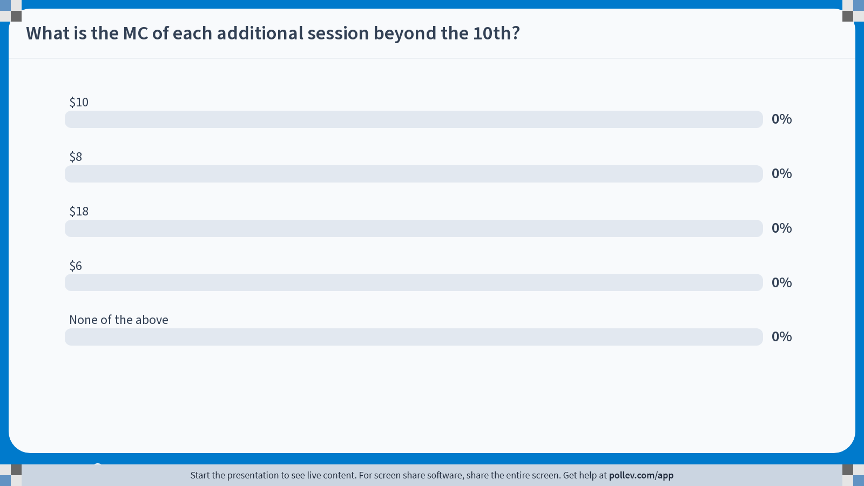
POLL
Notes:
Poll Title: Do not modify the notes in this section to avoid tampering with the Poll Everywhere activity.
More info at polleverywhere.com/support
What is the MC of each additional session beyond the 10th?
https://www.polleverywhere.com/multiple_choice_polls/bz2DVIeRRIPKKuFArIa8W?state=opened&flow=Default&onscreen=persist

Slide 29
Module 3 · Video 6 · Cost Concepts
Solution: MC = $6 per Additional Session
10-class pack ($10 / class)
20-class pack ($8 / class)
TC = 10 × $10 = $100
TC = 20 × $8 = $160
Marginal cost of each additional session beyond the 10th:
MC = ($160 − $100) / 10 = $6 / session
Bigger discount than the sticker: the first 10 sessions also drop from $10 → $8
Poll Break
Management 405 · Module 3 · Production and Costs
29
Notes:
Let's make marginal cost concrete with a small everyday example. Burn60 is a boutique fitness studio, and it sells class packs. A 10-class pack runs 10 dollars a class, so 100 dollars in total. A 20-class pack runs 8 dollars a class, so 160 dollars in total. Now here is the question. If you already have the 10-pack, what does each extra session actually cost you? The tempting answer is 8 dollars, the sticker rate on the bigger pack. But that is wrong. Going from the 10-pack to the 20-pack costs an extra 60 dollars, and that buys 10 more sessions. So the marginal cost of each additional session is 60 divided by 10, which is 6 dollars, not 8. Why is it even lower than the sticker rate? Because the bigger pack also re-prices the first ten sessions down from 10 dollars to 8. That saving on the sessions you were already buying is what pulls the true marginal cost below the sticker. The lesson is that with volume discounts, the marginal unit is cheaper than the average, so always price the decision at the margin.

Slide 30
Module 3 · Video 6 · Cost Concepts
Marginal Cost in Finance: The True Rate on a Bigger Loan
Option 1
Option 2
$100k loan
Extra $10k
$110k loan
at 5% annual interest
at 6% annual interest
%
Annual interest $5,000
%
Annual interest $6,600
≡
Total loan amount $100,000
≡
Total loan amount $110,000
$
Annual interest cost $5,000
$
Annual interest cost $6,600
What is the marginal interest rate on the additional $10k?
($6,600 − $5,000) / $10,000 = 16%
Marginal cost (16%) is much higher than average rate (6%)
Management 405 · Module 3 · Production and Costs
30
Notes:
The same marginal idea shows up in finance, and it can save you real money. Compare two loans. Option one is 100,000 dollars at 5 percent, which costs 5,000 dollars a year in interest. Option two is 110,000 dollars at 6 percent, which costs 6,600 dollars a year. So what is the true cost of that extra 10,000 dollars of borrowing? Do not look at the headline 6 percent, because that is the average rate on the whole loan. Look at the extra interest against the extra principal. You pay 1,600 dollars more to borrow 10,000 dollars more, and 1,600 over 10,000 is 16 percent. So the marginal rate on the last 10,000 dollars is a steep 16 percent, even though the loan is advertised at 6. Whenever you size up a bigger loan, ask what the extra dollars actually cost, not what the average rate is.

Slide 31
Module 3 · Video 7 · Agenda
Outline of Module 3
1
Introduction to Module 3
Video 1
2
The Production Function
Video 2
3
Short Run: Hiring Decisions
Video 3
4
Wage Searchers
Video 4
5
Long Run: The Optimal Input Mix
Video 5
6
Cost Concepts
Video 6
7
Economies of Scale and Scope
When bigger or broader production lowers cost per unit
Video 7
Management 405 · Module 3 · Production and Costs
31
Notes:
A quick transition. We have covered the cost concepts, fixed, variable, marginal, and average. Now we look at what happens in the long run, when the plant size itself can change. Three ideas are coming up. How long-run and short-run cost curves relate, how the long-run average cost curve is built as an envelope, and economies of scale.

Slide 32
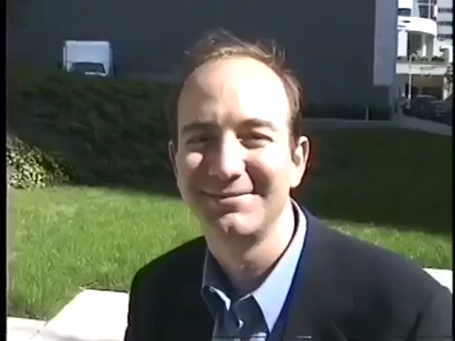
Module 3 · Video 7 · Economies of Scale and Scope
Amazon: Economies of Scale, Scope, or Both?
Jeff Bezos · 1997 interview
Group Discussion
Management 405 · Module 3 · Production and Costs
32
Notes:
To kick off the Amazon discussion, let's watch a short clip of Jeff Bezos from a 1997 interview. That was the year Amazon went public, when it was still, in his own words, just an online bookstore. Listen for how he describes the flywheel, where more selection and lower prices bring in more customers and more volume. Keep that in mind, because that same flywheel is what later grows into both huge scale and enormous scope. Let's play it.

Slide 33
Module 3 · Video 7 · Economies of Scale and Scope
Solution: Amazon: Economies of Scale, Scope, or Both?
Amazon is the textbook case for BOTH at once
Economies of SCALE
Economies of SCOPE
AWS (Amazon Web Services) – massive data-center fixed costs spread over huge volume
Fulfilment network density (FBA – Fulfilment by Amazon)
Bargaining power with suppliers
Prime = shipping + video + music + grocery
Customer data shared across retail / ads / AWS
Devices (Alexa, Kindle) lever the brand
Group Discussion
Management 405 · Module 3 · Production and Costs
33
Notes:
Now the discussion. Amazon is the textbook case of a company enjoying both economies of scale and economies of scope at once, and the interesting exercise is to say exactly where each one shows up. Start with scale. Amazon Web Services is a massive fixed-cost business, huge data centers whose cost gets spread across millions of customers. The fulfilment network gets cheaper per package the denser it becomes. And sheer size gives Amazon bargaining power with its suppliers. Now scope. Prime bundles shipping, video, music, and grocery into one subscription. Customer data created in the retail business feeds advertising and even AWS. The devices tie it all together. So as you look at each Amazon business, ask yourself, is this scale, is this scope, or is it both at once?

