Slide 1
Competitive Markets and Market Interventions
Module 4
Management 405
Prof. Nico Voigtländer · UCLA Anderson

Slide 2
Module 4 · Video 1 · Course Roadmap
Agenda for the Class
1. Basic Principles and Economic Way of Thinking
2. Value and Demand
3. Supply and Cost
4. Markets, Pricing, and Strategy
we are here
Management 405 · Module 4 · Competitive Markets and Market Interventions
2

Slide 3
Module 4 · Video 1 · Agenda
Outline of Module 4
1
Introduction to Market Structures
Where a firm sits between price taker and price setter
Video 1
2
Perfect Competition
Many small sellers, an identical product, and free entry
Video 2
2a
Profit Maximization of a Price Taker in the Short Run
How much to produce, and when to stop production
Video 3
2b
Firm-Level and Market Supply
Marginal cost is one firm’s supply curve; market supply sums across firms
Video 4
2c
Long-Run Competitive Equilibrium
Entry and exit drive economic profits to zero
Video 5
3
Market Distortions and Regulations
Who wins, who loses, and what is lost outright
In Class
4
Externalities
Costs and benefits that land on people outside the deal
In Class
Management 405 · Module 4 · Competitive Markets and Market Interventions
3

Slide 4
Module 4
In-Class Part
Management 405 · Module 4 · Competitive Markets and Market Interventions
4
Notes:
From here on we are in the classroom. The videos covered market structures, profit maximization of a price taker in the short run, market supply, and long-run competitive equilibrium. In class we first apply that material, and then turn to market distortions and externalities.

Slide 5
Some Applications of the Material
Covered in the Videos
Management 405 · Module 4 · Competitive Markets and Market Interventions
5
Notes:
The next stretch of slides applies what the videos covered on price takers in the short and the long run. These are applications rather than a new topic, which is why they are not a separate item on the module outline.

Slide 6
Module 4 · Video 1 · Introduction to Market Structures
The Four Basic Market Structures
 | Perfect Competition | Monopolistic Competition | Oligopoly | Monopoly
Number of firms | Many | Many | Few | One
Type of products sold | Identical | Differentiated | Identical or Differentiated | “Unique”
Barriers to entry | None | None | Some | Many
More firms, more similar products, easier entry, more competition
Management 405 · Module 4 · Competitive Markets and Market Interventions
6
Notes:
Here we start thinking about a firm’s competitive environment or market structure. We categorize market structure using three characteristics:
1. Number of firms: in general, when there are more companies in the market, the market is more competitive.
2. Whether the consumer cares which company made the good: are the goods identical or can the consumer distinguish who made the good? In general, if goods are closer to identical, the market is more competitive.
3. Barriers to entry: if new firms can enter the market easily, the market is more competitive.

Slide 7

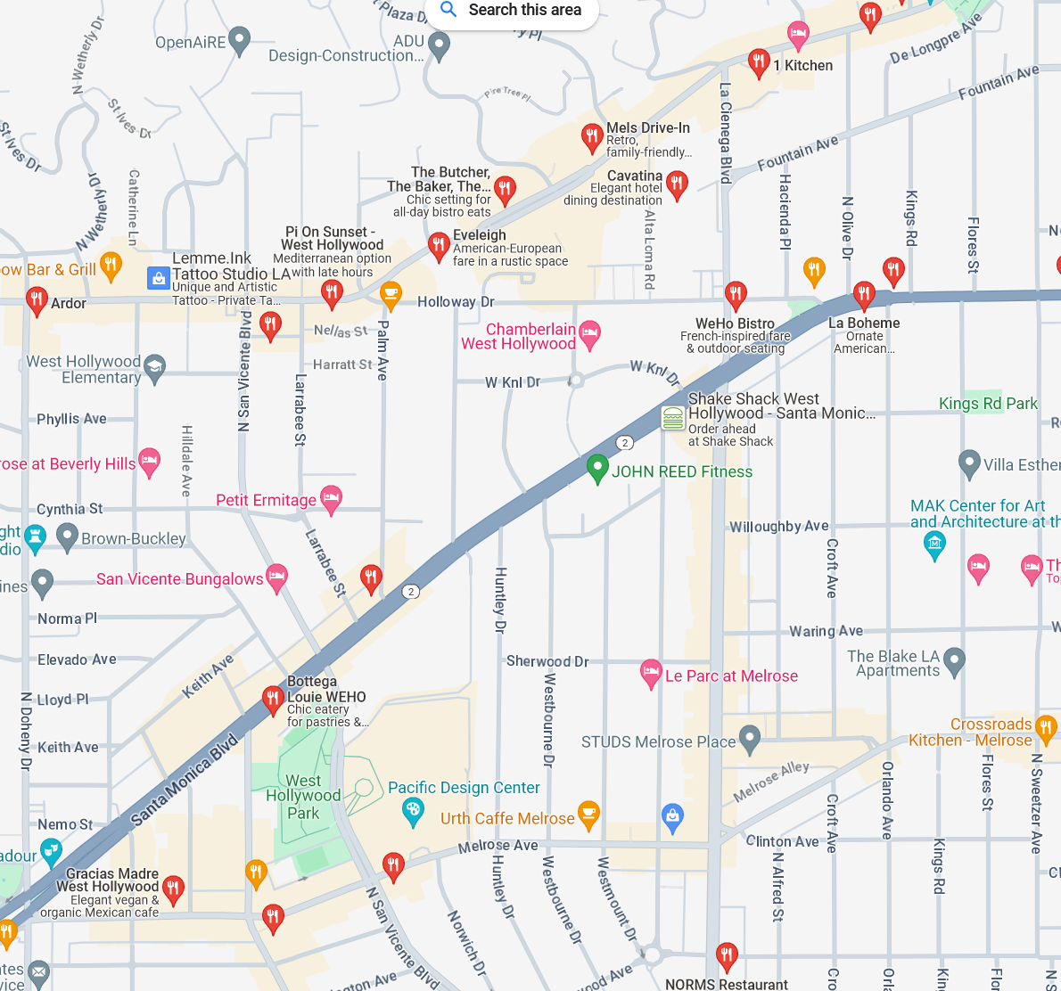



Module 4 · Video 1 · Introduction to Market Structures
Extent of Market Power: Price Takers vs. Price Searchers
Least Market Power
Most Market Power
Perfect
Competition
Monopolistic
Competition
Oligopoly
Monopoly
(Price Takers)
(Price Searchers)
Commodity markets
Restaurants in WeHo
Wide-body aircraft
Municipal utilities
TODAY
Management 405 · Module 4 · Competitive Markets and Market Interventions
7
Notes:
Extent of market power. The spectrum runs from price taker (today’s topic) to price searchers with increasing degrees of market power (subject of subsequent sessions):
A perfectly competitive firm has no market power; it has such a small percentage of the market that it can exert no effect on price.
A monopolistically competitive firm, such as gas stations and restaurants, offers a differentiated product and thus faces a downward sloping demand curve – offerings of other firms are not perfect substitutes. There is still intense competition because the products can substitute for each other so the elasticity of demand facing each firm tends to be high. Free entry drives long-run profits to zero.
Oligopolistic markets are cases of few firms. For example, a duopoly is a special case of an oligopoly with only 2 firms. Interesting strategic issues arise here as you need to think hard about your rivals’ response to your firm’s behavior. Entry may be limited.
Monopolistic markets are markets with only one seller, such as utilities in most cities (legal monopoly) or Microsoft (quasi-monopoly, due to demand-side economies of scale, i.e. network effects).

Slide 8
Module 4 · Video 2 · Perfect Competition
Perfect Competition: The Market and the Firm
Market
Firm (price taker)
Price ($)
Price ($)
Market
equilibrium
S
P*
Demand curve d = Marginal Revenue (MR)
P*
D
Quantity
Quantity
Management 405 · Module 4 · Competitive Markets and Market Interventions
8
Notes:
This slides explain the relationship between the market vs. the firm demand. It shows where the demand a price taker is coming from = market price, determined by the market equilibrium.
Now, let’s turn to see how a price taker maximizes profit in the short run.

Slide 9
Module 4 · Video 3 · Profit Maximization of a Price Taker in the Short Run
Maximizing Profits in the Short Run: The General Case
Profit Levels for Different Market Prices
Positive Profit
Zero Profit
Negative Profit (Loss)
P
MC
P
MC
P
MC
P
d = MR
π > 0
ATC
ATC
ATC
P
d = MR
π < 0
d = MR
P
P > ATC at Q*
P = ATC at Q*
P < ATC at Q*
Q*
Q
Q*
Q
Q*
Q
Management 405 · Module 4 · Competitive Markets and Market Interventions
9
Notes:
To measure profit, we subtract total cost from total revenue.
Profit = TR – TC
We can rewrite this as:
Profit = P*Q – ATC*Q
Profit = (P – ATC)*Q
This formula determines whether the firm has positive, zero, or negative profit.
Positive profit: In this figure, the firm’s total revenue is the area of the rectangle with height P and width Q*. The total cost is the area of the rectangle with the height ATC* and the width Q*. Because total revenue exceeds total costs at Q*, the firm is earning positive profits. This equation tells us that profit is positive when P>ATC at the profit maximizing quantity Q*.
Zero profit: Here P=ATC (=MC). We know that MC intersects ATC at its minimum.
Negative profit: P<ATC

Slide 10
Module 4 · Video 5 · Long-Run Competitive Equilibrium
Long-Run Competitive Equilibrium With Many Identical Producers
Competitive Markets: Large number of (actual and potential) firms that have the same cost structure and compete with each other
P
LMC
LAC
P₁
MR = P₁
Entry
P_{LR}
MR = P_{LR}
Exit
P₂
MR = P₂
Q₂
Q_{LR}
Q₁
Q
At Q_{LR}: P = LAC = LMC, and economic profit is zero
Management 405 · Module 4 · Competitive Markets and Market Interventions
10
Notes:
LAC is downward sloping because of economies of scale initially, and then upward-sloping because of dis-economies of scale. Note that this is different from ATC being down-ward sloping because of Fixed costs of a GIVEN technology.

Slide 11
Module 4 · Video 5 · Long-Run Competitive Equilibrium
Long-Run Equilibrium: The Drug Market
Can we use the toolbox on the market for illegal drugs?
  Assume individual dealers are price takers
The government has two one-time options:
1
Arrest the drug dealers
2
Arrest or punish the drug users
Which policy does more to reduce the use of illegal drugs?
Management 405 · Module 4 · Competitive Markets and Market Interventions
11
Notes:
Now the toolbox goes somewhere less comfortable. Treat individual drug dealers as price takers in a competitive market, and the entry-and-exit logic we just built tells you what happens when policy targets sellers rather than buyers. The two slides that follow work through each case.
Can we characterize the drug market as a “constant cost industry?” → Yes.
Fixed cost: gun, car…
Variable cost: drugs
Same for each dealer

Slide 12
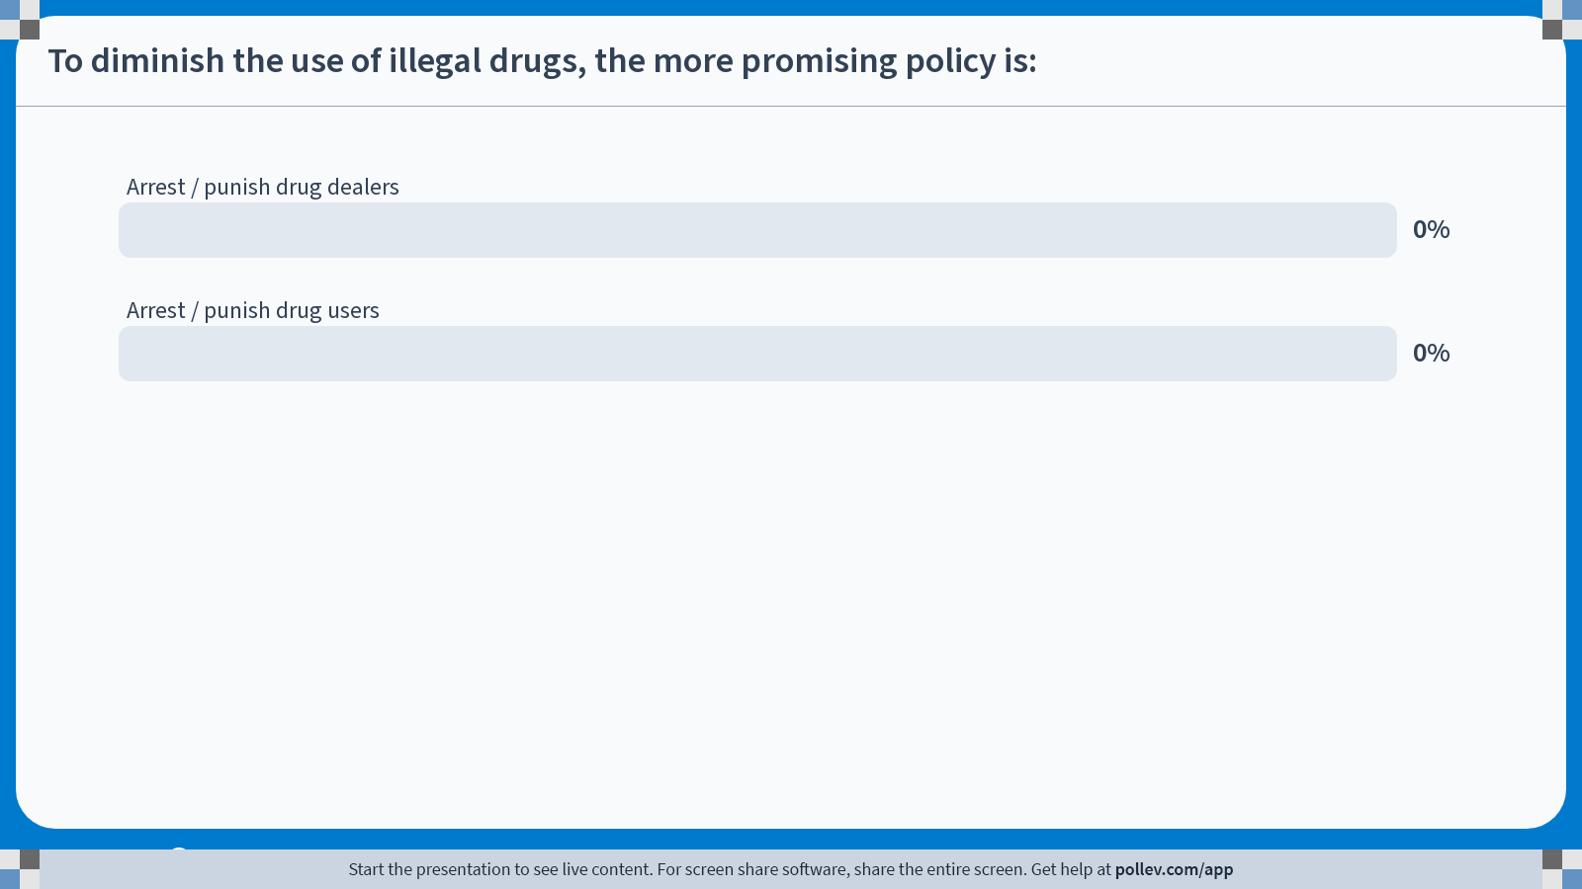
Notes:
Poll Title: Do not modify the notes in this section to avoid tampering with the Poll Everywhere activity.
More info at polleverywhere.com/support
To diminish the use of illegal drugs, the more promising policy is:
https://www.polleverywhere.com/multiple_choice_polls/SvRjzmwXUb4CnEPPO8MVg?state=opened&flow=Default&onscreen=persist

Slide 13
Module 4 · Video 5 · Long-Run Competitive Equilibrium
Arrest Drug Dealers
Management 405 · Module 4 · Competitive Markets and Market Interventions
13
Notes:
Arresting dealers raises the cost of supplying, which shifts supply back. Quantity falls, but the price rises - so revenue in the market can easily go UP, and the surviving dealers make more per unit. That is the uncomfortable arithmetic behind supply-side enforcement.
SR effect: More drugs supplied by remaining dealers at higher P. Profits!
LR effect: Entry → Return to old equilibrium.

Slide 14
Module 4 · Video 5 · Long-Run Competitive Equilibrium
Arrest / Punish Drug Users
Management 405 · Module 4 · Competitive Markets and Market Interventions
14
Notes:
Going after users works on the other side of the market. Demand shifts back, so both quantity and price fall. Dealers make less, and the trade shrinks on both counts - which is why economists generally favour demand-side policy here.
SR effect: Less drugs supplied by each dealer. Loss!
LR effect: Exit → Converge to new equilibrium with less drugs consumed!

Slide 15
Module 4 · Agenda
Outline of Module 4
1
Introduction to Market Structures
Video 1
2
Perfect Competition
Video 2
2a
Profit Maximization of a Price Taker in the Short Run
Video 3
2b
Firm-Level and Market Supply
Video 4
2c
Long-Run Competitive Equilibrium
Video 5
3
Market Distortions and Regulations
Who wins, who loses, and what is lost outright
In Class
4
Externalities
In Class
Management 405 · Module 4 · Competitive Markets and Market Interventions
15

Slide 16
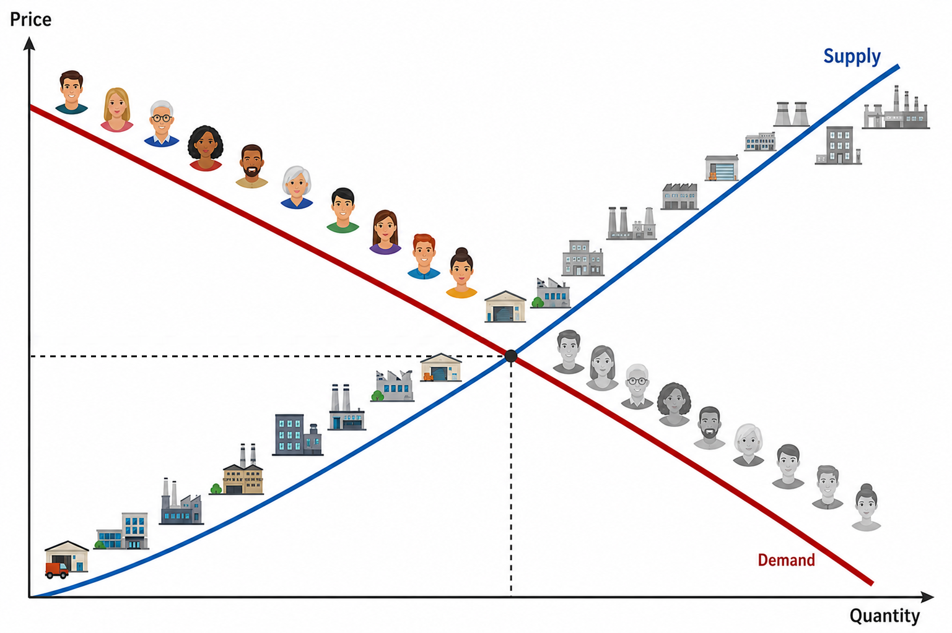
Module 4 · Market Distortions and Regulations
Welfare in a Market Economy and Distortions: Introduction
In a competitive market, equilibrium is where supply meets demand
Outside forces can push the market away from it
  Price controls — rent control, minimum wages
  Taxes and subsidies
How do we tell who gains and who loses?
  Consumer and producer surplus
  Deadweight loss
A competitive market with many consumers and producers
Management 405 · Module 4 · Competitive Markets and Market Interventions
16
Notes:
This section is about what happens when something pushes a market away from its competitive equilibrium - price controls, taxes, subsidies. The tools we need are consumer surplus, producer surplus and deadweight loss, and the next three slides build them.

Slide 17
Module 4 · Market Distortions and Regulations
Consumer Surplus
CS: the gap between what consumers would pay (the D curve) and what they do pay (P*)
P
S
Consumer surplus (CS) is the area below the demand curve and above the price line
What buyers were willing to pay, less what they actually paid
CS
P*
D
Q*
Q
Management 405 · Module 4 · Competitive Markets and Market Interventions
17
Notes:
Price consumers would be willing to pay = MPV we have seen in Module 2
We can tell them to check in the textbook how to compute CS from the demand curve (triangle area) + that it will be covered by the TA

Slide 18
Module 4 · Market Distortions and Regulations
Producer Surplus
PS: the gap between the price at which producers would sell (the S curve) and what they do receive (P*)
P
S
Producer surplus (PS) is the area above the supply curve and below the price line
What sellers received, less the least they would have accepted
P*
PS
D
Q*
Q
Management 405 · Module 4 · Competitive Markets and Market Interventions
18
Notes:
In this example PS>CS but it all depends on the relative steepness of the D and S curves
Willingness to sell depends on the producer cost structure

Slide 19


Module 4 · Market Distortions and Regulations
Market Distortions: Deadweight Loss
The inefficiency that a market intervention creates
Mutually beneficial transactions that no longer happen
  Workers willing to work at the market wage and firms willing to hire them — but a minimum wage stands in the way
$$Deadweight loss = {Welfare}_{free market} − {Welfare}_{regulation}$$
$$with Welfare = CS + PS$$
Management 405 · Module 4 · Competitive Markets and Market Interventions
19
Notes:
Deadweight loss is the value that simply disappears - trades that both sides would have been happy to make, which the intervention prevents. It is the difference between total welfare in the free market and total welfare under the regulation, where welfare means consumer surplus plus producer surplus.

Slide 20
Module 4 · Market Distortions and Regulations
Sales Tax: a 10 % Tax on Top of the Listed Price
P
Price received by the seller (P_{S}) drops.
Total price paid by the buyer (P_{B}, inclusive of tax) increases, but by less than the tax.
S’
S
tax (t)
The buyers lose A + B
P_{B}
A
B
The sellers lose C + D
P_{B} − P_{S} = t
P₀
C
D
P_{S}
Deadweight loss: B + D
The government gets A + C
Taxes on some goods (e.g. cigarettes, gasoline…) can still make sense due to externalities (more below)
D
Q₁
Q₀
Q
✎ Problem Set 3
Management 405 · Module 4 · Competitive Markets and Market Interventions
20
Notes:
Example: gasoline
The welfare losses and incidence (who pays the tax) depends on elasticities of demand and supply. For example, if supply is perfectly elastic (the supply curve is horizontal), all of the tax is paid by the consumers.
The analysis of a subsidy is similar, except the demand (or supply) curve will shift outward.

Slide 21
Module 4 · Market Distortions and Regulations
Tax Incidence: Who Really Pays?
Tax incidence: which side of the market — buyers or sellers — ends up bearing the burden of the tax
Who hands the money to the government does not matter
  The incidence is the same whether the tax is collected from the buyer or from the seller
What matters is the elasticity of supply and demand
  The side that responds less to price bears more of the tax
The less elastic side of the market pays the larger share of a tax
Management 405 · Module 4 · Competitive Markets and Market Interventions
21
Notes:
Here is the point that surprises most people. It does not matter which side of the market physically hands the money to the government - the burden splits the same way either way. What determines the split is elasticity: whichever side responds less to price ends up paying more of the tax.

Slide 22
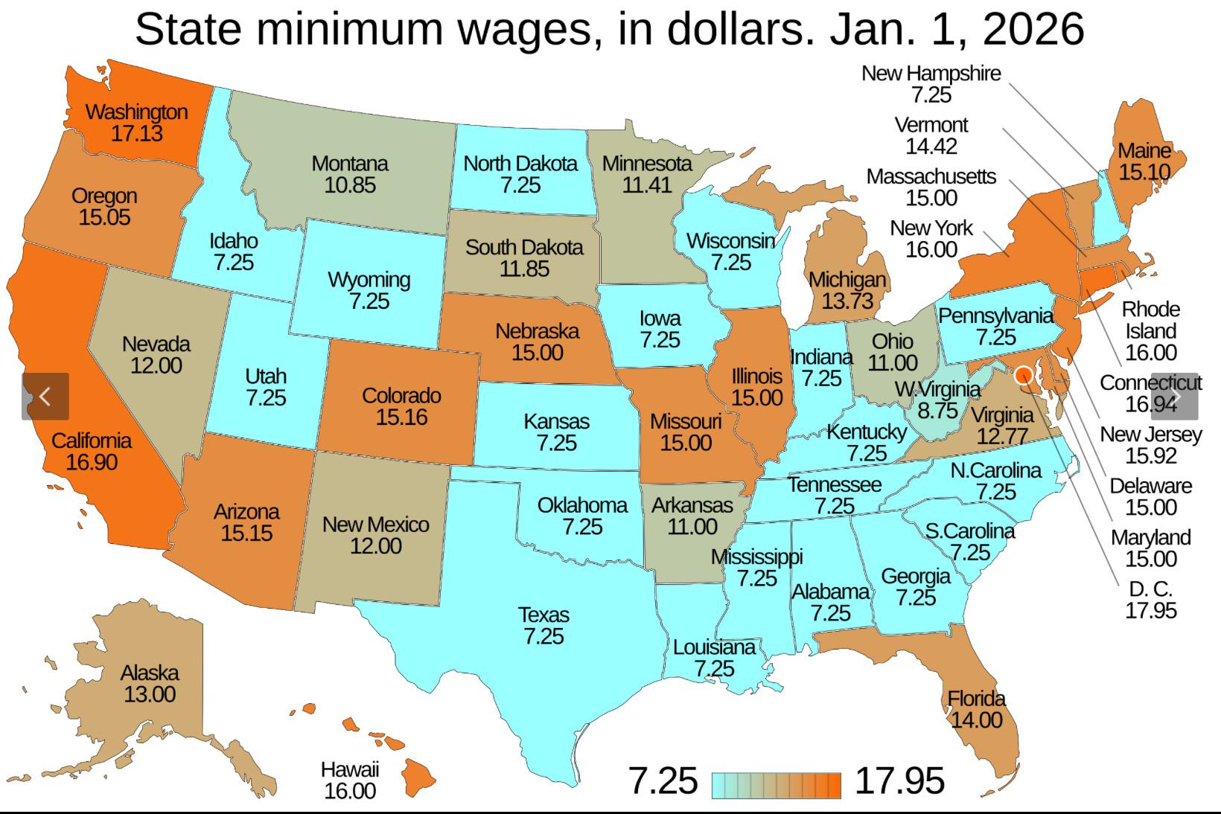
Module 4 · Market Distortions and Regulations
The Minimum Wage: A Popular Policy Tool
Source: Wikipedia / US Department of Labor
Management 405 · Module 4 · Competitive Markets and Market Interventions
22
Notes:
Before the theory, some context. Minimum wages are one of the most widely used price floors in the world, and the map shows how much the level varies across US states. Keep that variation in mind - it is what makes the empirical evidence possible.

Slide 23
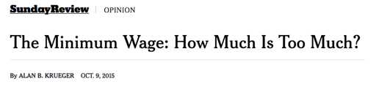
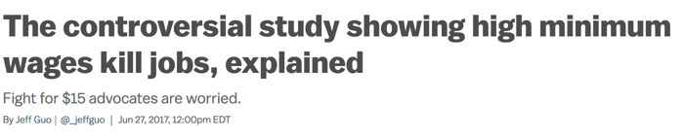

Module 4 · Market Distortions and Regulations
Podcast: What Does the Evidence Say on the Minimum Wage?
What is the expected effect of raising the minimum wage on employment?
  According to economic theory: Negative
Evidence: Mixed results
  Employment does not seem to decline, BUT:
  Hours worked decline (Seattle study)
    Experienced workers: moderate decline in hours, so total income ↑
    Low-skilled, inexperienced workers: substantial decline in hours and thus income ↓
    New workers: harder to find first job
What are possible long-run effects of a (high) minimum wage?
One way firms respond to a higher wage floor
Management 405 · Module 4 · Competitive Markets and Market Interventions
23
Notes:
This is the podcast slide. The theory says a minimum wage should reduce employment, but the evidence is genuinely mixed: employment itself often does not fall much, while hours worked do. Listen for the distinction between experienced workers, whose total income can still rise, and low-skilled or new entrants, who tend to lose on both counts.
https://www.epi.org/minimum-wage-tracker/

Slide 24
Module 4 · Market Distortions and Regulations
Price Floor: The Minimum Wage
Wage
Welfare effects
S_{Labor}
Some workers win A — they are paid more
Some workers lose C — they are not hired
Firms lose A + B
w_{min}
A
B
Deadweight loss: B + C
w*
C
Circumvention of minimum wages?
  Underground labor market
  Cutting non-wage benefits
  Unpaid internships
D_{Labor}
L_{D}
L*
L_{S}
Labor
L_{S} − L_{D} = unemployment
Management 405 · Module 4 · Competitive Markets and Market Interventions
24
Notes:
The minimum wage as a price floor. Set above the market wage, it raises the wage for those who keep their jobs (area A), but firms hire fewer workers, so some who would have worked do not (area C). The gap between labour supplied and labour demanded at the floor is unemployment, and B plus C is the deadweight loss.

Slide 25
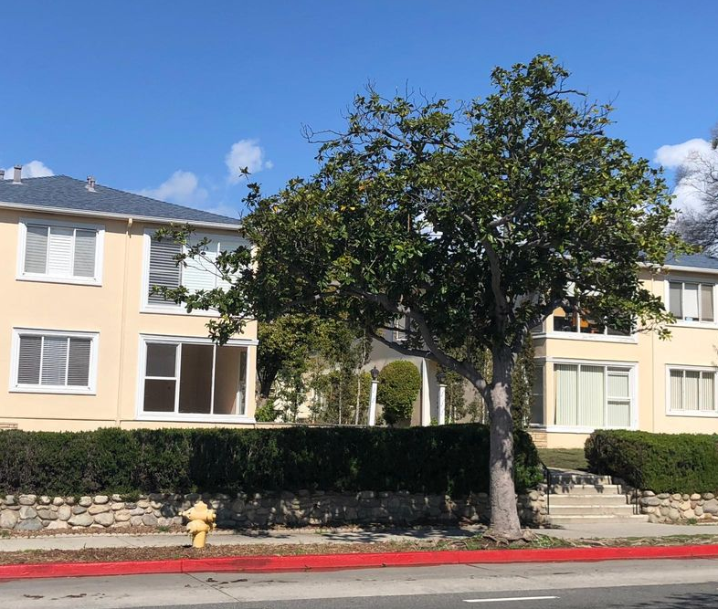
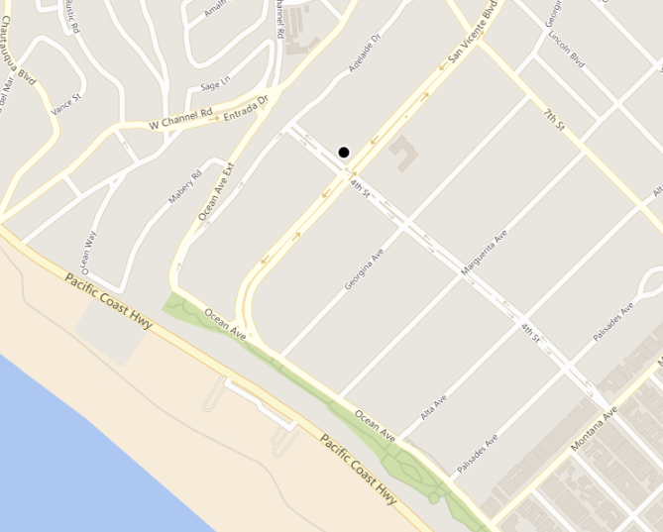
Module 4 · Market Distortions and Regulations
Guess the Rent!
1 bed, 1 bath
900 sqft
401 San Vicente Blvd., Santa Monica
  5-minute walk to the beach
  Best public school district in West LA
Poll Break
Management 405 · Module 4 · Competitive Markets and Market Interventions
25
Notes:
Before we do rent control, a quick calibration exercise. Look at the flat, the location and the map, and write down what you think it rents for. Hold your number - the answer on the next slide is usually a surprise.

Slide 26
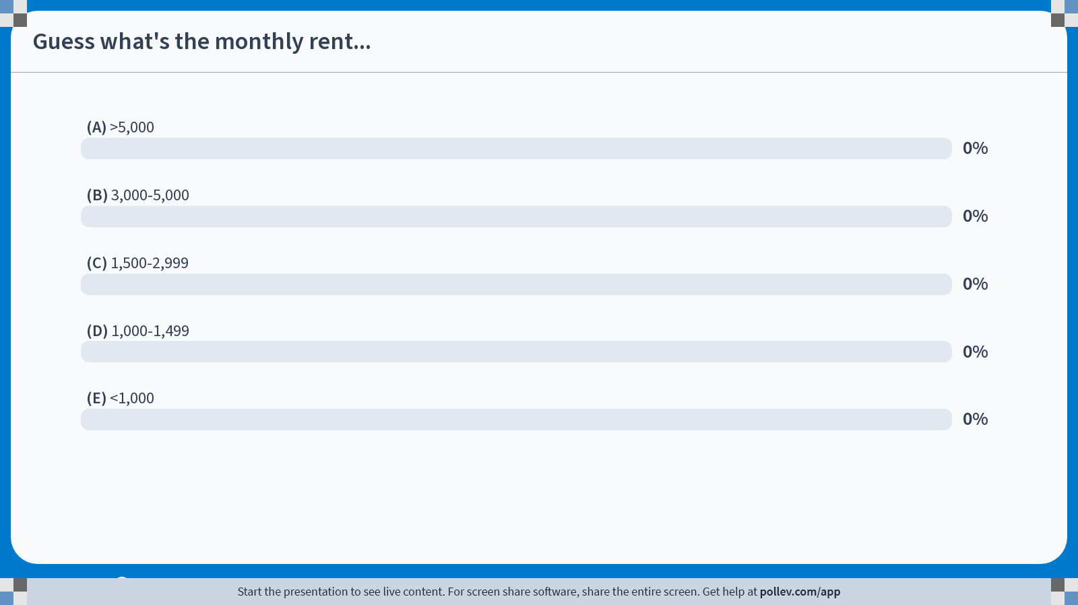
Notes:
Poll Title: Do not modify the notes in this section to avoid tampering with the Poll Everywhere activity.
More info at polleverywhere.com/support
Guess what's the monthly rent...
https://www.polleverywhere.com/multiple_choice_polls/Ba4892DreAxLjvidjmrOV?state=opened&flow=Default&onscreen=persist

Slide 27
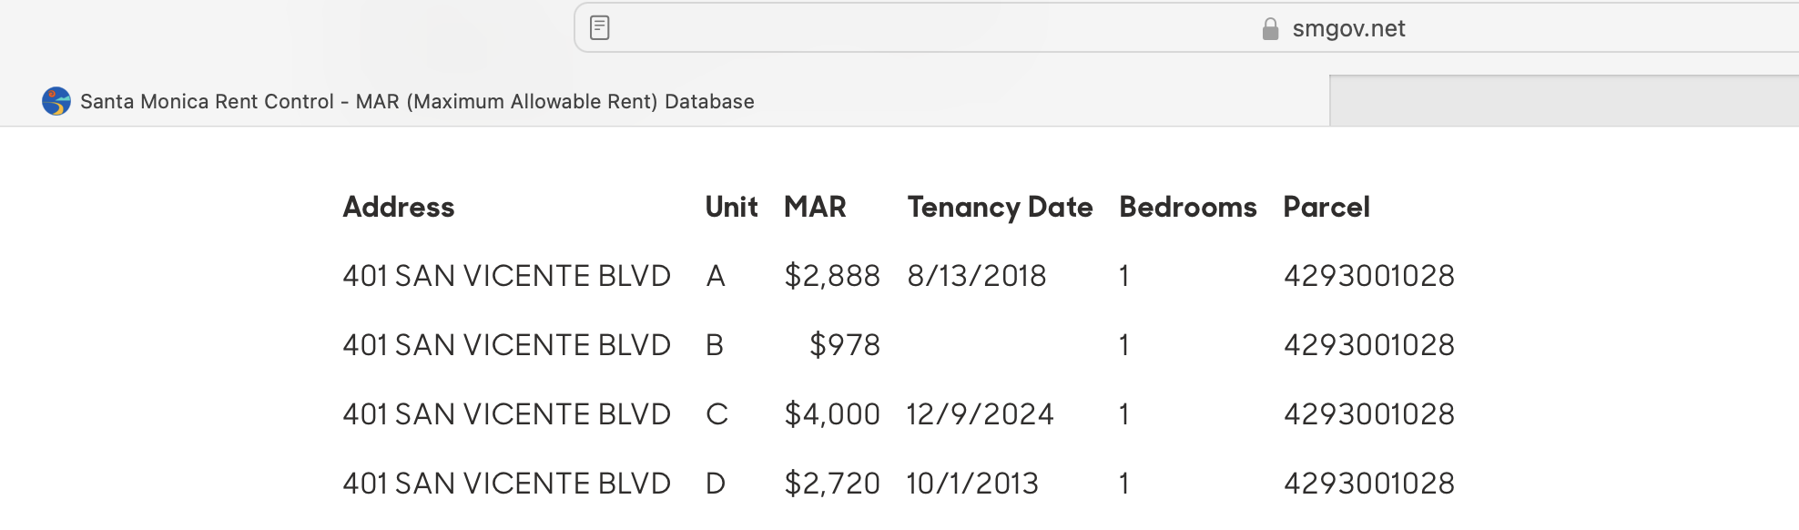
Module 4 · Market Distortions and Regulations
The Rent Is…
Poll Break
Management 405 · Module 4 · Competitive Markets and Market Interventions
27
Notes:
Here is the answer. The unit is rent-controlled, and the Maximum Allowable Rent on the city's own database is far below what the neighbouring units fetch. That gap between the controlled rent and the market rent is the whole subject of the next few slides.
https://www.smgov.net/departments/rentcontrol/mar.aspx

Slide 28
Module 4 · Market Distortions and Regulations
Price Ceiling: Rent Control
P
Welfare effects
S
Some renters win A — those who keep a place
Some renters lose B — they cannot find one
Landlords lose A + C
B
P*
C
Deadweight loss: B + C
A
P_{max}
D
Q_{S}
Q*
Q_{D}
Q
Q_{D} − Q_{S} = shortage
Management 405 · Module 4 · Competitive Markets and Market Interventions
28
Notes:
Rent control is the mirror image: a ceiling below the market price. Renters lucky enough to hold a place gain (area A), but landlords list fewer flats, so the quantity supplied falls and a shortage opens up between what renters want and what is offered. B plus C is again the deadweight loss.

Slide 29
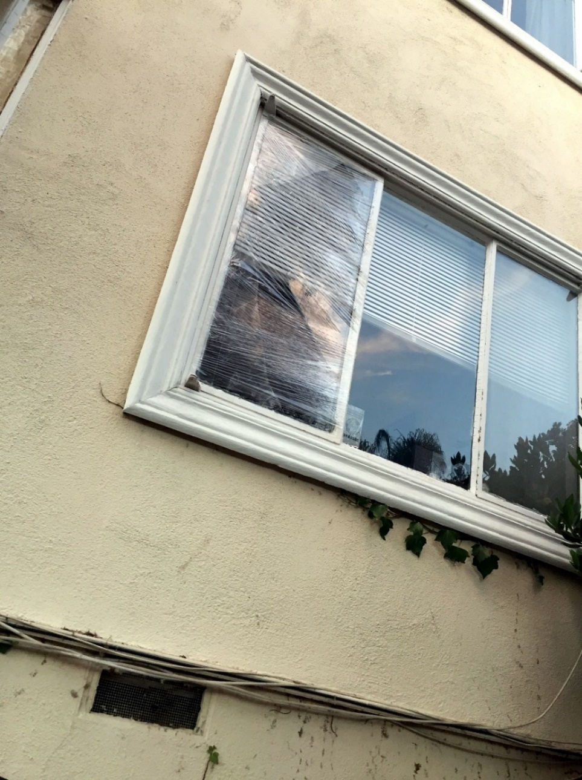

Module 4 · Market Distortions and Regulations
How Do Landlords React to Rent Control?
Non-price adjustments (e.g. neglect maintenance)
Buy the tenants out (legal)
Harass the tenants (illegal)
Management 405 · Module 4 · Competitive Markets and Market Interventions
29
Notes:
Price is not the only thing landlords can adjust. When they cannot raise the rent they can let maintenance slide, buy tenants out, or - illegally - make life unpleasant enough that people leave. The photographs are from rent-controlled buildings in Santa Monica.

Slide 30

Module 4 · Market Distortions and Regulations
Evidence on Rent Control: Cambridge, MA
A natural experiment: rent control in Cambridge ended suddenly in 1995
Source: Autor, Palmer and Pathak (2014)
Management 405 · Module 4 · Competitive Markets and Market Interventions
30
Notes:
The geography of residential properties and rent control in Cambridge, Massachusetts. Cambridge residential properties as of 2008 are marked with gray circles. Plots that were rent controlled as of 1994 are overlaid with black circles.
Source: Autor, Palmer and Pathak (2014), “Housing Market Spillovers: Evidence from the End of Rent Control in Cambridge, Massachusetts” — https://economics.mit.edu/files/9774

Slide 31
Module 4 · Market Distortions and Regulations
What Happened When Rent Control Ended?
“Natural” experiment: sudden end of rent control in Cambridge, MA in 1995
What do you think happened to:
  Rental price for previously rent-controlled units?
  Investment in previously rent-controlled units?
  Price/investment for nearby never-controlled units?
Discussion Break
Management 405 · Module 4 · Competitive Markets and Market Interventions
31
Notes:
Cambridge, Massachusetts gives us an unusually clean test. Rent control ended there suddenly in 1995, so we can compare what happened to controlled units against never-controlled units nearby. Think about your prediction for each of the three questions before we look.

Slide 32
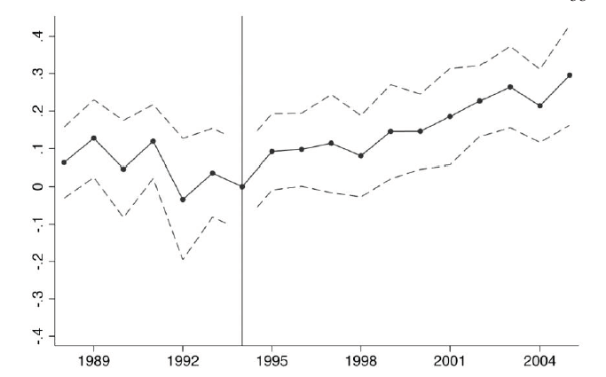
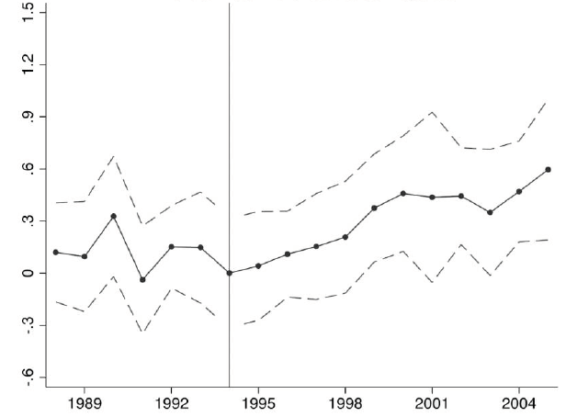
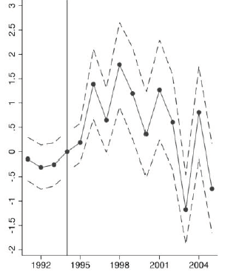
Module 4 · Market Distortions and Regulations
Evidence on Rent Control: Results
Impact on the price of never-controlled units
Impact on investment activities at decontrolled units ($1000s)
Impact on the price of decontrolled units
Rents rose, and so did investment — including at the units next door
Management 405 · Module 4 · Competitive Markets and Market Interventions
32
Notes:
The results. Rents rose sharply at the decontrolled units, as you would expect - but they also rose at units nearby that were never controlled, and investment went up at both. The spillover is the surprising part: rent control was holding down the value of the whole neighbourhood, not just the controlled flats.
Source of all three panels: Autor, Palmer and Pathak (2014), “Housing Market Spillovers: Evidence from the End of Rent Control in Cambridge, Massachusetts”.

Slide 33

Module 4 · Market Distortions and Regulations
Argentina Scrapped Its Rent Controls
Argentina repealed its rent-control law at the end of 2023
Reported since: many more flats listed, and rents lower in real terms
Not everyone gains — sitting tenants lost their protection
Management 405 · Module 4 · Competitive Markets and Market Interventions
33
Notes:
Magnitudes are as reported in the press, not from a study. Source: The Wall Street Journal, “Argentina Scrapped Its Rent Controls. Now the Market Is Thriving.”

Slide 34
Module 4 · Agenda
Outline of Module 4
1
Introduction to Market Structures
Video 1
2
Perfect Competition
Video 2
2a
Profit Maximization of a Price Taker in the Short Run
Video 3
2b
Firm-Level and Market Supply
Video 4
2c
Long-Run Competitive Equilibrium
Video 5
3
Market Distortions and Regulations
In Class
4
Externalities
Costs and benefits that land on people outside the deal
In Class
Management 405 · Module 4 · Competitive Markets and Market Interventions
34

Slide 35
Module 4 · Externalities
Externalities: Definitions
Externality: A cost or a benefit that falls on someone who is not part of the transaction
Negative externality — A cost imposed on an outsider
  Air pollution from coal-fired power plants
  The external cost of gasoline is about $1.50 per gallon
Positive externality — A benefit conferred on an outsider
  Your neighbor's well-kept front yard is a pleasure for you to look at too
Management 405 · Module 4 · Competitive Markets and Market Interventions
35
Notes:
The definitions we need. An externality is a cost or a benefit that lands on someone who is not part of the transaction - pollution from a power plant on one side, a well-kept front yard on the other. The gasoline number on this slide, about $1.50 a gallon in external cost, is the one we use in the worked example.

Slide 36

Module 4 · Externalities
Correcting for Externalities
The aim of the intervention: move the market toward the quantity that would be chosen if the outside cost or benefit were counted
Price mechanisms: taxes and subsidies
Tax the activity that imposes the cost, subsidize the one that confers the benefit
Quantity mechanisms: quotas and mandates
Negative externality — cap it: a limit on the tonnes of sulphur dioxide a power plant may emit in a year
Positive externality — require it: childhood vaccination as a condition of school entry
Management 405 · Module 4 · Competitive Markets and Market Interventions
36
Notes:
Two families of fix. Price mechanisms - a tax on the harm or a subsidy for the benefit - change what the decision-maker faces and let the market find the quantity. Quantity mechanisms - quotas, standards, outright bans - set the quantity directly. Each has its place, and the next slides work through the price route.

Slide 37
Module 4 · Externalities
The Externality: Gasoline
$ / gallon
Social marginal cost
SMC = MC_{I} + EMC
EMC = $1.50
per gallon
Supply = internal
marginal cost (MC_{I})
P_{Ext}
P_{Market}
Demand
Drivers weigh only their own cost, so the market settles at Q_{Market}. Counting the cost borne by everyone else, the efficient quantity is the smaller Q_{Ext}.
1.5
External marginal
cost (EMC)
Q_{Ext}
Q_{Market}
Gallons of gasoline per year
Management 405 · Module 4 · Competitive Markets and Market Interventions
37
Notes:
Here is the wedge. Drivers weigh only their own cost of a gallon, so the market settles where demand meets private marginal cost. Add the external cost that everyone else bears and the socially efficient quantity is smaller. The gap between the two supply curves is the external marginal cost - about $1.50 a gallon.

Slide 38
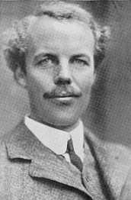
Module 4 · Externalities
A Carbon Tax to Correct the Negative Externality
$ / gallon
Marginal Cost plus tax
SMC = MC_{I} + tax
Tax = EMC = $1.50
Supply = internal
marginal cost (MC_{I})
P_{E}^{C}
P_{Market}
Arthur Pigou
P_{E}^{P}
Demand
A tax equal to the external cost makes each driver face the social marginal cost, and the market lands on Q_{Ext} on its own.
1.5
External marginal cost (EMC)
Q_{Ext}
Q_{Market}
Gallons of gasoline per year
P_{E}^{C} : Price paid by consumer with tax on externality
P_{E}^{P} : Price received by producer with tax on externality
Management 405 · Module 4 · Competitive Markets and Market Interventions
38
Notes:
Externality of gas is approx $1.5 per gallon: https://energyathaas.wordpress.com/2015/01/05/raise-the-gas-tax/
77 countries have committed to achieving net zero emissions by 2050
Half of emissions cuts must be in place by 2030 to keep warming below 1.5°C
Carbon taxes have been implemented (or scheduled) in 46 countries
$44 billion raised in carbon pricing revenues in 2018
But this is not enough
Covers only 20% of emissions
No carbon tax in the US nor in China…
Incentives for Coal countries to burn their coal even faster now, before regulation goes into effect
Other ways of limiting emissions?

Slide 39
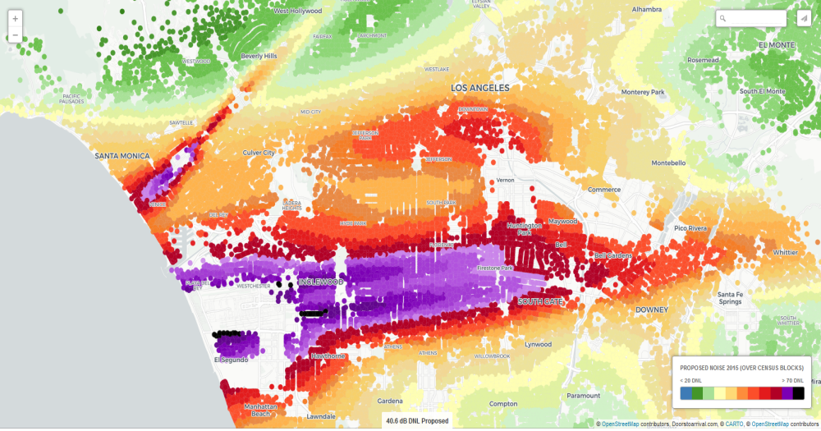

Module 4 · Externalities
Externality: Airplane Noise
Noise contours around Santa Monica Airport
Management 405 · Module 4 · Competitive Markets and Market Interventions
39
Notes:
Airport noise is the same problem in a form you can hear. Every flight in and out of Santa Monica imposes a cost on the neighbourhood that the pilot does not pay, and the article shows how sharply the community has pushed back.

Slide 40
Module 4 · Externalities
A Pigouvian Tax for Noise? The Case of Santa Monica Airport
Price
“Corner solution” with Q* = 0
→ shut down the airport
MC_{I} + tax = SMC
(social marginal cost)
Noise pollution (EMC)
Noise tax = EMC
Pilots' internal
MC_{I} of flying
D (MB of flying)
Q* = 0
Q_{current}
Flights per day
SMC lies above willingness to pay at every quantity — a corner solution at Q* = 0, so close the airport
Management 405 · Module 4 · Competitive Markets and Market Interventions
40
Notes:
And here is where the arithmetic gets uncomfortable. Add the noise cost to the pilots' own cost and social marginal cost lies above willingness to pay at EVERY quantity - so the efficient number of flights is zero. This is a corner solution, and in Santa Monica it is close to what actually happened.

