Slide 1
Complex Pricing
Advanced Pricing Strategies
Management 405
Prof. Nico Voigtländer · UCLA Anderson

Slide 2
Module 6 · Logistics
Some Logistics
Final Exam logistics: Will be presented under Module 7 slides
Management 405 · Module 6 · Complex Pricing and Advanced Pricing Strategies
2
Notes:
Two housekeeping points before we start. The practice final is on the class website and it is built to look like the real thing, so use it as a rehearsal rather than a reading exercise. The final itself is Saturday, December 12, 9:00 AM – 12:00 PM, and it is online. That window has to cover uploading your answers as well as solving the paper, so leave yourself a few minutes at the end rather than working right up to the deadline.

Slide 3
Module 6 · Video 1 · Course Roadmap
Agenda for the Class
1. Basic Principles and Economic Way of Thinking
2. Value and Demand
3. Supply and Cost
4. Markets, Pricing, and Strategy
we are here
Management 405 · Module 6 · Complex Pricing and Advanced Pricing Strategies
3
Notes:
This is where we are in the course. We have done the economic way of thinking, then value and demand, then supply and cost. Module 6 sits in the fourth block, markets and pricing strategy, and it is where the demand curve you learned to estimate starts earning its keep: everything today is about turning a demand curve into a pricing decision.

Slide 4
Module 6 · Video 1 · Agenda
Outline of Module 6
1
Simple vs. Complex Pricing
The pricing dilemma and why complex pricing pays
Video 2
2
Direct Price Discrimination
Videos 3+4
2a
Perfect Price Discrimination (First Degree)
Charging every customer her own willingness to pay
Video 3
2b
Segment Pricing (Third Degree)
Different prices for groups with different price sensitivity
Video 4
3
Indirect Price Discrimination (Second Degree)
Versioning and coupons let customers sort themselves
Video 5
4
Advanced Pricing Strategies
Videos 6–8
4a
Flat Fee Pricing
Unlimited access for one all-or-nothing fee
Video 6
4b
Two-Part Tariff
A flat fee plus a usage fee set at marginal cost
Video 7
4c
Block Pricing
A lower price as the same customer buys more
Video 8
5
Summary of Pricing Strategies
Which strategy fits which market conditions
Video 9
Management 405 · Module 6 · Complex Pricing and Advanced Pricing Strategies
4
Notes:
Here is the whole module. We start with why one price for everyone leaves money on the table, then work through the three degrees of price discrimination, and finish with the strategies you use when a single customer buys many units. The gold tags on the right tell you which video each topic is in.

Slide 5
Module 6
In-Class Part
Management 405 · Module 6 · Complex Pricing and Advanced Pricing Strategies
5
Notes:
From here on we are in the classroom. The videos covered simple versus complex pricing, first-degree price discrimination, segment pricing, versioning and coupons, flat fees, two-part tariffs and block pricing. In class we apply that material to examples.

Slide 6
Some Applications of the Material
Covered in the Videos
Management 405 · Module 6 · Complex Pricing and Advanced Pricing Strategies
6
Notes:
The next stretch of slides applies what the videos covered on complex pricing. These are applications rather than a new topic, which is why they are not a separate item on the module outline.

Slide 7
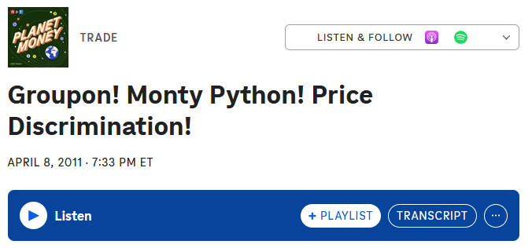
Module 6 · In Class · Examples · Simple vs. Complex Pricing
Dilemma of Simple Pricing, Explained by the Podcast
MC of a burger is $4.50
NYC restaurant sells it for $18
Lose customers with MPV = $15, $11, etc
What if you charge $10?
  Give it for too little to those with MPV > $18
Management 405 · Module 6 · Complex Pricing and Advanced Pricing Strategies
7
Notes:
The podcast puts the dilemma in a restaurant. A burger costs the kitchen four dollars fifty and sells for eighteen. At eighteen you lose everyone who would have paid fifteen, or eleven, and each of those is a sale worth making. Drop to ten and you win them, but you have just handed eight dollars to everyone who would have paid the eighteen.

Slide 8
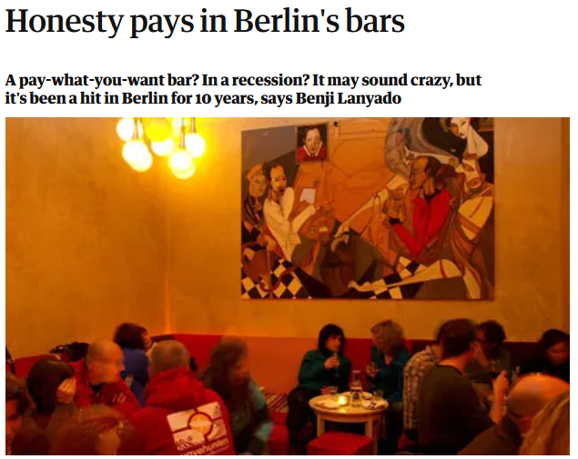

Module 6 · In Class · Examples · Perfect Price Discrimination (First Degree)
Recall from Video 3: First Degree Price Discrimination (Now MC > 0)
P
Price charged to
high-MPV customer
Now: MC > 0
Could you ask customers to reveal their true MPV?
Price charged to
median-MPV customer
Profits (before paying fixed costs)
Do not sell to the
low-MPV customer
MC
Demand = MPV
Q
Discussion
Management 405 · Module 6 · Complex Pricing and Advanced Pricing Strategies
8
Notes:
In an ideal world you would like to charge individual prices to mop up all the surplus – to capture all the area beneath the Demand curve in the form of corporate revenue. This type of customized pricing represents the ideal. Customized to what? To the buyers’ valuations! This is difficult to do in practice for a variety of reasons: e.g., arbitrage, legal restrictions.

Slide 9
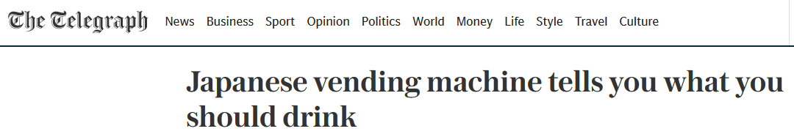
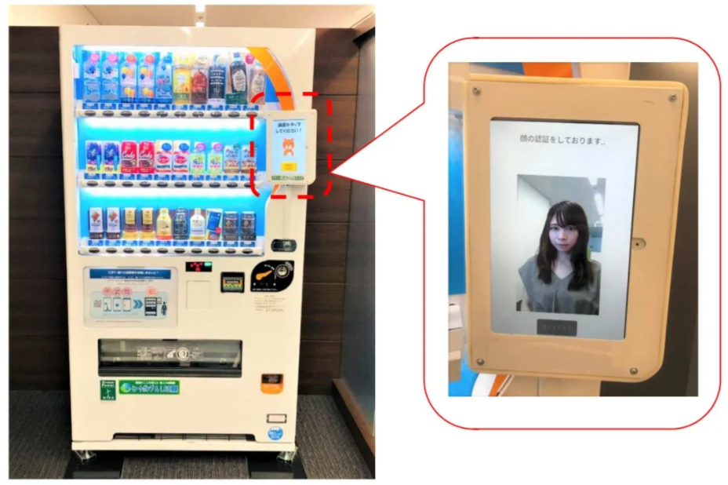
Module 6 · In Class · Examples · Perfect Price Discrimination (First Degree)
The Dystopian Future of Price Discrimination
Why are companies increasingly able to use first-degree price discrimination (personally tailored prices)? Any examples?
Is the trend towards more price discrimination good or bad for consumers?
Discussion
Management 405 · Module 6 · Complex Pricing and Advanced Pricing Strategies
9
Notes:
Two questions worth real discussion time. Why are firms getting better at this, and is the trend good or bad for consumers? The second one usually splits the room, which is the point: perfect price discrimination serves more customers than one price does, and it also leaves them with nothing.

Slide 10
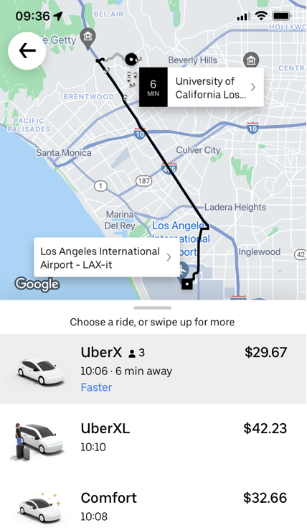
Module 6 · In Class · Examples · Perfect Price Discrimination (First Degree)
Is Uber Charging What You’re Willing to Pay?
I need 10 volunteers (5 for Uber, 5 for Lyft)
Open your Uber/Lyft app
Enter “LAX” in the destination address
Do NOT hit request
Just tell me the UberX/Lyft price
?
Discussion
Management 405 · Module 6 · Complex Pricing and Advanced Pricing Strategies
10
Notes:
Run this live. Ten volunteers, five on Uber and five on Lyft, same destination, same moment. Have them read out the price without requesting the ride. The spread is usually enough to make the point on its own, and it lands harder coming from the room than from me.

Slide 11
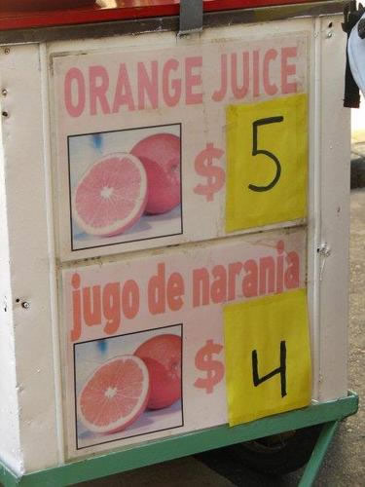
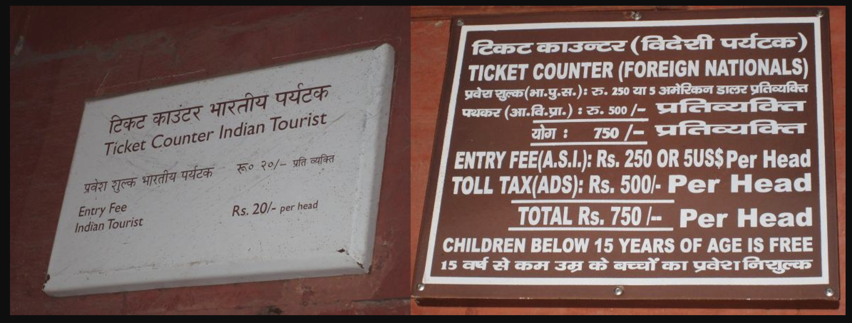
Module 6 · In Class · Examples · Segment Pricing (Third Degree)
Segment Pricing: Discounts for Locals
Management 405 · Module 6 · Complex Pricing and Advanced Pricing Strategies
11
Notes:
Disneyland and Taj Mahal: lower prices for Socal/Indian residents compared to tourists. Why? Tourists have lower elasticity of demand than locals that have more easily available alternatives (and in the Indian case, lower income). Generalized phenomenon in tourism – in India airlines used to charge higher fares to tourists.
Another Example: US drugs cheaper in Canada than in USA. There is more discretion as to price in the US because there is less collective bargaining between public entities and pharmaceutical companies for lower prices. This creates incentives for transshipping of drugs – parallel imports to take advantage of arbitrage opportunities.

Slide 12
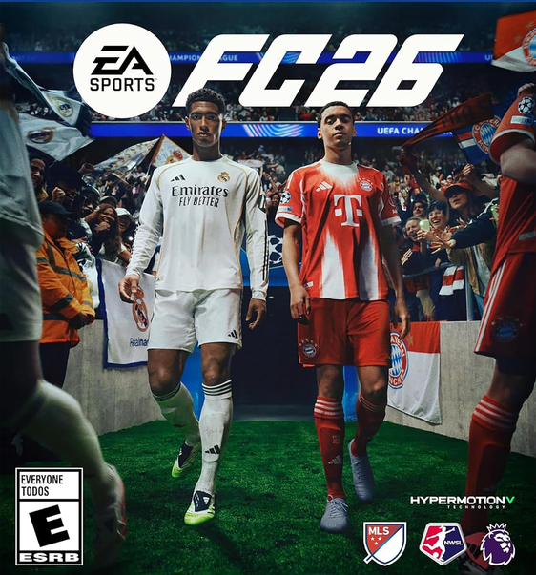
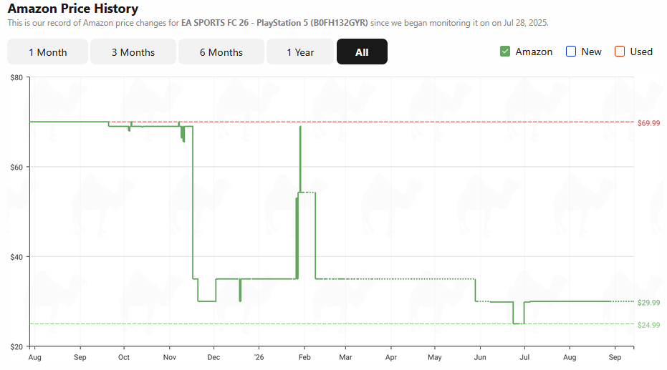
Module 6 · In Class · Examples · Segment Pricing (Third Degree)
Segment Pricing: Timing
Source: https://camelcamelcamel.com/
Management 405 · Module 6 · Complex Pricing and Advanced Pricing Strategies
12
Notes:
One can go directly to the website and look for favorite goods. I use coffee moka bialetti:
https://camelcamelcamel.com/

Slide 13

Module 6 · In Class · Examples · Segment Pricing (Third Degree)
Recall from Videos: Ways to Segment Consumers
By customer characteristics
  Discounts for new customers (gym memberships)
By location
Intertemporal
Management 405 · Module 6 · Complex Pricing and Advanced Pricing Strategies
13
Notes:
A quick recall before the examples. Four ways to split a market: by who the customer is, by whether she is new or already a customer, by where she is, and by when she buys. The gym is the clean case of the second one - the introductory rate exists for people who have not joined yet, and it disappears once they have, which is why it is never offered to the member renewing in year three. Ask the class for one example of each from their own industries before moving on.

Slide 14
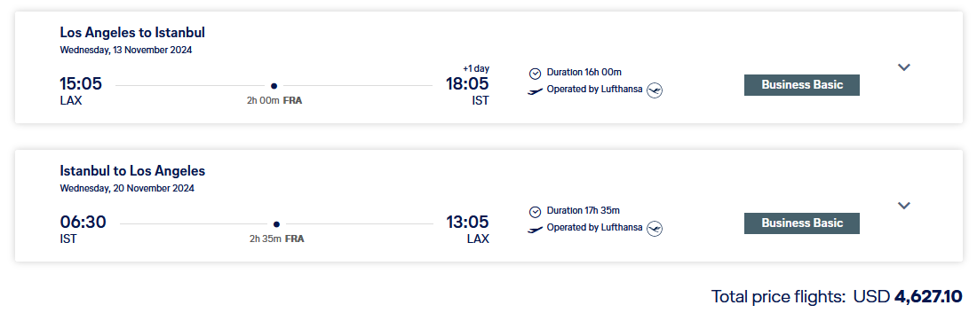
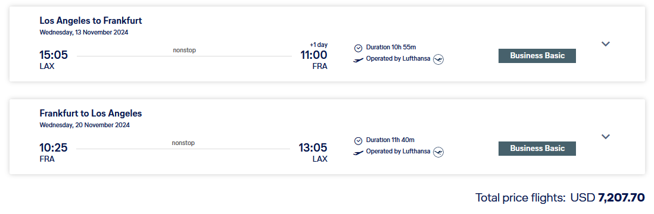
Module 6 · Video 4 · Segment Pricing (Third Degree)
Airline Pricing: We Can Now Solve the ‘Puzzle’ from Week 1
The longer trip is cheaper — why?
Management 405 · Module 6 · Complex Pricing and Advanced Pricing Strategies
14
Notes:
Back in week 1 we looked at these two Lufthansa fares and could not explain them. The connecting flight from LAX to Istanbul via Frankfurt is CHEAPER than the direct LAX to Frankfurt flight, even though the connecting passenger occupies the same seat on the same LAX-Frankfurt aircraft and then flies a second leg on top. On cost grounds that makes no sense. Now we have the tool: this is segment pricing. The two passengers are in different segments with different elasticities, and the airline can tell them apart and keep them apart.

Slide 15
Module 6 · In Class · Examples · Segment Pricing (Third Degree)
Lufthansa Pricing: Solution
Flight LAX – IST via FRA
Direct flight LAX – FRA
P
P
P*
P*
MC
MC
D
D
MR
MR
Q*
Q
Q*
Q
Higher price for the shorter direct flight — less elastic demand, despite its lower MC
Management 405 · Module 6 · Complex Pricing and Advanced Pricing Strategies
15
Notes:
Here is the answer. The marginal cost is the same in both panels, because it is the same aircraft on the same LAX to Frankfurt leg. What differs is the demand curve. The direct flight is bought largely by people who need to be in Frankfurt, and they have no good substitute, so their demand is steep — less elastic. The connecting passenger is going to Istanbul and has a dozen ways to get there, so that demand is flatter. Set marginal revenue equal to marginal cost in each panel and the less elastic market comes out with the higher price. That is why the shorter trip costs more, and it is exactly the rule from the practice video: charge the higher price where demand is less elastic.

Slide 16

Module 6 · In Class · Examples · Segment Pricing (Third Degree)
Consumer Segments in Medication
Lodine, a medication for arthritis, is used for both humans and dogs
Which segment ‘pays’ a higher price?
Poll Break
Management 405 · Module 6 · Complex Pricing and Advanced Pricing Strategies
16
Notes:
Lodine treats arthritis in humans and in dogs, and the two segments pay very different prices. Take the poll before you say which way it goes; the room usually splits, and the reasoning on both sides is worth hearing.

Slide 17
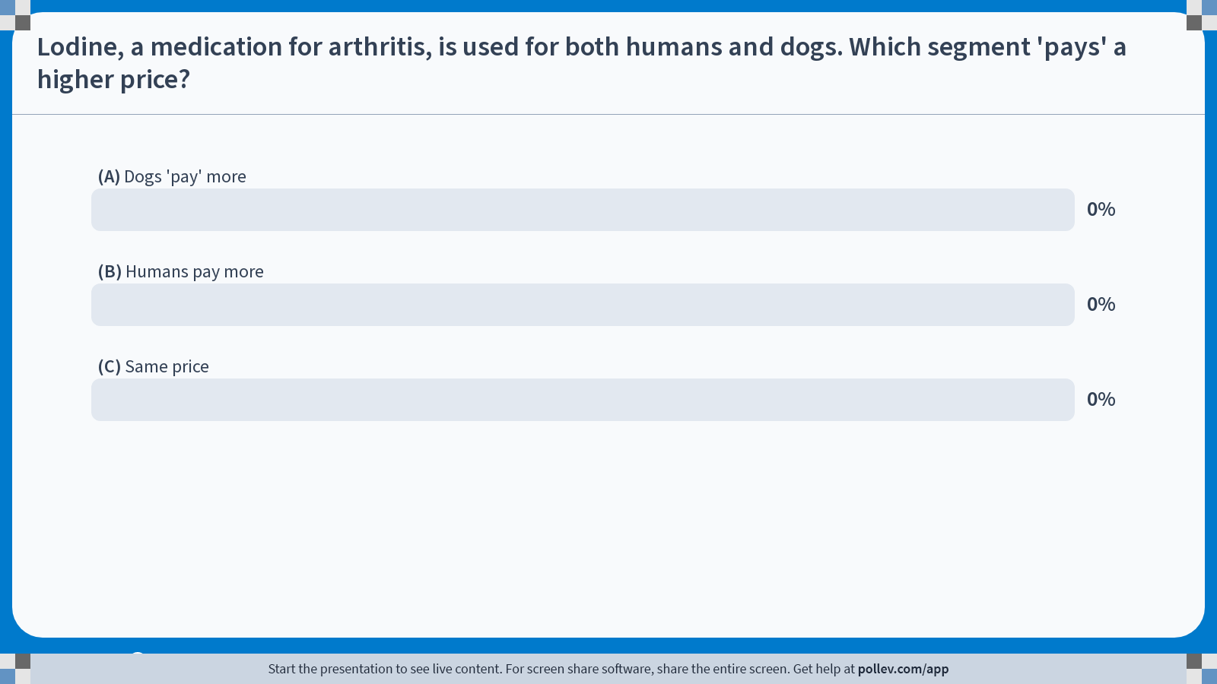
Notes:
Poll Title: Do not modify the notes in this section to avoid tampering with the Poll Everywhere activity.
More info at polleverywhere.com/support
Lodine, a medication for arthritis, is used for both humans and dogs. Which segment 'pays' a higher price?
https://www.polleverywhere.com/multiple_choice_polls/4BC5CeS5GrXrPVaYNwliJ?state=opened&flow=Default&onscreen=persist

Slide 18
Module 6 · In Class · Examples · Segment Pricing (Third Degree)
Solution
Poll Break
Management 405 · Module 6 · Complex Pricing and Advanced Pricing Strategies
18

Slide 19
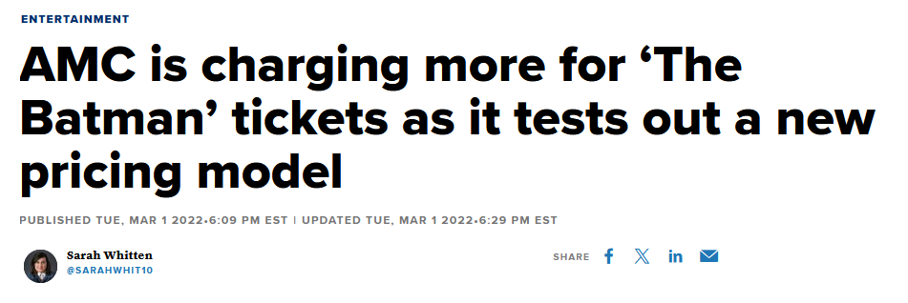

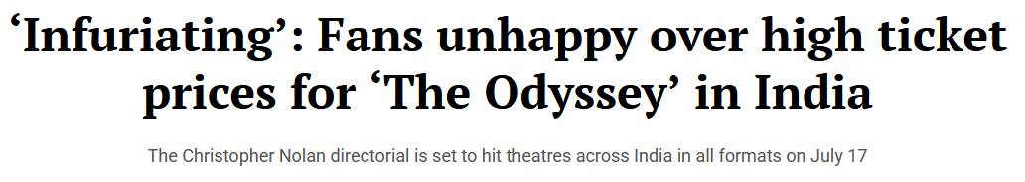
Module 6 · In Class · Examples · Segment Pricing (Third Degree)
Segment Pricing in Movies
Higher prices for new movies and blockbusters
The Odyssey (Nolan, released 17 July 2026)
Universal sold IMAX 70 mm seats a YEAR ahead, on 18 July 2025
95 % of them went in under 24 hours — most in the first hour
At the counter: $33 a seat at AMC Lincoln Square, against a $16.30 average US ticket in 2026
Resale reported at 400 % of face value, averaging $165, with one seat at $600
Reported figures — Variety (19 July 2025) and the Washington Post (16 July 2026)
Premium for: · Format (IMAX 70 mm) · Date · Seat location (in many theatres)
Management 405 · Module 6 · Complex Pricing and Advanced Pricing Strategies
19
Notes:
Intertemporal segmentation. The new release costs more, and it is the same film in the same seat two months later. What the studio is pricing is impatience, which is exactly a difference in elasticity.

Slide 20
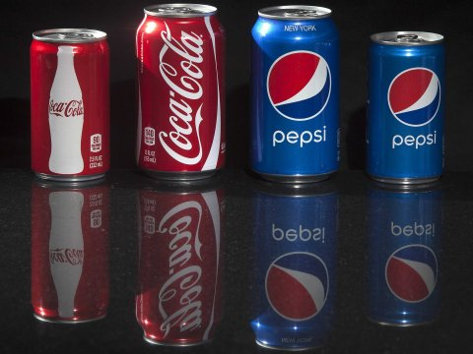
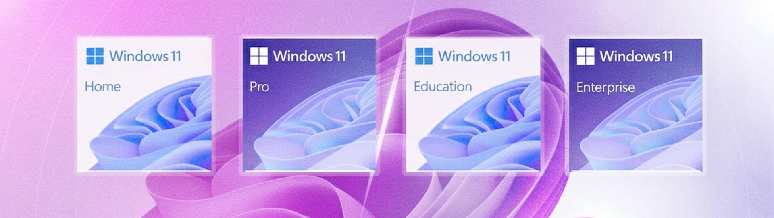
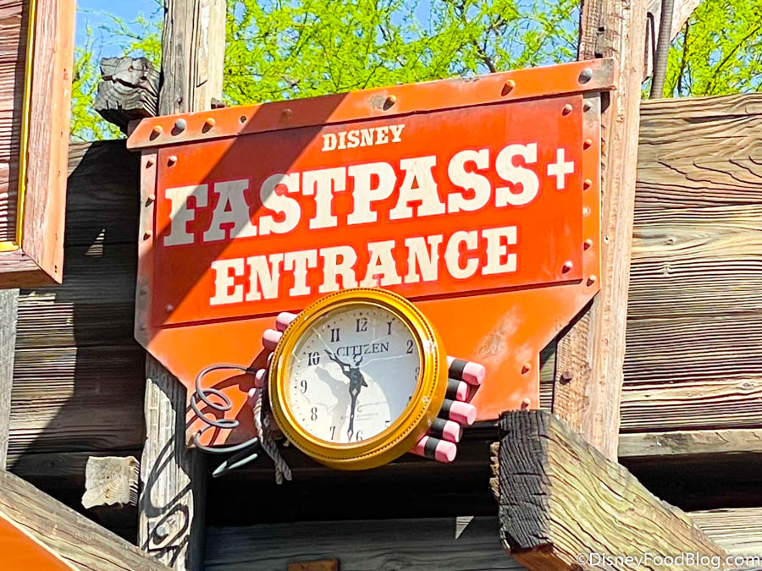
Module 6 · In Class · Examples · Indirect Price Discrimination (Second Degree)
Versioning
Offer a product line and let users sort themselves
Management 405 · Module 6 · Complex Pricing and Advanced Pricing Strategies
20
Notes:
An example of Second Degree Price Discrimination: Versioning
We will go in greater depth into one form of second degree price discrimination which is versioning. Versioning is incentive compatible and accomplishes everything that price discrimination accomplishes. Consumers who buy at a high price do so willingly. The key to understand this is that the version priced at a premium has to have features that generate some value to the consumer, but the cost differential to the company is minor relative to the price differential (otherwise there is no real discrimination on price if the surplus captured is the same across segments).
The perfect example is Microsoft: offers Windows Professional and Windows Home Edition. Windows Pro has more features than Home edition but they are otherwise close substitutes. The marginal cost of producing each is identical (and approximately zero) – in fact it may cost the company something to actually differentiate the products. Sometimes it costs nothing to make something better but you don’t want to do it: why doesn’t Microsoft offer the full version of Windows to all their customers since the MC of doing so is zero? Because they would then join the markets, and forego the benefits of price discrimination. You add features to the price insensitive segment so you can charge them more.

Slide 21
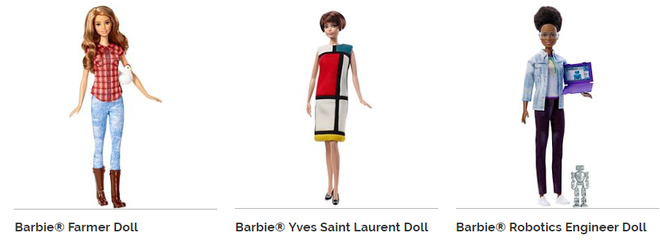



Module 6 · In Class · Examples · Indirect Price Discrimination (Second Degree)
Versioning: Dolls
Management 405 · Module 6 · Complex Pricing and Advanced Pricing Strategies
21
Notes:
Three Barbies, and the prices are hidden. Ask the room to guess before each reveal. The farmer is nine ninety-nine and the robotics engineer thirteen ninety-nine, which sound like the same product. Then the Yves Saint Laurent doll comes in at a hundred and fifty. The plastic is nearly identical; what differs is who is buying, and Mattel never had to ask.

Slide 22
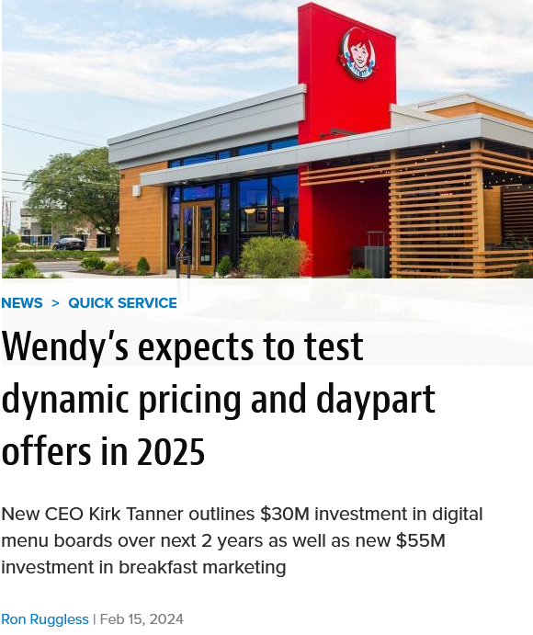
Module 6 · In Class · Examples · Indirect Price Discrimination (Second Degree)
Wendy’s Failed Attempt at Dynamic Pricing
Created immediate consumer backlash and a PR disaster: “charge higher prices when consumers are hungry”
Sen. Elizabeth Warren: “It’s price gouging plain and simple, and American families have had enough.”
Wendy’s issued a correction: now planning to introduce versioning (different menu options and discounts)
Direct price discrimination creates more backlash than indirect price discrimination
Management 405 · Module 6 · Complex Pricing and Advanced Pricing Strategies
22
Notes:
The tsunami lapped the foundations of the halls of Congress Wednesday when Sen. Elizabeth Warren, D-Mass., issued from her official U.S. Senate X/Twitter account:
“Wendy’s is planning to try out ‘surge pricing’ — that means you could pay more for your lunch, even if the cost to Wendy’s stays exactly the same. It’s price gouging plain and simple, and American families have had enough.”

Slide 23
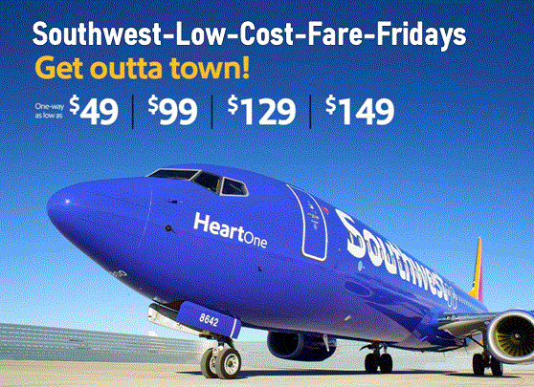
Module 6 · In Class · Examples · Indirect Price Discrimination (Second Degree)
Airline Response to Low-Cost Carriers
How should United respond to Southwest starting to offer flights on one of its routes?
Poll Break
Management 405 · Module 6 · Complex Pricing and Advanced Pricing Strategies
23
Notes:
Put the question to the class before the poll. Southwest starts flying one of United's routes: does United match the fare, hold its price, or do something else? Most rooms split between the first two, and the answer is the third.

Slide 24
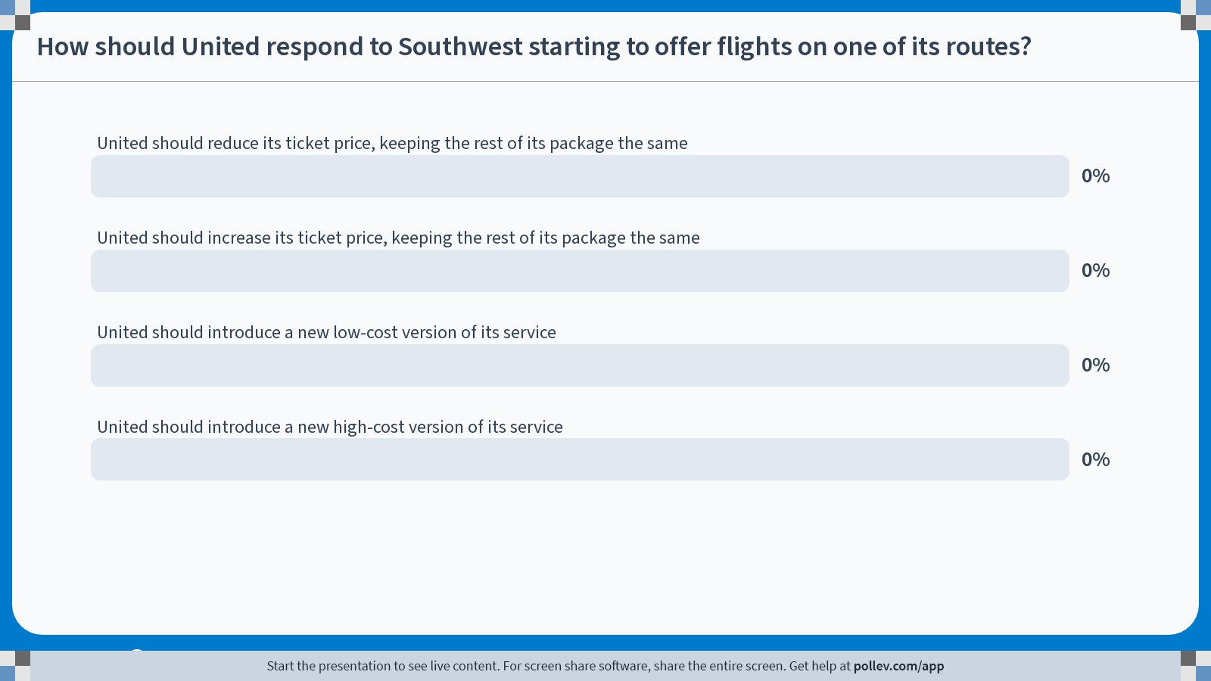
Notes:
Poll Title: Do not modify the notes in this section to avoid tampering with the Poll Everywhere activity.
More info at polleverywhere.com/support
How should United respond to Southwest starting to offer flights on one of its routes?
https://www.polleverywhere.com/multiple_choice_polls/kTjbo3Qwc1lQNUuHpIZ8D?state=opened&flow=Default&onscreen=persist

Slide 25
Module 6 · In Class · Examples · Indirect Price Discrimination (Second Degree)
Solution
Poll Break
Management 405 · Module 6 · Complex Pricing and Advanced Pricing Strategies
25

Slide 26
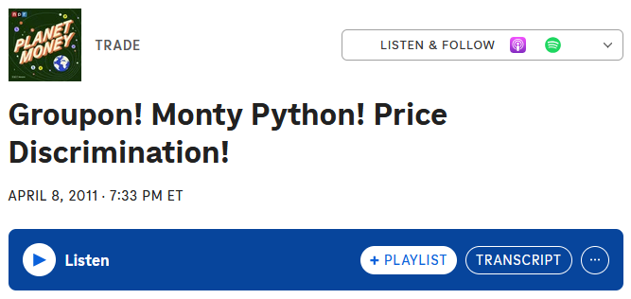
Module 6 · In Class · Examples · Indirect Price Discrimination (Second Degree)
Back to the Podcast on Price Discrimination
Historically: price discrimination by haggling
  Can it lead to perfect price discrimination?
  What’s the problem with haggling?
How does the NYC restaurant try to price discriminate?
  Regular price: $18
  MC of a burger + drinks is $4.50
  How much is the coupon? Does that make sense?
How do coupons relate to price discrimination?
Discussion
Management 405 · Module 6 · Complex Pricing and Advanced Pricing Strategies
26
Notes:
Coupon costs $9, but the restaurant gets only $4.50
Problems with haggling: -- Not incentive compatible…everybody tries to lie about their WTP
-- Takes very long to negotiate. So did not work in large department stores in late 19C

Slide 27
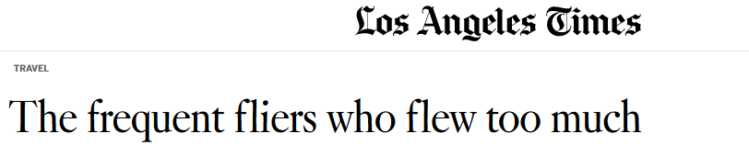
Module 6 · In Class · Examples · Flat Fee Pricing
What Can Go Wrong with Flat Rates…
Lifetime first class flat rate sold in the 1980-90s: “Each had paid American Airlines more than $350,000 for an unlimited AAirpass and a companion ticket that allowed them to take someone along on their adventures. Both agree it was the best purchase they ever made, one that completely redefined their lives.”
How many customers bought it?
  Only 65 customers
How did they behave?
  Two of them flew 30 million miles or more, each costing American more than $1 million a year
If MC > 0, offering a flat rate with unlimited access is a bad idea:
consumers will use ‘too much’ of the service — this can be solved by two-part tariffs
Management 405 · Module 6 · Complex Pricing and Advanced Pricing Strategies
27
Notes:
Only 65 customers bought the flat rate pass. Two of them, Steven Rothstein and Jacques Vroom, flew 30 million miles or more each. American's own review put the cost at more than $1 million a year for each of them, and in 2008 the airline revoked both passes, alleging fraud. Source: Ken Bensinger, "The frequent fliers who flew too much", Los Angeles Times, May 5, 2012. Some later accounts put the number of unlimited passes sold at 66. In 2026 dollars: $350,000 paid in the late 1980s corresponds to roughly $950,000 to $1.05 million today (CPI-U: 113.6 on average in 1987 and 124.0 in 1989, against 337.5 in October 2026).

Slide 28
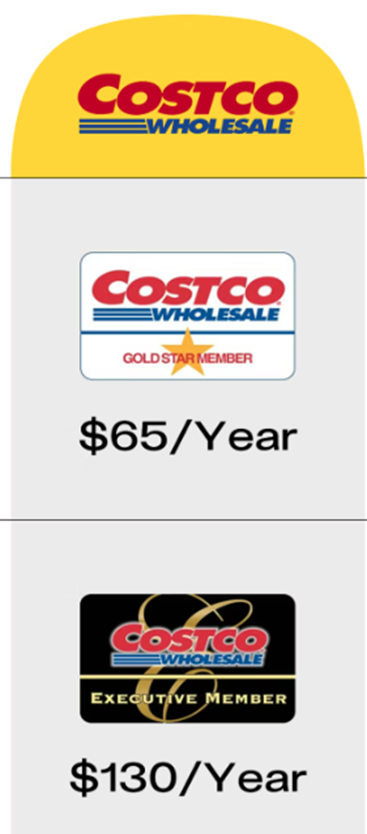
Module 6 · In Class · Examples · Two-Part Tariff
Costco: Combination of Versioning and Two-Part Pricing
Business model
  Make money on the memberships
  Sell goods at the cheapest price possible
Two membership versions, and the customer picks
WSJ video on the strategic layout of Costco stores
Management 405 · Module 6 · Complex Pricing and Advanced Pricing Strategies
28
Notes:
Costco is both of the things we have done today. The two membership tiers are versioning, and the membership plus the shopping is a two-part tariff, with the shelf prices close to cost. That is why the company can be relaxed about margins on the goods themselves.

Slide 29
Some Examples for Innovative Pricing Strategies

Slide 30
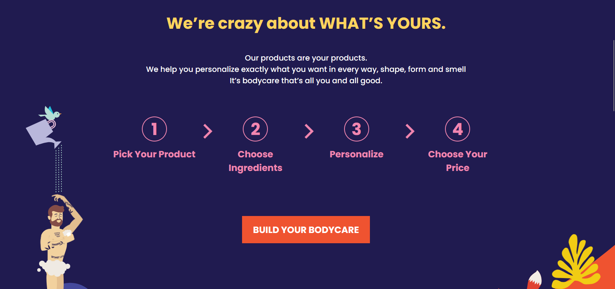
Module 6 · In Class · Examples · Summary of Pricing Strategies
The Mad Optimist
An interesting way to extract consumer surplus
Management 405 · Module 6 · Complex Pricing and Advanced Pricing Strategies
30
Notes:
A genuinely odd one to finish on. The company lets you set your own price. Ask the class why that is not simply giving the product away, and what it tells you about how much of willingness to pay is social rather than economic.

Slide 31
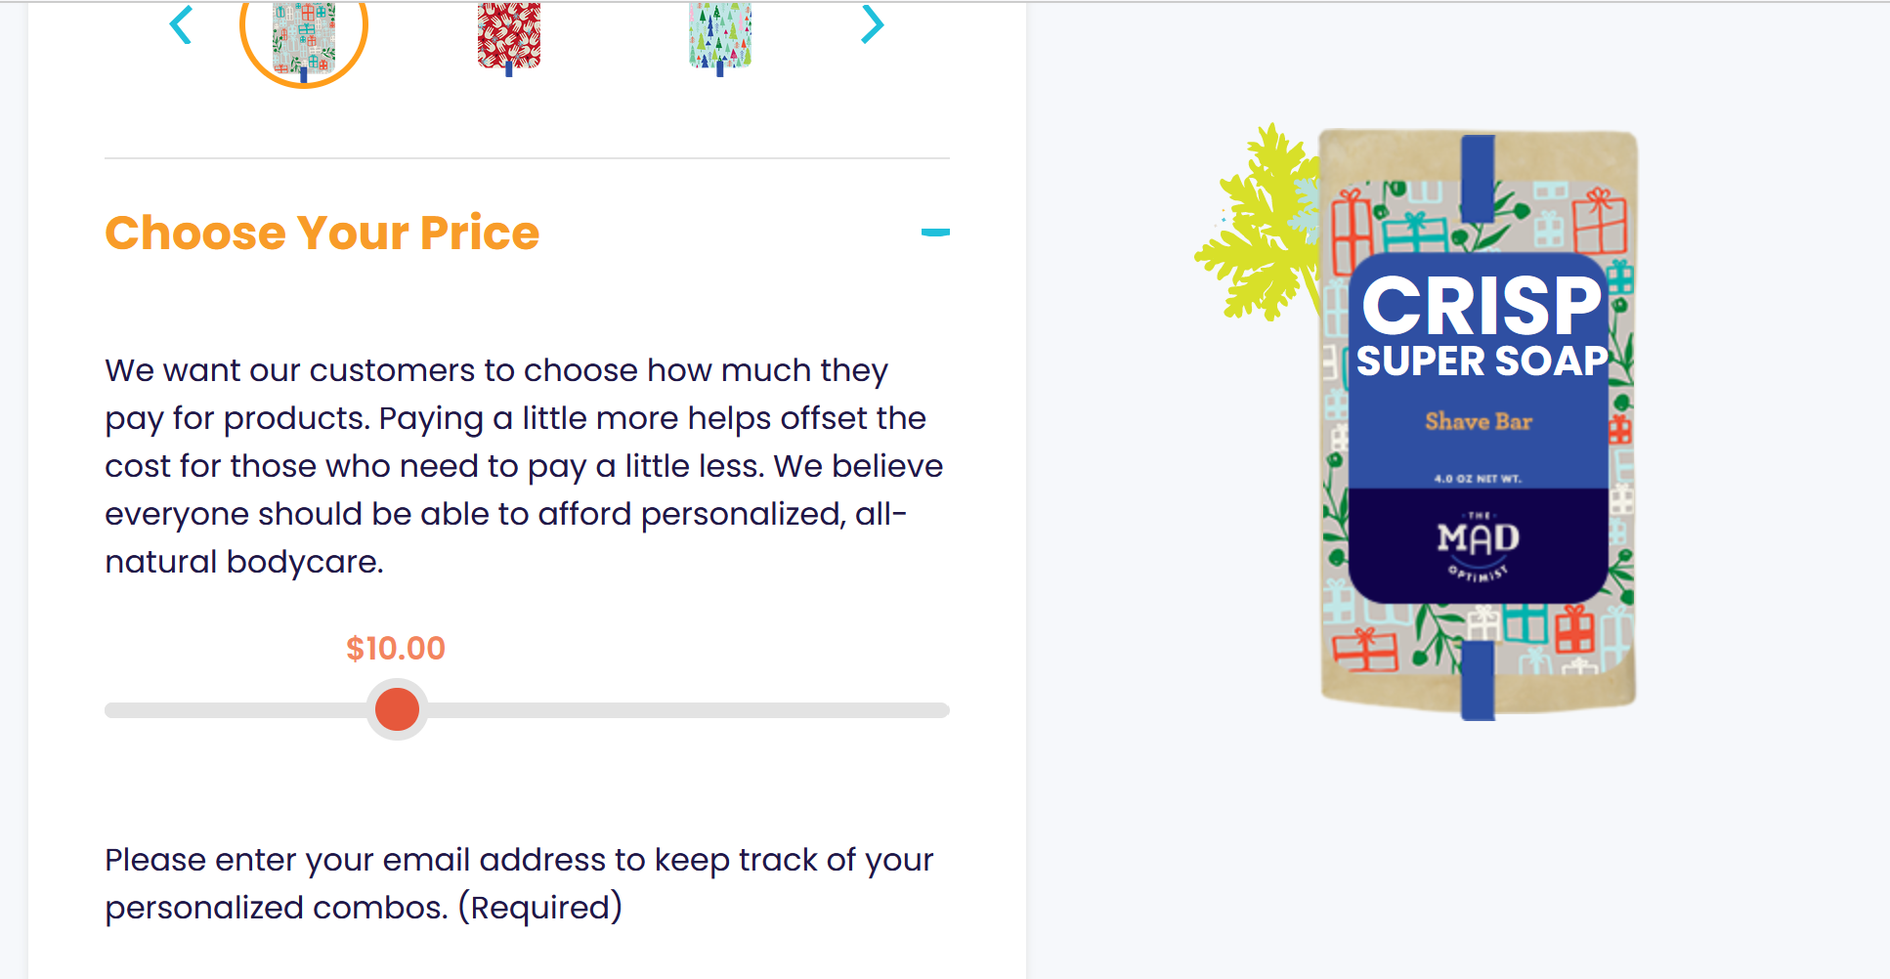
Module 6 · In Class · Examples · Summary of Pricing Strategies
The Mad Optimist – “Choose Your Price”
Management 405 · Module 6 · Complex Pricing and Advanced Pricing Strategies
31
Notes:
This is the choose-your-price screen itself. Note that they do anchor it: there is a suggested price, and most customers move only a little from it.

Slide 32
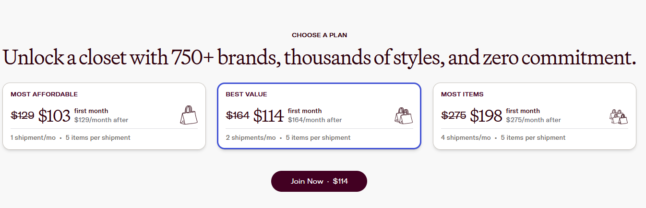
Module 6 · In Class · Examples · Summary of Pricing Strategies
Rent the Runway
Combination of block pricing and versioning
Management 405 · Module 6 · Complex Pricing and Advanced Pricing Strategies
32
Notes:
Combination of block pricing and versioning

Slide 33
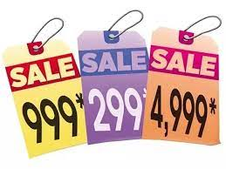
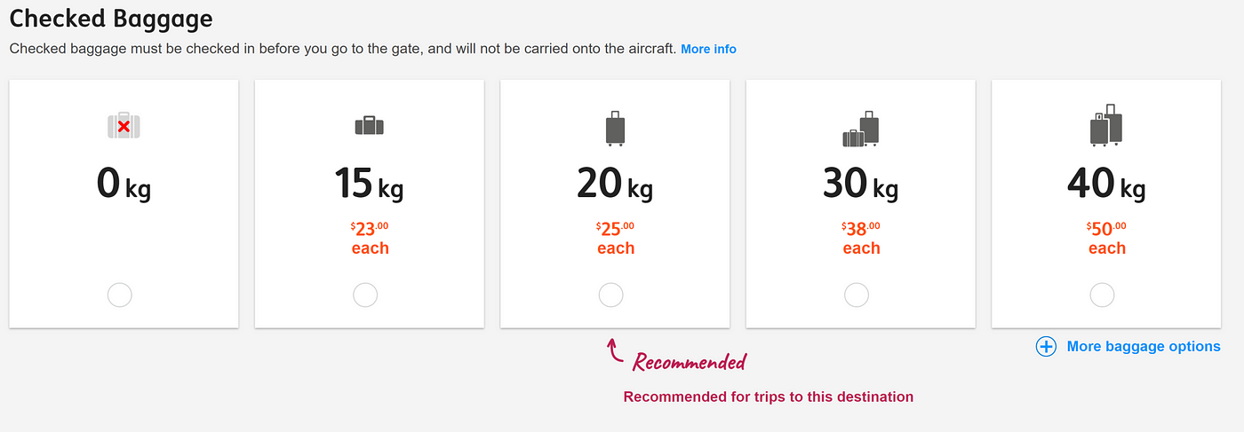
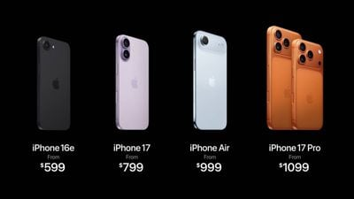
Module 6 · In Class · Examples · Summary of Pricing Strategies
Behavioral Insight: Price Framing
Adding a highly priced option draws attention to the intermediate prices
Prices ending in 9 or .99 draw focus to the previous digit
Management 405 · Module 6 · Complex Pricing and Advanced Pricing Strategies
33
Notes:
Two framing effects, both on the slide. First, prices ending in 9 or 99 cents. The eye anchors on the leading digits, so $19.99 reads as nineteen something rather than as basically twenty. Second, adding a deliberately expensive option pulls attention to the middle of the range, which is the decoy we just saw at The Economist. Neither of these changes the product or what it costs to make. Both change which comparison the customer makes. That is what price framing is: not what you charge, but how you present it.

Slide 34
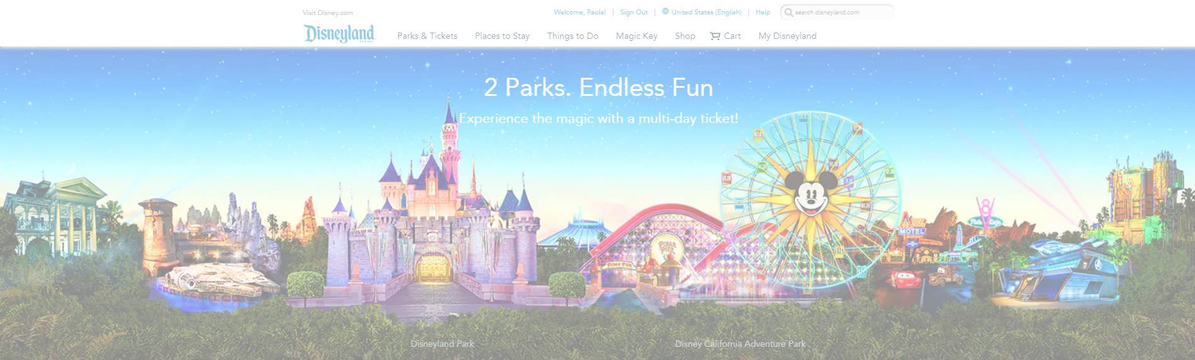
Module 6 · In Class · Examples · Segment Pricing (Third Degree)
Disneyland: Pricing Strategy
…we will look at different features of the overall strategy
Management 405 · Module 6 · Complex Pricing and Advanced Pricing Strategies
34
Notes:
Open this one to the room before showing anything. Disneyland runs nearly every strategy in the module at once, and the class will usually find three or four of them unprompted.

Slide 35
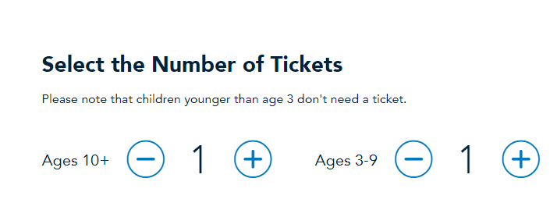
Module 6 · In Class · Examples · Segment Pricing (Third Degree)
Disneyland: Segment Pricing by Age
A child’s ticket is cheaper than an adult’s
The park can verify age at the gate, so the segments cannot swap
Management 405 · Module 6 · Complex Pricing and Advanced Pricing Strategies
35
Notes:
The first one is age. A child's ticket is cheaper, the park can check at the gate, and under-threes are free because they were never going to come on their own account.

Slide 36
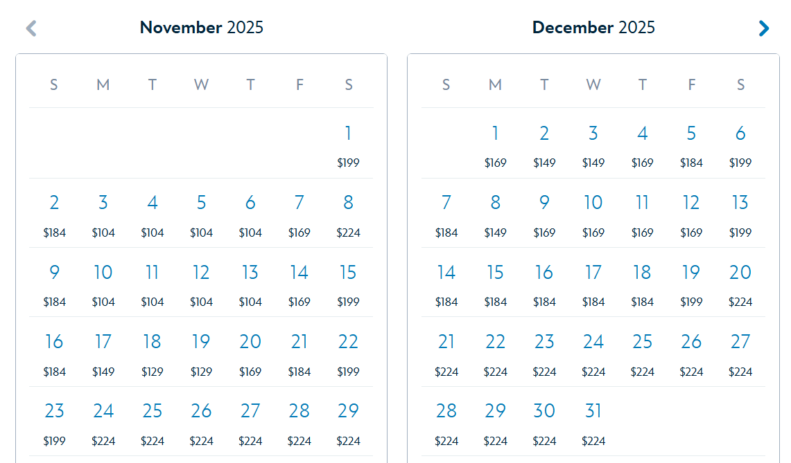
Module 6 · In Class · Examples · Segment Pricing (Third Degree)
Disneyland: Segment Pricing by Date
The same ticket runs from about $104 to $224 by DATE
Peak dates are when high-willingness-to-pay visitors can come
Segmenting by the calendar, with no need to identify anyone
Management 405 · Module 6 · Complex Pricing and Advanced Pricing Strategies
36
Notes:
The second is the calendar. The same ticket runs from about a hundred and four dollars to two hundred and twenty-four depending on the date. Peak dates are when high-willingness-to-pay visitors can come, and the park never has to identify anybody - the date does the sorting.

Slide 37
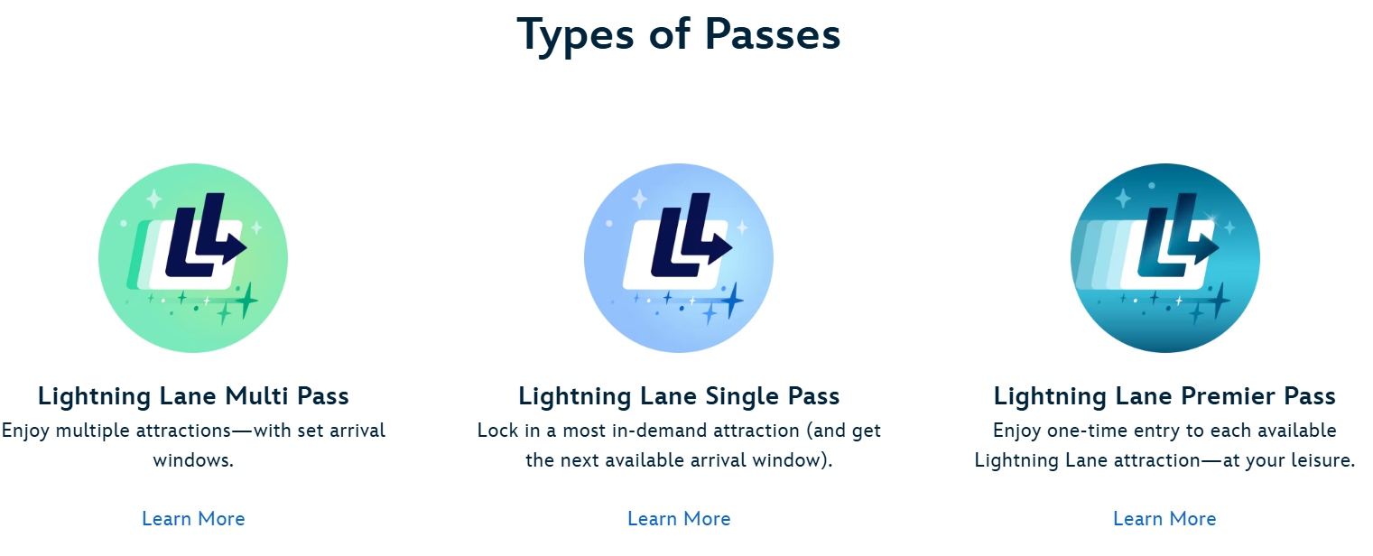
Module 6 · In Class · Examples · Indirect Price Discrimination (Second Degree)
Disneyland: Versioning
Lightning Lane comes in three versions: Multi, Single, Premier
Visitors sort themselves → second degree
The sorting is incentive-compatible (customers with high opportunity cost of time buy the Multi Pass)
Management 405 · Module 6 · Complex Pricing and Advanced Pricing Strategies
37
Notes:
Lightning Lane is versioning. Three tiers, and visitors sort themselves by choosing - that is what makes it second degree rather than third. The sorting is incentive-compatible: a visitor whose time is expensive buys the Multi Pass because it is genuinely worth more to her, not because the park worked out who she is.

Slide 38
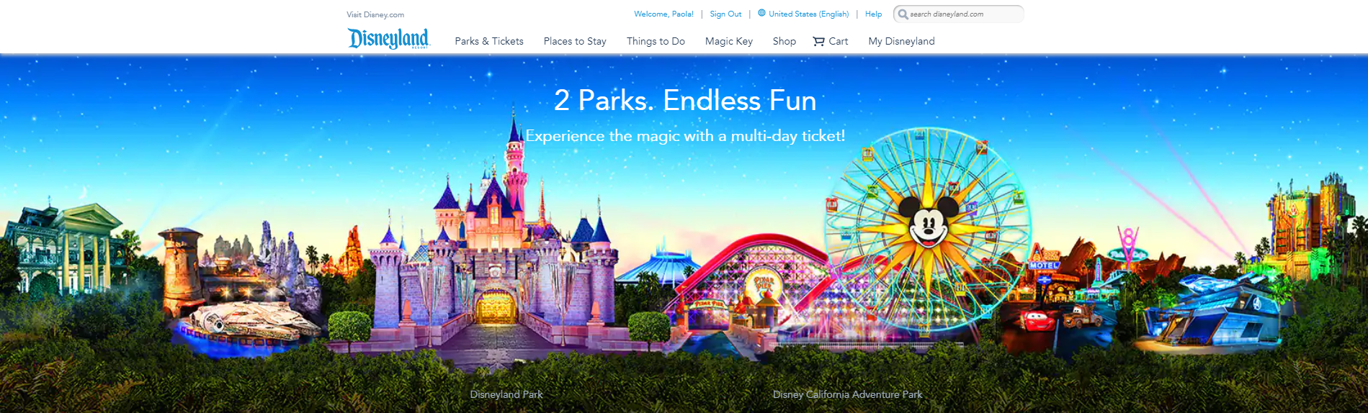
Module 6 · In Class · Examples · Two-Part Tariff
Disneyland: Two-Part Tariff
Park admission is the flat fee
Food, merchandise, etc are the usage fees
Management 405 · Module 6 · Complex Pricing and Advanced Pricing Strategies
38
Notes:
And the whole visit is a two-part tariff. Admission is the flat fee, and food, merchandise and the rest are the usage fees. The gate price takes the surplus; the in-park prices track the variable cost of serving you. Lightning Lane sits on the previous slide as versioning, so leave it out of this one.

Slide 39
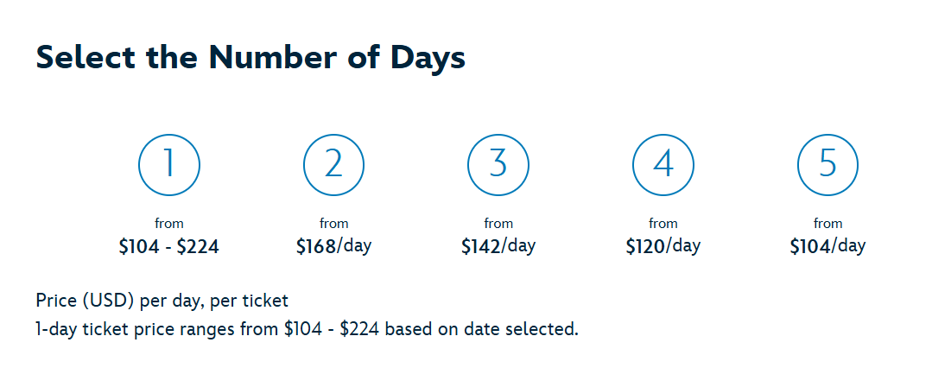
Module 6 · In Class · Examples · Flat Fee Pricing
Disneyland: Volume Pricing
The more you commit to, the less each visit costs
The frequent visitor pays a lower price per visit
Management 405 · Module 6 · Complex Pricing and Advanced Pricing Strategies
39
Notes:
The image is Disneyland's own day-ticket ladder: a single day runs from about $104 to $224, two days work out at about $168 a day, and five days at about $104. The more you commit to, the less each visit costs. That is block pricing under another name - the discount is tied to the quantity this visitor buys, not to who she is, so the park needs to know nothing about her.

Slide 40
Module 6 · In Class · Examples · Summary of Pricing Strategies
Disneyland: Summary
What Disneyland does | Which strategy it is
Child vs. adult tickets | Third degree — segment pricing
Prices that vary by date | Third degree — intertemporal
Lightning Lane tiers | Second degree — versioning
Gate price + in-park spending | Two-part tariff
Bundles of day tickets | Volume / block pricing
Management 405 · Module 6 · Complex Pricing and Advanced Pricing Strategies
40
Notes:
The table is the summary: every strategy in the module, running at one park on one afternoon. Worth leaving on screen while the class argues about which one is doing the most work. The usual answer is the two-part tariff, because the gate price is where the surplus actually gets taken.

Slide 41
Backup

Slide 42
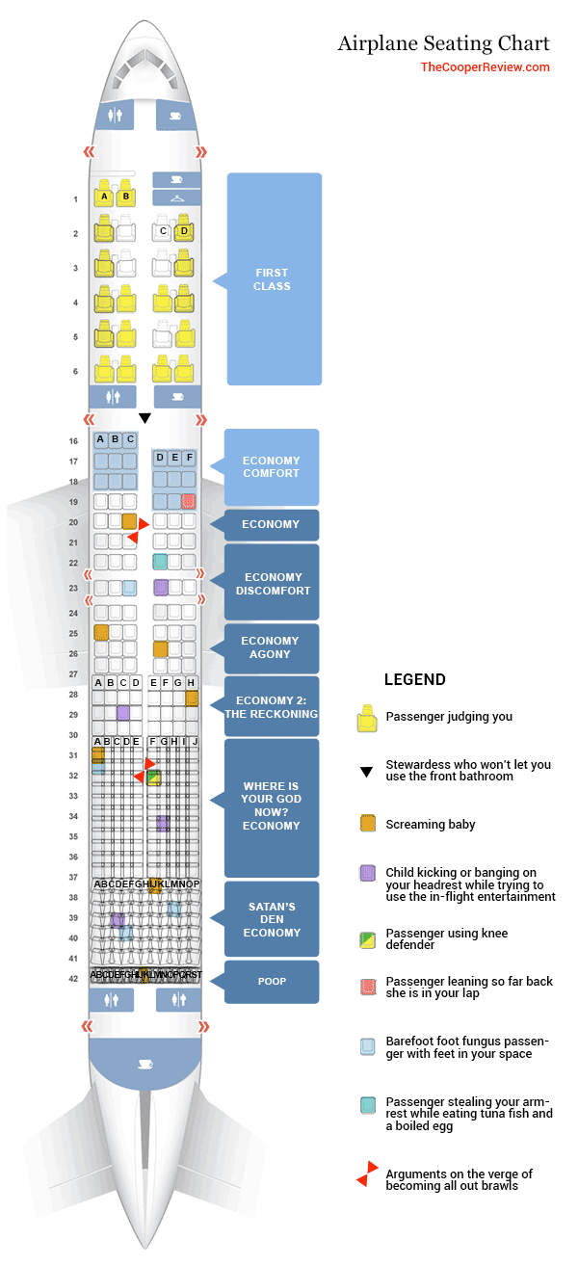
Airplane Seating Chart
TheCooperReview.com
← Back
Notes:
A backup slide, and a joke that makes the point better than a definition would. The Cooper Review's seating chart runs First Class, Economy Comfort and Economy, and then keeps going: Economy Discomfort, Economy Agony, Economy 2 The Reckoning, and Satan's Den Economy. It is versioning taken to its logical end. The cheap version has to be genuinely worse, or the customers who would have paid for the good one take it instead. Use it if the class pushes back on basic economy being made unpleasant on purpose.

