Slide 1
Auctions; Asymmetric Information
Module 8
Management 405
Prof. Nico Voigtländer · UCLA Anderson
Notes:
Module 8 covers two topics: auctions, and asymmetric information. We finish with elective classes in economics.

Slide 2
Module 8 · Course Roadmap
Agenda for the Class
1. Basic Principles and Economic Way of Thinking
2. Value and Demand
3. Supply and Cost
4. Markets, Pricing, and Strategy
we are here
Management 405 · Module 8 · Auctions; Asymmetric Information
2
Notes:
This is where we are in the course. We are in the last part, markets, pricing and strategy, and Module 8 is its final module.

Slide 3
Module 8 · Agenda
Outline of Module 8
1
Auctions
In class
2
Asymmetric Information [if we have time – not in the Final Exam]
In class
2a
Principal-Agent Problem
In class
2b
Moral Hazard
In class
2c
Adverse Selection
In class
2d
Signaling
In class
3
Elective Classes in Economics
In class
Management 405 · Module 8 · Auctions; Asymmetric Information
3
Notes:
Here is the plan for Module 8. We start with auctions. Then we look at asymmetric information: the principal-agent problem, moral hazard, adverse selection and signaling. We close with elective classes in economics.
The asymmetric information part is covered if we have time, and it is not part of the final exam.

Slide 4
Module 8 · Agenda
Outline of Module 8
1
Auctions
In class
2
Asymmetric Information
In class
2a
Principal-Agent Problem
In class
2b
Moral Hazard
In class
2c
Adverse Selection
In class
2d
Signaling
In class
3
Elective Classes in Economics
In class
Management 405 · Module 8 · Auctions; Asymmetric Information
4
Notes:
We begin with auctions: why sellers use them, the main formats, and how to bid in each.

Slide 5
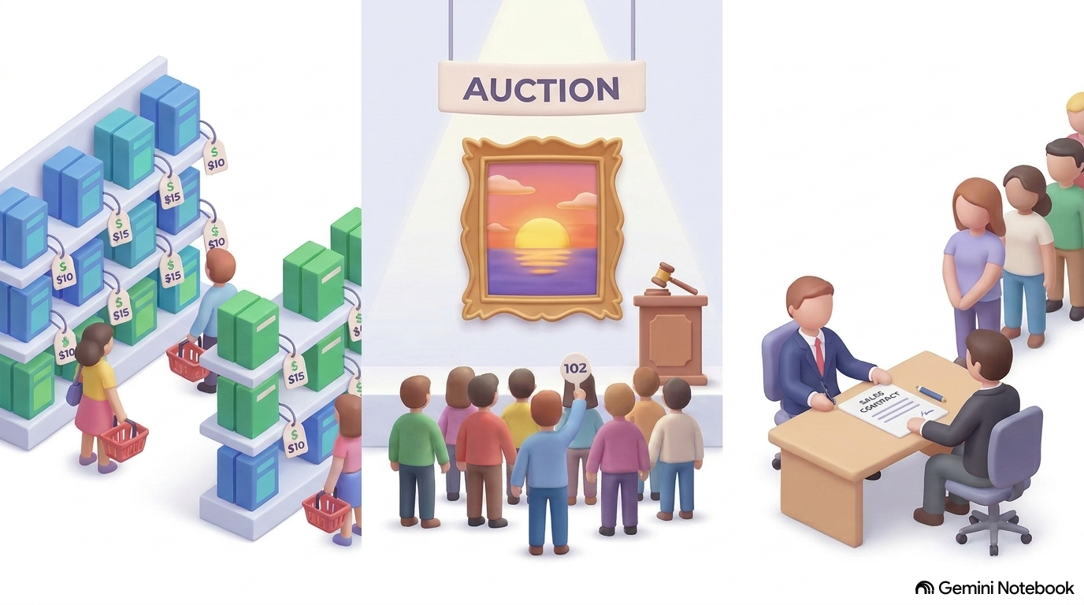
Module 8 · Auctions
Auctions
Auctions occupy a middle ground between markets with listed prices and individual deals / bargaining
Auctions are an efficient way to find a buyer with high willingness to pay for items that are special or unique
Management 405 · Module 8 · Auctions; Asymmetric Information
5
Notes:
Auctions sit between a posted price and a one-on-one negotiation. They are especially useful for items that are special or unique, where the seller does not know what buyers are willing to pay. The auction lets the buyers reveal it.

Slide 6
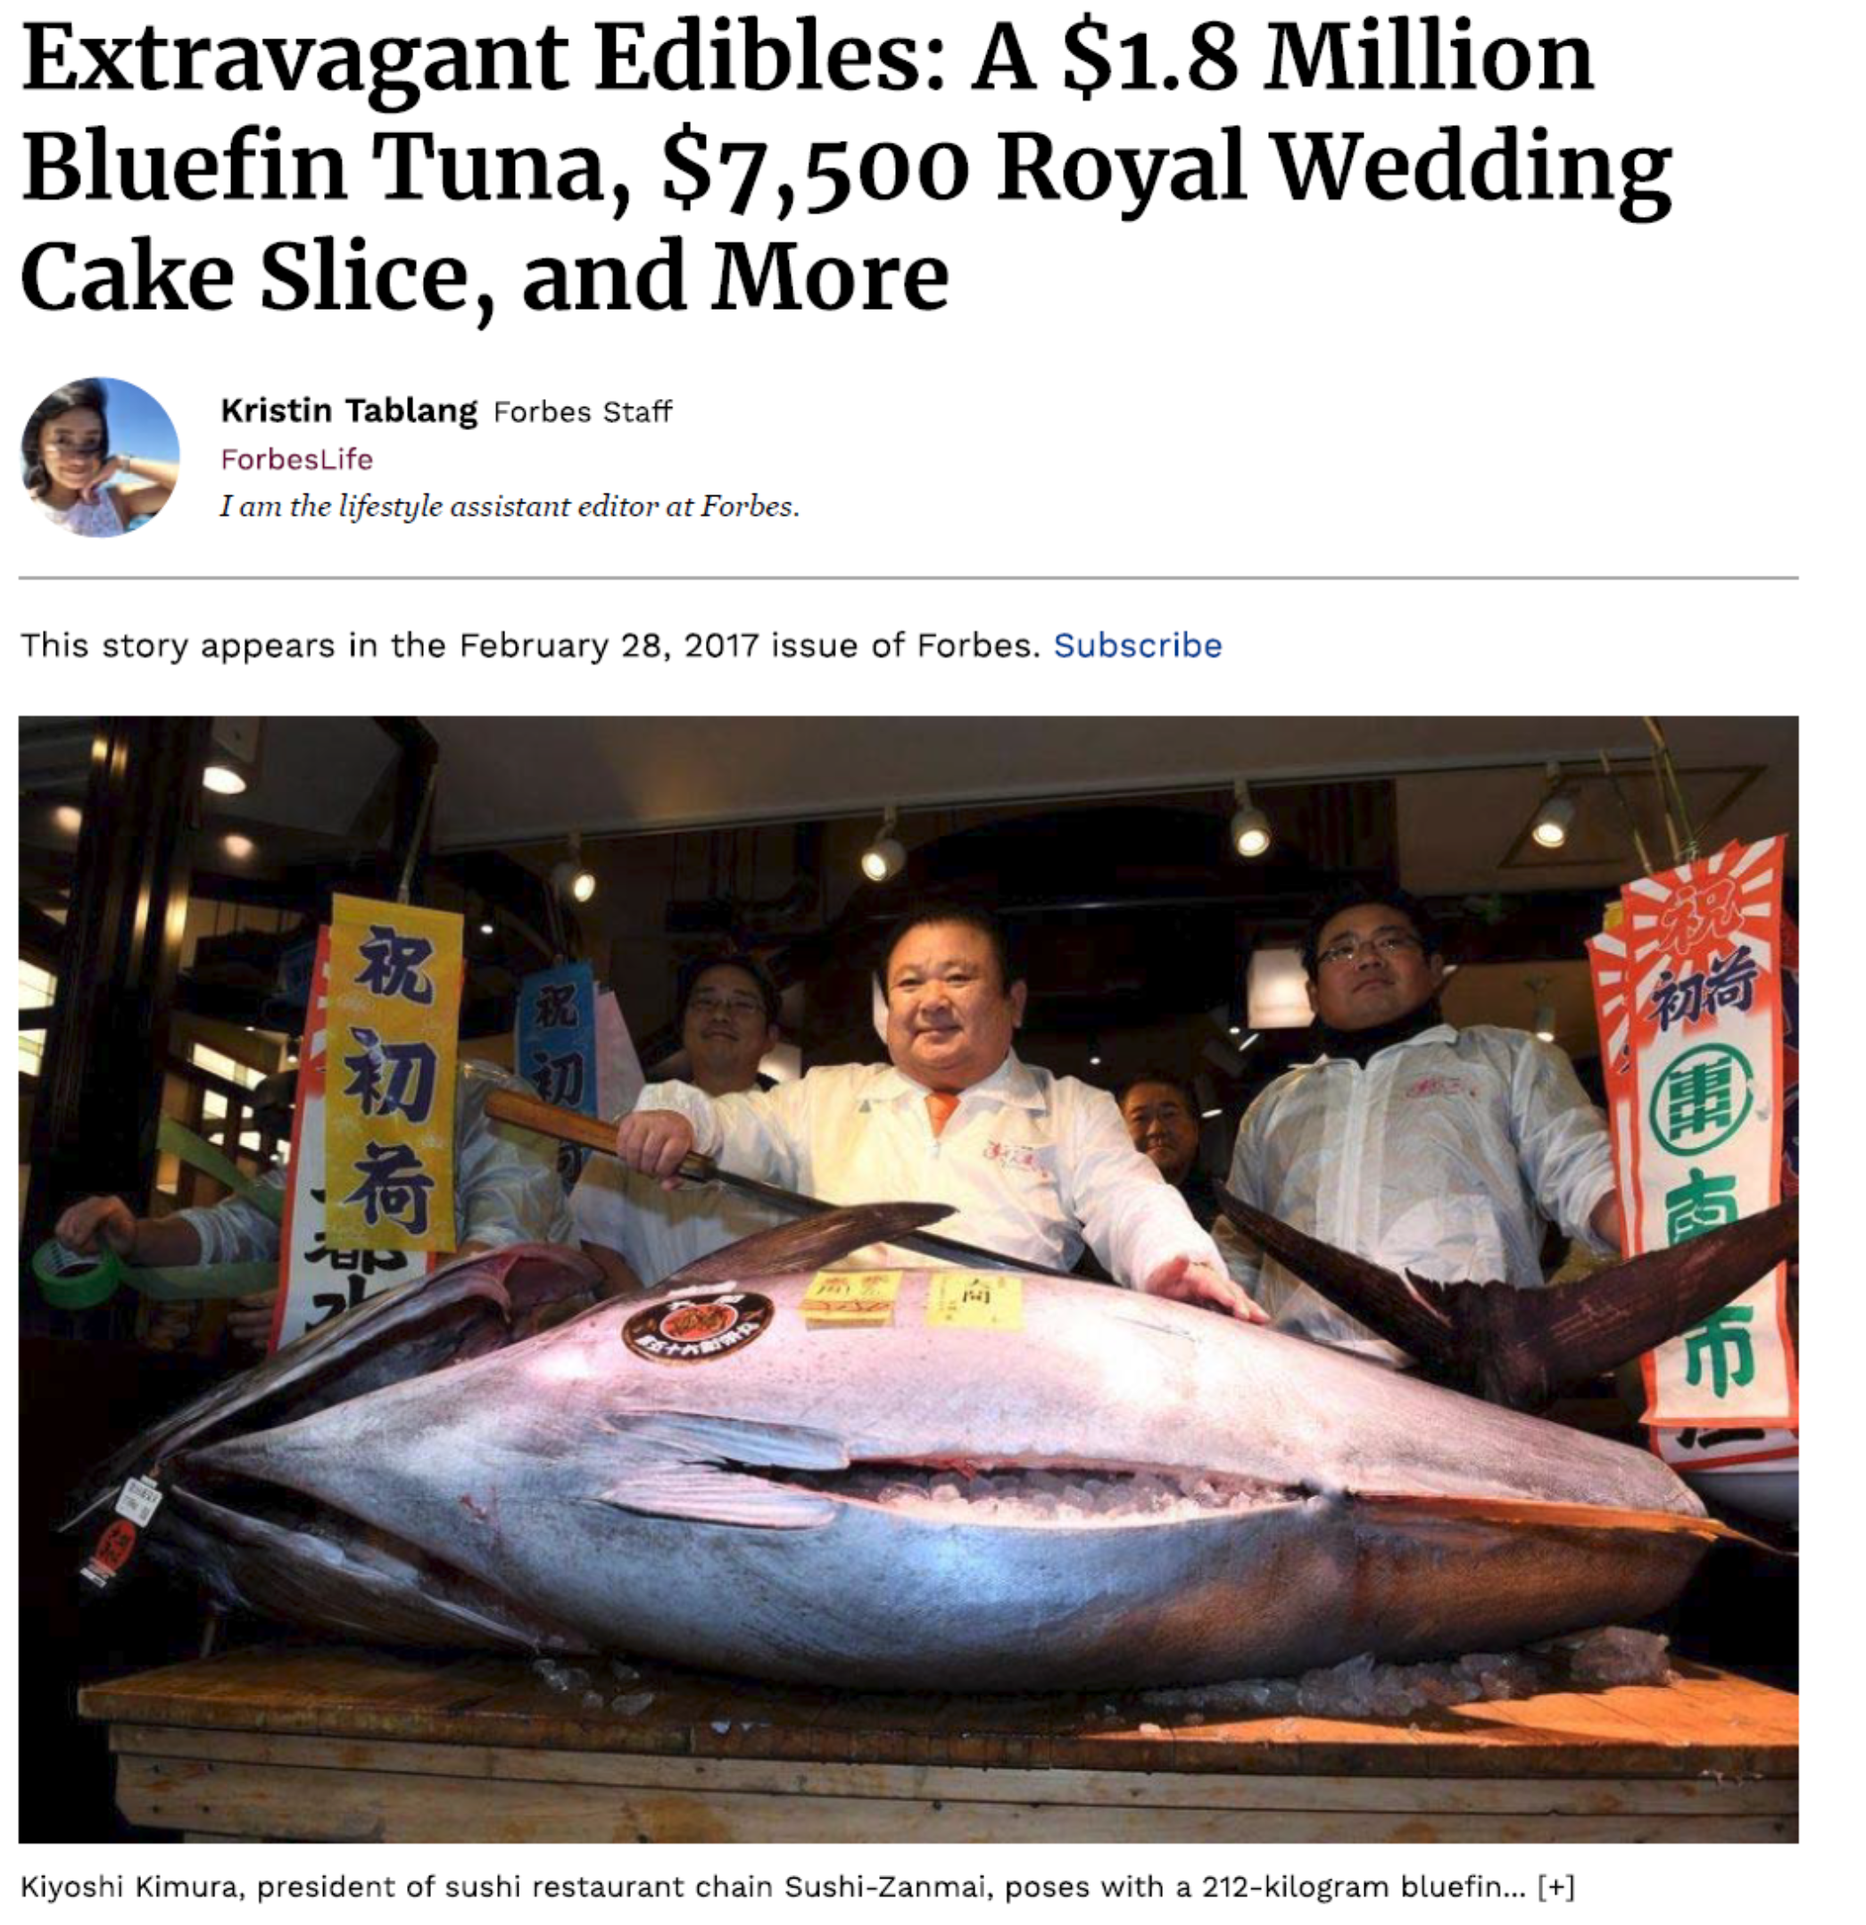
Management 405 · Module 8 · Auctions; Asymmetric Information
6
Notes:
Here is an extreme example from Forbes: a bluefin tuna sold at auction for $1.8 million. The fish is unique, and the auction finds the buyer who values it most.

Slide 7

Module 8 · Auctions
Advantages of Auctions
Better surplus extraction, when compared to list prices
Speed and flexibility, when compared to bargaining
Management 405 · Module 8 · Auctions; Asymmetric Information
7
Notes:
Compared with a list price, an auction extracts more of the buyers' willingness to pay, because the price rises to what the highest bidders will pay. Compared with bargaining, it is fast and flexible: many buyers are dealt with at once.

Slide 8
Module 8 · Auctions
Private Value vs. Common Value
Private Values
Common Values
Private values: buyers differ in how much they value the items being purchased
  Art auction: art lovers may have different willingness to pay for the same painting
Common values: buyers agree on the item’s value, but often the true value is unknown
  E.g., auctioning off an oil field: everyone is uncertain about how much oil there is in the ground. If it were known, all would have the same valuation
Management 405 · Module 8 · Auctions; Asymmetric Information
8
Notes:
An important distinction is between private value auctions and common value auctions:
In a private value auction, each bidder has a private value for an item (such as a Picasso painting) and this value is known to the bidder. Other bidders’ valuations for the item, however, are not necessarily known, and different bidders may have different valuations for the item. Each bidder must form expectations on what the other bidders’ valuations and bids are going to be.
In a common value auction, in contrast, bidders would all share the same valuation for the item, if that value were known. Unfortunately, in a common value auction the value of the item is not known to any of the bidders. Only the distribution of possible valuations is known. For instance, when bidding for an oil field, you might have some idea of the oil reserves it contains, and thus the potential value of exploiting the oil field, but there is uncertainty on that value. Everyone would agree on the value, if it were known, but it is not known. Each bidder must form expectations on the true value of the object, and on the beliefs of other bidders.

Slide 9

Module 8 · Auctions
Storage Wars: Private Value or Common Value?
Management 405 · Module 8 · Auctions; Asymmetric Information
9
Notes:
Watch the clip with the question in the title in mind: is a storage locker worth the same to every bidder, or does each bidder value it differently? Most bidders on the show are professional resellers, so a locker is worth roughly what its contents will fetch on resale, and that is about the same for everyone. But nobody knows that amount before the door opens. That makes the locker largely a common value item, the kind of auction we come back to with the winner's curse.
Storage Wars Season 1 Episode 3; Dave gets a collection of handcrafted bamboo fishing rods and makes a profit of $9,203.00.

Slide 10
Module 8 · Auctions
Types of Auctions
The following are four well-known auctions:
Live
Sealed bid
English Auction
First-Price Sealed Bid Auction
Dutch Auction
Second-Price Sealed Bid Auction
Management 405 · Module 8 · Auctions; Asymmetric Information
10
Notes:
We will consider 4 major types of auctions:
The English Auction. Also known as ascending auction. Under this form of auction bidders orally announce their bids in increasing order, and the last bidder to offer a bid obtains the item. Christie’s and Sotheby’s conduct art auctions like this.
The Dutch Auction. Also known as descending auction. The auctioneer starts at a high price and reduces it by given increments. The first bidder to bid wins the item. Flowers in Aalsmeer, Holland, the world’s largest flower market, are sold in this way.
The Sealed-Bid Auction. Bidders submit sealed bids, not knowing what other players have bid. The highest bid wins and pays the amount offered. Real-estate is often sold in this way.
The Second-Price Auction. Also known as the Vickrey Auction (after the economics Nobel Prize winner who studied them, William Vickrey). In this auction format, bidders submit sealed bids. The best bid wins, but the winner pays the amount offered by the second highest bidder. Slots for advertisers in Google’s search results pages are sold using this auction format.
There are many other types (e.g., all-pay auction).

Slide 11

Module 8 · Auctions
Live Auctions
English Auction
Bidders publicly announce bids in ascending fashion. E.g., Sotheby’s
Management 405 · Module 8 · Auctions; Asymmetric Information
11
Notes:
In an English auction, bidders call out ever higher bids, and the last bidder standing wins. Sotheby's and Christie's sell art this way, as the clip shows.

Slide 12
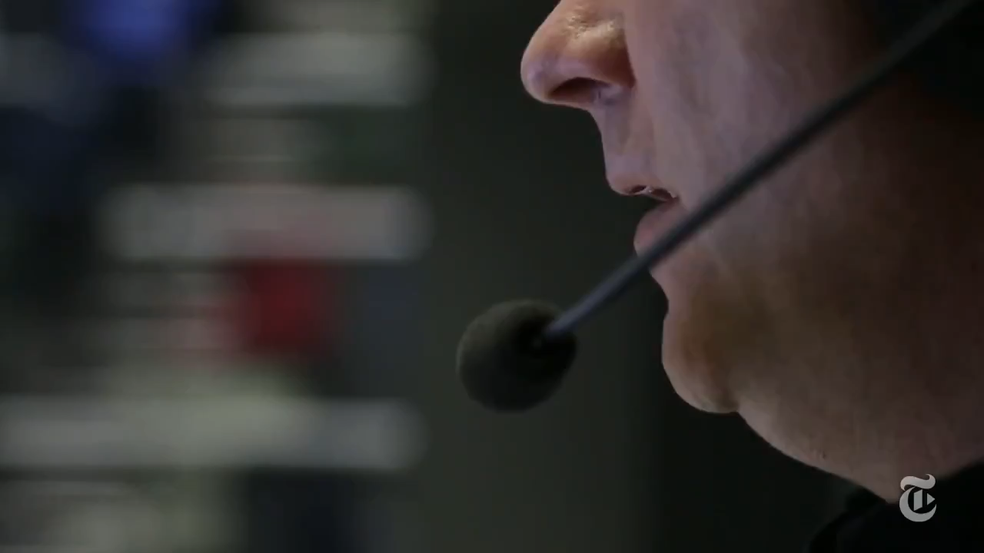
Module 8 · Auctions
Live Auctions
Dutch Auction
Descending auction: the auctioneer announces a high price and lowers it until someone decides to purchase at the going price. E.g., Aalsmeer flowers
Management 405 · Module 8 · Auctions; Asymmetric Information
12
Notes:
The Dutch auction runs the other way: the price starts high and falls until the first bidder accepts. The flower auction in Aalsmeer, in the Netherlands, uses a clock that counts the price down, as the clip shows.

Slide 13

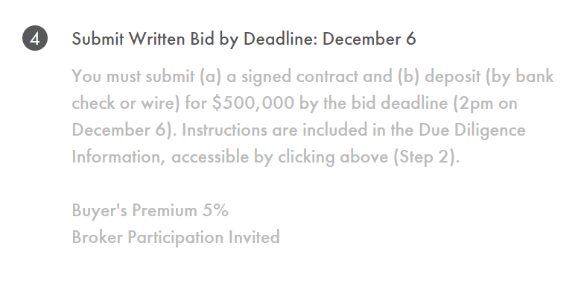
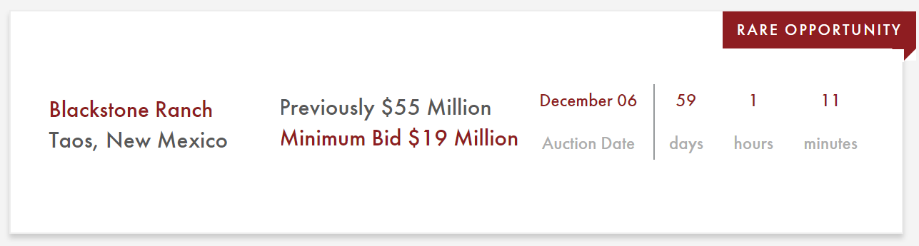
Module 8 · Auctions
Sealed-Bid Auctions
First-Price Sealed Bid Auction
Bidders submit sealed bids, not knowing what other players bid. The best bid wins. E.g., buying a house
Management 405 · Module 8 · Auctions; Asymmetric Information
13
Notes:
In a first-price sealed-bid auction, each bidder submits one bid without seeing the others, and the highest bid wins and pays its own bid. The example is a ranch sold by written bids with a deadline, much like buying a house.

Slide 14
Module 8 · Auctions
Sealed-Bid Auctions
Second-Price Sealed Bid Auction
Bidders submit sealed bids. The best bid wins, but the winner pays the amount bid by the second-best bidder. E.g., Google AdWords
Management 405 · Module 8 · Auctions; Asymmetric Information
14
Notes:
In a second-price sealed-bid auction, the highest bid still wins, but the winner pays the second-highest bid. Google's ad auctions are built on this idea, and the clip explains how.

Slide 15
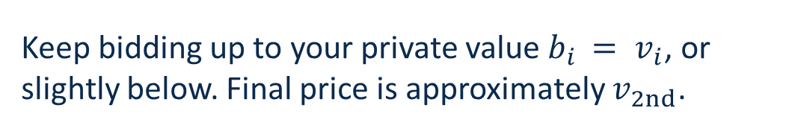
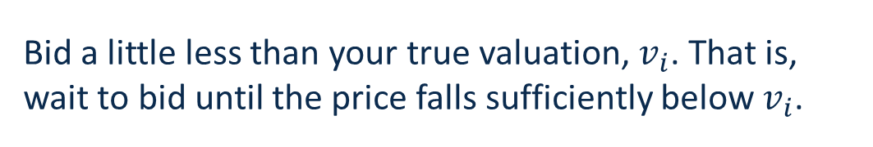
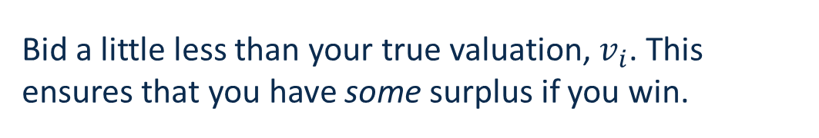
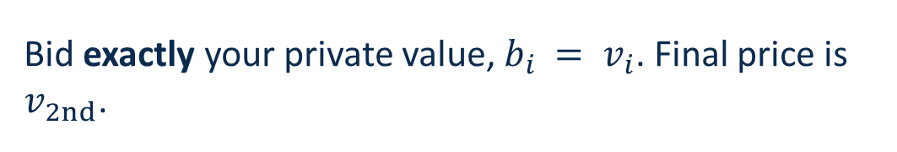
Module 8 · Auctions
Optimal Bidding Strategies
English Auction
(bidders publicly announce bids in ascending fashion)
Keep bidding up to your private value $b_{i} = v_{i}$, or slightly below. Final price is approximately $v_{2nd}$.
Second-Price Sealed Bid Auction
(sealed bids, best bid wins, but pays second-best bid)
Bid exactly your private value, $b_{i} = v_{i}$. Final price is $v_{2nd}$.
First-Price Sealed Bid Auction
(sealed bids, best bid wins)
Bid a little less than your true valuation, $v_{i}$. This ensures that you have some surplus if you win.
Dutch Auction
(the auctioneer announces a high price and lowers it until someone decides to purchase)
Bid a little less than your true valuation, $v_{i}$. That is, wait to bid until the price falls sufficiently below $v_{i}$.
Management 405 · Module 8 · Auctions; Asymmetric Information
15
Notes:
We will describe optimal bidding for each of the above 4 formats. Before we do so, it is useful to set some notation:
A buyer’s valuation for an object is denoted by vi, where i indexes the buyer. We will assume that valuations vi are distributed uniformly on some interval (i.e. support) [L,U]. That means that vi can take any value between the lower bound L and the upper bound U, with every value in-between equally likely.
Buyer i’s bid is denoted by bi. In this setup, the probability that any given bid b1 is greater than any other value b* drawn from the same distribution is:
Prob(b1 > b*) = (b1 − L) / (U − L)
So, for instance, if b1=L, the probability that b1 is greater than any other number drawn from the same uniform distribution is 0. If b1=U, that probability is 1. Makes sense. Try to see what happens if you bid at the halfway point of the distribution. It will also make sense.
In what follows we will assume that each bidder wishes to maximize the expected surplus from bidding. Expected surplus from bidding equals the probability of winning the auction times the surplus from obtaining the item. Formally, for bidder i:
E(profit) = Prob(bi wins) × (vi − bi)
This formula illustrates the fundamental trade-off of bidding: if your bid is high, your probability of winning is high but your surplus will be low. If your bid is low, your surplus will be high, but your chances of winning will be low. Optimal bidding balances out these two forces.
Finally we will define the second highest valuation among all the bidders as v2nd. This will turn out to be an important number.
We are now equipped to study optimal bidding in each format. We will examine this rapidly here, and spend more time on it in class.
The English Auction. The dominant strategy is for each player i to bid up to her valuation vi. The winning bid will pay just a little bit more than v2nd.
The Dutch Auction. This is trickier because bidders need to worry about other bidder’s likely behavior. As soon as the auctioneer quotes a price at or below my valuation, I should become willing to bid. But if I do so too soon, I may be left with too little surplus. If I do so too late, some other bidder may bid before I do, and I will lose. So each bidder’s optimal strategy is to wait to bid until the price falls “sufficiently” below vi before bidding. How much to wait depends on how many other bidders are playing (the greater the number, the less the bidder should wait), and their expected valuations for the object. The optimal bid turns out to be the same as under a sealed-bid auction. Despite their different formats, these auctions are actually the same!
The Sealed-Bid Auction. Each bidder’s optimal (equilibrium) strategy is to bid less than their willingness to pay vi. This is called shading your bid: bidding less than one’s valuation. The optimal bid is:
bi = L/N + vi × (N − 1)/N
where N is the number of bidders. The larger the number of bidders, the less one shades one’s bid. If there is an infinite number of bidders, bid your valuation. We will derive this in class.
The Second-Price Auction. Each bidder’s dominant strategy is always to bid their true valuation vi. You would never bid more, since your surplus would be negative. And you would never bid less, since that would reduce your chance of winning the item without affecting the amount you will pay. The item will be sold at a price equal to v2nd, just like under an English Auction.

Slide 16

Module 8 · Auctions
Bidding for a House
You bid in a first-price sealed-bid auction for a house
You value the house at $1.4M, but you’d like to get a good price on it
You are bidding against one other bidder. Their valuation is between $1.0M and $1.4M
How much would you bid?
Poll Break
Management 405 · Module 8 · Auctions; Asymmetric Information
16
Notes:
Here is the situation. You value the house at $1.4 million, and the only other bidder values it somewhere between $1.0 and $1.4 million. Take a moment and decide how much you would bid, then enter it in the poll.

Slide 17
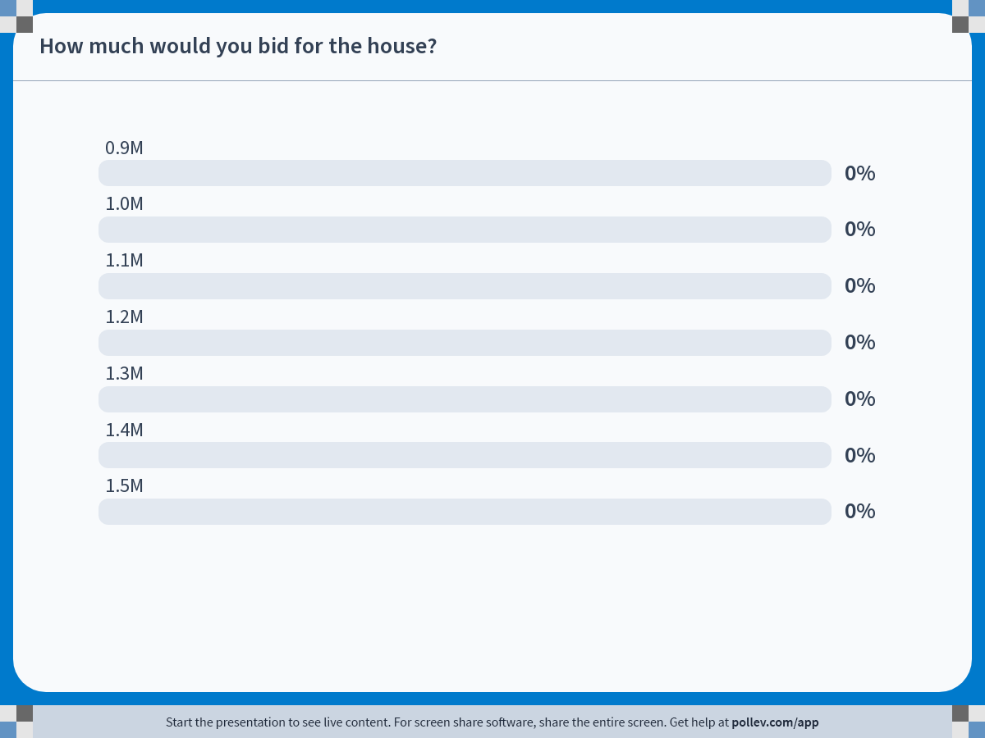
POLL
Notes:
Poll Title: Do not modify the notes in this section to avoid tampering with the Poll Everywhere activity.
More info at polleverywhere.com/support
How much would you bid for the house?
https://www.polleverywhere.com/multiple_choice_polls/3Ky9jjqCAyE1ZzpXHdeAA?state=opened&flow=Default&onscreen=persist

Slide 18

Module 8 · Auctions
(First Price) Sealed Bid Auction for a House
Your valuation (v) is $1.4M… but should you bid (b) that much?
Probability of winning
If you bid $1.4M, you win for sure
1.0
.75
Win probability
function
.50
If you bid $1.05M, the surplus (if you win) is high, but the probability of winning is low
.25
1. A low bid: $1.05M
If you bid $1.0M, there’s no way you’ll win
Expected surplus = $(v − b)·Pr(win)$
$1.0M
$1.1M
$1.2M
$1.3M
$1.4M
Bid
Poll Break
Management 405 · Module 8 · Auctions; Asymmetric Information
18
Notes:
This slide and the two following ones provide a geometric view of the tradeoff between winning probability and winning profitability in determining the optimal sealed bid.
The optimal sealed bid against a distribution of bids maximizes the area of the inscribed expected-profit rectangle.
Start with the two extremes. A bid of $1.0 million never wins, because the other bidder values the house at $1.0 million or more. A bid of $1.4 million always wins, but it leaves you no surplus. In between, the probability of winning rises in a straight line.
Now take a low bid of $1.05 million. If you win, you keep a surplus of $350,000. But you win only 1 time in 8, so the expected surplus is about $44,000. That is the area of the wide, flat rectangle.

Slide 19

Module 8 · Auctions
(First Price) Sealed Bid Auction for a House
Your valuation (v) is $1.4M
Probability of winning
1.0
Expected surplus =
$$(v − b)·Pr(win)$$
.75
Win probability
function
If you bid $1.35M, the probability of winning is high, but the surplus (if you win) is low
.50
.25
2. A high bid: $1.35M
$1.0M
$1.1M
$1.2M
$1.3M
$1.4M
Bid
Management 405 · Module 8 · Auctions; Asymmetric Information
19
Notes:
Now the opposite case. A high bid of $1.35 million wins 7 times out of 8, but if you win you keep only $50,000 of surplus. The expected surplus is again about $44,000, the same as for the low bid. The higher chance of winning is offset by the smaller gain, and the rectangle is now narrow and tall.
So neither extreme is a good idea. The next slide finds the bid in between that does best.

Slide 20
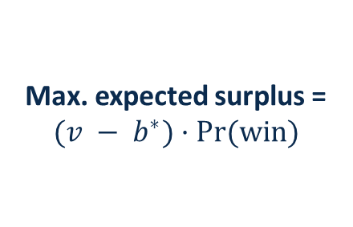
Module 8 · Auctions
(First Price) Sealed Bid Auction for a House
Your valuation (v) is $1.4M
Probability of winning
1.0
.75
Win probability
function
There is an optimal bid, b*, that maximizes expected surplus, balancing the probability of winning against the size of the realized surplus
.50
3. Optimal bid: $1.2M
Max. expected surplus =
$$(v − b^{∗})·Pr(win)$$
.25
$1.0M
$1.1M
$1.2M
$1.3M
$1.4M
Bid
Management 405 · Module 8 · Auctions; Asymmetric Information
20
Notes:
The best bid lies in between. At $1.2 million you win half the time, and you keep $200,000 when you do, so the expected surplus is $100,000. That is more than twice the expected surplus of the low or the high bid. Geometrically, the optimal bid gives the largest rectangle under the win-probability line.
The general lesson: in a first-price sealed-bid auction, you shade your bid below your valuation, trading a lower chance of winning against a larger surplus when you do win.
Math: Prob(win) = (b-1.0)*2.5. max (1.4-b)*(b-1.0)*2.5 → max [ (2.4b-b^2-1.4)*2.5 ] → d/db = 2.4-2b=0 → b*=1.2

Slide 21
Module 8 · Auctions
Common Value Auctions
Examples:
  Auctioning off an oil field
  FCC spectrum licenses for radio, cell phone, TV, etc.
  Auctioning off a jar of pennies
All bidders would agree on the value of the good, if only it were known
Management 405 · Module 8 · Auctions; Asymmetric Information
21
Notes:
Now the second kind of auction: common values. Here the item is worth the same to everyone, but nobody knows exactly how much. An oil field, spectrum licenses and a jar of pennies all have this feature.

Slide 22
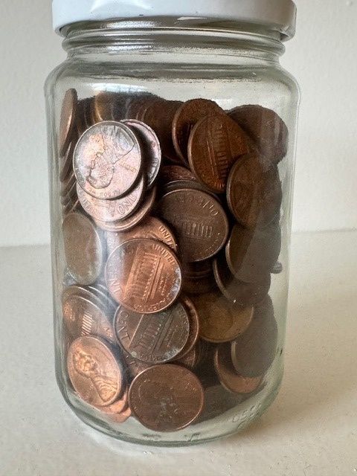
Module 8 · Auctions
Jar of Pennies Auction
Anyone care to bid real money for the contents of the jar?
  10 bidders
There are $X in the jar
Rules:
  If you bid b < X and win, you get the difference (X − b)
  If you bid b > X, you pay me the difference (b − X)
Management 405 · Module 8 · Auctions; Asymmetric Information
22
Notes:
Let's run this one live. There is an amount X in the jar. If you win with a bid below X, you keep the difference; if your bid is above X, you pay me the difference. Think about how much you would bid.
Notice what kind of auction this is. If we could count the coins, everyone in the room would agree on what the jar is worth. Nobody can, so each of you bids on an estimate. That makes it a common value auction, and the next slides show what tends to happen to the winner of such an auction.

Slide 23
Module 8 · Auctions
The Winner’s Curse: Setup
Suppose that you consider bidding on an oil field
The auction is a first-price sealed bid auction
Suppose the true value is $80 million, but it is unknown
It is reasonable to assume that the average bid among many bidders will be $80 million
By definition, the winning bid will tend to be on the high end of the distribution of bids
It is possible, even likely, that the winner will bid more than the true value of the good: the winner’s curse
Management 405 · Module 8 · Auctions; Asymmetric Information
23
Notes:
Take an oil field whose true value is $80 million, which nobody knows for sure. If the bidders' estimates are right on average, the average bid is about $80 million. But the winner is the bidder with the highest estimate, so the winner tends to be the one who overestimated. That is the winner's curse.

Slide 24
Module 8 · Auctions
The Winner’s Curse: Illustration
When the value of the auctioned item is highly uncertain, a winning bid (drawn from the right tail) will exceed the true value of the item
Value estimate distribution
w
w
w
w
$80M
Bid ($M)
Management 405 · Module 8 · Auctions; Asymmetric Information
24
Notes:
The red curve shows the bidders' estimates, centered on the true value of $80 million. The winning bids come from the right tail, marked with the w's. So the winner usually pays more than the item is worth.

Slide 25
Module 8 · Auctions
The Winner’s Curse: Shade Your Bid!
All bidders discount bids below their estimates (by $20M in this example)
Nonetheless, winning bids may still exceed the true value of the item, especially under high uncertainty about the true value (wide distribution)
Shaded bid distribution
Value estimate distribution
w
w
w
w
w
w
w
w
$60M
$80M
Bid ($M)
Management 405 · Module 8 · Auctions; Asymmetric Information
25
Notes:
The remedy is to shade your bid. If everyone bids $20 million below their estimate, the whole distribution of bids moves left, to the blue curve centered on $60 million. But winning bids can still end up above $80 million, especially when uncertainty is high and the distribution is wide.

Slide 26
Module 8 · Auctions
The Winner’s Curse: Remedies
Common value auction: shade your bid
The more bidders, the more you shade
  If you win against 50 bidders, you likely overestimated the value
Private value auction (sealed bid): shade less with more bidders
  Shading too much makes you lose, even with the highest valuation
Management 405 · Module 8 · Auctions; Asymmetric Information
26
Notes:
In a common value auction, shade your bid, and shade more when there are more bidders. If you win against 50 bidders, you very likely overestimated the value. With private values it is the other way around: more bidders mean you should shade less, or you will lose auctions you should have won.

Slide 27
Module 8 · Agenda
Outline of Module 8
1
Auctions
In class
2
Asymmetric Information [not relevant for the exam]
In class
2a
Principal-Agent Problem
In class
2b
Moral Hazard
In class
2c
Adverse Selection
In class
2d
Signaling
In class
3
Elective Classes in Economics
In class
Management 405 · Module 8 · Auctions; Asymmetric Information
27
Notes:
Next, asymmetric information: situations where one side of a deal knows more than the other. We look at the principal-agent problem and moral hazard, then at adverse selection and signaling.
This part is not relevant for the final exam.

Slide 28
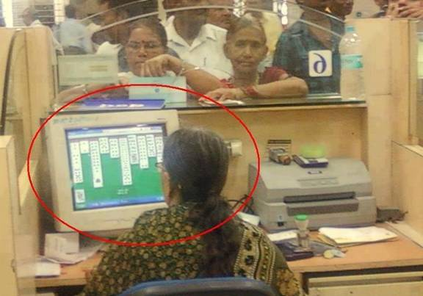
Module 8 · Principal-Agent Problem
Principal-Agent Problem
Two parties:
  Agent: person who acts (or recommends the action)
  Principal: person affected by the action
In a transaction between two individuals, one may have more information than the other:
  Asymmetric information
Moral hazard arises if:
  Agent has private information
  Agent and principal’s preferences are misaligned
Management 405 · Module 8 · Auctions; Asymmetric Information
28
Notes:
A principal-agent relationship has two parties: the agent, who acts or recommends the action, and the principal, who is affected by it. Often the agent knows more than the principal, which is asymmetric information. Moral hazard arises when the agent has private information and the two have different interests.

Slide 29
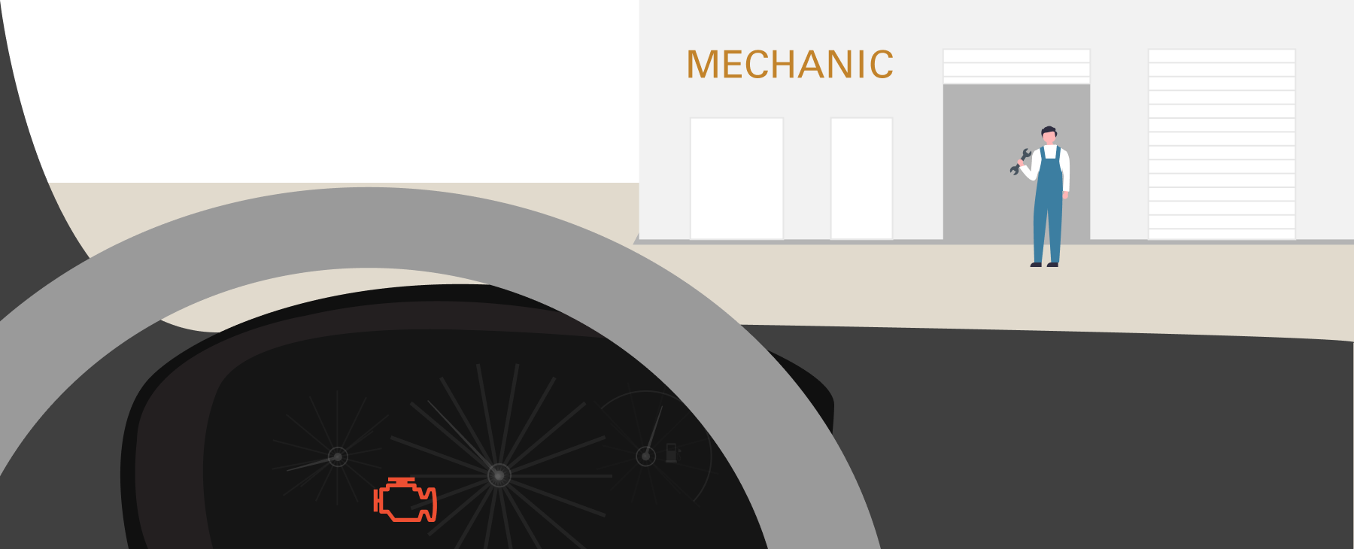
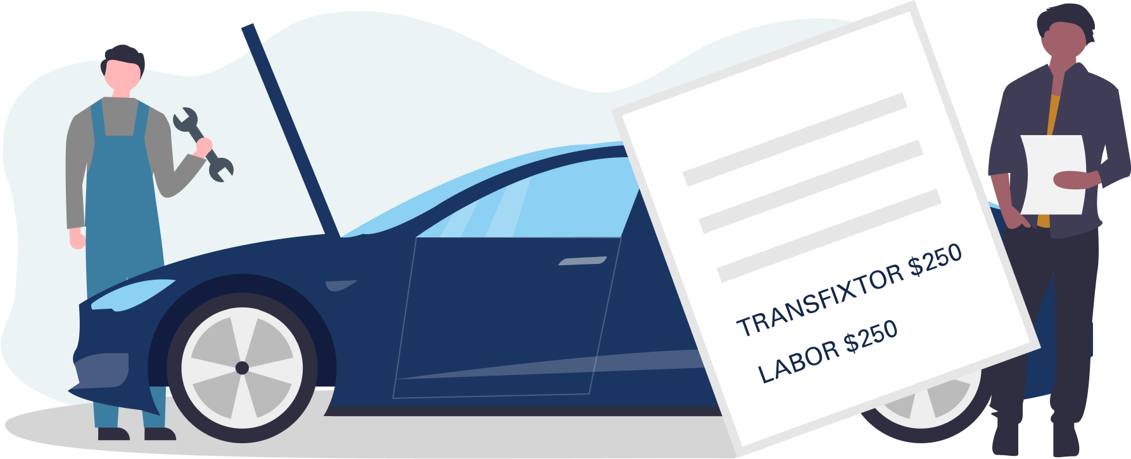
Module 8 · Principal-Agent Problem
Principal-Agent Relationship: Car Owner and Mechanic
Principal: Car owner
Agent: Mechanic
Asymmetric information
  Mechanic knows more about the true problem
Moral hazard
  Mechanic may exaggerate
Management 405 · Module 8 · Auctions; Asymmetric Information
29
Notes:
Let’s say that the engine light of your car turned on, so you take it to the shop. The mechanic runs some tests and comes back with a recommendation: you have to replace the “transfixtor”. It will cost you $250 for the parts and $250 for the labor.
In this situation, you are the principal, because you are the one who needs the car fixed and will have to pay for the repairs. The mechanic is the agent, because he is the one who can fix the car. There is asymmetric information because the mechanic knows a lot more about the car than you do. In fact, to show you how little you know about cars, “transfixtor” is not even a real car part. It is a word that I made up to prove this point. Why are the incentives misaligned? Well, you want to spend as little as possible, while the mechanic may want to recommend repairs that you don’t really need, in order to make a bit more money.

Slide 30


Module 8 · Principal-Agent Problem
Principal-Agent Relationship: Patient and Dentist
Principal: Patient
Agent: Dentist
Asymmetric information
Moral hazard
Experiment:
  Send person with perfect teeth to 180 dentists
  Ask for recommended procedure
Principal
Agent
Management 405 · Module 8 · Auctions; Asymmetric Information
30
Notes:
Now, I want you to think of your regular dentist appointment. The doctor takes a look at your teeth and recommends that you need a filling. You are the principal, because you care about your dental health and you would need to pay for the treatment. The doctor is the agent. There is asymmetric information because your dentist knows a lot more about dentistry than you. The incentives are misaligned because the dentist may want to recommend a treatment that you don’t really need, to make some extra money.
At this point, you may be a bit skeptical. You may think: in theory that sounds good, but in practice that will never happen. Some dentists may be more expensive than others, and some may do a better job than others, but there is NO WAY a dentist would put you through a painful procedure to make a few extra bucks. And you are right, dentists are honest… except when they are not.
Three economists designed a clever experiment to test this exact prediction.
They hired an actor with the perfect smile. This test patient was inspected by four trusted dentists, and they all confirmed that the patient did not have any cavities at all.

Slide 31
Module 8 · Principal-Agent Problem
Number of Recommended Fillings by 180 Dentists for a Patient with Verified ‘Perfect Teeth’
Number of fillings
6
50 out of 180 dentists recommended procedures, some as many as 5 or 6!
5
4
3
2
1
0
0
20
40
60
80
100
120
Number of dentists
Source: Gottschalk, F., Mimra, W. & Waibel, C. (2020). “Health Services as Credence Goods: A Field Experiment.” The Economic Journal, 130(629), 1346–1383
Management 405 · Module 8 · Auctions; Asymmetric Information
31
Notes:
Next, the researchers made check-up appointments with 180 dentists from the city of Zurich. Their hypothesis was straightforward: an honest dentist would not recommend any fillings.
On the contrary, they found that 50 out of the 180 dentists wanted to do a filling of at least one tooth. Some dentists recommended fixing up to 6 different teeth. They provide evidence that dentists were not just being sloppy, but intentionally dishonest: the dentists could not even agree on which tooth needed work. One dentist would recommend fixing one tooth, but another dentist would recommend fixing a different tooth. On top of the pain involved, those unnecessary treatments would have set the patient back, on average, 550 U.S. dollars.
I don’t want you to think that you can’t trust anyone. After all, I am an optimist. Rather than focusing on the 28% of dentists that were dishonest, we can celebrate the fact that 72% of them WERE honest. Those are really good odds. Indeed, there are economic forces that probably helped. For example: reputation. While doctors can make a quick buck recommending fillings that you do not need, that type of behavior may come back to bite them. They may get negative reviews and end up losing clients down the road.

Slide 32


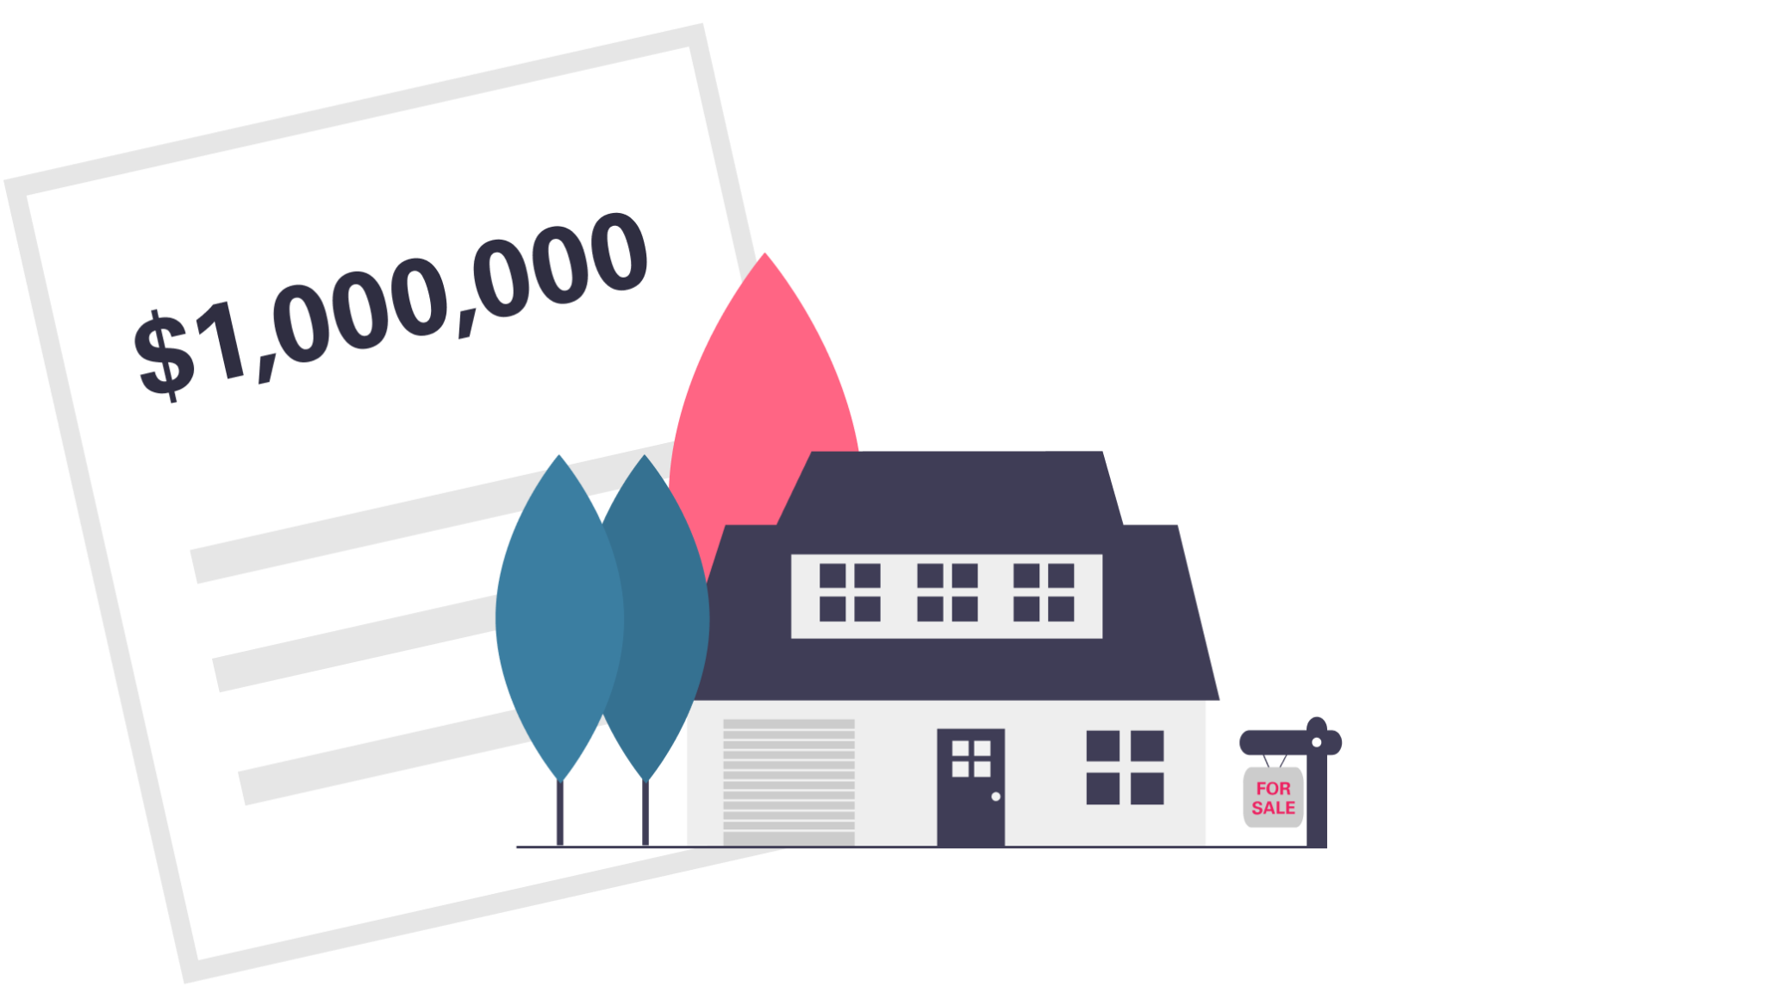


Module 8 · Moral Hazard
Solutions to Moral Hazard
Address the asymmetric information
  Collect information: true market value / second opinion →
Anticipate moral hazard
  Agents’ fees increase by little (3%) if you sell at a higher price → anticipate that the agent will push you to sell →
Address the incentive misalignment
Accept?
✗
or
✗
3% × $1M = $30K
3% × $1.2M = $36K
Only $6K more
Worth $1.2 million
Principal (owner)
Agent
Management 405 · Module 8 · Auctions; Asymmetric Information
32
Notes:
There are three ways to deal with moral hazard. First, address the information gap: find out the true market value or get a second opinion. Second, anticipate the agent's incentives. If the agent earns 3%, selling for $1.2 million instead of $1 million brings the agent only $6,000 more, so the agent may push you to accept the first offer. Third, address the misaligned incentives directly.

Slide 33

Module 8 · Moral Hazard
Health Insurance and Moral Hazard
Joey Loses His Insurance | Friends Vines, 2014
Source: https://www.youtube.com/watch?v=X8BPfLhH6MA
Management 405 · Module 8 · Auctions; Asymmetric Information
33
Notes:
Insurance is a classic case of moral hazard: once you are insured, you bear less of the cost of risky behavior. In this clip, watch how Joey behaves once he has lost his health insurance.

Slide 34
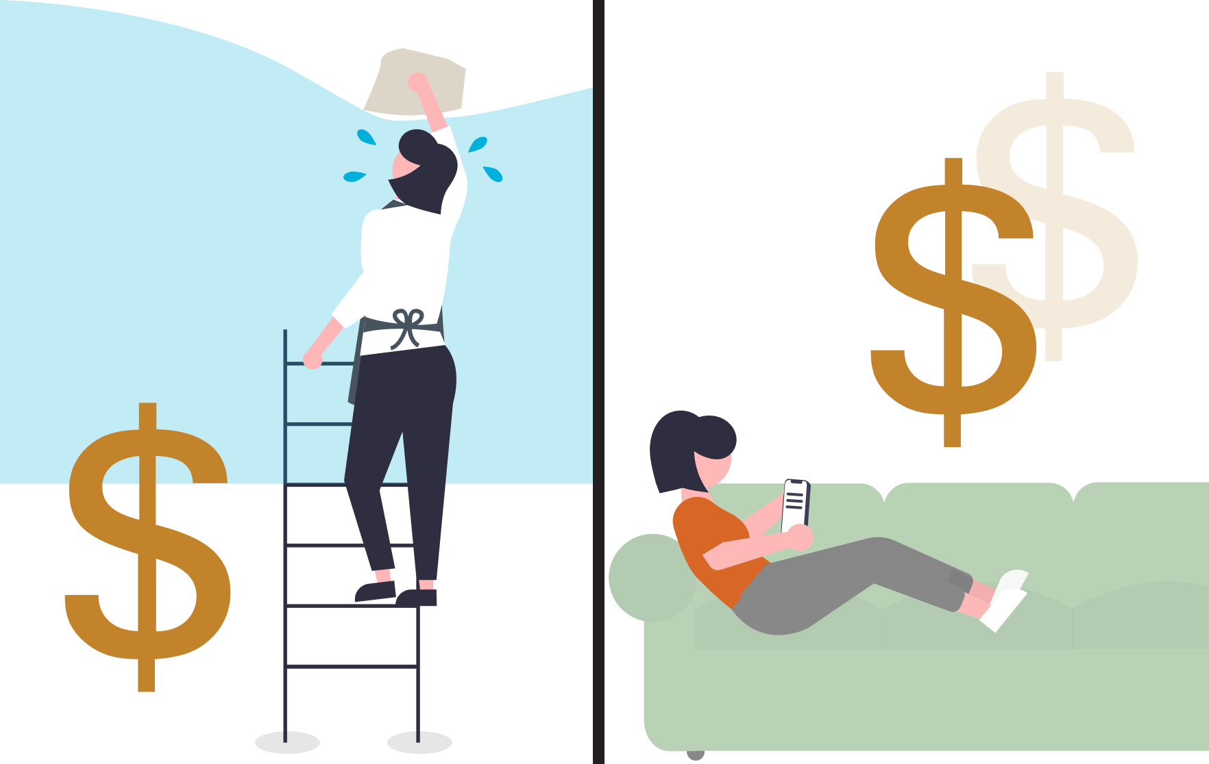
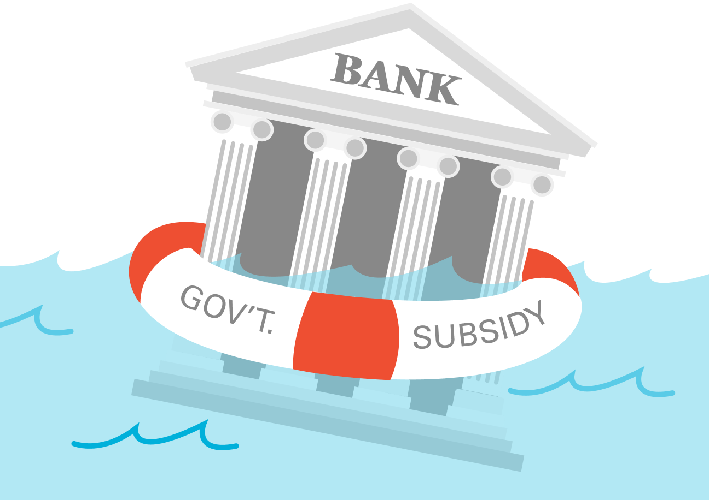
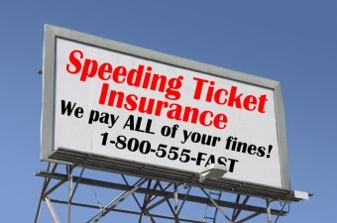

Module 8 · Moral Hazard
Insurance and Moral Hazard
Health insurance
Unemployment insurance
Bank insurance
Speeding ticket insurance
“Parental” insurance
Management 405 · Module 8 · Auctions; Asymmetric Information
34
Notes:
Each form of insurance on this slide shields people from part of the cost of a bad outcome, and that changes behavior. With health insurance, people may take less care of their health or use more medical care, because someone else pays. Unemployment insurance can make people search less hard for a new job. When bank deposits are insured, depositors have little reason to watch how their bank invests, so the bank can take more risk. And a driver whose speeding tickets are covered has less reason to slow down.
The last form of insurance I want to talk about is more abstract: parental insurance. Kids who grow up in rich families know that, when they grow up, their parents may be there to bail them out if needed. This could create moral hazard: these kids will not study and work hard, because they know they will get a great standard of living anyways.
On the other hand, this could end up being a good thing. Some of these kids may work hard, but take more risks than they would have taken without the insurance from their parents. They may want to become an entrepreneur, or an artist. Those are risky careers. If they had to support themselves, they would not have chosen them. But having parental insurance makes those career choices possible.

Slide 35
Module 8 · Adverse Selection
Adverse Selection
Adverse selection can arise when there is asymmetric information between buyers and sellers
  Used car market: buyer does not know whether a particular car has engine problems
  Labor market: employer does not know whether a particular worker is productive
  Financial market: a bank does not know if a particular loan applicant is trustworthy
  Insurance market: insurer does not know if a particular individual has high or low risk
Management 405 · Module 8 · Auctions; Asymmetric Information
35
Notes:
Adverse selection arises when one side knows its own type and the other does not. Used cars, workers, loan applicants and insurance customers are all examples: the seller of the car, the worker, the borrower and the insured each know more than the other side.

Slide 36
Module 8 · Adverse Selection
Illustrating Adverse Selection in the Used Car Market
There are two types of cars:
  “bad” (lemons)
  “good” (plums)
The seller knows the type of car
The buyer does not know the type
Illustration: separate slide deck
under “Lecture Slides” → “Module 8 – Lemons Market”
Result: “good” cars are pushed out of the market → market failure
Management 405 · Module 8 · Auctions; Asymmetric Information
36
Notes:
Take a used car market with good cars and bad cars, the lemons. The seller knows which one it is, but the buyer does not. The illustration is in a separate slide deck. The result is that good cars are pushed out of the market, which is a market failure.
Here is the logic in short. Because buyers cannot tell the cars apart, they will pay only what an average car is worth. That price is too low for the owners of good cars, so they keep their cars. The cars that remain on the market are worse on average, buyers lower what they are willing to pay again, and more good cars leave. This is George Akerlof's 'market for lemons' (1970).

Slide 37
Module 8 · Adverse Selection
Adverse Selection Lessons
Adverse selection leads to inefficiencies: untapped business
  Bad for firms, as they could also profit from low-risk individuals
  Bad for consumers, because low-risk types do not buy insurance
Learn to anticipate adverse selection. If you ignore it, you likely lose money
Next: ways to cope with adverse selection
Management 405 · Module 8 · Auctions; Asymmetric Information
37
Notes:
Adverse selection leaves business untapped. Firms lose the profitable low-risk customers, and those customers go without insurance. If you ignore adverse selection, you will likely lose money. Next we look at ways to cope with it.

Slide 38
Module 8 · Adverse Selection
Ways to Address Adverse Selection
Gather information: e.g., car insurance prices by risk group, to partly alleviate adverse selection
Screening: e.g., screen auto insurance applicants by driving histories, or let them choose combinations of premia / deductibles
Risk pooling: mandate people to buy insurance so they can’t select in or out (e.g., auto insurance, Medicare, Obamacare)
Reputation: earned from repeated interactions (e.g., Yelp, referrals)
Signaling: if a party can credibly signal their type, adverse selection (and/or moral hazard) may be reduced or eliminated
Management 405 · Module 8 · Auctions; Asymmetric Information
38
Notes:
There are five main responses. You can gather information and price by risk group, screen applicants, pool risks by making insurance mandatory, rely on reputation built over repeated interactions, or let the informed side send a credible signal.

Slide 39
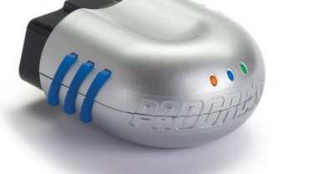
Module 8 · Signaling
Signaling
Suppose you could credibly signal to the insurance company that you are a low-risk customer: send a signal
The problem is that high-risk customers may have an incentive to lie and pretend to be low-risk customers
For signaling to work, sending the signal must be costly to the sender
The cost must be high enough to keep bad types from wanting to incur it, i.e., from pretending they are the good type
Progressive Snapshot
Management 405 · Module 8 · Auctions; Asymmetric Information
39
Notes:
Suppose you could prove to your insurer that you are a low-risk driver. The problem is that high-risk drivers would claim the same. A signal works only if it is costly, and costly enough that the bad types would not want to send it. Progressive's Snapshot device, which records how you drive, is an example.

Slide 40
Module 8 · Signaling
Signaling and Education (1)
Split workers half-half:
  “High type”: high productivity (MRPL = $70K per year)
  “Low type”: low productivity (MRPL = $50K per year)
Each worker is expected to work for 10 years
The firm cannot tell the type of the workers
Workers can signal their type by investing in education
Education is assumed not to affect productivity!
Management 405 · Module 8 · Auctions; Asymmetric Information
40
Notes:
Here is a simple model. Half of the workers are high types, with a marginal revenue product of $70,000 a year, and half are low types, with $50,000. The firm cannot tell them apart. Workers can invest in education, and we assume that education does not make anyone more productive.

Slide 41
Module 8 · Signaling
Signaling and Education (2)
The cost per year of college for the high type is:
  C_{H} = $40K × years of education
The cost per year of college for the low type is:
  C_{L} = $80K × years of education
Obtain a degree after 4 years
The firm follows the rule: “Pay $50K to workers without degree; pay $70K to workers with degree”
For simplicity: benefits over 10 years: $20K × 10 = $200K
What is the equilibrium? Is it separating?
Management 405 · Module 8 · Auctions; Asymmetric Information
41
Notes:
College costs the high type $40,000 a year and the low type $80,000 a year, and the degree takes 4 years. The firm pays $70,000 to workers with a degree and $50,000 to those without, so the degree is worth $20,000 a year, or $200,000 over 10 years. The question is whether the two types end up making different choices.

Slide 42
Module 8 · Signaling
Signaling and Education (3)
Low-productivity workers
High-productivity workers
Benefit / Cost
Benefit / Cost
What if the degree was awarded after 3? 2?
$400K
C_{L} = 80,000 × y
Benefit(y)
Benefit(y)
$200K
$200K
C_{H} = 40,000 × y
1
2
3
4
5
Years of college
1
2
3
4
5
Years of college
Degree
Degree
Management 405 · Module 8 · Auctions; Asymmetric Information
42
Notes:
For the low type, 4 years of college cost $320,000, more than the $200,000 benefit, so the low type does not get a degree. For the high type, the cost is $160,000, less than the benefit, so the high type does. The degree separates the two types. Now ask what happens if the degree took only 3 years, or only 2.
The answer depends on how costly the signal is for the low type. With a 3-year degree, college costs the low type $240,000, still more than the $200,000 benefit, so the degree still separates the two types. With a 2-year degree, it costs the low type only $160,000, less than the benefit, so the low type gets the degree too. Then the degree no longer tells the firm anything about who is productive.

Slide 43
Module 8 · Signaling
Signaling and Education: Take-Away
Education can serve as a signal of one’s productivity
The signal must be costly to yield separating equilibria
  i.e., education must be too costly for the low type to pursue it
Management 405 · Module 8 · Auctions; Asymmetric Information
43
Notes:
Education can signal productivity even if it does not raise it. For this to work, the signal has to be costly enough that the low type does not want to send it.

Slide 44
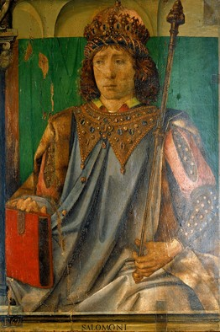
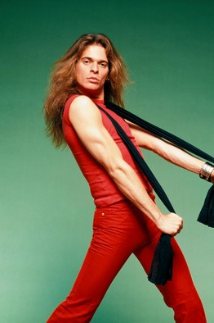
Module 8 · Signaling
More Examples for Signaling
What do King Solomon and David Lee Roth (Van Halen) have in common?
Both used signaling!
Medieval ordeals:
  Data on 308 cases that entered trial by ordeal in 13th-century Hungary (grab hold of a red-hot iron bar)
  100 aborted (defendant confessed)
  208 ordeals performed: only 78 were burnt! What happened?
Last example: ‘crazy’ claims by scammers
King Solomon
David Lee Roth
Source: Leeson, P. T. (2012). “Ordeals.” The Journal of Law and Economics, 55(3), 691–714
Management 405 · Module 8 · Auctions; Asymmetric Information
44
Notes:
Broad topic: Seducing people into sorting themselves into different categories can be all sorts of useful—and not just in admirable ways.
King Solomon built the First Temple in Jerusalem and was known throughout the land for his wisdom.
Early in Solomon's reign, two women came to him with a dilemma. They lived together—they were prostitutes by trade—and within the space of a few days had each given birth to a baby boy. One child had died, and now both women claimed the surviving baby as her own. "Fetch me a sword," Solomon said. "Divide the living child in two, and give half to the one, and half to the other." One woman embraced his solution. But the other begged Solomon not to hurt the baby and give it to her rival instead. Solomon promptly ruled in her favor, figuring that the real mother would rather give up her child than see it die.
David Lee Roth fronted the rock band Van Halen and was known throughout the land for his prima-donna excess.
By the early 1980s, Van Halen had become one of the biggest rock bands in history. Their touring contract carried a 53-page rider that laid out technical and security specs as well as food and beverage requirements. The "Munchies" section demanded potato chips, nuts, pretzels and "M&M's (WARNING: ABSOLUTELY NO BROWN ONES)."
When the M&M clause found its way into the press, it seemed like a typical case of rock-star excess, of the band "being abusive of others simply because we could," Mr. Roth said. But, he explained, "the reality is quite different."
Van Halen's live show boasted a colossal stage, booming audio and spectacular lighting. All this required a great deal of structural support, electrical power and the like. Thus the 53-page rider, which gave point-by-point instructions to ensure that no one got killed by a collapsing stage or a short-circuiting light tower. But how could Van Halen be sure that the local promoter in each city had read the whole thing and done everything properly?
Cue the brown M&M's. As Roth tells it, he would immediately go backstage to check out the bowl of M&M's. If he saw brown ones, he knew the promoter hadn't read the rider carefully—and that "we had to do a serious line check" to make sure that the more important details hadn't been botched either.
Medieval ordeals work the same way, as Peter Leeson (2012) argues. People believed that God would protect the innocent from the hot iron. So a guilty defendant expected to be burnt and preferred to confess, while an innocent defendant was willing to go through with the ordeal. Those who chose the ordeal were therefore mostly innocent, and the priests who ran it appear to have made sure that most of them passed: of the 208 defendants who carried the iron, only 78 were burnt.
The last example is the absurd story in a typical scam email. Cormac Herley of Microsoft Research (2012) argues that the far-fetched claims are deliberate: they make everyone but the most gullible readers stop right away. The scammer then spends time only on the people who are most likely to pay.

Slide 45
Module 8 · Agenda
Outline of Module 8
1
Auctions
In class
2
Asymmetric Information
In class
2a
Principal-Agent Problem
In class
2b
Moral Hazard
In class
2c
Adverse Selection
In class
2d
Signaling
In class
3
Elective Classes in Economics
In class
Management 405 · Module 8 · Auctions; Asymmetric Information
45
Notes:
Now a look at elective classes in economics that build on this course.

Slide 46
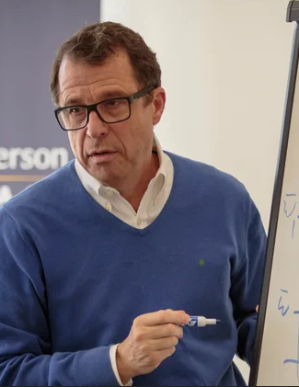

Module 8 · Elective Classes in Economics
“Global Economics and Business Cycles”
Sebastian Edwards, Brian Wheaton
Core Class
Analysis of the national and global economy: the environment in which every firm operates
Financial crises, recessions, and recoveries
The role of the Federal Reserve in the macroeconomy
Costs and benefits of a monetary union
How do countries grow over long periods of time?
Why do some countries grow faster than others?
Sebastian Edwards
Brian Wheaton
Management 405 · Module 8 · Auctions; Asymmetric Information
46
Notes:
If you want more on the macroeconomy, the core class Global Economics and Business Cycles covers the economic environment that every firm operates in.

Slide 47
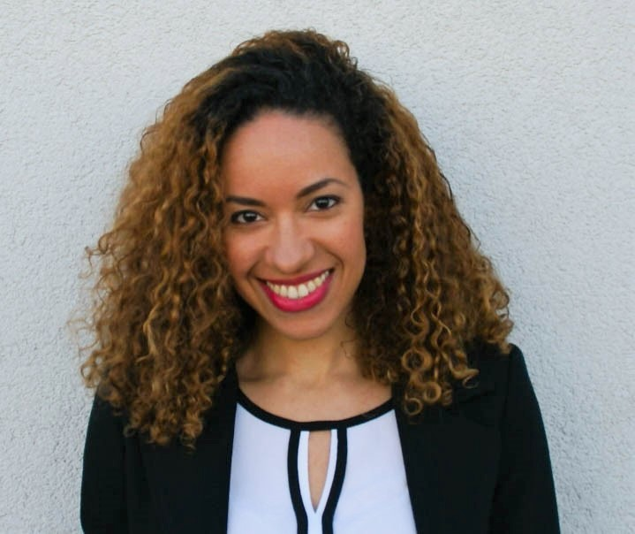
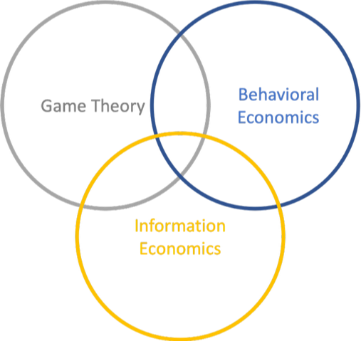
Module 8 · Elective Classes in Economics
“Market Games: How to Be Ahead of Competition”
Kathleen Ngangoue
Elective
What happens in markets when some parties are less informed than others?
How strategic do you have to be to conceal, reveal, or infer information?
Who is paying attention to what? How can we monetize information in today’s Attention Economy?
Kathleen Ngangoue
This course combines three disciplines: Game Theory (how to be strategic), Behavioral Economics (which pitfalls to avoid), and Information Economics (understand today’s trends in the Information Economy)
Management 405 · Module 8 · Auctions; Asymmetric Information
47
Notes:
Market Games builds directly on Module 8: it is about markets where some parties know more than others, and how to be strategic about information.

Slide 48

Module 8 · Elective Classes in Economics
“Global Trends”
Romain Wacziarg
Elective
Explores recent global trends affecting business: economic and geopolitical evolutions with first-order effects on management practices and business opportunities worldwide
A big-picture class covering a wide range of topics, e.g.:
  Is globalization reversing?
  How is automation altering the economy?
  How will the rise of new powers and new interest groups affect the conduct of business and policy?
  What are the major sources of global risk and uncertainty?
Debate and varying viewpoints among participants are encouraged, both in class and on online forums
Romain Wacziarg
Management 405 · Module 8 · Auctions; Asymmetric Information
48
Notes:
Global Trends is a big-picture class on economic and geopolitical developments that affect business worldwide.

Slide 49

Module 8 · Elective Classes in Economics
“International Business Economics”
Jerry Nickelsburg
Elective
Study the rich fabric of the international economic network
Analyze the impact of global events (e.g., the war in Ukraine) and how they affect risk and business decisions
Guest speakers will discuss foreign direct investment, intellectual property, and multinational retail
The course is centered around a practical student business case of a cross-border opportunity
Jerry Nickelsburg
Management 405 · Module 8 · Auctions; Asymmetric Information
49
Notes:
International Business Economics studies the international economic network and how global events affect business decisions.

Slide 50
Module 8 · Elective Classes in Economics
“Business Forecasting”
Jerry Nickelsburg
Elective
Forecasting (the art of constructing forward-looking statements) permeates all aspects of business decision making
This is a hybrid class that develops a practical tool kit for investment, business development, and business plans
Guest speakers will discuss forecasting in the airline and finance industries
Students will apply the techniques in a quarter-long business case forecasting project
Jerry Nickelsburg
Management 405 · Module 8 · Auctions; Asymmetric Information
50
Notes:
Business Forecasting develops a practical tool kit for forecasting in business decisions.

