Slide 1
Marginal Revenue
Module 2 · Video 2
Management 405
Prof. Nico Voigtländer · UCLA Anderson

Slide 2
Module 2 · Outline
Outline of Module 2
1
The Law of Demand
2
Elasticities
3
Demand and Revenue
3a
Elasticity and Revenue
3b
Marginal Revenue
The extra revenue from selling one more unit
4
Demand Estimation
Management 405 · Module 2 · Demand Analysis
2

Slide 3
Module 2 · Video 2 · Marginal Revenue
Context: Why Do We Care About Marginal Revenue?
General objective: maximize net benefits
Use marginal analysis
Net benefits are maximized where MB = MC
Firms’ objective: maximize profits
Produce where Marginal Revenue (MR) = Marginal Cost (MC)
Today: how to compute MR
Management 405 · Module 2 · Demand Analysis
3

Slide 4
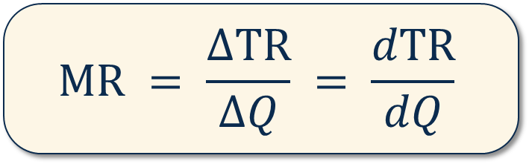
Module 2 · Video 2 · Marginal Revenue
Marginal Revenue: Definition
Intuitively: Additional revenue from selling one more unit
Mathematically: How much total revenue changes when quantity sold increases by one unit
$$MR = \frac{ΔTR}{ΔQ} = \frac{dTR}{dQ}$$
Derivative
How to compute MR : start from the demand function and use a 3-step method
Management 405 · Module 2 · Demand Analysis
4

Slide 5
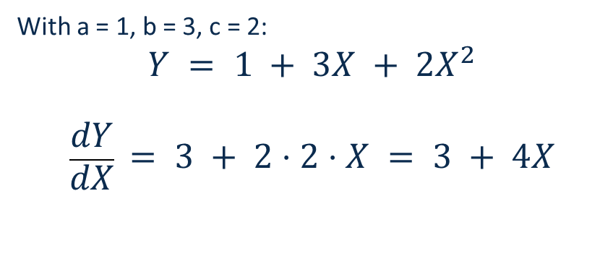
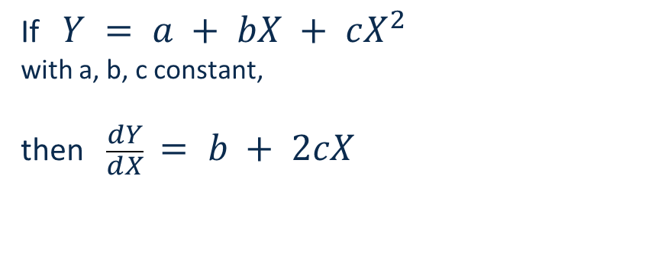
Module 2 · Video 2 · Marginal Revenue
Calculus Refresher: Derivatives
A derivative measures a rate of change. dY/dX is the change in Y caused by a small (marginal) change in X
The general rule
A worked example
If $Y = a + bX + cX^{2}$
with a, b, c constant,
then $\frac{dY}{dX} = b + 2cX$
With a = 1, b = 3, c = 2:
$$Y = 1 + 3X + 2X^{2}$$
$$\frac{dY}{dX} = 3 + 2⋅2⋅X = 3 + 4X$$
→ See TA’s Math Review Videos
Management 405 · Module 2 · Demand Analysis
5

Slide 6

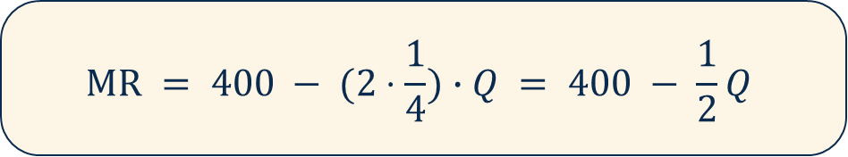
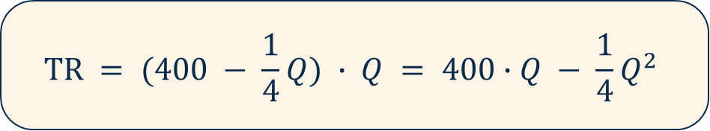
Module 2 · Video 2 · Marginal Revenue
3-Step Method to Compute Marginal Revenue
Suppose demand is: Q = 1,600 − 4P
Step 1: Calculate inverse demand (solve for P)
Rearrange demand so P is a function of Q: P(Q)
$$P = 400 − \frac{1}{4}Q$$
Step 2: Calculate total revenue (multiply P(Q) by Q)
TR = P · Q; replace P with inverse demand so TR is a function of Q only
$$TR = (400 − \frac{1}{4}Q) ∙ Q = 400∙Q − \frac{1}{4}Q^{2}$$
Step 3: Compute Marginal Revenue from total revenue (MR = dTR/dQ)
Take the derivative of TR with respect to Q
$$MR = 400 − (2⋅\frac{1}{4})∙Q = 400 − \frac{1}{2}Q$$
✎ Problem Set 2
▤ Teaching Note: Marginal Revenue
Management 405 · Module 2 · Demand Analysis
6
Notes:
Marginal Revenue = Marginal Cost when Demand is Linear
To set MR=MC, you need to know MC. For now, we assume a constant marginal cost: MC=$200. The harder part is MR. What is marginal revenue? In words, it is the change in revenues when you sell one more unit of the good. To get there, we want to find out what total revenue is only as a function of Q, so that we can take the derivative of revenue with respect to Q.
Let's write down a specific demand function and work through an example using this demand function:
Q=1600-4P
The Recipe
There are three steps to get to the mathematical answer for MR. You can apply this recipe whenever you face this type of problem:
Invert your demand. That's the inconvenient legacy of Alfred Marshall that I mentioned in class:
P=400 - 1/4 Q
(If you're wondering what I did here, I just took our demand function, put P on the left side, Q on the right side and divided everything by 4).
Write down total revenue. What's total revenue? It is P times Q. So:
PQ=400Q-1/4 * Q^2
(Here I just multiplied the previous equation by Q: easy!)
Find Marginal Revenue. That's the hardest step. It entails taking the derivative of PQ with respect to Q. You may or may not know any calculus. But (I promise!) you can do this even if you don't know any calculus. All you need to know is that the derivative of Q with respect to Q is 1, and that the derivative of Q2 with respect to Q is 2Q:
MR=(∆PQ)/∆Q=400-1/2Q
So now we have MR. You will notice that MR has twice the slope of the inverse demand function. The slope of the inverse demand function is -1/4 and the slope of MR is -1/2. When demand is linear, MR is always twice as steep as demand.
Where MR=0, demand is unit elastic
Try to understand intuitively why the elasticity of demand is exactly -1 when MR=0!
Total revenue is maximized where E_d=-1. If MR>0, then TR must be rising as Q increases. If MR<0, then TR must be declining.
Note that your goal is to maximize profits, not total revenue. A consideration of costs matters.
Now we set MR equal to MC ($200) and we are done:
MR=MC
400-12Q=200
Q=400
So now we know that maximizing profits entails setting Q=400. What about the price P? Well, that's easy to find: our price-quantity combination must be located on the demand curve. So from the inverse demand we derived earlier, we find:
P=400-1/4Q=400-100=$300
Maximizing profits, here, entails setting Q=400 units and P=$300.

Slide 7
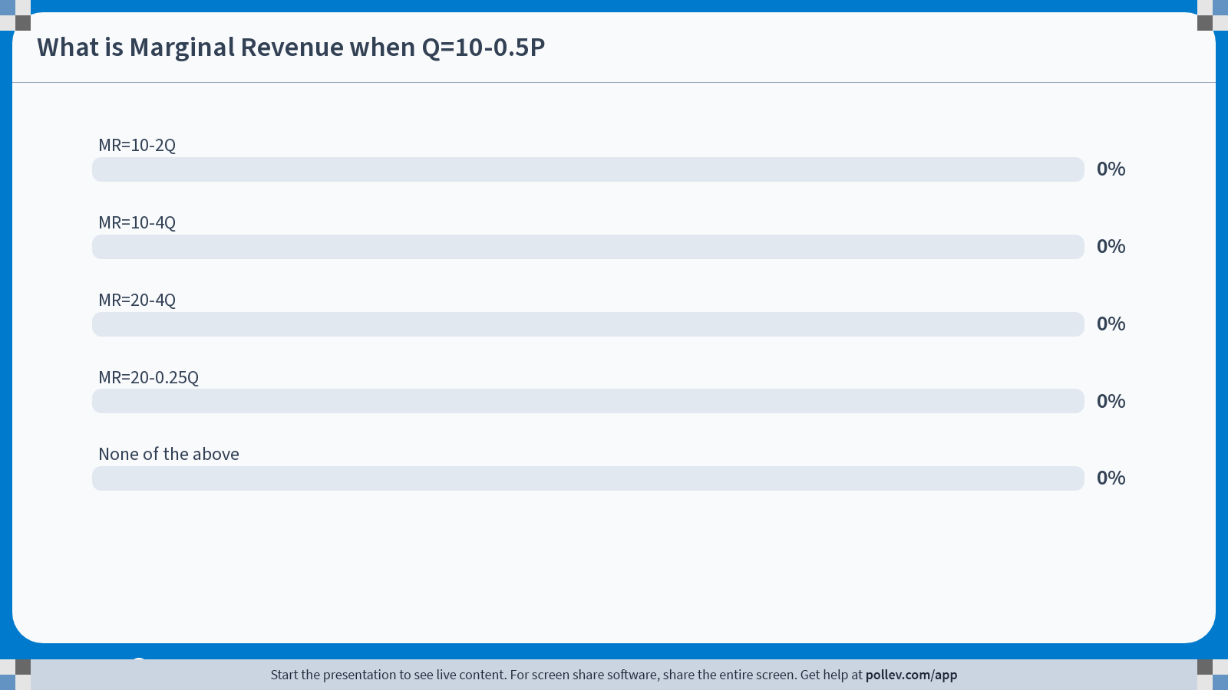
Poll Break
Notes:
Poll Title: Do not modify the notes in this section to avoid tampering with the Poll Everywhere activity. More info at polleverywhere.com/support What is Marginal Revenue when Q=10-0.5P https://www.polleverywhere.com/multiple_choice_polls/hj1ivMTBaXH6hMPPQBFLc?state=opened&flow=Default&onscreen=persist

Slide 8



Module 2 · Video 2 · Marginal Revenue
Solution: If Q = 10 − 0.5P , What Is MR ?
$$P = 20 − 2Q$$
1. Inverse Demand:
$$TR = (20 − 2Q) ∙ Q = 20Q − 2Q^{2}$$
2. Total revenue: TR = P ∙ Q
$$MR = \frac{dTR}{dQ} = 20 − 4Q$$
3. Derivative of TR w.r.t. Q:
Management 405 · Module 2 · Demand Analysis
8

Slide 9
Module 2 · Video 2 · Marginal Revenue
MR: Graphical Representation
P
400
Q = 1,600 − 4P
Elastic portion
P = 400 − Q/4
E_{D} = −1
TR = 400Q − Q²/4
Inelastic portion
MR
D
MR = 400 − Q/2
800
1600
Q
TR
TR is maximized where MR = 0
TR
800
Q
Management 405 · Module 2 · Demand Analysis
9
Notes:
Why isn’t MR just P?
For a firm with market power (which we will assume here), they will face downward sloping demand. In order to sell additional unit, it will have to lower the price. It will lower the price not just for the marginal unit, but for all units. This reduces the revenue the firm receives for the other units it sells. When computing the marginal revenue from the additional unit, it must also subtract the loss it suffers on every other unit.
Is there any situation under which MR=P?
Infinite elasticity. When the good is perfectly elastic, a firm doesn’t have to lower the price in order to sell more goods [quantity doesn’t depend on price]; the firm can sell any amount at a given price, so marginal revenue just equals P. This is known as perfect competition, which we will return to in the second half of the course when we discuss market power.
Can MR be negative?
Yes! In the left side of this plot, we see that MR is negative. To the right of the point of unit elasticity, TR is declining, meaning that each additional unit contributes negatively. That is another way of saying that MR is negative.

Slide 10
Module 2 · Video 2 · Marginal Revenue
Why Is MR Different From the Price?
MR : additional revenue from selling one more unit. Sounds like the price! But…
Law of demand: you need to lower the price to sell one more unit
The lower price will apply to all units, not just the extra one
MR from selling one additional unit takes into account the loss on every other unit → MR < P
Note: When MR < 0, Total Revenues (TR) decrease as price falls (and Q increases)
Management 405 · Module 2 · Demand Analysis
10

