Slide 1
Demand Estimation
Module 2 · Video 3
Management 405
Prof. Nico Voigtländer · UCLA Anderson

Slide 2
Module 2 · Outline
Outline of Module 2
1
The Law of Demand
2
Elasticities
3
Demand and Revenue
3a
Elasticity and Revenue
3b
Marginal Revenue
4
Demand Estimation
Measuring demand from data – market experiments and regression
Management 405 · Module 2 · Demand Analysis
2

Slide 3
Module 2 · Video 3 · Demand Estimation
How to Estimate a Demand Curve?
Use regression analysis to estimate the relationship between price and quantity
Need data linking prices to quantities
Several approaches
Transaction data (marketing firms, internet shopping, store club cards)
Surveys
Market experimentation
Management 405 · Module 2 · Demand Analysis
3
Notes:
Here we can say that we'll focus on market experimentation = cleanest way + increasingly ued thanks to new technologies + we'll discuss at the end why better than using transaction data

Slide 4

Module 2 · Video 3 · Demand Estimation
A/B Testing: What Is the Demand Function for This Product?
Management 405 · Module 2 · Demand Analysis
4

Slide 5
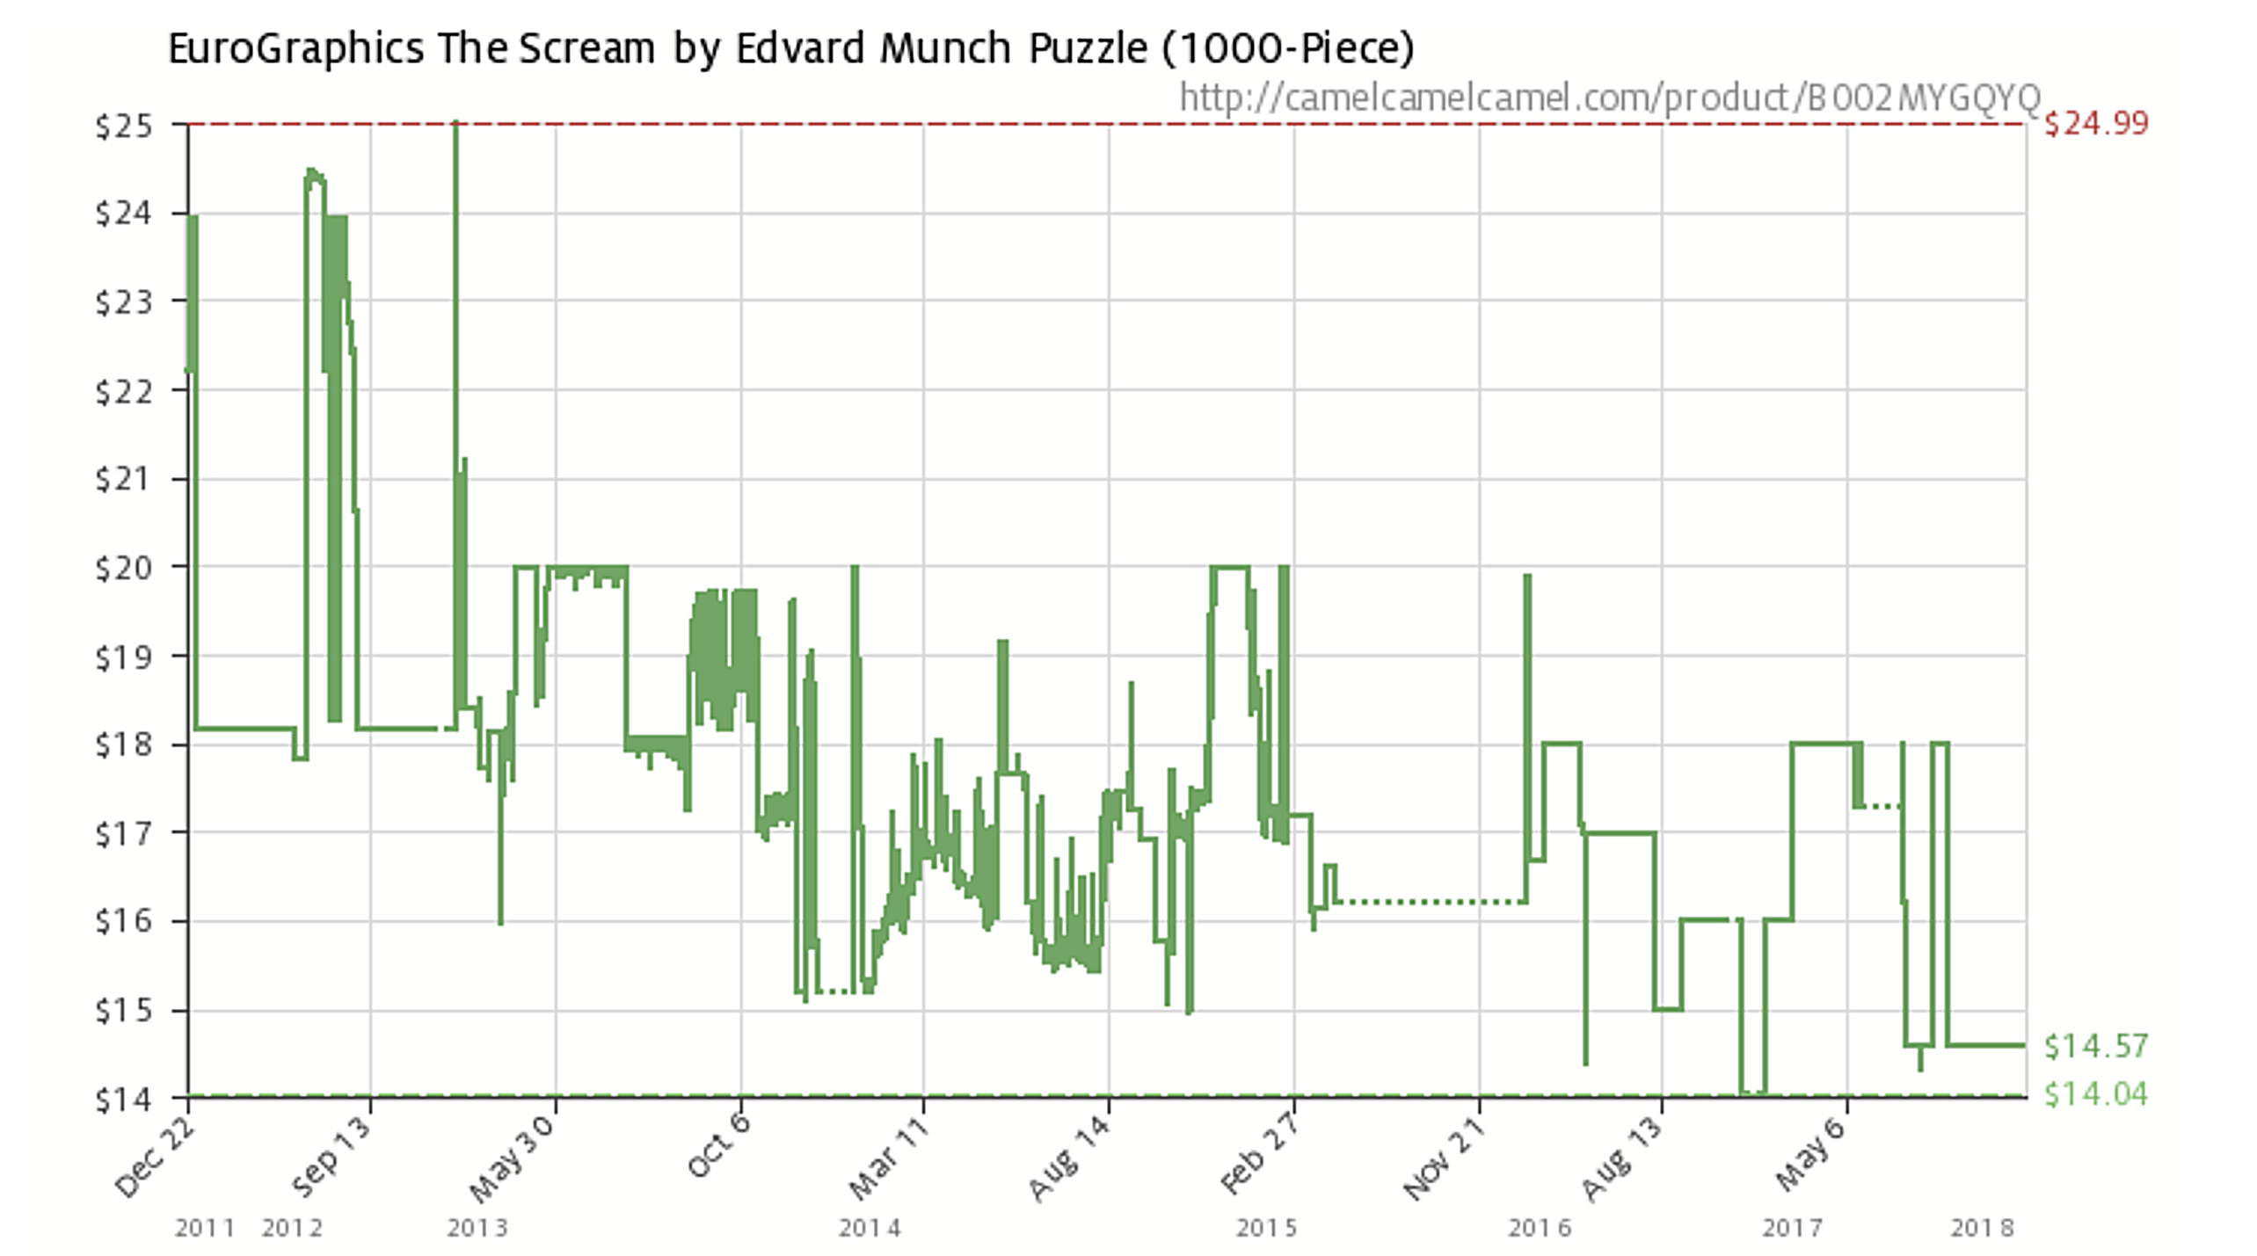
Module 2 · Video 3 · Demand Estimation
A/B Testing: Amazon “Experiments”
Management 405 · Module 2 · Demand Analysis
5

Slide 6
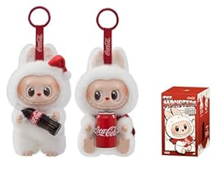
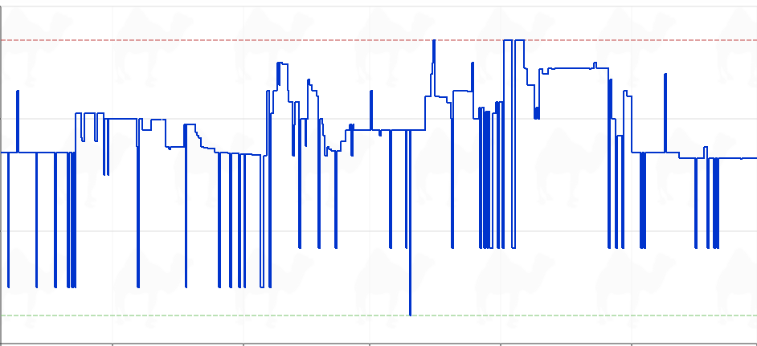
Module 2 · Video 3 · Demand Estimation
Recent Amazon “Experiments”
Pop Mart × Coca-Cola Labubu keychain
$90
$83.99
$70
$62.98
$50
$35.00
$30
May
Jun
Jul
Aug
Sep
camelcamelcamel.com
Management 405 · Module 2 · Demand Analysis
6
Notes:
camelcamelcamel.com is a free Amazon price tracker. It has followed Amazon listings since 2008 and plots the price history of a single product, marking the highest and lowest price it has ever recorded. The blue line on this slide is one listing over about five months, and the point is how restless it is: the price moves almost daily and swings between roughly $35 and $84 for the same item.
That is the illustration. Amazon is not running one A/B test and then settling on an answer, the way the previous slide's classic experiment does. It re-prices continuously, so the price variation we would need to estimate a demand curve is being generated all the time. The flip side is the warning that comes a few slides later: these price moves are not randomized, so quantity differences across high- and low-price days also reflect whatever else changed on those days (a holiday, a competitor's promotion, a stock-out).
The product above the chart is a Labubu, in case that name means nothing to you. Labubu is a character - an elf-like creature with pointed ears and a wide, serrated grin - created by the Hong Kong illustrator Kasing Lung for his picture-book series THE MONSTERS, which he started in 2015 and drew from Nordic folklore. In 2019 Lung signed an exclusive licence with Pop Mart, a Chinese designer-toy company, which turned the character into small vinyl and plush collectibles sold in BLIND BOXES: you pay for a sealed box and only find out which variant of the series you got when you open it, with one rare 'secret' version per case.
From about 2024 the toys became a global craze, helped by celebrities photographed with one clipped to a handbag, and Pop Mart's Labubu lines have been a large part of its revenue growth. The one on this slide is from the Coca-Cola collaboration series. That background is exactly why the price line is so restless: supply comes in limited drops, demand is faddish, and the listing gets re-priced constantly. Nothing in the economics turns on the product, though - any item with a volatile price would make the same point.

Slide 7
Module 2 · Video 3 · Demand Estimation
Econometric Estimates
Econometrics: combine economics, statistics, and mathematical model building
Develop hypotheses linking dependent variables (e.g., sales) to explanatory variables (e.g., price)
How: Least Squares regression analysis
Covered in detail in your Stats class
Today: A broad overview
What you need for our class: Interpret and use the estimated coefficients
Management 405 · Module 2 · Demand Analysis
7

Slide 8
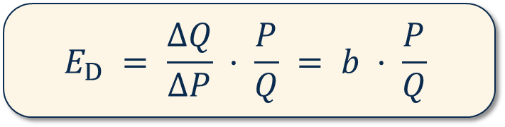
Module 2 · Video 3 · Demand Estimation
Ordinary Least Squares: Estimating the Demand Function
Q = a + b · P
Q = dependent variable
P = independent variable
a = intercept with the y-axis (Q on y-axis)
b = slope of the regression line (demand curve)
$$E_{D} = \frac{ΔQ}{ΔP} · \frac{P}{Q} = b · \frac{P}{Q}$$
Management 405 · Module 2 · Demand Analysis
8
Notes:
The basic equation is a demand equation: Q=a+bP. We expect b<0, because that determines that the own-price elasticity is negative.

Slide 9

Module 2 · Video 3 · Demand Estimation
Airline Ticket Experimentation: Data
Price ($) | Seats sold
250.00 | 64
265.00 | 33
265.00 | 37
240.00 | 83
230.00 | 111
225.00 | 137
225.00 | 109
220.00 | 96
230.00 | 59
235.00 | 83
245.00 | 90
240.00 | 105
250.00 | 75
240.00 | 91
240.00 | 112
235.00 | 102
Management 405 · Module 2 · Demand Analysis
9

Slide 10
Module 2 · Video 3 · Demand Estimation
First Pass: Eyeball the Relationship
Scatterplot of Q versus P
Quantity
150
Which line provides the best fit?
100
50
220
240
260
Price ($)
Management 405 · Module 2 · Demand Analysis
10

Slide 11
Module 2 · Video 3 · Demand Estimation
Least Squares Estimation
Quantity
150
Least Squares Algorithm
1. Calculate all vertical distances
2. Square them
3. Sum them over all data points
4. Choose the line that minimizes the sum of squares
100
50
220
240
260
Price ($)
Management 405 · Module 2 · Demand Analysis
11

Slide 12
Module 2 · Video 3 · Demand Estimation
Regression Results for the Airline Data
Coefficient | Value
Constant (intercept) | 478.95
Own price | −1.64
Q = 478.95 − 1.64 P
Now that we have an estimated demand curve, we can compute MR (Following the 3 steps we’ve seen above)
Management 405 · Module 2 · Demand Analysis
12
Notes:
The intercept term is the value of a: horizontal intercept. When the price is zero you sell 479 units.
The price has a negative coefficient: b=-1.64. Price and volume are inversely related, as in a demand function. For every unit you drop the price, you get a 1.64 unit expansion in volume sold.
So now we have our values for a and b, respectively.

Slide 13
Module 2 · Video 3 · Demand Estimation
Application Using the Airline Demand Function
Q = 478.95 − 1.64 P
Use the estimated airline demand to compute:
What Is E_{D} at P = 140?
What Is MR at P = 140?
Can you provide a Pricing Recommendation?
✎ Problem Set 2
Poll Break
Management 405 · Module 2 · Demand Analysis
13
Notes:
So, can we do better than an R2 of 0.59? Yes. Economics tells us a lot of other things besides your own price drive demand: income, price of substitutes, how much you spend on promotion and advertising, etc. So let’s include them in the regression and see what happens. -> even if we have randomized prices, these factors might change and including them will increase precisions
The multivariate model includes two additional regressors or independent variables:
1. There is a competitor with a substitute product available (say United versus American)
2. You have data on average income in the US at the time of the sales. That is a factor that influences demand (what is the expected direction? Positive if air travel is a normal good).
Move to multiple regression module of the Excel workbook. Units are $ for price but an index for the income level. Run a multivariate regression of quantity on own price, price of substitute and income. The dependent variable stays the same, the independent variables now include Y and Pc.
On Problem Set 2, you will have the opportunity to run a regression, and interpret and use the coefficients!

Slide 14
Module 2 · Video 3 · Demand Estimation
Solution: E_{D} at P=140
Q = 478.95 − 1.64 P
Recall E_{D} = (ΔQ/ΔP) · (P/Q)
ΔQ/ΔP is the slope of demand ⇒ ΔQ/ΔP = −1.64
Plug P in to get Q: Q = 478.95 − 1.64 · 140 = 249.35
E_{D} = −1.64 · (140 / 249.35) = −0.92
Demand is inelastic
Management 405 · Module 2 · Demand Analysis
14
Notes:
What has changed?
The coefficient on Pc, which is dQ/dPc, equals 1.04. This indicates how my quantity sold changes with a one unit change in the competitor’s price. Since the product is a substitute, I expect a positive sign, which is what we get.
The coefficient on Y is 3.09 indicating a normal good. For every 1 point increase in the index of income, you get a 3.09 increase in airline seats sold.
You can derive elasticities from these numbers.
There is not much meaning to the intercept here – value of Q is all the independent variables are zero.
Note that R2 (which is not stated on this slide) is now up to 0.88, which mean 88% of the variation in Q is explained by our model, so we are doing much better. R2 always goes up when you include more variables, but how much it goes up matters.

Slide 15
Module 2 · Video 3 · Demand Estimation
Solution: MR at P=140
3-step method
1. Inverse demand: P = 292 − (1/1.64) Q
2. Total revenue: TR = 292 Q − (1/1.64) Q²
3. Derivative: MR = 292 − 1.22 Q
MR at P = 140?
P = 140 → Q = 249.35 → MR = −12
Management 405 · Module 2 · Demand Analysis
15

Slide 16
Module 2 · Video 3 · Demand Estimation
Solution: Raise the Price
P
MR is negative
So you want to sell less
By increasing the price
Elastic
E_{D} = −1
MR
Inelastic
D
Q
Management 405 · Module 2 · Demand Analysis
16

Slide 17
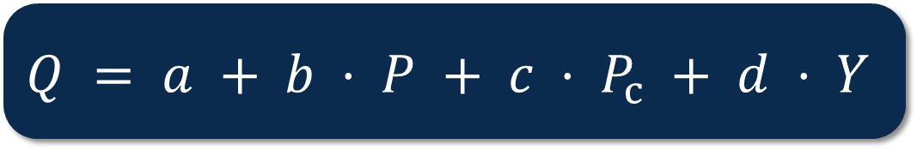
Module 2 · Video 3 · Demand Estimation
Note: We can also Run Multivariate Regressions
Incorporating other determinants of demand
$$Q = a + b · P + c · P_{c} + d · Y$$
Q = amount purchased
P = own price
P_{C} = competitor’s price
Y = income
Management 405 · Module 2 · Demand Analysis
17
Notes:
Other reported statistics (by Excel, R, or Stata) are interesting.
— The first is a measure of FIT. The better the overall fit, the closer the data points are to the regression line, i.e. the regression line captures a lot of the variation in the data. A measure of what we can explain. Here R2 is about 60%. We can explain 60% of the variation in quantity only using the price. Not bad, but there is room for improvement – 40% to be precise. The logical next step is to try to explain more. You can do that by adding more variables on the right hand side. If all the points were exactly on the regression line, we would have R2=1. Needless to say, that is almost never the case.
The second set of statistics measure statistical significance – i.e. how precisely each individual coefficient is measured. You can look at the standard error of your estimate, or the t-statistic that is simply the coefficient divided by the standard error. The rule of thumb is you want the absolute value of the t-statistic to be greater than 2 – for enough precision you want your coefficient to be twice the magnitude of its standard error. Then you can be 95% certain that the true coefficient is different from zero

Slide 18
Module 2 · Video 3 · Demand Estimation
Results With Added Variables
Coefficient | Value
Constant (intercept) | 26.70
Own price | −2.13
Competitor’s price | 1.04
Income | 3.10
Q = 26.70 − 2.13 P + 1.04 P_{C} + 3.10 Y
Management 405 · Module 2 · Demand Analysis
18
Notes:
The basic equation is a demand equation: Q=a+bP. We expect b<0, because that determines that the own-price elasticity is negative.

Slide 19
Module 2 · Video 3 · Demand Estimation
Issues With Transaction Data: Why Randomization Is Key
Transaction data: prices and quantities evolving over time, across locations and stores
Can we be sure the change in quantity is due to the price change?
Airline example:
August: Sell 5000 tickets to Hawaii for $600
September: Sell 3,500 tickets at $500
Should we conclude demand slopes upward?
What else changed between those two periods?
Management 405 · Module 2 · Demand Analysis
19
Notes:
Then we show the graph to say that when MR is negative it means you are in the inelastic portion and in this portion you always want to increase the price + we can ask them
Then which value do you expect for the elasticity at the current price (should answer absolute value below 1)
How would you compute it? + if time could be done on the board

Slide 20


Module 2 · Video 3 · Demand Estimation
Correlation Does Not Mean Causation
Example: on average, people who drink two glasses of wine a day are healthier than those who drink none
Causal interpretation: wine improves health (I wish!)
Management 405 · Module 2 · Demand Analysis
20

Slide 21

Module 2 · Video 3 · Demand Estimation
Correlation Does Not Mean Causation
Potential problem: some other factor is causing the correlation
Management 405 · Module 2 · Demand Analysis
21

Slide 22
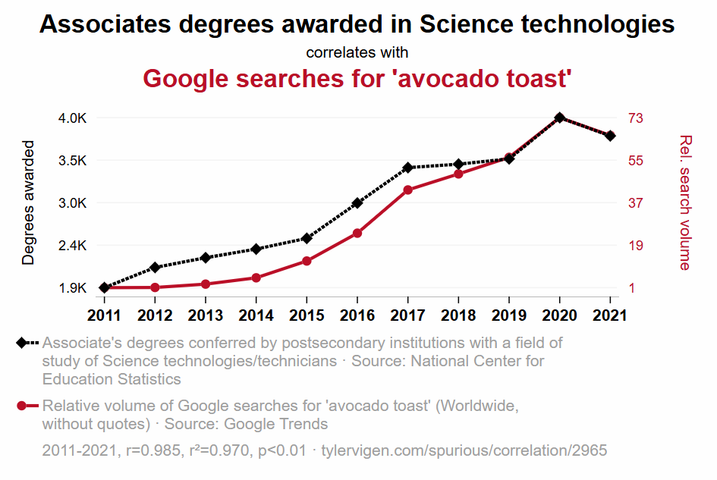
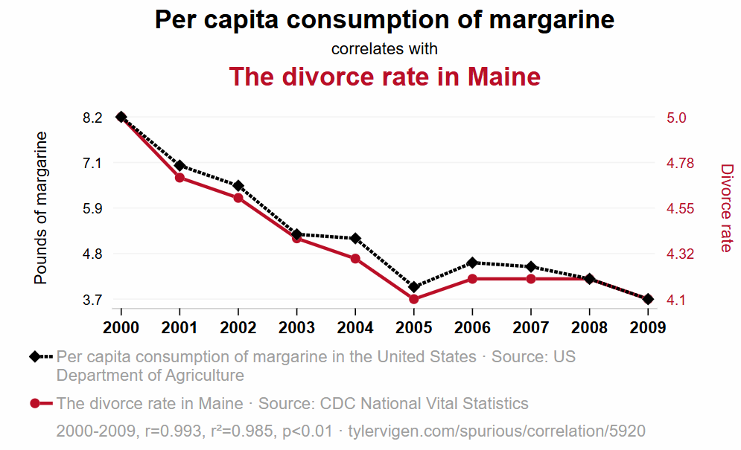
Module 2 · Video 3 · Demand Estimation
Spurious Correlations
tylervigen.com/spurious-correlations
Management 405 · Module 2 · Demand Analysis
22
Notes:
We call this omitted variable bias.
https://www.thegreatcoursesdaily.com/correlation-or-causality-wine-and-heart-health/
“But experts warn that the two studies, both published in the Annals of Internal Medicine, do not show that drinking coffee was behind the overall lower risk, pointing out that it could be that coffee drinkers are healthier in various ways or that those who are unwell drink less coffee. In addition, levels of coffee drinking were self-reported.”

Slide 23
Module 2 · Video 3 · Demand Estimation
Why Randomization Is Key
Randomizing prices ensures that “all else is equal” other than the price change
Allows us to estimate the causal effect of price on quantity demanded → the demand curve!
Management 405 · Module 2 · Demand Analysis
23

