Slide 1
Introduction to Market Structures
Module 4 · Video 1
Management 405
Prof. Nico Voigtländer · UCLA Anderson

Slide 2
Competitive Markets and Market Interventions
Module 4
Management 405
Prof. Nico Voigtländer · UCLA Anderson

Slide 3
Module 4 · Video 1 · Course Roadmap
Agenda for the Class
1. Basic Principles and Economic Way of Thinking
2. Value and Demand
3. Supply and Cost
4. Markets, Pricing, and Strategy
we are here
Management 405 · Module 4 · Competitive Markets and Market Interventions
3

Slide 4
Module 4 · Video 1 · Agenda
Outline of Module 4
1
Introduction to Market Structures
Where a firm sits between price taker and price setter
Video 1
2
Perfect Competition
Many small sellers, an identical product, and free entry
Video 2
2a
Profit Maximization of a Price Taker in the Short Run
How much to produce, and when to stop production
Video 3
2b
Firm-Level and Market Supply
Marginal cost is one firm’s supply curve; market supply sums across firms
Video 4
2c
Long-Run Competitive Equilibrium
Entry and exit drive economic profits to zero
Video 5
3
Market Distortions and Regulations
Who wins, who loses, and what is lost outright
In Class
4
Externalities
Costs and benefits that land on people outside the deal
In Class
Management 405 · Module 4 · Competitive Markets and Market Interventions
4

Slide 5
Module 4 · Video 1 · Agenda
Outline of Module 4
1
Introduction to Market Structures
Where a firm sits between price taker and price setter
Video 1
2
Perfect Competition
Video 2
2a
Profit Maximization of a Price Taker in the Short Run
Video 3
2b
Firm-Level and Market Supply
Video 4
2c
Long-Run Competitive Equilibrium
Video 5
3
Market Distortions and Regulations
In Class
4
Externalities
In Class
Management 405 · Module 4 · Competitive Markets and Market Interventions
5

Slide 6
Module 4 · Video 1 · Introduction to Market Structures
The Four Basic Market Structures
 | Perfect Competition | Monopolistic Competition | Oligopoly | Monopoly
Number of firms | Many | Many | Few | One
Type of products sold | Identical | Differentiated | Identical or Differentiated | “Unique”
Barriers to entry | None | None | Some | Many
More firms, more similar products, easier entry → more competition
Management 405 · Module 4 · Competitive Markets and Market Interventions
6
Notes:
Here we start thinking about a firm’s competitive environment or market structure. We categorize market structure using three characteristics:
1. Number of firms: in general, when there are more companies in the market, the market is more competitive.
2. Whether the consumer cares which company made the good: are the goods identical or can the consumer distinguish who made the good? In general, if goods are closer to identical, the market is more competitive.
3. Barriers to entry: if new firms can enter the market easily, the market is more competitive.

Slide 7
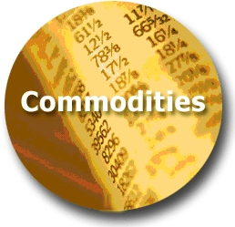
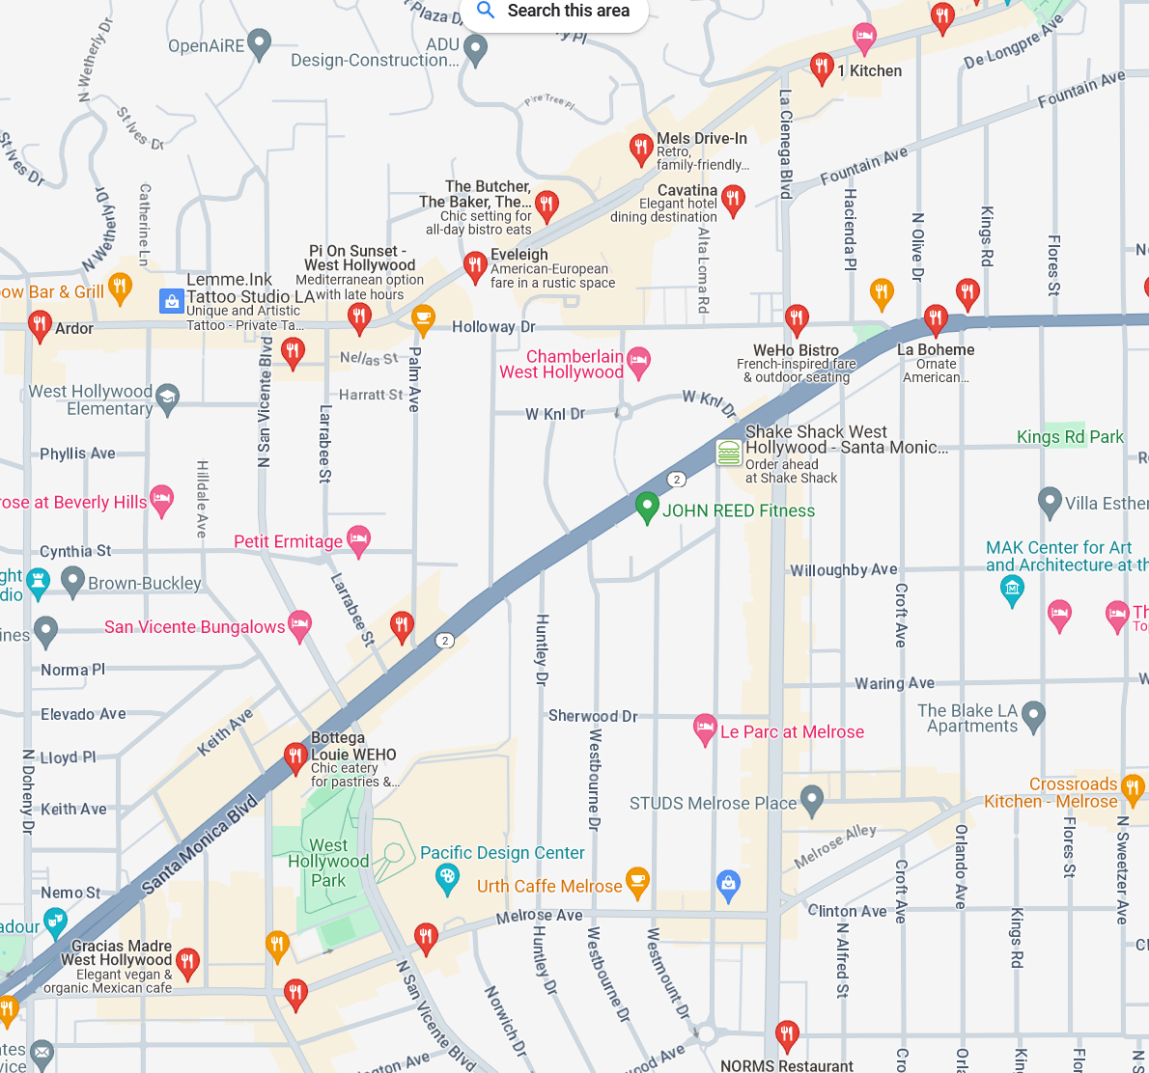



Module 4 · Video 1 · Introduction to Market Structures
Extent of Market Power: Price Takers vs. Price Searchers
Least Market Power
Most Market Power
Perfect Competition
Monopolistic Competition
Oligopoly
Monopoly
(Price Takers)
(Price Searchers)
Commodity markets
Restaurants in WeHo
Wide-body aircraft
Municipal utilities
TODAY
Management 405 · Module 4 · Competitive Markets and Market Interventions
7
Notes:
Extent of market power. The spectrum runs from price taker (today’s topic) to price searchers with increasing degrees of market power (subject of subsequent sessions):
A perfectly competitive firm has no market power; it has such a small percentage of the market that it can exert no effect on price.
A monopolistically competitive firm, such as gas stations and restaurants, offers a differentiated product and thus faces a downward sloping demand curve – offerings of other firms are not perfect substitutes. There is still intense competition because the products can substitute for each other so the elasticity of demand facing each firm tends to be high. Free entry drives long-run profits to zero.
Oligopolistic markets are cases of few firms. For example, a duopoly is a special case of an oligopoly with only 2 firms. Interesting strategic issues arise here as you need to think hard about your rivals’ response to your firm’s behavior. Entry may be limited.
Monopolistic markets are markets with only one seller, such as utilities in most cities (legal monopoly) or Microsoft (quasi-monopoly, due to demand-side economies of scale, i.e. network effects).

