Slide 1
Profit Maximization of a Price Taker
Module 4 · Video 3
Management 405
Prof. Nico Voigtländer · UCLA Anderson

Slide 2
Module 4 · Video 3 · Agenda
Outline of Module 4
1
Introduction to Market Structures
Video 1
2
Perfect Competition
Video 2
2a
Profit Maximization of a Price Taker in the Short Run
How much to produce, and when to stop production
Video 3
2b
Firm-Level and Market Supply
Video 4
2c
Long-Run Competitive Equilibrium
Video 5
3
Market Distortions and Regulations
In Class
4
Externalities
In Class
Management 405 · Module 4 · Competitive Markets and Market Interventions
2

Slide 3
Module 4 · Video 3 · Profit Maximization of a Price Taker in the Short Run
Price Taker Revenue Conditions
Market Price P=$3
Total Revenue
The Firm's Demand
P | Q | TR | MR
$3 | 10 | $30 | $3
3 | 11 | 33 | 3
3 | 12 | 36 | 3
3 | 13 | 39 | 3
TR ($)
P ($)
TR = P · Q
36
30
d = P = MR
3
Selling one more unit always brings in the same $3, so MR = P at every quantity
10
12
Quantity
Quantity
Management 405 · Module 4 · Competitive Markets and Market Interventions
3
Notes:
For a price taker, revenue is simple: every extra unit sells at the same market price, so marginal revenue equals that price and never falls. This is the one case where MR = P, and it is why the profit-maximising rule collapses to P = MC. Keep that in mind, because it will not hold once we get to firms with market power.

Slide 4

Module 4 · Video 3 · Profit Maximization of a Price Taker in the Short Run
Price Taker Profit Maximization
Set MR = MC — the rule for every profit maximizer
But MR is far easier to "compute" for a price taker
For a price taker, MR = P, the market price
P is given: the firm cannot set it
So there is only one decision left: how much to produce
$$Find Q^{∗} such that P = MC$$
➜
Management 405 · Module 4 · Competitive Markets and Market Interventions
4
Notes:
Any perfectly competitive firm sells at the price set by the market. Perfectly competitive firms then have one decision to make: the quantity to supply.

Slide 5

Module 4 · Video 3 · Profit Maximization of a Price Taker in the Short Run
Profit Maximization of a Price Taker: Visual Representation
Firm revenue, cost and profit ($)
TC
(TR has constant slope for a price taker)
TR
Slope of TR = slope of TC: MR = MC
Profit = 0
Maximum profit
TFC
Quantity (Q)
Q*
Profit $π$
Profit = TR − TC Widest where the two slopes are equal (MR = MC)
Management 405 · Module 4 · Competitive Markets and Market Interventions
5
Notes:
Here is profit maximisation seen through totals rather than margins. Total revenue is a straight line because price is constant; total cost rises and then curves up as diminishing returns bite. Profit is the vertical gap between them, and it is widest exactly where the two curves are parallel - which is the same thing as saying marginal revenue equals marginal cost.

Slide 6

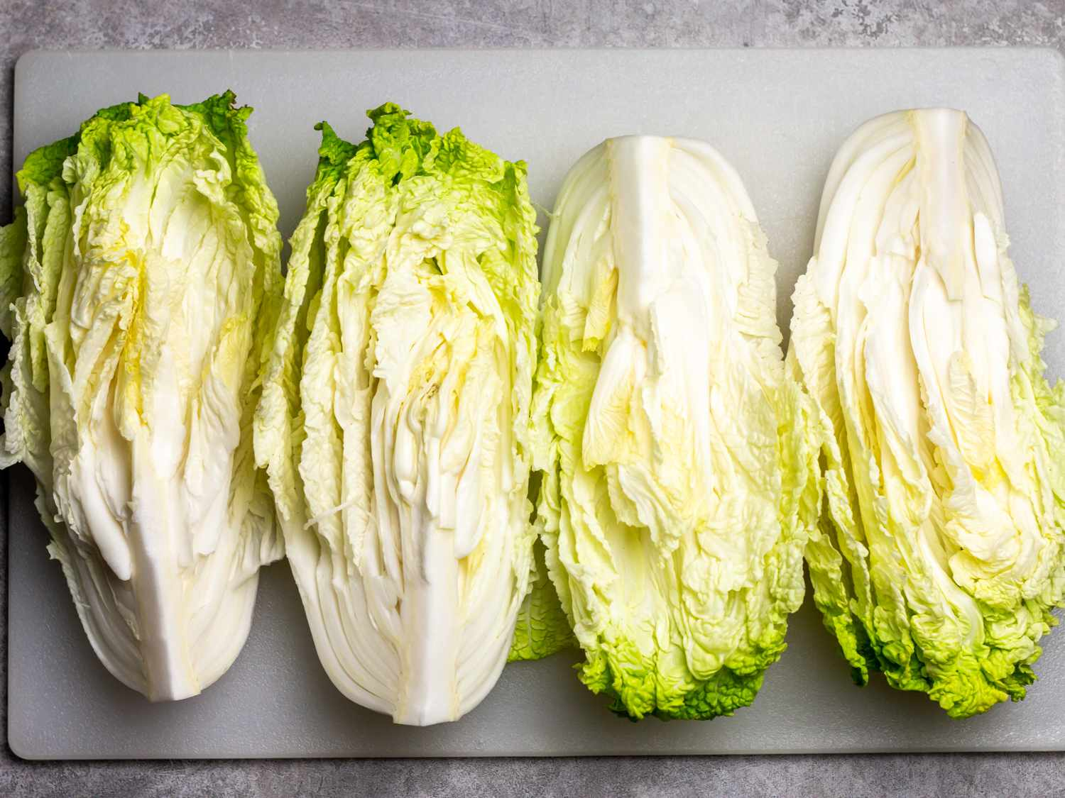
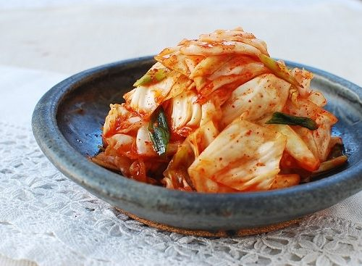
Module 4 · Video 3 · Profit Maximization of a Price Taker in the Short Run
Example: The Yi Family
A South Korean family moves from California to rural Arkansas to start a farm
Their goal: grow Korean produce and sell it to vendors in Dallas, at the market price
We follow their cabbage crop — the raw material for kimchi
Minari (2020)
🎬 Yi Family Example
Management 405 · Module 4 · Competitive Markets and Market Interventions
6
Notes:
Meet the Yi family. They have moved from California to rural Arkansas to grow Korean cabbage and sell it to vendors in Dallas at whatever the market price happens to be. We will follow their cabbage crop for the rest of this section, so every abstract rule gets tested against a real set of numbers.
https://www.vulture.com/article/minari-movie-review-a-gentle-immigrant-drama-set-in-u-s.html
https://time.com/5938842/minari-korean-american-farmers/

Slide 7
Module 4 · Video 3 · Profit Maximization of a Price Taker in the Short Run
Business Relevance
Key questions:
Should the Yi family produce at all?
1
How much should they produce?
2
We start with the second question: profit maximization
Key concept: marginal analysis
🎬 Yi Family Example
Management 405 · Module 4 · Competitive Markets and Market Interventions
7
Notes:
Why this matters to you as a manager: almost no business is a textbook price taker, but many face something close to it in at least one market - a commodity input, a contract-manufacturing line, a spot market. The discipline of asking what you can and cannot influence about your price is the useful part.
In bullet number 2: emphasize that no price decision since we are price takers

Slide 8


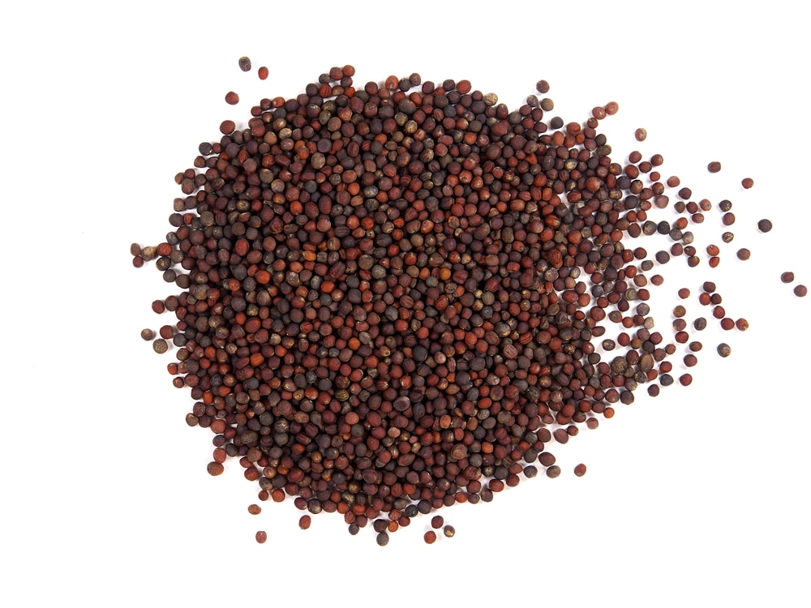
Module 4 · Video 3 · Profit Maximization of a Price Taker in the Short Run
Cabbage Production Costs
Q (tons) | TC | TFC | TVC
50 | 67,250 | 60,000 | 7,250
200 | 95,000 | 60,000 | 35,000
400 | 146,000 | 60,000 | 86,000
600 | 213,000 | 60,000 | 153,000
800 | 296,000 | 60,000 | 236,000
1,000 | 395,000 | 60,000 | 335,000
Fixed costs: land rent, equipment, and the salary the family gives up (opportunity cost)
Variable costs: seeds, water, fertilizer, pesticides, fuel…
Seeds · irrigation · fertilizer
🎬 Yi Family Example
Management 405 · Module 4 · Competitive Markets and Market Interventions
8
Notes:
Source for the costs: https://ucanr.edu/sites/Farm_Management/files/179212.pdf
Opportunity costs: salary from working somewhere else, estimated at about 15k
Quantity in tons
Fixed Costs: land rent, equipment + opportunity costs
Variable Costs: seeds, water, fertilizers, pesticides
Images: right (water), top left (fertilizers), bottom left (seeds)

Slide 9
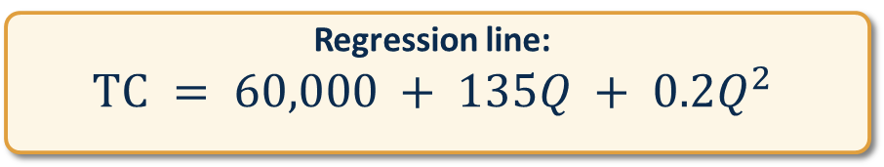
Module 4 · Video 3 · Profit Maximization of a Price Taker in the Short Run
Cabbage Total Cost Function
Regression line:
$$TC = 60,000 + 135Q + 0.2Q^{2}$$
Q (tons) | TC ($)
50 | 67,250
200 | 95,000
400 | 146,000
600 | 213,000
800 | 296,000
1,000 | 395,000
Total cost ($)
400,000
300,000
200,000
100,000
200
400
600
800
1,000
Quantity (tons)
🎬 Yi Family Example
Management 405 · Module 4 · Competitive Markets and Market Interventions
9
Notes:
This is the Yi family's cost function. The fixed cost of 60,000 dollars is the land and equipment they are committed to for the season. The variable part rises more than proportionally with output, which is exactly the diminishing returns we saw in Module 3 showing up in dollars.
Source for the costs: https://ucanr.edu/sites/Farm_Management/files/179212.pdf
Opportunity costs: salary from working somewhere else, estimated at about 15k

Slide 10
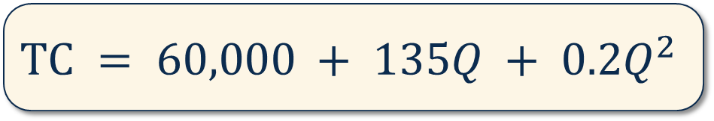

Module 4 · Video 3 · Profit Maximization of a Price Taker in the Short Run
Maximizing Profit: Cabbage Production
The Yi family has estimated its total cost:
$$TC = 60,000 + 135Q + 0.2Q^{2}$$
Q is the quantity produced, in tons
The market price of cabbage is:
$$P = \$400 per ton$$
How many tons should the Yi family produce to maximize profits?
🎬 Yi Family Example
Management 405 · Module 4 · Competitive Markets and Market Interventions
10
Notes:
Market price: $400 per ton is about $20 per cwt, which is the USDA season-average price for fresh-market cabbage in 2020. Recent years run higher — $31.10 per cwt in 2024.
https://www.agmrc.org/commodities-products/vegetables/cabbage

Slide 11
Module 4 · Video 3 · Profit Maximization of a Price Taker in the Short Run
POLL
Management 405 · Module 4 · Competitive Markets and Market Interventions
11

Slide 12

Module 4 · Video 3 · Profit Maximization of a Price Taker in the Short Run
Profit-Maximizing Quantity: Solution
We need to set MR = MC
MC is the derivative of TC with respect to Q, with $TC = 60,000 + 135Q + 0.2Q^{2}$
$$MC = \frac{dTC}{dQ} = 135 + 0.4Q$$
The cabbage market is competitive, so MR is just the market price:
$$MR = P = 400$$
MR = MC thus implies:
$$135 + 0.4Q = 400$$
Solve for Q* (the optimal production)
$$Q^{∗} = 662.5 tons$$
🎬 Yi Family Example
Management 405 · Module 4 · Competitive Markets and Market Interventions
12
Notes:
Work through the algebra with me. Marginal cost is the derivative of total cost, we set it equal to the market price, and we solve for quantity. The answer is the only output level at which the family cannot do better by producing one more or one less ton.

Slide 13
Module 4 · Video 3 · Profit Maximization of a Price Taker in the Short Run
Profit at Q*: Solution
What is the economic profit at the profit-maximizing output level (Q* = 662.5) ?
$$Profit: π = TR − TC$$
$$TR = P · Q = 400 · 662.5 = 265,000$$
$$TC = 60,000 + 135 · 662.5 + 0.2 · {662.5}^{2} = 237,218.75$$
$$Profit: π = 265,000 − 237,218.75 = 27,781.25$$
The Yi family makes a positive economic profit at Q*
🎬 Yi Family Example
Management 405 · Module 4 · Competitive Markets and Market Interventions
13
Notes:
Now the profit itself. We take the optimal quantity, compute total revenue and total cost at that quantity, and take the difference. Notice that the answer is positive here - that will not always be the case, and the rest of this section is about what to do when it is not.

Slide 14


Module 4 · Video 3 · Profit Maximization of a Price Taker in the Short Run
Profits and Average Total Costs (ATC)
$$Profit: π = TR − TC$$
$$π= (P · Q) − (ATC · Q)$$
$$π= (P − ATC) · Q$$
$$where ATC = \frac{TC}{Q} (average total cost per ton)$$
$$Profit is positive if P ≥ ATC$$
Management 405 · Module 4 · Competitive Markets and Market Interventions
14
Notes:
Average total cost is the second lens on the same problem. Total cost divided by quantity tells you what each ton costs on average, and comparing that to the price tells you immediately whether you are making money. It is the version of the calculation that most managers actually carry in their head.

Slide 15


Module 4 · Video 3 · Profit Maximization of a Price Taker in the Short Run
Illustrating Positive Profits of the Yi Family
P
MC
$$MC = 135 + 0.4Q$$
P = MR
400
358
Profit
ATC
$$Profit = (P − ATC) · Q^{∗}$$
where ATC is evaluated at the optimal point Q*
135
Q* = 662.5
Quantity (tons)
🎬 Yi Family Example
Management 405 · Module 4 · Competitive Markets and Market Interventions
15
Notes:
This is the picture behind the arithmetic. The height of the shaded box is price minus average total cost - the profit on each ton - and the width is the number of tons. Multiply the two and you have total profit, which is why the box is the profit.

Slide 16
Module 4 · Video 3 · Profit Maximization of a Price Taker in the Short Run
Maximizing Profits in the Short Run: The General Case
Profit Levels for Different Market Prices
Positive Profit
Zero Profit
Negative Profit (Loss)
P
MC
P
MC
P
MC
P
d = MR
π > 0
ATC
ATC
ATC
P
d = MR
π < 0
d = MR
P
P > ATC at Q*
P = ATC at Q*
P < ATC at Q*
Q*
Q
Q*
Q
Q*
Q
Management 405 · Module 4 · Competitive Markets and Market Interventions
16
Notes:
To measure profit, we subtract total cost from total revenue.
Profit = TR – TC
We can rewrite this as:
Profit = P*Q – ATC*Q
Profit = (P – ATC)*Q
This formula determines whether the firm has positive, zero, or negative profit.
Positive profit: In this figure, the firm’s total revenue is the area of the rectangle with height P and width Q*. The total cost is the area of the rectangle with the height ATC* and the width Q*. Because total revenue exceeds total costs at Q*, the firm is earning positive profits. This equation tells us that profit is positive when P>ATC at the profit maximizing quantity Q*.
Zero profit: Here P=ATC (=MC). We know that MC intersects ATC at its minimum.
Negative profit: P<ATC

Slide 17

Module 4 · Video 3 · Profit Maximization of a Price Taker in the Short Run
If Profit Is Negative, Should a Firm Stop Production / Shut Down?
“Shutting down” in the long run is different from “Stopping production” in the short run
Short Run Temporarily halt production, with the option to restart later Fixed costs still have to be paid — e.g. a building rent or a business truck lease
Long Run Exit the industry altogether, shut down No further payment of fixed costs — e.g. sell the truck and let the building lease expire
We decompose TC into TVC (Short Run) and TFC (Long Run):
$Short run: Profit = P · Q − \underset{ TC}{\underbrace{TVC − TFC}}$, where $TVC=AVC⋅Q$
$$Profit: π = (P−AVC) · Q − TFC$$
Fixed costs still have to be paid
Management 405 · Module 4 · Competitive Markets and Market Interventions
17
Notes:
Here is the question that trips people up. If profit is negative, should the firm stop? Not necessarily - the fixed costs are owed either way in the short run, so the only question is whether revenue covers the costs that producing actually adds. That is the distinction the next slide makes precise.

Slide 18

Module 4 · Video 3 · Profit Maximization of a Price Taker in the Short Run
The Short Run Decision to Stop Production
In the short run, fixed costs have to be paid even if the firm does not produce
Option 1: continue to produce
Option 2: stop production
$$Profit: π = (P − AVC) · Q − TFC$$
$$Profit: π = − TFC$$
Producing adds (P − AVC) · Q to cover fixed costs
Continue to pay the full fixed costs
Difference in profits when producing:
$$Δπ = Q · (P − AVC)$$
⇒ Rule: Continue to produce if P ≥ AVC · Stop production if P < AVC
Management 405 · Module 4 · Competitive Markets and Market Interventions
18
Notes:
The short-run rule in one line. Compare price to average VARIABLE cost, not to average total cost. If price covers the variable cost of each unit, producing contributes something towards the fixed costs and the firm should keep going; if it does not, producing makes the loss bigger than the fixed costs alone.

Slide 19
Module 4 · Video 3 · Profit Maximization of a Price Taker in the Short Run
Optimizing in the Short Run: A New Market Price
The US starts importing large quantities of cabbage from China
The US market price drops from $400 to $210 per ton
Remember: $TC = 60,000 + 135Q + 0.2Q^{2}$
Questions
1. What quantity should the Yi family now produce?
2. What profit do they make at that quantity?
3. Should they continue to produce in the short run?
🎬 Yi Family Example
Poll Break
Management 405 · Module 4 · Competitive Markets and Market Interventions
19
Notes:
Now the market moves against the Yi family. Cheap Chinese imports push the US price down from 400 to 210 dollars a ton. Work through the three questions with the person next to you before we look at the answer - the numbers are all on the earlier slides.
Questions 2 and 3 solved by instructor

Slide 20
Module 4 · Video 3 · Profit Maximization of a Price Taker in the Short Run
Solution: New Q* and Profit
Question 1: Optimal Quantity
$$MC = MR = P$$
$$135 + 0.4Q = 210 → Q^{∗} = 187.5$$
Question 2: Profits
$$TR = P · Q = 210 · 187.5 = 39,375$$
$$TC = 60,000 + 135 · 187.5 + 0.2 · {187.5}^{2} = 92,343.75$$
$$π = 39,375 − 92,343.75 = −52,968.75$$
At the new price, the Yi family makes a loss at the optimal output level
🎬 Yi Family Example
Poll Break
Management 405 · Module 4 · Competitive Markets and Market Interventions
20
Notes:
The new optimum. Same rule, new price: set marginal cost equal to 210 and solve. The quantity falls, and when we compute profit at that quantity it is now negative - so the interesting question is the one on the next slide.

Slide 21
Module 4 · Video 3 · Profit Maximization of a Price Taker in the Short Run
Solution to Question 3: Decision to Continue Production
$$AVC = \frac{135Q + 0.2Q^{2}}{Q} = 135 + 0.2Q$$
$$AVC at Q^{∗} = 187.5 is 135 + 37.5 = 172.5$$
$$Recall: P = 210$$
$$Thus: P > AVC$$
⇒ Keep producing in the short run
Alternatively, compare the two options directly:
▪ Continue to produce: loss of 52,968.75
▪ Stop production: loss of 60,000, the whole of TFC
🎬 Yi Family Example
Poll Break
Management 405 · Module 4 · Competitive Markets and Market Interventions
21
Notes:
And here is the decision. At the new price the family loses money, but price still exceeds average variable cost, so every ton they sell contributes something towards the land and equipment they are paying for anyway. They should keep producing through the season and reconsider in the long run.

Slide 22
Module 4 · Video 3 · Profit Maximization of a Price Taker in the Short Run
High Price: Positive Profits in the Short Run
P
MC
P high
d = MR
Profit
ATC
AVC
Q*
Q
Optimal output is where MC = MR = P. This occurs at Q*. At that output positive economic profits are being made because P > ATC.
Management 405 · Module 4 · Competitive Markets and Market Interventions
22
Notes:
Recap slides, say that we show them in the general case (MC not linear)
Context: At the beginning can sell at a very high price… Profit maximization in the short run. This figure depicts positive profit in the short run.

Slide 23
Module 4 · Video 3 · Profit Maximization of a Price Taker in the Short Run
High Price: Positive Profits in the Short Run
Example with more complex cost functions
P
MC
P
d = MR
Profit
ATC
AVC
Q*
Q
Optimal output is where MC = MR = P. This occurs at Q*. At that output positive economic profits are being made because P > ATC.
Management 405 · Module 4 · Competitive Markets and Market Interventions
23
Notes:
The same logic on a more realistic cost function, where average variable cost is U-shaped rather than rising throughout. Optimal output is still where marginal cost meets price. Here price sits above average total cost at that quantity, so the shaded rectangle is genuine economic profit.

Slide 24
Module 4 · Video 3 · Profit Maximization of a Price Taker in the Short Run
Low Price: Producing at a Loss in the Short Run
P
MC
ATC
Loss
AVC
P low
d = MR
Q*
Q
Negative economic profits (losses) are being made because P < ATC. But P > AVC → the firm should continue to produce in the short run.
Management 405 · Module 4 · Competitive Markets and Market Interventions
24
Notes:
The general case at a lower price. Q* is still where MC meets P, but now price is below average total cost, so the rectangle is a loss. The firm keeps producing anyway, because price is still above average variable cost.

Slide 25
Module 4 · Video 3 · Profit Maximization of a Price Taker in the Short Run
Low Price: Producing at a Loss in the Short Run
Example with more complex cost functions
P
MC
ATC
P
Loss
AVC
d = MR
Q*
Q
Negative economic profits (losses) are being made because P < ATC. But P > AVC → the firm should continue to produce in the short run.
Management 405 · Module 4 · Competitive Markets and Market Interventions
25
Notes:
The same loss case on the complex cost function. Notice that nothing about the rule changed - only where the price line happens to sit relative to the two average-cost curves.

Slide 26
Module 4 · Video 3 · Profit Maximization of a Price Taker in the Short Run
Very Low Price: Stopping Production in the Short Run
P
MC
ATC
AVC
P very low
d = MR
P < AVC at every output
Q
There is no output at which producing covers variable cost: P < AVC everywhere → the firm should stop production, and its loss is then TFC.
Management 405 · Module 4 · Competitive Markets and Market Interventions
26
Notes:
The lowest price case. Here the price line lies below average variable cost at every output, so there is no quantity at which producing helps. The firm stops production and eats the fixed costs.

Slide 27
Module 4 · Video 3 · Profit Maximization of a Price Taker in the Short Run
Very Low Price: Stopping Production in the Short Run
Example with more complex cost functions
P
MC
ATC
Loss
AVC
P
d = MR
Q*
Q
MC really does run below AVC for a while, so there is a Q* where MC = P. But P < AVC at Q* → producing would lose more than TFC, so the firm stops production.
Management 405 · Module 4 · Competitive Markets and Market Interventions
27
Notes:
And the same conclusion on the complex cost function. Because marginal cost really does dip below average variable cost here, there IS a quantity where MC equals P - but price is still below AVC at that quantity, so producing would lose more than the fixed costs. Stopping is still right.

Slide 28
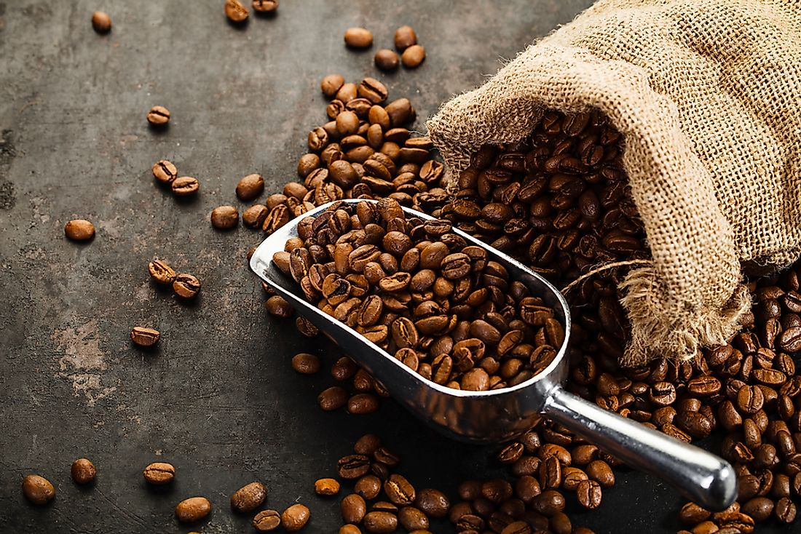
Module 4 · Video 3 · Profit Maximization of a Price Taker in the Short Run
Coffee Bean Producer
Your firm is a price taker in the coffee bean market
You have just optimized your output level for the short run
 | Your costs at that output
AVC | $12
ATC | $15
MC | $10
Should you continue to produce in the short run?
Poll Break
Management 405 · Module 4 · Competitive Markets and Market Interventions
28
Notes:
Your turn. A coffee bean producer, marginal cost of 10, average variable cost of 12, and a market price you can read off the slide. Decide what they should do before we work it through.

Slide 29
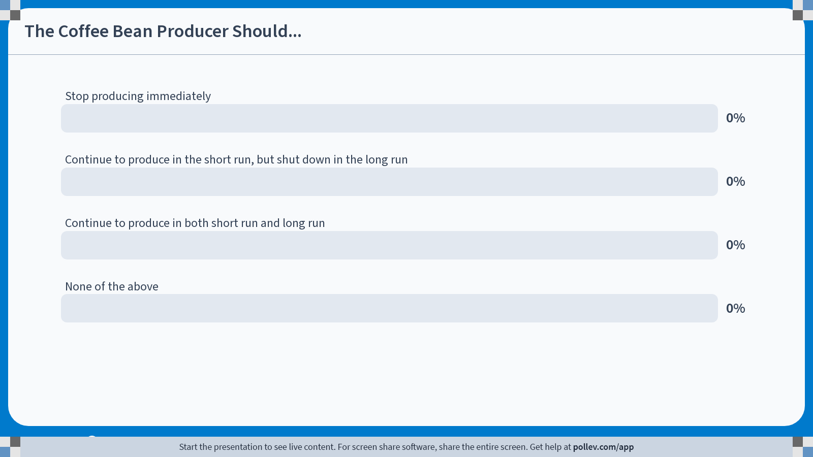
POLL
Notes:
Poll Title: Do not modify the notes in this section to avoid tampering with the Poll Everywhere activity. More info at polleverywhere.com/support The Coffee Bean Producer Should... https://www.polleverywhere.com/multiple_choice_polls/sry3DICjteteqyV1Ny4gL?state=opened&flow=Default&onscreen=persist

Slide 30
Module 4 · Video 3 · Profit Maximization of a Price Taker in the Short Run
Coffee Bean Producer: Solution
The output level is already profit-maximizing, so for a price taker P = MC
$$MC = 10 → P = 10$$
$$AVC = 12$$
$$Thus: P < AVC$$
$$You lose money on every unit — stop production$$
You will then continue to pay the fixed costs in the short run
— that minimizes the loss
Poll Break
Management 405 · Module 4 · Competitive Markets and Market Interventions
30
Notes:
The answer. The output level is already profit-maximising, because for a price taker marginal cost equals price - so price is 10. But average variable cost is 12, which means every unit sold loses money on its own variable cost. Stop production; the fixed costs still have to be paid, and that is the smaller loss.

Slide 31
Module 4 · Video 3 · Profit Maximization of a Price Taker in the Short Run
Summary: Short-Run Decisions for a Price Taker
$$Optimal output: Q^{∗} where MC = MR = P$$
If P ≥ AVC at Q*: continue to produce
Profits can still be positive or negative
Positive if P ≥ ATC, negative if P < ATC
If P < AVC at Q*: stop production
The loss is then TFC
Producing anyway would make the loss larger than TFC
✎ Problem Set 3
Management 405 · Module 4 · Competitive Markets and Market Interventions
31
Notes:
Everything from this section on one slide. Find the quantity where marginal cost equals price, then use the price-versus-AVC test to decide whether to produce at all. Problem Set 3 works through both steps on new numbers.

