Slide 1
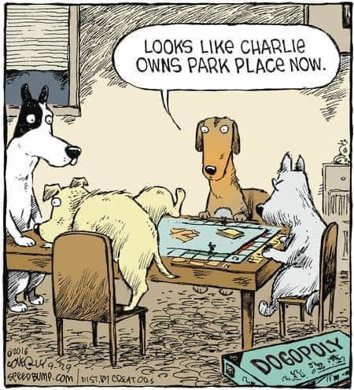
Oligopoly and Game Theory
Module 7
Management 405
Prof. Nico Voigtländer · UCLA Anderson

Slide 2
Module 7 · Video 1 · Announcements
Exam-Specific Announcements
Final Exam: Sat 12/12, 2:00 – 5:00 pm
  3 hours for the exam, then 15 minutes to upload your PDF
  Same logistics as the Midterm Exam (see the next slides)
Practice Final Exam on the class website
  Similar to the actual final
More practice: online quizzes (see the class website)
Management 405 · Module 7 · Oligopoly and Game Theory
2
Notes:
The final exam is on Saturday, December 12, from 2:00 to 5:00 pm. You have 3 hours for the exam. At 5:00 pm the exam closes, and you then have 15 minutes to upload your PDF on BruinLearn. Everything else works the same way as for the midterm, and the next slides go through the details. To prepare, take the practice final exam on BruinLearn. It is similar to the actual final, and the solutions are posted there as well. For more practice, the TA's practice site has an online quiz for every module.

Slide 3
Module 7 · Video 1 · Announcements
Final Exam: Structure
Covers material from the full quarter: Modules 1 – 8
  All modules relevant, more weight on post-midterm topics
40% Multiple Choice: about 20 questions, 2 points each
  Directly on BruinLearn; only one answer correct, no partial credit
60% Problem Solving: 3 – 4 problems
  Type final answers on BruinLearn; upload ONE PDF with your detailed steps
  Show your work for full / partial credit, even if you get stuck or run out of time
Extra assumptions: write them down and email the TA after the exam
Management 405 · Module 7 · Oligopoly and Game Theory
3
Notes:
The final covers the full quarter, Modules 1 to 8. All modules are relevant, but the topics after the midterm get more weight. 40% of the points come from about 20 multiple-choice questions, worth 2 points each. You answer them directly on BruinLearn, only one answer is correct, and there is no partial credit. The other 60% come from 3 to 4 problem-solving questions. You type your final answers on BruinLearn and upload one PDF with your detailed steps. Show your work, because that is how you earn full or partial credit, even if you get stuck or run out of time: write down the steps, the intuition and the formulas you would use. If you think a question needs an extra assumption, write it down and email the TA after the exam, and we will consider it for credit.

Slide 4
Module 7 · Video 1 · Announcements
Final Exam: Logistics
Same logistics as the Midterm Exam
  Respondus LockDown Browser + webcam; show your workspace at the start
  Anything on paper is allowed; own summary (“cheat”) sheets strongly recommended
  TA on Zoom during the exam: join from your phone, as for the midterm
  No other devices, internet, or AI; calculator is built into the browser
  After the exam: webcam photos, then upload ONE PDF within 15 minutes
Different from the midterm
  One fixed time slot for everyone: Sat 12/12, 2:00 – 5:00 pm
  TA will be available via Zoom (same logistics as during Midterm)
Management 405 · Module 7 · Oligopoly and Game Theory
4
Notes:
The logistics are the same as for the midterm. You take the exam in Respondus LockDown Browser with your webcam on, and you show your workspace at the start. Anything on paper is allowed: slides, notes, books and your own summary sheets, which I strongly recommend. The TA is available on Zoom during the exam, exactly as for the midterm: join the call from your phone before you start, and if you have a question, show the phone to the webcam and raise your hand. Phones for anything other than the TA call, other devices, the internet and AI tools are not allowed, and the browser has a built-in calculator. When the 3 hours are up, you take webcam photos of all your pages, and you then have 15 minutes to upload one combined PDF of your work on BruinLearn. The one thing that is different from the midterm is the timing: there is no window to choose from, and everyone takes the exam in the same slot, Saturday, December 12, from 2:00 to 5:00 pm.

Slide 5
Module 7 · Video 1 · Announcements
Further Exam-Related Announcements
Review session with Nico: Sun 12/6, time TBA
  Send me topics you’d like to be covered!
  Additional office hours on demand
TA review sessions and practice sessions: see email announcements
  More review videos by the TA during the exam-prep weeks
  «Last-minute» review with the TA: Fri 12/11, time TBA
Management 405 · Module 7 · Oligopoly and Game Theory
5
Notes:
Before the final there will be a review session with me on Sunday, December 6. I will announce the time, and please send me the topics you would like me to cover. I am also happy to add office hours on demand. The TA runs review sessions and practice sessions, which are announced by email, and posts more review videos during the exam-prep weeks. There will also be a last-minute review session with the TA on Friday, December 11, the day before the exam.

Slide 6
Module 7 · Video 1 · Course Roadmap
Agenda for the Class
1. Basic Principles and Economic Way of Thinking
2. Value and Demand
3. Supply and Cost
4. Markets, Pricing, and Strategy
we are here
Management 405 · Module 7 · Oligopoly and Game Theory
6
Notes:
This is where Module 7 sits in the 405 course as a whole. We built the economic way of thinking, then demand, then supply and cost. Module 7 continues part 4: markets, pricing, and strategy — moving from monopoly and monopolistic competition to oligopoly, where a few firms interact strategically, and to game theory, the toolkit for analyzing that interaction.

Slide 7
Module 7 · Video 1 · Agenda
Outline of Module 7
1
Introduction to Oligopoly and Game Theory
What makes a market an oligopoly, and why firms must think strategically
Video 1
2
Collusion and Cartels
Why firms are tempted to collude, and how cartels can break down
Video 2
3
Cournot Competition
Competing by choosing quantities: capacity decisions in oligopoly
Video 3
4
Bertrand Competition
Competing by setting prices, and why it can compete profits away
Video 4
5
Bertrand Competition with Differentiated Goods
How differentiation softens price competition
Video 5
6
Game Theory
In class
6a
Strategic Thinking: Key Concepts
Best responses, dominant strategies, and Nash equilibrium
In class
6b
Prisoner’s Dilemma, Game of Chicken…
Classic games and what they teach about business strategy
In class
Management 405 · Module 7 · Oligopoly and Game Theory
7

Slide 8
Module 7
In-Class Part
Management 405 · Module 1 · Basic Concepts and Economic Principles
8
Notes:
From here on we are in the classroom. The videos have covered markets, demand and supply, and equilibrium; the in-class part takes on opportunity costs, sunk costs, and cost-benefit and marginal analysis.

Slide 9
Some Applications of the Material
Covered in the Videos
Management 405 · Module 1 · Basic Concepts and Economic Principles
9
Notes:
The next stretch of slides applies what the videos covered on markets, demand and supply, and equilibrium. These are applications rather than a new topic, which is why they are not a separate item on the module outline.

Slide 10
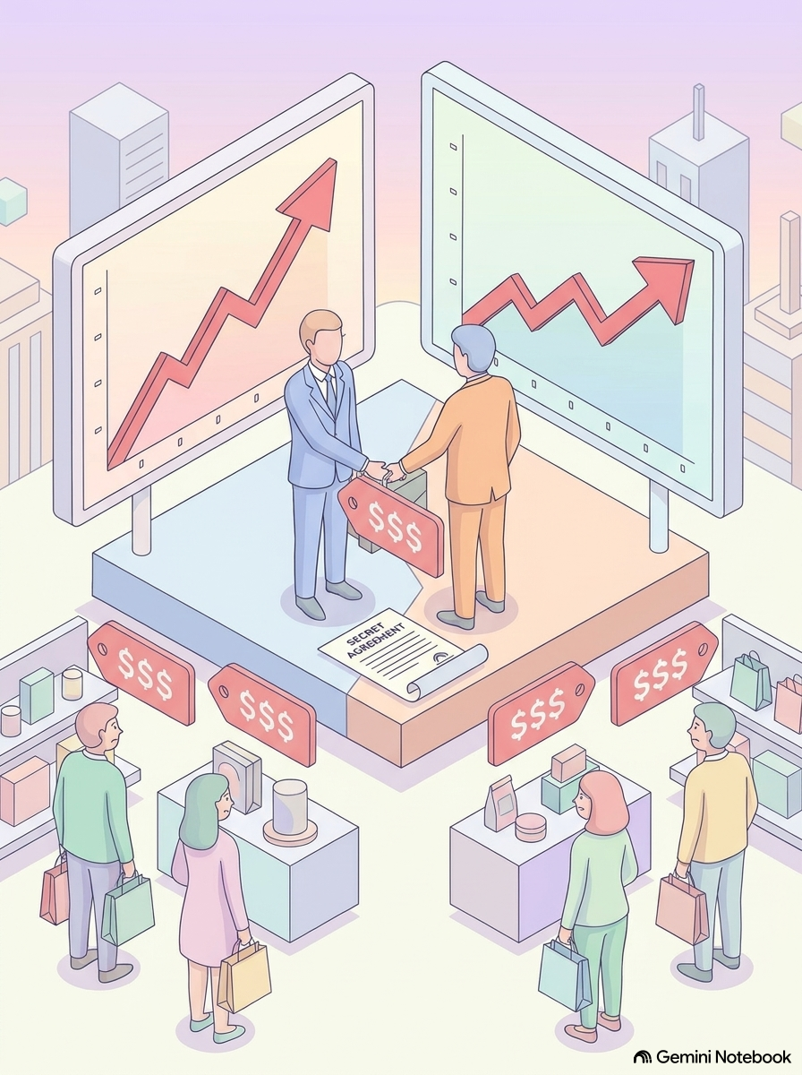
Module 7 · Video 2 · Collusion and Cartels
Recall: Collusion and Cartels
A cartel seeks to raise market prices by reducing supply
At the inflated cartel price, each firm would like to produce more than its reduced amount
  Incentives to deviate
How do cartels coordinate to avoid deviation?
Management 405 · Module 7 · Oligopoly and Game Theory
10

Slide 11


Module 7 · Video 2 · Collusion and Cartels
Collusion: The Case of ADM
Archer Daniels Midland (ADM) involved in organized effort to raise the price of the animal feed additive lysine
Unique case with FBI mole
  Taped price-fixing meetings
Original FBI footage on course webpage (under Module 7 In-Class Content)
Podcast, Movie, Related Podcast: The Poop Cartel
Matt Damon in “The Informant!” (2009)
Management 405 · Module 7 · Oligopoly and Game Theory
11
Notes:
International Price Fixing. It harms consumers, and it is hard to prove price co-movements are indeed due to collusion.
Mark Whitacre, the FBI mole at ADM, recorded the price fixing meetings. Mention special role of golf on Hawaii.
FBI Video: Jump to 2:00. Tyson and ConAgra: major food producers, customers buying lysine: those that would be most hurt by price fixing. Actual price fixing at 7:20 – at some point, they even check the FX rate with the Canadian dollar to fix the price in a billion-dollar market within a minute.
From the Poop Cartel Podcast: “Poop is big business in Dakar, Senegal. That's because a lot of the homes have septic tanks, which need to be cleaned out regularly. The best way to clean your tank is by hiring a proper truck, which arrives with a vacuum. The problem is that for years, the guys who drove the poop trucks operated as a cartel, and they squashed competition and kept prices high. So a lot of people turned to a cheaper alternative: men who clear out septic tanks by hand, with shovels and buckets, and basically bury the poop in the street. It's terrible work and bad for the environment. Today on the show: how economists got sewage off the streets of Dakar by making poop-truck drivers compete with each other. In other words, by breaking up the poop cartel.”

Slide 12
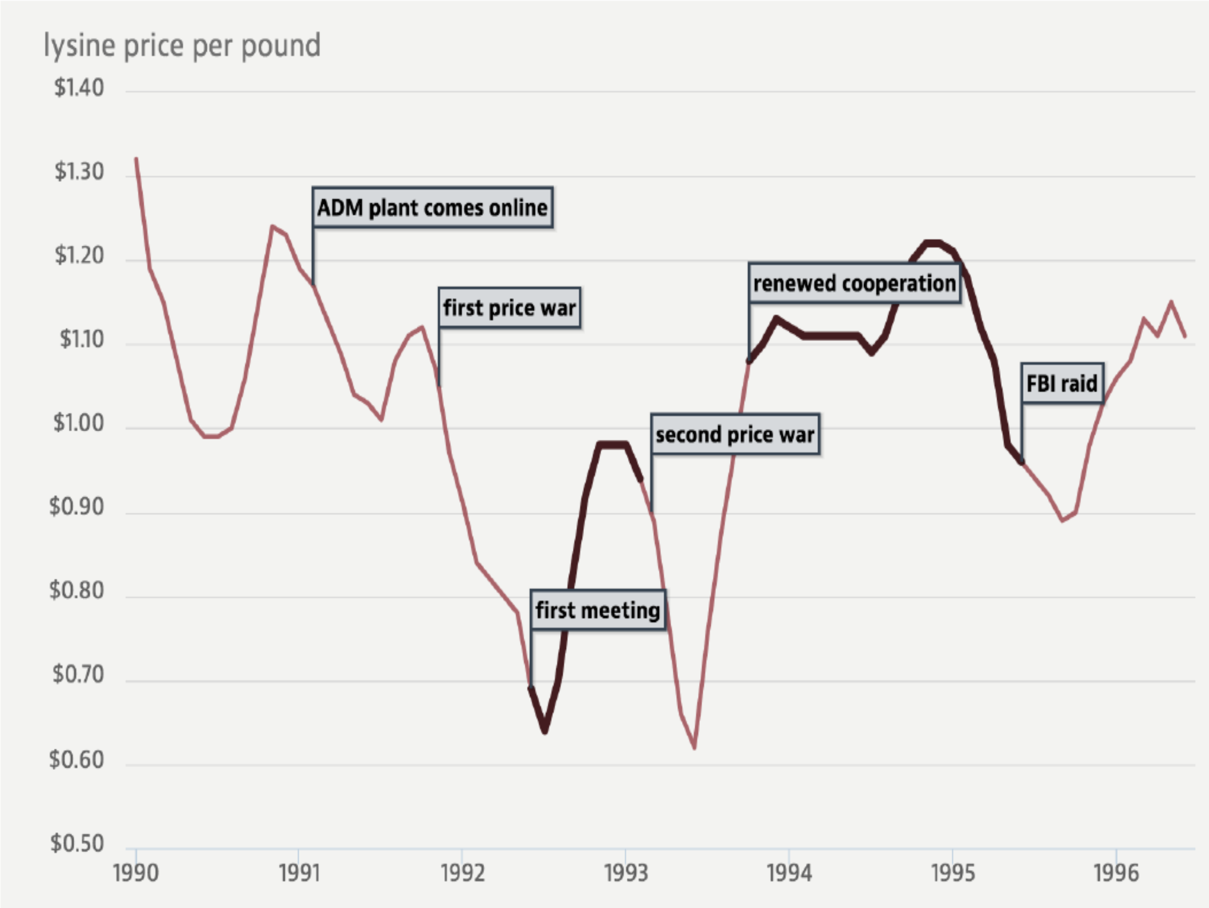
Module 7 · Video 2 · Collusion and Cartels
The ADM Price-Fixing Scandal
Source: American Economic Association, “Conspiracies against the public” (aeaweb.org)
Management 405 · Module 7 · Oligopoly and Game Theory
12
Notes:
The lysine price per pound around the ADM cartel: prices fall during the price wars, rise when the conspirators meet and cooperate, and collapse again after the FBI raid. Source: https://www.aeaweb.org/research/conspiracies-against-the-public

Slide 13
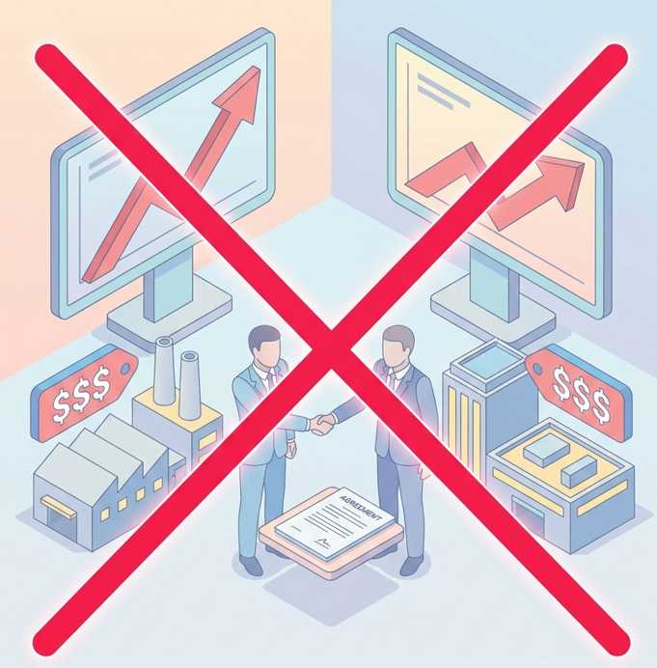
Module 7 · Video 3 · Cournot Competition
For the Rest of Module 7: Competition, Not Collusion
No collusion among competitors
→ Firms compete strategically (“games”)
Management 405 · Module 7 · Oligopoly and Game Theory
13

Slide 14
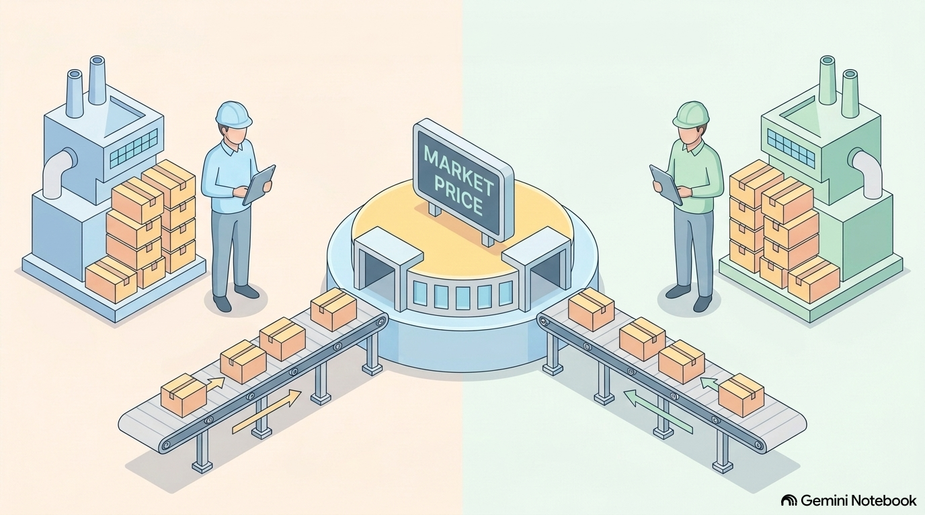
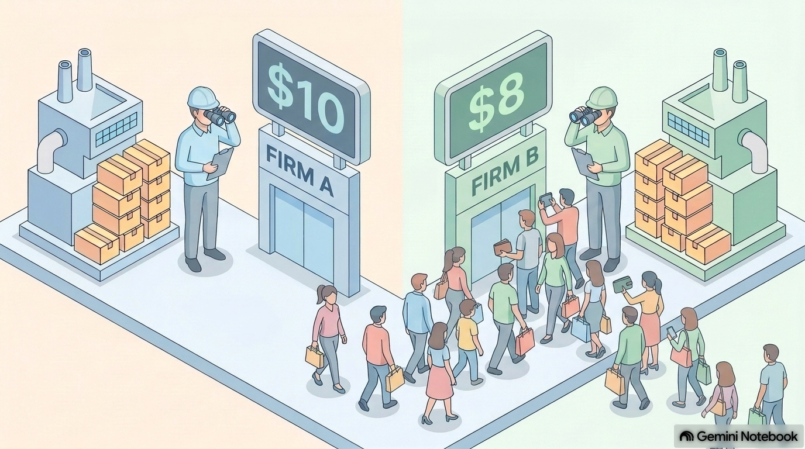
Module 7 · Video 3 · Cournot Competition
Two Models of Oligopoly Competition
Cournot
Bertrand
The rival's price is taken as given
Firm reacts by adjusting its own price (underbidding, if feasible)
Firms then supply the quantity that is demanded at the price they set
The rival's supply is taken as given
Firm reacts by adjusting its own quantity accordingly
Price is determined in the market
Management 405 · Module 7 · Oligopoly and Game Theory
14

Slide 15
Module 7 · Video 3 · Cournot Competition
Cournot Competition: Reaction Function (I)
P
$100
Firm A assumes that B produces 50 units (Q_{B} = 50)
→ Firm A's optimal response is 20 units
$50
D_{A} (residual demand):
$$P = 100 − (Q_{A} + 50)$$
$$= 50 − Q_{A}$$
Market price determined by
overall Q = Q_{A} + Q_{B}
$30
D_{Market} : $P = 100 − Q_{M}$
50 units
$10
MC
20
50
70
100
Q
$${MR}_{A}$$
Management 405 · Module 7 · Oligopoly and Game Theory
15
Notes:
Cournot assumed quantity competition: each firm sets quantity taking as fixed the quantity set by the other. The assumption is that the other firm will continue to produce the same quantity whatever I do. [Of course most of the time this assumption will prove false, but not at the equilibrium]. The residual demand curve is just the amount of demand left over when subtracting the other firm's fixed supply from market demand. As we will see shortly price does not go to the competitive level but settles between the monopoly and perfect competition price.
Step 1: Go from the market-level demand to the individual-level demand by 'assuming' QB=50: P=100−(QA+50)=50−QA
Step 2: Once you have the individual-level demand, find the profit-maximizing quantity as usual (MR=MC): MRA=50−2QA; 50−2QA=10 → QA=20.

Slide 16
Module 7 · Video 3 · Cournot Competition
Cournot Competition: Reaction Function (II)
P
$100
D_{A} (residual demand):
$$P = 80 − Q_{A}$$
Now Firm A assumes that B produces 20 units (Q_{B} = 20)
$80
→ Firm A's optimal response is 35 units
$45
Market price determined by
overall Q = Q_{A} + Q_{B}
20 units
D_{Market} : $P = 100 − Q_{M}$
$10
MC
35
$${MR}_{A}$$
55
80
100
Q
Management 405 · Module 7 · Oligopoly and Game Theory
16
Notes:
Cournot assumed quantity competition: each firm sets quantity taking as fixed the quantity set by the other. The assumption is that the other firm will continue to produce the same quantity whatever I do. [Of course most of the time this assumption will prove false, but not at the equilibrium]. The residual demand curve is just the amount of demand left over when subtracting the other firm's fixed supply from market demand. As we will see shortly price does not go to the competitive level but settles between the monopoly and perfect competition price.
Step 1: Go from the market-level demand to the individual-level demand by 'assuming' QB=20: P=100−(QA+20)=80−QA
Step 2: Once you have the individual-level demand, find the profit-maximizing quantity as usual (MR=MC): MRA=80−2QA; 80−2QA=10 → QA=35.

Slide 17
Module 7 · Video 3 · Cournot Competition
Firm A's Reaction Function
45
Reaction point (II)
35
Firm A's Reaction ($Q_{A}$)
Reaction point (I)
20
Firm A's reaction function
$$Q_{A} = 45 − 0.5·Q_{B}$$
20
50
90
Firm B's Output ($Q_{B}$)
Practice Video “Cournot Competition Math”
Management 405 · Module 7 · Oligopoly and Game Theory
17
Notes:
Don't say they move sequentially — it's just 'contemplating'. The reaction function collects Firm A's optimal responses: for every quantity B might produce, it gives A's profit-maximizing quantity. The two points we just derived — B produces 50, A responds with 20; B produces 20, A responds with 35 — pin down the line QA = 45 − 0.5·QB. The same logic (with the general algebra) is worked through in the practice video.

Slide 18
Module 7 · Video 3 · Cournot Competition
Cournot Equilibrium
90
Firm B's reaction function
$$Q_{B} = 45 − 0.5·Q_{A}$$
Cournot equilibrium: neither firm would like to deviate
→ Look for intersection of reaction functions
Firm A's Output ($Q_{A}$)
Cournot Equilibrium
$$Q_{A} = Q_{B} = 30 and P = 40$$
45
30
Firm A's reaction function
$$Q_{A} = 45 − 0.5·Q_{B}$$
15
Starting point: Firm B contemplates its reaction to Q_{A} = 15
30
45
90
Firm B's Output ($Q_{B}$)
Management 405 · Module 7 · Oligopoly and Game Theory
18
Notes:
Don't say they move sequentially — it's just 'contemplating'. The last step is to figure out the Cournot equilibrium, given by the 'intersection' of the two reaction functions. The intuition: we want a pair (QA*, QB*) so that A wants to respond to QB* with QA*, and B wants to respond to QA* by picking QB*.
We start from the reaction function for A: QA=45−0.5QB (1). Then we repeat the analysis for firm B (everything is symmetric, so it is the mirror image): QB=45−0.5QA (2). Last, we need the pair (QA*, QB*) that satisfies both — two equations, two unknowns. Replace (1) in (2): QB=45−0.5(45−0.5QB)=22.5+0.25QB → 0.75QB=22.5 → QB=30. By symmetry QA=30 as well (verify: QA=45−0.5·30=30). The figure shows the graphical version: two lines with different slopes intersect in exactly one point. The staircase from QA=15 shows how the contemplated responses converge to the equilibrium.

Slide 19
Module 7 · Video 3 · Cournot Competition
Cournot: Math – Also Relevant for the Exam
Practice Video “Cournot Competition Math”
More general case with different MC:
Practice Video “Oligopoly with different MC”
Management 405 · Module 7 · Oligopoly and Game Theory
19
Notes:
Two practice videos on BruinLearn walk through the Cournot algebra step by step: the baseline case we just did, and the more general case where the two firms have different marginal costs.

Slide 20
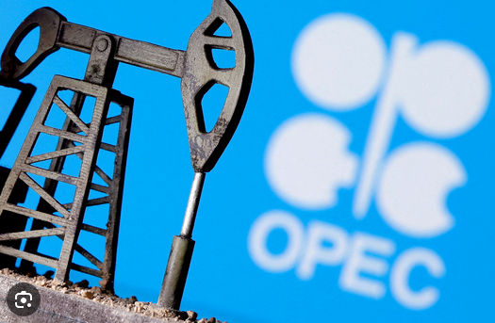
Module 7 · Video 3 · Cournot Competition
Examples for Cournot Competition
Oil
  However: Includes a cartel (OPEC)
Steel producers
US crude steel production by producer, 2024
Source: worldsteel, company reports. U.S. Steel acquired by Nippon Steel, June 2025
Management 405 · Module 7 · Oligopoly and Game Theory
20
Notes:
Why OPEC is not sued for antitrust: '[i]f the members of OPEC were private companies and not nations, they long ago would have been prosecuted for engaging in illegal price fixing.' However, OPEC member nations have argued that doctrines of sovereign immunity and act of state make them immune from U.S. antitrust prosecution for their otherwise illegal price fixing cartel. Indeed, a federal court decision in 1979 ruled that the actions of OPEC were immune from U.S. antitrust scrutiny because of the doctrine of sovereign immunity (the proposition that the government cannot be sued without its consent).
Source: https://energyfuse.org/should-we-still-be-concerned-about-opec/
Steel pie (updated 2026): shares of US crude steel production 2024, total 79.5 Mt (worldsteel). Nucor 26% (20.7 Mt), Cleveland-Cliffs 20% (~16 Mt - it absorbed BOTH ArcelorMittal USA and AK Steel in 2020, which is why the old chart looks so different), U.S. Steel 13% (10.7 Mt, acquired by Nippon Steel June 2025, still operating as U.S. Steel), Steel Dynamics 13% (10.2 Mt), CMC ~6% (approx., fiscal-year basis), Others ~22% (Gerdau, North Star BlueScope, NLMK USA, SSAB Americas, etc). Sources: worldsteel company rankings 2024; U.S. Steel 10-K segment data; company reports.

Slide 21
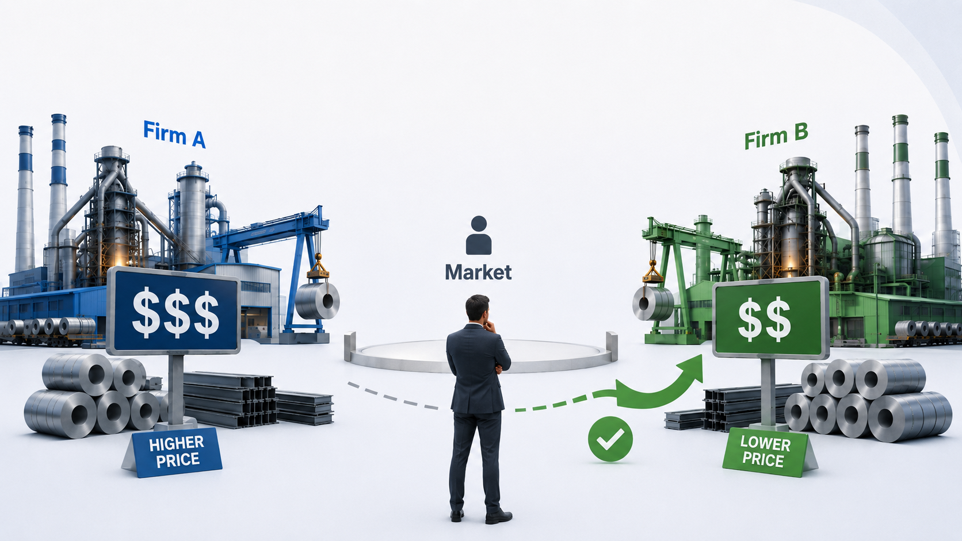
Module 7 · Video 4 · Bertrand Competition
Bertrand Competition (with Identical Goods)
Assumptions:
▪ Firms make identical products
▪ Firms compete by choosing the price at
which they sell their products
Management 405 · Module 7 · Oligopoly and Game Theory
21

Slide 22
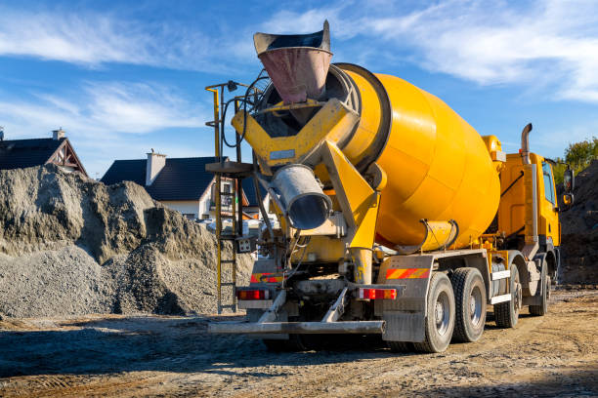
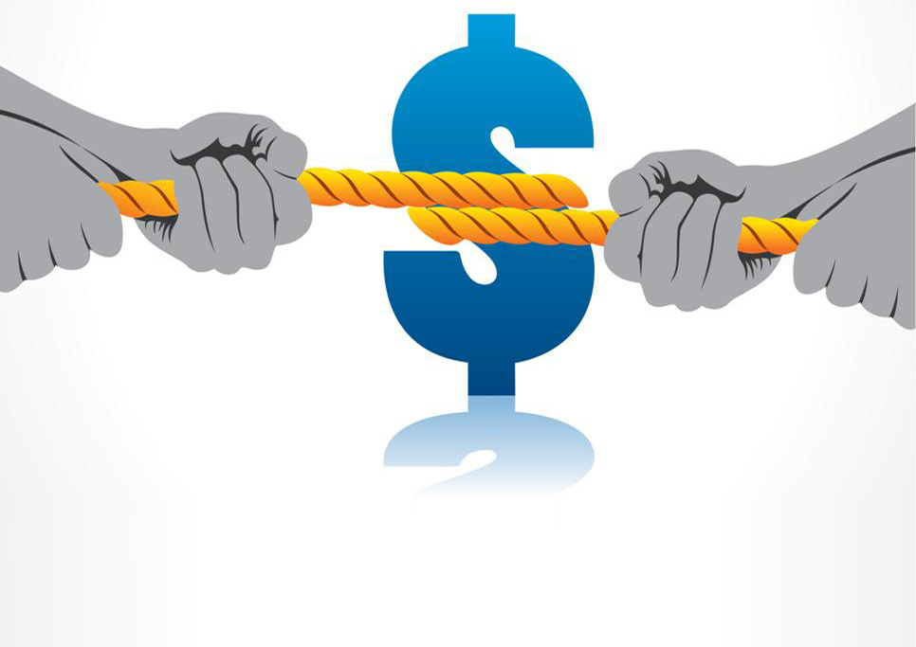
Module 7 · Video 4 · Bertrand Competition
Choose Your Concrete Price
Two competitors, identical good: Concrete
Same marginal cost: MC = $120 per cubic yard
You and your competitor submit a sealed price bid for a huge project
What's your price bid?
Poll Break
Management 405 · Module 7 · Oligopoly and Game Theory
22
Notes:
Updated 2026-08-06 (fact-checked): US ready-mix concrete is quoted per CUBIC YARD, and MC = $120/yd3 matches industry data - materials (cement, aggregates, admixtures) ran $89-96/yd3 in 2023-24 plus roughly $15-25/yd3 delivery (NRMCA benchmarking and monthly surveys). The average US selling price was about $180/yd3 in 2025, so students should bid down from around the market price toward the $120 marginal cost. NOTE: the PollEverywhere answer bands (slide 32) are being updated by Nico to match the new $120 anchor. Sources: NRMCA Performance Benchmarking Survey (Oct 2024); concretefinancialinsights.com; US Concrete 10-K.

Slide 23
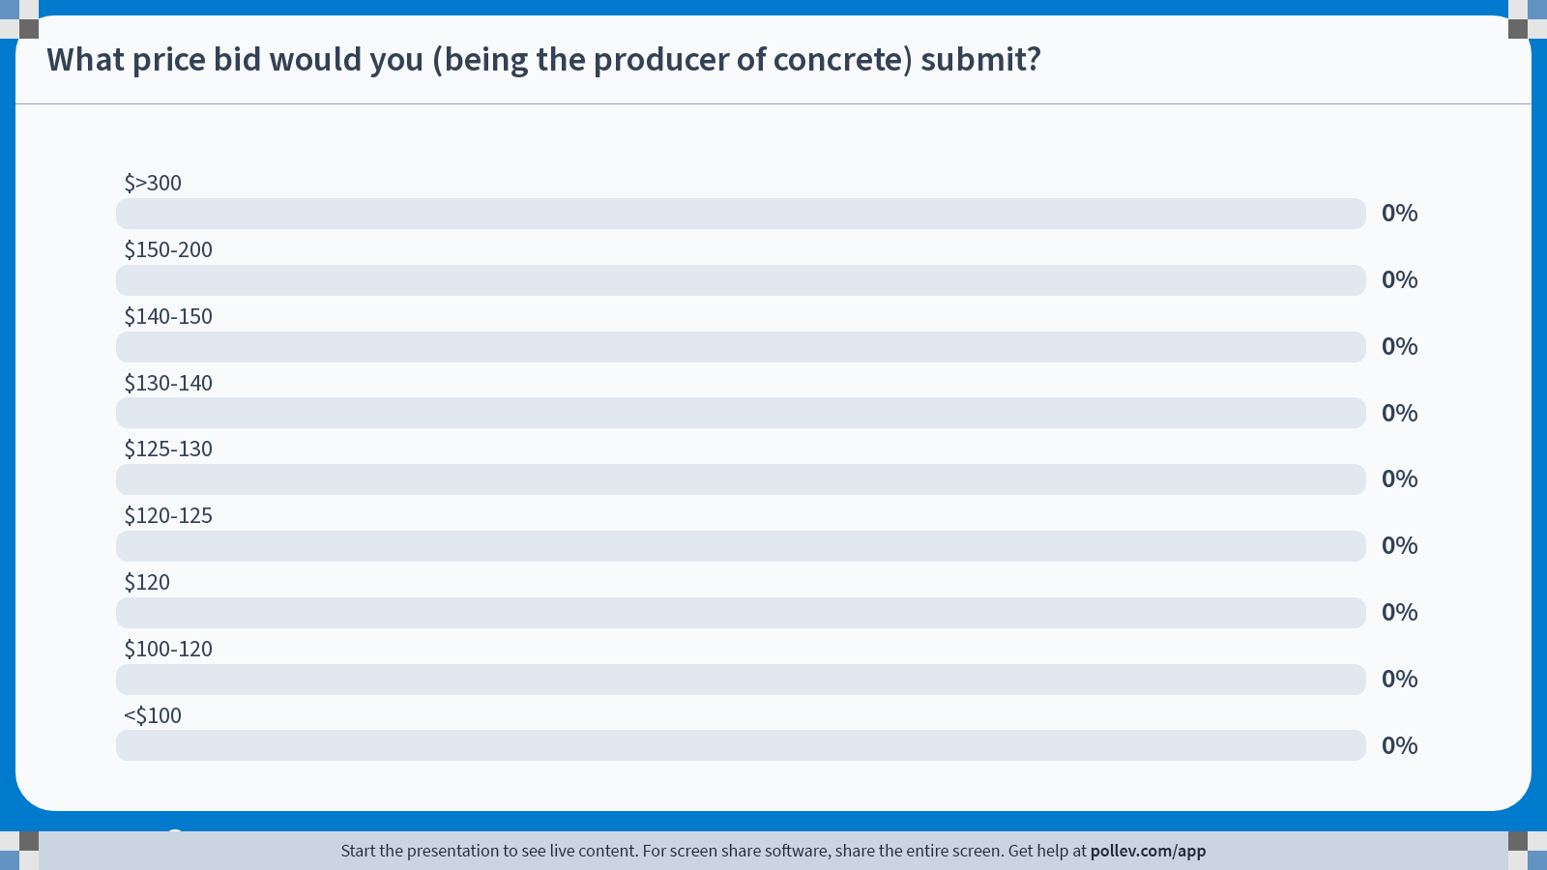
Notes:
Poll Title: Do not modify the notes in this section to avoid tampering with the Poll Everywhere activity.
More info at polleverywhere.com/support
What price bid would you (being the producer of concrete) submit?
https://www.polleverywhere.com/multiple_choice_polls/cPmM4EjskHq9d0maIszSW?state=opened&flow=Default&onscreen=persist

Slide 24
Module 7 · Video 4 · Bertrand Competition
Bertrand Competition
P
Suppose Firms A and B start at a price of $40, where each supplies Q=30
A believes that B will maintain its price. What will A do? How will B respond?
$100
$$P = 100 − Q_{M}$$
Bertrand Equilibrium
$40
Lost by A
$39
Gained by A
→ A and B will continue to lower their price until they reach P = MC
MC
$10
30
60
61
90
100
Q
Management 405 · Module 7 · Oligopoly and Game Theory
24
Notes:
Bertrand assumed that firms choose a price and stand ready to meet all demand at that price. Each firm sets a price that maximizes profits holding constant the price set by the other firm. Contrast this with the Cournot case where the game is played on quantities.
What is the outcome of Bertrand competition? The only equilibrium is P1 = P2 = MC. If, say P2 >= P1 > MC, P2 will undercut by a small amount, so there are no such equilibria. Proof: starting at P1 = P2 = MC, neither firm gains from raising (sells nothing) or cutting (negative profit). And any price above MC invites undercutting — the situation in the figure (both at $40, one drops to $39: it loses the thin strip on its old sales but gains the whole market).
Bertrand with identical goods has a clean solution, but the conditions are rare. A market that came close: online retail of computer chips for home-built CPUs — consumers bought the cheapest chip and prices were approximately marginal cost, with retailers trying to escape via obfuscation (loss-leader ads, add-ons). With differentiated goods, equilibrium prices can stay above marginal cost.

Slide 25

Module 7 · Video 4 · Bertrand Competition
Bertrand Competition with Different MC
P
Now Firm A has MC_{A} = 20
Firm B still has MC_{B} = 10
$100
$$P = 100 − Q_{M}$$
Firm B (with lower MC_{B}) will charge a price just under MC_{A}. This pushes Firm A out of the market.
$20
MC_{A}
P_{B} = 19.99
MC_{B}
$10
~80
100
Q
Management 405 · Module 7 · Oligopoly and Game Theory
25
Notes:
Bertrand assumed that firms choose a price and stand ready to meet all demand at that price. Each firm sets a price that maximizes profits holding constant the price set by the other firm. Contrast this with the Cournot case where the game is played on quantities.
What is the outcome of Bertrand competition? The only equilibrium is P1 = P2 = MC. If, say P2 >= P1 > MC, P2 will undercut by a small amount, so there are no such equilibria. Proof: starting at P1 = P2 = MC, neither firm gains from raising (sells nothing) or cutting (negative profit). And any price above MC invites undercutting — the situation in the figure (both at $40, one drops to $39: it loses the thin strip on its old sales but gains the whole market).
Bertrand with identical goods has a clean solution, but the conditions are rare. A market that came close: online retail of computer chips for home-built CPUs — consumers bought the cheapest chip and prices were approximately marginal cost, with retailers trying to escape via obfuscation (loss-leader ads, add-ons). With differentiated goods, equilibrium prices can stay above marginal cost.

Slide 26
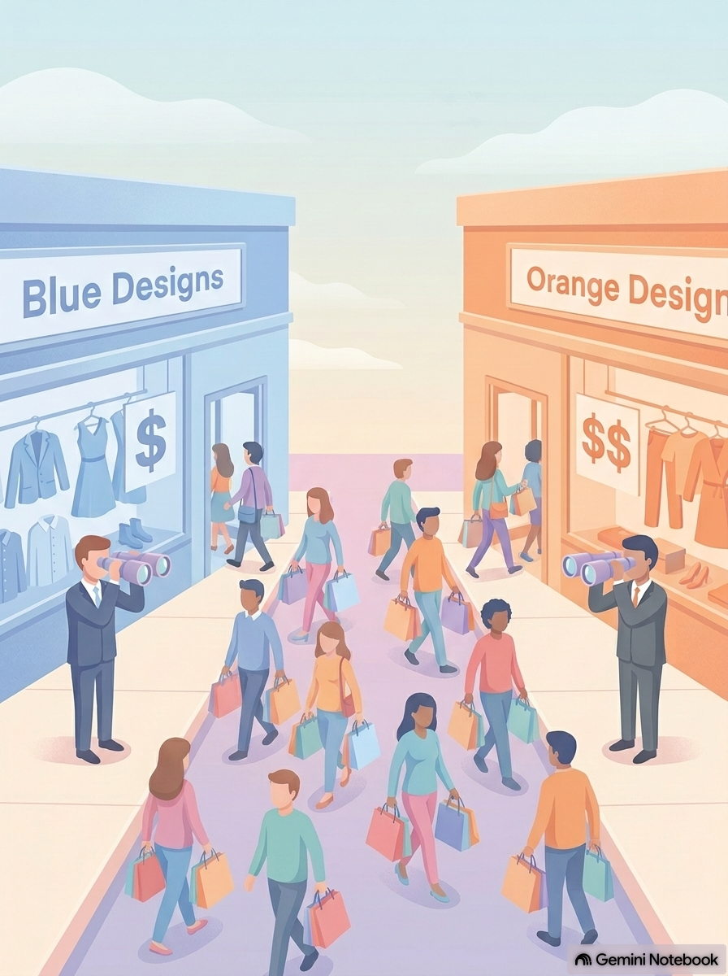
Module 7 · Video 5 · Bertrand Competition with Differentiated Goods
Bertrand Competition (with Differentiated Goods)
Assumptions:
▪ Firms do not sell identical products. They sell differentiated products
▪ Each firm faces its own demand function
▪ Each firm chooses its price, responding to the price of the other firm
Management 405 · Module 7 · Oligopoly and Game Theory
26
Notes:
The three assumptions for Bertrand with differentiated goods: differentiated products, an own demand function for each firm, and prices chosen simultaneously. Why do we need simultaneity? It means neither firm can observe the rival's price before setting its own, and neither can commit to moving first — so the equilibrium is a pair of mutual best responses rather than a leader-follower outcome. It also answers the natural question about the price war: the second mover cannot simply wait and undercut at the last moment, because in this setting there is no last mover. In Part 2 we deliberately break exactly this assumption — commitment is what changes when one player CAN move first.

Slide 27
Module 7 · Video 5 · Bertrand Competition with Differentiated Goods
Reaction Function: Airbus' Reaction to Boeing's Price (I)
Note: Airbus Demand:
${ Q}_{A} = 400 − 2P_{A} + P_{B}$
Derive inverse Airbus Demand:
→ $P_{A} = 200 − 0.5·Q_{A} + 0.5·P_{B}$
P
Airbus assumes that Boeing charges P_{B} = 200
200
Airbus (inverse) Demand:
$$P_{A} = 200 − 0.5·Q_{A} + 0.5·P_{B}$$
$$= 200 − 0.5·Q_{A} + 100$$
$$= 300 − 0.5·Q_{A}$$
300
A higher price $P_{B}$ increases demand for Airbus
250
200
MC
→ Airbus' optimal price response is P_{A} = 250
$${MR}_{A}$$
100
300
600
Q
Management 405 · Module 7 · Oligopoly and Game Theory
27
Notes:
Same two-step logic as in the Cournot case, but now in prices. Step 1: fix Boeing's price at PB=200 and substitute it into Airbus' demand, giving the inverse demand PA = 300 − 0.5·QA. Step 2: maximize profit as usual (MR = MC with MC = 200): the optimal quantity is 100 and the optimal price response is PA = 250. Note the difference to Cournot: price responds POSITIVELY to price increases by the other firm.

Slide 28
Module 7 · Video 5 · Bertrand Competition with Differentiated Goods
Reaction Function: Airbus' Reaction to Boeing's Price (II)
P
Now Airbus assumes that Boeing charges P_{B} = 400
400
400
Airbus Demand:
$$P_{A} = 200 − 0.5·Q_{A} + 0.5·P_{B}$$
$$= 400 − 0.5·Q_{A}$$
→ Airbus' optimal price response is P_{A} = 300
300
MC
200
Higher demand for Airbus because $P_{B}$ has increased
$${MR}_{A}$$
Previous demand at $P_{B} = 200$
200
400
800
Q
Management 405 · Module 7 · Oligopoly and Game Theory
28
Notes:
Same two-step logic as in the Cournot case, but now in prices. Step 1: fix Boeing's price at PB=400 and substitute it into Airbus' demand, giving the inverse demand PA = 400 − 0.5·QA. Step 2: maximize profit as usual (MR = MC with MC = 200): the optimal quantity is 200 and the optimal price response is PA = 300. Note the difference to Cournot: price responds POSITIVELY to price increases by the other firm.

Slide 29
Module 7 · Video 5 · Bertrand Competition with Differentiated Goods
Equilibrium Prices
Boeing's reaction function
$$P_{B} = 200 + 0.25·P_{A}$$
Reaction point (I)
Airbus' reaction function
$$P_{A} = 200 + 0.25·P_{B}$$
300
267
250
Reaction point (II)
Airbus' Price ($P_{A}$)
200
Equilibrium
$$P_{A} = P_{B} = 267$$
150
Starting point: Boeing responds to Airbus charging P_{A} = 150
200
267
400
Boeing's Price ($P_{B}$)
Management 405 · Module 7 · Oligopoly and Game Theory
29
Notes:
Price responds POSITIVELY to price increases by the other firm. Note that this is the opposite of Cournot, where Firm A wants to produce less if firm B produces more. The two reaction functions — Airbus' PA = 200 + 0.25·PB and Boeing's mirror image — intersect at the equilibrium PA = PB = 267. Starting from PA = 150, the contemplated responses move both firms toward the equilibrium.

Slide 30
Module 7 · Video 5 · Bertrand Competition with Differentiated Goods
Play This Game on the Class Website
Under Module 7
You can choose Boeing's price and observe Airbus's reaction (price)
  You also see the profits of both companies
You can also change the demand functions (make payoffs asymmetric)
Class Website → Module 7
Management 405 · Module 7 · Oligopoly and Game Theory
30

Slide 31
Module 7 · Video 5 · Bertrand Competition with Differentiated Goods
Oligopoly: Concluding Discussion
If you could pick one type of Oligopoly competition for your firm, which would you choose? Why?
In which oligopoly case can you improve your product?
  What is the effect of improving your product?
Discussion
Management 405 · Module 7 · Oligopoly and Game Theory
31

Slide 32
Module 7 · Agenda
Outline of Module 7
1
Introduction to Oligopoly and Game Theory
Video 1
2
Collusion and Cartels
Video 2
3
Cournot Competition
Video 3
4
Bertrand Competition
Video 4
5
Bertrand Competition with Differentiated Goods
Video 5
6
Game Theory
In class
6a
Strategic Thinking: Key Concepts
Best responses, dominant strategies, and Nash equilibrium
In class
6b
Prisoner’s Dilemma, Game of Chicken…
In class
Management 405 · Module 7 · Oligopoly and Game Theory
32

Slide 33
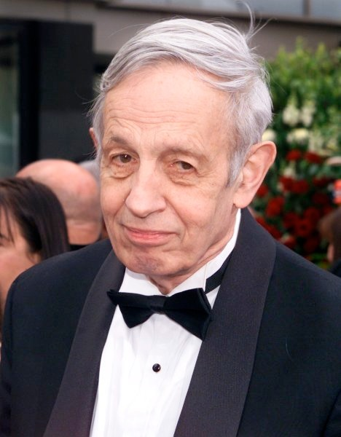
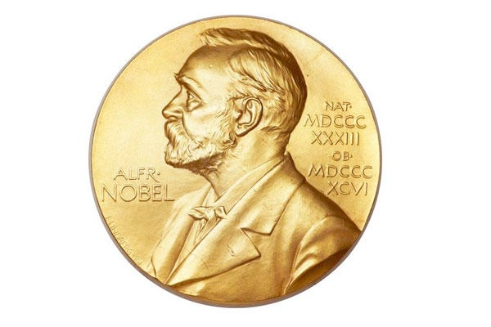

Module 7 · Strategic Thinking: Key Concepts
What Is Game Theory?
Branch of economics concerned with interdependent situations
  The outcome of a participant's choice depends critically on the actions of other participants
Game theory has transformed not only economics, but also the study of war, of business strategy, and of biological systems
Father of Game Theory: John Nash
  1994 Nobel Prize in Economics
  Inspired the movie “A Beautiful Mind”
John Nash (1928–2015)
Management 405 · Module 7 · Oligopoly and Game Theory
33
Notes:
In biology, game theory is used to explain how organisms behave when their success depends on the actions of others. It helps clarify why an organism might cooperate, compete, form alliances, or adopt particular signaling or mating strategies. Classic examples include the evolution of cooperation, predator–prey interactions, and stable ratios of aggressive vs. passive behavioral types within a species.

Slide 34
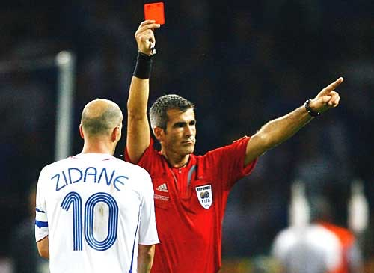
Module 7 · Strategic Thinking: Key Concepts
A Warm-Up Game
I brought 5 yellow and 5 red cards
But this is not about soccer…
Instead:
  I distribute the 5 yellow cards to students
  Suppose I get $100 from the Dean for each red-yellow pair that I take back to her after class
  You can ‘sell’ your yellow card back to me
  What's your asking price for your yellow card?
World Cup Final, 2006
Management 405 · Module 7 · Oligopoly and Game Theory
34

Slide 35
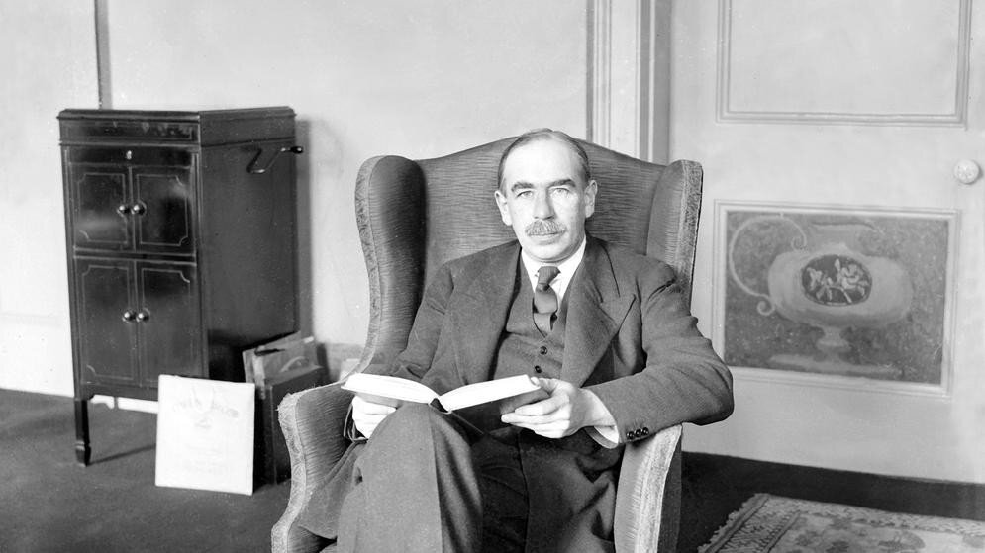
Module 7 · Strategic Thinking: Key Concepts
Strategic Thinking: The Beauty Contest
Prominent game in newspapers in the 1930s:
  Get a reward if you select the face that is the most popular among others (not the one that you find most attractive)
John Maynard Keynes (1936) used it as analogy
John Maynard Keynes
Management 405 · Module 7 · Oligopoly and Game Theory
35

Slide 36
Module 7 · Strategic Thinking: Key Concepts
Strategic Thinking: Numerical Beauty Contest
Numerical application:
  All participants are asked to pick a number between 0 and 100
  Winner: the number that is closest to 2/3 of the average of all numbers submitted
Poll Break
Management 405 · Module 7 · Oligopoly and Game Theory
36

Slide 37
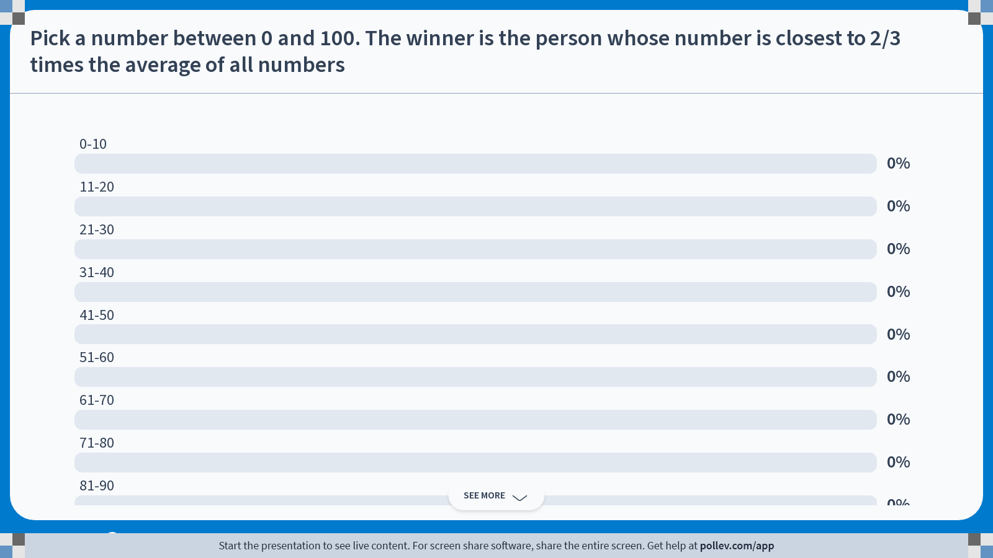
Notes:
Poll Title: Do not modify the notes in this section to avoid tampering with the Poll Everywhere activity.
More info at polleverywhere.com/support
Pick a number between 0 and 100. The winner is the person whose number is closest to 2/3 times the average of all numbers
https://www.polleverywhere.com/multiple_choice_polls/DjDvltTZeGUAsHqkC2i4G?state=opened&flow=Default&onscreen=persist

Slide 38
Module 7 · Strategic Thinking: Key Concepts
Key Concepts of Game Theory
Strategic behavior by all participants
  Optimization: maximize individual payoff
To study strategic behavior:
  Best response: optimal decision given what the other player does
  Dominant strategy: optimal action no matter what the other player does
  Nash equilibrium: «intersection of best responses»
    Position from which neither player would find it advantageous to deviate (e.g., Cournot equilibrium)
Management 405 · Module 7 · Oligopoly and Game Theory
38

Slide 39
Module 7 · Agenda
Outline of Module 7
1
Introduction to Oligopoly and Game Theory
Video 1
2
Collusion and Cartels
Video 2
3
Cournot Competition
Video 3
4
Bertrand Competition
Video 4
5
Bertrand Competition with Differentiated Goods
Video 5
6
Game Theory
In class
6a
Strategic Thinking: Key Concepts
In class
6b
Prisoner’s Dilemma, Game of Chicken…
Classic games and what they teach about business strategy
In class
Management 405 · Module 7 · Oligopoly and Game Theory
39

Slide 40

Module 7 · Prisoner’s Dilemma, Game of Chicken…
Prisoner's Dilemma: Setup and Payoffs
Prisoner 2
Silent
Betray
-1 , -1
-1 , -1
-1 , -1
-10 , 0
-10 , 0
Silent
-10 , 0
Prisoner 1
0 , -10
0 , -10
0 , -10
-8 , -8
-8 , -8
Betray
-8 , -8
Payoffs to (Prisoner 1, Prisoner 2)
Interpretation of payoffs:
Negative values, because they indicate years in prison
Management 405 · Module 7 · Oligopoly and Game Theory
40
Notes:
We start with the payoff table. Payoffs to the player on the left (Prisoner 1) are blue, and shown on the left. Payoffs to the player on top of the matrix (Prisoner 2) are gold, and shown on the right.

Slide 41
Module 7 · Prisoner’s Dilemma, Game of Chicken…
Prisoner's Dilemma: Strategy of Prisoner 1
Prisoner 2
Silent
Betray
Silent
-1 , -1
-10 , 0
Prisoner 1
Betray
0 , -10
-8 , -8
Payoffs to (Prisoner 1, Prisoner 2)
Interpretation of arrows:
Prisoner 1 picks his best response to Prisoner 2's (hypothetical) choices
Management 405 · Module 7 · Oligopoly and Game Theory
41
Notes:
This slide analyzes the strategy of Prisoner 1. Here we blind out the payoffs for Prisoner 2 because Prisoner 1 only cares about his own payoffs when deciding on a strategy. The arrows for Prisoner 1 (in general, for the player to the left of the matrix) are drawn vertically.

Slide 42
Module 7 · Prisoner’s Dilemma, Game of Chicken…
Prisoner's Dilemma: Strategy of Prisoner 2
Prisoner 2
Silent
Betray
Silent
-1 , -1
-10 , 0
Prisoner 1
Betray
0 , -10
-8 , -8
Payoffs to (Prisoner 1, Prisoner 2)
Interpretation of arrows:
Prisoner 2 picks his best response to Prisoner 1's (hypothetical) choices
Management 405 · Module 7 · Oligopoly and Game Theory
42
Notes:
And now we blind out the payoffs for Prisoner 1 because Prisoner 2 only cares about his own payoffs when deciding on a strategy. The arrows for Prisoner 2 (in general, the player on top of the matrix) are drawn horizontally.

Slide 43
Module 7 · Prisoner’s Dilemma, Game of Chicken…
Prisoner's Dilemma: Equilibrium
Prisoner 2
Silent
Betray
Silent
-1 , -1
-10 , 0
Prisoner 1
Betray
0 , -10
-8 , -8
Payoffs to (Prisoner 1, Prisoner 2)
Nash Equilibrium
Both players' dominant strategy is to betray, so individual optimization produces a “socially” sub-optimal outcome
Management 405 · Module 7 · Oligopoly and Game Theory
43
Notes:
In the Nash Equilibrium, neither player has the incentive to deviate: If Prisoner 1 betrays, then Prisoner 2 also wants to betray, and vice-versa.

Slide 44

Module 7 · Prisoner’s Dilemma, Game of Chicken…
Ways to Solve the Dilemma
Communication:
  What would a lawyer do?
External solutions:
  What would the Mafia do?
  Commitment
  Moral rules (guilt/“conscience”)
Repetition
  Podcast (next slide)
Management 405 · Module 7 · Oligopoly and Game Theory
44

Slide 45
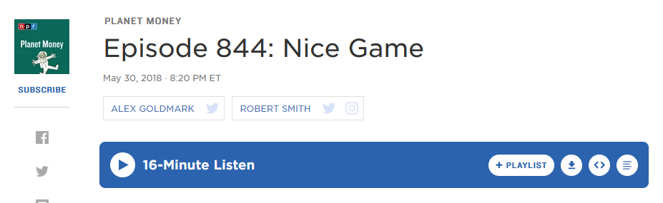
Module 7 · Prisoner’s Dilemma, Game of Chicken…
Podcast on Prisoner's Dilemma
What's the experiment that Bob Axelrod ran in the 1980s?
What was the winning strategy?
Management 405 · Module 7 · Oligopoly and Game Theory
45

Slide 46
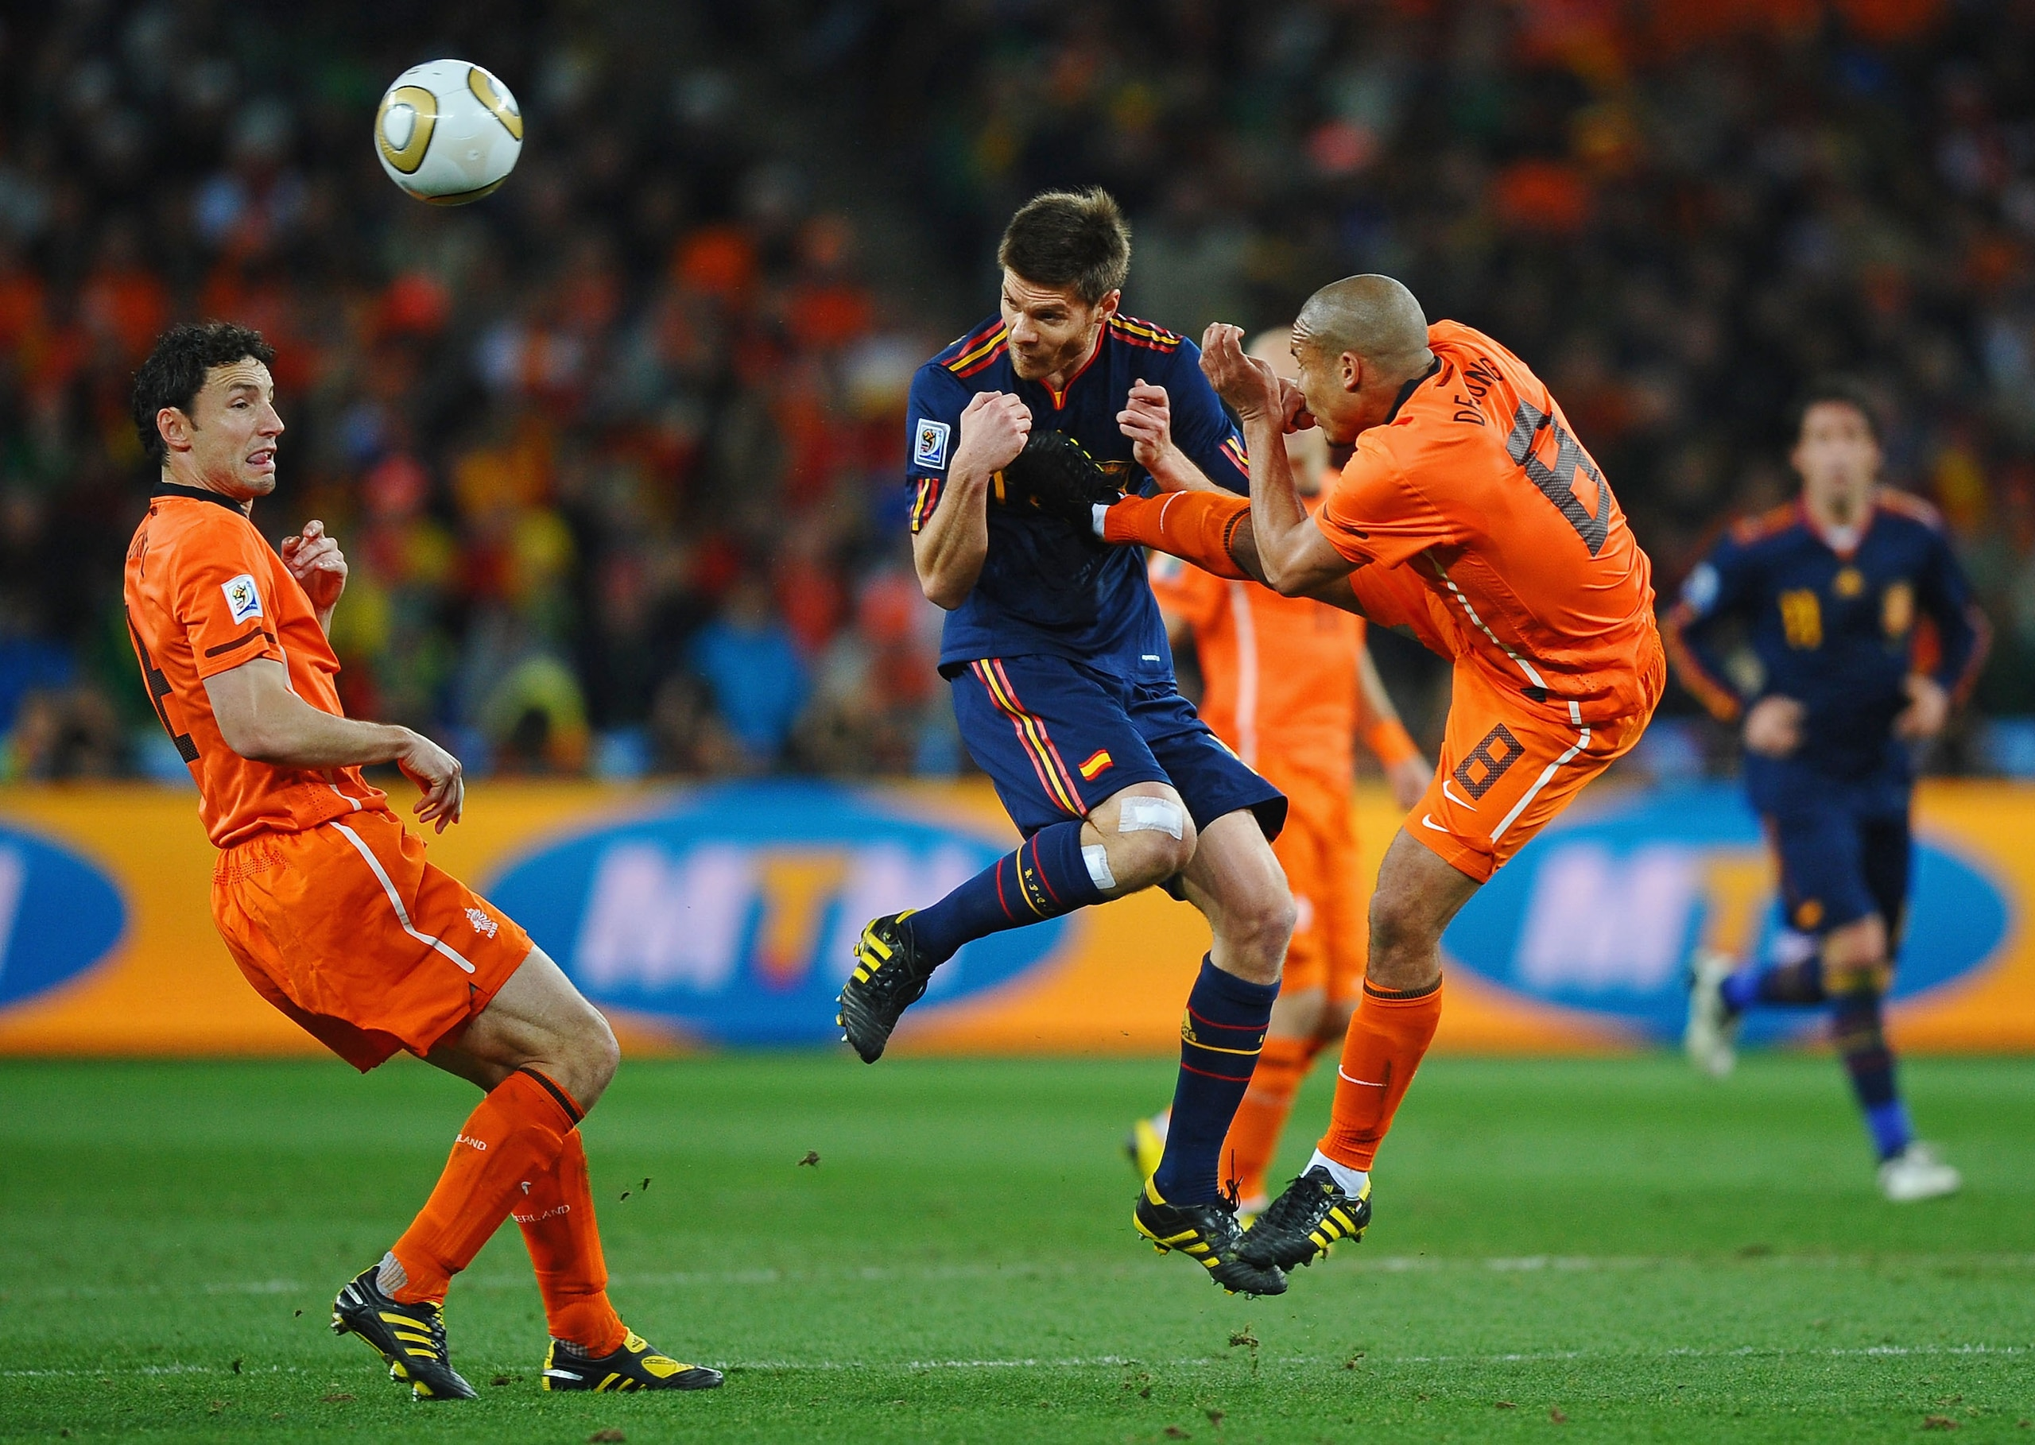
Module 7 · Prisoner’s Dilemma, Game of Chicken…
Fair Play vs. “Dirty” Play
Team 2
Play fair
Play dirty
Play fair
0.5 , 0.5
0.3 , 0.7
Team 1
Play dirty
0.7 , 0.3
0.5 , 0.5
Payoffs to (Team 1, Team 2)
Nash Equilibrium
World Cup Final, 2010
Interpretation of payoffs:
Teams' odds of winning
Each team's dominant strategy is to play dirty
Management 405 · Module 7 · Oligopoly and Game Theory
46

Slide 47
Module 7 · Prisoner’s Dilemma, Game of Chicken…
Game Theory and Trade Wars
In a trade war, each country's dominant strategy is to set high tariffs
China
Low Tariffs
High Tariffs
Low Tariffs
20 , 20
13 , 24
US
Nash Equilibrium
High Tariffs
24 , 13
15 , 15
Payoffs to (US, China)
Interpretation of payoffs:
Countries' real GDP ($ trillion, price-adjusted)
2025–26 tariff war: US average tariff on Chinese goods ≈ 48%; China's on US goods ≈ 32% (PIIE)
Management 405 · Module 7 · Oligopoly and Game Theory
47
Notes:
The payoff numbers are stylized, but they are calibrated to real magnitudes. Interpretation of payoffs: real GDP in $ trillion. Actual 2025 nominal GDP: US ≈ $30.6 trillion, China ≈ $19.4 trillion (IMF World Economic Outlook, Oct 2025).
Where we actually are: after the 2025 tariff escalations and the partial truces (Geneva, May 2025; Korea, Nov 2025), the average US tariff on Chinese imports is ≈ 47.5% and China's average tariff on US imports ≈ 31.9% (PIIE US–China trade war tariff tracker, Nov 2025) — i.e., the high-tariff / high-tariff cell.
Estimated costs behind the payoff gaps: the 2025 tariff actions are estimated to reduce long-run US GDP by roughly 0.3–0.7% (Yale Budget Lab; Tax Foundation), on the order of $100–200B per year; for China, estimates run from 0.5 to 2.5 percentage points off GDP growth over 2025–27 depending on escalation (EIU).
The game's structure matches the evidence: a unilateral tariff shifts some surplus to the imposing country (the 24 vs. 13 cells), but when both retaliate, both end up worse off (15, 15) than under mutual low tariffs (20, 20) — the prisoner's-dilemma logic.

Slide 48
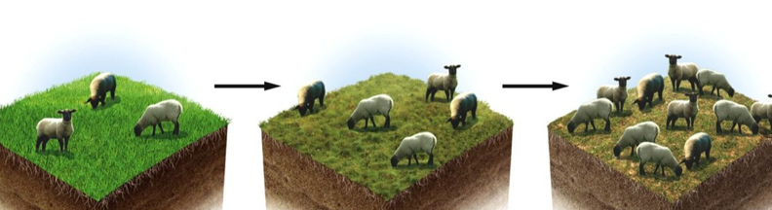
Module 7 · Prisoner’s Dilemma, Game of Chicken…
General Lesson: Collective Action Problem
Acting selfishly can lead to socially suboptimal outcomes
  Also holds in situations with more than 2 players
  Known as “tragedy of the commons”
▪ Stark contrast with “invisible hand” principle (Adam Smith)
Management 405 · Module 7 · Oligopoly and Game Theory
48

Slide 49
Module 7 · Prisoner’s Dilemma, Game of Chicken…
The Game of Chicken
You and your arch-enemy drive towards each other on a narrow street
You
Similar game in “Rebel Without a Cause”
avoid
drive on
avoid
0 , 0
-10 , 10
Arch enemy
drive on
10 , -10
-100 , -100
2 Nash Equilibria
Payoffs to (Arch enemy, You)
Real world examples:
  Entry into a market that can only sustain one firm profitably (natural monopoly)
  The Cold War (next slide)
Management 405 · Module 7 · Oligopoly and Game Theory
49

Slide 50
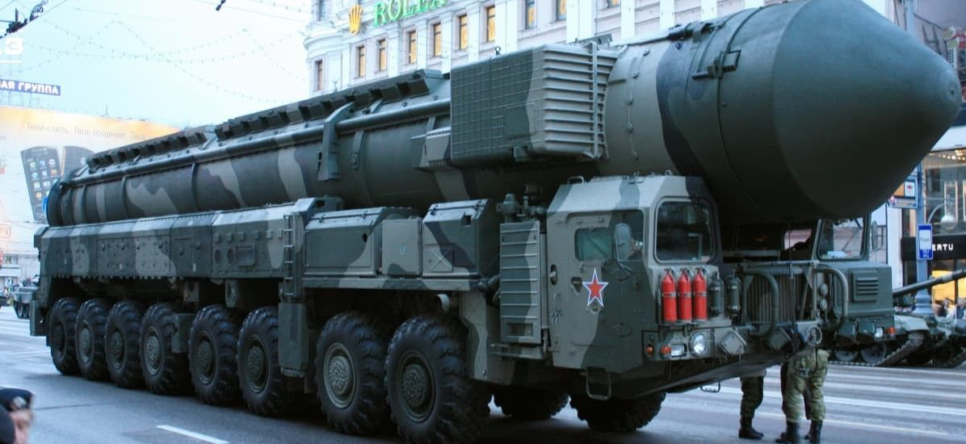
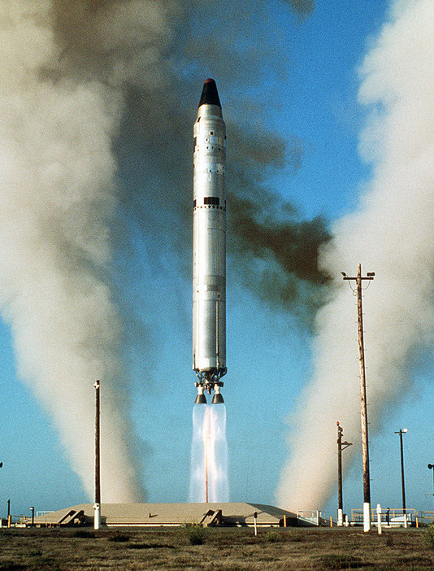
Module 7 · Prisoner’s Dilemma, Game of Chicken…
The Cold War and M.A.D.
Why did none of the two super-powers use nukes?
  Mutually Assured Destruction (M.A.D.)
USSR
Don't use
nuclear weapons
Use nuclear
weapons
No
nukes
0 , 0
-20 , 10
USA
Use
nukes
10 , -20
-100 , -100
2 Nash Equilibria
Payoffs to (USA, USSR)
Management 405 · Module 7 · Oligopoly and Game Theory
50
Notes:
Picture left: US Titan II nuclear missile. Picture right: Soviet Union nuclear warhead.

Slide 51
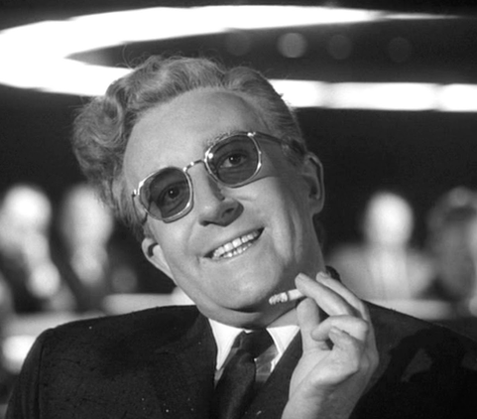
Module 7 · Prisoner’s Dilemma, Game of Chicken…
Group Work
How does the payoff table change under M.A.D.?
  “Doomsday device” (also explained by Dr. Strangelove)
USSR
Don't use
nuclear weapons
Use nuclear
weapons
No
nukes
0 , 0
(Cell impossible due to M.A.D.)
Dr. Strangelove
USA
Use
nukes
(Cell impossible due to M.A.D.)
-100 , -100
Payoffs to (USA, USSR)
The world came very close to destruction: Documentary
Discussion
Management 405 · Module 7 · Oligopoly and Game Theory
51
Notes:
See here for an illustration using a decision tree: https://www.spaceship.com.au/learn/game-theory-cold-war/
Documentary: “The Man Who Saved the World”: Vasili Arkhipov.
How close did it get? On October 27, 1962, at the height of the Cuban Missile Crisis, US Navy destroyers cornered the Soviet submarine B-59 near Cuba and dropped small practice depth charges to force it to surface. The crew had lost contact with Moscow for days, the batteries were running low and the heat inside was extreme, so the captain, Valentin Savitsky, believed that war might already have started. B-59 carried a torpedo with a nuclear warhead, and Savitsky wanted to fire it. On this submarine a launch needed the agreement of three senior officers: the captain, the political officer, and Vasili Arkhipov, the commander of the submarine flotilla, who happened to be on board. Arkhipov refused. The submarine surfaced and sailed back to the Soviet Union. A nuclear strike on US warships would very likely have triggered a nuclear response. The story only became widely known in 2002, when the US National Security Archive's director said at a conference in Havana that "a guy called Vasili Arkhipov saved the world." Much of what we know comes from the later recollections of crew members, so some details are still debated. Arkhipov died in 1998.

Slide 52
Module 7 · Prisoner’s Dilemma, Game of Chicken…
Commitment and Strategy
Note that M.A.D. represents a commitment (to retaliate)
USSR
Don't use
nuclear weapons
Use nuclear
weapons
No
nukes
USA
Use
nukes
Payoffs to (USA, USSR)
(Much) more on commitment in your Strategy class!
  Crucial: Is the player's “commitment” credible?
Tickets →
Management 405 · Module 7 · Oligopoly and Game Theory
52

Slide 53
Module 7 · Prisoner’s Dilemma, Game of Chicken…
Penalty Kicks: Find the (Pure-Strategy) Nash Equilibrium
Note:
  Pure Strategy: Each player picks either “Left” or “Right” (as in all games we've seen thus far)
  Mixed Strategy: Players can also assign probabilities with which they pick Left or Right (not relevant for our class)
Goalie
Left
Right
Left
-1 , 1
1 , -1
Kicker
Right
1 , -1
-1 , 1
Payoffs to (Kicker, Goalie)
Poll Break
Management 405 · Module 7 · Oligopoly and Game Theory
53

Slide 54
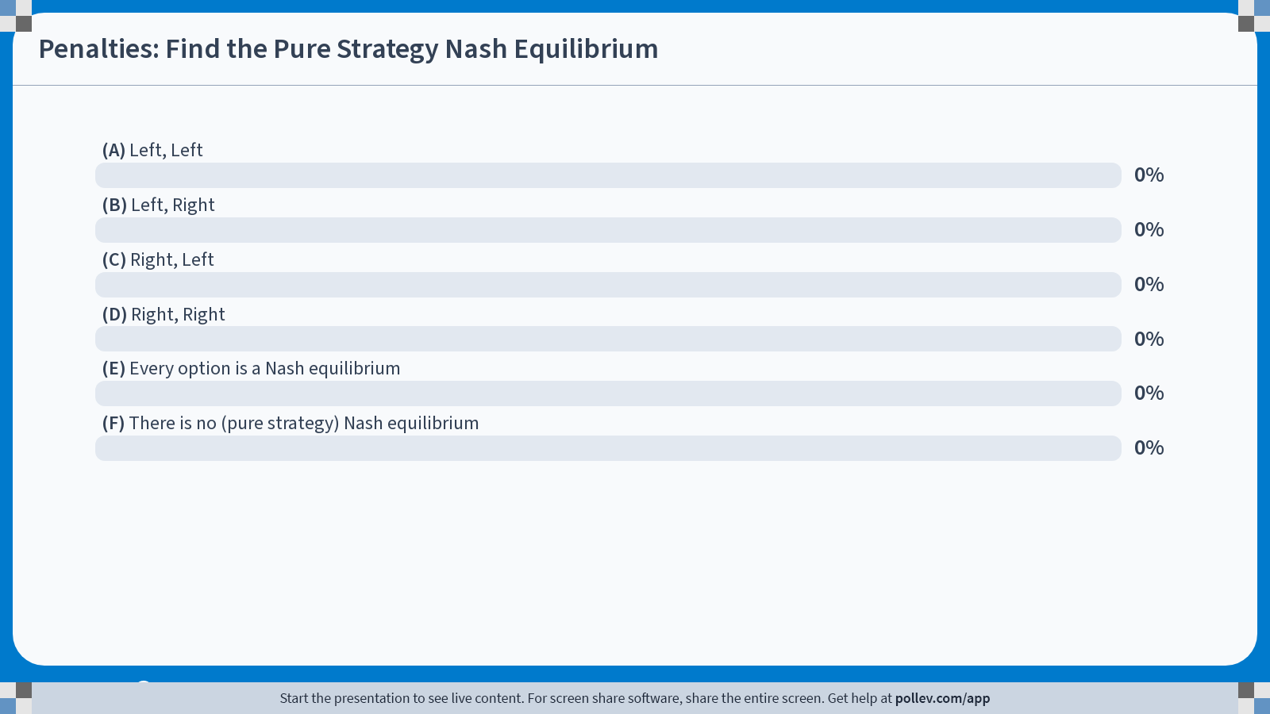
Notes:
Poll Title: Do not modify the notes in this section to avoid tampering with the Poll Everywhere activity.
More info at polleverywhere.com/support
Penalties: Find the Pure Strategy Nash Equilibrium
https://www.polleverywhere.com/multiple_choice_polls/t4Y7W1k6RDyOlzV2FYc6c?state=opened&flow=Default&onscreen=persist

Slide 55
Module 7 · Prisoner’s Dilemma, Game of Chicken…
Solution
Poll Break
Management 405 · Module 7 · Oligopoly and Game Theory
55

Slide 56
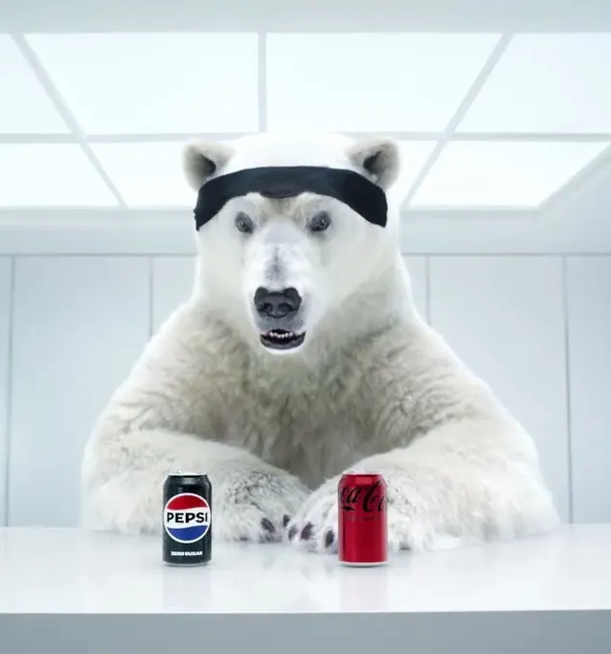
Module 7 · Prisoner’s Dilemma, Game of Chicken…
Find the (Pure-Strategy) Nash Equilibrium
Pepsi
Advertise
Don't Advertise
150 , 150
450 , -75
Advertise
Coke
-75 , 450
225 , 225
Don't
Advertise
Payoffs to (Coke, Pepsi)
Interpretation of payoffs:
Firms' profits
Poll Break
Management 405 · Module 7 · Oligopoly and Game Theory
56
Notes:
The answer is 1. Both advertise, and make lower profits than if they could coordinate on not advertising. This is just like the prisoner's dilemma.

Slide 57
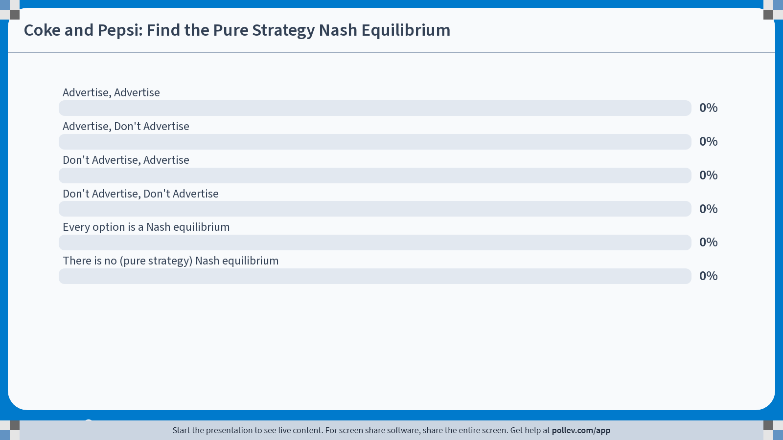
Notes:
Poll Title: Do not modify the notes in this section to avoid tampering with the Poll Everywhere activity.
More info at polleverywhere.com/support
Coke and Pepsi: Find the Pure Strategy Nash Equilibrium
https://www.polleverywhere.com/multiple_choice_polls/YNUeNl8wgPKa30BY4bpLT?state=opened&flow=Default&onscreen=persist

Slide 58
Module 7 · Prisoner’s Dilemma, Game of Chicken…
Solution
Poll Break
Management 405 · Module 7 · Oligopoly and Game Theory
58

Slide 59
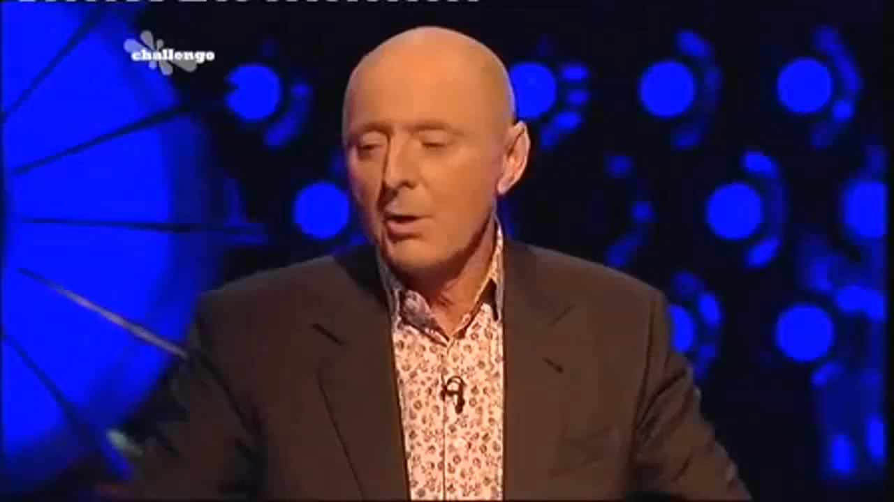
Module 7 · Prisoner’s Dilemma, Game of Chicken…
Game Theory on TV: Split or Steal?
Management 405 · Module 7 · Oligopoly and Game Theory
59

Slide 60
Module 7 · Prisoner’s Dilemma, Game of Chicken…
“Split or Steal”: Payoff Matrix
We assume that good reputation (when splitting) is worth £5k (while bad reputation is worth £0)
We round the total jackpot to £100k
Sarah
Split
Steal
Split
£55 , £55
£5 , £100
Steven
2 Nash Equilibria
Steal
£100 , £5
£0 , £0
Payoffs to (Steven, Sarah)
Management 405 · Module 7 · Oligopoly and Game Theory
60

Slide 61
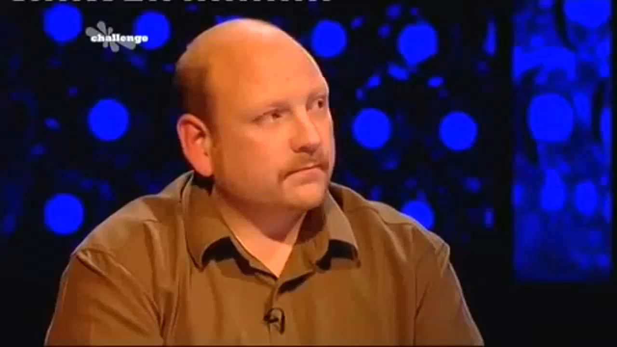
Module 7 · Prisoner’s Dilemma, Game of Chicken…
Split or Steal: Cheap Talk
Management 405 · Module 7 · Oligopoly and Game Theory
61

Slide 62
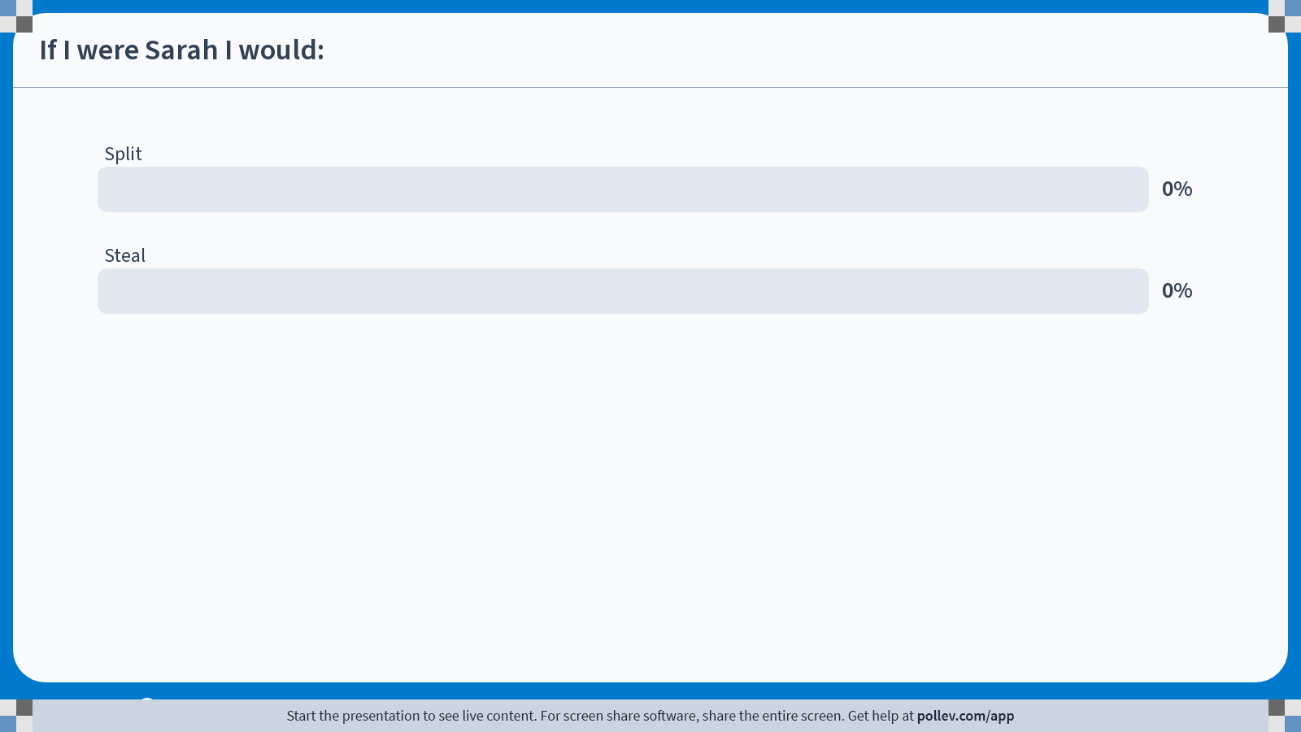
Notes:
Poll Title: Do not modify the notes in this section to avoid tampering with the Poll Everywhere activity.
More info at polleverywhere.com/support
If I were Sarah I would:
https://www.polleverywhere.com/multiple_choice_polls/rTbGp9xZwHKS0LAOTFReT?state=opened&flow=Default&onscreen=persist

Slide 63

Notes:
Poll Title: Do not modify the notes in this section to avoid tampering with the Poll Everywhere activity.
More info at polleverywhere.com/support
If I were Steve I would:
https://www.polleverywhere.com/multiple_choice_polls/Z3mjbL68gBmWdcBUe5EsI?state=opened&flow=Default&onscreen=persist

Slide 64
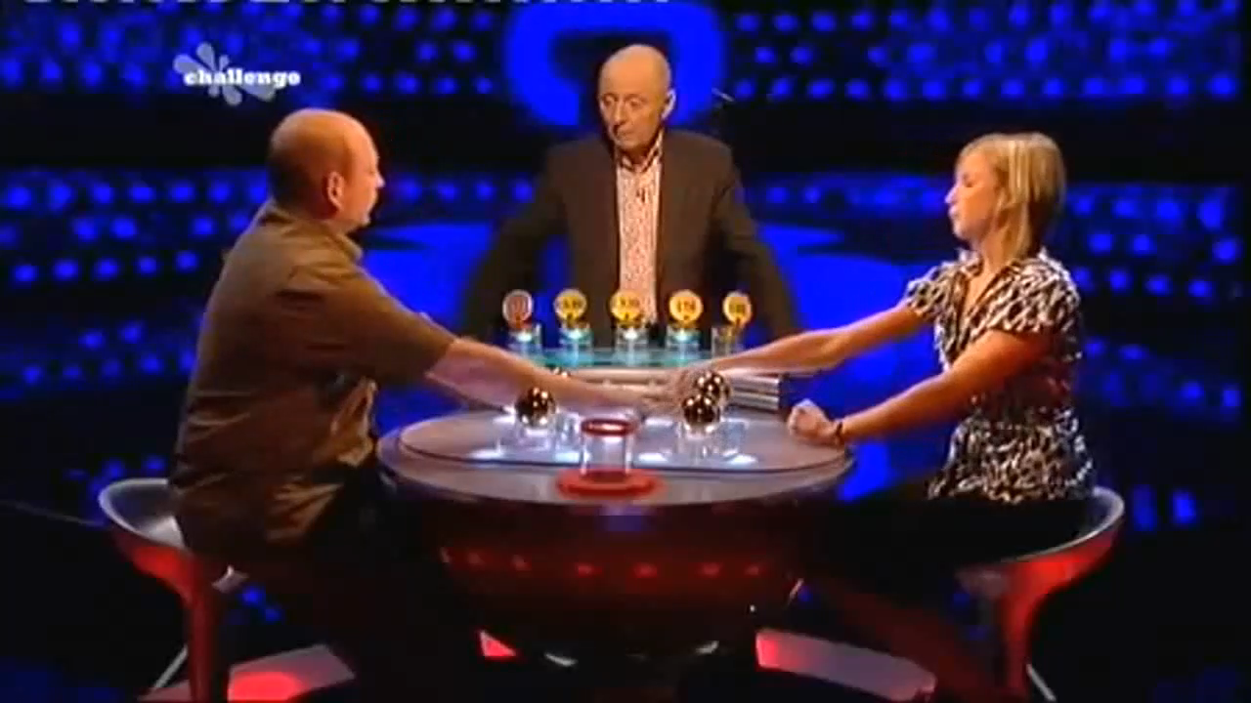
Module 7 · Prisoner’s Dilemma, Game of Chicken…
Split or Steal
Management 405 · Module 7 · Oligopoly and Game Theory
64

Slide 65
Module 7 · Prisoner’s Dilemma, Game of Chicken…
Commitment and Strategy
If Steven could commit to Steal, what would be Sarah's optimal response?
Sarah
Split
Steal
Split
(Cell impossible due to Steven's commitment)
(Cell impossible due to Steven's commitment)
Steven
Steal
£100 , £5
£0 , £0
Payoffs to (Steven, Sarah)
(Much) more on this in your Strategy class!
  Crucial: Is the player's “commitment” credible?
Management 405 · Module 7 · Oligopoly and Game Theory
65

Slide 66
Module 7 · Prisoner’s Dilemma, Game of Chicken…
“Split or Steal”: Payoff Matrix
Nick credibly argues that he will steal. Let's assume he gets “satisfaction” = 10 from stealing and seriously plans to share 50-50
Good reputation for splitting is still worth 5
Ibrahim believes that Nick will share winnings with probability p > 0
Ibrahim
Split
Steal
Split
£55 , £55
£5 , £100
Nick
Steal
£60* , p×£50
£10 , £0
Payoffs to (Nick, Ibrahim)
*Assuming that payoff is shared after stealing. Thus, payoff = 0.5×100 + 10
Management 405 · Module 7 · Oligopoly and Game Theory
66
Notes:
Video that will be shown in Strategy: http://www.youtube.com/watch?v=S0qjK3TWZE8

Slide 67
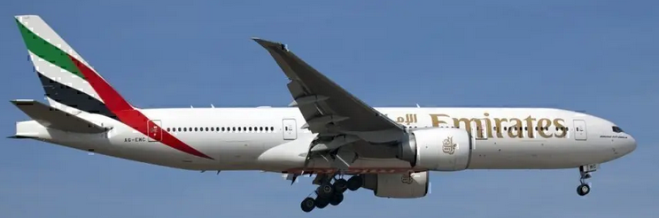
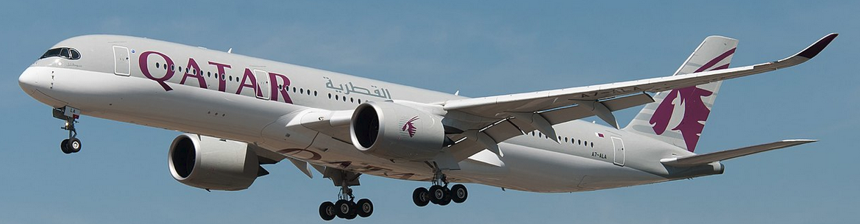
Module 7 · Prisoner’s Dilemma, Game of Chicken…
Boeing vs. Airbus: Entry Game
2 firms: Boeing and Airbus
One type of product: Ultra-long-range (ULR) aircraft
Decision: produce or not produce
  Boeing: incumbent (777-200LR)
  Airbus: must decide whether to enter (A350 ULR)
Analyze the situation with and without subsidies
Management 405 · Module 7 · Oligopoly and Game Theory
67
Notes:
Some background on the 777-200LR, in case it comes up: https://aeronauticsonline.com/why-it-failed-boeing-777-200lr/

Slide 68
Module 7 · Prisoner’s Dilemma, Game of Chicken…
No Subsidy Case
Interpretation of payoffs:
Annual profits from ULR aircraft (in $B)
Airbus
Produce
Don't Produce
Produce
-1 , -1
5 , 0
Boeing
Don't
Produce
0 , 5
0 , 0
Payoffs to (Boeing, Airbus)
Boeing is already incumbent. So we're initially in this Nash equilibrium
Management 405 · Module 7 · Oligopoly and Game Theory
68

Slide 69
Module 7 · Prisoner’s Dilemma, Game of Chicken…
Subsidy Case
EU pays $2B to Airbus if they produce
Airbus
Produce
Don't Produce
Produce
-1 , 1
5 , 0
Boeing
Don't
Produce
0 , 7
0 , 0
Payoffs to (Boeing, Airbus)
Unique Nash equilibrium in the EU-only subsidy case
Management 405 · Module 7 · Oligopoly and Game Theory
69

Slide 70
Module 7 · Prisoner’s Dilemma, Game of Chicken…
Subsidy in Both EU and US
US now also pays $2B to Boeing if they produce
Airbus
Produce
Don't Produce
Produce
1 , 1
7 , 0
Boeing
Don't
Produce
0 , 7
0 , 0
Payoffs to (Boeing, Airbus)
Unique Nash equilibrium in the EU+US subsidy case
Management 405 · Module 7 · Oligopoly and Game Theory
70

Slide 71
Module 7 · Summary
Recap of Module 7 (For Your Notes)
Oligopoly
Game Theory
Competition with homogeneous products:
  Cournot: Firms compete on quantity. Positive profits
    Equilibrium = intersection of the reaction functions
  Bertrand: Firms compete on price. Zero profit if both have same MC
    Price wars → same outcome as perfect competition (if same MC)
Competition with differentiated products:
  The two products are imperfect substitutes (differentiated)
  Bertrand: Each firm sets price for its differentiated product
    If one firm sets a higher price, the other firm also reacts by raising its price
    Equilibrium = intersection of the reaction functions
Strategic thinking: Anticipate other player's reaction
  Strategy: Optimized reaction to each action by other player
Use payoff tables
  Dominant Strategy
  Nash Equilibrium
Management 405 · Module 7 · Oligopoly and Game Theory
71

Slide 72
BACKUP

Slide 73
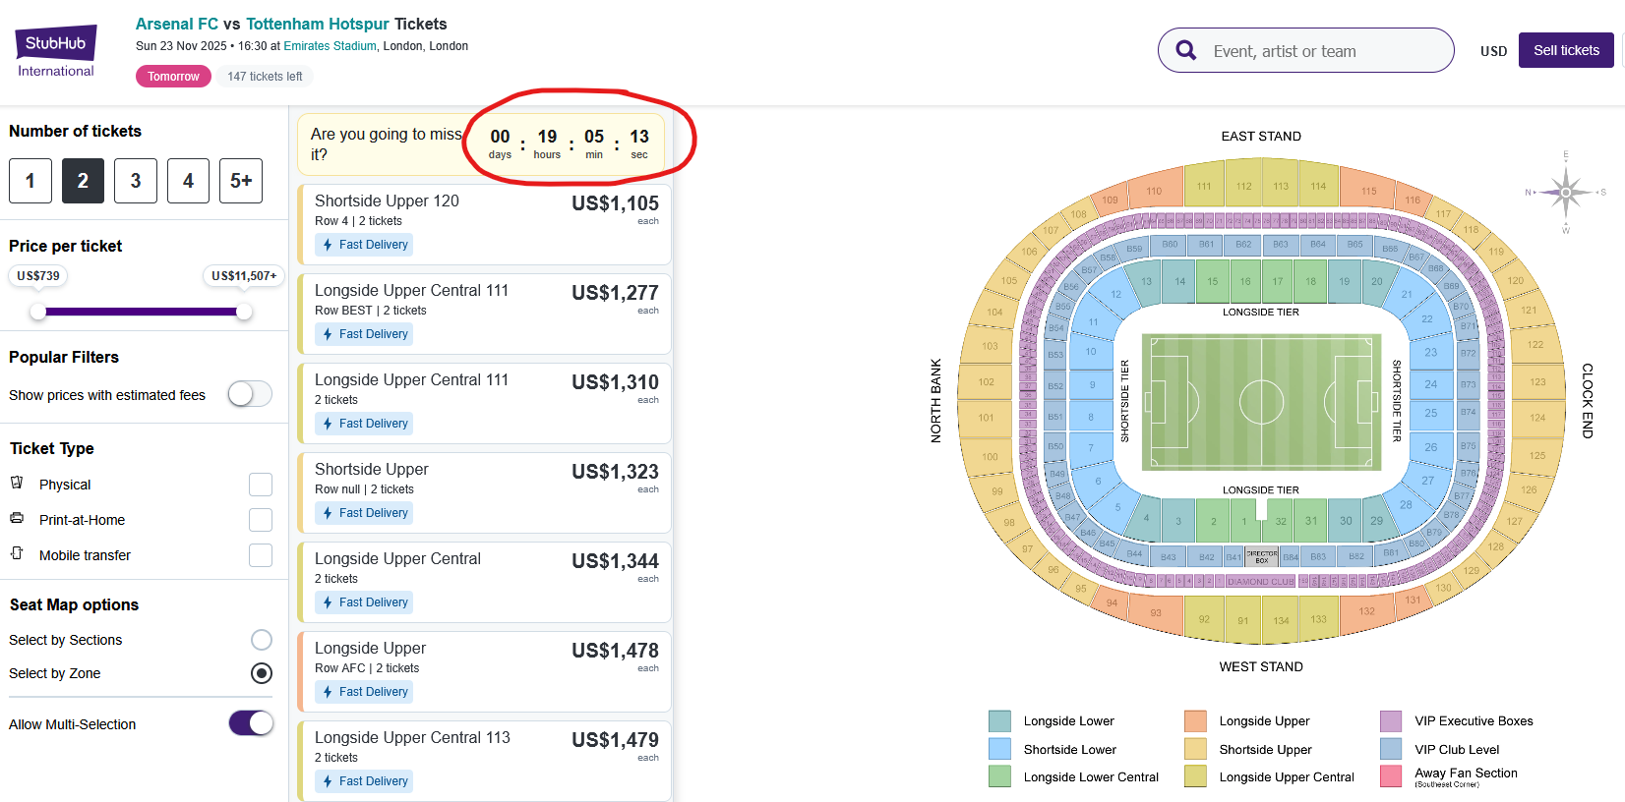
Module 7 · Backup
Commitment in Selling Tickets
← Back
Management 405 · Module 7 · Oligopoly and Game Theory
73

Slide 74
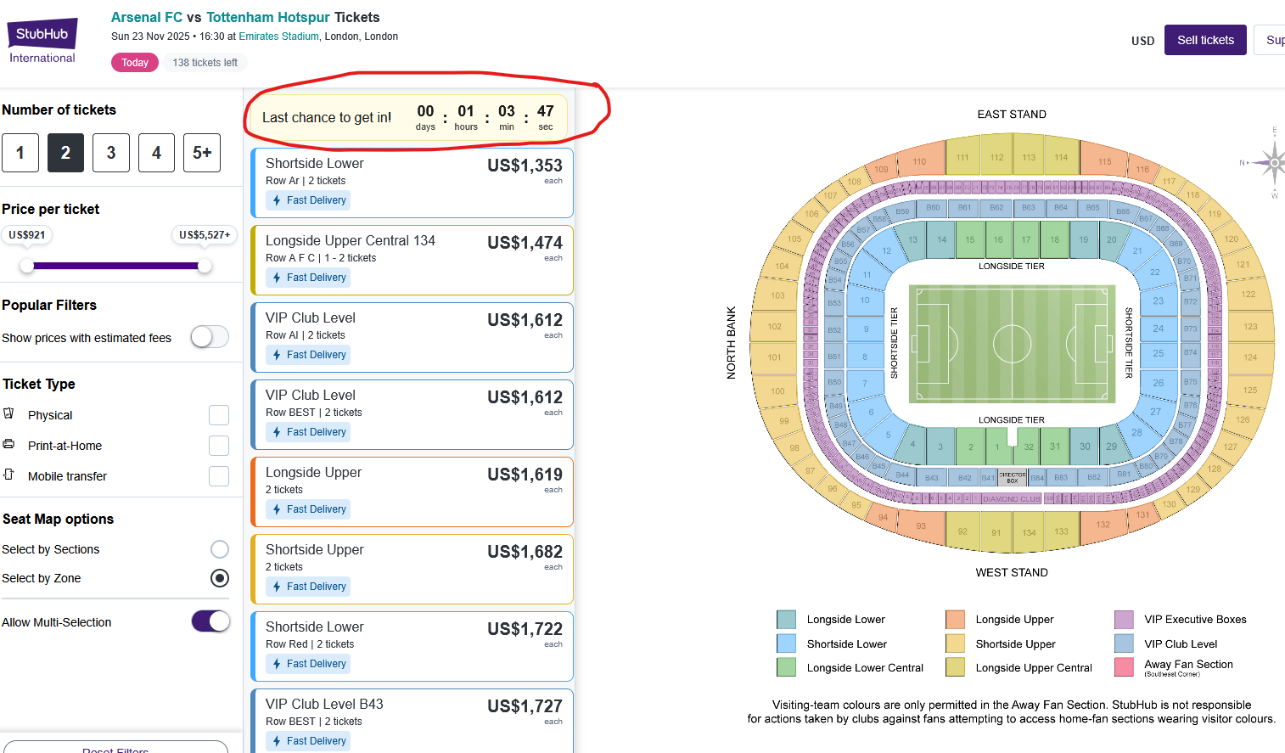
Module 7 · Backup
Commitment in Selling Ticket Sales
No sign of falling prices as the game comes closer. Why?
← Back
Management 405 · Module 7 · Oligopoly and Game Theory
74

