Slide 1
Cournot Competition
Module 7 · Video 3
Management 405
Prof. Nico Voigtländer · UCLA Anderson

Slide 2
Module 7 · Video 3 · Agenda
Outline of Module 7
1
Introduction to Oligopoly and Game Theory
Video 1
2
Collusion and Cartels
Video 2
3
Cournot Competition
Competing by choosing quantities: capacity decisions in oligopoly
Video 3
4
Bertrand Competition
Video 4
5
Bertrand Competition with Differentiated Goods
Video 5
6
Game Theory
In class
6a
Strategic Thinking: Key Concepts
In class
6b
Prisoner’s Dilemma, Game of Chicken…
In class
Management 405 · Module 7 · Oligopoly and Game Theory
2

Slide 3

Module 7 · Video 3 · Cournot Competition
Note
From now on:
No collusion among competitors
→ Firms compete strategically (“games”)
Management 405 · Module 7 · Oligopoly and Game Theory
3

Slide 4
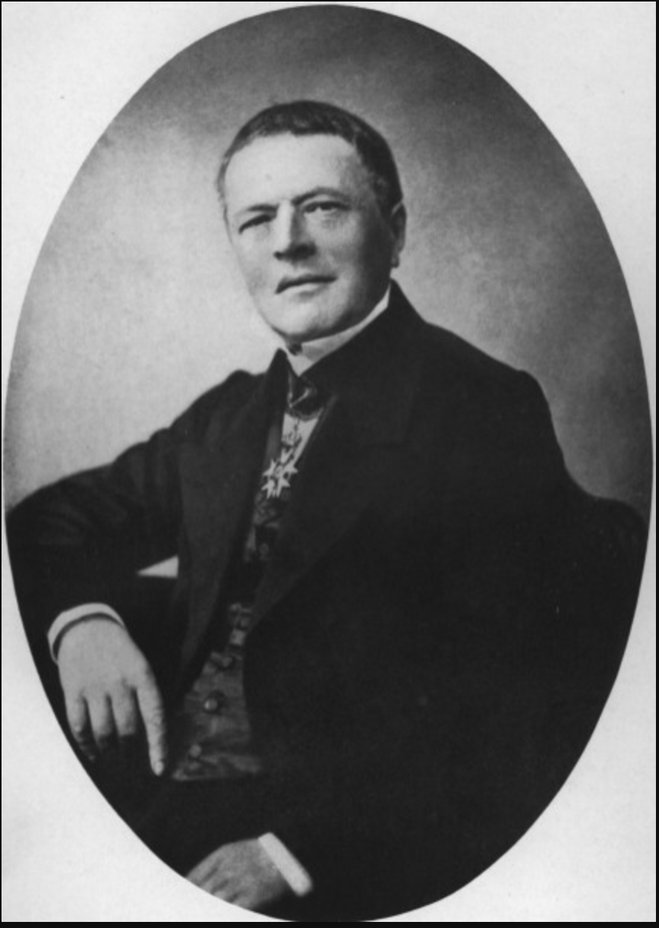
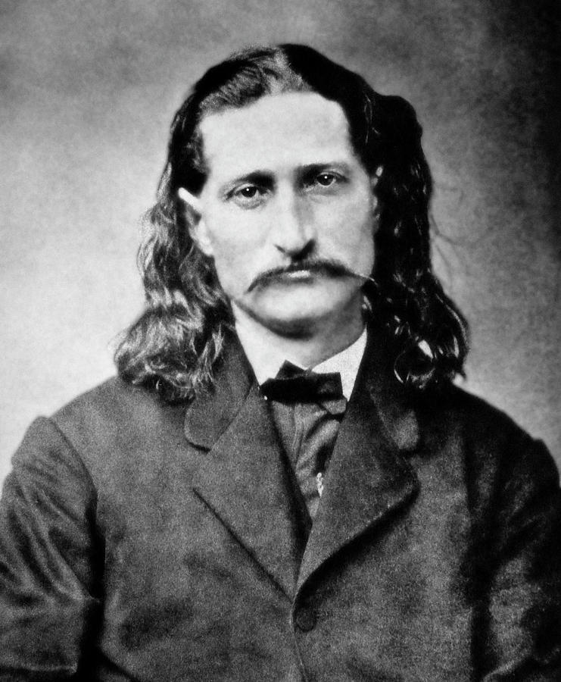
Module 7 · Video 3 · Cournot Competition
Two Models of Oligopoly Competition
Cournot (1801–1877)
Bertrand (1822–1900)
Cournot Model: Competition in Quantity
Bertrand Model: Competition in Price
Management 405 · Module 7 · Oligopoly and Game Theory
4
Notes:
Oligopoly: Cournot versus Bertrand. In what follows we will assume no collusion: competition rather than cooperation between firms. There are a lot of models of oligopoly – as many as assumptions you are willing to make on rivals' responses. You will come back to these issues in your strategy class, for now we give the foundations that will be used in strategy.
Two oligopoly models – the two most famous ones.
Cournot assumed quantity competition: each firm sets quantity taking as fixed the quantity set by the other. The assumption is that the other firm will continue to produce the same quantity whatever I do. As we will see shortly price does not go to the competitive level but settles between the monopoly and perfect competition price.
Bertrand (in his review of the Cournot book) proposed an alternative – that competition occurs on prices, not quantity. That is, the rival's price is held fixed when setting price. The idea is that in response to my price cut, others don't match. The equilibrium is where this assumption turns out to be correct (as before the assumption is false for all except the equilibrium point). What happens? As we will see shortly, equilibrium ends up equal to perfect competition.

Slide 5

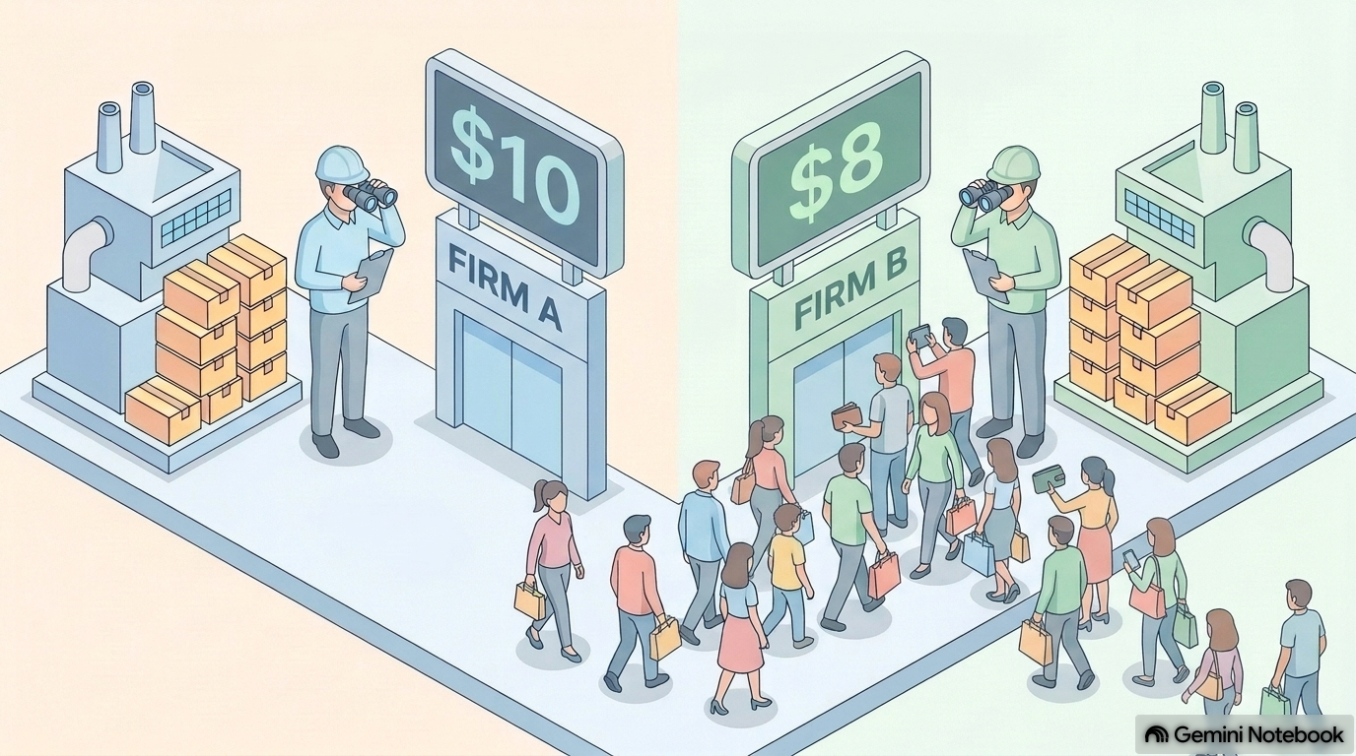
Module 7 · Video 3 · Cournot Competition
Two Oligopoly Models
Cournot
Bertrand
The rival's price is taken as given
Firm reacts by adjusting its own price (underbidding, if feasible)
Firms then supply the quantity that is demanded at the price they set
The rival's supply is taken as given
Firm reacts by adjusting its own quantity accordingly
Price is determined in the market
Management 405 · Module 7 · Oligopoly and Game Theory
5

Slide 6

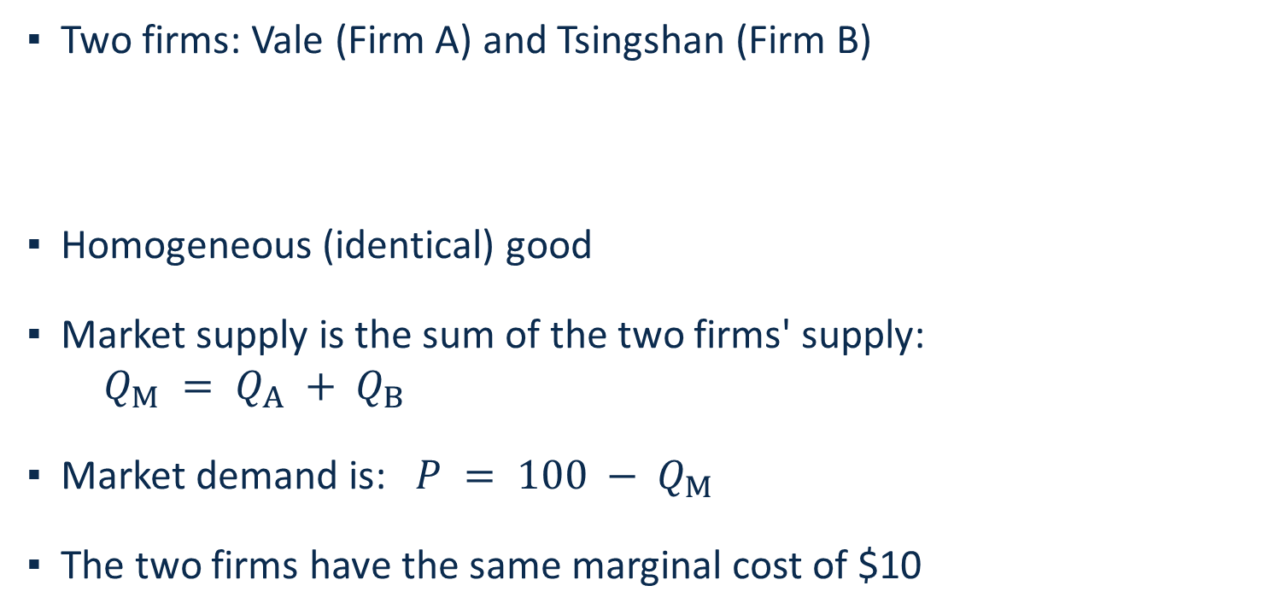
Module 7 · Video 3 · Cournot Competition
Duopoly Example: Nickel
▪ Two firms: Vale (Firm A) and Tsingshan (Firm B)
▪ Homogeneous (identical) good
▪ Market supply is the sum of the two firms' supply:
$Q_{M} = Q_{A} + Q_{B}$
▪ Market demand is: $P = 100 − Q_{M}$
▪ The two firms have the same marginal cost of $10
TSINGSHAN
HOLDING GROUP
Management 405 · Module 7 · Oligopoly and Game Theory
6
Notes:
The setup for our Cournot analysis. Two firms — Vale as Firm A and Tsingshan as Firm B — produce an identical good, nickel. Market supply is the sum of the two firms' quantities, market demand is P = 100 minus total quantity, and both firms have the same marginal cost of $10 per kg. All numbers are stylized to keep the algebra clean.

Slide 7

Module 7 · Video 3 · Cournot Competition
Cournot Competition (with Homogeneous Goods)
Assumptions:
▪ Firms make identical products
▪ Firms compete by choosing a quantity to produce
Management 405 · Module 7 · Oligopoly and Game Theory
7

Slide 8


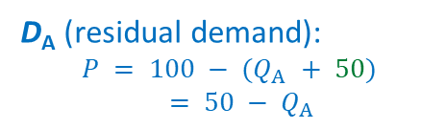
Module 7 · Video 3 · Cournot Competition
Cournot Competition: Reaction Function (I)
P
$100
Firm A assumes that B produces 50 units (Q_{B} = 50)
→ Firm A's optimal response is 20 units
$50
D_{A} (residual demand):
$$P = 100 − (Q_{A} + 50)$$
$$= 50 − Q_{A}$$
Market price determined by
overall Q = Q_{A} + Q_{B}
$30
D_{Market} : $P = 100 − Q_{M}$
50 units
$10
MC
20
50
70
100
Q
$${MR}_{A}$$
Management 405 · Module 7 · Oligopoly and Game Theory
8
Notes:
Cournot assumed quantity competition: each firm sets quantity taking as fixed the quantity set by the other. The assumption is that the other firm will continue to produce the same quantity whatever I do. [Of course most of the time this assumption will prove false, but not at the equilibrium]. The residual demand curve is just the amount of demand left over when subtracting the other firm's fixed supply from market demand. As we will see shortly price does not go to the competitive level but settles between the monopoly and perfect competition price.
Step 1: Go from the market-level demand to the individual-level demand by 'assuming' QB=50: P=100−(QA+50)=50−QA
Step 2: Once you have the individual-level demand, find the profit-maximizing quantity as usual (MR=MC): MRA=50−2QA; 50−2QA=10 → QA=20.

Slide 9


Module 7 · Video 3 · Cournot Competition
Cournot Competition: Reaction Function (II)
P
$100
D_{A} (residual demand):
$$P = 80 − Q_{A}$$
Now Firm A assumes that B produces 20 units (Q_{B} = 20)
$80
→ Firm A's optimal response is 35 units
$45
Market price determined by
overall Q = Q_{A} + Q_{B}
20 units
D_{Market} : $P = 100 − Q_{M}$
$10
MC
35
$${MR}_{A}$$
55
80
100
Q
Management 405 · Module 7 · Oligopoly and Game Theory
9
Notes:
Cournot assumed quantity competition: each firm sets quantity taking as fixed the quantity set by the other. The assumption is that the other firm will continue to produce the same quantity whatever I do. [Of course most of the time this assumption will prove false, but not at the equilibrium]. The residual demand curve is just the amount of demand left over when subtracting the other firm's fixed supply from market demand. As we will see shortly price does not go to the competitive level but settles between the monopoly and perfect competition price.
Step 1: Go from the market-level demand to the individual-level demand by 'assuming' QB=20: P=100−(QA+20)=80−QA
Step 2: Once you have the individual-level demand, find the profit-maximizing quantity as usual (MR=MC): MRA=80−2QA; 80−2QA=10 → QA=35.

Slide 10

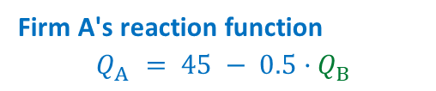

Module 7 · Video 3 · Cournot Competition
Firm A's Reaction Function
45
Reaction point (II)
35
Firm A's Reaction ($Q_{A}$)
Reaction point (I)
20
Firm A's reaction function
$$Q_{A} = 45 − 0.5·Q_{B}$$
20
50
90
Firm B's Output ($Q_{B}$)
Practice Video “Cournot Competition Math”
Management 405 · Module 7 · Oligopoly and Game Theory
10
Notes:
Don't say they move sequentially — it's just 'contemplating'. The reaction function collects Firm A's optimal responses: for every quantity B might produce, it gives A's profit-maximizing quantity. The two points we just derived — B produces 50, A responds with 20; B produces 20, A responds with 35 — pin down the line QA = 45 − 0.5·QB. The same logic (with the general algebra) is worked through in the practice video.

Slide 11

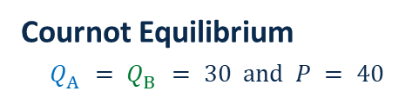

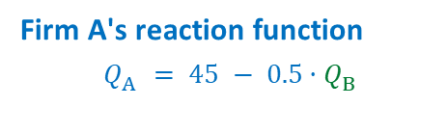

Module 7 · Video 3 · Cournot Competition
Cournot Equilibrium
90
Firm B's reaction function
$$Q_{B} = 45 − 0.5·Q_{A}$$
Cournot equilibrium: neither firm would like to deviate
→ Look for intersection of reaction functions
Firm A's Output ($Q_{A}$)
Cournot Equilibrium
$$Q_{A} = Q_{B} = 30 and P = 40$$
45
30
Firm A's reaction function
$$Q_{A} = 45 − 0.5·Q_{B}$$
15
Starting point: Firm B contemplates its reaction to Q_{A} = 15
30
45
90
Firm B's Output ($Q_{B}$)
Management 405 · Module 7 · Oligopoly and Game Theory
11
Notes:
Don't say they move sequentially — it's just 'contemplating'. The last step is to figure out the Cournot equilibrium, given by the 'intersection' of the two reaction functions. The intuition: we want a pair (QA*, QB*) so that A wants to respond to QB* with QA*, and B wants to respond to QA* by picking QB*.
We start from the reaction function for A: QA=45−0.5QB (1). Then we repeat the analysis for firm B (everything is symmetric, so it is the mirror image): QB=45−0.5QA (2). Last, we need the pair (QA*, QB*) that satisfies both — two equations, two unknowns. Replace (1) in (2): QB=45−0.5(45−0.5QB)=22.5+0.25QB → 0.75QB=22.5 → QB=30. By symmetry QA=30 as well (verify: QA=45−0.5·30=30). The figure shows the graphical version: two lines with different slopes intersect in exactly one point. The staircase from QA=15 shows how the contemplated responses converge to the equilibrium.

Slide 12
Module 7 · Video 3 · Cournot Competition
Cournot: Math
Practice Video “Cournot Competition Math”
More general case with different MC:
Practice Video “Oligopoly with different MC”
Management 405 · Module 7 · Oligopoly and Game Theory
12
Notes:
Two practice videos on BruinLearn walk through the Cournot algebra step by step: the baseline case we just did, and the more general case where the two firms have different marginal costs.

