Slide 1
Bertrand Competition
Module 7 · Video 4
Management 405
Prof. Nico Voigtländer · UCLA Anderson

Slide 2
Module 7 · Video 4 · Agenda
Outline of Module 7
1
Introduction to Oligopoly and Game Theory
Video 1
2
Collusion and Cartels
Video 2
3
Cournot Competition
Video 3
4
Bertrand Competition
Competing by setting prices, and why it can compete profits away
Video 4
5
Bertrand Competition with Differentiated Goods
Video 5
6
Game Theory
In class
6a
Strategic Thinking: Key Concepts
In class
6b
Prisoner’s Dilemma, Game of Chicken…
In class
Management 405 · Module 7 · Oligopoly and Game Theory
2

Slide 3
Module 7 · Video 4 · Bertrand Competition
Bertrand Competition
Bertrand assumed that firms choose a price and stand ready to meet all demand at that price
Each firm sets a price that maximizes profits, conditional on the price set by the other firm
Contrast this with the Cournot case, where the game was played on quantities
Management 405 · Module 7 · Oligopoly and Game Theory
3

Slide 4

Module 7 · Video 4 · Bertrand Competition
Bertrand Competition (with Identical Goods)
Assumptions:
▪ Firms make identical products
▪ Firms compete by choosing the price at
which they sell their products
Management 405 · Module 7 · Oligopoly and Game Theory
4

Slide 5

Module 7 · Video 4 · Bertrand Competition
Bertrand Competition
P
Suppose Firms A and B start at a price of $40, where each supplies Q=30
A believes that B will maintain its price. What will A do? How will B respond?
$100
$$P = 100 − Q_{M}$$
Bertrand Equilibrium
$40
Lost by A
$39
Gained by A
→ A and B will continue to lower their price until they reach P = MC
MC
$10
30
60
61
90
100
Q
Management 405 · Module 7 · Oligopoly and Game Theory
5
Notes:
Bertrand assumed that firms choose a price and stand ready to meet all demand at that price. Each firm sets a price that maximizes profits holding constant the price set by the other firm. Contrast this with the Cournot case where the game is played on quantities.
What is the outcome of Bertrand competition? The only equilibrium is P1 = P2 = MC. If, say P2 >= P1 > MC, P2 will undercut by a small amount, so there are no such equilibria. Proof: starting at P1 = P2 = MC, neither firm gains from raising (sells nothing) or cutting (negative profit). And any price above MC invites undercutting — the situation in the figure (both at $40, one drops to $39: it loses the thin strip on its old sales but gains the whole market).
Bertrand with identical goods has a clean solution, but the conditions are rare. A market that came close: online retail of computer chips for home-built CPUs — consumers bought the cheapest chip and prices were approximately marginal cost, with retailers trying to escape via obfuscation (loss-leader ads, add-ons). With differentiated goods, equilibrium prices can stay above marginal cost.

Slide 6

Module 7 · Video 4 · Bertrand Competition
Oligopoly Outcomes: Comparison
P
$100
$$P = 100 − Q_{M}$$
Monopoly Equilibrium
(also collusive/cartel equilibrium)
$55
Cournot Equilibrium
Bertrand Equilibrium
$40
(same as Perfect Competition
when both firms have same MC)
MR
MC
$10
45
60
90
100
Q
Management 405 · Module 7 · Oligopoly and Game Theory
6
Notes:
You can use this graph to understand the welfare consequences of these different forms of competition.
Producer welfare ranks: Perfect Competition = Bertrand < Cournot < Monopoly. Consumer welfare ranks: Perfect Competition = Bertrand > Cournot > Monopoly. Total surplus ranks: Perfect Competition = Bertrand > Cournot > Monopoly.
These last two comparisons (consumer welfare and total surplus decrease with market power) are the reason why the Federal Trade Commission cares about market power.

Slide 7

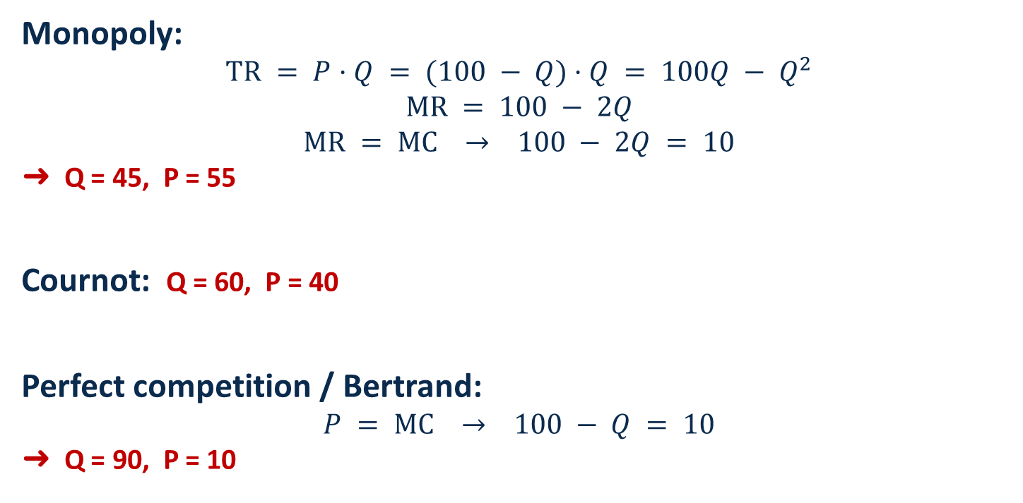
Module 7 · Video 4 · Bertrand Competition
Comparison of Outcomes: (The Numbers)
$$P = 100 − Q and MC = 10$$
Monopoly:
$$TR = P·Q = (100 − Q)·Q = 100Q − Q^{2}$$
$$MR = 100 − 2Q$$
$$MR = MC → 100 − 2Q = 10$$
➜ Q = 45, P = 55
Cournot: Q = 60, P = 40
Perfect competition / Bertrand:
$$P = MC → 100 − Q = 10$$
➜ Q = 90, P = 10
Practice Video “Cournot Competition Math”
Management 405 · Module 7 · Oligopoly and Game Theory
7
Notes:
The algebra behind the comparison chart, all with the same market demand P = 100 − Q and MC = 10. The monopolist (or cartel) sets MR = MC and produces 45 at a price of 55. The Cournot duopoly ends up at 60 and a price of 40 — between monopoly and competition. Bertrand price competition drives the price all the way down to marginal cost: 90 units at a price of 10, the perfectly competitive outcome.

Slide 8
Module 7 · Video 4 · Bertrand Competition
Wrapping Up: Cournot vs. Bertrand
Cournot: quantity competition
Bertrand: price competition
Firms set quantity/capacity strategically
Firms set price strategically
There isn't a “correct” and an “incorrect” model, they just make different assumptions
  Often Bertrand (price) competition in the short run
  Cournot (quantity) competition in the long run (e.g., by setting up production capacities)
Management 405 · Module 7 · Oligopoly and Game Theory
8
Notes:
Bertrand with identical goods has a nice solution but the conditions that give rise to this outcome are rare in the real world. A market that was close was the online market for computer chips for consumers that like to build their own CPUs. Consumers bought the cheapest chip. Researchers found that prices were approx. marginal cost. An interesting wrinkle is that computer chip retailers attempted to differentiate their goods through obfuscation: either by advertising an inferior chip as a loss leader and then redirecting the consumer to their website or by offering product add-ons. In a Bertrand model with differentiated goods, there is the potential for the equilibrium price to be above marginal cost.

