Slide 1
Bertrand Competition with
Differentiated Goods
Module 7 · Video 5
Management 405
Prof. Nico Voigtländer · UCLA Anderson

Slide 2
Module 7 · Video 5 · Agenda
Outline of Module 7
1
Introduction to Oligopoly and Game Theory
Video 1
2
Collusion and Cartels
Video 2
3
Cournot Competition
Video 3
4
Bertrand Competition
Video 4
5
Bertrand Competition with Differentiated Goods
How differentiation softens price competition
Video 5
6
Game Theory
In class
6a
Strategic Thinking: Key Concepts
In class
6b
Prisoner’s Dilemma, Game of Chicken…
In class
Management 405 · Module 7 · Oligopoly and Game Theory
2

Slide 3
Module 7 · Video 5 · Bertrand Competition with Differentiated Goods
Bertrand Competition with Differentiated Products
So far: We assumed that all firms produce identical products
More common situation: Differentiated products
  Pepsi and Coke
  Airbus A320 vs. Boeing 737 (medium-range)
  Airbus A350 vs. Boeing 787 (long-range)
Setting now:
  2 firms producing differentiated products
Management 405 · Module 7 · Oligopoly and Game Theory
3

Slide 4

Module 7 · Video 5 · Bertrand Competition with Differentiated Goods
Bertrand Competition (with Differentiated Goods)
Assumptions:
▪ Firms do not sell identical products. They sell differentiated products
▪ Each firm faces its own demand function
▪ Each firm chooses its price, responding to the price of the other firm
Management 405 · Module 7 · Oligopoly and Game Theory
4
Notes:
The three assumptions for Bertrand with differentiated goods: differentiated products, an own demand function for each firm, and prices chosen simultaneously. Why do we need simultaneity? It means neither firm can observe the rival's price before setting its own, and neither can commit to moving first — so the equilibrium is a pair of mutual best responses rather than a leader-follower outcome. It also answers the natural question about the price war: the second mover cannot simply wait and undercut at the last moment, because in this setting there is no last mover. In Part 2 we deliberately break exactly this assumption — commitment is what changes when one player CAN move first.

Slide 5
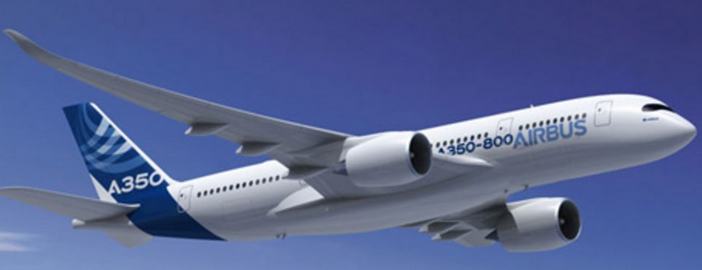




Module 7 · Video 5 · Bertrand Competition with Differentiated Goods
Oligopoly with Differentiated Goods
Oligopoly on long-range aircraft:
  Airbus A350 (Firm A)
  Boeing 787 (Firm B)
Interdependent demand:
$$Q_{A} = 400 − 2P_{A} + P_{B}$$
$$Q_{B} = 400 − 2P_{B} + P_{A}$$
substitutes
Note: Now we have 2 demand functions! (Differentiated products)
Same marginal cost (all in $Million):
$${MC}_{A} = {MC}_{B} = 200$$
Optional Advanced Practice Video: “Bertrand Competition with Differentiated Goods – Math”
Management 405 · Module 7 · Oligopoly and Game Theory
5

Slide 6

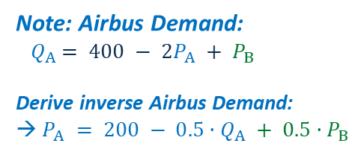

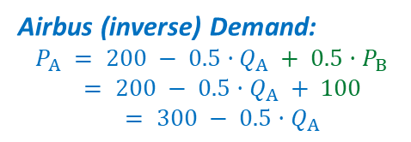
Module 7 · Video 5 · Bertrand Competition with Differentiated Goods
Reaction Function: Airbus' Reaction to Boeing's Price (I)
Note: Airbus Demand:
${ Q}_{A} = 400 − 2P_{A} + P_{B}$
Derive inverse Airbus Demand:
→ $P_{A} = 200 − 0.5·Q_{A} + 0.5·P_{B}$
P
Airbus assumes that Boeing charges P_{B} = 200
200
Airbus (inverse) Demand:
$$P_{A} = 200 − 0.5·Q_{A} + 0.5·P_{B}$$
$$= 200 − 0.5·Q_{A} + 100$$
$$= 300 − 0.5·Q_{A}$$
300
A higher price $P_{B}$ increases demand for Airbus
250
200
MC
→ Airbus' optimal price response is P_{A} = 250
$${MR}_{A}$$
100
300
600
Q
Management 405 · Module 7 · Oligopoly and Game Theory
6
Notes:
Same two-step logic as in the Cournot case, but now in prices. Step 1: fix Boeing's price at PB=200 and substitute it into Airbus' demand, giving the inverse demand PA = 300 − 0.5·QA. Step 2: maximize profit as usual (MR = MC with MC = 200): the optimal quantity is 100 and the optimal price response is PA = 250. Note the difference to Cournot: price responds POSITIVELY to price increases by the other firm.

Slide 7




Module 7 · Video 5 · Bertrand Competition with Differentiated Goods
Reaction Function: Airbus' Reaction to Boeing's Price (II)
P
Now Airbus assumes that Boeing charges P_{B} = 400
400
400
Airbus Demand:
$$P_{A} = 200 − 0.5·Q_{A} + 0.5·P_{B}$$
$$= 400 − 0.5·Q_{A}$$
→ Airbus' optimal price response is P_{A} = 300
300
MC
200
Higher demand for Airbus because $P_{B}$ has increased
$${MR}_{A}$$
Previous demand at $P_{B} = 200$
200
400
800
Q
Management 405 · Module 7 · Oligopoly and Game Theory
7
Notes:
Same two-step logic as in the Cournot case, but now in prices. Step 1: fix Boeing's price at PB=400 and substitute it into Airbus' demand, giving the inverse demand PA = 400 − 0.5·QA. Step 2: maximize profit as usual (MR = MC with MC = 200): the optimal quantity is 200 and the optimal price response is PA = 300. Note the difference to Cournot: price responds POSITIVELY to price increases by the other firm.

Slide 8


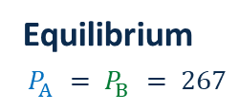
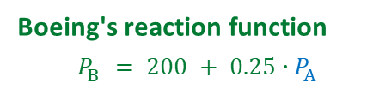
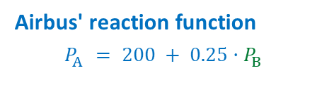
Module 7 · Video 5 · Bertrand Competition with Differentiated Goods
Equilibrium Prices
Boeing's reaction function
$$P_{B} = 200 + 0.25·P_{A}$$
Reaction point (I)
Airbus' reaction function
$$P_{A} = 200 + 0.25·P_{B}$$
300
267
250
Reaction point (II)
Airbus' Price ($P_{A}$)
200
Equilibrium
$$P_{A} = P_{B} = 267$$
150
Starting point: Boeing responds to Airbus charging P_{A} = 150
200
267
400
Boeing's Price ($P_{B}$)
Management 405 · Module 7 · Oligopoly and Game Theory
8
Notes:
Price responds POSITIVELY to price increases by the other firm. Note that this is the opposite of Cournot, where Firm A wants to produce less if firm B produces more. The two reaction functions — Airbus' PA = 200 + 0.25·PB and Boeing's mirror image — intersect at the equilibrium PA = PB = 267. Starting from PA = 150, the contemplated responses move both firms toward the equilibrium.

Slide 9
Module 7 · Video 5 · Bertrand Competition with Differentiated Goods
Play This Game on the Class Website
Under Module 7
You can choose Boeing's price and observe Airbus's reaction (price)
  You also see the profits of both companies
You can also change the demand functions (make payoffs asymmetric)
Class Website → Module 7
Management 405 · Module 7 · Oligopoly and Game Theory
9

Slide 10
Module 7 · Video 5 · Bertrand Competition with Differentiated Goods
Take-Aways: Oligopoly with Differentiated Goods
The two firms produce differentiated products, so each has its own demand curve
However, each firm's demand curve is affected by the other firm's price
When the competitor raises its price, the optimal response is for the other firm to also raise its price
In equilibrium, neither firm has an incentive to deviate
If MC are different, the optimal prices will be different for the two firms
Note: Math for this problem is optional (not required for final exam)
Optional Advanced Practice Video: “Bertrand Competition with Differentiated Goods – Math”
Management 405 · Module 7 · Oligopoly and Game Theory
10

