Slide 1
Investigating the performance of different algorithms for the DSP/arboricity
Nadya Voronova
Boston University

Slide 2
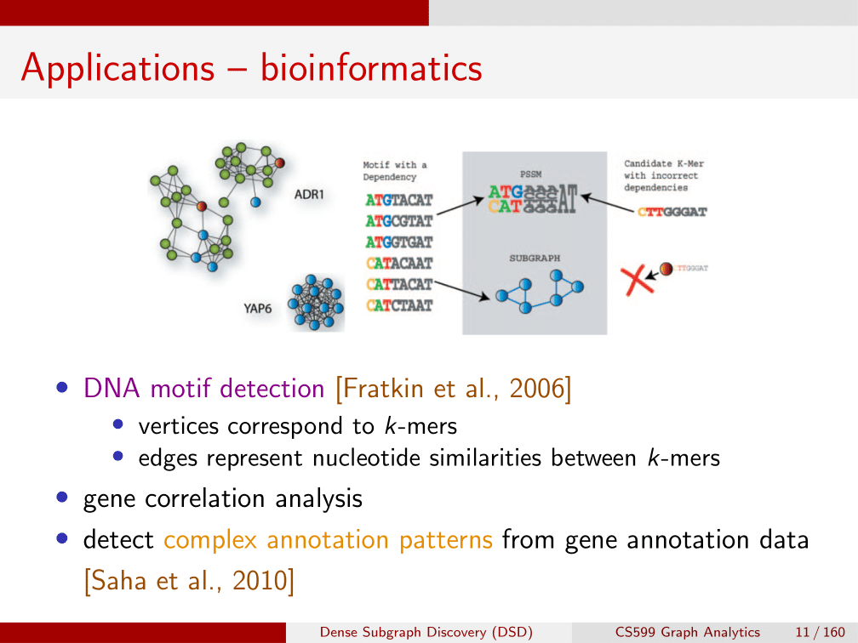
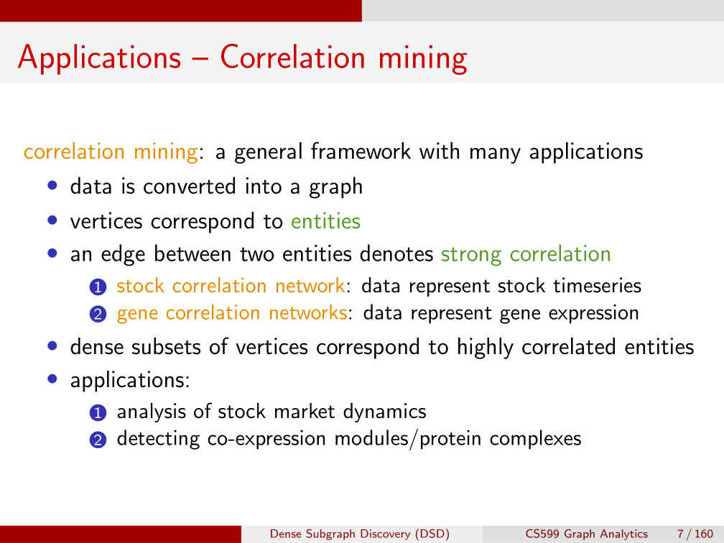
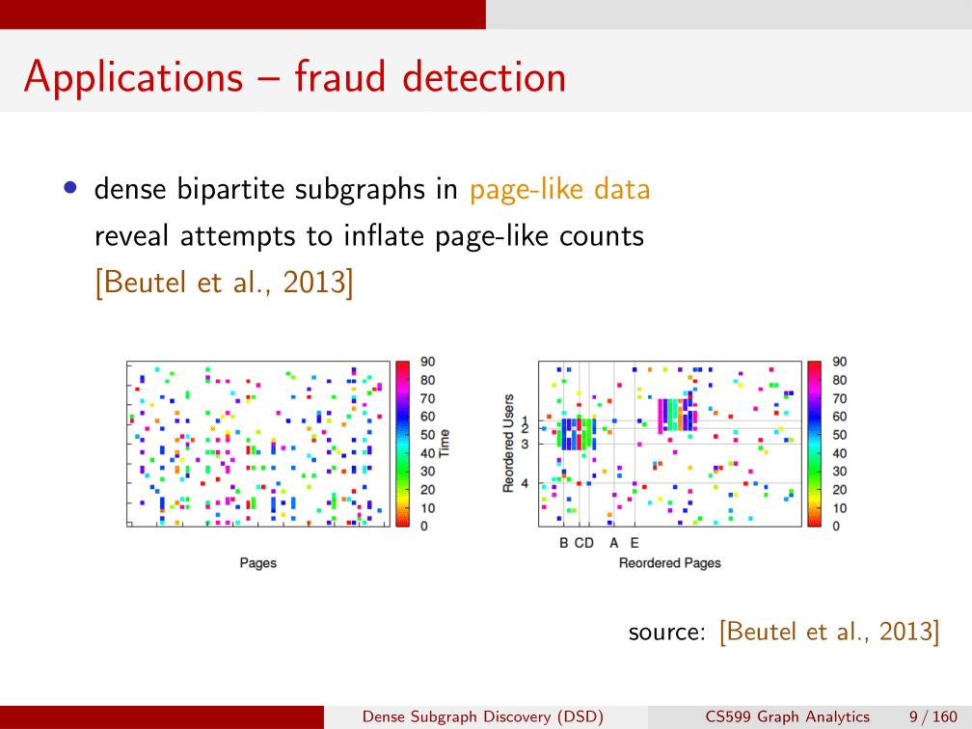
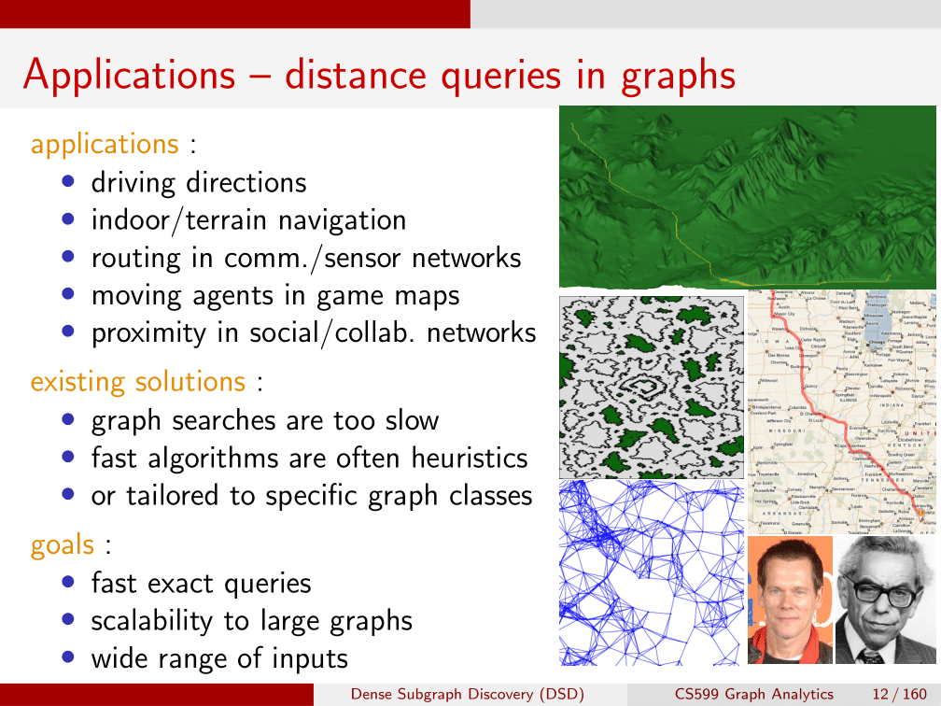
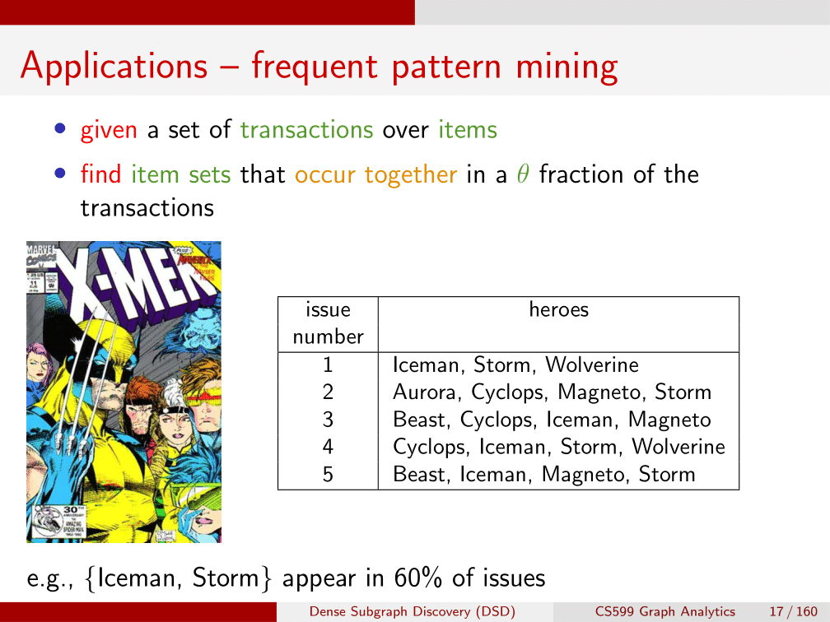
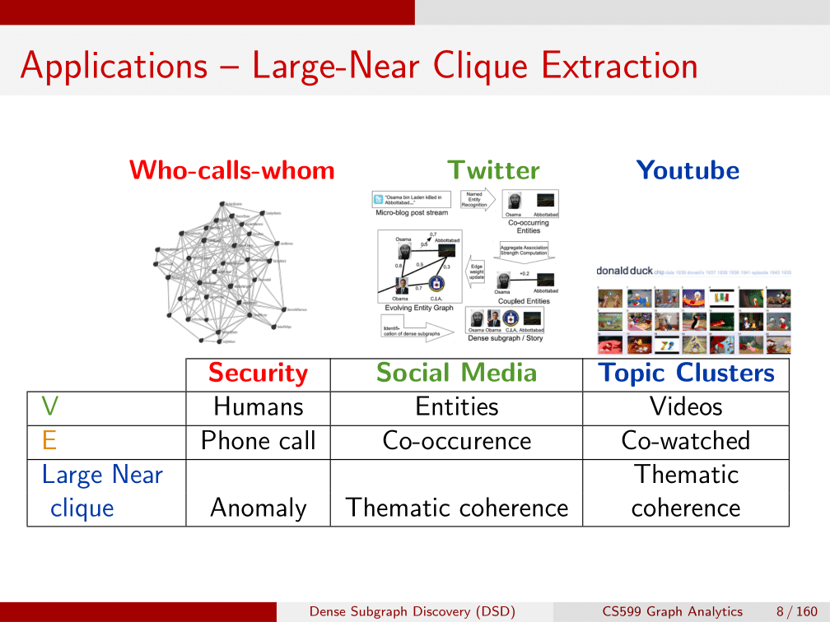
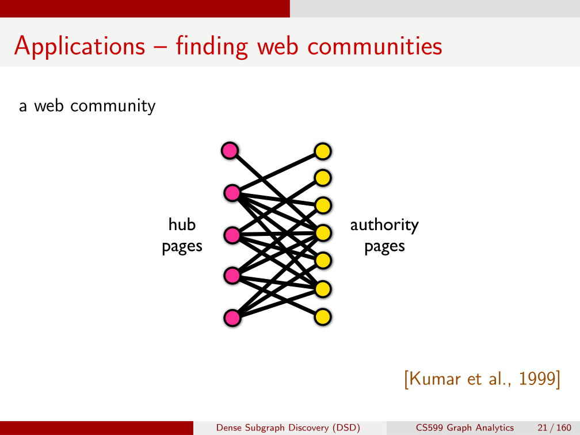
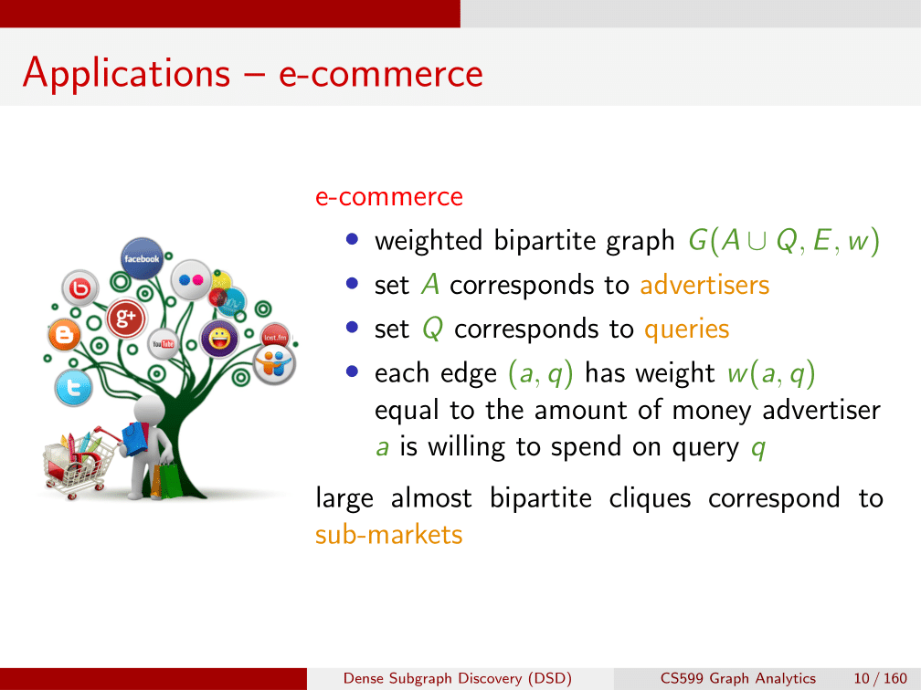
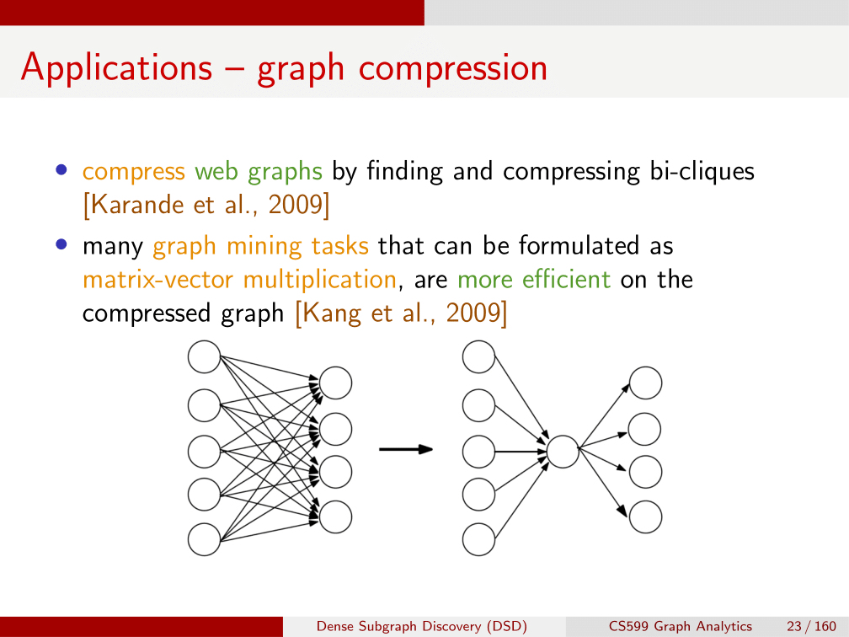
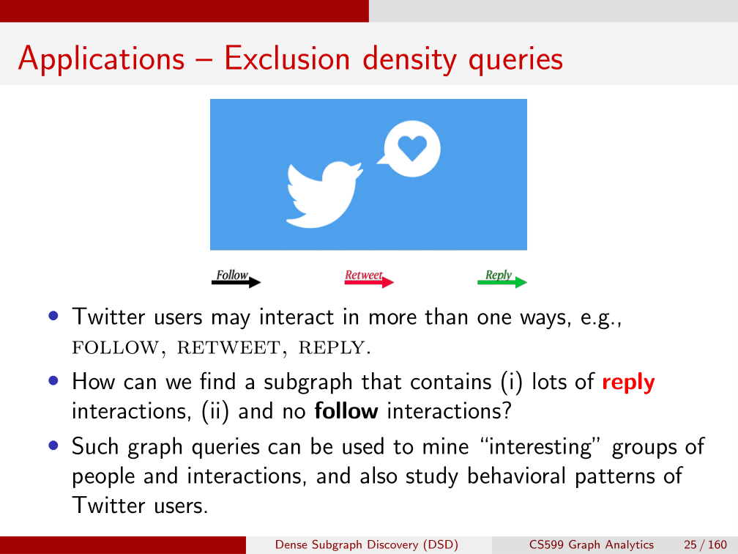

Densest subgraph problem
$$dens\left(G\right)=\max_{S ⊆V(G)}{\frac{|E\left(S\right)|}{|S|}}$$

Slide 3
Project goal
Identify a set of algorithms computing the solution for DSP
Implement algorithms that don’t have an implementation
Compare the performance of the chosen algorithms on different datasets according to accuracy and time

Slide 4
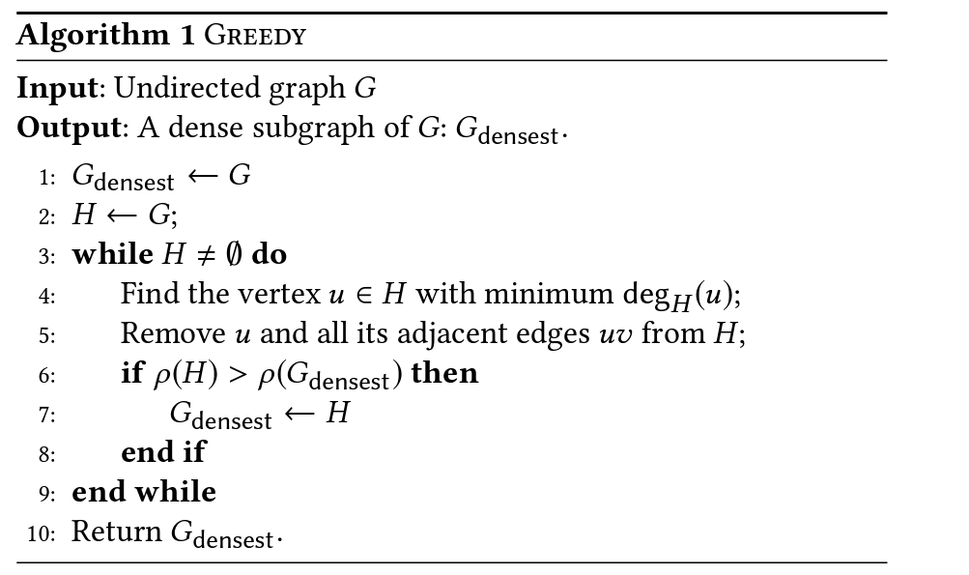

Algorithms for DSP: Greedy [Charikar, 2000]
$\frac{1}{2}$-approximation

Slide 5
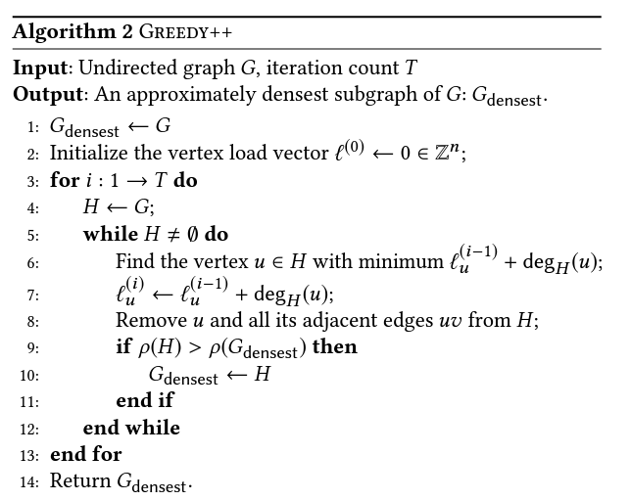

Algorithms for DSP: Greedy++ [Boob, Gao, Peng, Sawlani, Tsourakakis, Wang, Wang, 2020]
Conjecture:
$1+O\left(\frac{1}{\sqrt{T}}\right)$-approximation

Slide 6
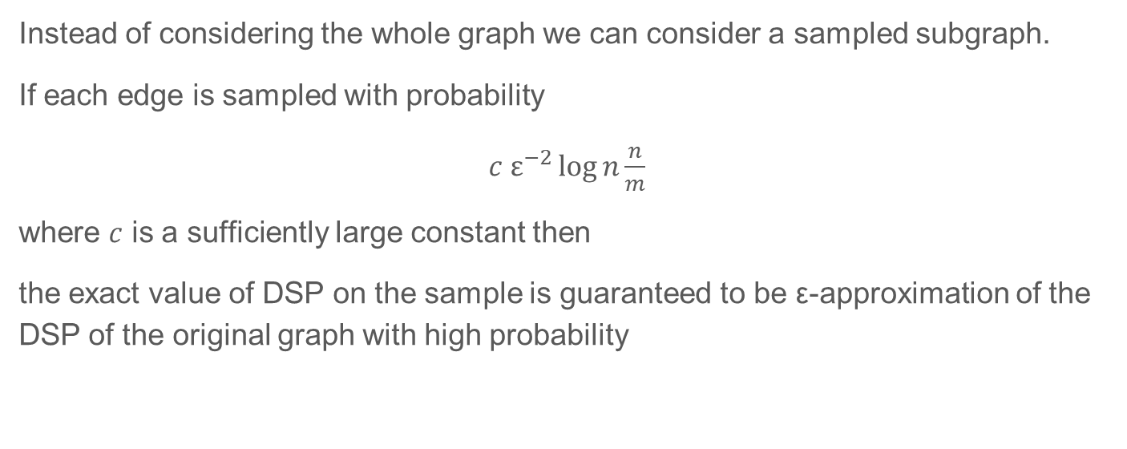
Algorithms for DSP: sampling [Mitzenmacher et al., 2015, Esfandiari et al., 2015, McGregor et al., 2015]
Instead of considering the whole graph we can consider a sampled subgraph.
If each edge is sampled with probability
$c ε^{−2}\log{n}\frac{n}{m}$
where $c$ is a sufficiently large constant then
the exact value of DSP on the sample is guaranteed to be ε-approximation of the DSP of the original graph with high probability

Slide 7

Arboricity and relation to DSP
Arboricity of a graph is the minimal number of disjoint forests that can cover all the edges of the graph G.
$$arb\left(G\right)=\max_{S ⊆V}{\frac{|E\left(S\right)|}{\left|S\right|−1}}$$
$$dens\left(G\right)≤arb\left(G\right)≤dens\left(G\right)+1$$

Slide 8
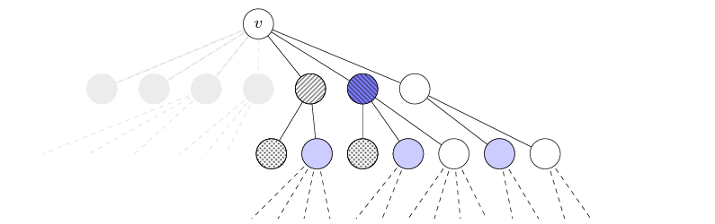

Algorithm for arboricity [Eden, Mossel, Ron, 2021]
Input: G
Output: α
$$\frac{arb(G)}{200\log^{2}{n}}≤α≤arb(G)$$

Slide 9
Implementation
Used already existing implementation for Greedy, Greedy++ and the exact computation
Implemented arboricity approximation algorithm
Implemented a script that samples the subgraph of the input graph and outputs the subgraph

Slide 10
Datasets
Artificial inputs: 1k nodes, complete graph and one-edge graph
Social circles from Facebook (anonymized), 4k nodes
Social network of LastFM users from Asia, 7k nodes
Collaboration network of Arxiv High Energy Physics, 12k nodes
Collaboration network of Arxiv Condensed Matter, 23k nodes
Social network of Github developers, 37k nodes
Gemsec Facebook dataset, artist, 50k nodes

Slide 11
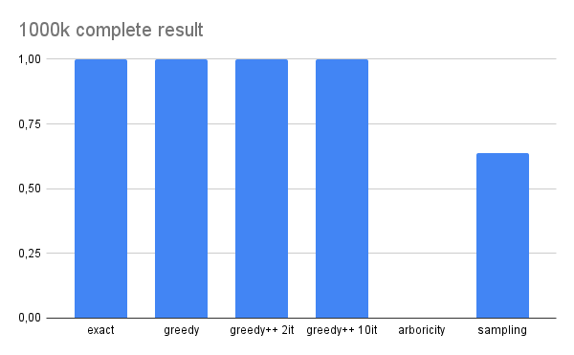
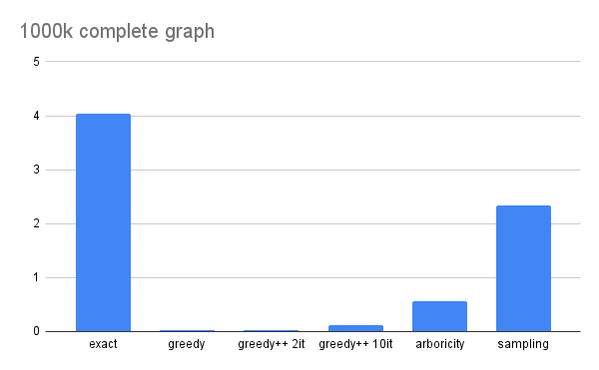
Results: artificial datasets
Accuracy
Time

Slide 12
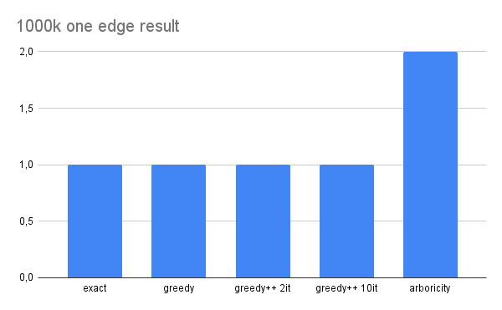
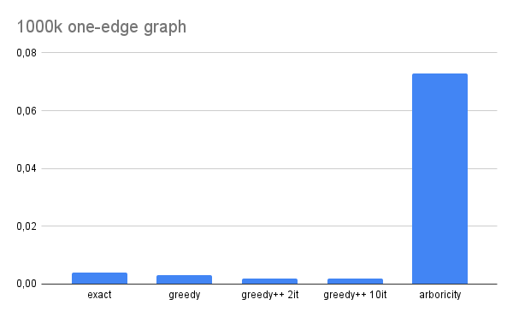
Results: artificial datasets
Accuracy
Time

Slide 13
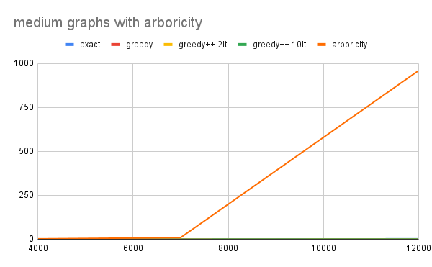
Time: medium datasets

Slide 14
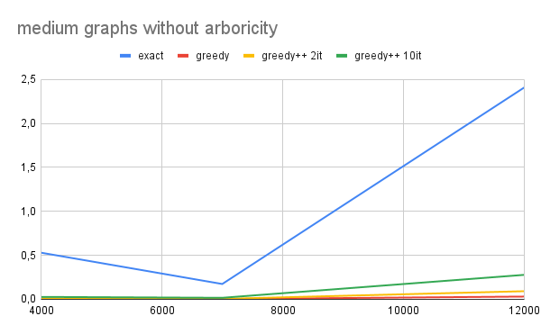
Time: medium datasets

Slide 15
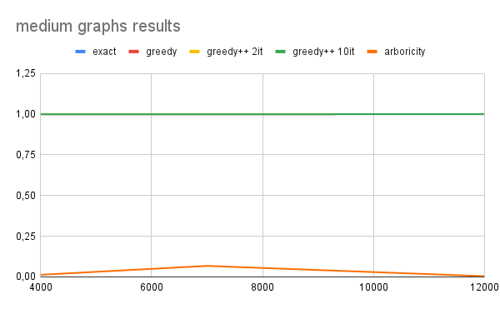
Accuracy: medium datasets

Slide 16
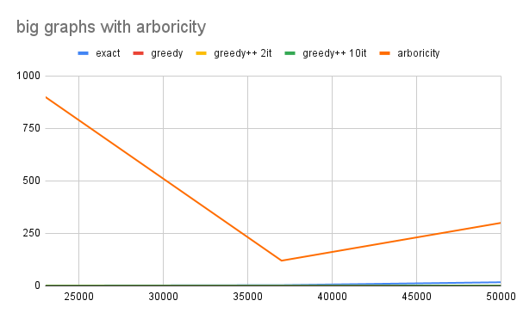
Time: big datasets

Slide 17
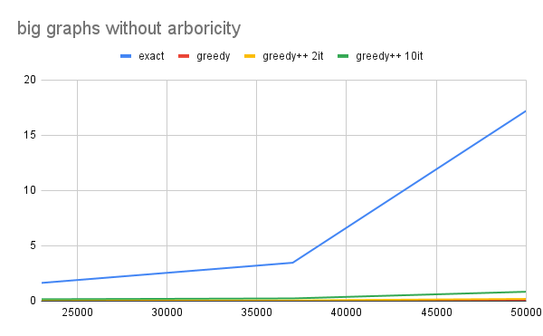
Time: big datasets

Slide 18
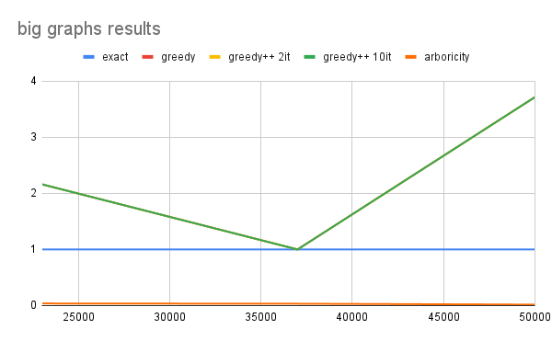
Accuracy: big datasets

Slide 19
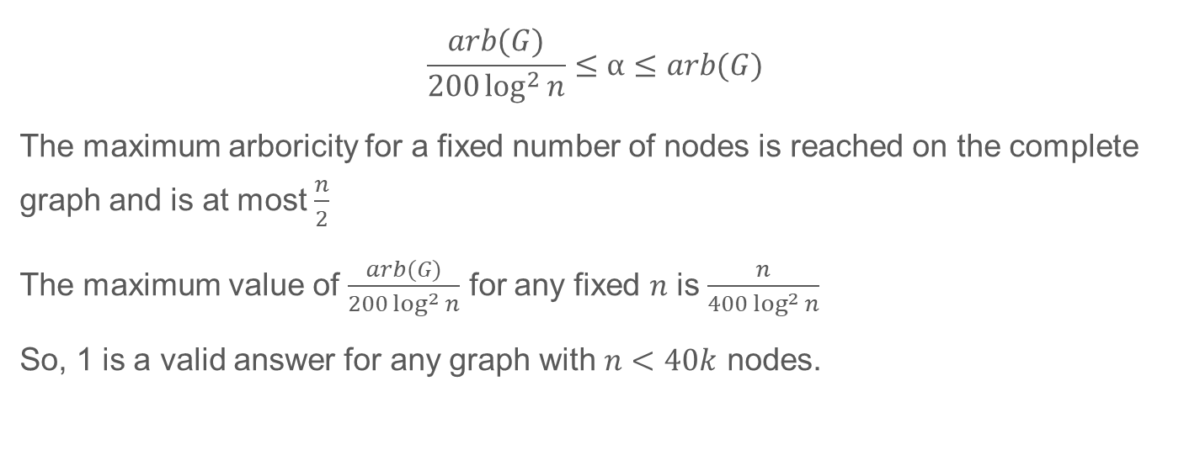
Arboricity approximation only works for big graphs
$$\frac{arb(G)}{200\log^{2}{n}}≤α≤arb(G)$$
The maximum arboricity for a fixed number of nodes is reached on the complete graph and is at most $\frac{n}{2}$
The maximum value of $\frac{arb(G)}{200\log^{2}{n}}$ for any fixed $n$ is $\frac{n}{400\log^{2}{n}}$
So, 1 is a valid answer for any graph with $n<40k$ nodes.

Slide 20
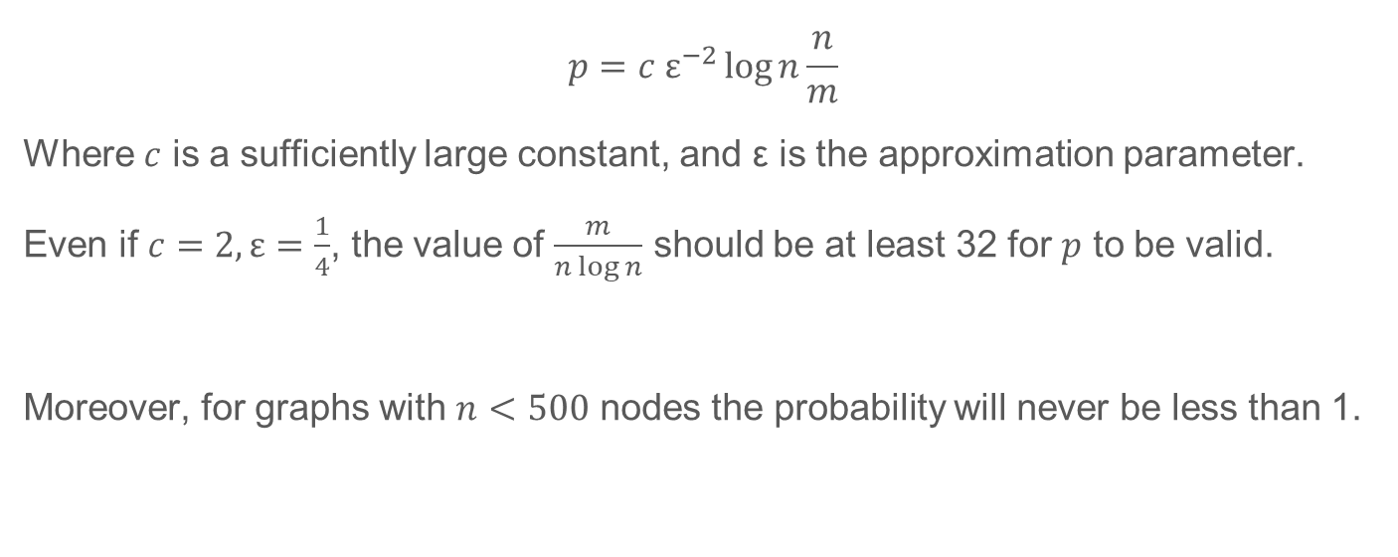
Sampling only works for dense graphs
$$p=c ε^{−2}\log{n}\frac{n}{m}$$
Where $c$ is a sufficiently large constant, and ε is the approximation parameter.
Even if $c=2, ε=\frac{1}{4}$, the value of $\frac{m}{n\log{n}}$ should be at least 32 for $p$ to be valid.
Moreover, for graphs with $n<500$ nodes the probability will never be less than 1.

Slide 21
Summary and possible future work
Greedy++ works the best in general case
Arboricity approximation can be useful for big graphs but it needs to be optimized in terms of space and time
Sampling can be useful on very dense graphs
Optimize arboricity approximation
Investigate the artefacts found for Greedy++ and exact algorithm

Slide 22

Thank you!

