Slide 1


US Software Engineering Job's Analysis
Sai Ganesh Pendela
Akash Perni
Samba Sivesh Kurra
Venkata Phani AdityA Nutalapati

Slide 2

CONTENTS
INTRODUCTION
DATASET
EXPLORATORY DATA ANALYSIS
DATA PREPROCESSING
MODEL BUILDING
RESULTS
CONCLUSION

Slide 3

INTRODUCTION
US job market has a wide range of software jobs and salaries for each job varies depending on various factors like location, type of job etc.
The US SDE Jobs dataset is a comprehensive collection of information related to job postings in the United States, specifically focusing on the salaries associated with various positions.
In this project, we aim to leverage machine learning algorithms to classify salaries based on a diverse set of features.

Slide 4
DATA SET
The US Software Engineer Jobs dataset is downloaded from Kaggle.
The dataset contains 58433 rows and 29 columns.
The dataset contains various features related to the US SDE jobs, some of the key features are:
Title: The job title associated with the posting.
Company: The name of the hiring company.
Salary: The expected or offered salary for the job.
Rating: Company rating, reflecting its reputation.
Location: Job location.
Snippet: A brief description or snippet of the job.

Slide 5
AIM OF THE EDA
Maximize insight into a dataset
Uncover underlying structure
Extract important variables
Detect outliers and anomalies
Test underlying assumptions
Develop valid models

Slide 6
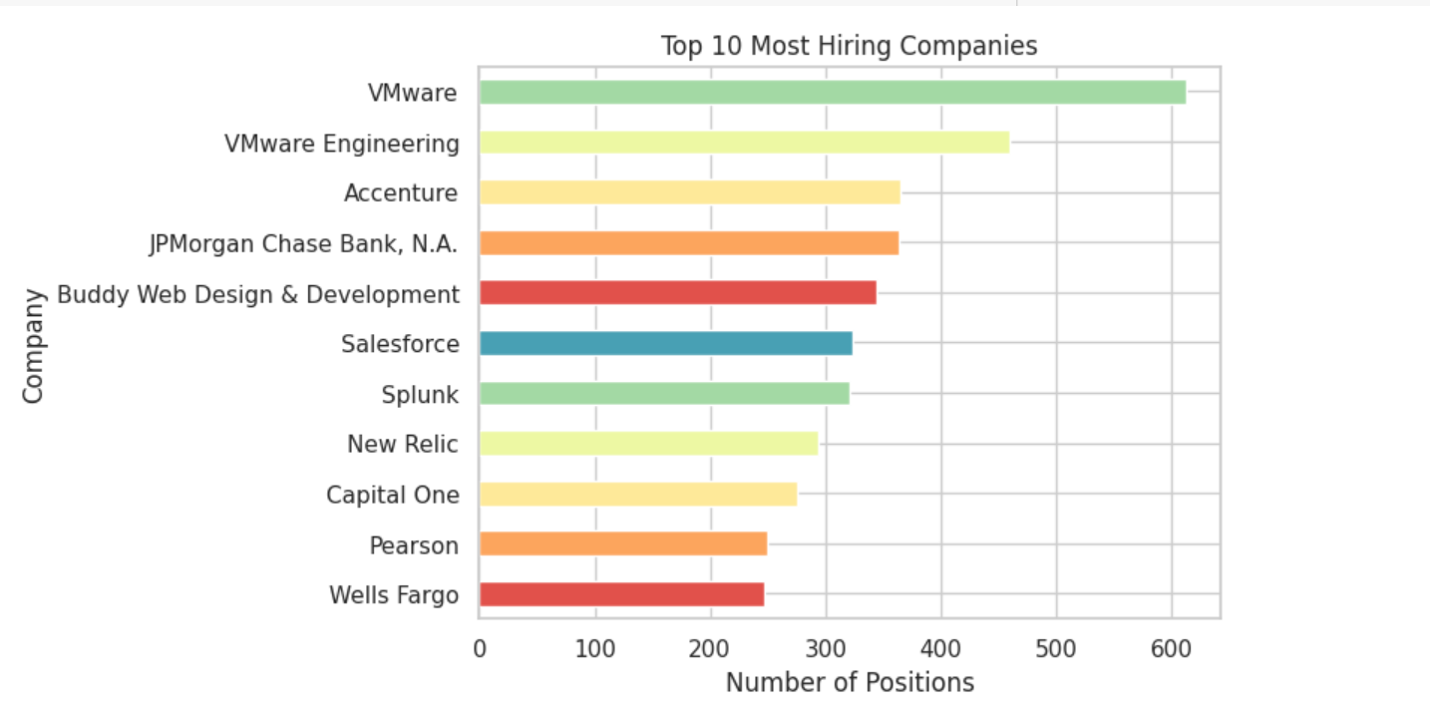
EXPLORATORY DATA ANALYSIS

Slide 7
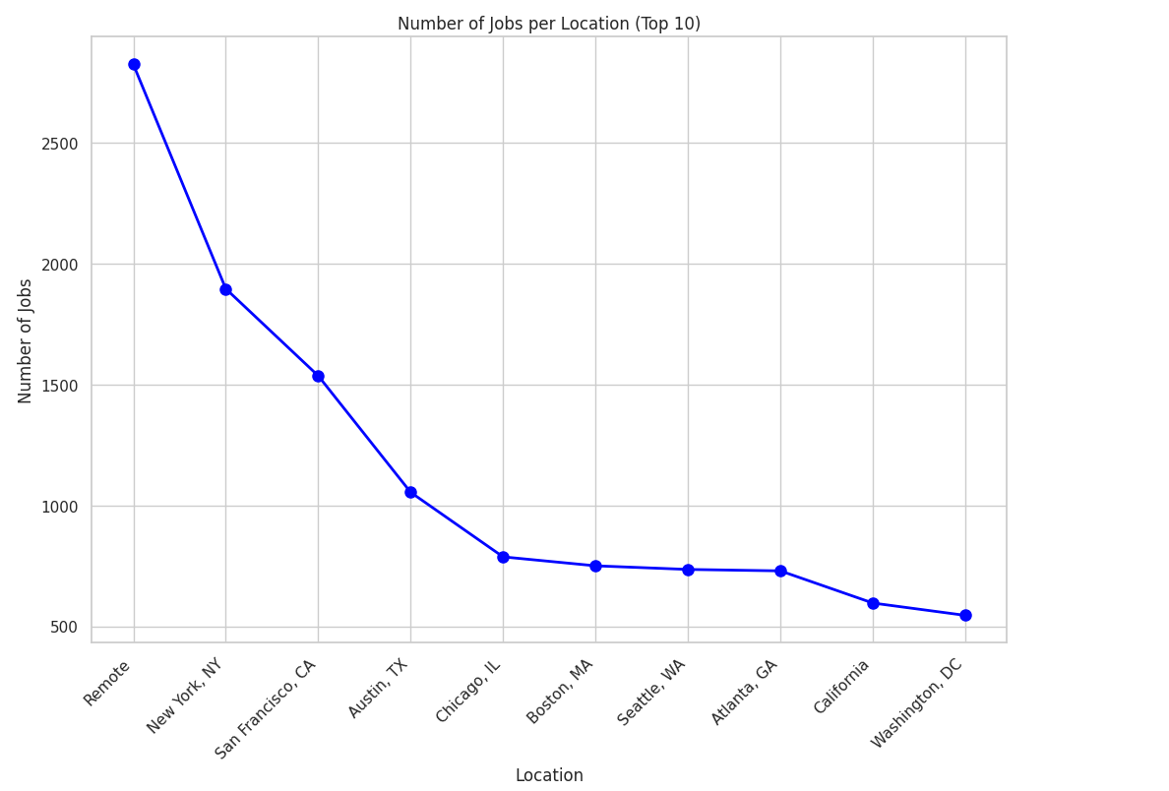
EXPLORATORY DATA ANALYSIS

Slide 8
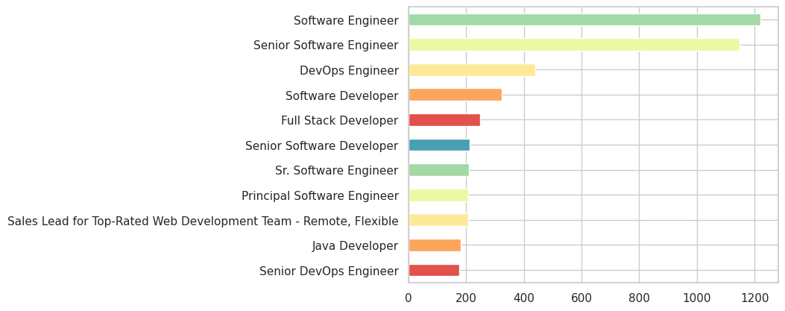
EXPLORATORY DATA ANALYSIS

Slide 9
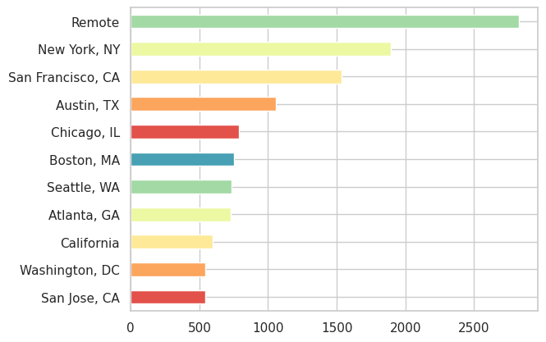
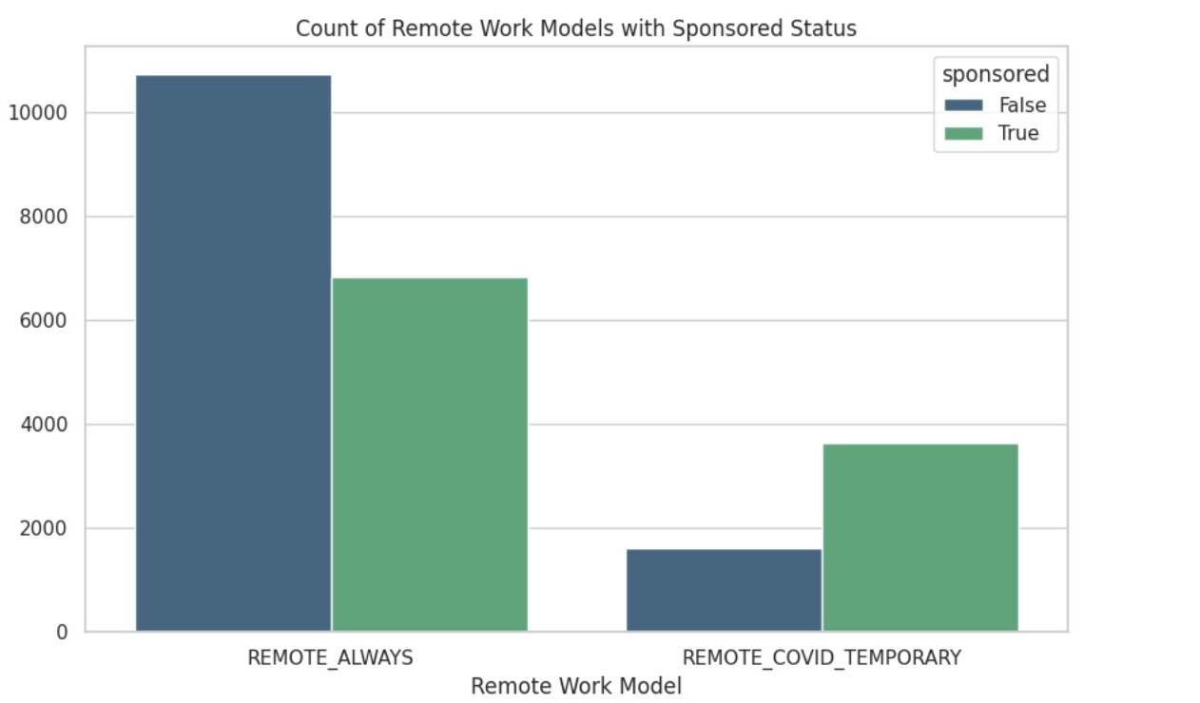
EXPLORATORY DATA ANALYSIS

Slide 10
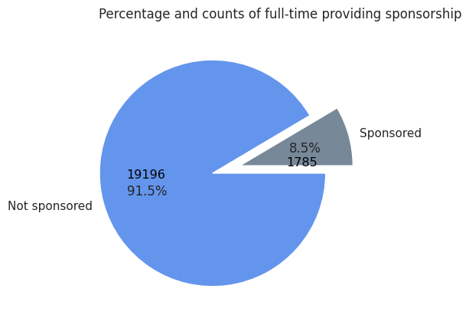
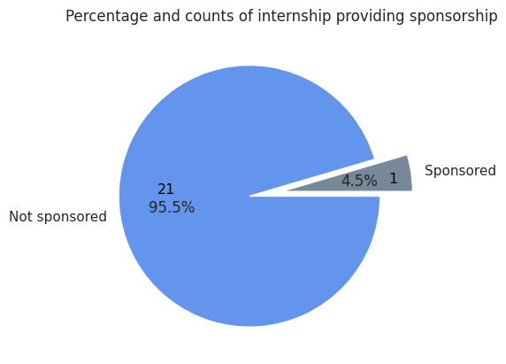
EXPLORATORY DATA ANALYSIS

Slide 11
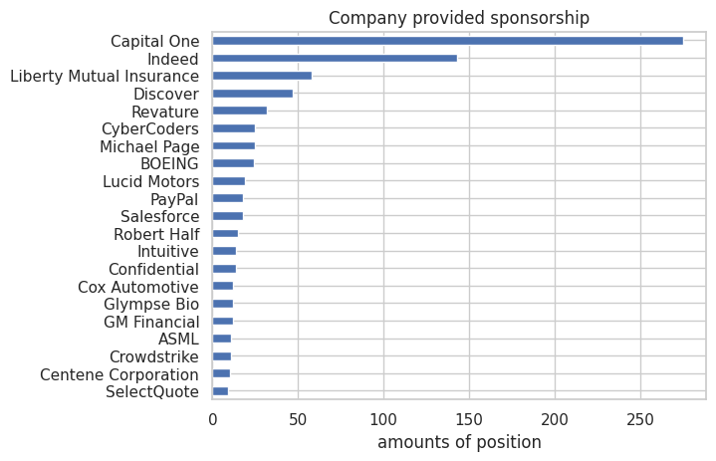
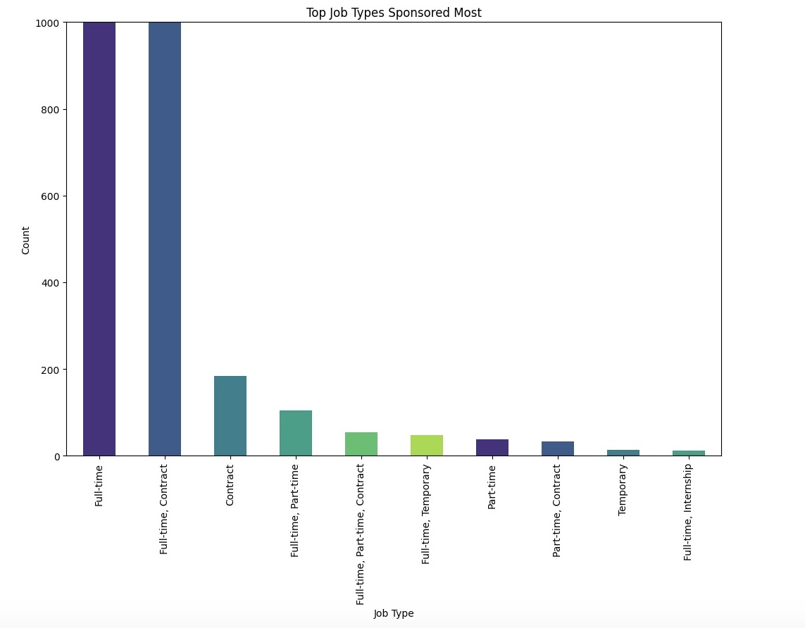
EXPLORATORY DATA ANALYSIS

Slide 12
Key Findings From EDA
Jobs in California has the highest proportion and Remote job has the highest amounts of visa sponsorship.
Software engineer, Senior Software Engineer, and DevOps are highly demanded among jobs roles.
Capital One, Indeed, and Liberty Mutual Insurance are the top 3 companies that provide jobs with visa sponsorship.
It is more difficult to land an internship than a full-time job for an F1 visa holder.

Slide 13
DATA PREPROCESSING
Data preprocessing is a crucial step in preparing the dataset for analysis and modeling.
It involves cleaning and transforming raw data into a format that is suitable for machine learning algorithms.
Following are the preprocessing steps that we have followed for this dataset
Handling Missing values
Encoding data
Feature Engineering

Slide 14
Data Preprocessing
Handling Missing values
We have filled the missing values of the salary column with the mean salary of the job title, company and location combined. For example, the missing salary of a front-end developer in Amazon at Virginia is set as the mean salary of all front-end developers in Amazon at Virginia location.
Encoding Data
We have used techniques such as word2vec and frequency encoding for encoding location, company and job title data.
Word2Vec is a technique used to represent words as vectors in a way that captures their meanings based on how they are used in dataset.
Bin Creation
For classification models we have created bins of salaries. The salaries are in range of 10000$ to 400000$, we created 4 bins of equal intervals for the salary column to perform classification algorithms.

Slide 15
Data Preprocessing
No Duplicates Found in the dataset
Feature Engineering
We have introduced new features in our dataset, including 'years of experience' and 'relative_time' of job postings.
The 'snippet' column contains concise job descriptions, like 'years of experience', which provides information on the required experience level for job applicants.
To determine the duration a job has been posted, we extracted the number of days from the 'relative_time' column. This allows us to analyze the recency of each job posting.
Furthermore, we calculated the annual salary based on the provided salary information for month, days, hours etc.
In cases where the salary is presented as a range, we opted for the midpoint of the range as the final salary. For example, if the salary range for a Java Developer is $14,000 - $20,000, we considered $17,000 as the estimated annual salary.

Slide 16
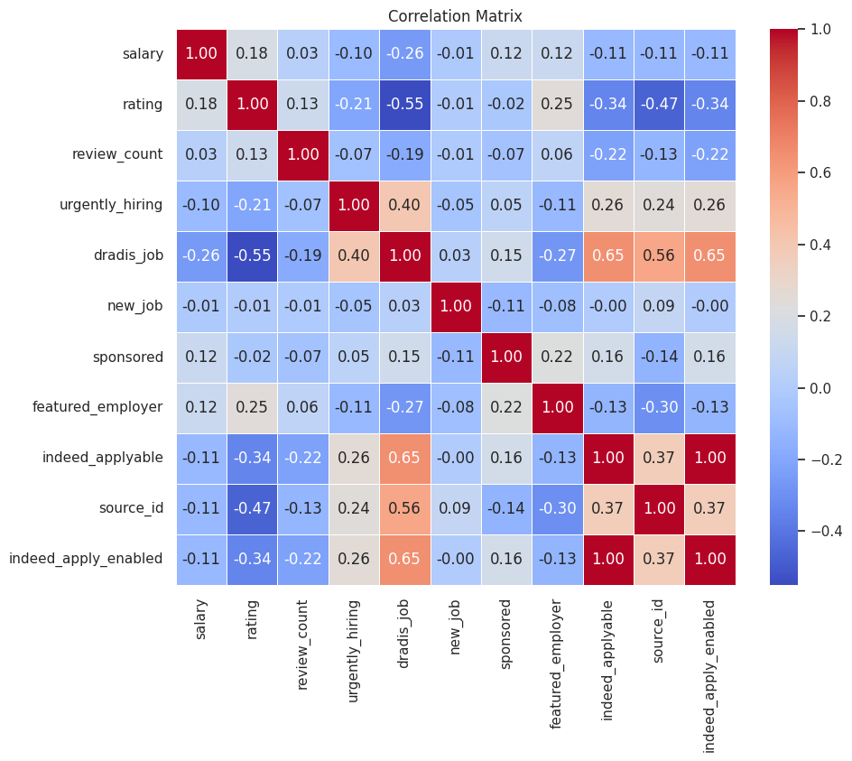
CORRELATION MATRIX

Slide 17
MODEL BUILDING
Logistic Regression
Decision Tree
Random Forest
K. Nearest Neighbours

Slide 18
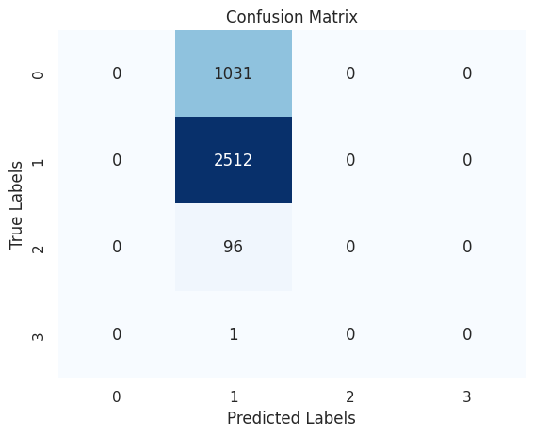
LOGISTIC REGRESSION
A classification algorithm which uses the logistic function to model the probability that a given input belongs to a particular class.
We build the model using scikit package from python with Hyper Parameters max_iter and random_state set to 7600 and 1 respectively.

Slide 19
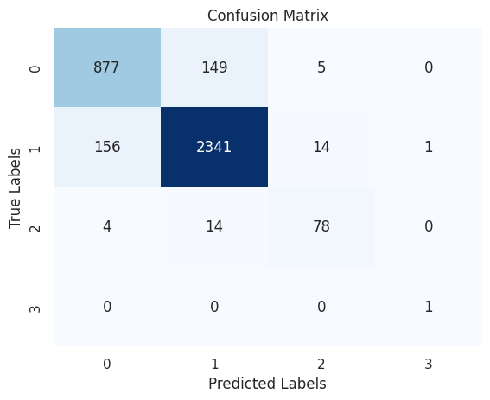
DECISION TREE
A supervised machine learning algorithm which builds a tree-like model where each internal node represents a decision based on value of a particular feature , each branch represents an outcome of the decision, and each leaf node represents the final predicted output or class label.
We build a decision tree classifier from the scikit learn package with hyperparameter random_state=42.

Slide 20

RANDOM FOREST
Random Forest is an ensemble learning technique based on the construction of multiple decision trees during training and outputting the class that is the mode of the classes.
We built a Random Forest Classifier using scikit learn python package with hyperparameters n_estimators and random_state set to 100 and 42, respectively.

Slide 21

K NEAREST NEIGHBOURS
K-Nearest Neighbours is a supervised machine learning, where predictions are made based on the majority class the k-nearest data points in the feature space.

Slide 22
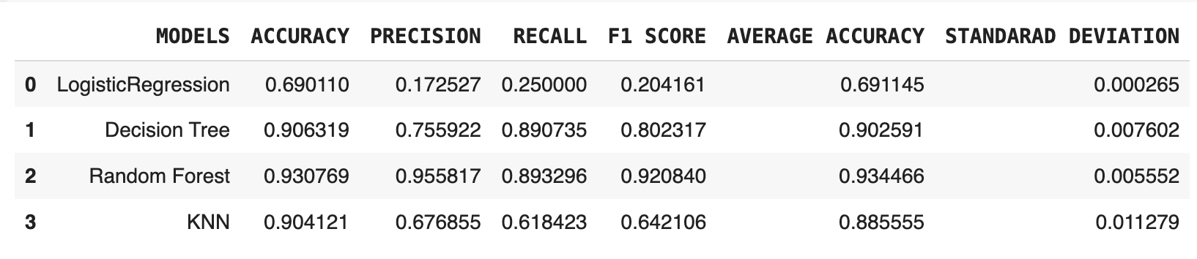
RESULTS

Slide 23
CONCLUSION
Based on the classification metrics i.e, accuracy, f1 score, precision, recall, and cross validation results, Random Forest performed well with an accuracy of 93.57%, precision of 0.96 and a recall of 0.89, and can be declared as best model when compared to all the other models.
The other two models i.e, Decision Tree and KNN also performed well with an accuracy of 90% but the precision and recall values are very low .
The logistic Regression has a low accuracy of 69%.

Slide 24
THANK YOU

