Slide 1

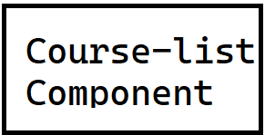
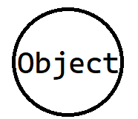
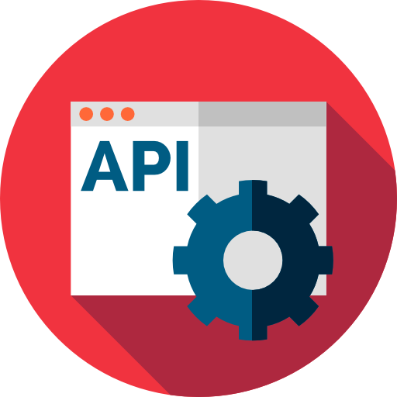

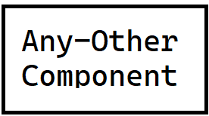
Without Using Design Pattern
creates
displays
Get/courses
Select * from course
courses
courseList

Slide 2
Without Using Design Pattern
creates
displays
Get/courses
Select * from course
Localhost:4200/any-other
courses
courseList
Localhost:4200/course-list

Slide 3
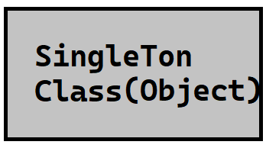
With Using Design Pattern
1. check/courses
creates
displays
2. Get/courses
Select * from course
Localhost:4200/any-other
courses
courseList
Localhost:4200/course-list

Slide 4
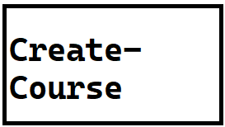

With Using Design Pattern
Insert course into courses
courseList
creates
post/course
Get/courseId
add

