Slide 1
People Analytics: Employee Attrition Prediction
Noah Vriese

Slide 2
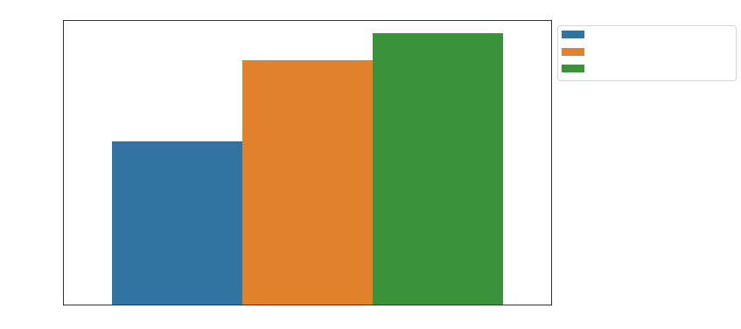
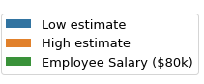
The Problem: Attrition
Cost to Replace One Employee ($80k Salary)
Employee Attrition (n):
“Voluntary and involuntary terminations resulting in workforce reduction.”
Attrition is expensive, see Figure.
$80,000
$72,000
90% of salary
$48,000
60% of salary
Notes:
Employee attrition is expensive, so how can we address the problem systematically?
Let’s begin by posing two questions:
What are the top factors influencing an employee’s decision to leave a company?
Can we accurately identify employees within the top 20th percentile of likelihood of attrition?
What will be our method in addressing these questions?

Slide 3
The Solution
Employee Data +
Supervised Learning

Slide 4
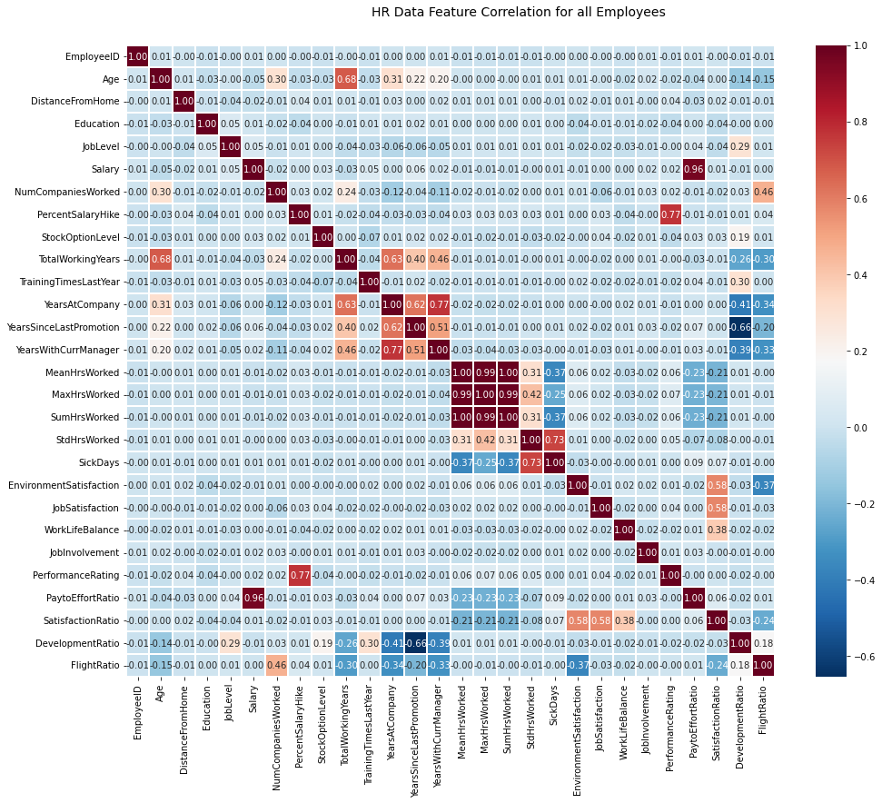
The Data
HR Data Feature Correlations
1.0
0.8
0.6
IBM Human Resources Data (Kaggle)
4,410 rows x 24 cols
Target: ‘Attrition’
0.4
0.2
0.0
-0.2
-0.4
-0.6

Slide 5
Data Wrangling
Timesheet Data
Time-out.csv
Employee Survey Data
Time-in.csv
Final DataFrame
Manager Survey Data
General Employee Data
Duplicate records dropped
Units converted to English
Missing values imputed
4,382 rows x 33 columns

Slide 6
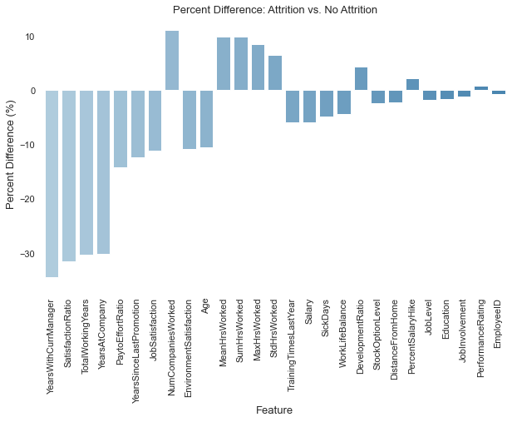
Exploratory Data Analysis (EDA)
Mean % Difference (Attrition = N vs. Attrition = Y)
1st Goal of EDA
Identify significant differences between
Attrition = ‘N’
Attrition = ‘Y’
(-) class
(+) class

Slide 7
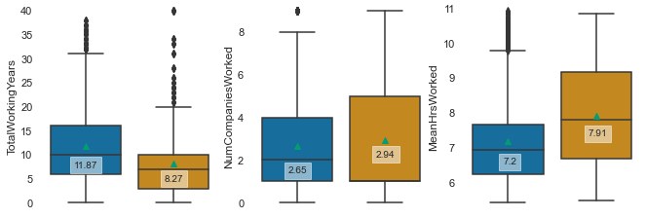
Exploratory Data Analysis (EDA)
Employee Averages (Attrition = N vs. Attrition = Y)
Total Working Years
# Companies Worked For
Mean Daily Working Hours
No
Yes
No
Yes
No
Yes
Attrition?
Attrition?
Attrition?
p << 0.05
p < 0.05
p << 0.05

Slide 8
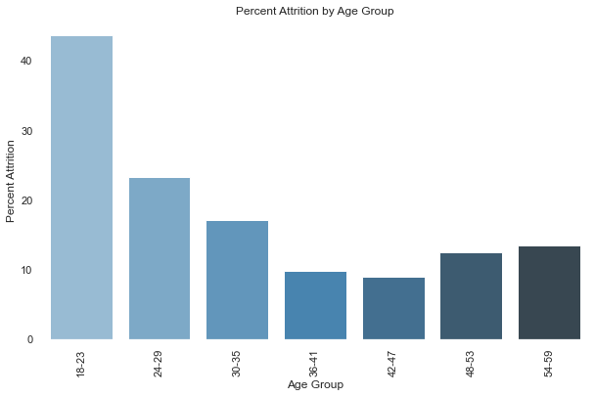
Exploratory Data Analysis (EDA)
% Attrition by Age Group
2nd Goal of EDA
Identify significant attritional demographics
Attrition = ‘N’
Attrition = ‘Y’
(-) class
(+) class

Slide 9
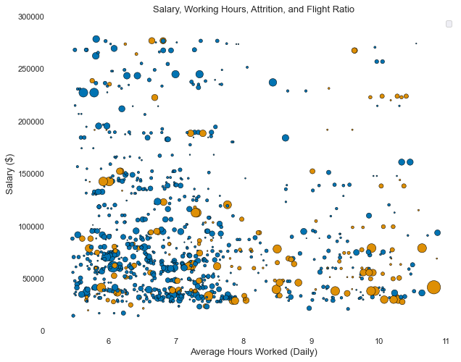
Exploratory Data Analysis (EDA)
Scatterplot: Hours Worked vs. Salary ($)
2nd Goal of EDA
Identify significant attritional demographics
Attrition = ‘N’
Attrition = ‘Y’
(-) class
(+) class
Notes:
$$FlightRatio=\frac{NumCompaniesWorked}{TotalWorkingYears∗EnvironmentSatisfaction}$$

Slide 10
Model Preprocessing
Engineered Features
‘PaytoEffortRatio’ ‘SatisfactionRatio’ ‘DevelopmentRatio’
‘FlightRatio’
Processed Data: 74 Features
Numerical features
StandardScaler
X_train.csv
Employee DataFrame
y_train.csv
Train-Test Split
X_test.csv
Categorical features
Dummy encoder
(70/30)
y_test .csv
4,382 rows x 37 features
idx_test.csv
idx_train.csv

Slide 11
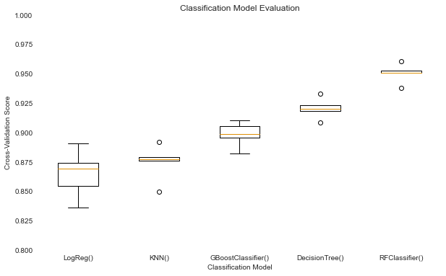
Model Selection
CV Score by Baseline Classification Model
Baseline Model Selection
Evaluation Data:
Test split
Evaluation Metric:
5-fold CV Score
Algorithms Tested:
Logistic Regression
K-Nearest-Neighbors
Gradient Boosting Classifier
Decision Tree
Random Forest Classifier
Notes:
RandomForestClassifier is the base model winner

Slide 12
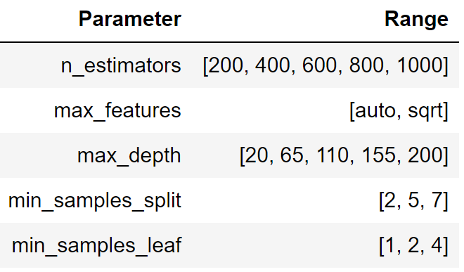
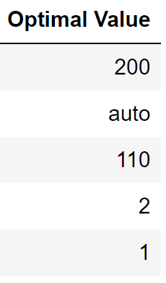
Hyperparameter Tuning
Randomized Search Cross Validation
RandomizedSearchCV()
Baseline
RFClassifier
100 model candidates: 5 fits per: 500 total fits
Notes:
- Optimized for highest 5-fold cross-validation score

Slide 13
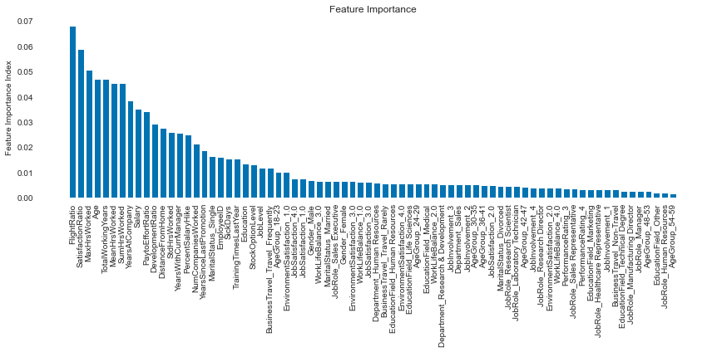
Feature Reduction & Optimization
Feature Importance Rank
Top 20 most predictive features extracted
Notes:
Feature importance ranked via RandomForestClassifier() feature importance ranking
Top 20 features selected to reduce dimensionality from 74 features

Slide 14
Tested Models
Model A
RFClassifier (Base)
Five models built for evaluation:
3 RandomForestClassifier()
2 LogisticRegression()
Model B
RFClassifier
(Tuned)
Model C
RFClassifier
(Tuned / 20 Features)
Model D
LogReg
(Base)
Model E
LogReg
(Tuned / 20 Features)
Notes:
$$FlightRatio=\frac{NumCompaniesWorked}{TotalWorkingYears∗EnvironmentSatisfaction}$$

Slide 15
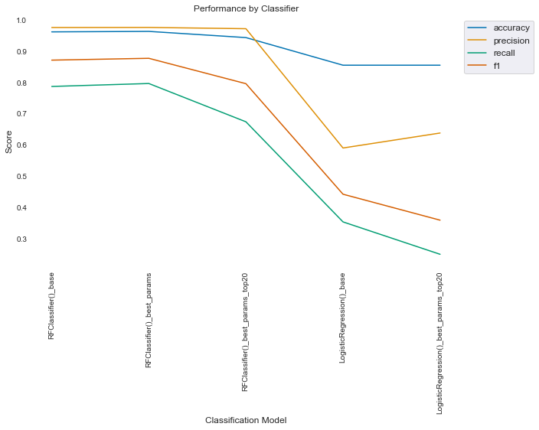
Model Evaluation I
Performance by Classifier
Model A
RFClassifier (Base)
Model B
RFClassifier
(Tuned)
Model C
RFClassifier
(Tuned / 20 Features)
Model D
LogReg
(Base)
Model E
LogReg
(Tuned / 20 Features)
Notes:
$$FlightRatio=\frac{NumCompaniesWorked}{TotalWorkingYears∗EnvironmentSatisfaction}$$

Slide 16
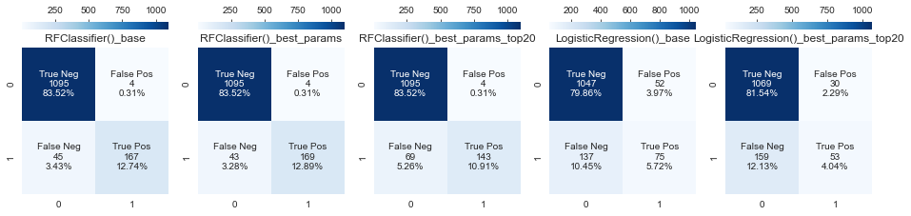
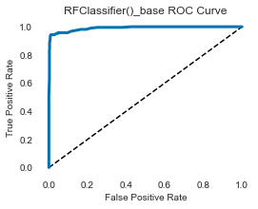
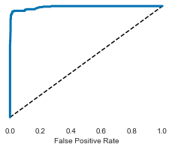
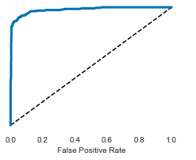
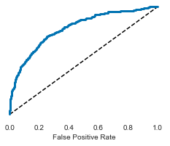
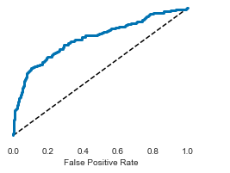
Model Evaluation II
Model A
RFClassifier (Base)
Model B
RFClassifier
(Tuned)
Model C
RFClassifier
(Tuned / 20 Features)
Model D
LogReg
(Base)
Model E
LogReg
(Tuned / 20 Features)

Slide 17
Response to Key Questions I
QI. What are the top factors influencing an employee’s decision to leave a company?
AI. Based upon the RandomForest feature importance ranking, the top five factors influencing an employee's probability of attrition are:
FlightRatio
SatisfactionRatio
MaxHrsWorked
Age
TotalWorkingYears

Slide 18
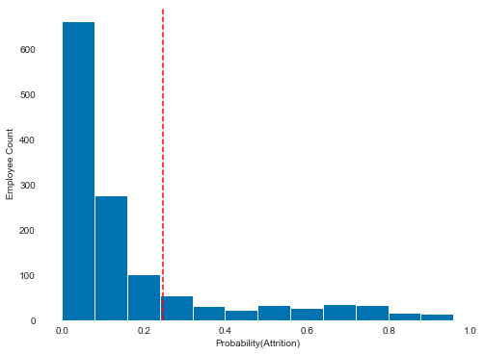
Response to Key Questions II
QII. Can we accurately identify employees within the top 20th percentile of likelihood of attrition?
Employee Attrition Probability Distribution
AII. See Figure.
20th percentile
At elevated risk of attrition

Slide 19
Conclusion
Using common employee data, 95%+ accuracy in attrition classification was achieved via RFC.
The final model can leverage as few as 20 features for 95% accuracy.
In deployed form, the model could be a dashboard tool for HR departments.

Slide 20
Thank you
Noah Vriese
noah@datawhirled.com

Slide 21
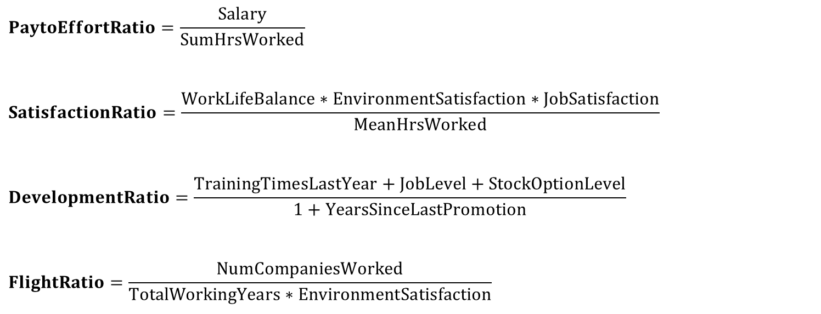
Appendix: Feature Engineering
$$PaytoEffortRatio=\frac{Salary}{SumHrsWorked}$$
$$SatisfactionRatio=\frac{WorkLifeBalance∗EnvironmentSatisfaction∗JobSatisfaction}{MeanHrsWorked}$$
$$DevelopmentRatio=\frac{TrainingTimesLastYear+JobLevel+StockOptionLevel}{1+YearsSinceLastPromotion}$$
$$FlightRatio=\frac{NumCompaniesWorked}{TotalWorkingYears∗EnvironmentSatisfaction}$$

