Slide 1
Computer Vision: Wind Turbine Detection
Noah Vriese

Slide 2
The Problem: Estimating Wind Power Capacity
U.S. Wind Turbine Database
Current best database for on-shore turbines
Low update frequency (temporal resolution)
Updated once quarterly (3 months)
Wind energy production is growing rapidly
U.S. on-shore wind capacity grew +11% from 122k to 135k (MW) between 2021-2022 ^{[1]}
[1]: Land-based Wind Market Report: 2022 Edition; USDOE, 2022
Notes:
Employee attrition is expensive, so how can we address the problem systematically?
Let’s begin by posing two questions:
What are the top factors influencing an employee’s decision to leave a company?
Can we accurately identify employees within the top 20th percentile of likelihood of attrition?
What will be our method in addressing these questions?

Slide 3
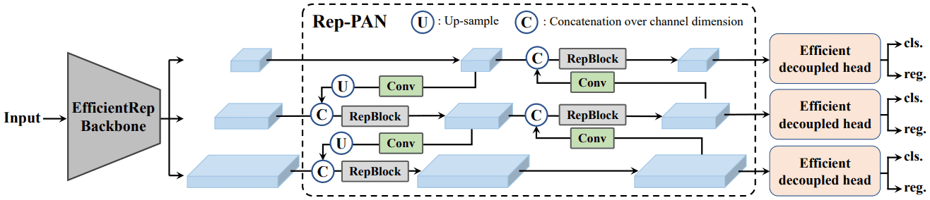
Key Questions to Address
Q-I. How to estimate U.S. on-shore wind growth with greater temporal resolution than existing data sources?
*NEW DATA*
Wind turbine installations
U.S. Wind Turbine Database
Q-II. Can a deep learning approach be implemented to automate estimation with reasonable precision?
Figure. YOLO v6 Model Architecture

Slide 4
Proposed Solution
Via Satellite Imagery +
Deep Learning (Object Detection)

Slide 5
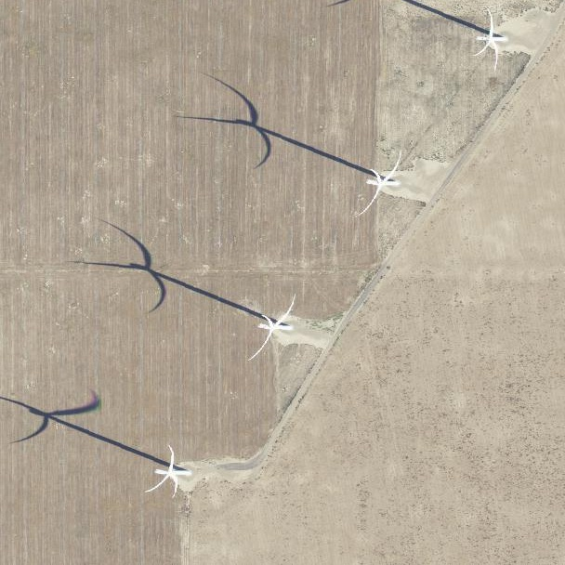
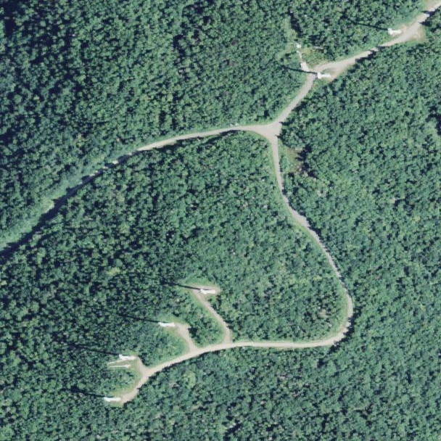
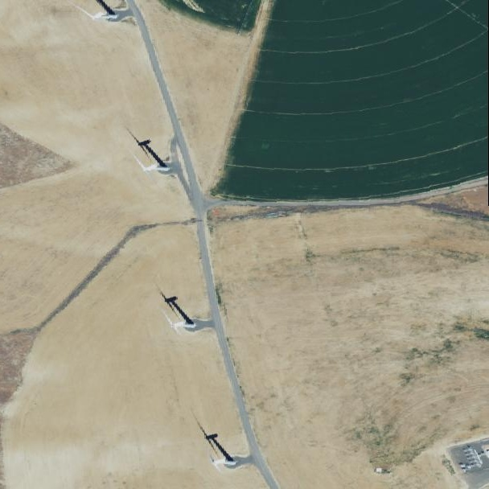
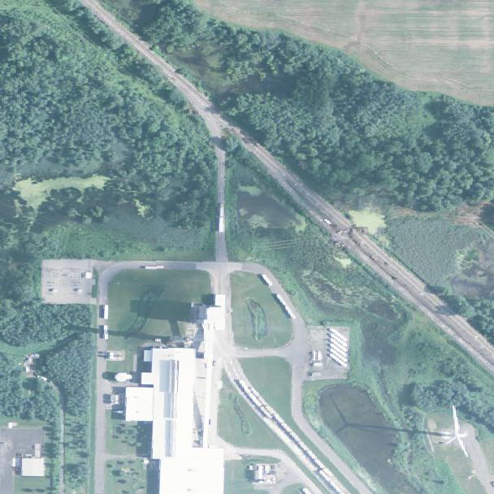
The Dataset
Raw LANDSAT & NAIP Satellite imagery (Kaggle + Open Source)
2,130 images + labels (YOLO format)
Dimensions: 608 x 608 pixels
U.S. terrestrial biomes included:
Desert, farmland, urban, forested
Classes trained: {1: ‘Turbine’}

Slide 6
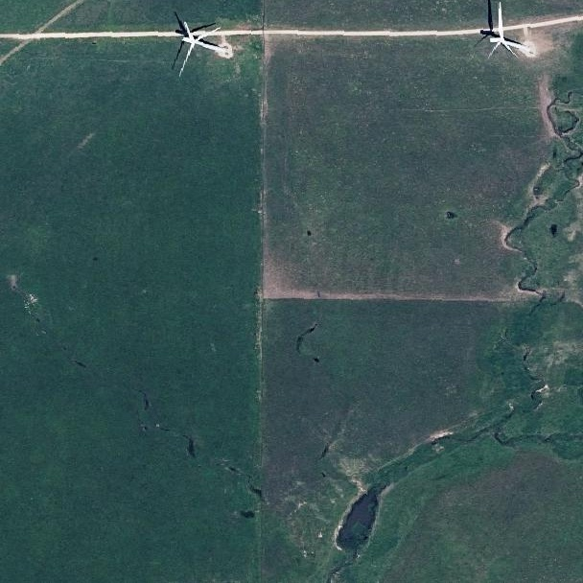
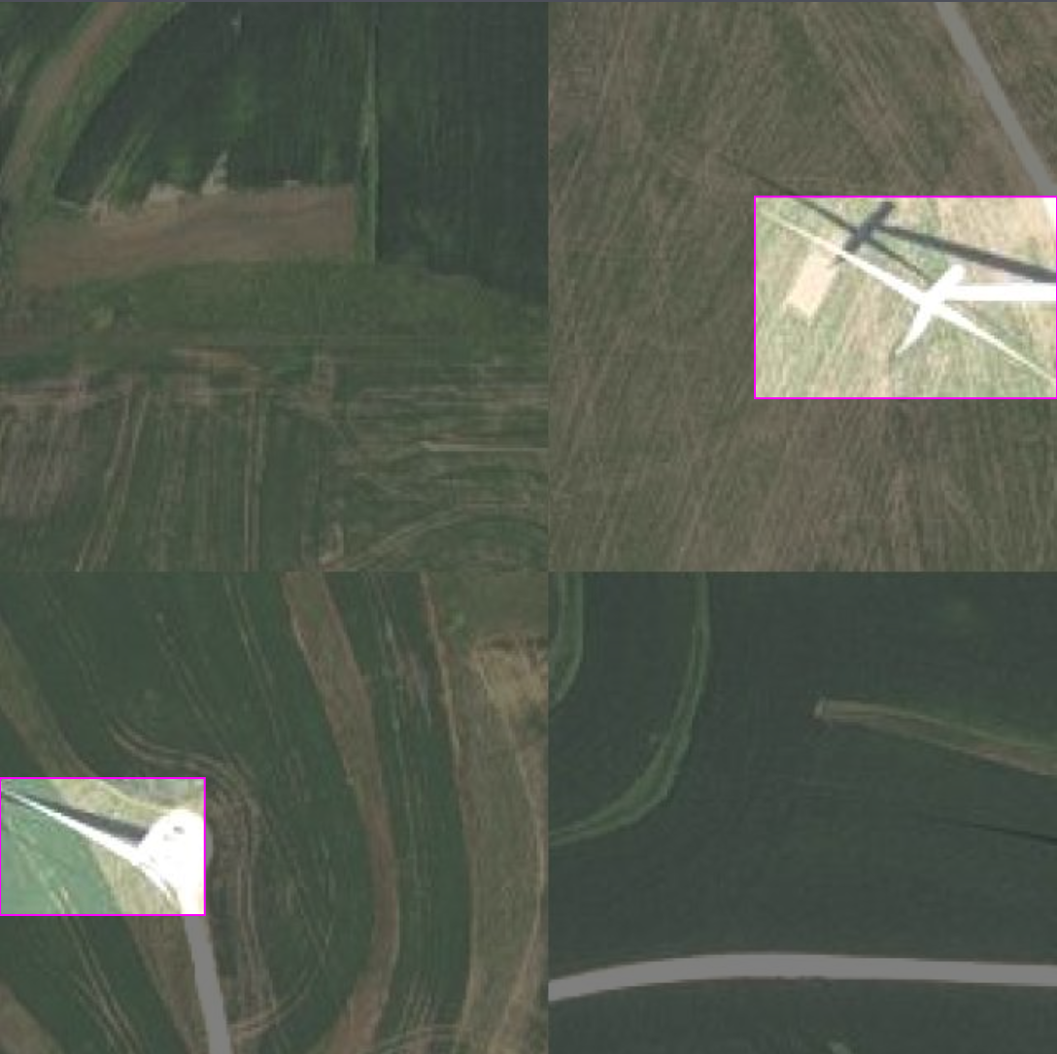
Data Wrangling
PyTorch Data Augmentation
Train-Test-Valid
Split
PyTorch Dataset
Class
Resize
608x608 → 640x640
2,130 images
2,130 labels
Train
Train
RandomRotation
(+/-) 90˚ rotation
‘Imagery.zip’
Test
Test
RandomHorizontalFlip
50% chance of flip
Valid
Valid
MosaicImage
Mosaic from RoboFlow
AdjustBrightness
(+/-) 25% brightness
Final dataset: 5,215 images/labels
Augmented for training
Final Training Dataset
Original Image
Augmented Image

Slide 7



Model Training Workflow
5,215 images/labels
Final Training Dataset
.YAML configuration
Upload
Import
Drive mount
Run
Export
train.py
Trained model weights
Batch size: 16
Epochs: 250
best_weights.pt
Google Drive
Google Colab
Clone
Import
Pre-trained YOLOv7 weights
Yolov7 Repository
WIND TURBINE DETECTION

Slide 8
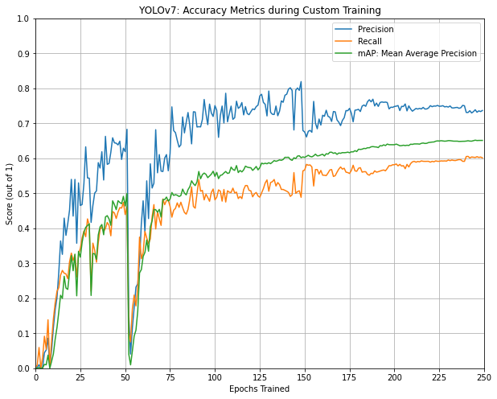
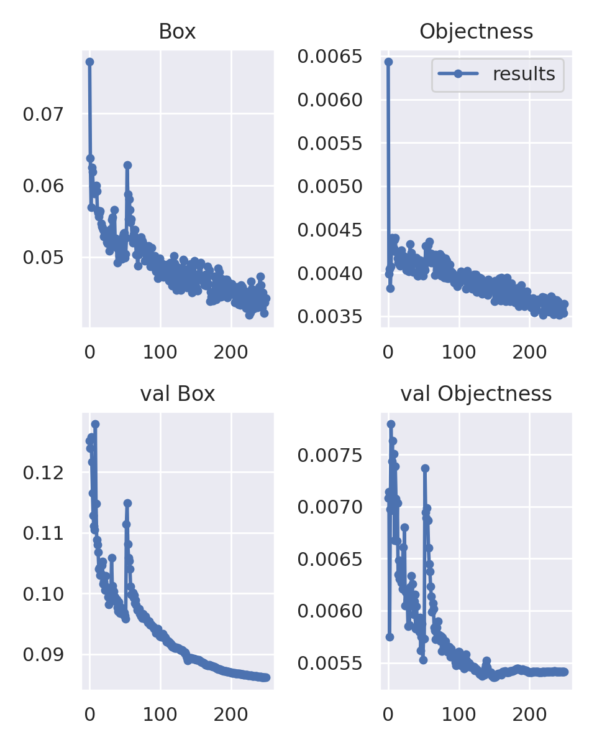
Model Training Progress
Loss Metrics during Custom Training
Training restarted
Training restarted
Epochs Trained
Figures. Model performance metrics (precision, recall, mAP, losses) as recorded during training.
WIND TURBINE DETECTION

Slide 9
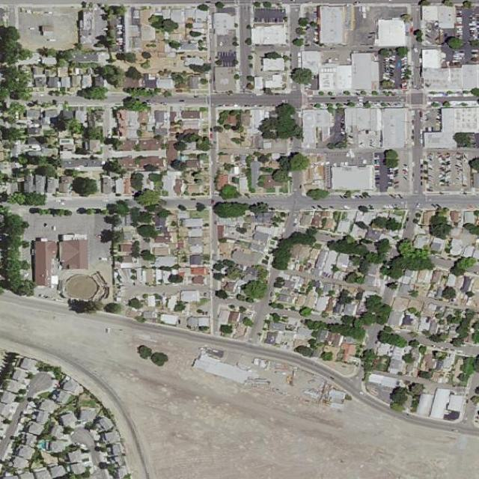
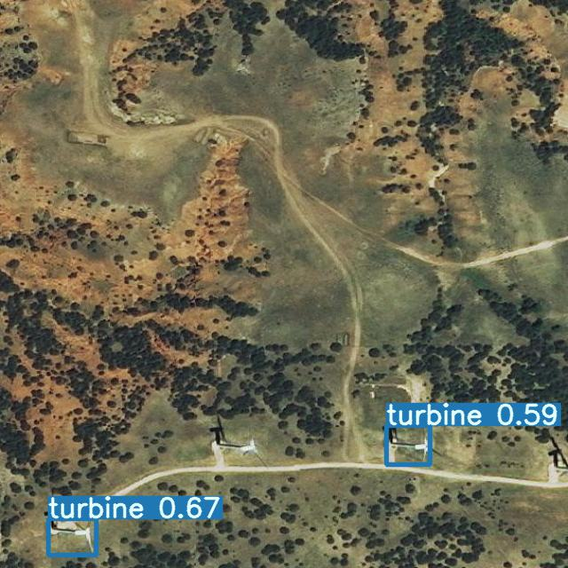
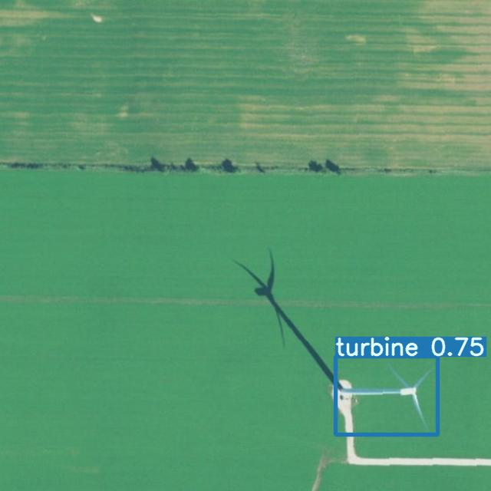
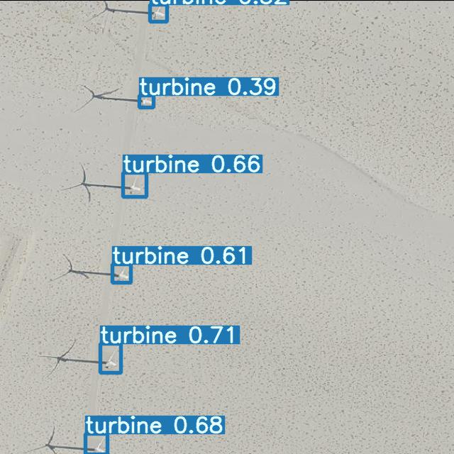
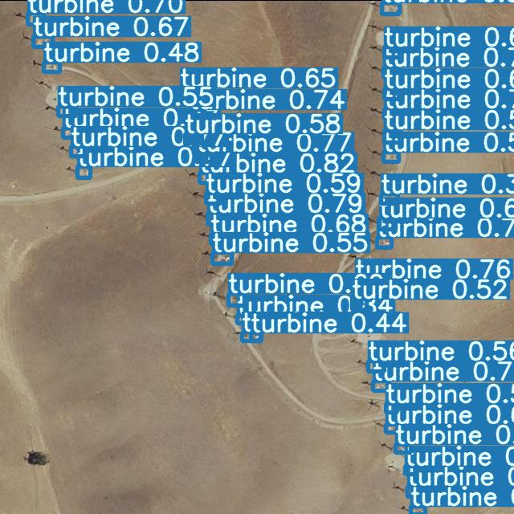
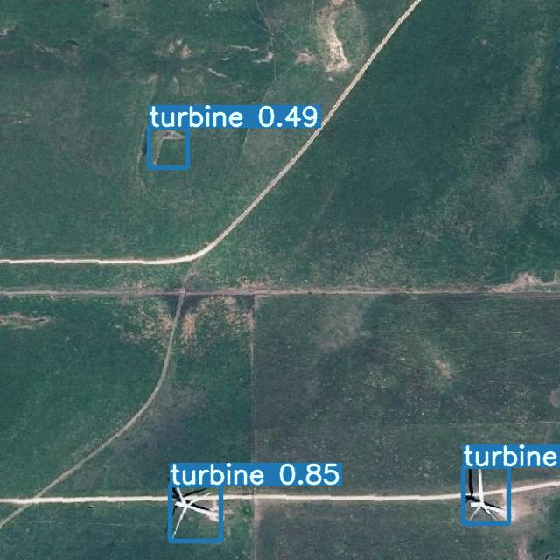
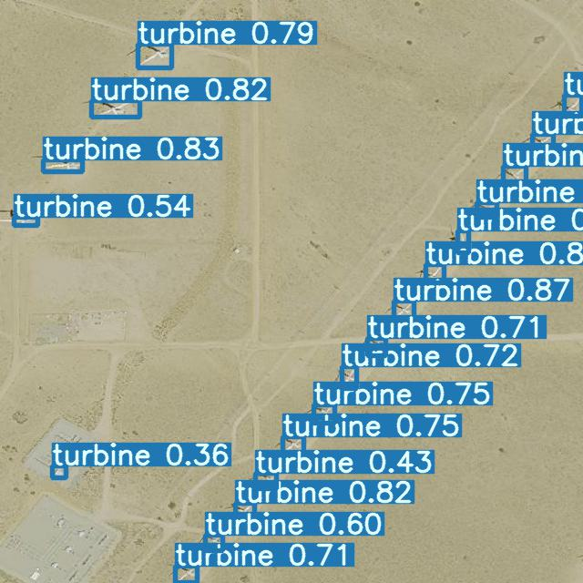
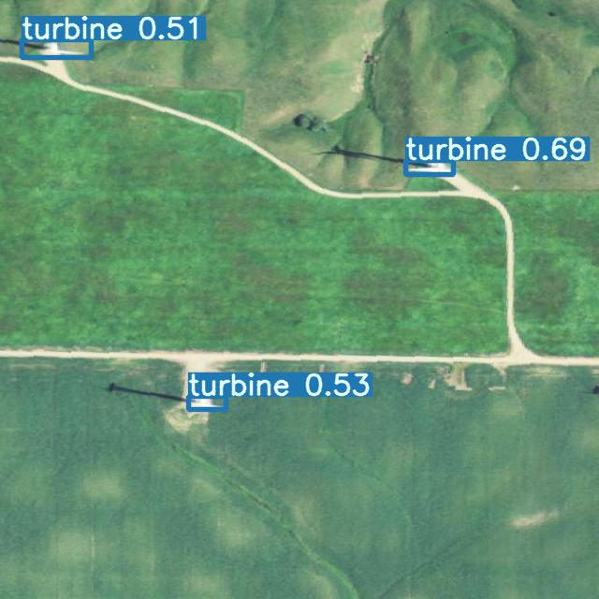
Model Output: Detections
Figure. Sampled model detections with confidence scores displayed.
WIND TURBINE DETECTION

Slide 10
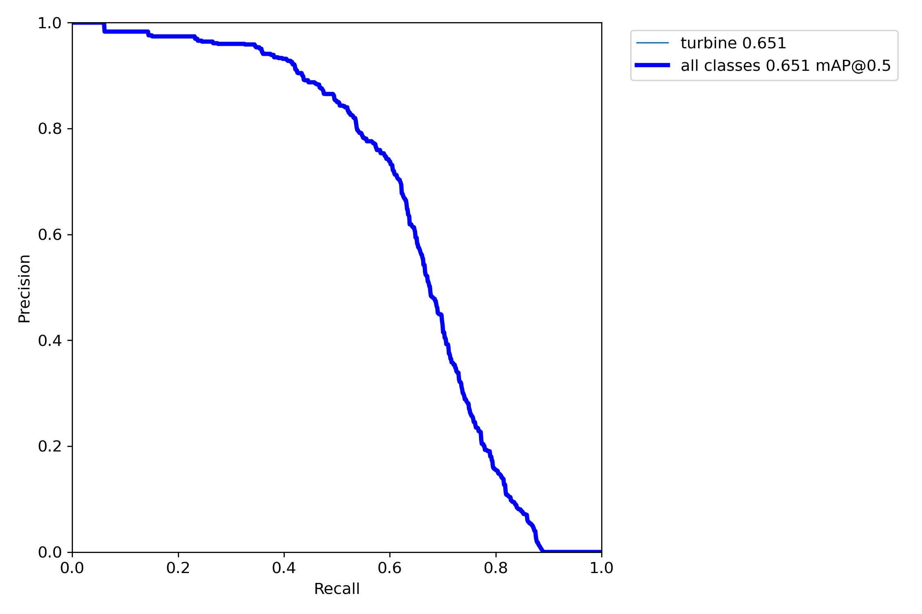
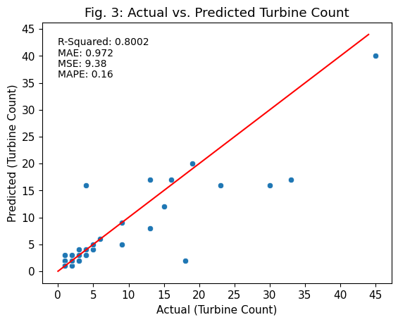
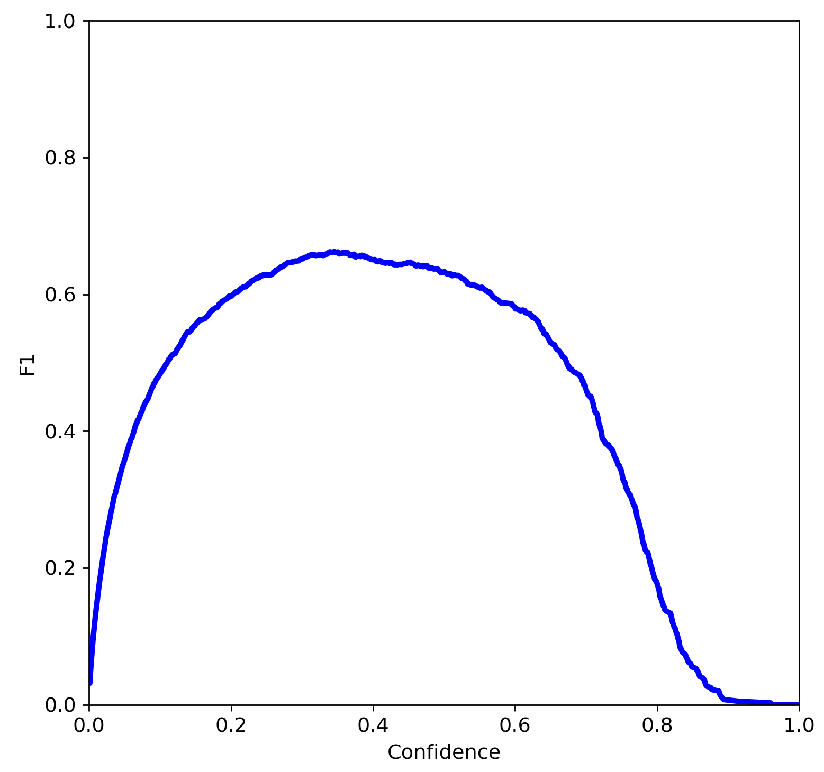
Model Performance Evaluation I
Precision - Recall
0.651 mAP @0.5 IoU
F1 - Confidence
Best performance:
< 10 turbines / image
0.66 F1 @0.345 confidence
Figures. P-R & F1-confidence curves.
Figure. Predicted vs. Actual turbines present in inferenced images.
WIND TURBINE DETECTION

Slide 11
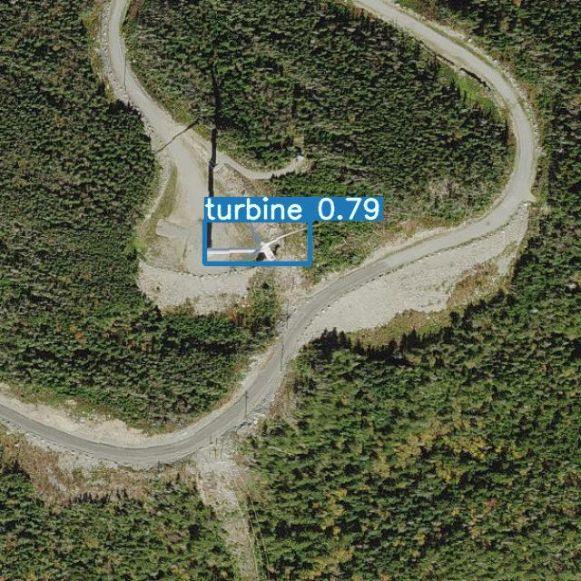
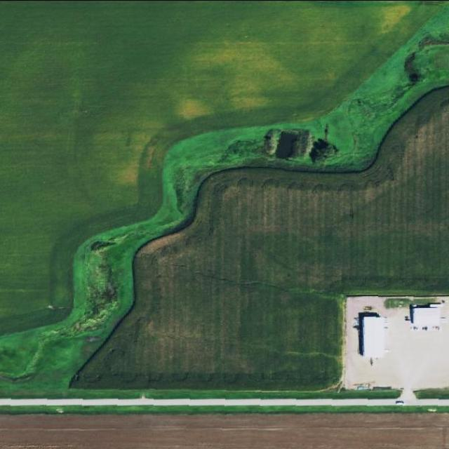
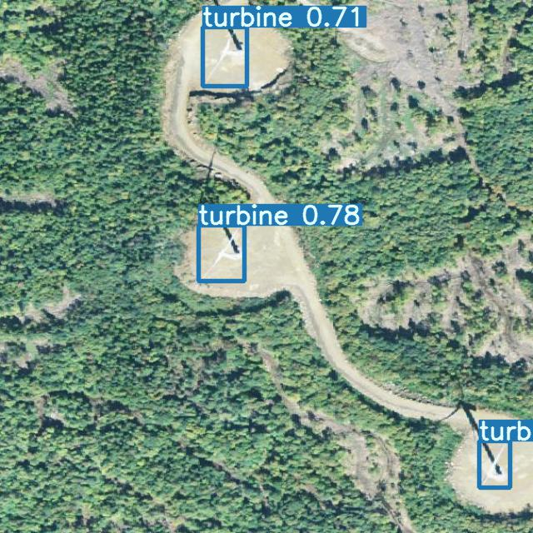
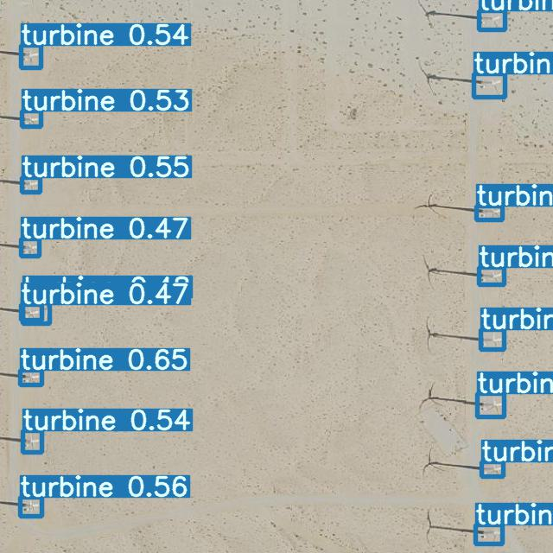
Response to Key Questions I
Q-I. How to estimate U.S. on-shore wind growth with greater temporal resolution than existing data sources?
A-I. Use an automated solution (object detection) paired with a sufficiently high temporal-resolution U.S. imagery dataset.
Examples include:
Sentinel-3 RGB bands (global coverage every 4 days)
Sentinel-2 RGB bands (global coverage every 5 days)
Landsat 8 products (global coverage every 16 days)
For model training:
National Agriculture Imagery Program (NAIP)
Quarterly acquisition, but 60 cm resolution
WIND TURBINE DETECTION

Slide 12
Response to Key Questions II
Q-II. Can a deep learning approach be implemented to automate estimation with reasonable precision?
A-II. Yes, with caveats.
The developed model performs best on large-scale imagery.
Model performance generally declines at smaller scale & in arid regions.
More training data & augmentations recommended.
FN
FP
WIND TURBINE DETECTION
Notes:
More biomes should be included! Brightening, darkening operations to improve performance in arid climates (tan background).

Slide 13
Thank you
Noah Vriese
noah@datawhirled.com
GitHub: nvriese1

