Slide 1
OOP Snake
Part 1 – Setting up the Game Structure

Slide 2
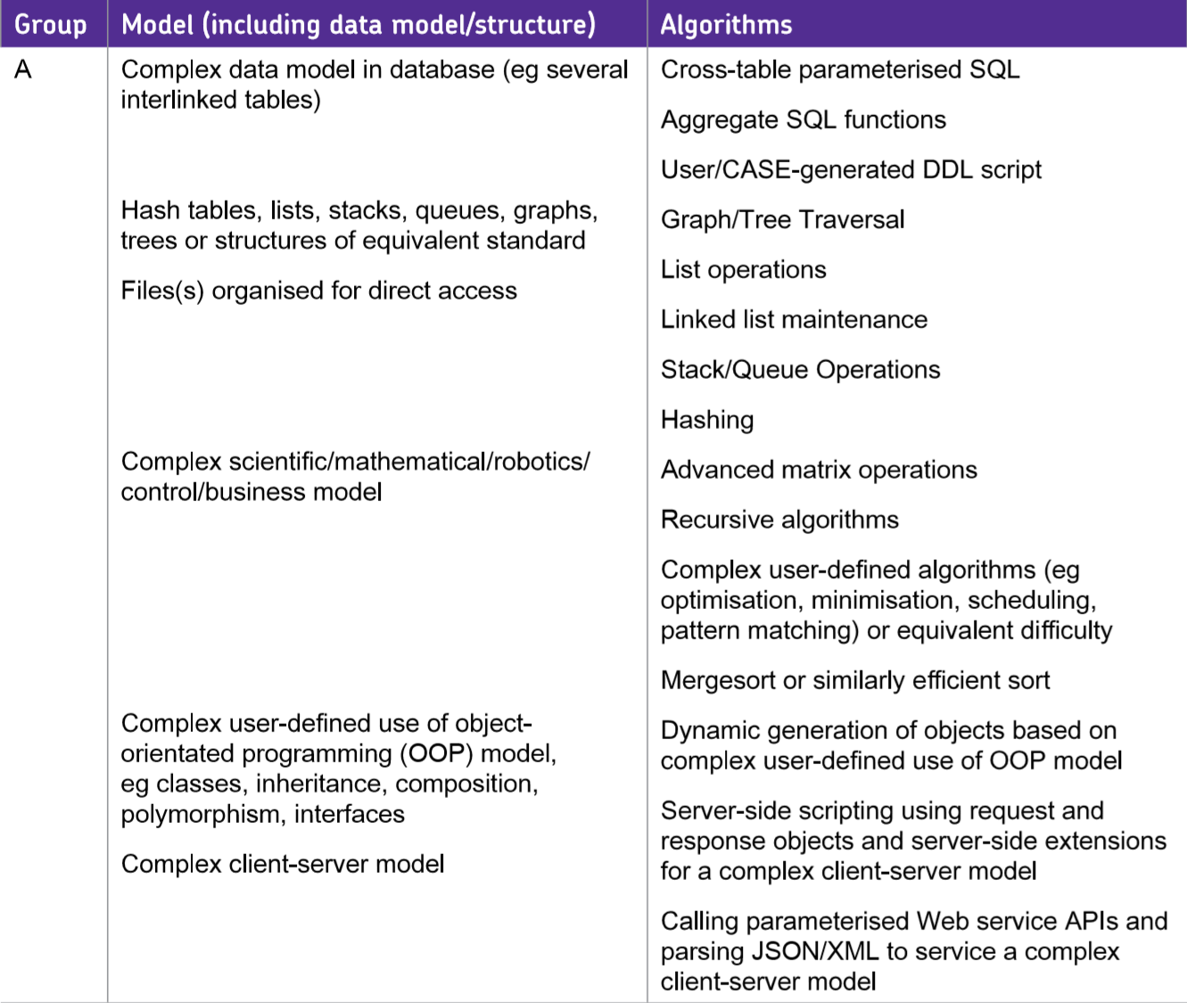
AQA A Level NEA
This example of the Snake game will not meet A Level Standard. It will involve some OOP but this is mainly simplistic and based around structuring the game.
There are no algorithms involving OOP that would meet the criteria for Table A.
However, it will hopefully help you to appreciate how to set up an application/game using OOP which would generate some marks.

Slide 3
Game OOP Structure
World Component
Knows where everything is in the game and what is happening
Visualiser Component
Knows how to draw every shapes, sprite, image
A good game structure will separate the drawing/rendering of objects from the objects themselves.
Objects have enough to do in the game without worrying about how to draw themselves!

Slide 4
Game OOP Structure
World Component
Object
i.e. player, enemy, weapon
A good game structure will separate the drawing/rendering of objects from the objects themselves.
Objects have enough to do in the game without worrying about how to draw themselves!

Slide 5
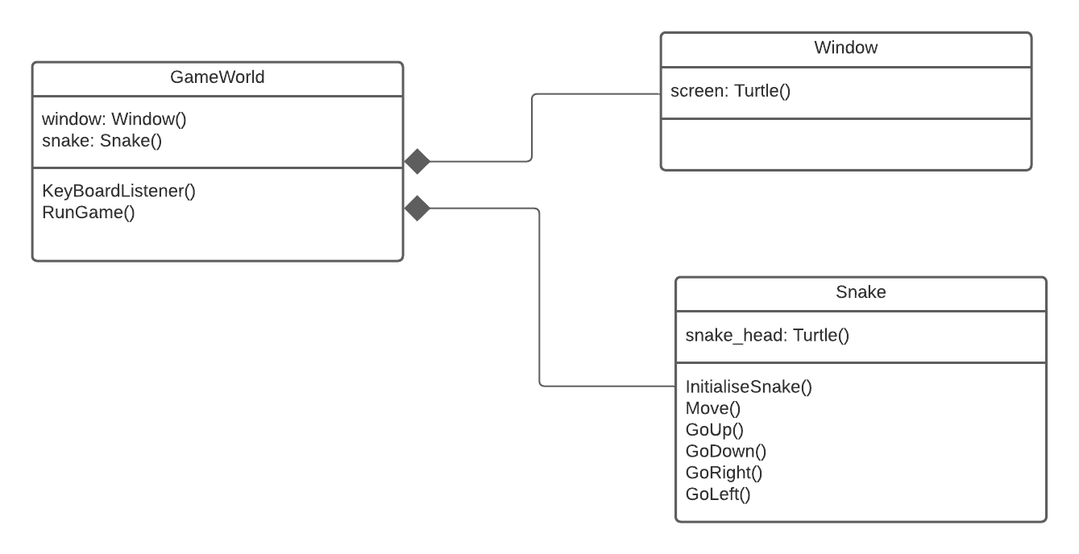
Game OOP Structure
In our SnakeGame the GameWorld Class will act as the game container holding (Composition) the window (our visualiiser class) and a Snake Object i.e. the Game has a Window, the Game has a Snake
As we are using the Turtle library the Window Class will be minimal as most of the drawing/rendering is hidden.
Note – there is no Private or protected attributes with publich getters/setters. If this was your NEA you should consider making use of this technique where appropriate

Slide 6
Files
You should really make use of 3 separate files for the separate components: GameWorld.py, Window.py and Objects.py (we will add additional objects to the snake later)

Slide 7
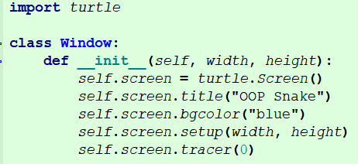
Setting up the Window Class (window.py)
Within the class constructor the attribute screen is assigned an istantiated turtle screen object. Appropriate settings for the window are specified.
The window size is setup using the width and height parameters passed to the constructor.
Colours can be specified with names or HEX values i.e.
Don’t forget to start with a #, i.e. #AAFF55
RED | GREEN | BLUE
”00” to “FF” | ”00” to “FF” | ”00” to “FF”

Slide 8
Game Screens
0,0
The screen in most games has the origin set to the top left with a inverted y axis.
However, the Turtle Screen doesn’t follow this convention
Y= 800

Slide 9
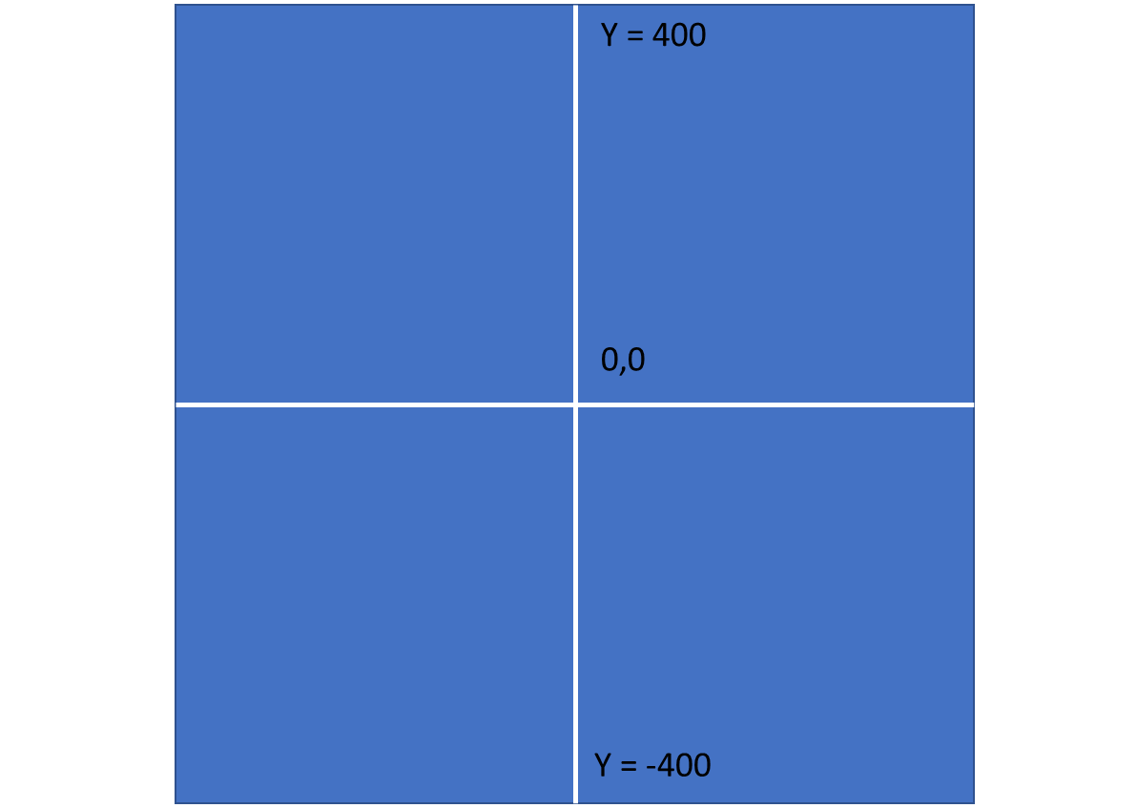
Turtle Screen
The screen follows the normal mathematical coordinate system with the origin the center.
When you set the value for the contstants for screen WIDTH and HEIGHT you will need to divide by 2 to know the extreme X and Y co-ordinates.

Slide 10
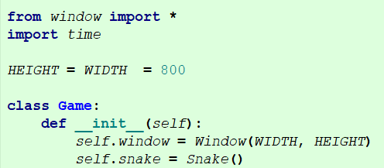
Setting up the Game Class (world.py)
You will need to setup some constant for the Width and Height of the screen. You can change these values as you please.
Within the constructor for our Game World Class we have our two main attributes; the window and snake objects where the instantiated objects are assigned to our attributes.

Slide 11
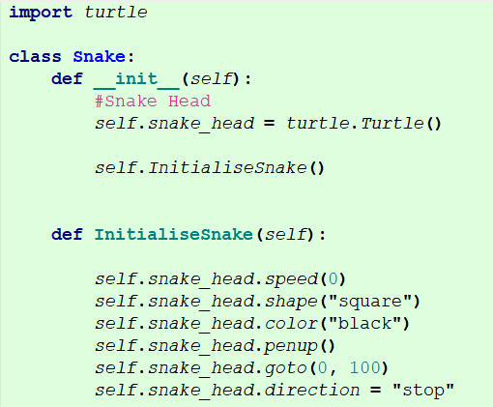
Snake Class (objects.py)
Within the constructor the attribute snake is assigned an instantiated turtle object which will act as the head of the snake.
The InitialiseSnake() method is called to setup basic settings.

Slide 12
Snake Class
Initial position on screen
Flag variable used ot later ensure the snake head does not move.
The snake head attribute (turtle object) will be represented by a square shape. The colour as before is up to you.
We make use of the penup() method so that as the snake head moves it doesn’t leave any markings.

Slide 13

Import the Objects file (world.py)
At the top of the World.py file don’t forget to ‘import all’ from your objects.py file
If you have used different file names will need to adapt the code.

Slide 14
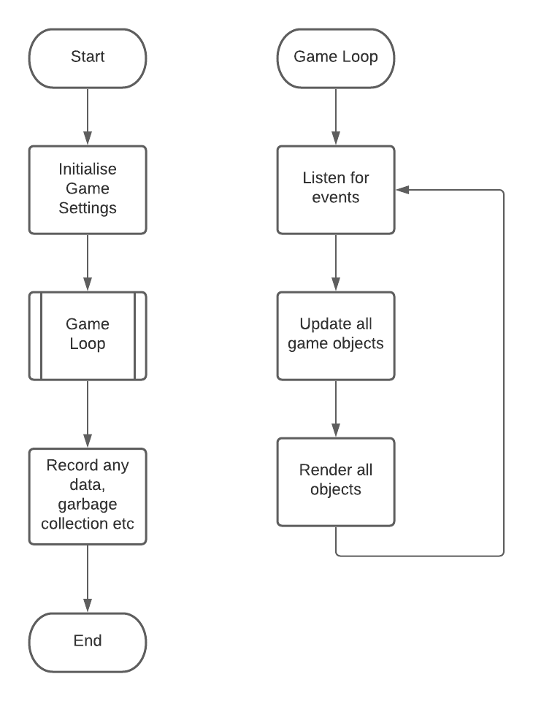
Game Loops
All games have a game loop. The game loop runs continuously and checks listens for user input and acts on it, Updates all objects in the game, Renders all objects in the game
The Program only exits the game loop once the game has ended, at which point the game may record data such as scores, handle garbage collection (releasing memory used by game objects) and end

Slide 15
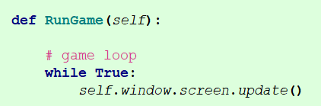
RunGame() (World.py)
In our GameWorld class we need to add our method to run the game.
The purpose of this method is initiate the game loop. At this point our main loop is very minimalistic and will just update the screen.

Slide 16
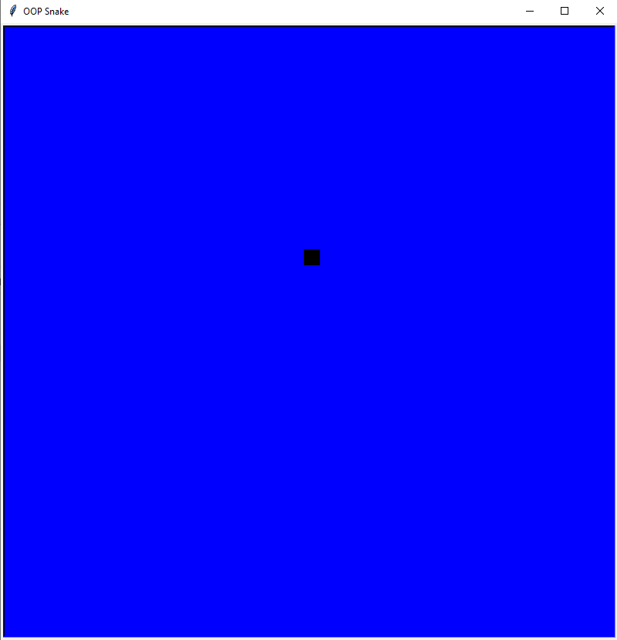
Running Game
When you run the game it should simply display the snake (a square)

Slide 17
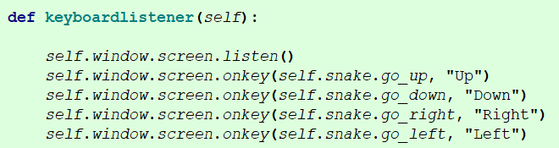
Movement
Brackets are intentionally missing from the method names.
This is a feature of the turtle libray
Our program needs to listen for keyboard events so it knows when the user wants to move the snake in a particular direction.
There is a quite a lot going on behind the code with the Turtle library. Essentially the screen component listens for when a key is pressed. If it happens to be an UP arrow key it calls the method of the snake class go_up()

Slide 18
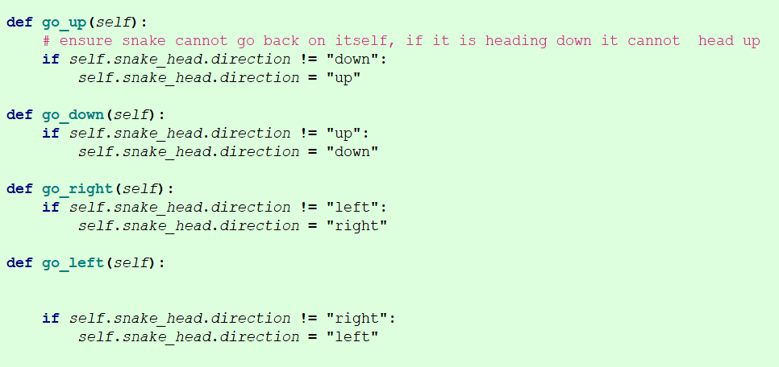
Movement (snake class)
Looking at these methods that are called by the previous code on a specific key press we can see they set the direction the snake should go in.
They do check the snake isn’t going in the opposite direction first as you can do a 180 degree turn in snake.

Slide 19
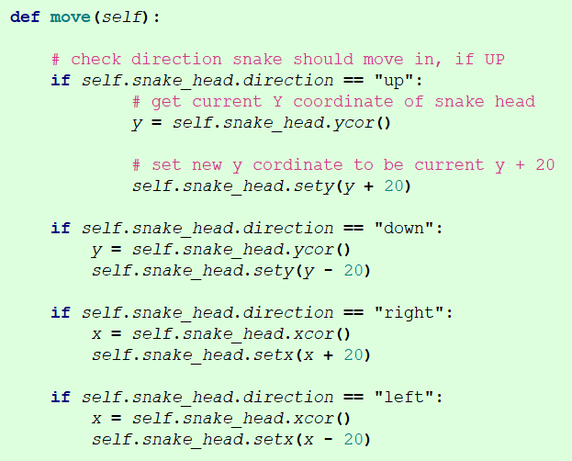
Movement (snake class)
Looking at the snakes move function we can see that the direction to move in is first checked.
For example, if UP has been pressed, we update the y co-ordinate of the snake to be current y + 20 – causing the snake to move up by 20 places.

Slide 20
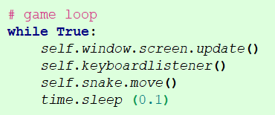
Update the Game loop (world.py)
We have now added the functionality to move on keypress but this hasn’t been actioned in the game loop. We therefore need to use the keyboardListener method and call the snake move function to update the snake object.
Time.sleep is there to allow changes to be made over time. A game loop usually uses delta time to drawing the screen at a number of frames per second.
We are using time.sleep to fudge this a little.

Slide 21
Problems
Compare code you have written back to the snippets shown
If you are unsure about where the code should go in terms of files or class, have a look back at the class diagrams.
Check the top of the files – everything imported correctly?

Slide 22
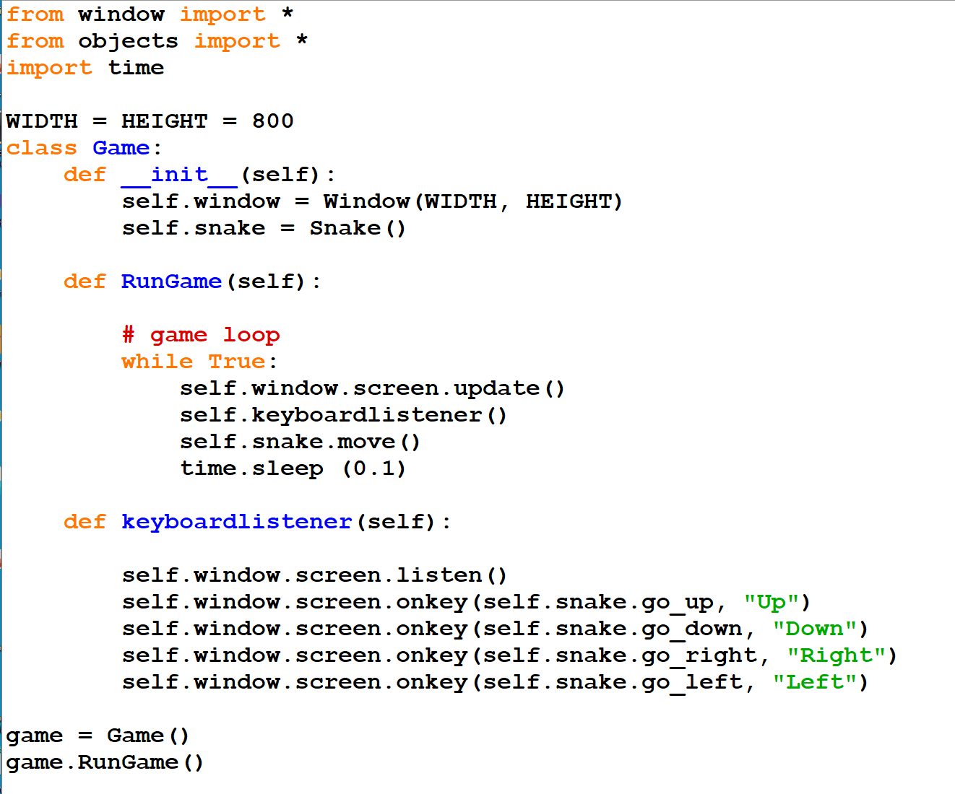
World.py

Slide 23
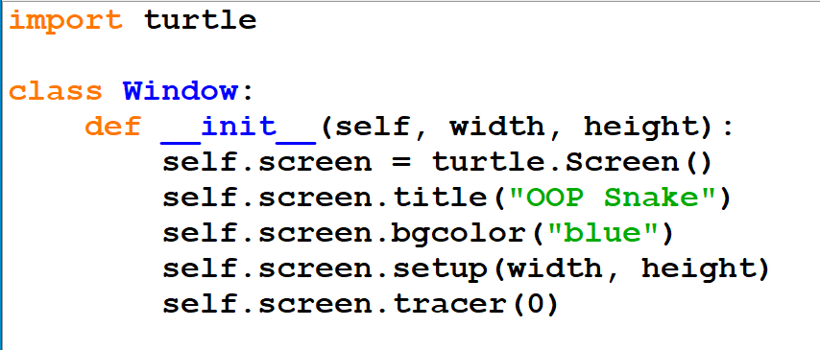
Window.py

Slide 24
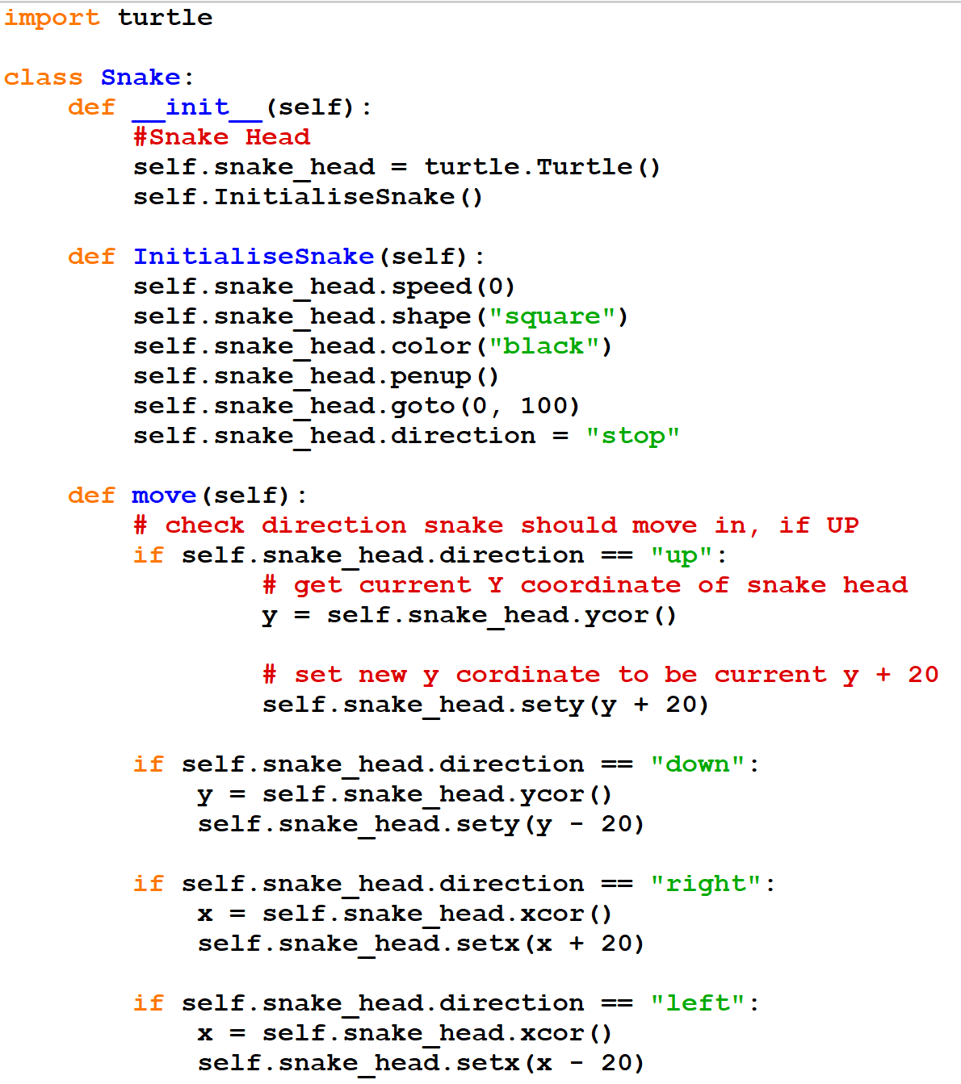
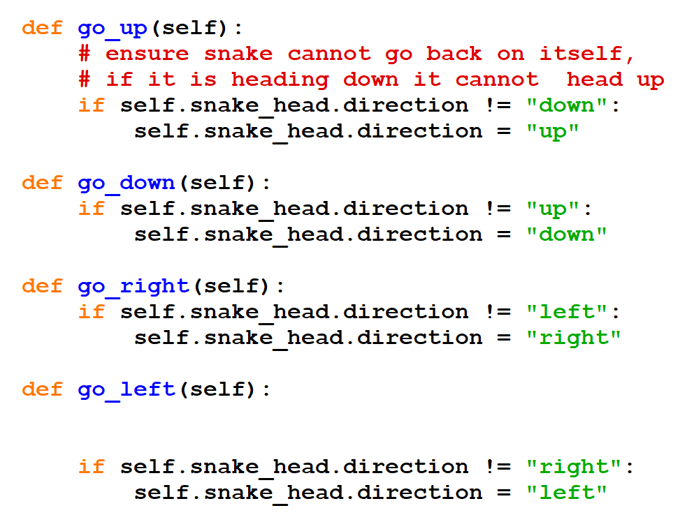
objects.py

