Slide 1
OOP Snake
Part 2 – Eating and Growing

Slide 2
Game OOP Structure
World Component
Knows where everything is in the game and what is happening
Objects
Snake
Food
Visualiser Component
Knows how to draw every shapes, sprite, image
We are going to be developing our objects in this tutorial. We will be adding the ability for the snake to grow as it eats food. This will require a new object (class) called food and some changes will need to be made to the snake class

Slide 3
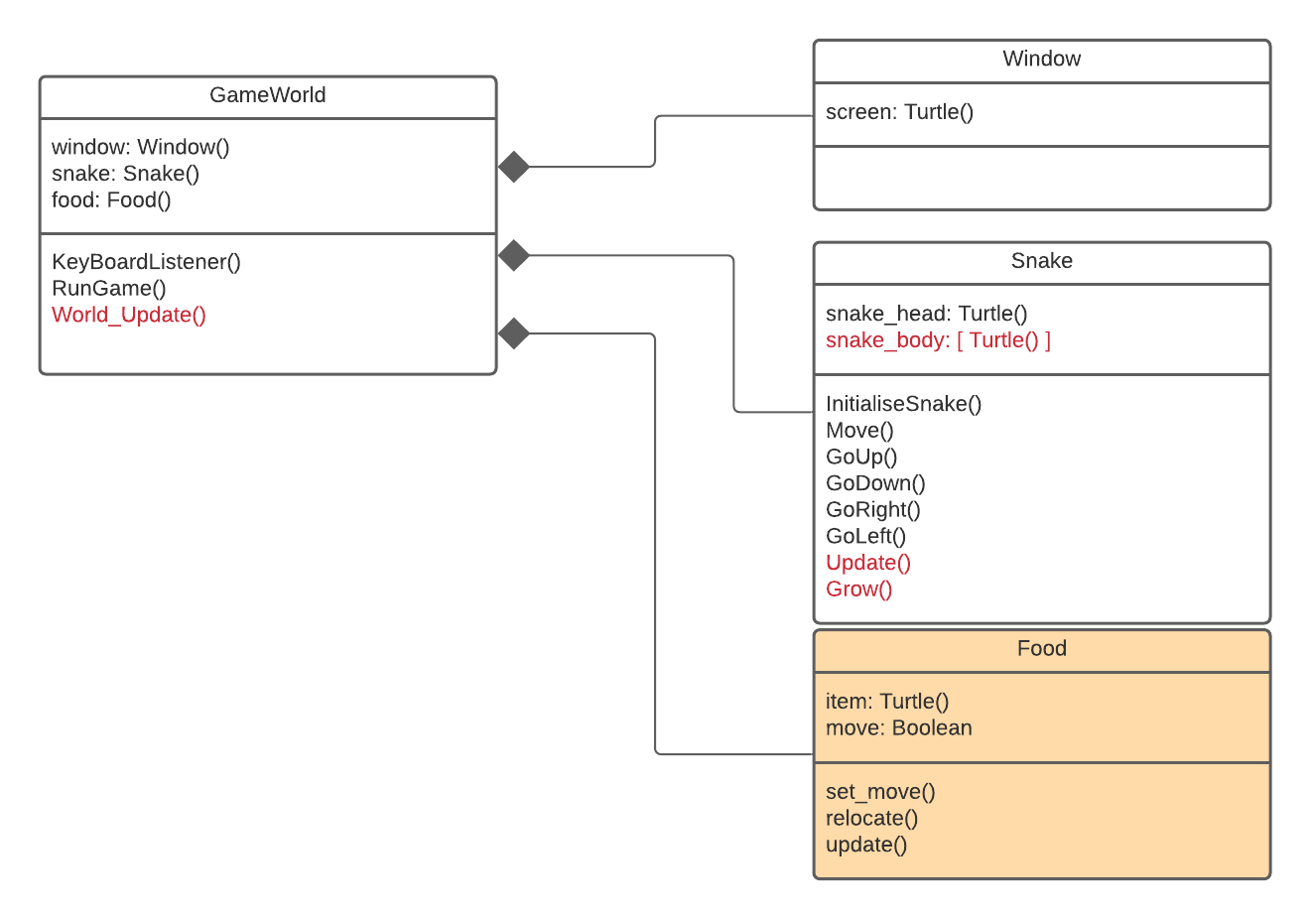
Game OOP Structure
We can see the additional Methods being added to the GameWorld Class and Snake class highlighted in red as well as the new class Food we are adding to the objects file.

Slide 4
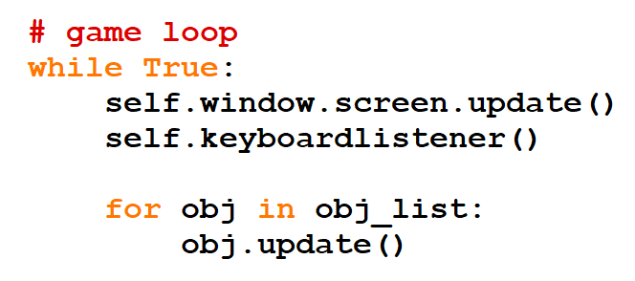
Objects Update (Read this slide)
All objects should really have an update method()
The reason behind this is that all objects once instantiated should be (although we aren’t doing it this tutorial) added to an array of objects in the game class.
This is powerful because we can loop through all objects, regardless of type and call its own update function.
Whilst we aren’t doing this, you should understand or appreciate this is very useful in a game full of many objects (players, enemies, power-ups, weapons, etc)

Slide 5
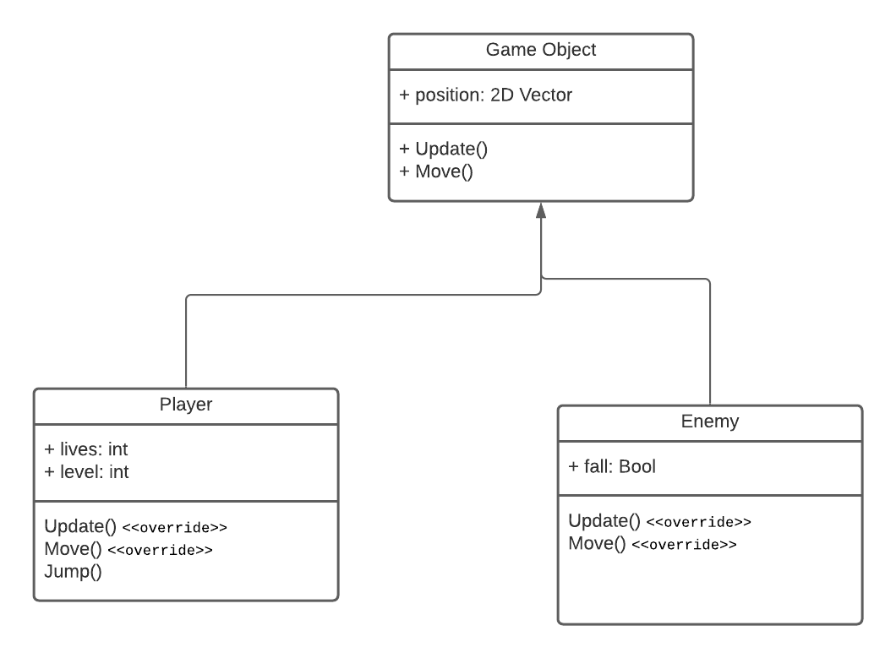
Inheritance (Read this slide)
If we were designing a more complex game we would probably also have a Game Object class which acts as a base class (we don’t create an instance of it) that all other objects in the game inherit properties from.
In some cases base class methods will be overridden

Slide 6
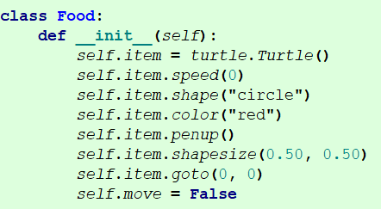
Adding Food
The food object ‘item’ is assigned an instantiated turtle object.
Similair to the snake some basic settings are assigned (Colours could be set using hex values as before)
It is currently set to appear at the origin. You can change this if you wish.
The attribute ‘move’ is a flag variable that determines the food needs to be moved or not. Once placed a food item will stay in its current position until the snake head collides with it. If it does the, it will then need to be relocated where it can be eaten again.
An other solution would have been to delete the item and create another which would have also worked just fine.

Slide 7
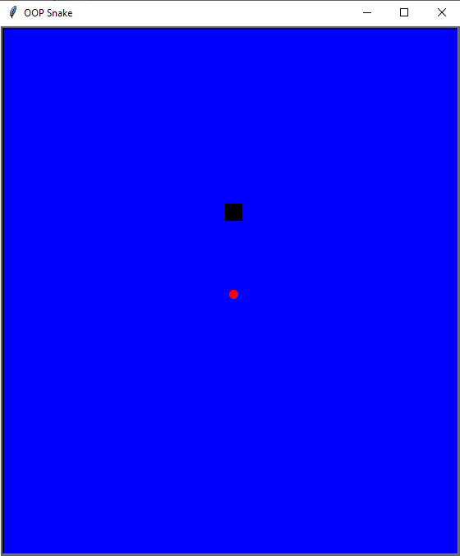
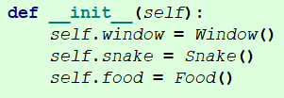
Instantiate our Food
In our GameWorld constructor we create our new attribute for food and assign it the value of an instantiated food instance.
When you run the game you should see your food item on screen

Slide 8
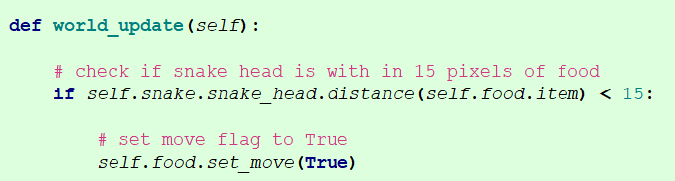
Colliding with the Food Item
Currently the Food Item and the Snke know where they are on the screen but not each other. For this reason the GameWorld will manage collision detection.
To do this we will create a world_update() method.

Slide 9
Colliding with the Food Item
In this method we check whether the distance between the head of the snake and the food item is less than 15 pixels. If so we set the move flag of the food item to be True.
.distance() is a turtle method that returns the distance between two turtle objects. This saves us time having to write a method to do this!

Slide 10
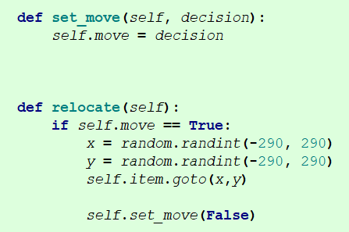
Relocating the Food item eaten
As mentioned earlier we are going to relocate the eaten food item as oppose to deleting it and creating another.
We know when the move flag is TRUE we want to generate a new position on the screen to move the Food item ( a turtle object).

Slide 11
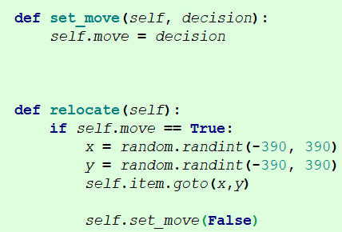
Relocating the Food item eaten
The set_mve method is just a setter to assign a Boolean value to the move attribute
Relocate() checks if the food item needs to be relocated. If so, it generates a random value for x and y that will be on the screen. It then moves the food item to this location and sets the move flag back to False.

Slide 12
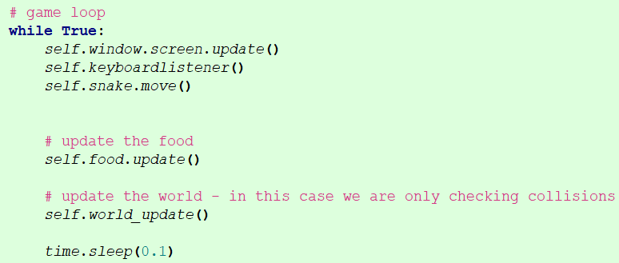

Game Loop
We want to continually check the distance between the Snake and the Food item. We also want to continually check if we need to update the Food item’s location.
We have also added an update method to the food.
The update method for the food simply checks if it needs to move it due to a collision

Slide 13
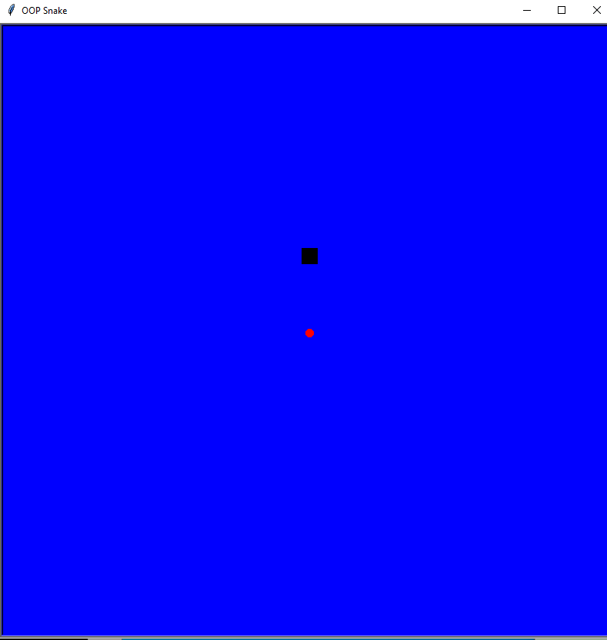
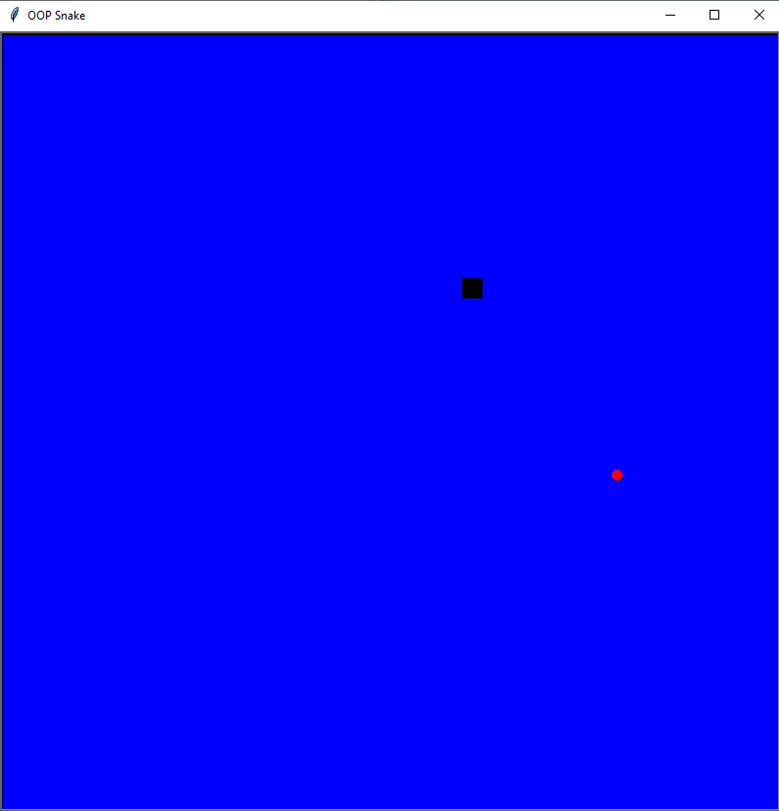
Test the Game
When you run the game now if the snake collides with the food it should relocate to another area on the screen

Slide 14

Snake Body
The snake body will grow by one block each time the snake eats a food item. Each block of the the snake body will be make up of another instantiated turtle object
We will store these as an array in an attribute in the class snake
Body Part
Body Part
Body Part
Head

Slide 15
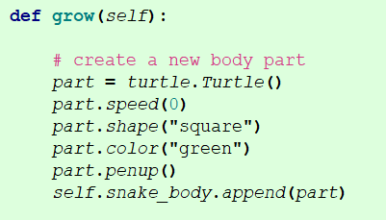
Growing Snake
Adding a body part to our snake is reasonable easy as we are just adding a new turtle object to the array

Slide 16
Moving the Snake
This is a little bit technical.
First aspect of this algorithm is that we can use:
Turtle methods .xcor() and .ycor() to obtain the current (x,y) position of the a snake body part
We can therefore move the BodyPart last in list (furthest from head) to the position of the body part infront
Head
Body Part
Body Part
Body Part
Head
Body Part
Body Part
Body Part

Slide 17
Moving the Snake
We can then repeat this step in the algorithm for the next item from the back of the array
This works for all elements of the snake body accept the one closest to the head as their isn’t an elemtent in front to copy the (x,y) position from.
Head
Body Part
Body Part
Body Part
Head
Body Part
Body Part
Body Part

Slide 18
Moving the Snake
After we have moved all the elements but the one closest, we can manually set the position of this element to be the same as the head.
We then just need use the same code we had before to move the head – and all the snake (head and body) has moved.
Head
Body Part
Body Part
Body Part
Head
Body Part
Body Part
Body Part

Slide 19
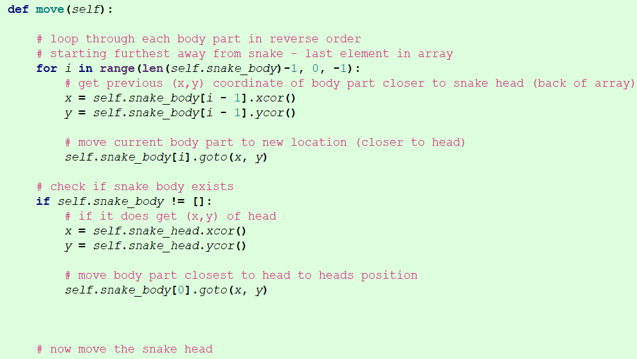
Moving the Snake
Here we can see our new algorithm using a for loop in to move through the snake body in reverse order towards the snake head
Head
Exit loop at 0
2nd pass
1st pass

Slide 20
Moving the Snake
We then check if the body exists. If it does we move the body part closest the snake
Lastly we leave our code for moving the head as it was
Head
Move Me

Slide 21

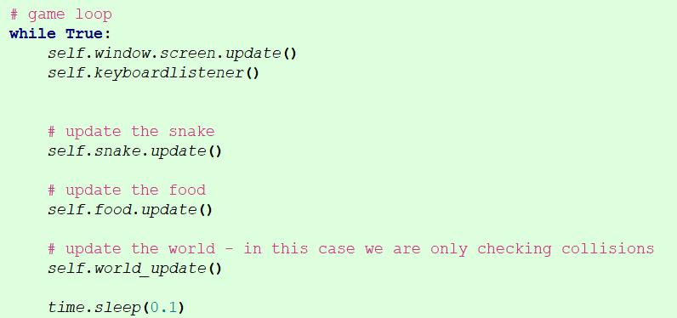
Game Loop
As we did before with the Food class we now add an update method for the snake that moves the snake.
Adjust the game loop to use update rather than .move() itself.
If we wanted we could then have an objects array that loops through the objects calling their update method that processes differently depending on the object.
Assuming these classes were (as mentioned earlier inheriting from a base class we could have Polymorphism!

Slide 22
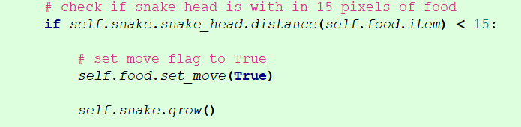
Grow Snake Grow
Finally, we need to tell the snake to actually grow when the head collides with the food item. We do this in our world_update method

Slide 23
Problems
Compare code you have written back to the snippets shown
If you are unsure about where the code should go in terms of files or class, have a look back at the class diagrams.
The snake body part added after eating food is automatically created at the center of the screen before then being moved to the rear of the snake. Can you think of a better solution?

