Slide 1
OOP Snake
Part 4 – The Head-Up-Display

Slide 2
Game OOP Structure
World Component
Knows where everything is in the game and what is happening
Visualiser Component
Knows how to draw every shapes, sprite, image
HUD
In this tutorial we will be looking to develop the world model to display a head-up display providing information on scoring the game

Slide 3
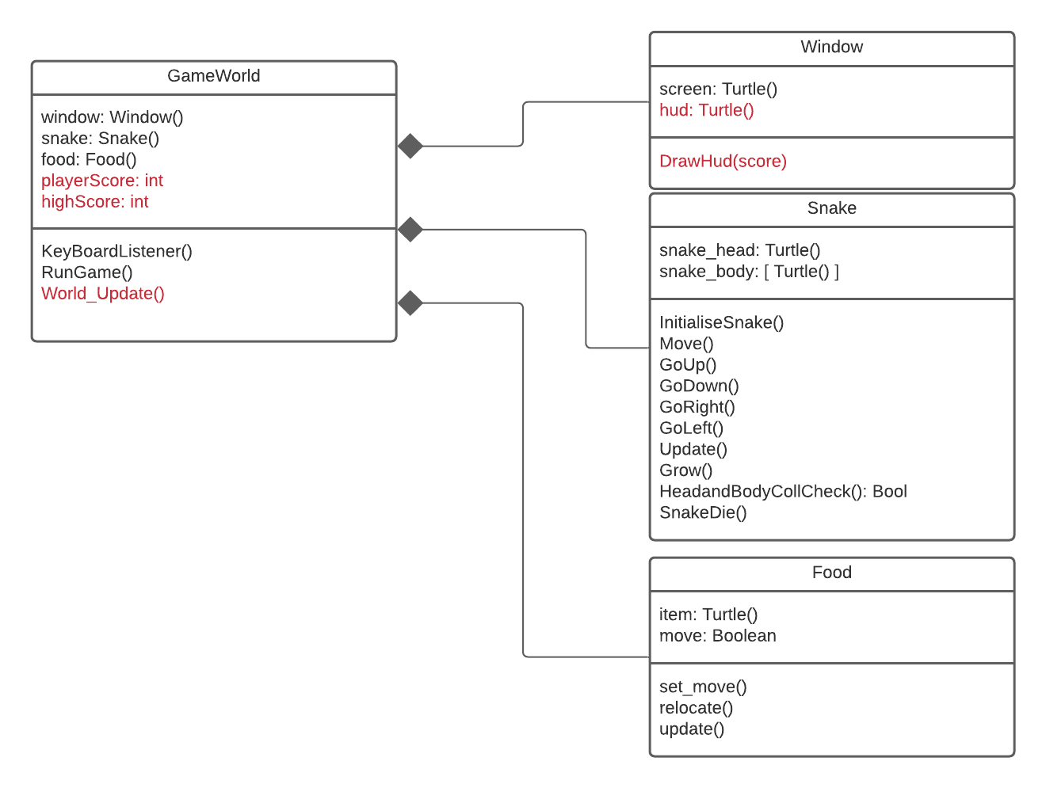
Game OOP Structure
We will need to add a new attribute to our Window class to represent the turtle object responsible for drawing the display. We will also need a method for Drawing the HUD.
Finally we will be developing the World_Update() method to ensure the display is drawn/updated in the game loop
Notice the extra attributes for scores in GameWord
Notice that DrawHud is expecting a parameter

Slide 4
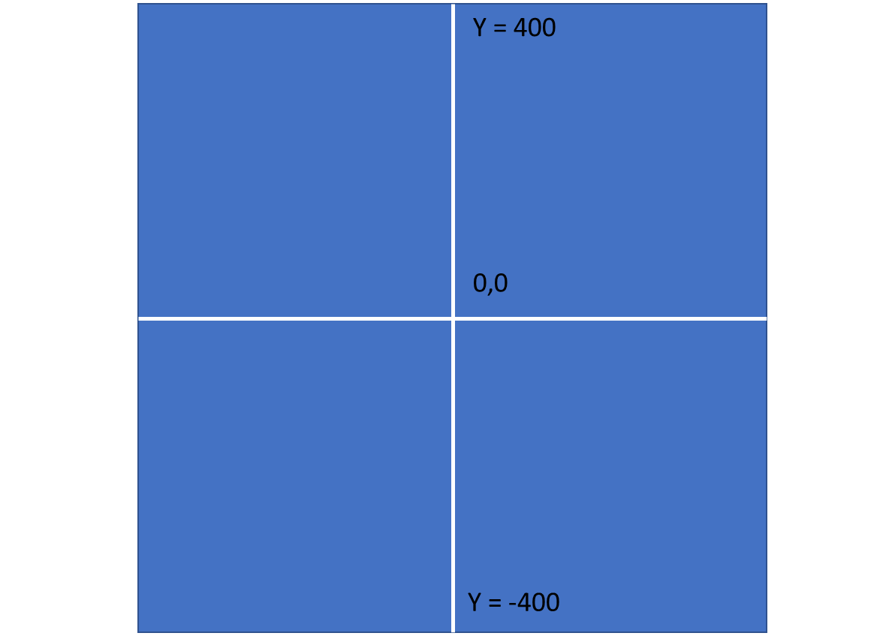
The HUD
The HUD can be placed anywhere on the screen. Usually it is found at the top of bottom.

Slide 5
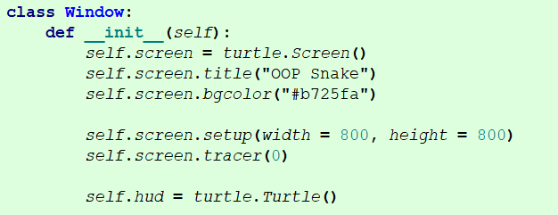
HUD Turtle
To start off with we need to create our hud turtle and assign it with an instantiated turtle object.

Slide 6
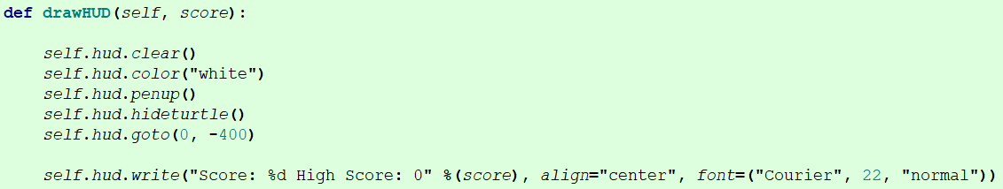

Drawing the HUD
Our method here will clear the HUD drawing when called. If we don’t do this we will be writing on top of writing. As scores grow this will cause an unpleasant effect.

Slide 7
Drawing the HUD
The colour is simply the colour of the text and it uses pen up to ensure as it moves it doesn’t draw lines. AS the HUD is drawn the turtle is set to be hidden so you can’t actually see the turle shape (arow, square etc).
The .goto() method is used to specify where you want the HUD to appear on the screen. In this example it is set to the bottom.
The last line of the method writes on the screen and substitutes the value held in the score variable (passed as a parameter) where %d is located in the string. You can change font and alignment as you please.

Slide 8
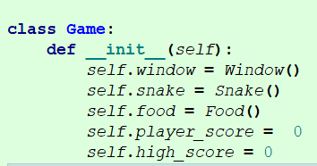
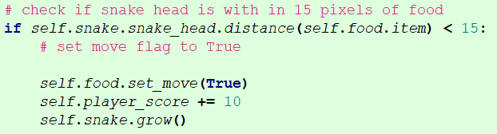
Scoring
We will need to set up attributes to track player score and high score
The players score will increase by an amount everytime the snake eats a food item.

Slide 9
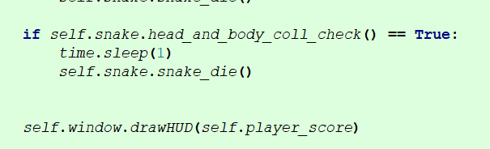
Game Loop
Within the game loop we need to call our DrawHud() method to display, passing the attribute for the score

Slide 10
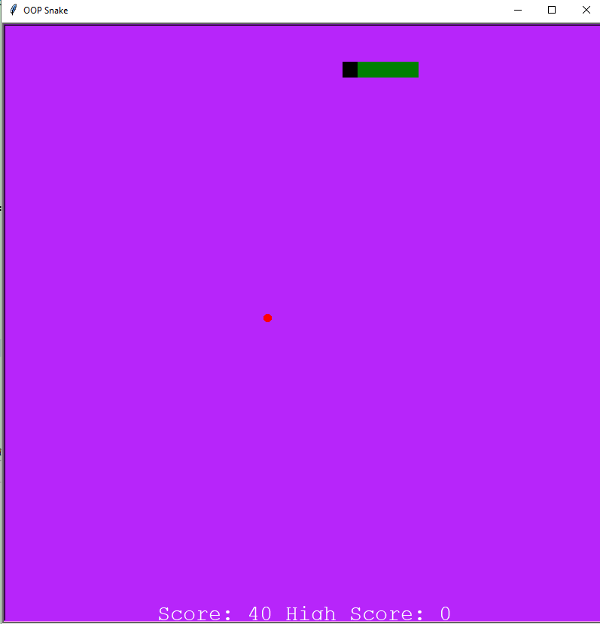
Test the game
When you now run the game you should see the HUD and the score increasing as the snake eats food

Slide 11
Unfinshed
You still to work out the following:
Resetting the score to 0 when the player dies
Keeping track and updating and displaying the highscore

Slide 12
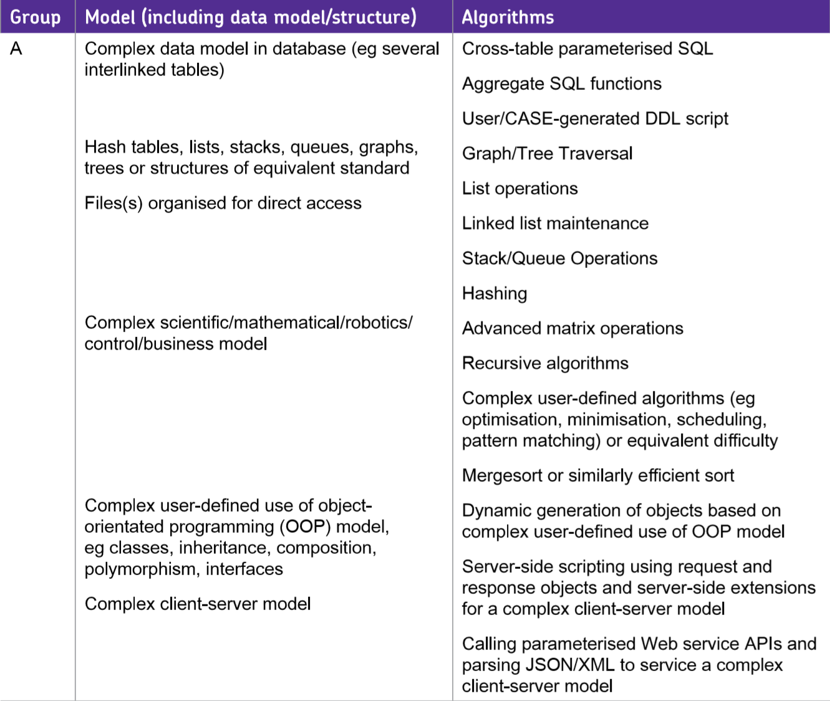
A Level Projects –Some ideas
How could this game be developed into an A level project?
Create a client server application where the server allows the player to connect and play the game.
(Server probably just tracks high scores and authenticates the player against known accounts). Server allows multiple clients to connect.
Use a priority Queue to maintain a High score table

Slide 13
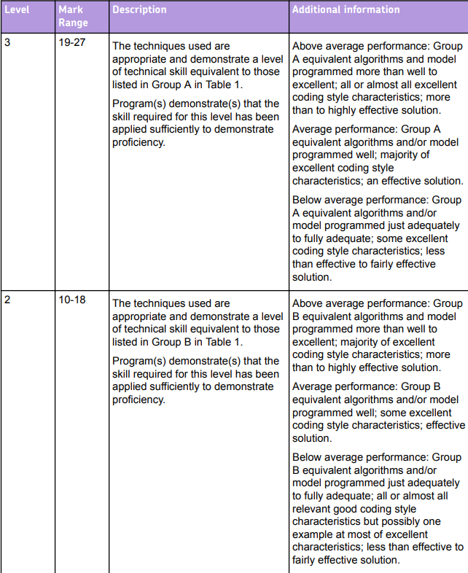
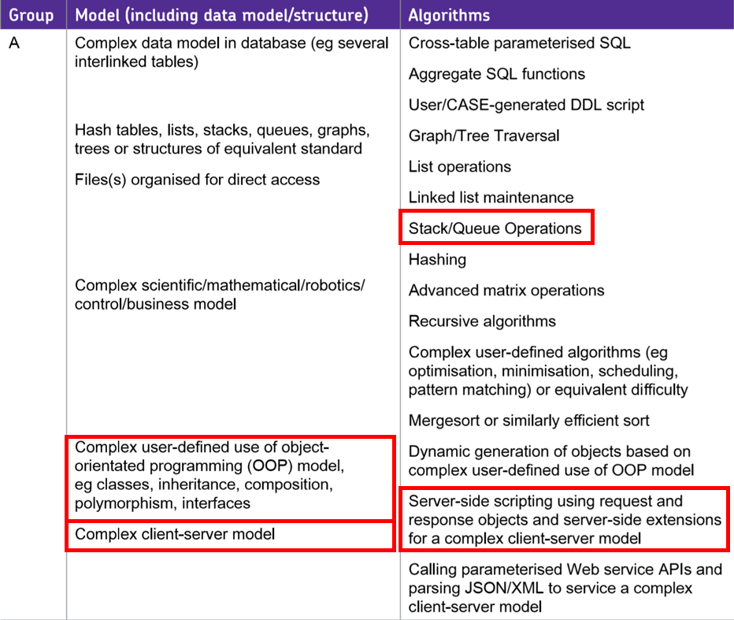
A Level Projects –Some ideas
It might not be the most complex or technically challenging problem to tackle.
But you would be able to access the higher tier in techniques used.
Project is marked out 75
so 19-27 is a good place to be scoring marks for techniques.

