Slide 1

BANGALORE INSTITUTE OF TECHNOLOGY
K.R Road, V.V Pura, Bengaluru-04
DEPARTMENT OF COMPUTER SCIENCE & ENGINEERING
“Automatic Hate Speech Detection using Natural Language Processing and Ensemble Machine Learning Approach”
Presented by: 18P47
1BI18CS091 N V Sahana
1BI18CS097 Niharika S
1BI18CS115 Prerana R
1BI18CS120 Rakshitha S
Under the Guidance of
Dr. Bhanushree K J
Assistant Professor
Computer Science and Engg

Slide 2
Agenda
Introduction
Highlights of
Literature Survey
Requirement Engineering
Project Planning and Scheduling
System Design
Architecture
Module Decomposition/Description
Component Design
Interface Design
Data Structure Design
Algorithm Design
Implementation
Applications
Conclusion
References

Slide 3
Introduction
Hate speech is any form of expression through which speakers intend to vilify, humiliate, or incite hatred against a group or a class of persons.
In recent years, hate speech has been increasing in-person and online communication and social media is playing a major role.
There is a need to monitor and prevent hate speech on these platforms.
The proposed solutions employs the different feature engineering technique NLP and Ensemble ML algorithms to classify content as hate speech.

Slide 4
Objectives
To minimize the misclassification rate.
To build an efficient system to accurately detect and classify hate speech.
To implement the techniques of Ensemble Machine Learning approach to obtain precise results.

Slide 5
Literature Survey
Sl. No. | Title | Author | Year | Contributions & Drawbacks
1 | Multi-level stacked ensemble learning for identifying hate speech spreaders on Twitter | Darko Tosev and Sonja Gievska | 2021 | This paper contributes to research pertaining to detecting hate speech on social networks. A variety of sparse and dense feature representations have been explored, and used in conjunction with a multi-level stacked ensemble learning using SVM, RF and Logistic Regression. Limitation - Low accuracy results was obtained by the ensemble model, indicating that pre-trained vector embedding and other ML methods can be used in the future.
2 | Genetic Programming Approach to Detect Hate Speech in Social Media | Mona Khalifa A Aljero and Nazife Dimililer | 2021 | A novel hybrid mutation technique called Genetic Programming(GP) model based on Darwinian principles to solve the binary text classification task of hate speech detection in social media. Limitation - The proposed model deals with the text classification as a binary classification problem and has not yet been adapted for multi-classification problems.

Slide 6
Sl. No. | Title | Author | Year | Contributions & Drawbacks
3 4 | Detection of hate speech in Hindi –English code mixed data. Automatic hate speech detection using killer natural language processing optimizing ensemble deep learning approach | Shreelakshmi K, Premjith B, Soman K.P Zafer Al‐Makhadmeh, Amr Tolba | 2020 2019 | Machine learning model to detect hate speech in Hindi-English code-mixed social media text with fastText characteristics giving better feature representation with (SVM)-Radial Basis Function (RBF) classifiers. Limitation - Limited data set which is only binary classified as hate and non-hate. A hybrid NLP and ML technique to predict hate speech from social media websites collected dataset is examined using a killer natural language processing optimization ensemble deep learning approach (KNLPEDNN). Limitation - Classification of hate speech detection is done on an English dataset and not employed on a multilingual dataset.
5 | Multi-label Hate Speech and Abusive Language Detection in Indonesian Twitter | Muhammad Okky Ibrahim, Indra Budi | 2019 | This research discusses multi-label text classification for abusive language and hate speech detection using machine learning approaches with Support Vector Machine (SVM), Naive Bayes (NB), and Random Forest Decision Tree (RFDT) classifier, as the data transformation method. Limitation - Error analysis shows that a lot of false-negative errors are probably caused by the unbalanced dataset.

Slide 7
Sl. No. | Title | Author | Year | Contributions & Drawbacks
6 | Detecting Hate Speech and Offensive Language on Twitter using Machine Learning: An N-gram and TFIDF based Approach | Aditya Gaydhani, Vikrant Doma, Shrikant Kendre, and Laxmi Bhagwat | 2018 | Detection of hate speech and offensive language on Twitter through machine learning using n-gram features weighted with their term frequency-inverse document frequency (TFIDF) values. Limitation - It was seen that 4.8% of the offensive tweets were misclassified as hateful as more examples of offensive language which does not contain hateful words are not considered.
7 | Ensemble Method for Indonesian Twitter Hate Speech Detection | M. Ali Fauzi , Anny Yuniarti | 2018 | Identification of hate Speech in Indonesian Twitter data using two ensemble methods hard voting, soft voting, and compared results with five stand-alone classifiers. Limitation - BOW and ensembles of feature sets were applied to reduce the risk of selecting a poor classifier but there was no significant improvement in results.

Slide 8
Sl. No. | Title | Author | Year | Contributions & Drawbacks
8 | Text analysis using hate speech detection using back popagation network | Nabiila Adani Setyadi, Muhammad Nasrun | 2018 | To classify elements of hate speech in a text by a computer, which later speech of hate can be recognized. By using an Artificial Neural Network method optimized with Backpropagation algorithm. Limitation - Only Boolean classification of tweets to hate or non-hate.
9 | Using Naïve Bayes Algorithm in the detection of Hate Tweets. | Kelvin Kiema Kiilu, George Okeyo, Richard Rimiru, Kennedy Ogada | 2018 | The proposed system develops an approach for detecting and classifying hateful speech that uses content produced by self-identifying hateful communities from Twitter. Limitation - The problem addressed is the limitation of Twitter API for commercial research where authorization is limited.

Slide 9
Sl. No. | Title | Author | Year | Contributions & Drawbacks
10 | Hate speech on Twitter A Pragmatic Approach to Collect Hateful and Offensive Expressions and Perform Hate Speech Detection | Hajime Watanabe, Mondher Bouazizi, Tomoaki Ohtsuki | 2018 | The proposed system automatically detects hate speech patterns and most common unigrams and uses these along with sentimental and semantic features to classify tweets into hateful, offensive, and clean. Limitation - Words highly related to hate are almost the same as those usually used to offend, demean or insult them. That being the case, tweet features qualified as “Unigram'' present lower accuracy when we split the class “offensive” from the binary classification into two classes which are “hateful” and “offensive”.
11 | Degree based Classification of Harmful Speech using Twitter Data | Sanjana Sharma, Saksham Agrawal, Manish Shrivastava | 2018 | This paper describes how an ontological classification of harmful speech is created based on degree of hateful intent, and used it to annotate twitter data accordingly using Naïve Bayes, SVM, random forest classification. Limitation - The class-based labeling of tweets makes the task at hand very one dimensional.

Slide 10
Drawbacks of Existing System
Most models deal with the text classification as a binary classification problem (Hate and Not hate), which may be seen as a limitation.
An attempt at multi-label classification resulted in decreased performance due to a large amount of unbalanced data in the dataset.

Slide 11
Majority of the approaches deal with feature extraction from the text using dictionaries and bag-of-words. It was observed that the word-order is ignored and causes misclassification as different words are used in different contexts.
Hate content could be in code-mixed language form. But due to the lack of availability of dataset, there is less work done in hate speech detection from Hindi-English code-mixed comments.

Slide 12
Problem Statement
“To implement hate speech detection system which classifies code-mix hate speech into multiclass using NLP and ensemble techniques ”
Input: A textual comment entered by the user.
Output: A desktop UI which detects the given input and classify into hate, non-hate and offensive.

Slide 13
Proposed System
The system proposes " Automatic Hate Speech Detection using Natural Language Processing and Ensemble Machine Learning Approach ".
A desktop application where the user enters the textual comments and as a result hate speech is detected and are classified as Hate, Non-Hate or Offensive in an effective manner by employing NLP and Ensemble Techniques.

Slide 14
Requirement Engineering
Software Requirements:
Operating system : Windows
Coding Language : Python
IDE : Jupiter Notebook
Hardware Requirements
Processor : i5 9th generations.
Hard Disk : 250 GB.
Monitor : 15 VGA Color.
RAM : 1 GB
Mouse : Optical
Keyboard : Multimedia

Slide 15
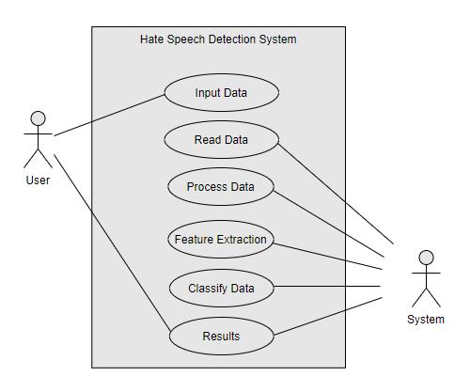
Conceptual/Analysis Modelling
Use Case Diagram
Figure 1:Use Case Diagram of proposed Application

Slide 16
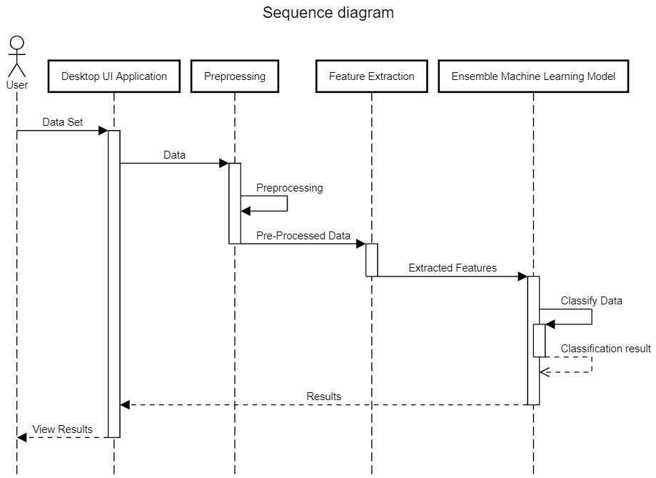
Sequence Diagram
Figure 2:Sequence diagram representing communication between modules of proposed system

Slide 17
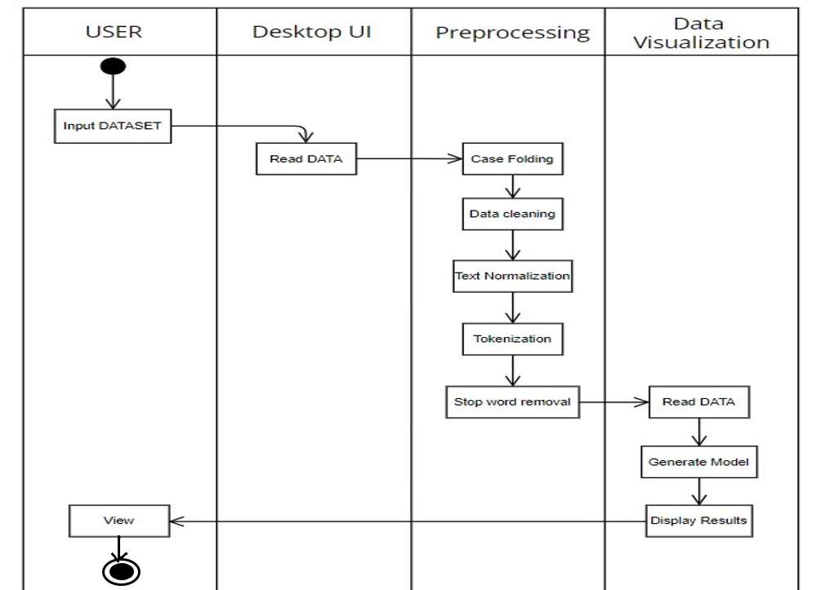
Activity Diagram
Figure 3:Activity diagram representing sequence actions performed in proposed system

Slide 18
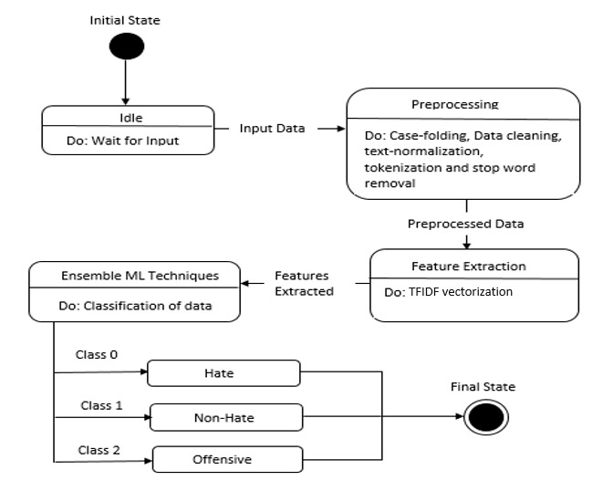
State Diagram
Figure 4: State Diagram representing states/conditions of the system

Slide 19
Software Requirements Specification
Functional Requirements
Accurate classification: The system should be able to classify tweets into hate, non hate, offensive accurately.
Accessibility: The User should be able to access the application to enter tweets for further classification
User friendly: The software should be user-friendly for users who are not well versed in computer science.

Slide 20
Non-Functional Requirements
Performance: The model should respond to the input in relatively less time.
Portability: The code can be run in any operating system that runs python and has required libraries installed
Usability: User interface should be minimalistic and easy to work with.
Reliability: The system should be trustworthy and reliable in providing the functionalities.

Slide 21
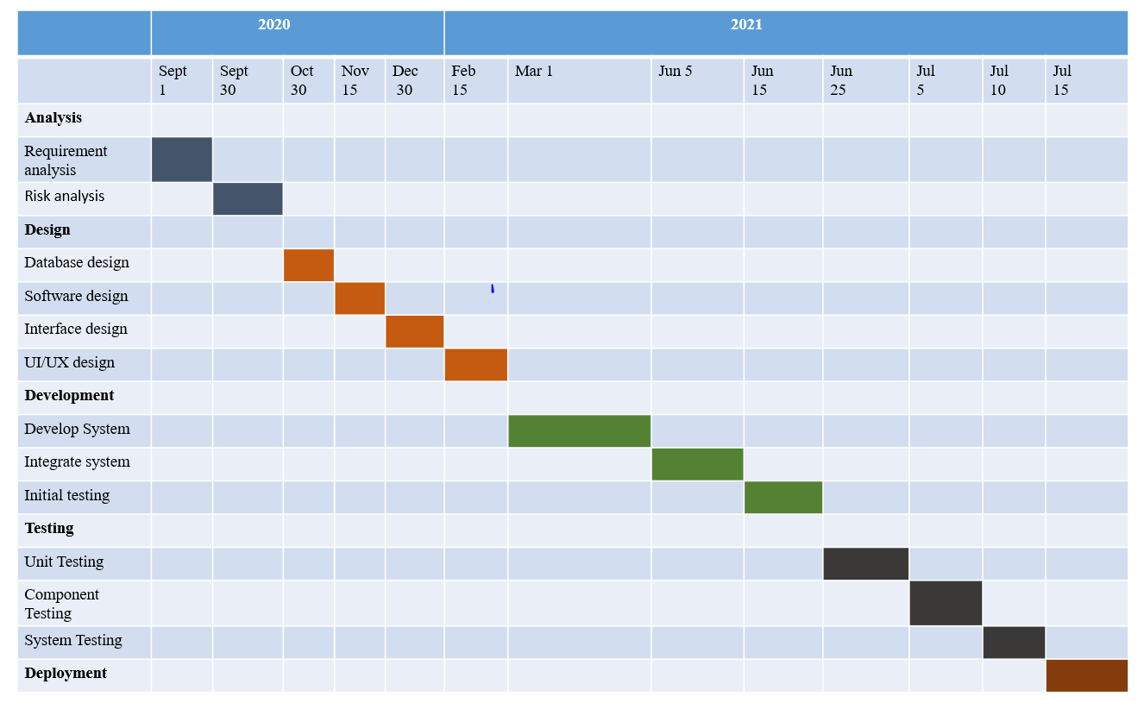
Project Planning/Scheduling
Figure 5:Gantt chart representing action plan for the entire one year of project duration

Slide 22
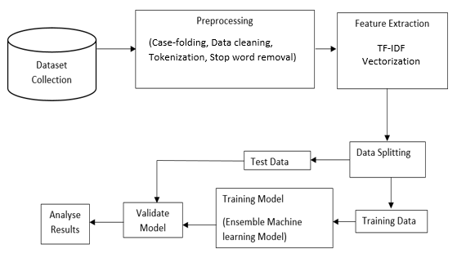
System Design
Figure 6: proposed system architecture

Slide 23
Module Decomposition.
Dataset Collection: The dataset collected is a publicly available data, it consists of both english and hinglish tweets.
Data Preprocessing: Preprocessing of data needs to be done after collecting datasets where removal of unwanted characters such as username, URL links, multiple spaces, emojis, numbers etc.

Slide 24
The Feature Extraction: is performed to extract features from data and convert the textual data into a matrix (or vector) of features where TF-IDF vectorization is used.
Data Splitting: Splitting the data into training dataset and testing dataset for training and validating the system is done.
Training model: An ensemble machine learning approach is used to build a model that can classify the data using classifiers such as Random forest classifier, Logistic Regression, Decision Tree Classifier etc.
Validating the model: The model will be validated using the testing data

Slide 25
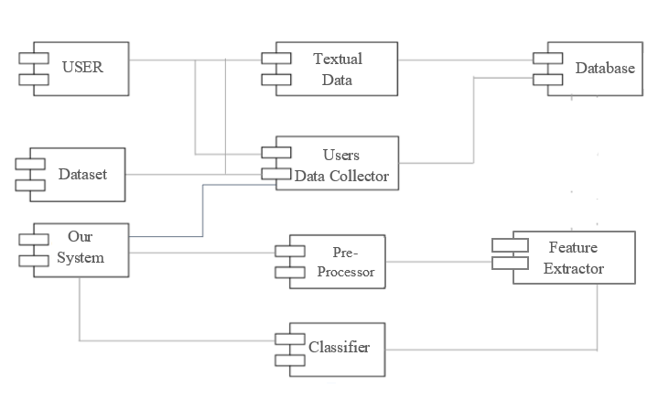
Component Design
Figure 6: Component design of the proposed system

Slide 26
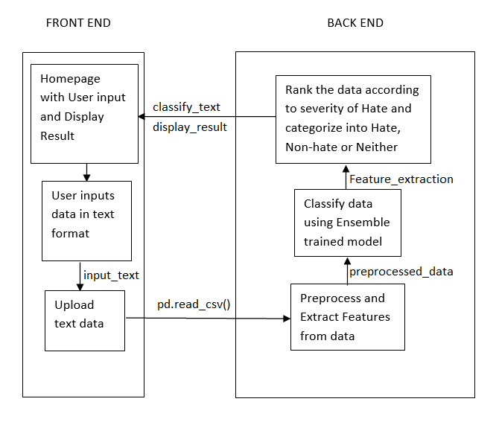
Interface Design
Figure 7: Interface Design for proposed system

Slide 27
Data Structure Design
Numpy ndarray: It is a multidimensional container of items of the same type and size. The number of dimensions and items in an array is defined by its shape, which is a tuple of non negative integers that specify the sizes of each dimension.
Pandas DataFrame: Its two-dimensional size-mutable, potentially heterogeneous tabular data structure with labeled axes (rows and columns). A Data frame is a two-dimensional data structure, i.e., data is aligned in a tabular fashion in rows and columns.
Dictionary: It is a collection which is unordered and changeable. It doesn't allow duplicates.

Slide 28
Algorithms
Cleanup Hindi-English Mixed Text (Data Preprocessing).
Input: Text in a dataset
Output: Clean text
Begin:
1. Read the text in the dataset;
2. While (! end of the text in a dataset):
If the text contains username_pattern= r'@[\w]+'
then remove username_pattern
If the text contains url_links= r'https?://[A-Za-z0-9./]+‘
then remove url_links

Slide 29
If the text contains special_char [,’! @#$%^&*]
then Remove special_char
If the text contains symbol [<>‹›«»=፦‘~_/]
then Replace symbol and add space;
If a text contains punctuation=[! . ?”]
then Remove punctuation
If text contain number = [0–9] then Remove number
If a text contains extra white space then Trim the text
3. Return a new data frame with clean_text

Slide 30
4. separating the Hinglish words from English words
5. Translate the hindi words to english by Going through each word and finding the closest match for it in the profanity list.
6. Save the results into csv file

Slide 31
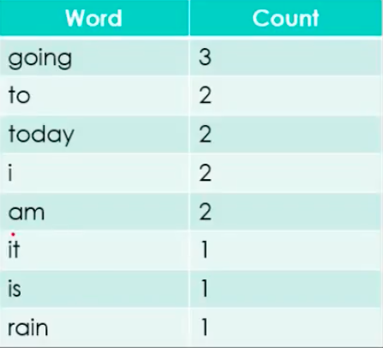
Algorithm Design Contd...
Vectorisation Algorithm - TF IDF model
Document 1: It is going to rain today.
Document 2: Today I am not going outside.
Document 3: I am going to watch the season premiere.
Step 1: Clean data and Tokenize

Slide 32
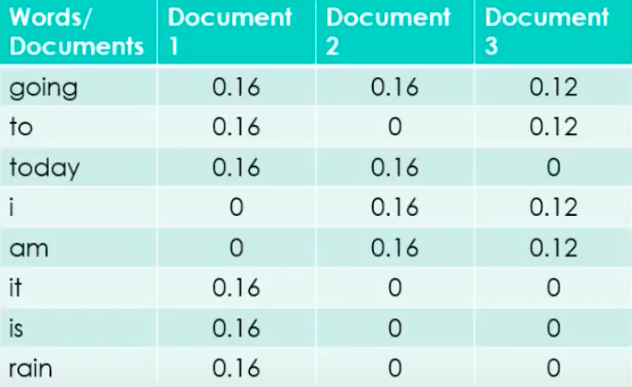
Step 2: Compute the term frequency. Frequency indicates the number of occurrences of a particular term t in document d.
tf(t,d) = count of t in d / number of words in d

Slide 33
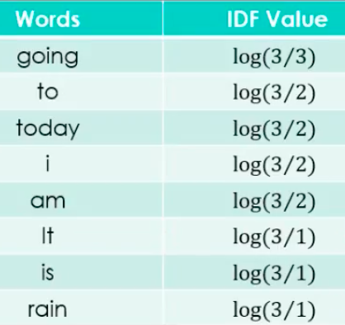
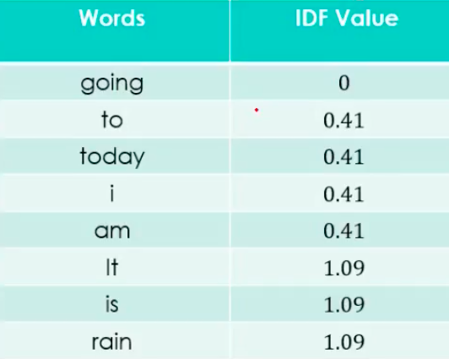
Step 3: Compute the Inverse Document Frequency – idf. It typically measures how important a term is.
idf(t) = log(Total Number Of Documents / Number Of Documents with term t in it)

Slide 34
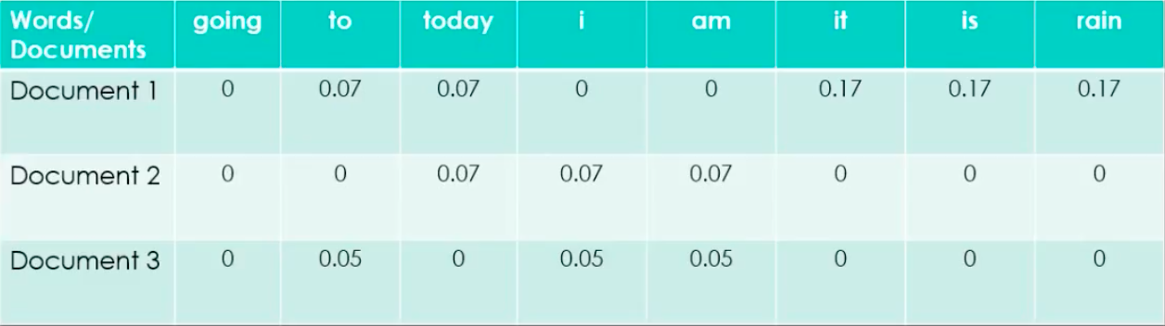
Step 3: tf-idf scoring. Now we can combine these to produce the ultimate score of a term t in document d.
tf-idf(t, d) = tf(t, d)* idf(t, d)

Slide 35
Algorithm (Contd..)
Training Model
Step 1: Load Dataset.
Step 2: Split dataset into training (80%) and testing (20%).
Step 3: Loading Random Forest, Decision Tree, and Logistic regression model.
Step 4: Train the developed model.
Step 5:Evaluating the developed model and displaying classification report.

Slide 36
Algorithm Design Contd... Ensemble based bagging classifier
Classifier generation:
Let N be the size of the training set.
for each of t iterations:
sample N instances with replacement from the original training set.
apply the learning algorithm to the sample.
store the resulting classifier.
Classification:
for each of the t classifiers:
predict class of instance using classifier.
return class that was predicted most often.

Slide 37
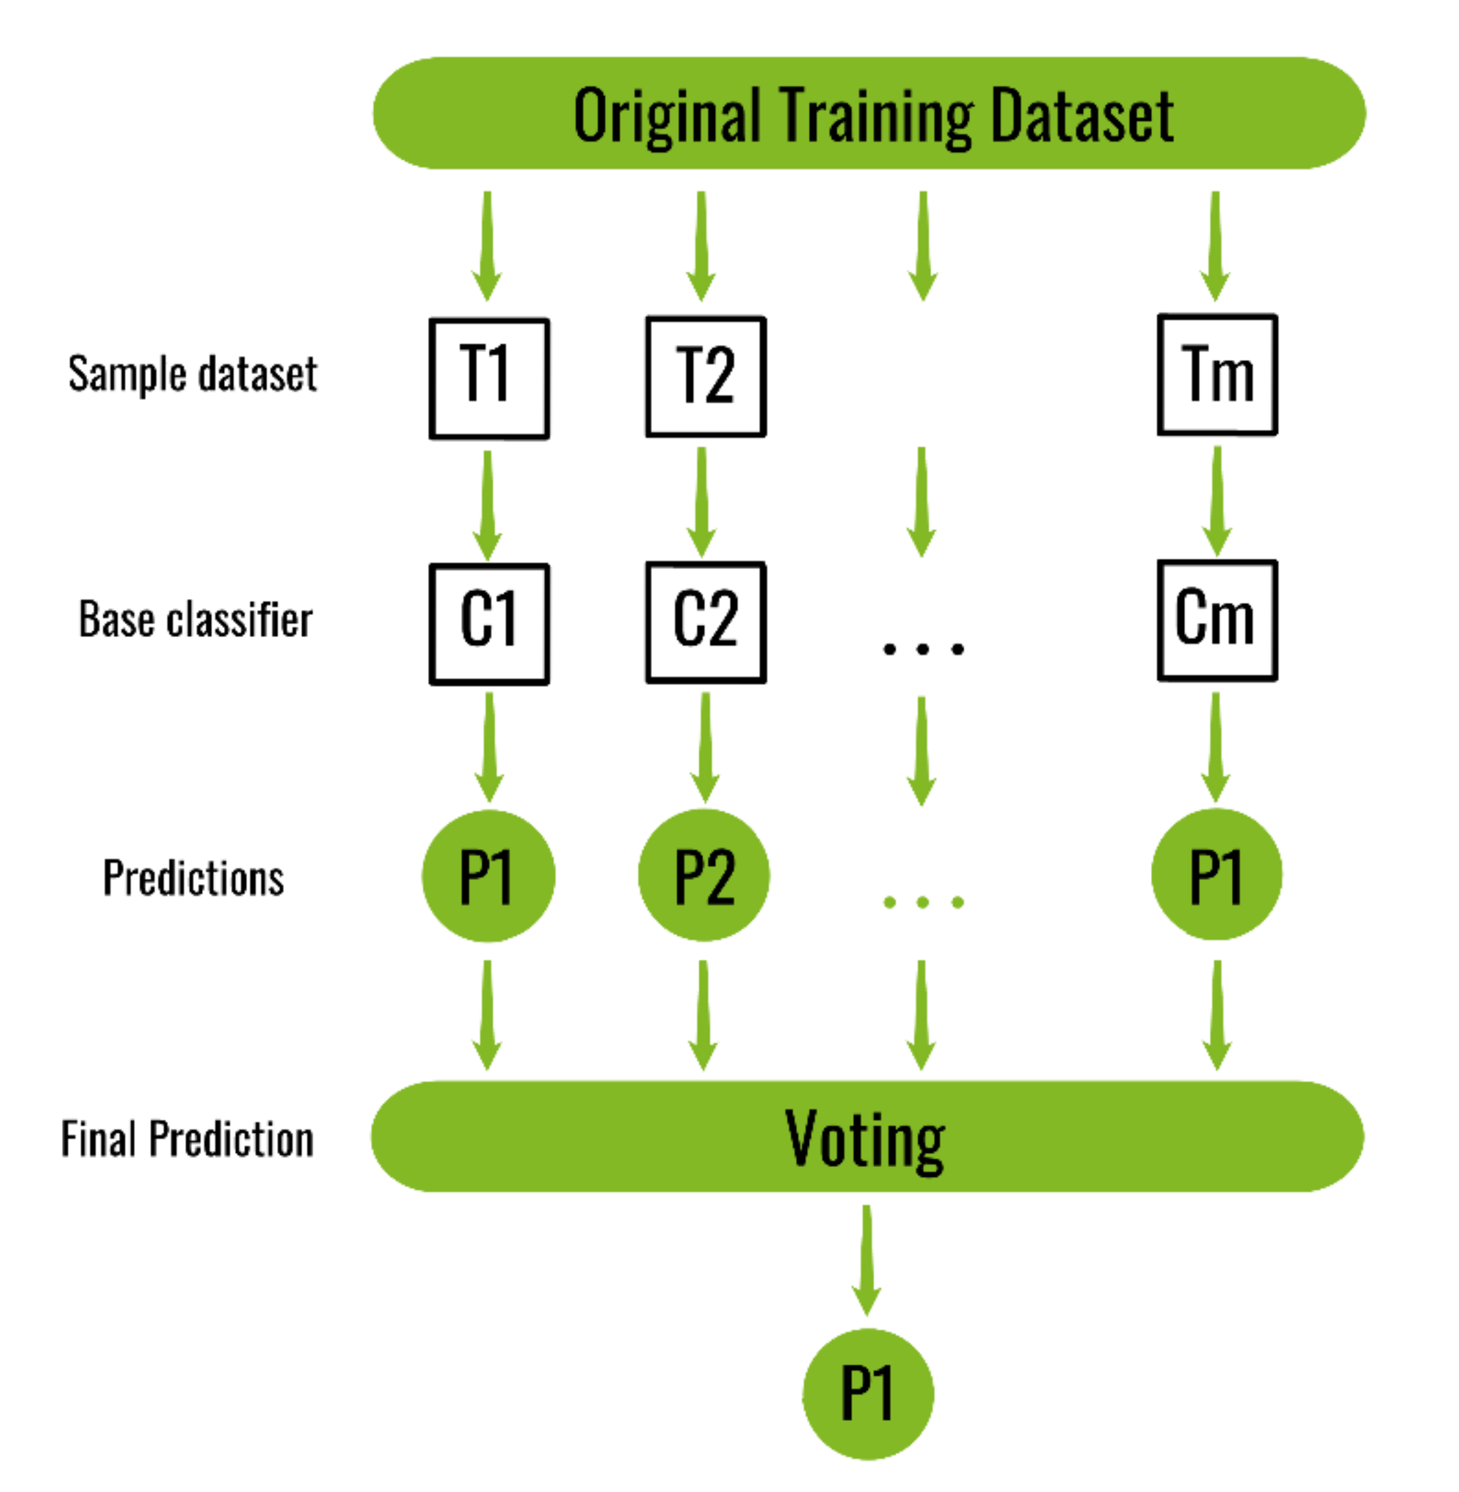
Algorithm Design Contd... Ensemble based bagging classifier

Slide 38
Implementation
Import numpy as np # linear algebra
import pandas as pd # data processing, CSV file I/O (e.g. pd.read_csv)
#Visualization library
import seaborn as sns
import re
import string
#import the dataset
data=pd.read_csv("hatespeech/labeled_data.csv")

Slide 39
#Doing some adjustments\n
c=data['class']
data.rename(columns={'tweet' : 'text',
'class' : 'category'},
inplace=True)
a=data['text']
b=data['category'].map({0: 'hate_speech', 1: 'offensive_language',2: 'neither'})
df= pd.concat([a,b,c], axis=1)
df.rename(columns={'class' : 'label'},
inplace=True)
# Grouping data by label
df.groupby('label').count()
sns.countplot('label',data=df)

Slide 40
#textcleaning
def review_cleaning(text):
#Make text lowercase, remove text in square brackets,remove links,remove punctuation and remove words containing numbers
text = str(text).lower()
text = re.sub('\\[.*?\\]', '', text)
text = re.sub('https?://\\S+|www\\.\\S+', '', text)
text = re.sub('<.*?>+', '', text)
text = re.sub('[%s]' % re.escape(string.punctuation), '', text)
text = re.sub('\\n', '', text)
text = re.sub('\\w*\\d\\w*', '', text)
return text
df['text']=df['text'].apply(lambda x:review_cleaning(x))
df.head()

Slide 41
stop_words= ['yourselves', 'between', 'whom', 'itself', 'is', \"she's\", 'up', 'herself', 'here', 'your', 'each', ‘'we', 'he', 'my', \"you've\", 'having', 'in', 'both', 'for', 'themselves', 'are', 'them', 'other','and', 'an', 'during', 'their', 'can', 'yourself', 'she', 'until', 'so', 'these', 'ours', 'above',’what', 'while', 'have', 're', 'more', 'only', \"needn't\", 'when', 'just', 'that', 'were', \"don't\", 'very', 'should', 'any', 'y', 'isn', 'who', 'a', 'they', 'to', 'too', \"should've\", 'has', 'before','into', 'yours', \"it's\", 'do', 'against', 'on', 'now', 'her', 've', 'd', 'by', 'am', 'from','about', 'further', \"that'll\", \"you'd\", 'you', 'as', 'how', 'been', 'the', 'or', 'doing', 'such', 'his', 'himself', 'ourselves', 'was', 'through', 'out', 'below', 'own', 'myself', 'theirs', 'me', 'why', 'once', 'him', 'than', 'be', 'most', \"you'll\", 'same', 'some', 'with', 'few', 'it','at', 'after', 'its', 'which', 'there','our', 'this', 'hers', 'being', 'did', 'of', 'had', 'under', 'over','again', 'where', 'those', 'then', \"you're\", 'i', 'because', 'does', 'all‘, ‘a’, ‘aadi’, ‘aaj’, ‘aap’, ‘aapne’, ‘aata’, aati’, ‘bilkul’, ‘bohot’..]
df['text'] = df['text'].apply(lambda x: ' '.join([word for word in x.split() if word not in (stop_words)]))
df.head()

Slide 42
#Separating input feature and label
X=df.text
y=df.label
# spliting the dataset for train and test
from sklearn.model_selection import train_test_split
X_train, X_test, y_train, y_test = train_test_split(X, y, test_size = 0.20, random_state = 100)
# Transforming Dataset using TF-IDF Vectorizer
from sklearn.feature_extraction.text import TfidfVectorizer
#Fit the TF-IDF Vectorizer
vectoriser = TfidfVectorizer(ngram_range=(1,2), max_features=25000)
vectoriser.fit(X_train)
print('No. of feature_words: ', len(vectoriser.get_feature_names())))

Slide 43
#Transform the data using TF-IDF Vectorizer
X_train = vectoriser.transform(X_train)
X_test = vectoriser.transform(X_test)
from sklearn.ensemble import RandomForestClassifier
from sklearn.linear_model import LogisticRegression
from sklearn.neighbors import KNeighborsClassifier
from sklearn.tree import DecisionTreeClassifier
#model selection
from sklearn.metrics import confusion_matrix, accuracy_score
Decision tree
#DecisionTreeClassifier(criterion='entropy', random_state=0)
classifier_dt = DecisionTreeClassifier(criterion = 'entropy', random_state = 0)
classifier_dt.fit(X_train, y_train)

Slide 44
#Decision Tree Validation
y_pred_dt = classifier_dt.predict(X_test)
cm = confusion_matrix(y_test, y_pred_dt)
print(cm)
dt_score = accuracy_score(y_test, y_pred_dt)
print('Decision Tree Accuracy: ', str(dt_score))
#logistic regression
classifier_lr = LogisticRegression(random_state = 0)
classifier_lr.fit(X_train, y_train)
#Logistic Regression Validation
y_pred_lr = classifier_lr.predict(X_test)
cm = confusion_matrix(y_test, y_pred_lr)
print(cm)
classifier_rf.fit(X_train, y_train)

Slide 45
#random forest
classifier_rf = RandomForestClassifier(n_estimators = 10, criterion = 'entropy', random_state = 0)
#Random Florest
y_pred_rf = classifier_rf.predict(X_test)
cm = confusion_matrix(y_test, y_pred_rf)
print(cm)
rf_score = accuracy_score(y_test, y_pred_rf),
print('Random Forest Accuracy: ', str(rf_score))

Slide 46
Testing
Unit Testing:
Component: Preprocessing
Test case 1:
Pd.read_csv()
Test # | Test Data(input) | Expected Result | Actual Result | Pass/ Fail
1 | (Hinglish).csv | Uploaded success | Uploaded success | Pass
2 | (English).csv | Uploaded success | Uploaded success | Pass

Slide 47
Testing
Unit Testing:
Component: Pre-processor
Test case 3:
Test # | Test Data(input) | Expected Result | Actual Result | Pass/ Fail
1 | Case folding | Converted sentences to lower case | Converted sentences to lower case | Pass
2 | Data cleaning | Texts without unwanted characters | texts without unwanted characters | Pass
3 | Tokenization | Sentences split into tokens | Sentences split into tokens | Pass
4 | Stop word Removal | Texts without the identified stop words | Texts without the identified stop words | Pass

Slide 48
Testing
Unit Testing
Component: Feature Extractor; TF-IDF Vectorizer
Test # | Test Data(input) | Expected Result | Actual Result | Pass/ Fail
1 | Sentences of data | extracted n-gram features from the textual content | Extracted n-gram features from the textual content | Pass

Slide 49
Testing
Unit Testing
Component:
Test # | Test Data(input) | Expected Result | Actual Result | Pass/ Fail
1 | Sentences of data | extracted n-gram features from the textual content | Extracted n-gram features from the textual content | Pass

Slide 50
Testing
Unit Testing:
Component: Classification model
Test case 3: Testing Single Classifier
Test # | Test (Single Classifiers) | Pass Rate
1 | XGBoost | 87%
2 | Random Forest | 88%
3 | Naïve Bayes | 86%
4 | Logistic Regression | 86%
5 | Decision Tree | 84%
6 | Support Vector Classifier | 88%

Slide 51
Testing
Unit Testing:
Component: Classification model
Test case 3: Ensemble model
Test # | Test(Ensemble model) | Pass Rate
1 | Random Forest, SVC, Logistic Regression | 89%
2 | Random Forest, SVC, Naïve Bayes | 88%
3 | SVC, Naïve Bayes and XGBoost | 85%
4 | Random Forest, SVC | 90.7%

Slide 52
Testing
Integrated Testing:
Component: Web application
Test case 3:
Test # | Test Data(input) | Expected Result | Actual Result | Pass Rate
1 | Sentences containing hate data in English and hindi-English code mix format | Classify and display result: Hate | Classify and display result: Hate | 90.7%

Slide 53
2 | Sentences containing Offensive data in English and hindi-English code mix format | Classify and display result: Offensive | Classify and display result: Offensive | 90.7%
3 | Sentences containing neither hate nor offensive data in English and hindi-English code mix format | Classify and display result: Neither | Classify and display result: Neither

Slide 54
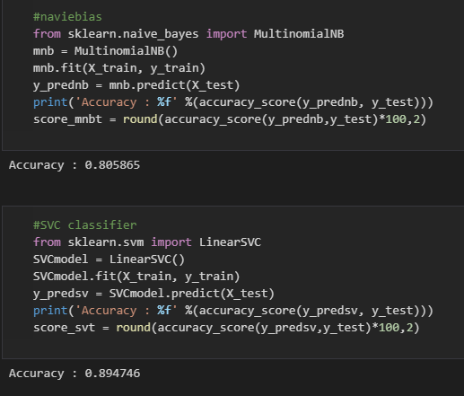
Results
Figure 8: accuracy result of naïve bias and SVC as single classifiers

Slide 55
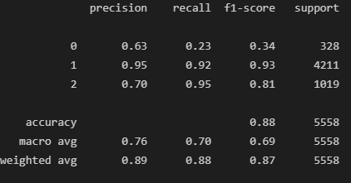
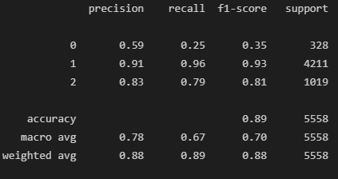
Figure 9: accuracy of random forest classifier
Figure 10 : accuracy of xg boost classifier

Slide 56
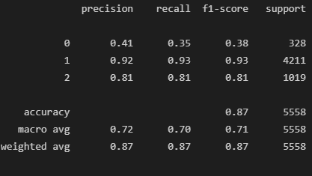
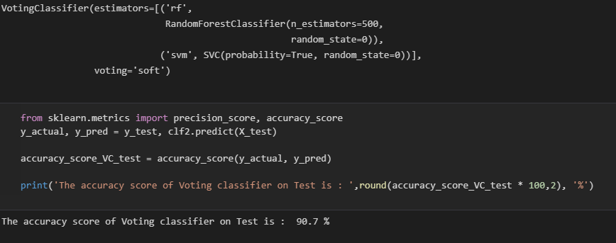
Figure 11: accuracy of decision tree classifier
Figure 12 : accuracy of ensemble randomforest and SVC

Slide 57
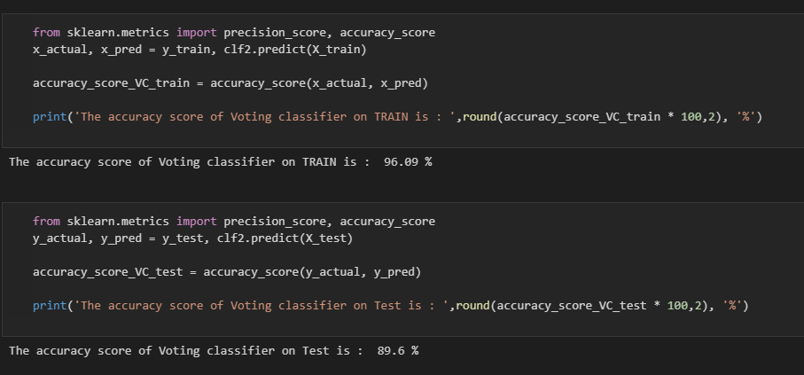
Figure 13: accuracy of ensemble random forest ,SVC and logistic regression

Slide 58
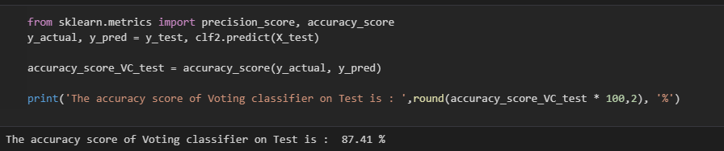
Figure 14: accuracy of ensemble randomforest , SVC and naïve bias

Slide 59

Figure 15: home page where user can enter a statement

Slide 60

Figure 16: result for English hate statement

Slide 61
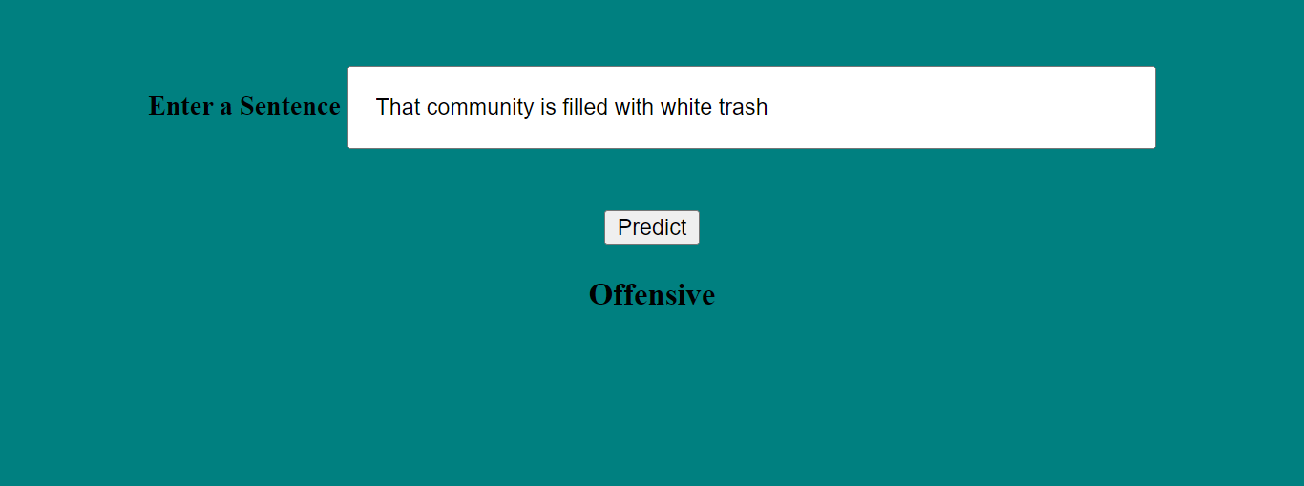
Figure 17 : result of English offensive statement

Slide 62
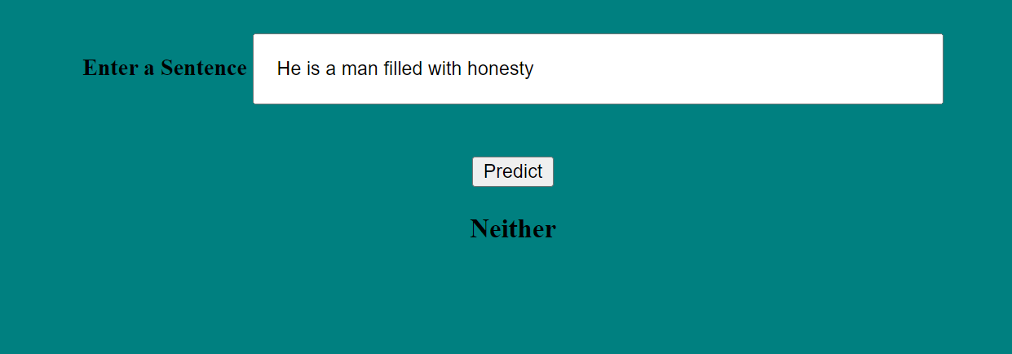
Figure 18: result for neither hate nor offensive statement

Slide 63
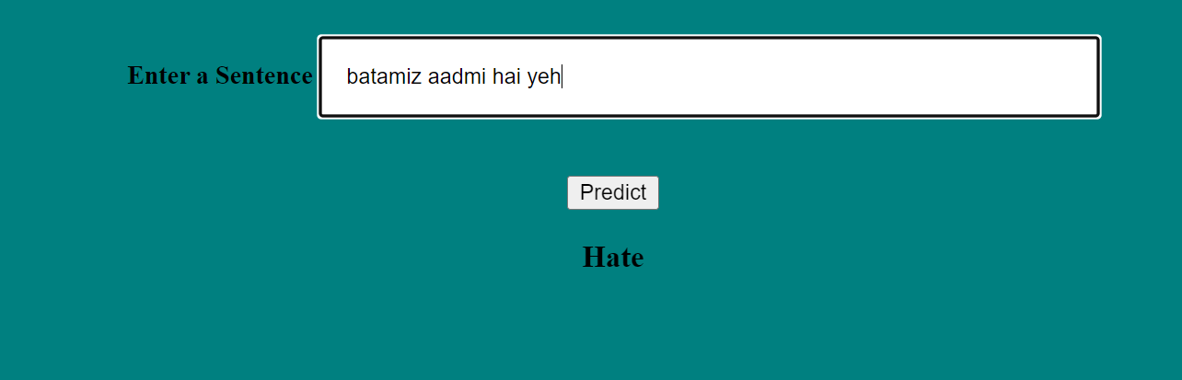
Figure 19: result for Hinglish hate statement

Slide 64
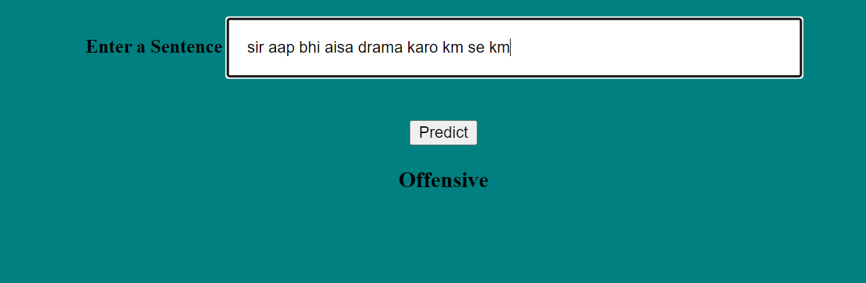
Figure 20: result for Hinglish offensive statement

Slide 65

Figure 21 : result for neither hate nor offensive Hinglish statement

Slide 66
Applications
To classify textual content into non-hate or hate speech, in which case the method may also identify the targeting characteristics (i.e., types of hate, such as race, and religion) in the hate speech in social media.
The hate speech detection system proposed here will help reduce illegal activities and communications on social media websites.

Slide 67
Conclusion
The proposed system will efficiently classify code-mix hate textual content given by the user into three classes i.e. hate, non-hate or offensive using techniques of NLP and ensemble learning.

Slide 68
References
[1] Das, Kumar & Garai, Buddhadeb & Das, Srijan & Patra, Braja. (2021). Profiling Hate Speech Spreaders on Twitter-Notebook for PAN at CLEF 2021.
[2] M. K. A. Aljero and N. Dimililer, "Genetic Programming Approach to Detect Hate Speech in Social Media," in IEEE Access, vol. 9, pp. 115115-115125, 2021, doi: 10.1109/ACCESS.2021.3104535.
[3] K. Sreelakshmi, B. Premjith, K.P. Soman, “Detection of Hate Speech Text in Hindi-English code mixed Data”, Procedia Computer Science, Vol. No. 171, Page No. 737-744, 2020.

Slide 69
[4] Al-Makhadmeh, Zafer, and Amr Tolba. "Automatic hate speech detection using killer natural language processing optimizing ensemble deep learning approach." Computing 102, no. 2 (2020): 501-522.
[5] Ibrohim, Muhammad Okky, and Indra Budi. "Multi-label hate speech and abusive language detection in Indonesian twitter." In Proceedings of the Third Workshop on Abusive Language Online, pp. 46-57. 2019.
[6] Aditya Gayadhani, Vikrant Doma, Shrikant Kndre, Laxmi Bhagwat, “Detecting Hate Speech and Offensive Language on Twitter using Machine Learning: An N-gram and TFIDF based Approach”, IEEE International Advance Computing Conference(2018), 2018.

Slide 70
[7] Fauzi, M. Ali, and Anny Yuniarti. "Ensemble method for indonesian twitter hate speech detection." Indonesian Journal of Electrical Engineering and Computer Science 11.1 (2018): 294-299.
[8] N. A. Setyadi, M. Nasrun and C. Setianingsih, "Text Analysis For Hate Speech Detection Using Backpropagation Neural Network," 2018 International Conference on Control, Electronics, Renewable Energy and Communications (ICCEREC), 2018, pp. 159-165, doi: 10.1109/ICCEREC.2018.8712109.
[9] Kiilu, Kelvin & Okeyo, George & Rimiru, Richard & Ogada, Kennedy. (2018). “Using Naïve Bayes Algorithm in detection of Hate Tweets. International Journal of Scientific and Research Publications” (IJSRP). 8. 10.29322/IJSRP.8.3.2018.p7517.

Slide 71
[10] H. Watanabe, M. Bouazizi and T. Ohtsuki, "Hate Speech on Twitter: A Pragmatic Approach to Collect Hateful and Offensive Expressions and Perform Hate Speech Detection," in IEEE Access, vol. 6, pp. 13825-13835, 2018, doi: 10.1109/ACCESS.2018.2806394.
[11] Sharma Sanjana and Agarwal, Saksham and Srivatsava, Manish, “Degree based Classification of Harmful Speech using Twitter data”, Proceedings of the first Workshop on Trolling, Aggression and Cyberbullying ({TRAC}-2018) , Page No. 106-112.

Slide 72
THANK YOU

