Slide 1
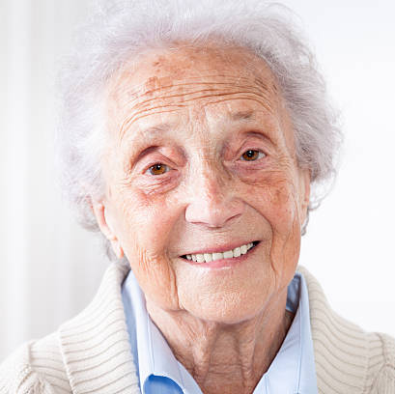









Celia Márquez
My children live far away and I don't want to bother them every time I need to book an appointment. If someone from the club goes with me, I'll do it myself, but I'm not giving my passwords to just anyone.
CM
About Celia Celia lives alone and her family lives in another city, so there isn't always someone available to help her with errands that now require connecting to an online platform, such as booking an appointment at the clinic. She belongs to a senior citizens' club.
Requester · Older adult
Frustrations
Goals
She depends on a relative or acquaintance being available to do her errands online.
She is afraid of making a mistake or having her data stolen if she gives her passwords to a stranger.
She can never be sure the errand was actually completed.
Receive help from a trusted person from the club.
Book medical appointments easily.
Keep control of her passwords.
Socialize.
AGE
74
LOCATION
Temuco, Chile
OCCUPATION
Retired
DEVICE
Mobile phone, basic use
DIGITAL LEVEL
Low
Interests
Knitting
Nature
Romance novels
Classical music
Plants
Notes:
Celia Márquez — Requester · Older adult.

Slide 2
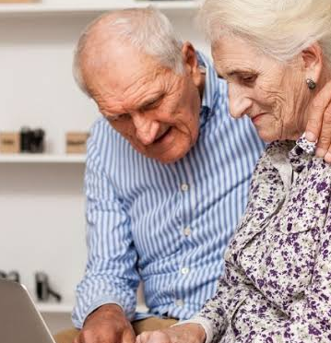


Roberto Pérez
I learned to use the government portal on my own. If you give me a simple app without so many hoops, I'm happy to go with the other club members to get their things done.
RP
About Roberto Roberto is a 67-year-old retiree with an intermediate level of digital literacy: he is comfortable with government portals and basic online banking. He volunteers at his senior citizens' club, where he helps other members with their online errands.
Volunteer · Club peer facilitator
Frustrations
Goals
He is bothered by tools with overly technical processes.
He gets frustrated when he has to fill in long forms.
He is uncomfortable not having an organized way to know whom to help and when.
Feel useful in his community by helping his peers.
Learn to use the platform quickly, with little training.
AGE
67
LOCATION
Temuco, Chile
OCCUPATION
Retired
DEVICE
Mobile phone and computer
DIGITAL LEVEL
Intermediate
Interests
Patiently teaching friends
Learning new phone tricks
Reading the news
Notes:
Roberto Pérez — Volunteer · Club peer facilitator.

Slide 3
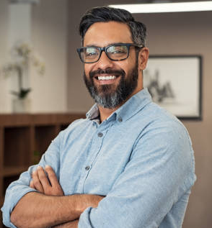


Andrés Rivera
I can't rely on volunteers' good memory. I need to see on a screen how many seniors are waiting for help today and who is taking care of them.
AR
About Andrés Andrés is a social programs coordinator at the municipality. He manages limited resources and must show that initiatives for older adults are working properly.
Municipal coordinator
Frustrations
Goals
Lack of concrete data to demonstrate results.
He gets stressed when he learns that informal coordination with older adults has failed.
He cannot reliably verify who each volunteer is.
Oversee the older adults' support network from a single place.
Verify the identity of volunteers.
Obtain statistics on the help provided.
AGE
40
LOCATION
Temuco, Chile
OCCUPATION
Social programs coordinator
DEVICE
Office computer
DIGITAL LEVEL
Medium-high
Interests
Social events
Local public policy
Management reports and indicators
Notes:
Andrés Rivera — Municipal coordinator.

Slide 4
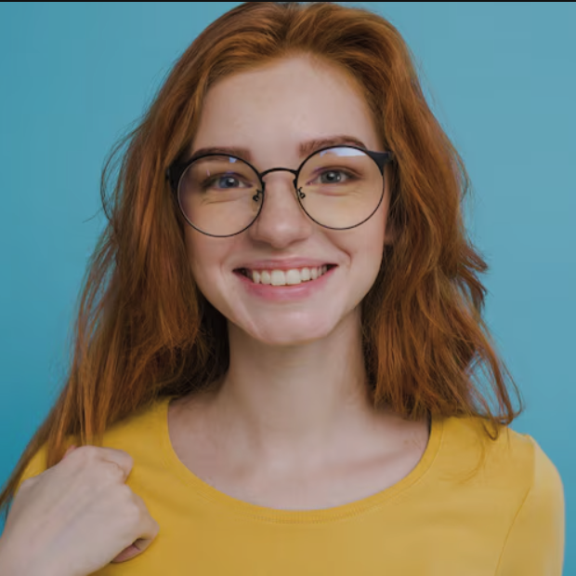


Sofía Morales
I have the whole Friday afternoon free to help, but in the WhatsApp group I get lost among so many messages and I don't know who needs which errand or what time to go.
SM
About Sofía Sofía is a 24-year-old who takes part in the municipality's digital literacy outreach. She is a digital native and quick with technology, but finds it hard to coordinate with older adults.
Volunteer · Student
Frustrations
Goals
She wastes time coordinating and helping through WhatsApp chats.
She gets lost among so many messages and doesn't know who needs what.
She sometimes feels her time isn't respected.
Organize her time reliably and efficiently.
Keep an organized record of the people she helps.
Build trust right away with the older adults she assists.
AGE
24
LOCATION
Temuco, Chile
OCCUPATION
Student
DEVICE
Smartphone
DIGITAL LEVEL
High (digital native)
Interests
TV series
Digital inclusion
Taking part in social support activities
Social media
Notes:
Sofía Morales — Volunteer · Student.

