Slide 1
Demo Project
Using Go create simple REST API

Slide 2
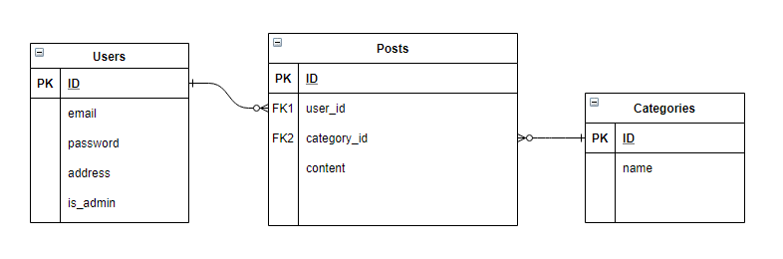
Entity Relationship Diagram

Slide 3
TABLE OF CONTENTS
01
02
03
04
Route config
Connect database
Login with token
CRUD simple

Slide 4
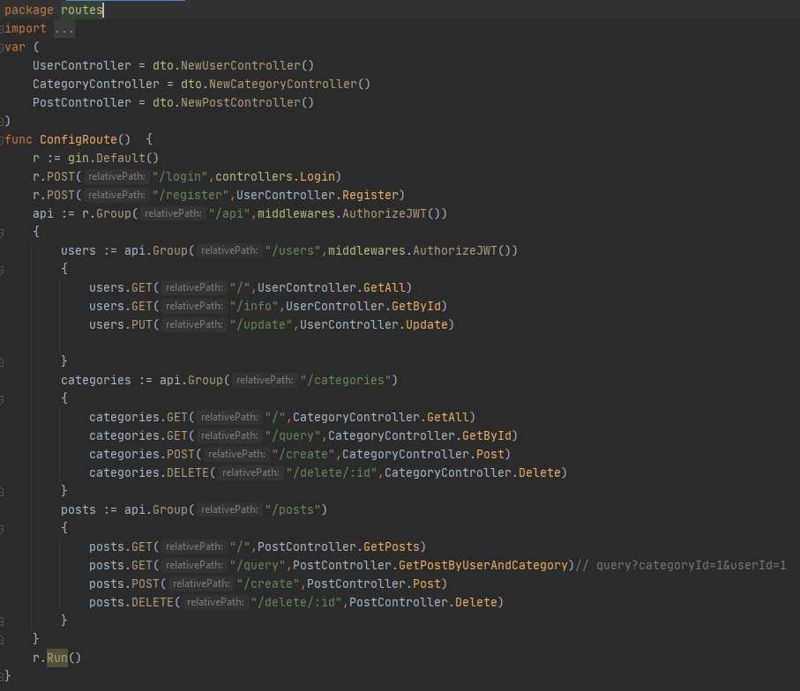
Route config

Slide 5
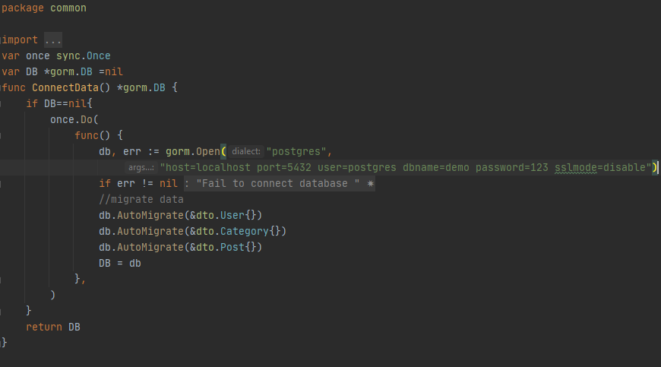
Connect to Database

Slide 6
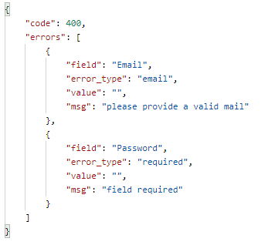
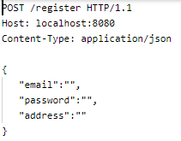
Fail Validate Register

Slide 7
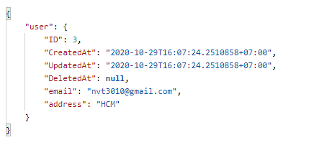
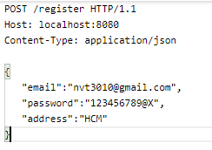
Success Register

Slide 8
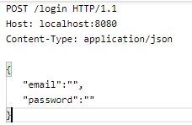
Fail Validate Login

Slide 9
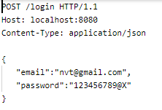

Incorrect Account

Slide 10
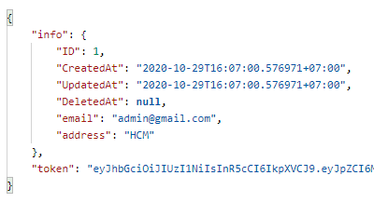
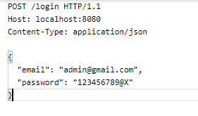
Success Login

Slide 11
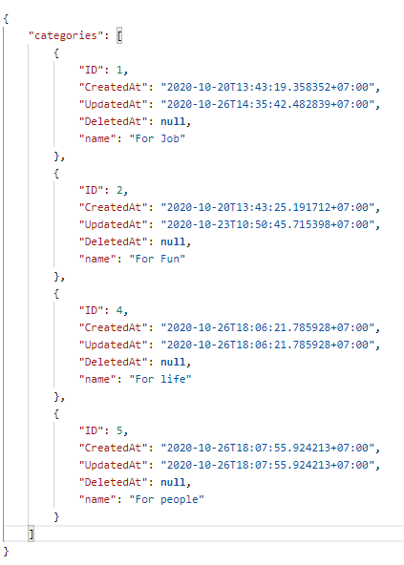
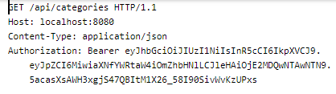
GET:
All user can get

Slide 12
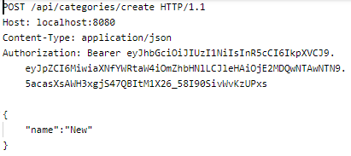
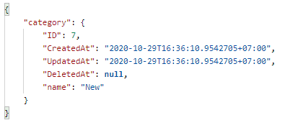
POST:
All user can post

Slide 13
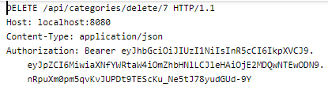



DELETE:
Only Admin account can delete
User account token
Admin account token

