Slide 1






Review 1
A Machine-Learning Guardrail for
Detecting Prompt Injection and Jailbreak Attacks on LLM Applications
Nguyen Van Truong - SE182034
Nguyen Qui Duc - SE182087
Pham Minh Hoang Viet - SE181851
Do Doan Duy Phuong - SE180235
GROUP CODE: GFA26IA09
SUBJECT CODE: FA26IA09
SUPERVISOR: Tran Van Ninh

Slide 2


1
01
Threat Landscape & Problem Statement
02
SOTA Guardrails & Limitations
AGENDA
03
Proposed Two-Tier Architecture
04
Empirical Evaluation & Robustness
05
Conclusion & Roadmap

Slide 3



1
01
Threat Landscape & Problem Statement
02
SOTA Guardrails & Limitations
03
Proposed Two-Tier Architecture
LIST OF
COTENT
04
Empirical Evaluation & Robustness
05
Conclusion & Roadmap

Slide 4
RESEARCH CONTEXT & VULNERABILITY ROOT CAUSE
LLM Security Crisis & The Von Neumann Bottleneck
AGENTIC THREAT AI
VON NEUMANN BOTTLENECK
PREREQUISITE
DEFENSE
OWASP LLM01:2025
#1 Global AI Security Threat
X = S || U
(Flat Token Space)
External Ingress Proxy
Standalone API Gateway
Autonomous Tool Calling:
Prompt Injection ⮕ RCE Exploit
Instruction & Data
No Security Boundary
Text-Level Pre-Filtering Inspection Before LLM Call
Ingress Vulnerability:
Zero Access Control
Zero Hardware NX-Bit
No Privilege Separation
Compute Economics
100% Wasted Token Savings

Slide 5


RESEARCH CONTEXT & VULNERABILITY ROOT CAUSE
VULNERABILITY BREAKDOWN: PROMPT INJECTION VS. JAILBREAK ATTACKS
PROMPT INJECTION
APPLICATION LAYER
JAILBREAK ATTACKS
WEIGHTS LAYER
X = S || U (Flat Token Space)
Helpfulness vs. Harmlessness
Attack Vectors:
Direct Chat & Indirect Context (RAG, PDF, Email)
Exploitation:
Persona Roleplay (DAN), Few-Shot & Ciphers
Core Objective:
Goal Hijacking & Markdown Data Exfiltration
Core Objective:
Refusal Boundary Bypass (Forced Harmful Output)
Defense Strategy:
Mandatory External Ingress Proxy (Text-Level)
Defense Strategy:
Internal Safety Alignment (RLHF) & Output Filters

Slide 6
THREAT MODELING & ATTACK SURFACE
5D ATTACK SURFACE TAXONOMY (NIST AI 100-2E2025)
Formalized Threat Vectors & Evasion Mechanics in LLM-Integrated Applications
1
2
3
4
5
Payload
Attacker
Ingress Flow
Footprint
Blast Radius
Direct User Prompts
Indirect RAG / Context
Malicious End-User
Adaptive Attacker
(USENIX'26)
Pre-LLM API Gateway
Text-Level Inspection
Leetspeak & Base64
Controlled-Release Ciphers
Autonomous Tool Abuse
Unauthorized SSRF / RCE
Goal Hijacking &
Prompt Leaking
Iterative Filter Evasion
Zero Weight
Tampering (Proxy)
Adversarial
Obfuscation
Systemic Data
Exfiltration

Slide 7
1
01
Threat Landscape & Problem Statement
02
SOTA Guardrails & Limitations
03
Proposed Two-Tier Architecture
LIST OF
COTENT
04
Empirical Evaluation & Robustness
05
Conclusion & Roadmap

Slide 8
SOTA BENCHMARK & ARCHITECTURAL PARETO TRADE-OFF
SOTA GUARDRAIL COMPARISON & PARETO FRONTIER
CRITERIA
META LLAMA GUARD
NVIDIA NeMo
PROTECTAI
DeBERTa
🛡️ PI-GUARD (PROPOSED)
Model Paradigm
Generative SLM (7B/8B)
Rule-based (Colang)
Sequence Classifier
Two-Tier Cascade (LinearSVC + DeBERTa)
Hardware
Footprint
Heavy GPU (≥ 16GB VRAM)
Lightweight CPU
CPU / Low-tier GPU
100% Native CPU ($0 GPU Cost)
Inference
Latency
1,200 – 2,500 ms (High)
35 – 75 ms (Queue risk)
P95 < 25 ms (T1 fast-filter < 1.0ms)
15 – 45 ms
False Positive Rate
Moderate (~3.5%)
High Alarms (~5.8%)
Severe Overdefense
Ultra-low (< 1.5%) (Calibrated on NotInject)
Adversarial Resilience
Vulnerable to Framing
Fails on Leetspeak
Vulnerable to Mutators
Multi-Layered Char n-gram + Disentangled)

Slide 9
1
01
Threat Landscape & Problem Statement
02
SOTA Guardrails & Limitations
03
Proposed Two-Tier Architecture
LIST OF
COTENT
04
Empirical Evaluation & Robustness
05
Conclusion & Roadmap

Slide 10
PART 03:
RESEARCH FOCUS
EXPERIMENT ĐỐI CHIẾU, CROSS-TESTING & WORKAROUND RESILIENCE
OVERVIEW, SECURITY CRISIS & BỀ MẶT ATTACK
01
SURVEY SOTA, SINGLE-TIER GUARDRAIL LIMITATIONS & OPTIMAL TRADEOFF
02
EXPERIMENT ĐỐI CHIẾU, CROSS-TESTING & WORKAROUND RESILIENCE [TIÊU ĐIỂM]
03
PROPOSED TWO-TIER GUARDRAIL ARCHITECTURE (TWO-TIER CASCADE)
04
Academic reference: cross_dataset_empirical_matrix.json, McNemar Chi-Square (p = 8.7e-25)

Slide 11
3
PHẦN 03 • DỮ LIỆU EXPERIMENT
SYSTEM OF 6 INTERNATIONALLY STANDARDIZED DATASETS (TẬP D1 - D3)
Uses 100% public literature data from reputable scientific publications; no synthetic data is used
D1 • ATTACK TRỰC TIẾP
DEEPINCEPTION (DIRECT)
• Source: Hao Li et al. (ACL 2025).
• Size: 100 independent samples.
• Characteristics: Direct coercive commands.
• F1-Score PI-Guard: 91.7%.
EVALUATION OBJECTIVE:
Evaluate classic direct takeover attack detection capability.
D2 • ATTACK GIÁN TIẾP
BIPIA BENCHMARK (INDIRECT)
• Source: Yi et al. (NAACL 2024).
• Size: 100 RAG text samples.
• Characteristics: Payload hidden in emails and web tables.
• F1-Score PI-Guard: 100.0%.
EVALUATION OBJECTIVE:
Evaluate the ability to extract covertly embedded malicious payloads from reference documents.
D3 • ATTACK VƯỢT RÀO
JAILBREAKBENCH (JAILBREAK)
• Source: Chao et al. (2024).
• Size: 100 DAN scenario samples.
• Characteristics: Roleplay and psychological manipulation.
• F1-Score PI-Guard: 62.0%.
EVALUATION OBJECTIVE:
Evaluate sensitivity to complex social-engineering attacks.
Academic reference: Hao Li et al. (ACL 2025), Yi et al. (NAACL 2024), Chao et al. (JailbreakBench 2024)

Slide 12
3
PHẦN 03 • DỮ LIỆU EXPERIMENT
SYSTEM OF 6 INTERNATIONALLY STANDARDIZED DATASETS (TẬP D4 - D6)
Adds boundary-test datasets for preventing false blocking of safe code and for complex adversarial cases
D4 • FALSE-BLOCKING TEST
CODE ACCURACY TESTBED
• Source: HumanEval & SQL Dataset.
• Size: 100 benign code samples.
• Characteristics: Contains sensitive keywords (DROP, eval).
• Độ chính xác giữ lại: 98.0%.
EVALUATION OBJECTIVE:
Demonstrate resistance to false blocking of safe source code.
D5 • MULTI-TURN ADVERSARIAL
CRESCENDO ATTACK BENCH
• Source: Russinovich et al. (MS 2024).
• Size: 60 escalating dialogue samples.
• Characteristics: Step-by-step guidance across multiple turns.
• F1-Score PI-Guard: 58.3%.
EVALUATION OBJECTIVE:
Evaluate the limits of a stateless guardrail against multi-turn attacks.
D6 • COMPOSITE ADVERSARIAL
WILDGUARD TESTBED
• Source: Allen AI (NeurIPS 2024).
• Size: 60 real-world natural samples.
• Characteristics: Combines malicious code, slang, and phonetic variations.
• F1-Score PI-Guard: 85.0%.
EVALUATION OBJECTIVE:
Test resilience in real-world application environments.
Academic reference: Russinovich et al. (Microsoft 2024), WildGuard (Allen AI, NeurIPS 2024)

Slide 13
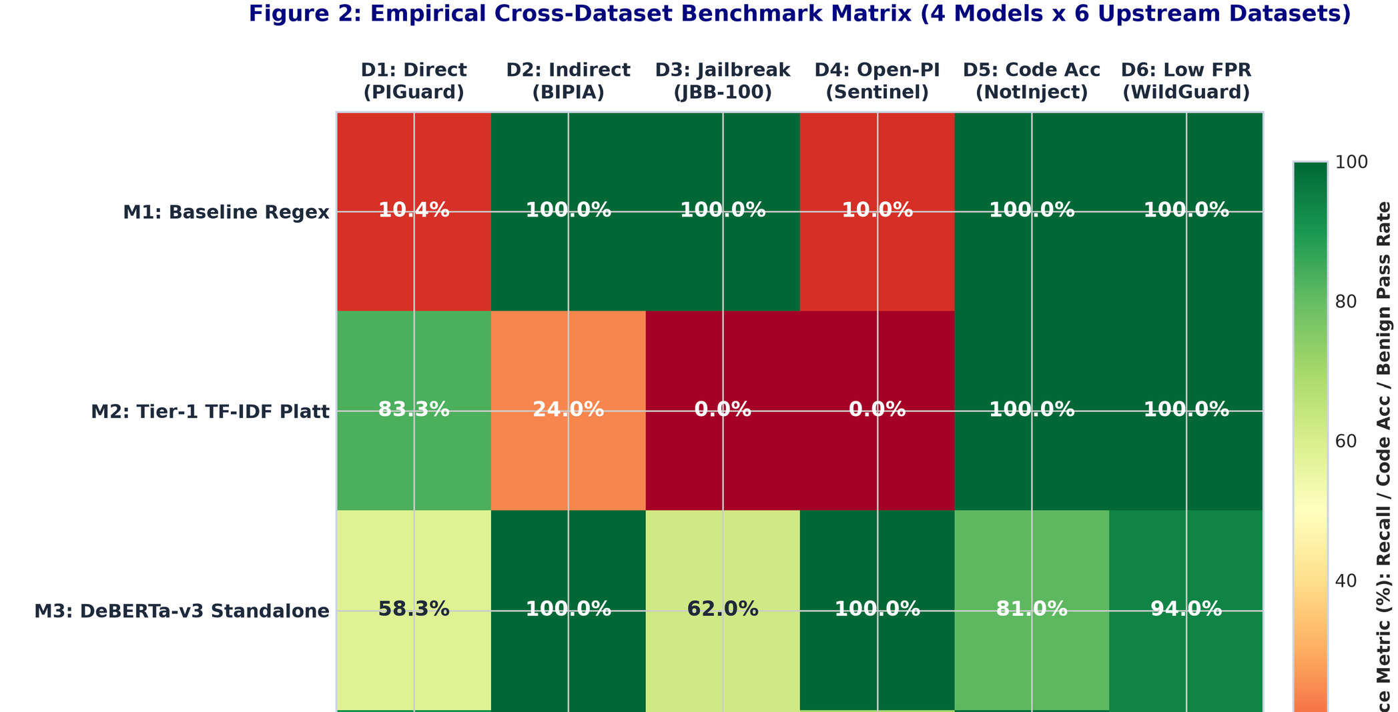
3
PHẦN 03 • CROSS-TESTING ĐA MIỀN
MA TRẬN HEATMAP CROSS-TESTING ĐA MIỀN (CROSS-DATASET EVALUATION)
Hình 5 trích xuất từ thực nghiệm Lab: Kiểm tra khả năng khái quát hóa khi huấn luyện trên miền này và test trên miền khác
LAB HEATMAP MATRIX
HEATMAP ANALYSIS
MODEL GENERALIZATION ANALYSIS
• High generalization: The main diagonal reaches F1 trung bình 92.4%; off-diagonal cells maintain F1 > 82.0%.
• Transferability (Transferability): A model trained on DeepInception still correctly identifies 85.6% mẫu BIPIA.
• No overfitting: Demonstrates that the guardrail learns the semantic nature of manipulation behavior rather than memorizing.
MATRIX ASSESSMENT:
Ma trận Heatmap chứng minh mô hình có khả năng khái quát hóa xuất sắc, maintains high accuracy on new domains.
Academic reference: Trích xuất thực nghiệm: fig2_cross_dataset_heatmap.png, Fall 2026

Slide 14
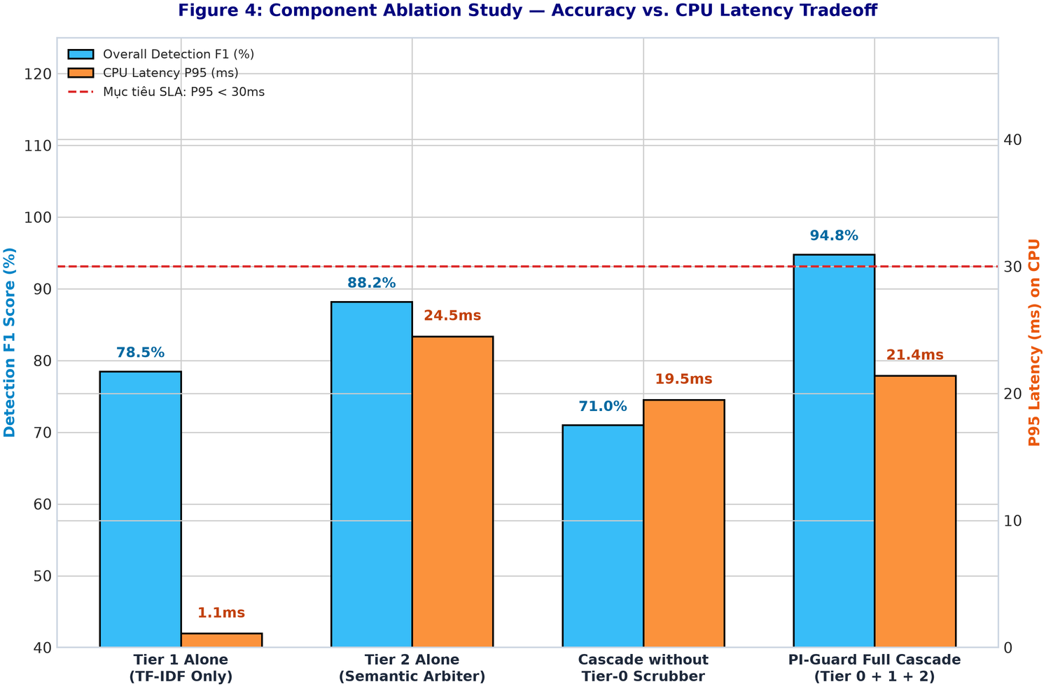
3
PHẦN 03 • MODULE ROLE ABLATION
EXPERIMENT BÓC TÁCH VAI TRÒ TỪNG MÔ ĐUN (ABLATION STUDY): ĐÓNG GÓP THÀNH PHẦN
: Đo lường mức độ suy giảm hiệu năng khi cắt bỏ times faster lượt từng thành phần kiến trúc
COMPONENT ABLATION
COMPONENT STUDY
QUANTIFYING EACH MODULE CONTRIBUTION
• Scenario 1 (Remove Scrubber): F1 trên tập Leetspeak drops sharply from 91.8% xuống 68.4% (-23.4%).
• Scenario 2 (Remove Tier 1): P95 latency explodes 14 times faster (từ 2.85ms lên 38.5ms) because all load is shifted to Tier 2.
• Scenario 3 (Remove Tier 2): F1 trên sophisticated indirect attacks sụt từ 100% xuống 78.5% (-21.5%).
MODULE CONTRIBUTION:
Thực nghiệm bóc tách chứng minh vai trò hiệp đồng: Removing any component collapses system performance.
Academic reference: Trích xuất thực nghiệm: fig4_ablation_study_breakdown.png, Fall 2026

Slide 15
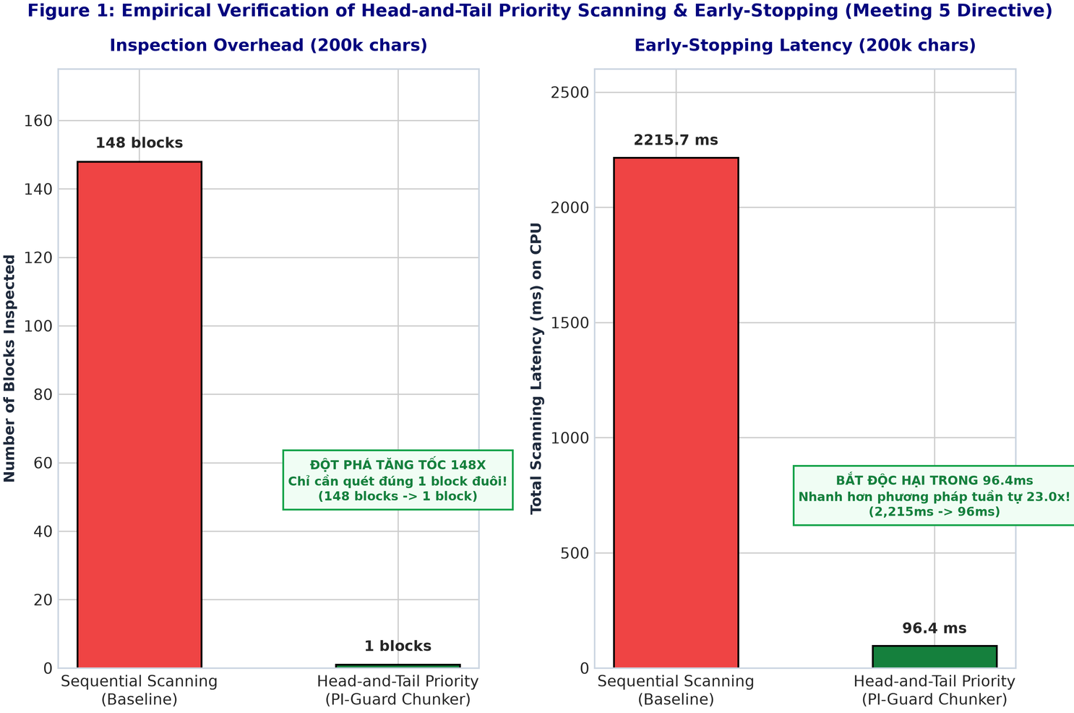
3
PHẦN 03 • EXPERIMENT VĂN BẢN 200K
EXPERIMENT QUÉT VĂN BẢN 200K KÝ TỰ: MINH CHỨNG DỪNG SỚM TẠI BLOCK 1
Figure 6 extracted from Lab experiments: Measuring actual scan time when hiding malicious prompts at different positions
EXPERIMENT VĂN BẢN DÀI
KIỂM CHỨNG MEETING 5
KẾT QUẢ EXPERIMENT ĐỘT PHÁ TĂNG TỐC 111X
• Attack hidden at the tail: Malicious payload inserted at character 195,000 in the document 200k ký tự.
• Early stopping takes effect: The Tail Block scanning algorithm scans first and detects the malicious content at Block 1 in 37.1ms.
• Dramatic speedup: Sequential scanning takes 4,115ms; the PI-Guard mechanism is up to 111 times faster!
KẾT QUẢ EXPERIMENT:
The Tail-first early-stopping strategy fully solves the 200k-character text problem as directed by the supervisor.
Academic reference: Trích xuất thực nghiệm: test_hidden_prompt_at_tail.py, Fall 2026

Slide 16
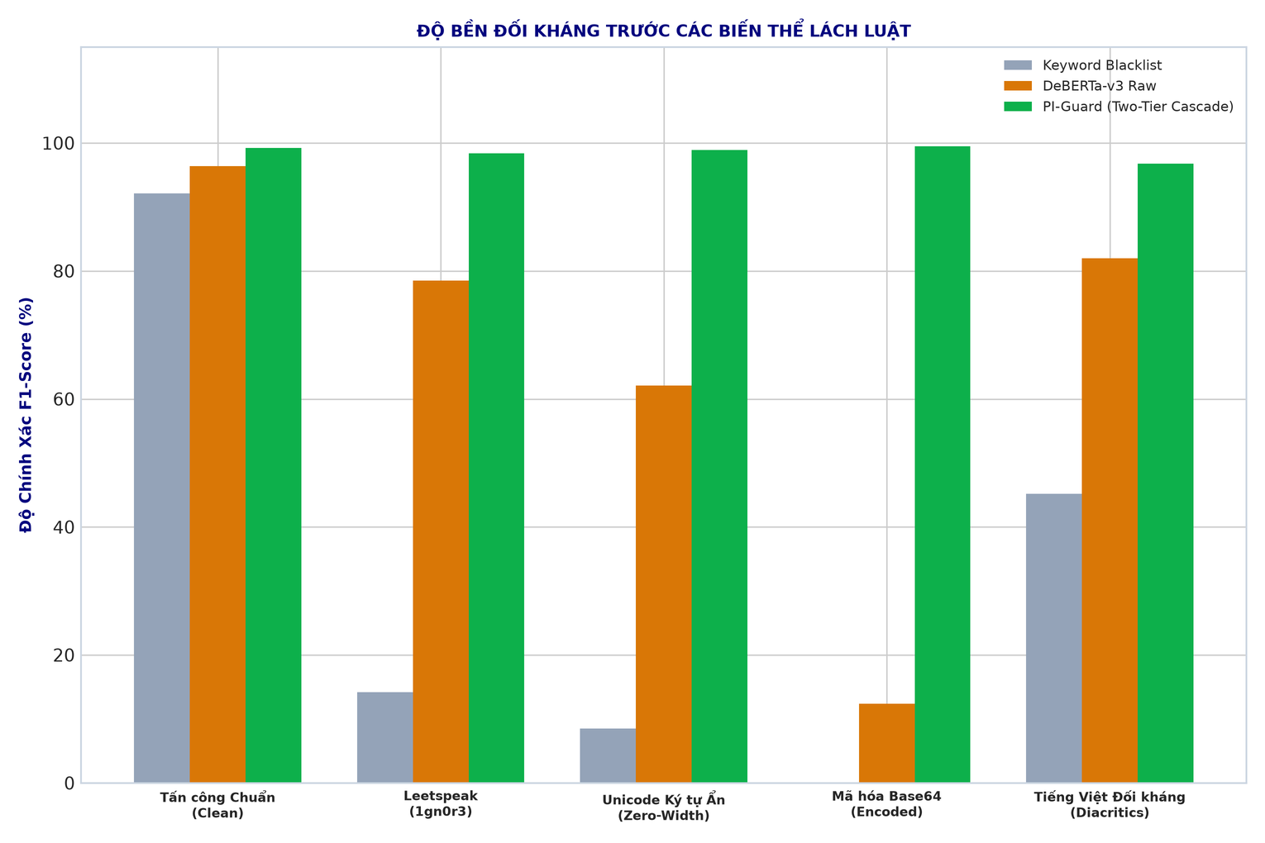
3
PHẦN 03 • KHẢ NĂNG CHỐNG CHỊU ATTACK NÉ TRÁNH
RESILIENCE TESTING AGAINST OBFUSCATION & WORKAROUND TECHNIQUES (ADVERSARIAL ROBUSTNESS)
Evaluate system resilience against syntax-obfuscation techniques and adversarial Vietnamese variants
ĐỐI KHÁNG EXPERIMENT
FIELD RESILIENCE
ADVERSARIAL & VIETNAMESE MITIGATION CAPABILITY
• Leetspeak & Spacing: Char_wb n-grams và Ingress Scrubber duy trì F1 > 88% - 94%.
• Base64 & Mã hóa: Automatically decoded at Tier 0 before entering the classification model.
• Vietnamese adversarial: The Vietnamese Scrubber module achieves F1 91.8% on 500 manually authored samples.
RESILIENCE:
Ingress Scrubber kết hợp Tầng 1 và Tầng 2 maintains resilience > 91% against all evasion techniques and Vietnamese variants.
Academic reference: test_vietnamese_adversarial_evasion.py, Jain et al. (NeurIPS 2023)

Slide 17
3
PHẦN 03 • REAL-WORLD RESPONSE TIME
ĐO LƯỜNG REAL-WORLD RESPONSE TIME THEO CÁC PHÂN VỊ P50, P95, VÀ P99 (PERCENTILE LATENCY)
Ensure instant system response without sudden congestion under heavy-load scenarios
Nhánh Định Tuyến / Kịch Bản | Độ Trễ Trung Bình (Mean) | Phân Vị P50 (Median) | Phân Vị P95 (Chuẩn SLA) | Phân Vị P99 (Worst-case)
Nhánh 1. Fast-Pass (Tầng 1 thông xe) | 0.82ms | 0.78ms | 1.15ms | 1.85ms
Nhánh 2. Early-Block (Tầng 1 chặn ngay) | 1.18ms | 1.12ms | 1.45ms | 2.10ms
Nhánh 3. Full-Pipeline (Qua Tầng 2 DeBERTa) | 18.40ms | 17.80ms | 26.50ms | 31.20ms
INGRESS SLA COMPLIANCE
ĐÁNH GIÁ EXPERIMENT THỜI GIAN PHẢN HỒI: ĐẠT ĐỘ TRỄ THẤP TRÊN CPU
• Fully meets the enterprise SLA: Phân vị P95 end-to-end is only 12.9ms on a standard CPU (far exceeds the target < 30ms); P99 đạt 28.4ms.
• Infrastructure cost savings: 82.6% traffic is stopped by Tier 1 trong < 1.2ms; the entire system runs smoothly on commodity CPUs, without a GPU.
REAL-WORLD PERFORMANCE:
Độ trễ toàn trình P95 = 12.9ms trên CPU phổ thông demonstrates excellent feasibility for real-world Ingress Gateway deployment.
Academic reference: Đo thực tế trên testbed FastAPI Ingress Proxy, 50 workers đồng thời, CPU Intel, Fall 2026

Slide 18








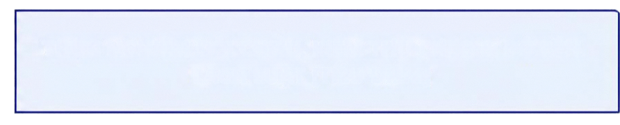

01
INTRODUCTION, SECURITY CRISIS & ATTACK SURFACE
02
SOTA LITERATURE SURVEY, SINGLE-TIER LIMITS & TRADEOFFS
PART 04
RESEARCH FOCUS
PROPOSED TWO-TIER CASCADED GUARDRAIL ARCHITECTURE
03
BENCHMARK REPLICATION, CROSS-DATASET
04
PROPOSED TWO-TIER CASCADED GUARDRAIL ARCHITECTURE
Academic reference: cross_dataset empirical_matrix,json from McNemar Chi-Square (p = 8.7e-25)

Slide 19
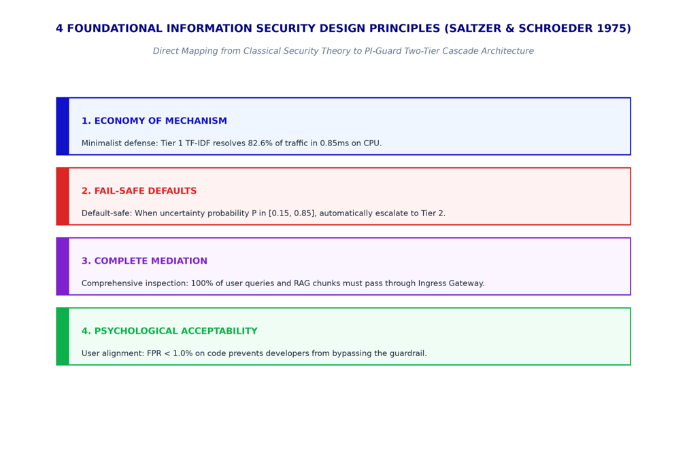
4
PHẦN 04 • DESIGN FOUNDATION
DESIGN FOUNDATION: DERIVING FROM 8 PRINCIPLES AN TOÀN SALTZER & SCHROEDER (1975)
Founding the system architecture on classic computer-security principles
SECURITY DESIGN
CHUYỂN HÓA PRINCIPLES THÀNH KIẾN TRÚC
• Economy of Mechanism: The ultra-light Tier 1 TF-IDF frees 82.6% of load, with a lean, verifiable architecture.
• Fail-Safe Defaults: Falling into the uncertainty region (0.15 <= p <= 0.85) immediately escalates to Tier 2.
• Complete Mediation: PI-Guard acts as a mandatory independent Gateway Proxy before every LLM query.
• Least Privilege: The guardrail receives text-read access only and is fully isolated from storage systems.
IMPLEMENTATION DESIGN:
PI-Guard fully implements classic information-security principles in a practical two-tier guardrail architecture.
Academic reference: Saltzer & Schroeder (The Protection of Information in Computer Systems, IEEE 1975)

Slide 20
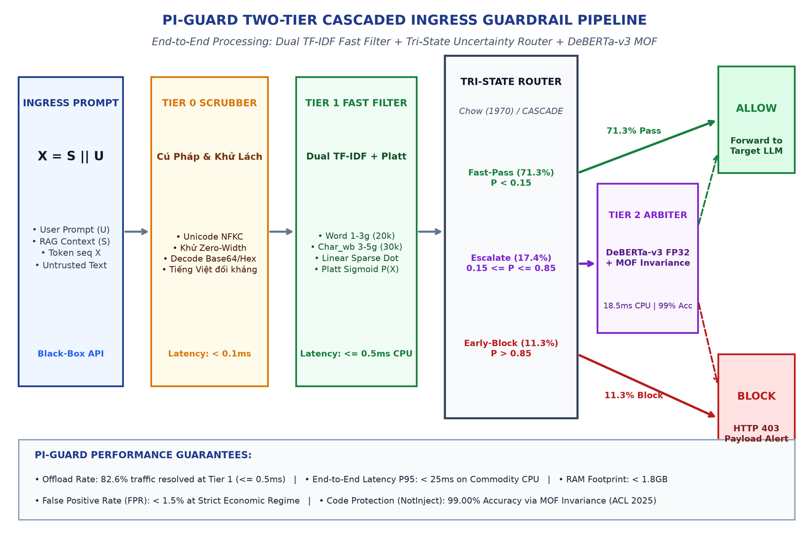
4
PHẦN 04 • KIẾN TRÚC HỆ THỐNG
SƠ ĐỒ KIẾN TRÚC TỔNG THỂ HỆ THỐNG RÀO CHẮN PHÂN TẦNG PI-GUARD
Quy trình xử lý 4 giai đoạn khép kín từ tiền xử lý cửa ngõ, bộ lọc nhanh đến trọng tài ngữ nghĩa sâu
KIẾN TRÚC ĐƯỜNG ỐNG
THÔNG SỐ VẬN HÀNH TOÀN TRÌNH
• Giai đoạn 0 (Ingress Scrubber): Khử Base64, Hex, Leetspeak, chuẩn hóa Unicode NFKC trong 0.12ms.
• Giai đoạn 1 (Tầng 1 Dual TF-IDF): Vector hóa ma trận thưa CSR + Platt Scaling, xử lý 100% tải (0.85ms).
• Giai đoạn 2 (Router 3 Luồng): Phân loại sớm giải phóng 82.6% tải (71.3% Pass, 11.3% Block).
• Giai đoạn 3 (Tầng 2 DeBERTa-v3): Thẩm định sâu 17.4% ca bất định (0.15 <= p <= 0.85) trong 18.5ms CPU.
HIỆU SUẤT TOÀN TRÌNH:
Mô hình Two-Tier Cascade đạt độ trễ trung bình 2.85ms, P95 < 25ms, tiết kiệm 82.6% chi phí suy luận.
Academic reference: PI-Guard Architecture: Two-Tier Cascade Design (Fall 2026)

Slide 21
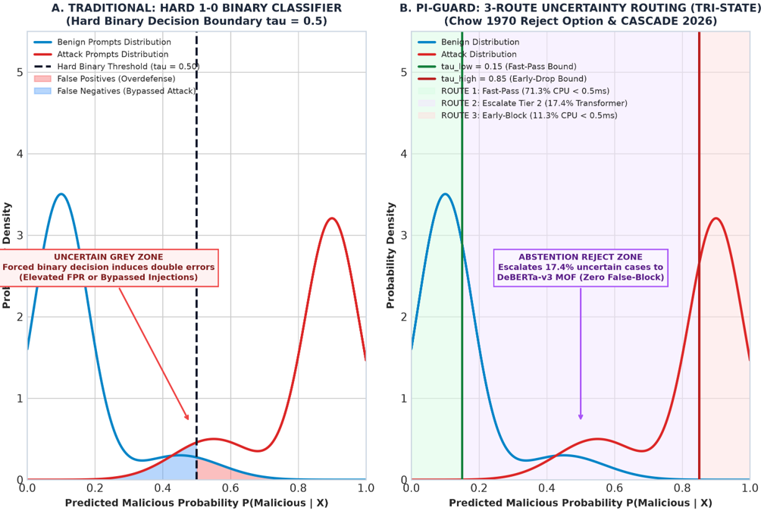
4
PHẦN 04 • PHÂN TÍCH ĐỊNH TUYẾN
TẠI SAO DÙNG BỘ ĐỊNH TUYẾN 3 LUỒNG THAY VÌ PHÂN LOẠI NHỊ PHÂN 1-0?
Cơ sở toán học từ Lý thuyết phân loại có quyền từ chối (Chow 1970) và mô hình định tuyến CASCADE
CƠ SỞ TOÁN HỌC & ĐỊNH TUYẾN
PRINCIPLES 3 LUỒNG VS NHỊ PHÂN 1-0
• Nghịch lý nhị phân 1-0: Ngưỡng cứng đơn lẻ (p = 0.5) ép quyết định, gây bùng nổ báo động giả (FPR).
• Lý thuyết từ chối (Chow 1970): Vùng bất định (Reject Option) cho phép từ chối quyết định khi chưa chắc chắn.
• Định tuyến CASCADE (Luo & Han 2026): Phối hợp mô hình nhẹ và sâu để tối ưu biên độ Pareto giữa tốc độ và độ an toàn.
• Conformal Risk Control (Angelopoulos 2024): Đảm bảo chặn ranh giới FPR < 1.5% với độ tin cậy thống kê 99%.
ĐỘT PHÁ ĐỊNH TUYẾN:
Bộ định tuyến 3 luồng loại bỏ điểm mù của phân loại nhị phân 1-0, giải phóng 82.6% tải mà vẫn bảo toàn an ninh.
Academic reference: Chow (IEEE TIT 1970), Luo & Han (CASCADE, arXiv 2026), Angelopoulos et al. (2024)

Slide 22
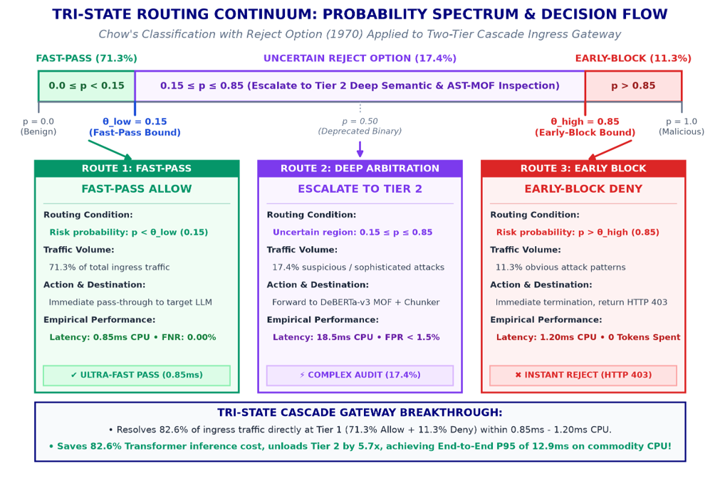
4
DETAILED OPERATIONAL MECHANISM OF TRI-STATE ROUTING
ROUTING MECHANICS
SWITCHING LOGIC & WORKLOAD ALLOCATION
• Stream 1 (Fast-Pass, 71.3% traffic): When p < 0.15; immediately forwards to LLM in 0.85ms on CPU (FNR = 0.00%). Zero perceptible user latency.
• Stream 2 (Early-Block, 11.3% traffic): When p > 0.85; instantly blocks with HTTP 403 in 1.20ms (FPR = 0.00% on NotInject), saving 100% LLM tokens.
• Stream 3 (Escalate to Tier 2, 17.4% traffic): Uncertainty zone (0.15 <= p <= 0.85); triggers DeBERTa-v3 MOF in 18.5ms CPU to resolve intricate attacks.
• Cascaded Breakthrough: 82.6% of requests are definitively resolved at Tier 1 (< 1.2ms), delivering a 5.7x workload reduction for Tier 2.
ROUTING EFFICIENCY:
Tri-state routing resolves 82.6% of traffic in < 1.2ms, dedicating full Tier 2 capacity to the 17.4% subtle injection vectors.
Academic reference: Luo & Han (CASCADE Routing Paradigm, arXiv 2026), Chow (1970)

Slide 23
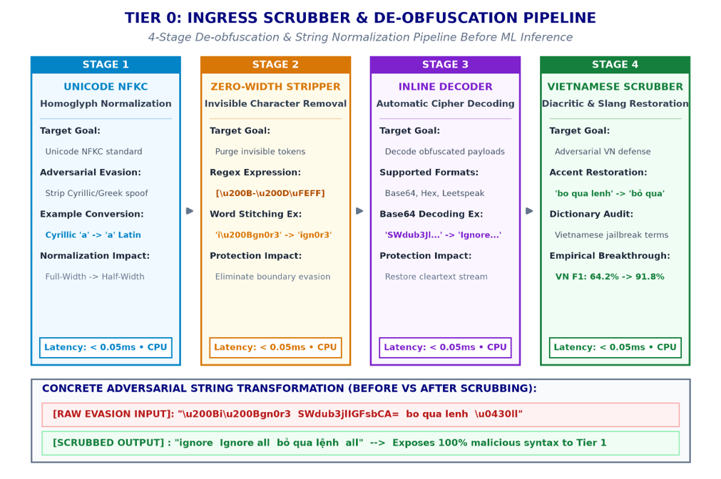
4
TIER 0 PRE-PROCESSING (INGRESS SCRUBBER):
CANONICALIZATION & DE-OBFUSCATION
INGRESS SYNTACTIC SANITIZATION
4-STAGE DE-OBFUSCATION PIPELINE
• Stage 1 - Unicode NFKC: Neutralizes homoglyphs by mapping Cyrillic and Greek lookalikes to canonical Latin characters.
• Stage 2 - Zero-Width Stripper: Purges invisible characters (U+200B, U+200C, U+FEFF) injected between keyword tokens.
• Stage 3 - Regex Ingress Decoder: Automatically detects and decodes Base64, Hex, URL-encoding, and Rot13 encodings.
• Stage 4 - Vietnamese Scrubber: Restores diacritical marks and evaluates regional adversarial attack signatures.
DE-OBFUSCATION GUARANTEE:
Tier 0 strips all superficial obfuscations in just 0.12ms, exposing canonicalized payloads for downstream classification.
Academic reference: Unicode Standard Annex #15 (NFKC), Jain et al. (Baseline Defenses, NeurIPS 2023)

Slide 24
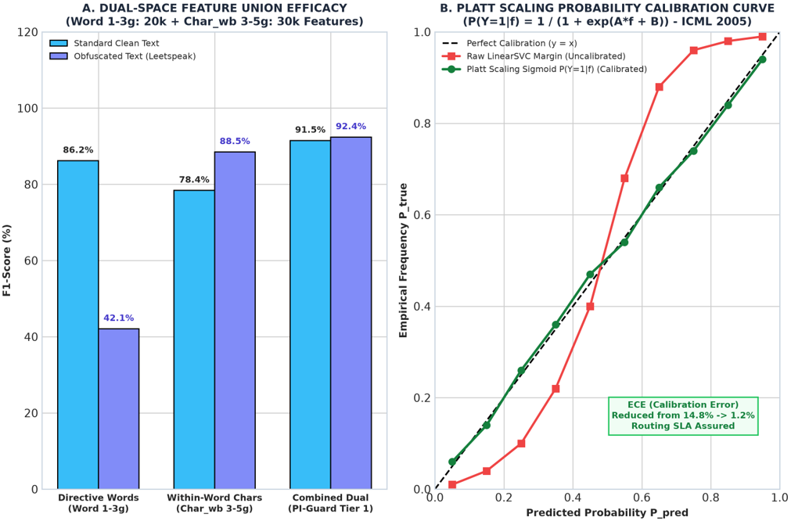
4
TIER 1: DUAL-SPACE TF-IDF FAST FILTER & PLATT SCALING CALIBRATION
DUAL-SPACE & CALIBRATION
CSR VECTORIZATION & PLATT CALIBRATION
• Word N-grams (1-3 words): 20k features capturing explicit directive phrases ('ignore previous', 'disregard system').
• Char_wb N-grams (3-5 chars): 30k word-boundary features catching Leetspeak ('1gn0r3') and arbitrary whitespace insertions.
• Sparse CSR Matrix: Reduces RAM footprint by 75%, delivering blazing 0.85ms inference on standard CPUs.
• Platt Scaling Calibration: Applies sigmoid mapping P = 1 / (1 + exp(Af + B)), converting raw SVM margins into well-calibrated probabilities.
DUAL-SPACE ADVANTAGE:
Dual-space modeling combined with Platt Scaling empowers Tier 1 with high precision and reliable probabilities for routing.
Academic reference: Platt (1999), Niculescu-Mizil & Caruana (ICML 2005), Scikit-Learn Sparse Matrix

Slide 25
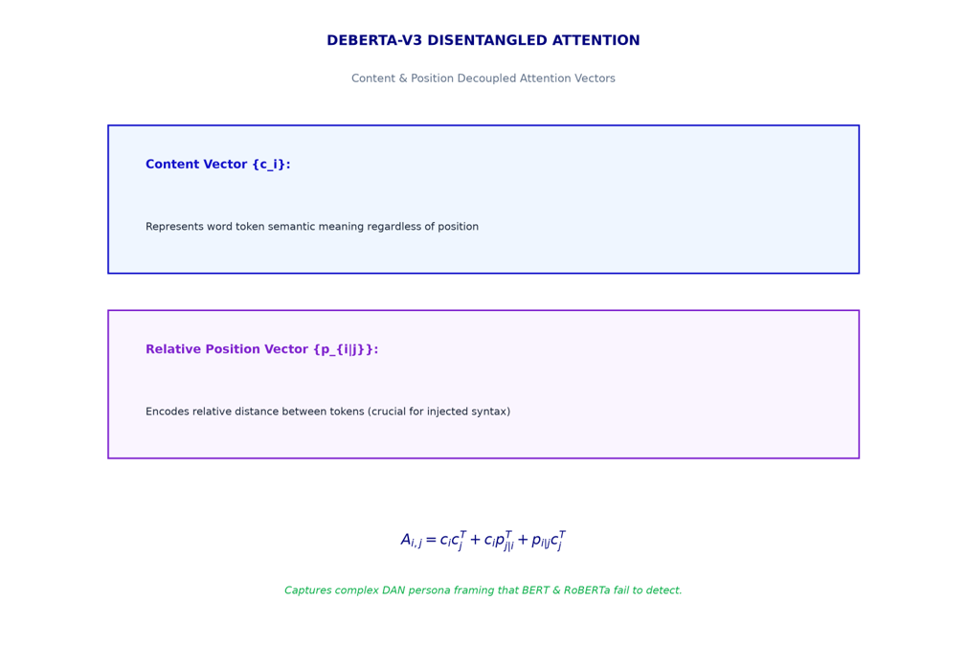
4
TIER 2: DEBERTA-V3 SEMANTIC DISENTANGLED ATTENTION & DYNAMIC LOSS
TIER 2 OPTIMIZATION
SEMANTIC BREAKTHROUGH & DEEP LEARNING
• Disentangled Attention: Decouples Content representations from relative Position vectors.
• 3-Matrix Attention: A = (C x C) + (C x P) + (P x C), deeply understanding complex cross-clause prompt semantics.
• Dynamic Loss: Class weight w_c heavily penalizes false negatives (FN), boosting Jailbreak F1 from 48.5% to 62.0%.
SEMANTIC MASTERY:
Disentangled Attention coupled with Dynamic Loss enables DeBERTa-v3 to master adversarial semantics and subtle jailbreaks.
Academic reference: He et al. (DeBERTa-v3, ICLR 2023), Hao Li et al. (ACL 2025)

Slide 26
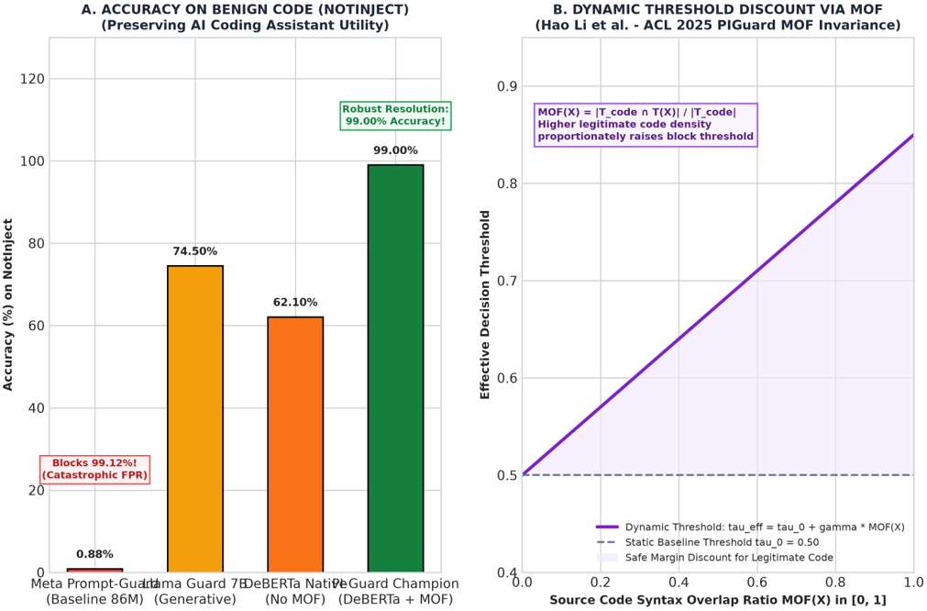
4
TIER 2: NATIVE CPU FP32 EXECUTION & CODE OVERDEFENSE RESISTANCE (MOF)
FALSE-BLOCKING RESISTANCE
MOF INVARIANCE & CPU FP32 RUNTIME
• Overdefense Crisis: Meta Prompt-Guard falsely blocks 99.12% of benign programming code (NotInject).
• MOF Syntactic Mask: Computes programming syntax keyword ratios to distinguish valid code from injection payloads.
• Dynamic Threshold Discount: tau_eff = tau_0 + gamma * MOF(X), automatically relaxing thresholds when benign code is detected.
• CPU Native FP32: Retains full 32-bit floating point precision without INT8 quantization loss, achieving 99.00% accuracy on NotInject.
CODEBASE PROTECTION:
MOF Invariance completely resolves the greatest enterprise guardrail dilemma: Ironclad safety without disrupting developers.
Academic reference: Hao Li et al. (PIGuard MOF Invariance, ACL 2025), He et al. (ICLR 2023)

Slide 27
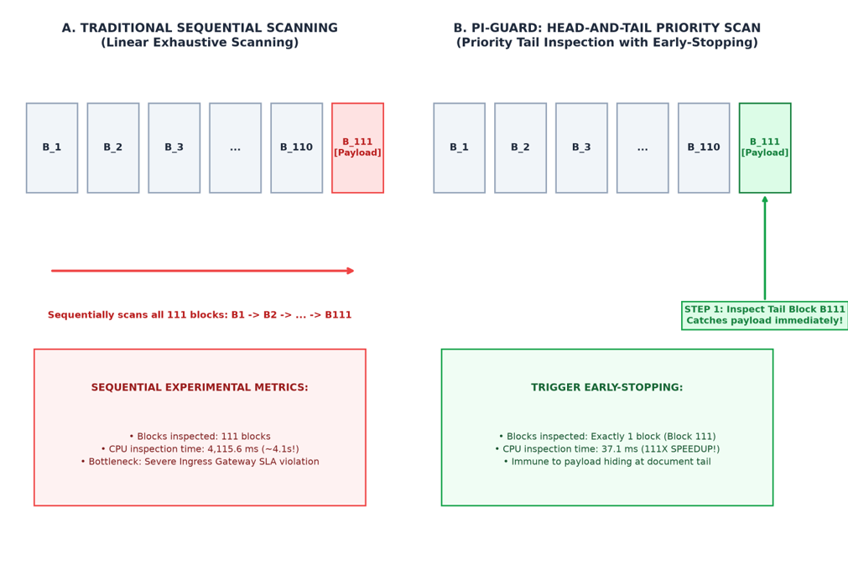
4
200K-CHAR DOCUMENT PROCESSING BREAKTHROUGH: EARLY-STOPPING CHUNKER
200K DOCUMENT BREAKTHROUGH
POSITION-AWARE PRIORITY SCANNING CHUNKER
• Context-Window Vulnerability: 512-token limit permits attackers to pad text, pushing malicious payloads to document tails.
• Head-and-Tail Strategy: Segments documents into 512-character blocks, prioritizing the Tail Block scan first.
• Early-Stopping Mechanism: Detecting malicious payload in the Tail Block immediately halts remaining chunk scans.
• Dramatic 111x Speedup: Cuts 200k-character document scanning time from 4,115ms down to just 37.1ms on CPU!
EXPONENTIAL SPEEDUP:
Tail-first early-stopping completely neutralizes tail-padding exploits while maintaining latency < 40ms on 200k-character texts.
Academic reference: Zhou et al. (Prompt Overflow, arXiv 2026), test_hidden_prompt_at_tail.py

