Slide 1

Music Recommendation with Collaborative
Filtering on Last.fm Data
Karel Beckeringh, s2600358
Wessel Reijngoud, s2580748
Nik van ’t Slot, s2536420

Slide 2
Context
Introduction
Materials
Methodology
Evaluation
Results
Analysis
Description of individual contributions

Slide 3
Introduction
Last.fm, website counts listens
Dataset is rather unique and appeals to us on a personal level
User-based, item-based or a combination of techniques
Friend relations
What (combination of) recommender technique(s) generates the best results in recommending artists to users?

Slide 4
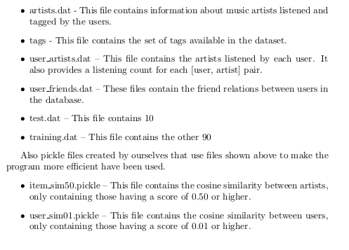
Materials
The dataset used is mostly the same as found in HetRec (1)
%
%

Slide 5
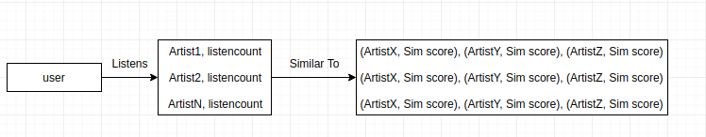
Methodology
Item based
Sorted by listencount
Sorted by similarity score
Weight = Listencount * Similarity score
Heighest weights recommended
N=30 most efficient

Slide 6
Methodology

Slide 7
Methodology

Slide 8
Evaluation
user_artist.dat split → 10% test 90% training
Baseline Random recommendation
Like assignment 3 predict missing artists
Determine hits

Slide 9
Results
 | Baseline | Item-Based | User-Based | Friend-Based | User + friend | Friend + User
Correct out of 9283 | 28 | 643 | 1794 | 1010 | 1823 | 1186
% | 0.30% | 6.93% | 19.33% | 10.88% | 19.64% | 12.78%
Time in s | 13.127 | 54.887 | 20.639 | 6.929 | 22.813 | 6.953

Slide 10
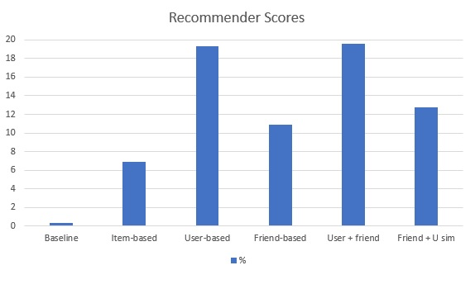
Results

Slide 11
Analysis
All better than baseline
User-based combined with friend best results
Way of evaluating could be better
False misses

Slide 12
Contributions
Research proposal used – Karel
User / Friend based – Karel
Item based – Karel, Wessel, Nik
Report – Karel, Wessel, Nik
Presentation – Karel, Wessel, NIk

