Slide 1


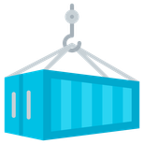


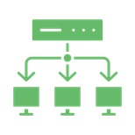


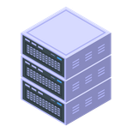








Siam.AI Cloud: Service Models
Infrastructure-as-a-Service
Container & Orchestration
IAM
Resource Reserve Service
Platform-as-a-Service
Virtual Private Cloud
GPU Cluster
AI Training
Storage
GPU Server
AI Inferencing
Database
HPS
Model Repository
Virtual Machine
Data Security & Threat Protection
Cloud Resource Monitoring and Management

