Slide 1
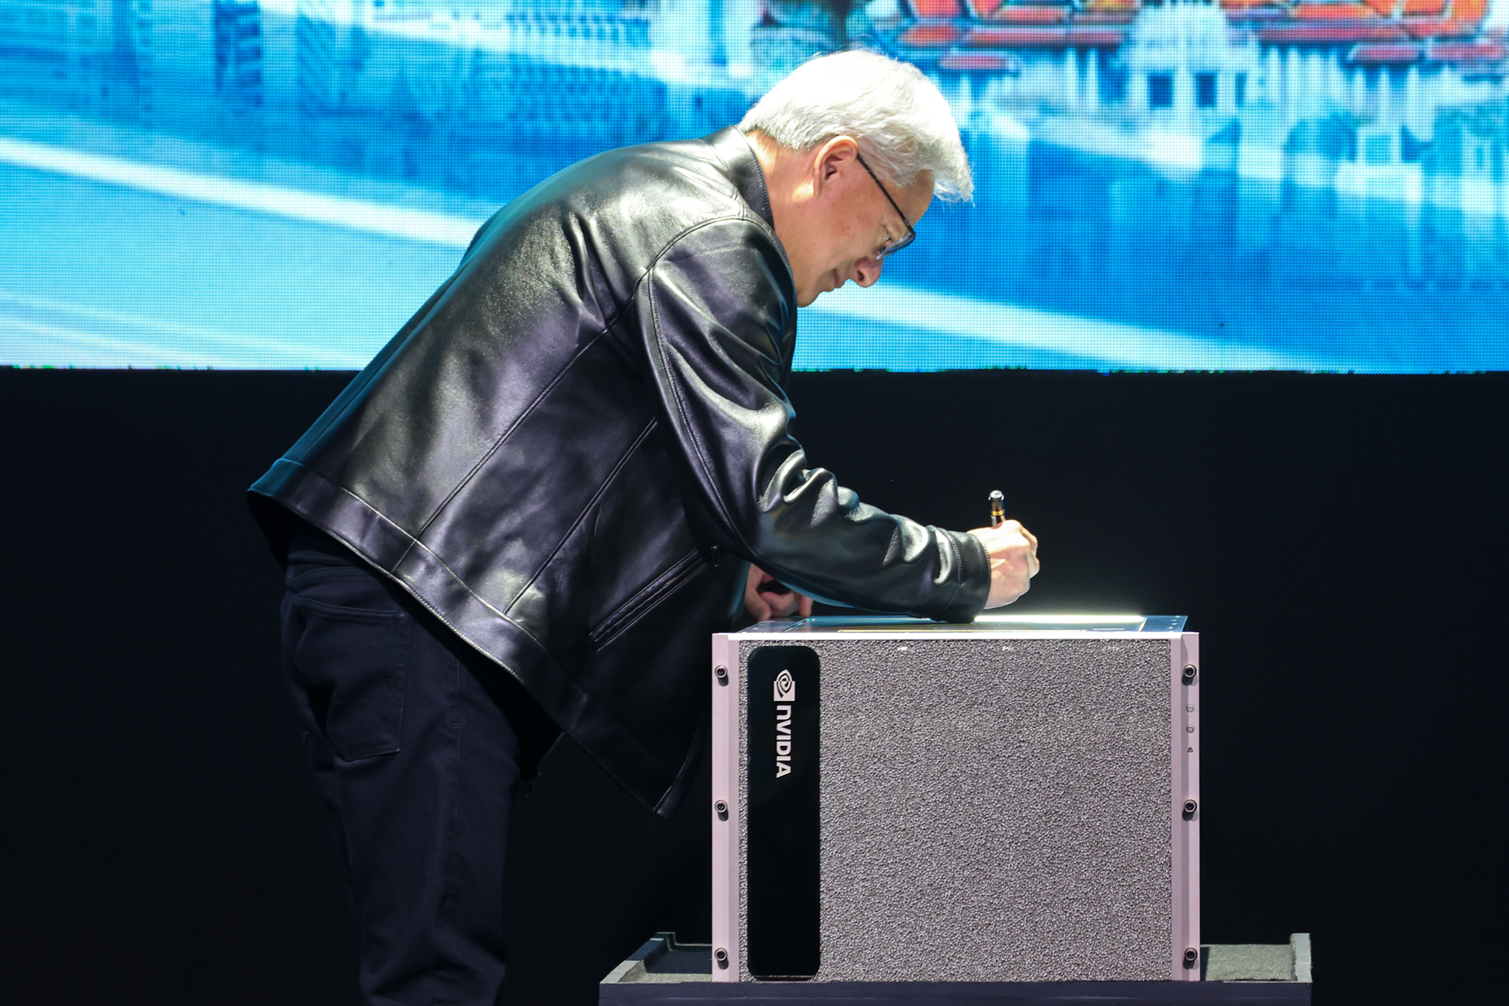

The Landmark Launch of Siam AI’s GPU Cluster
A Historic Moment: Jensen Huang personally signed our flagship DGX H200 system, marking a key milestone for Thailand’s AI ecosystem.
AI Vision for Thailand December 4, 2024

