Slide 1

Principal Component Analysis
&
Multi Linear Regression
Nanang Wijaya Kusuma
1202922001
UAS BIG DATA

Slide 2
Business Understanding
N.W. Kusuma | UAS-PCA-MLR
PCA
MLR
Big Data
Bank BCA Syariah wants to create a Conforming Loan Limit model for its mortgage products based on historical data from customers who apply for mortgages, some of which are accepted and some are rejected.
Perform modeling using Principal Component Analysis and Multi Linear Regression to the training data, display and explain the output and the modeling algorithm.
Finance/Banking Real Estate
Apply your algorithm to the test data, what is the % accuracy?
Business Scope
Business Case
Task to do

Slide 3
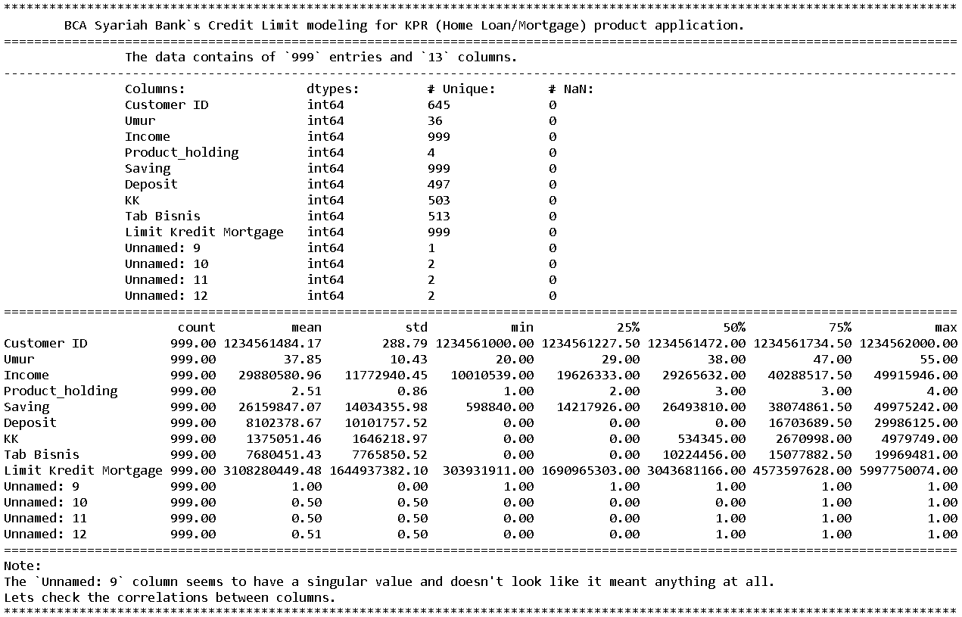
N.W. Kusuma | UAS-PCA-MLR
Data Understanding
Dataset
UAS_PCA dan Multi Linear Regression.xlsx
Data contains 999 entries across 13 columns.
Columns
Unnamed
The curious things is the unnamed columns and what their meant to.
We need to investigate how they correlate with the other known columns.
Its stores 645 customers records.
The Unnamed: 9 seem to just held a single value of 1 across it’s rows.
Datatype integer (int64).
Unnamed:9, Unnamed:10, Unnamed:11, Unnamed:12
Customer ID, Umur (age), Income, Product_Holding,
Saving, Deposit, KK (credit card !?), Tab Bisnis (busines saving !?),
Limit kredit Mortgage (conforming loan limit),
and four Unnamed cloumns.

Slide 4
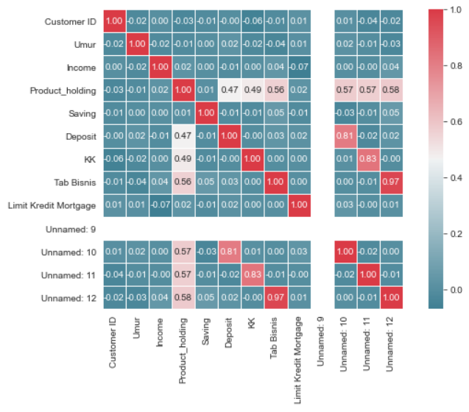
N.W. Kusuma | UAS-PCA-MLR
Data Understanding
As expected, we can see taht the column Unnamed: 9 doesn't have a linear correlation with other columns, not even with it self.
The other three unnamed column have high positive linear correlation with each Deposit, KK, and Tab Bisnis columns respectively.
It might be that those column is an indication whether the customers own those products or not.
Accordingly, each rows in the Saving column also has non-zero and non-null records, which might be the reason why the Unnamed: 9 has a single value.
Interpreting the matrix

Slide 5
N.W. Kusuma | UAS-PCA-MLR
Data Understanding
We can, for example, assume one of those three unnamed column as some sort of approval term for the conforming loan limit to indicate whether the customer’s mortgage loan application are accepted or not. So we choose which one to pick and either drops or keep (doesn’t matter, see point above) the other two. This could be a really good idea since linear regression work best with a true or false questions.
Since we will be doing linear regression, we have to drop the Unnamed: 9 column because its non-existant correlation will hamper our regression model by eliciting an overfit. We can then use all the remaining columns as a whole, or...
The three remaining unnamed columns highly correlated with three of known columns, which means PCA will classify the variances of each groups can be explained by the other groups then will consider any from each paired groups to pass it through and ignores the other one accordingly. So we will just end up with either one group, or...

Slide 6
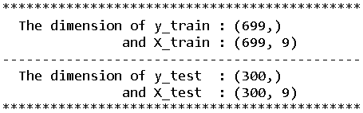
N.W. Kusuma | UAS-PCA-MLR
Data Preparation
Assign target feature
Lets pick the Unnamed: 12 as our target feature (y) for the regression and drops the other two.
For convenience, we can rename it to Approved and replaces any whitespace in the other column’s names with underscore too.
Splitting the data
Next we divides the data into training (70%) and testing (30%) datasets.
To do this, we will import and utilize train_test_split function from the Scikit-Learn model selection library.
Scaling the data
Lastly, standardizes the features for our PCA process.
We will use the StandardScaler function from Scikit-Learn preprocessing library to do this.

Slide 7
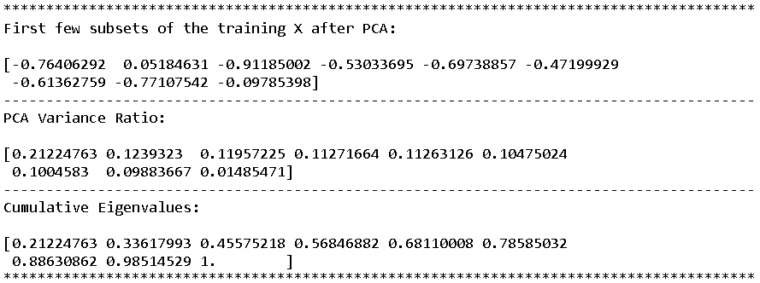
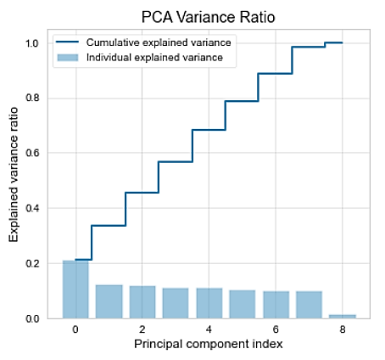
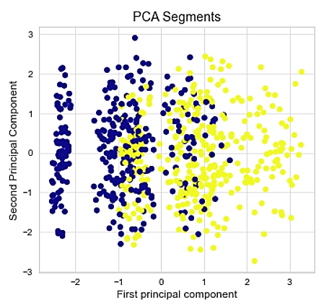
N.W. Kusuma | UAS-PCA-MLR
Data modelling
The preparation done, we can now apply PCA modelling to our data, the result:
First few subset of training X features, PCA Variance Ratio, and Cumulative eigenvalues
The Visualization of PCA Cumulative & Individual Explained Variance Ratio
The preparation done, we can now apply PCA modelling to our data
The scatter map visualization of the first two PCA components
PCA Cumulative & Individual Explained Variance Ratio
First two PCA components scatter map

Slide 8
N.W. Kusuma | UAS-PCA-MLR
Data modelling
Multi-linear Regression
Applying multi-linear regression to later make a prediction.
The regression model’s intercept and coefficient are shown here.
The result also shows a promising accuracy score

Slide 9
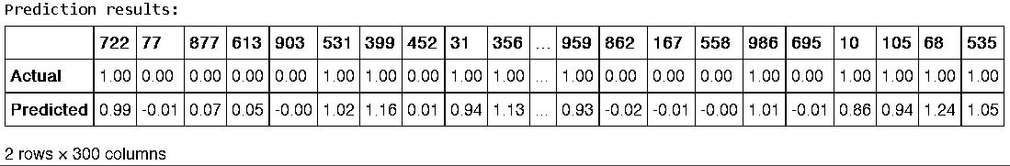
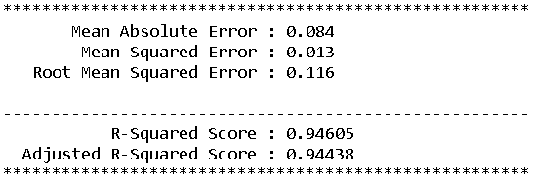
N.W. Kusuma | UAS-PCA-MLR
Deployment & Evaluation
Prediction result compared to the actual value given in the testing sets.
The evaluation for the prediction model with error terms and R2 Squared as well as adjusted R2 scores.

