Slide 1

Recency
Frequency
monetary
Segmentation
Recency
Frequency
Monetary
Nanang Wijaya Kusuma
1202922001
UAS BIG DATA

Slide 2
Business Understanding
Big Data
Segments
Campaign
Business Case:
Giant Superstore retailer wish to analyze their big data to see the segementation of Permata Bank customers who had transaction using Permata bank credit card at their store.
Business Scope:
Marketing
Task to do:
Construct an RFM (Recency/Frequency/Monetary) models for Giant visitor segmentation.
Determine campaign recommendations for each segment.

Slide 3
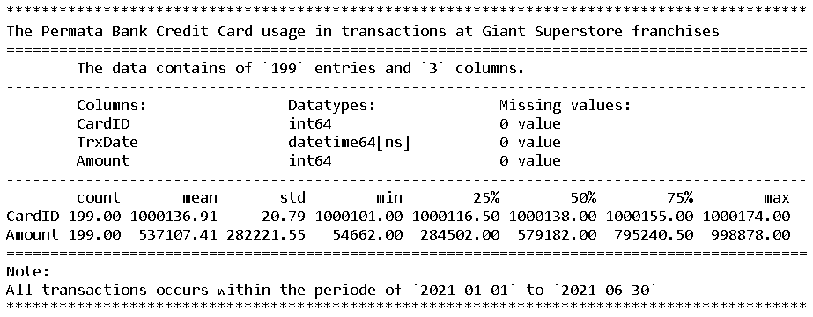
Data Understanding
Datasets (UAS_RFM.xlsx)
Data contains 199 entries stored in 3 columns.
CardID (interger) This column listed the identification number of the customer’s Permata Bank credit cards used in transaction at Giant Superstore.
TrxDate (datetime) This column records the date when the cards was used for transaction, given date in data ranging between 2021-01-01 to 2021-06-30
Amount (integer) This column store the paid amount of the transaction.
There are no missing value or NaN in the data.

Slide 4
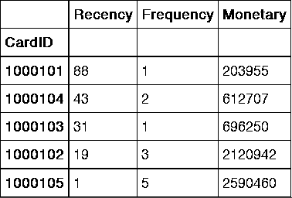
Data Preparation
Aggregate Data
We begin with setting the today’s date, which is the latest (max) date in the data plus one day.
Then we aggregate data into Recency, Frequency, and Monetary columns with CardID column as index.
Recency: today date - last order date by each customer For this column we count the number of day since last transaction.
Frequency: the count of transaction by each CardID For this we count the number of occurences for each and every CardID used in transaction.
Monetary: the total (sum) of paid amount Then we sum-up the amount of paid expense at each transaction.

Slide 5
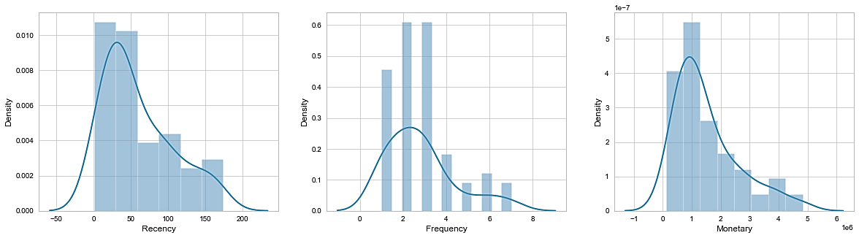
Data Preparation
Aggregated RFM Distribution Chart

Slide 6
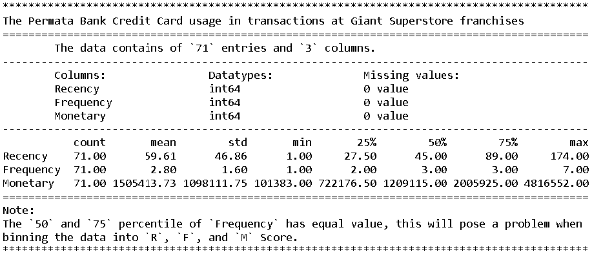
Data Modeling
Percentile Values
Next we inspects the values for each percentile quantities of the new aggregated data to determine each metrices (Recency, Frequency, and Monetary) scores.
From the snapshot picture, we can see that the data has been reduced to 71 entries from previously 199. This is because we had aggregates the data by grouping them to each unique or distinct CardID.
As shown in the sanpshot picture, the 50 and 70 percentile of Frequency has an equal value, this will pose a problem when cutting or binning the Frequency data into each score level.

Slide 7
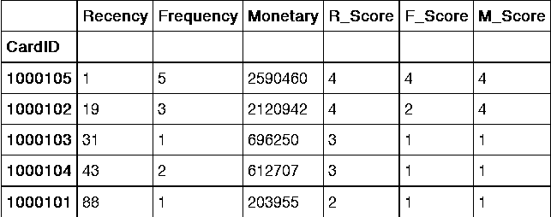
Data Modeling
R, F, and M scores
We begin our modeling with determining and assigning score to each RFM (Recency, Frequency, and Monetary) metrices.
We did this by taking the quantity of data at each percentile and segregate them into discreete values then classify them in the categorical order based on the Recency, Frequency, and Monetary values range at each percentile.
For Frequency and Monetary, we take the highest value range (the max or 100 to 75 percentile) as a score of 4 (four) and down to the score of 1 (one) at the lowest value range (the 25 to 0 or min percentile).
The Recency score however, we did it in reverse, so the lowest percentile value range or get the high score of 4 and the highest percentile value range get the low score of 1 because the low Recency value means the transaction is more recent.

Slide 8
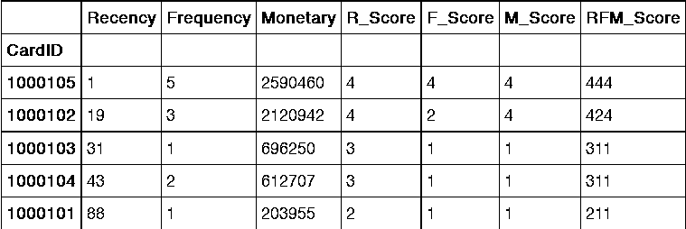
Model Evaluation
Combined RFM score
Next step in our modeling process is taking each Recency, Frequency, and Monetary scores and concatenates them into final RFM score.
444 RFM score means the Cards was recently and frequently used in transaction with quite big expenses on each transaction.
On the other hand, the RFM score 111 means the Card was rarely and hadn’t been used for quite a while with very low expenses in each transactions.
We will build customers segments by mapping their transaction histories reflected in this RFM scores.

Slide 9
Result Segementation
5
Premium Customers
7
Loyal Customers
1
Frequent Buyers
9
Big Spenders
14
Promising New Cust.
1
Inactive Frequent
11
Inactive High Value
9
Cheap Customers
14
Lost Customers
Here we take the RFM scores to segments the customers who use Permata Bank credit cards in transaction.
Premium Customers are the pinnacle of customers that any business or marketing team could hope for. They pose a perfect 444 RFM score. In the given data, we have 5 customers belong to this group.
Loyal Customers are those who had a very recent transaction with high range of Frequency and Monetary score. We have 7 customers belong to this group.
Frequent Buyers and Big Spenders are those with a very recent transaction and either a high range of Frequency or Monetary score albeit having either mid-low range of Frequency or Monetary score accordingly.
Promising New Customers are those who just recently started made some transaction for a few first time.
Inactive Frequent and High Value customers, as the name implied, are those who could belong to the Frequent Buyers & Big Spender if it wasn’t for the fact that they hasn’t made any new transaction for quite a while.
Cheap Customers are those with mid-low range of score spread through their Recency, Frequency, and Monetary scores.
Lost Customers, well they’re just that, a lost cause. They’re probably just a passer-by who happens to be in the area for a time and hasn’t been seen to make any transaction later on.
Segments Customer

Slide 10
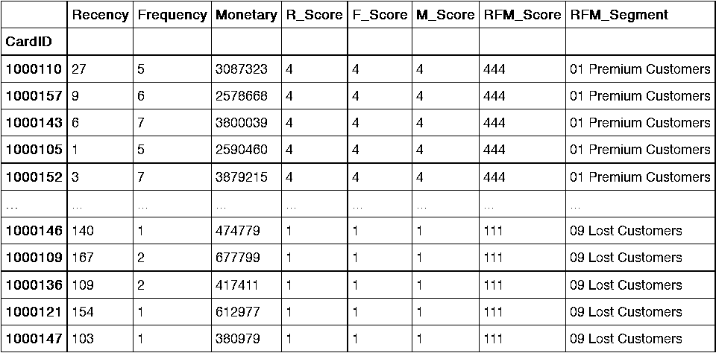
Result Segementation
Segmented Customers

Slide 11
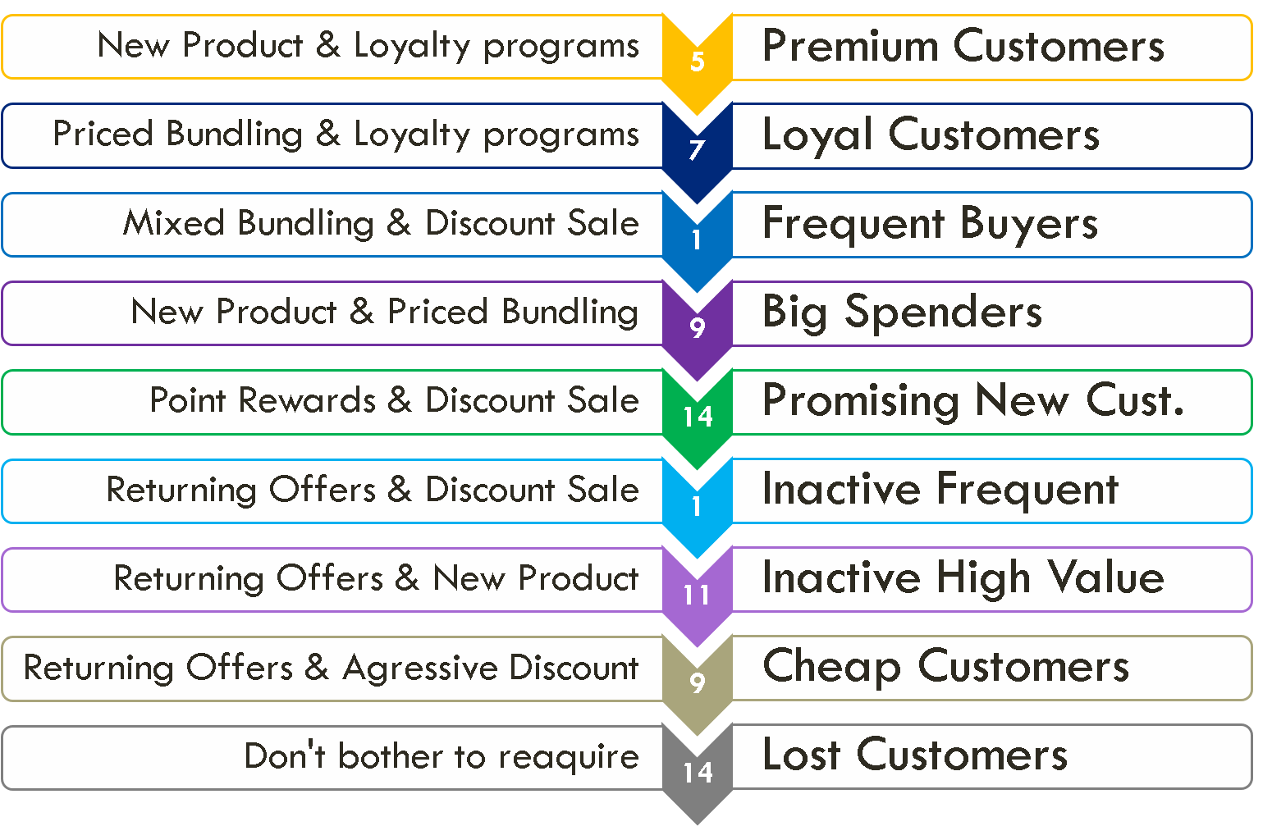
Model Deployment
Campaign Recomendation

Slide 12
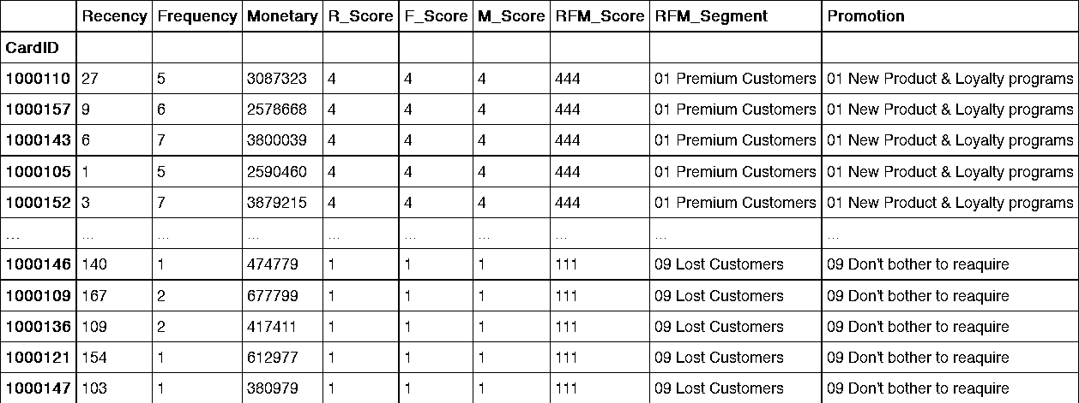
Model Deployment
Campaign Recomendation

Slide 13
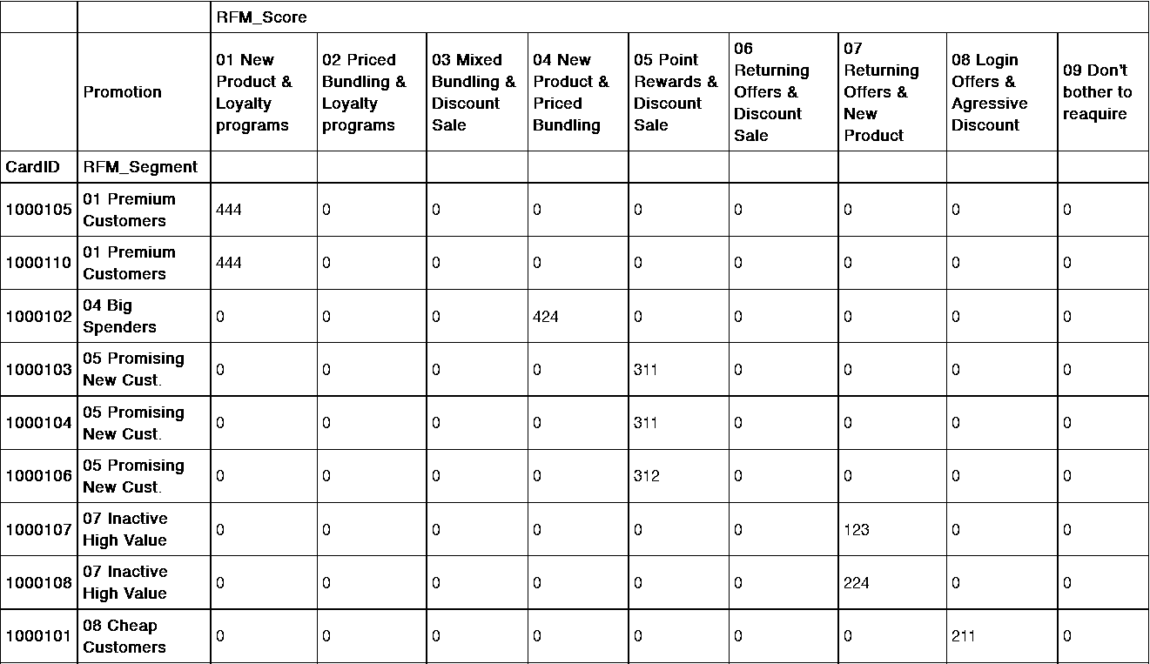
RFM Segmentation
Segmented Customers :: Promotion (Campaign)

