Slide 1

Principal Component Analysis
&
Multi Linear Regression
Nanang Wijaya Kusuma
1202922001
UAS BIG DATA

Slide 2
Business Understanding
N.W. Kusuma | UAS-SVM
Permata Syariah Bank wants to create a model of credit customers who make accelerated mortgage loan repayments based on customer historical data where some have applied and some did not.
Perform modeling using the Support Vector Machine to the training data, display and explain the output and the modeling algorithm
Finance/Banking Real Estate
Apply your algorithm to the test data, what is the % accuracy?
Business Scope
Business Case
Task to do

Slide 3
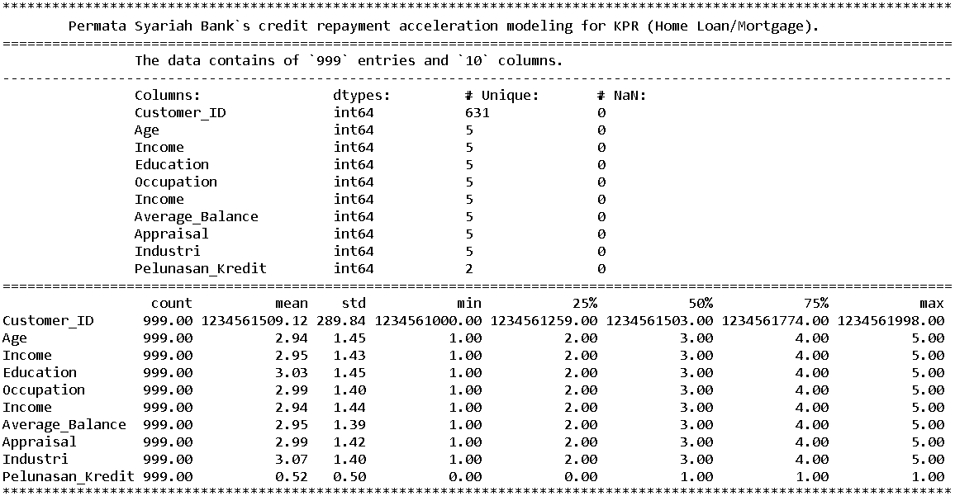
N.W. Kusuma | UAS-SVM
Data Understanding
Dataset
UAS_PCA dan Multi Linear Regression.xlsx
Data contains 999 entries across 10 columns.
Columns
Values
No null (NaN) value found.
Its stores 631 distinct customers records.
The Pelunasan_Kredit column will act as our target feature. .
Datatype integer (int64).
Value types mostly Discrete numeric
Customer_ID, Age, Income, Education, Occupation,
Income, Average_Balance, Appraisal, Industri,
Pelunasan_Kredit (Credit Repayment).

Slide 4
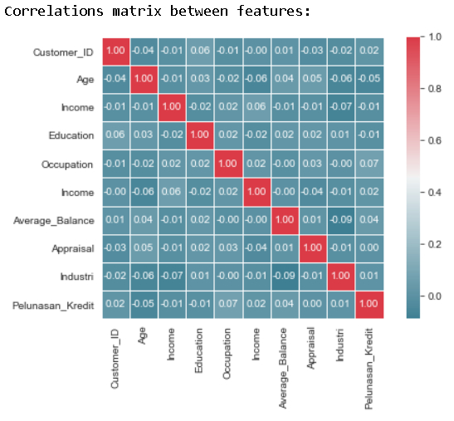
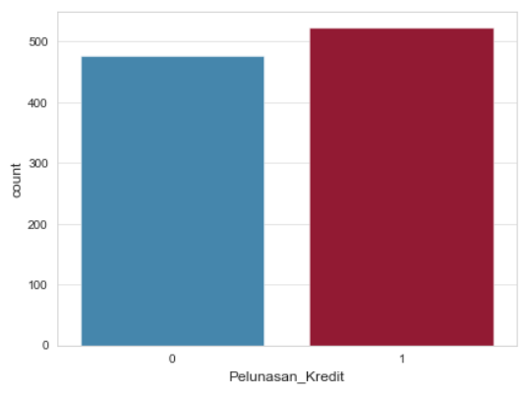
N.W. Kusuma | UAS-SVM
Data Understanding
The matrix above shows that the columns has no linear correlation with each other, which is expecteusedd because the discrete value are not to picture linearity.
The bar plot shows the ratio of accelerated mortgage loan repayment application.
We can see that the customer who does apply for it are slightly more than the one who doesn’t.
Interpreting the data

Slide 5
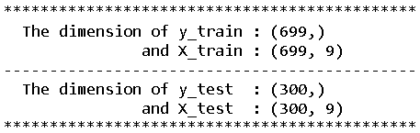
N.W. Kusuma | UAS-SVM
Data Preparation
Assign target feature
Next we assign target feature (y) and independent features (X).
Not much to be done because the data has been structured well for classification.
Splitting the data
Next we divides the data into training (70%) and testing (30%) datasets.
To do this, we will import and utilize train_test_split function from the Scikit-Learn model selection library.
Scaling the data
Lastly, standardizes the features for our PCA process.
We will use the MinMaxScaler function from Scikit-Learn preprocessing library to do this.

Slide 6
N.W. Kusuma | UAS-SVM
SVM modelling
C parameter: Controlls trade-off between classifying training points correctly and having a smooth decision boundary.
Small C (loose) makes cost (penalty) of misclassification low (soft margin)
Large C (strict) makes cost of misclassification high (hard margin), forcing the model to explain input data stricter and potentially over it.
Gamma parameter: Controlls how far the influence of a single training set reaches.
Large gamma: close reach (closer data points have high weight)
Small gamma: far reach (more generalized solution)
Degree parameter: Degree of the polynomial kernel function.
The parameter ('poly’) will be ignored by all other kernels, if specified.
Support Vector Machine’s kernel parameters explained

Slide 7
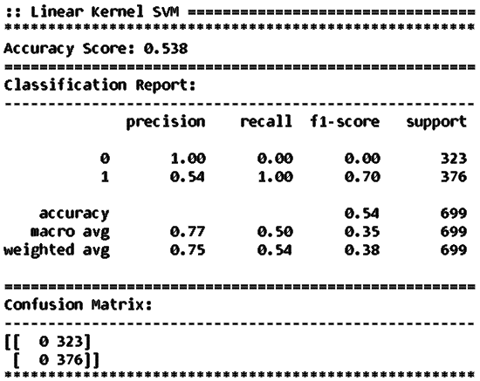
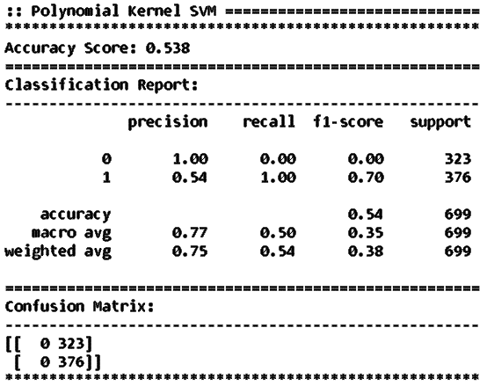
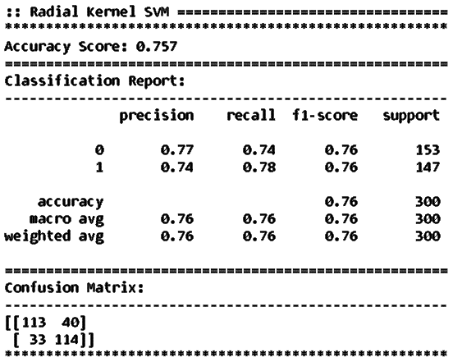
N.W. Kusuma | UAS-SVM
SVM modelling
Linear Kernel
Model
Polynomial Kernel
Model
Radial Kernel
Model
Applying SVM Modeling to the training set
Linear Kernel
Polynomial Kernel
Radial Kernel
Accuracy: 54%
Accuracy: 76%
Parameter: none
Accuracy: 54%
degree: 2
gamma: 1

Slide 8
N.W. Kusuma | UAS-SVM
SVM Deployment
Linear Kernel
Radial Kernel
Polynomial Kernel
Applying SVM Modeling to the testing set
Linear Kernel
Polynomial Kernel
Radial Kernel
Parameter: none
degree: 2 gamma: ‘auto’
gamma: 1
Applying SVM Modeling to the testing set
Linear Kernel
Polynomial Kernel
Radial Kernel
Accuracy: 54%
Accuracy: 76%
Accuracy: 54%

