Slide 1
Prediction Online News Popularity

Slide 2
Content
Data & Features
Exploratory Data Analysis
Features Selection
Machine Learning Comparison

Slide 3
Data & Features
Aspects | Features
Words | Number of words in the title Number of words in the article Average words length | Rate of non-stop words Rate of unique words Rate of unique non-stop words
Links | Number of links Number of Mashable article links | Minimum, average and maximum number of shares of Mashable links
Digital Media | Number of images Number of videos
Publication Time | Day of the week Published on a weekend
Key Words | Number of key words Worst keyword Average keyword | Best keywords Article category
NLP | Closeness to top 5 LDA topics Title subjectivity Article text subjectivity score and its absolute difference to 0.5 Title sentiment polarity Rate of positive and negative words | Rate of positive and negative words Neg. words rate among non-neutral words Polarity of positive words (min./avg./max.) Polarity of negative words (min./avg./max.) Article text polarity score and its absolute difference to 0.5
Response | Number of article shares

Slide 4
Exploratory Data Analysis

Slide 5
Features Selection
Remove redundant variables
We consider pair-wise correlations
Rank variables by importance
We use Pearson's correlation as the indicator to measures the linear relationship between continuous variables and the response variable. Then rank them from the highest correlated to the lowest correlated.

Slide 6
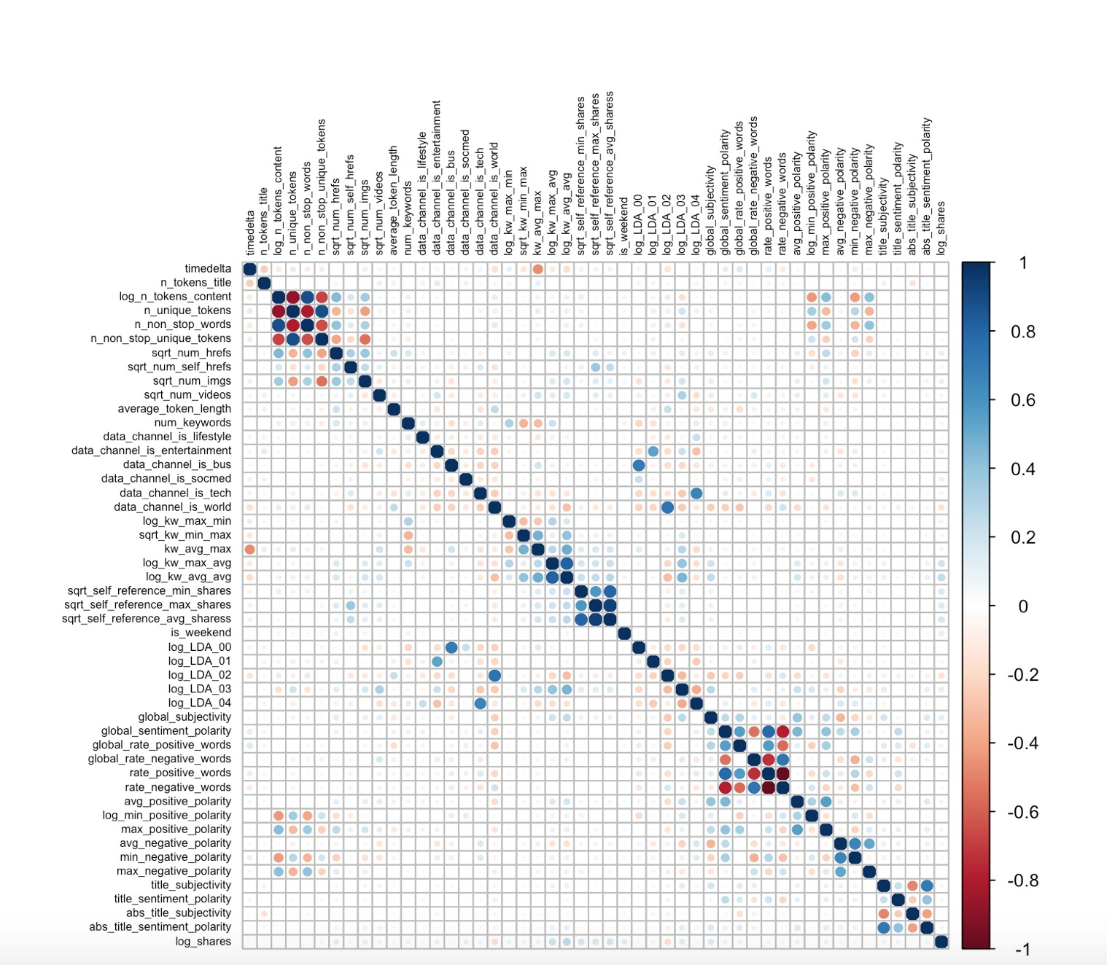
Correlation

Slide 7
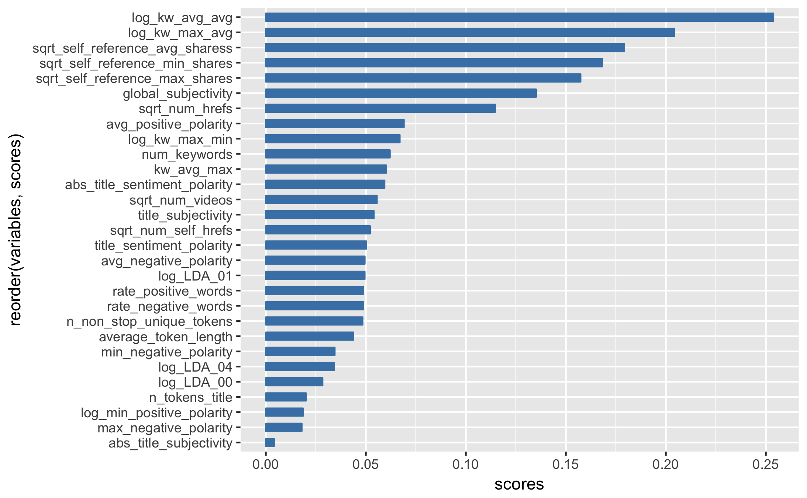
Importance rank

Slide 8
Machine Learning Comparison

Slide 9
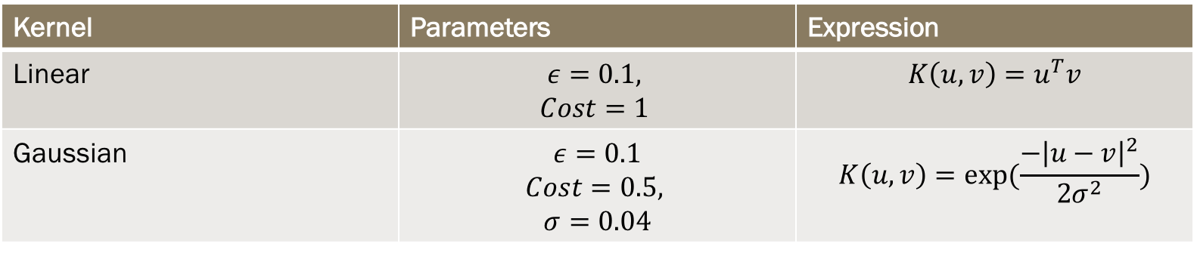
Support Vector Machine
Kernel | Parameters | Expression
Linear | $$ε=0.1,$$ $$Cost=1$$ | $$K\left(u,v\right)=u^{T}v$$
Gaussian | $$ε=0.1$$ $$Cost=0.5,$$ $$σ=0.04$$ | $$K\left(u,v\right)=exp⁡(\frac{−{\left|u−v\right|}^{2}}{2σ^{2}})$$

Slide 10
Comparison
Algorithms | MSE | Time
Linear Regression
Support Vector Machine (Linear) | 0.82 | 557s
Support Vector Machine (Gaussian)
Random Forest
Gradient Boosting
Regression Tree

