Slide 1
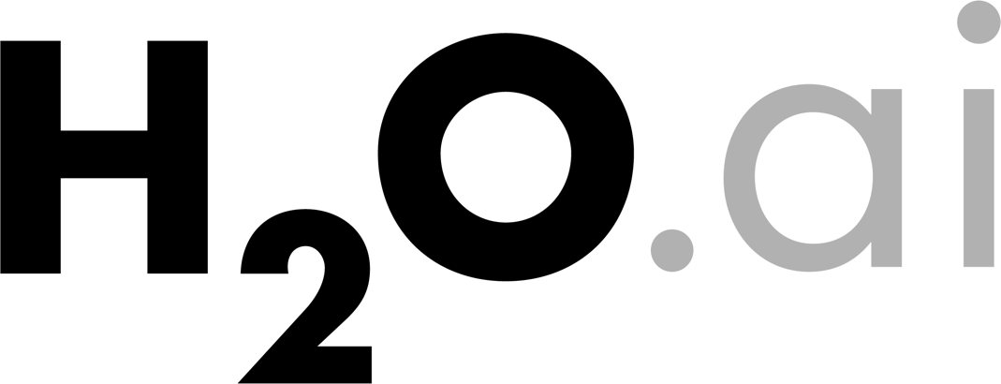
Top 10 Data Science Practitioner Pitfalls
H2O World 2015
Mark Landry

Slide 2

Train vs Test
1 of 10
Top 10 Data Science Practitioner Pitfalls

Slide 3
1. Train vs Test
Training Set vs.
Test Set
Partition the original data (randomly or stratified) into a training set and a test set. (e.g. 70/30)
Training Error vs.
Test Error
It can be useful to evaluate the training error, but you should not look at training error alone.
Training error is not an estimate of generalization error (on a test set or cross-validated), which is what you should care more about.
Training error vs test error over time is an useful thing to calculate. It can tell you when you start to overfit your model, so it is a useful metric in supervised machine learning.

Slide 4
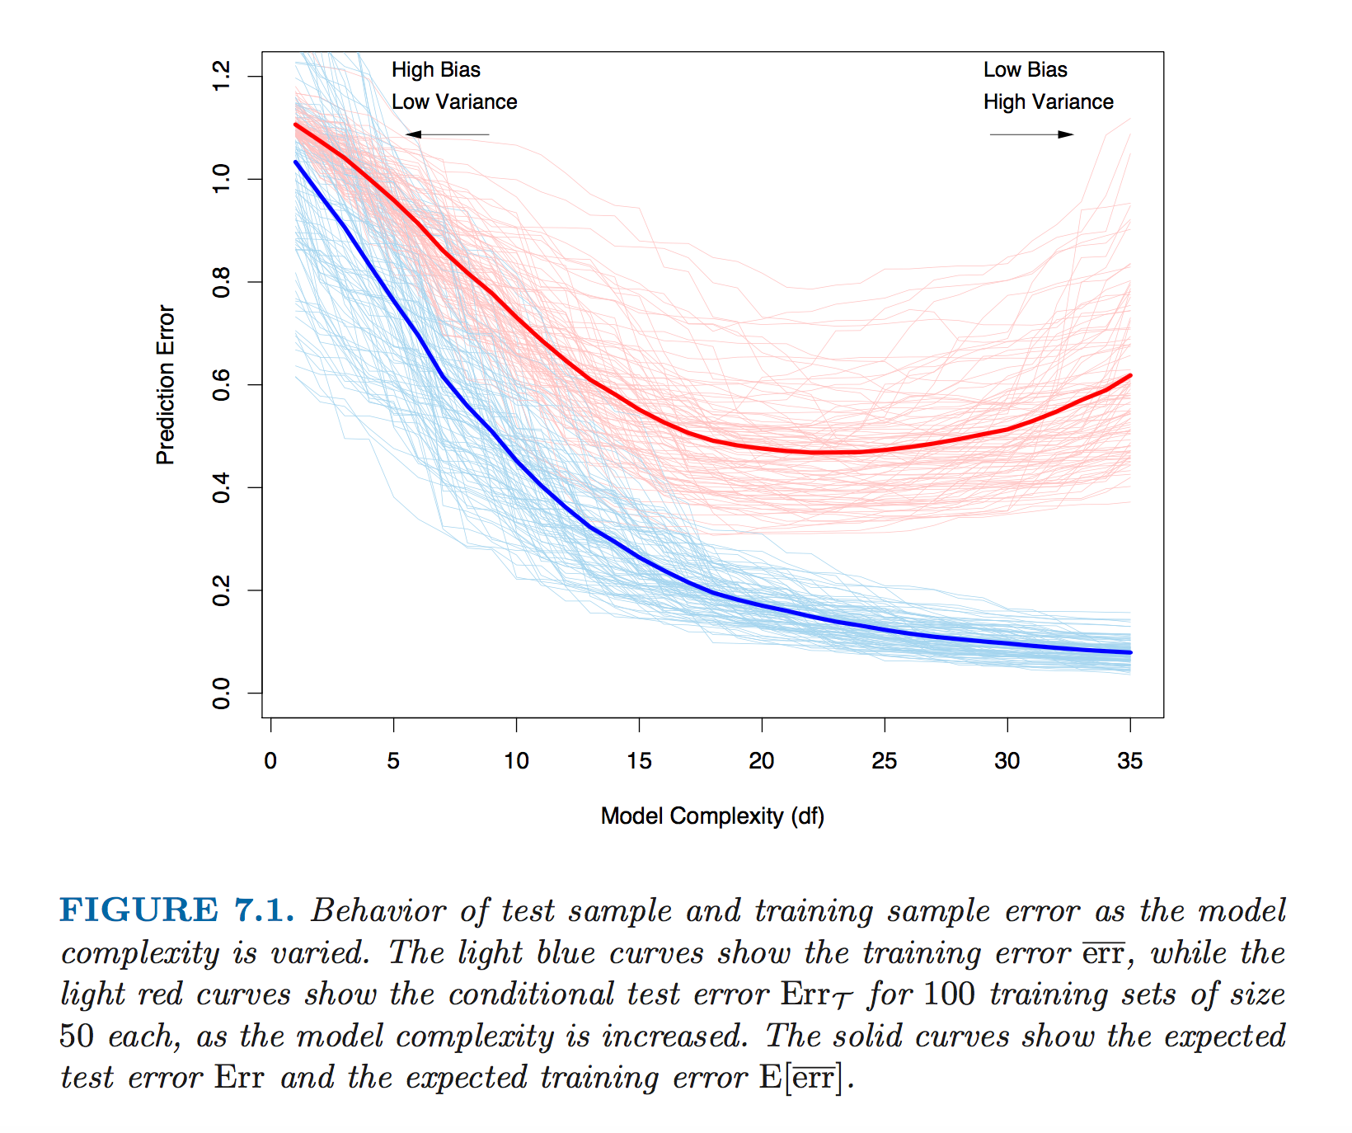
1. Train vs Test Error
Source: Elements of Statistical Learning

Slide 5
Validation Set
2 of 10
Top 10 Data Science Practitioner Pitfalls

Slide 6

2. Train vs Test vs Valid
Training Set vs.
Validation Set vs.
Test Set
If you have “enough” data and plan to do some model tuning, you should really partition your data into three parts — Training, Validation and Test sets.
There is no general rule for how you should partition the data and it will depend on how strong the signal in your data is, but an example could be: 50% Train, 25% Validation and 25% Test
Validation is for Model Tuning
The validation set is used strictly for model tuning (via validation of models with different parameters) and the test set is used to make a final estimate of the generalization error.

Slide 7
Model Performance
3 of 10
Top 10 Data Science Practitioner Pitfalls

Slide 8
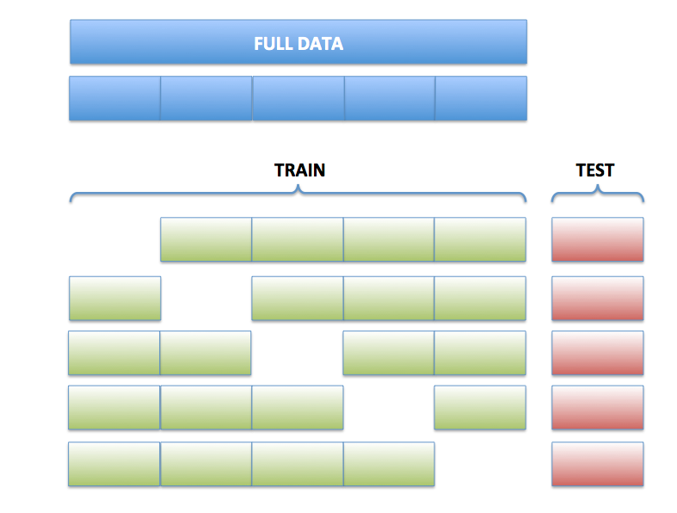
3. Model Performance
Test Error
Partition the original data (randomly) into a training set and a test set. (e.g. 70/30)
Train a model using the training set and evaluate performance (a single time) on the test set.
K-fold
Cross-validation
Train & test K models as shown.
Average the model performance over the K test sets.
Report cross-validated metrics.
Performance Metrics
Regression: R^2, MSE, RMSE
Classification: Accuracy, F1, H-measure, Log-loss
Ranking (Binary Outcome): AUC, Partial AUC

Slide 9
Class Imbalance
4 of 10
Top 10 Data Science Practitioner Pitfalls

Slide 10
4. Class Imbalance
Imbalanced Response Variable
A dataset is said to be imbalanced when the binomial or multinomial response variable has one or more classes that are underrepresented in the training data, with respect to the other classes.
Very common
This is incredibly common in real-word datasets.
In practice, balanced datasets are the rarity, unless they have been artificially created.
There is no precise definition of what defines an imbalanced vs balanced dataset — the term is vague.
My rule of thumb for binary response: If the minority class makes <10% of the data, this can cause issues.
Industries
Advertising — Probability that someone clicks on ad is very low… very very low.
Healthcare & Medicine — Certain diseases or adverse medical conditions are rare.
Fraud Detection — Insurance or credit fraud is rare.

Slide 11
4. Remedies
Artificial Balance
You can balance the training set using sampling.
Potential Pitfalls
Notice that we don’t say to balance the test set. The test set represents the true data distribution. The only way to get “honest” model performance on your test set is to use the original, unbalanced, test set.
The same goes for the hold-out sets in cross-validation. For this, you may end up having to write custom code, depending on what software you use.
H2O has a “balance_classes” argument that can be used to do this properly & automatically.
You can manually upsample (or downsample) your minority (or majority) class(es) set either by duplicating (or sub-sampling) rows, or by using row weights.
The SMOTE (Synthetic Minority Oversampling Technique) algorithm generates simulated training examples from the minority class instead of upsampling.
Solutions

Slide 12
Categorical Data
5 of 10
Top 10 Data Science Practitioner Pitfalls

Slide 13
5. Categorical Data
Real Data
Most real world datasets contain categorical data.
Too Many Categories
Problems can arise if you have too many categories.
A lot of ML software will place limits on the number of categories allowed in a single column (e.g. 1024) so you may be forced to deal with this whether you like it or not.
When there are high-cardinality categorical columns, often there will be many categories that only occur a small number of times (not very useful).
Solutions
If you have some hierarchical knowledge about the data, then you may be able to reduce the number of categories by using some sensible higher-level mapping of the categories.
Example: ICD-9 codes — thousands of unique diagnostic and procedure codes. You can map each category to a higher level super-category to reduce the cardinality.

Slide 14
Missing Data
6 of 10
Top 10 Data Science Practitioner Pitfalls

Slide 15
6. Missing Data
Types of
Missing Data
Unavailable: Valid for the observation, but not available in the data set.
Removed: Observation quality threshold may have not been reached, and data removed
Not applicable: measurement does not apply to the particular observation (e.g. number of tires on a boat observation)
What to Do
It depends! Some options:
Ignore entire observation.
Create an binary variable for each predictor to indicate whether the data was missing or not
Segment model based on data availability.
Use alternative algorithm: decision trees accept missing values; linear models typically do not.

Slide 16
Outliers
7 of 10
Top 10 Data Science Practitioner Pitfalls

Slide 17
7. Outliers/Extreme Values
Types of Outliers
Outliers can exist in response or predictors
Valid outliers: rare, extreme events
Invalid outliers: erroneous measurements
What Can
Happen
Outlier values can have a disproportionate weight on the model.
MSE will focus on handling outlier observations more to reduce squared error.
Boosting will spend considerable modeling effort fitting these observations.
Remove observations.
Apply a transformation to reduce impact: e.g. log or bins.
Choose a loss function that is more robust: e.g. MAE vs MSE.
Impose a constraint on data range (cap values).
Ask questions: Understand whether the values are valid or invalid, to make the most appropriate choice.
What to Do

Slide 18
Data Leakage
8 of 10
Top 10 Data Science Practitioner Pitfalls

Slide 19
8. Data Leakage
What Is It
Leakage is allowing your model to use information that will not be available in a production setting.
Obvious example: using the Dow Jones daily gain/loss as part of a model to predict individual stock performance
What Happens
Model is overfit.
Will make predictions inconsistent with those you scored when fitting the model (even with a validation set).
Insights derived from the model will be incorrect.
What to Do
Understand the nature of your problem and data.
Scrutinize model feedback, such as relative influence or linear coefficient.

Slide 20
Useless Models
9 of 10
Top 10 Data Science Practitioner Pitfalls

Slide 21
9. Useless Models
What is a
“Useless” Model?
Solving the Wrong Problem.
Not collecting appropriate data.
Not structuring data correctly to solve the problem.
Choosing a target/loss measure that does not optimize the end use case: using accuracy to prioritize resources.
Having a model that is not actionable.
Using a complicated model that is less accurate than a simple model.
What To Do
Understand the problem statement.
Solving the wrong problem is an issue in all problem-solving domains, but arguably easier with black box techniques common to ML
Utilize post-processing measures
Create simple baseline models to understand lift of more complex models
Plan on an iterative approach: start quickly, even if on imperfect data
Question your models and attempt to understand them

Slide 22
No Free Lunch
10 of 10
Top 10 Data Science Practitioner Pitfalls

Slide 23
10. No Free Lunch
No Such Thing as a Free Lunch
No general purpose algorithm to solve all problems.
No right answer on optimal data preparation.
General heuristics are not always true:
Tree models solve problems equivalently with any order-preserving transformation.
Decision trees and neural networks will automatically find interactions.
High number of predictors may be handled, but lead to a less optimal result than fewer key predictors.
Models can not find relative information that span multiple observations.
Model feedback can be misleading: relative influence, linear coefficients
What To Do
Understand how the underlying algorithms operate
Try several algorithms and observe relative performance and the characteristics of your data
Feature engineering & feature selection
Interpret and react to model feedback

Slide 24
Where to learn more about H2O?
H2O Online Training (free): http://learn.h2o.ai
H2O Slidedecks: http://www.slideshare.net/0xdata
H2O Video Presentations: https://www.youtube.com/user/0xdata
H2O Community Events & Meetups: http://h2o.ai/events
Machine Learning & Data Science courses: http://coursebuffet.com

