Slide 1
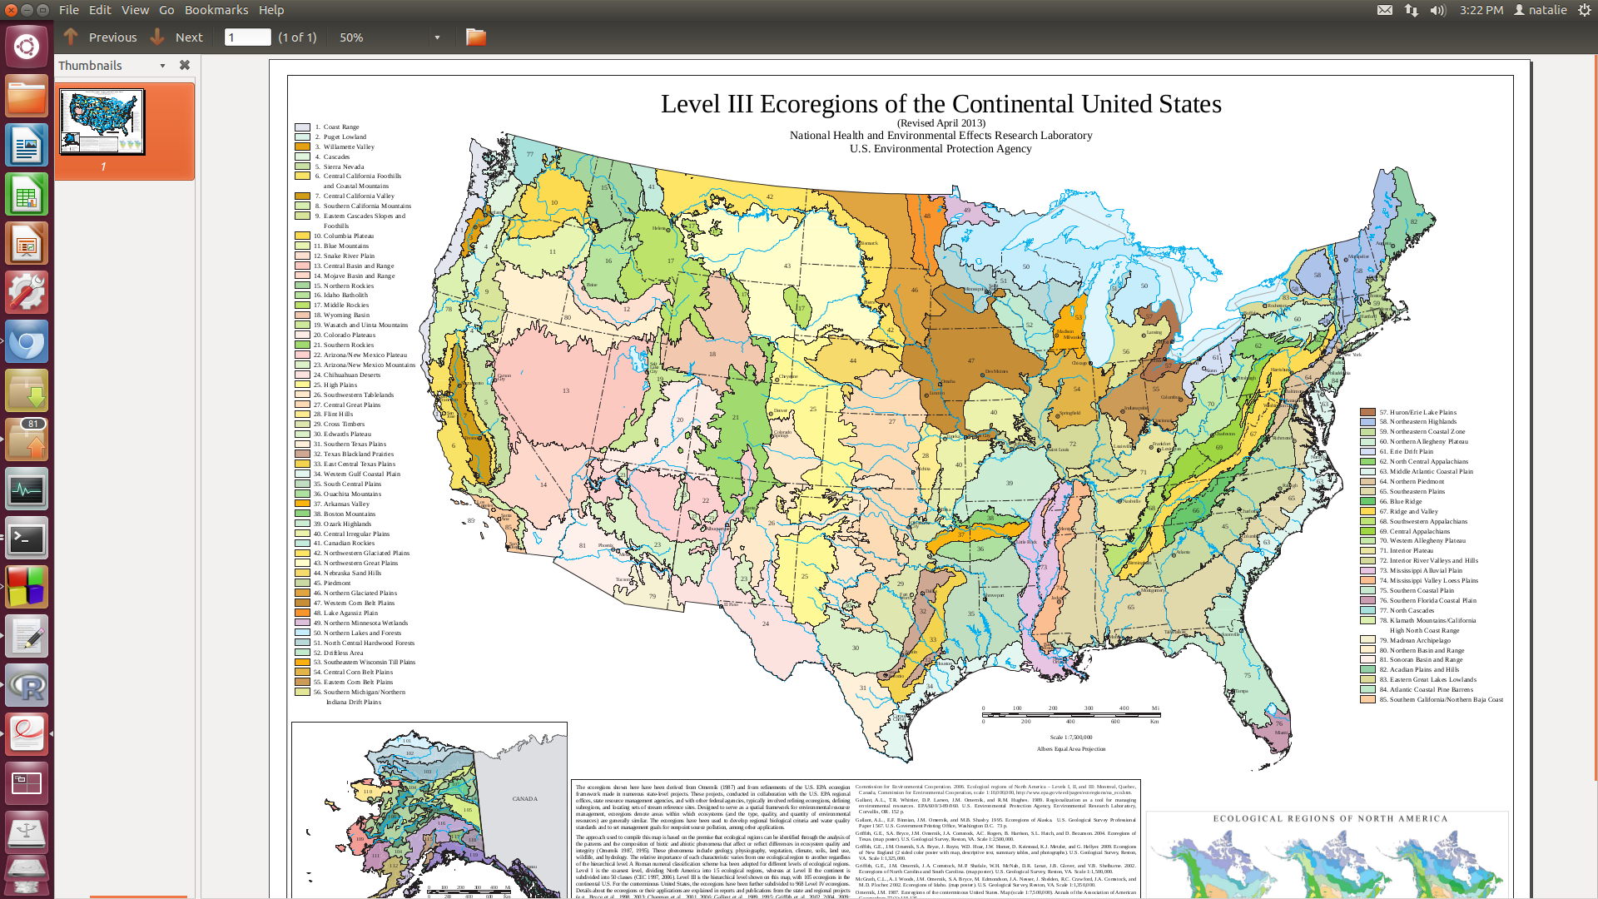

Slide 2
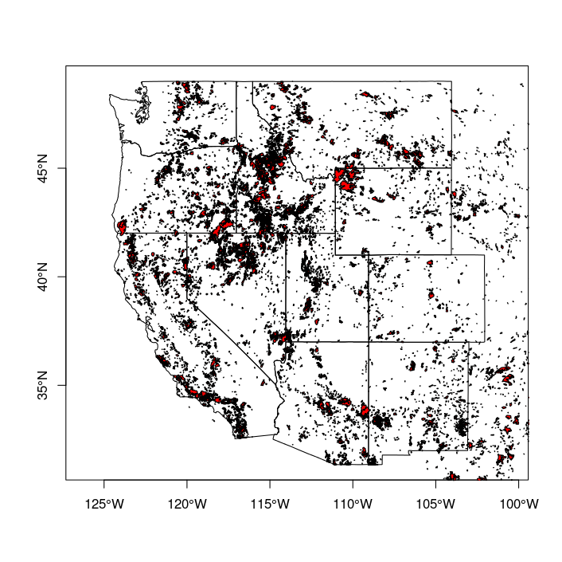
All fires 1984-2012

Slide 3
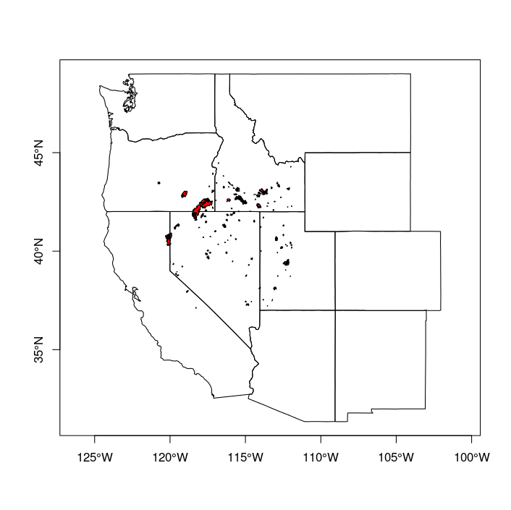
2012 wildfire fires
Ecoregions:
Central Basin Range (52)
Northern Basin Range (38)
Snake River Plain (30)
120 fire perimeters
0.4 – 452336 acres
1st: 1/19/12
Last:10/31/12
Only have start dates, currently we are simulating the day after the start date until 12/31/12 (or 11/30/12)?

