Slide 1
Phase 3 Router Benchmark: Canary-Green, Multi-Provider, Ready for Funded Smoke
Claude Code remains fixed; LiteLLM routes the same benchmark flow across 13 canary-green arms spanning 8 provider families.
READY ARMS
PROVIDER FAMILIES
5-TASK SMOKE
CONTAMINATION AUDIT
13
8
$44.72
Clean
Active router arms passed the canary task.
Anthropic, DeepSeek, Gemini, OpenAI, xAI, Moonshot, DashScope, Z.AI.
Canary-scaled estimate; recommended 2x reserve: $89.44.
No WebSearch/WebFetch events in passing canaries.
Decision path
STEP 1
STEP 2
STEP 3
Fund 5-task smoke
Replace estimates with smoke data
Approve, resize, or defer full sweep
Core message: Phase 3 is operational enough for funded smoke testing, but the full sweep should wait until smoke results replace canary-scaled estimates.
Evidence ledger
Cost summary
Dashboard spec
Phase 3 Router Benchmark | 1
Evidence-backed sponsor briefing

Slide 2
From Three-Arm Baseline to Multi-Provider Router Harness
PHASE 1 BASELINE
PHASE 3 ROUTER LAYER
3 arms
13 green arms
Anthropic Sonnet, DeepSeek Pro, DeepSeek Flash. Claude Code fixed as the agent harness. Harbor ran Terminal-Bench tasks.
LiteLLM routes the same benchmark flow across 8 provider families. Canary-first execution catches auth, route, quota, schema, and tool-mode issues.
Continuity: Claude Code remains the fixed harness.
Change: model/provider coverage expands through LiteLLM.
Methodology: results remain separated under results/phase3.
Phase 3 Router Benchmark | 2
Evidence-backed sponsor briefing

Slide 3
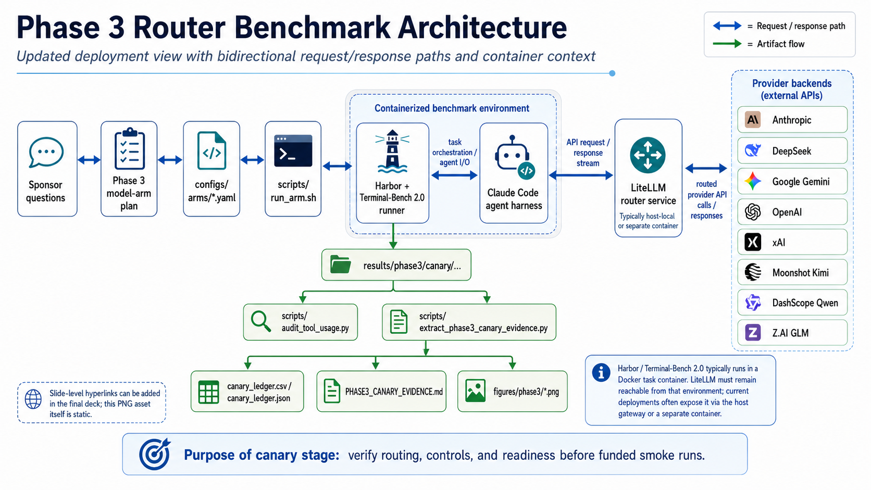
Phase 3 Router Benchmark Architecture
Request and response flow is bidirectional between Claude Code, LiteLLM, and provider backends.
Phase 3 Router Benchmark | 3
Evidence-backed sponsor briefing

Slide 4
Canary Gate: Infrastructure Readiness, Not Final Model Ranking
Current gate uses Terminal-Bench 2.0 task modernize-scientific-stack.
The task exercises read, write, execute, verify, routing, results, and audit flow.
A canary pass means routing/config/tool controls are ready for smoke.
It does not rank model quality across the full Terminal-Bench distribution.
PASS SIGNAL
End-to-end path works
Harbor -> Claude Code -> LiteLLM -> provider -> results -> audit
FAIL SIGNAL
Classify before spending
Auth, quota, route, model slug, schema, tool-mode, or benchmark failure
NEXT GATE
5-task smoke
Use representative multi-task evidence to replace canary-scaled cost estimates
Phase 3 Router Benchmark | 4
Evidence-backed sponsor briefing

Slide 5
Current Canary-Green Model Arms
13 active router arms spanning 8 provider families.
Arm
Provider
Backend model
Cost
Runtime
router-anthropic-haiku-sanitized
anthropic
claude-haiku-4-5-20251001
$0.315
486.1s
router-anthropic-opus
anthropic
claude-opus-4-7
$0.315
289.3s
router-anthropic-sonnet
anthropic
claude-sonnet-4-6
$0.293
82.3s
router-deepseek-flash
deepseek
deepseek-v4-flash
$0.115
252.2s
router-deepseek-pro
deepseek
deepseek-v4-pro
$0.092
425.1s
router-gemini-3.1-pro
google-gemini
gemini-3.1-pro-preview
$0.291
129.3s
router-gemini-flash
google-gemini
gemini-3.5-flash
$2.451
150.9s
router-glm-5.1
zai-glm
glm-5.1
$0.107
135.8s
router-gpt-5.4
openai
gpt-5.4
$0.799
115.2s
router-gpt-5.5
openai
gpt-5.5
$2.547
165.1s
router-grok-build-0.1
xai
grok-build-0.1
$0.710
103.0s
router-kimi-k2.6
moonshot-kimi
kimi-k2.6
$0.465
198.0s
router-qwen-3.7-plus
dashscope-qwen
qwen3.7-plus
$0.444
149.8s
Phase 3 Router Benchmark | 5
Evidence-backed sponsor briefing

Slide 6
Provider-Specific Engineering Lessons
Gemini
OpenAI
Resolved
Resolved
Route correction and no-plan tool mitigation were needed.
Router validation completed; costs need smoke confirmation.
Qwen
xAI Grok
Resolved
Resolved
Singapore endpoint and model-access normalization were required.
Funding/access recovery and model selection unblocked canary.
Moonshot Kimi
Z.AI GLM
Resolved
Resolved
Temperature/max-token behavior matters for direct probes.
Funding/access recovery and model update unblocked canary.
Interpretation: these were infrastructure learnings unless the model actually ran and failed the benchmark task.
Phase 3 Router Benchmark | 6
Evidence-backed sponsor briefing

Slide 7
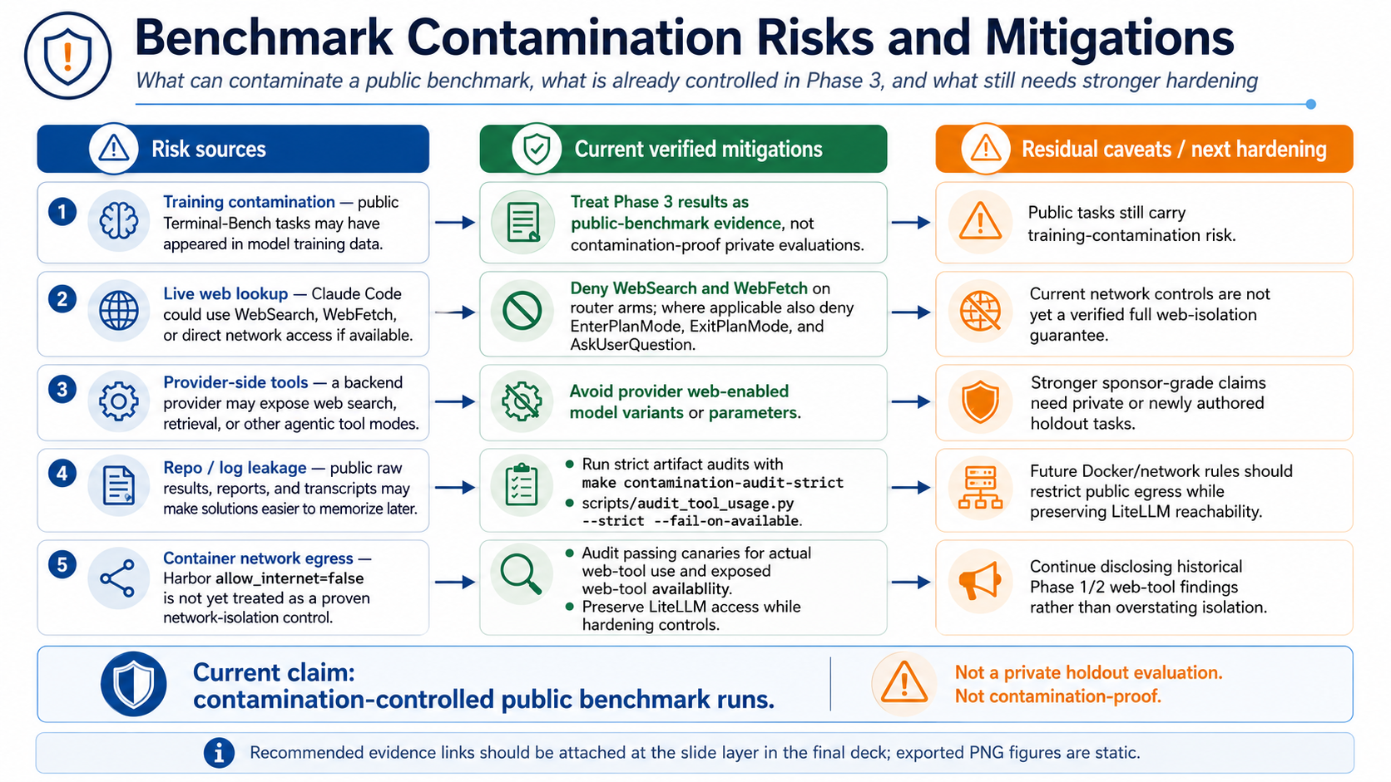
Benchmark Contamination Controls
Contamination risk is treated as a first-class control, not an afterthought.
Phase 3 Router Benchmark | 7
Evidence-backed sponsor briefing

Slide 8
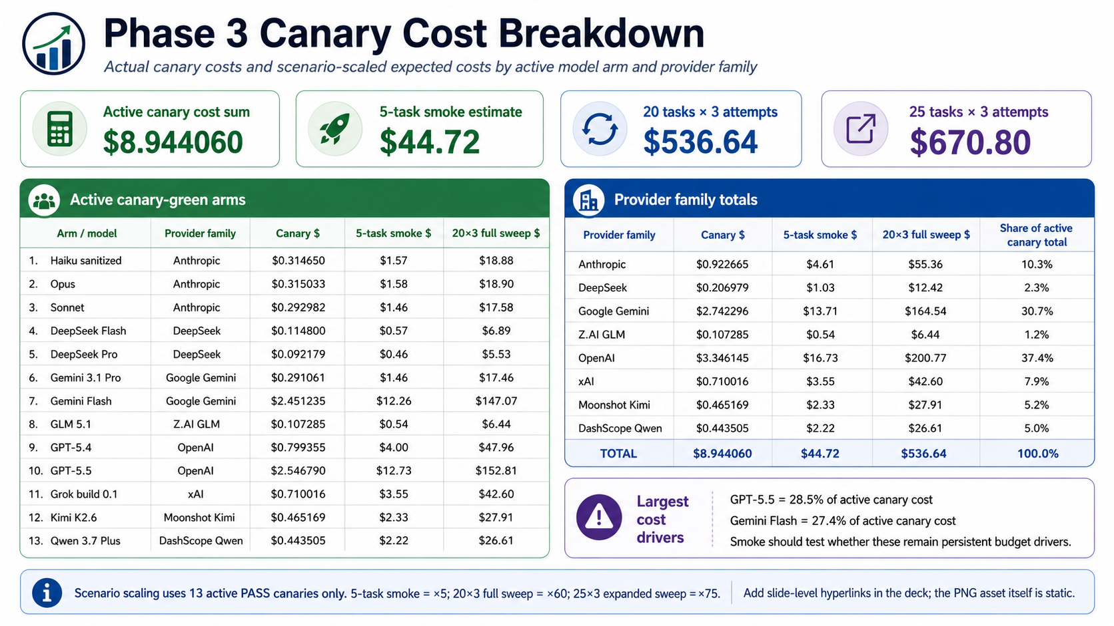
Canary Cost Breakdown
Canary costs reveal budget drivers before smoke/full-sweep funding.
Phase 3 Router Benchmark | 8
Evidence-backed sponsor briefing

Slide 9
Funding Gate and Forecast
5-TASK SMOKE
20 TASKS x 3
25 TASKS x 3
$44.72
$536.64
$670.80
Recommended reserve: $89.44. Run first.
Reserve: $804.97. Approve after smoke.
Reserve: $1,006.21. Expanded coverage option.
Canary-scaled estimates are useful for order-of-magnitude planning only.
GPT-5.5 and Gemini Flash were high-cost canary outliers.
The ask is to fund the next statistically and financially sensible gate.
Phase 3 Router Benchmark | 9
Evidence-backed sponsor briefing

Slide 10
Recommended Next Actions
ACTION 1
ACTION 2
ACTION 3
Confirm exact 5-task smoke set
Approve smoke and/or full sweep budget plus reserve
Run smoke across 13 active green router arms
ACTION 4
ACTION 5
Re-run evidence extraction after smoke
Approve, resize, or defer full sweep
Phase 3 Router Benchmark | 10
Evidence-backed sponsor briefing

Slide 11
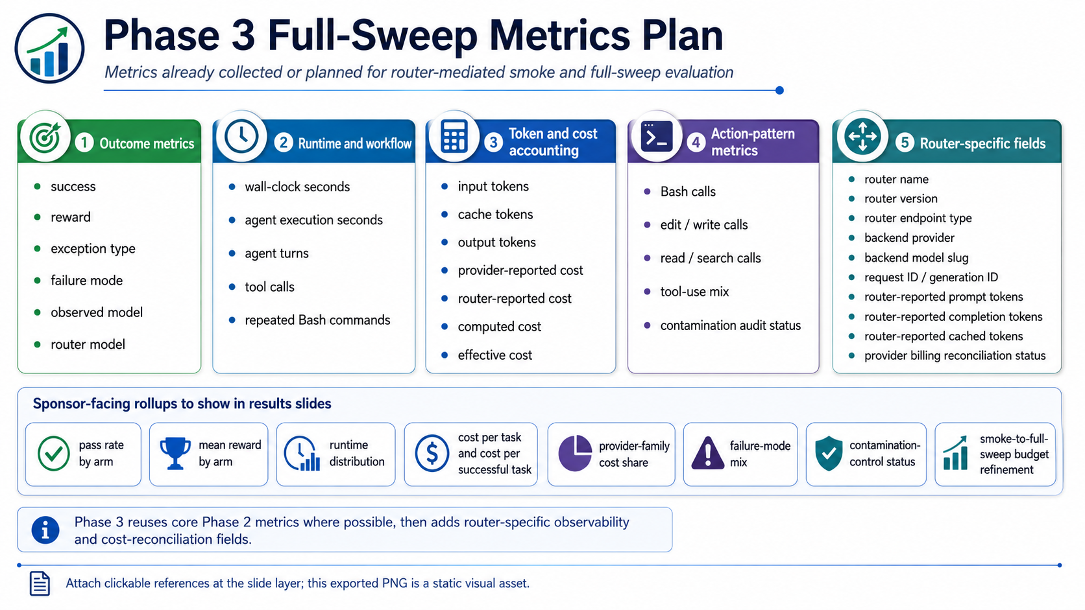
Appendix A: Metrics Collected and Planned
Phase 3 Router Benchmark | 11
Evidence-backed sponsor briefing

Slide 12
Appendix B: Evidence and Reproducibility Hub
Canary evidence report
Canary ledger CSV
Canary ledger JSON
Cost forecast CSV
Cost forecast summary
LiteLLM router config
Router arm configs
Contamination notes
Runbook
Artifact policy
Phase 3 Router Benchmark | 12
Evidence-backed sponsor briefing

