Slide 1
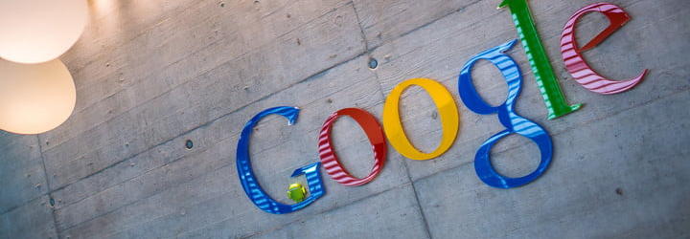
Google Analytics Customer Revenue Prediction
Notes:
Good afternoon everyone. We are here to present our analysis on Google analytics customer revenue prediction.

Slide 2
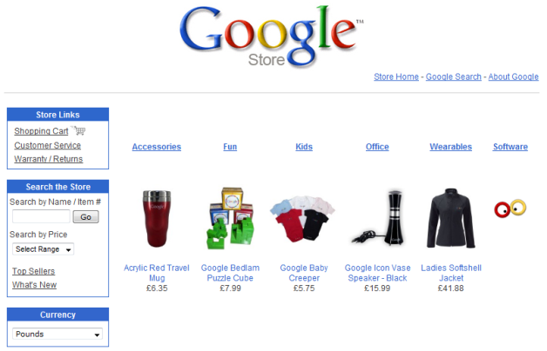
Problem Statement
Google Store is an online hardware retailer store.
Lot of people visit Google Store every day, which generates huge volumes of data.
08/01/2016
10/15/2018
12/1/2018
1/31/2019
Data
Prediction
The data recorded visit history to Google Store in this period
Each row in the dataset is one visit to the store.
Predict how much Google Store customers will spend in this period.
Target: Log transaction revenue
Notes:
Google Store is an online hardware retailer store. Lot of people visit Google Store every day, which generates huge volumes of data. It’s a good source for Google Store to use this data as a guiding tool for their decision-making.
We have such visit data from 08, 2016 to 10, 2018. More than 2 years visit history data. The data recorded visit history to Google Store in this period. Each row in the dataset is one visit to the store.
Our goal is to predict how much Google store customer will spend from Dec, 2018 to Jan 2019 based on the data we have.

Slide 3
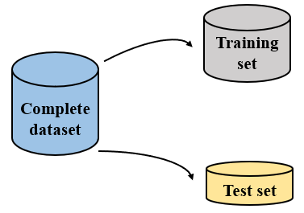
Data Description
Kaggle.com
Data source
23.67 GB
Training set size
60
Variables
> 2 years
Records In training set
5.5 months
Records in test size
7 GB
Test set size
Notes:
The data is available at kaggle.com. We get two data set from kaggle, one is training set and another one is test set. For training set, it’s 23 gb and has more than 2 years records. For the test set, it’s 7 gb and has 5 and a half months records. Both have 60 variable.

Slide 4
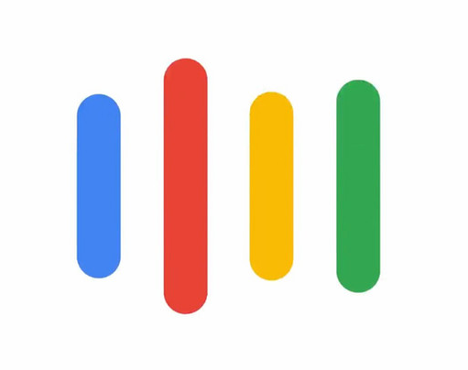
Solution Overview
Will the customer return to the store in the next 2 months?
Use LightGBM model to predict if a customer will comeback
If the customer returns, how much will he/she spend?
Use LightGBM model to predict the transaction revenue
RMSE: 0.881
So what? What can Google do with the analysis results?
Precisely customize marketing offer
Predict performance of the store to decide future investment
Notes:
Our solution is to build two models to help Google Store understand customers.
Firstly, we want to know whether a customer will return to the store in the next 2 months. So we build a model to predict whether a customer will comeback or not. This model help us to identify customers who will return to the store.
After identifying customers who will return, we are interested in how much he will spend. We build another lightGBM model to predict the transaction revenue.
Our model can be a guiding tool for google store’s marketing strategies. For example, it can help google to precisely customize marketing offer and predict performance of the store to decide future investment.
*** will talk about the challenge we have and the details of our approach.

Slide 5
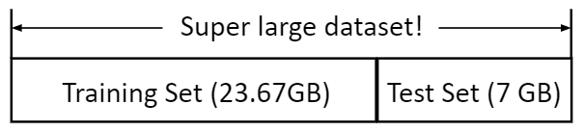
Challenges
How to load the data?
Chunksize
Google Colab
How to deal with training set?
Different time periods
Keep them in the same level
Dataset | Starting data | End Date | Period
Training | 08/01/2016 | 04/30/2018 | > 2 years
Test | 05/01/2018 | 10/15/2018 | 5.5 months
Prediction | 12/1/2018 | 01/31/2019 | 2 months
How to deal with categorical data?
LabelEncoder
Target Encoder
One hot Encoder
Notes:
Before hands on modeling and prediction, there are three challenges we will have, and here we figure out solutions.
The first one is the large data size, which makes it difficult to load and process in local environment. In this case, we use Google Colab to do the initial data loading. We load them by chunks, each chunk got 1 million rows and we concat the chunks into one data frame, fallten the json fields, and output the datasets. In this way, the data size become 10 times smaller.
Second, when we predict future revenues of each customer, we are using 5 months data to predict the future 2 months. However, the training data is 3 years long. If we train our model to predict future based on three years data, it might not be that accurate. Therefore, we split the training data into 4 chunks, each chunk contains 5 months data.
Lastly, we have many categorical variables. Usually, when we do prediction, we have to convert them into numeric. We tried different
our goal is to predict revenues for each customer in the future two months. The data we have is 5 months data, the data we predict is two months in the future.
that, based on five months data, to predict the revenues for each customer in the future two months based on five months of data.
In light of the Kaggle champion solution, we broke this goal into two steps: firstly we predict whether a customer is going to return in the future two months, secondly we predict if the customer is going to return, how much this customer will spend.
This means we should conduct two models.
we create two new target variables, showing the future value for the current period. The first one shows whether a customer is going to return in the future two months starting from the current period. The second target shows if the customer is going to return, how much this customer is going to spend. Then we have two targets, each target for a model.
showing the future value for the current period.

Slide 6
Approach
Flatten JSON columns
Missing values
Encoding categorical variables
Create return label
RMSE
Random Forest
XGBoost
LightGBM
Evaluation
Predict & Validate
Model Selection
Cross Validation
Feature Selection
Data Preparation
Drop redundant features
Feature importance

Slide 7
Data Preparation
Flatten JSON columns
JSON_NORMALISE
Redundant & Missing Values
Drop categorical columns with constant values
Numerical: fill with 0
Categorical: Keep NaN
Encoding categorical variables
LabelEncoder
Target Encoder (doesn’t work on test data for we don’t have future target value)
OneHotEncoder
Create Return Label
Divide data in 5.5 month window
Return if the customer visit again in 46 + 62 days
(46: gap between train/ test data
62: # of days of prediction period)
Notes:
Flatten JSON columns
Missing values
Encoding categorical variables
Create return label

Slide 8
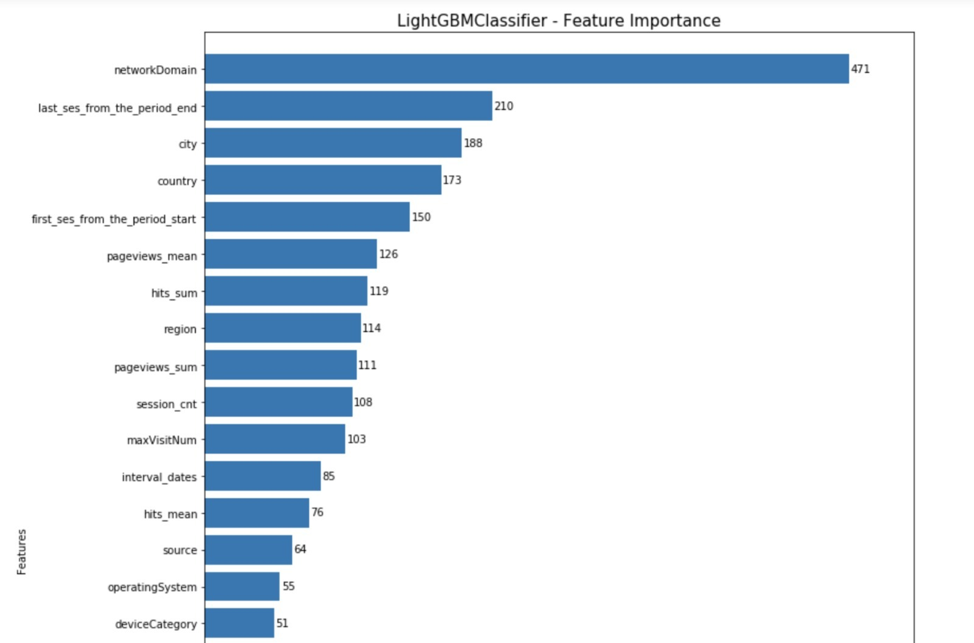
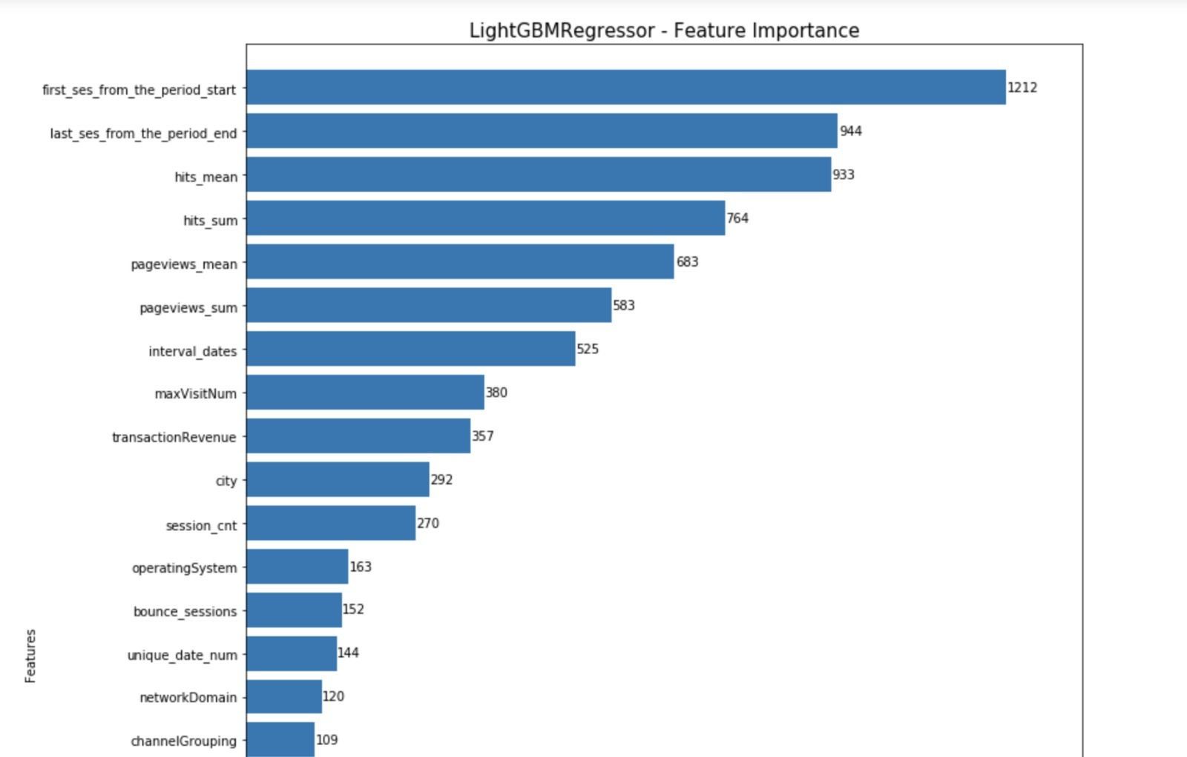
Feature Selection
Use Feature Importance Provided by LightGBM

Slide 9






Model Selection
Bagging based ensemble model with improved accuracy due to randomization | Gradient Boosting based algorithm which improves performance by parallel processing, tree pruning and regularization | Advanced model built on XGBoost Handle larger dataset quicker and directly deals with categorical variables without any transformation
Best RMSE: 1.07444 | Best RMSE: 1.03434 | Best RMSE: 0.88188

Slide 10

Conclusion & Recommendation
Our best model LightGBM can be a guiding tool for marketing strategies.
1. Customize marketing strategies
Using the prediction on whether the customer will return or not, we can devise separate marketing strategies to different customers. For our valued customers, we can provide them customize service.
2. Forecast the revenue and budget control
Our model can help Google Store predict how much a customer will spend, which helps marketing teams to make better use of their
budgets
Notes:
Using the prediction on whether the customer will return or not; devise separate marketing strategies.
Send them offers on products based on their predicted purchase amount.
For those, who are predicted as non-returning, send them incentivized surveys to understand the reason for their behaviour
Also, send them offers of their loss leaders so that we can lure them to visit our website.

Slide 11
THANK YOU! ANY QUESTIONS?

