Slide 1
Digital Assistant to summarize meeting minutes and distill actionable insights

Slide 2
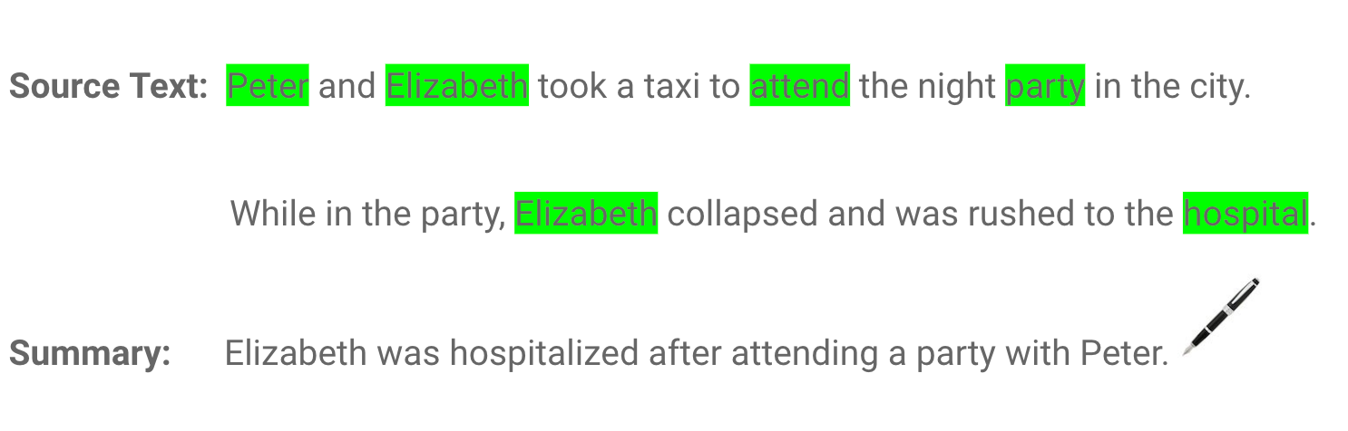
Let’s initiate you into the world of text summarizers
Extractive
Abstractive

Slide 3
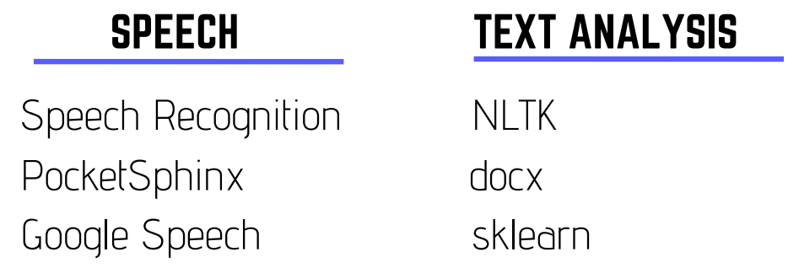

Python offers extensive support libraries, allowing us to conceptualize, iterate and demo the product in 2 weeks
Notes:
Advantages or Benefits of Python
Extensive Support Libraries
It provides large standard libraries that include the areas like string operations, Internet, web service tools, operating system interfaces and protocols. Most of the highly used programming tasks are already scripted into it that limits the length of the codes to be written in Python.
Improved Programmer’s Productivity
The language has extensive support libraries and clean object-oriented designs that increase two to ten fold of programmer’s productivity while using the languages like Java, VB, Perl, C, C++ and C#.

Slide 4
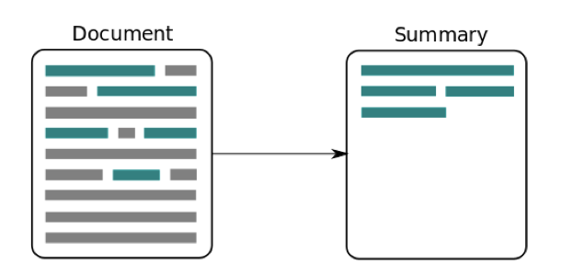
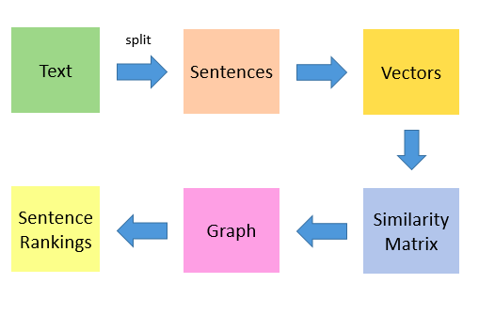
A bird’s eye view of the process
Notes:
The first step would be to concatenate all the text contained in the articles
Then split the text into individual sentences
In the next step, we will find vector representation (word embeddings) for each and every sentence
Similarities between sentence vectors are then calculated and stored in a matrix
The similarity matrix is then converted into a graph, with sentences as vertices and similarity scores as edges, for sentence rank calculation
Finally, a certain number of top-ranked sentences form the final summary

Slide 5

Speech to Text and Sentence Tokenization
Google SpeechRecognition API in Python to convert speech to text.
Text Tokenization
Removing StopWords, Punctuations and special characters (if any).
Notes:
SpeechRecognition is a library in Python which supports multiple speech to text APIs by Bing, Houndify, IBM, CMU. We used Google API as it was giving the best results out of all these and also provide free usage till some limit.

Slide 6
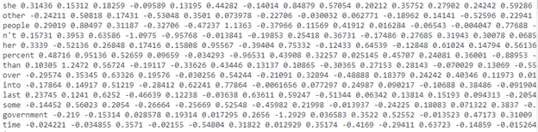

Vectorization of Sentences - GloVe
Used pre-trained GloVe embedding.
Notes:
GloVe (Global Vectors for Word Representation) is developed as an open source project at Stanford. The model is an unsupervised learning algorithm for obtaining vector representations for words. This is achieved by mapping words into a meaningful space where the distance between words is related to semantic similarity.

Slide 7

GloVe - How it works?
Given two words ice and steam, if a third work “k” is
Very similar to ice (i) but irrelevant to steam, if P_ik/P_jk is very high (>1)
Very similar to steam (j) but irrelevant to ice, if the ratio is very low (<1)
Unrelated to either words, if around 1.

Slide 8
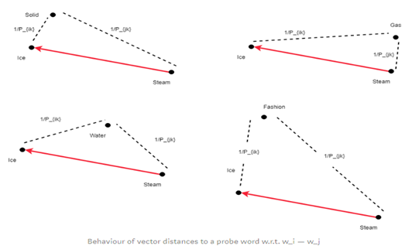


GloVe - How it works?
Notes:
[Citation] GloVe: Global Vectors for Word Representation Jeffrey Pennington, Richard Socher, Christopher D. Manning Computer Science Department, Stanford University, Stanford, CA 94305

Slide 9
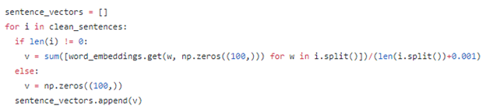
Creating Sentence Embeddings
Average of all embedding normalized over the size of sentence vector.

Slide 10
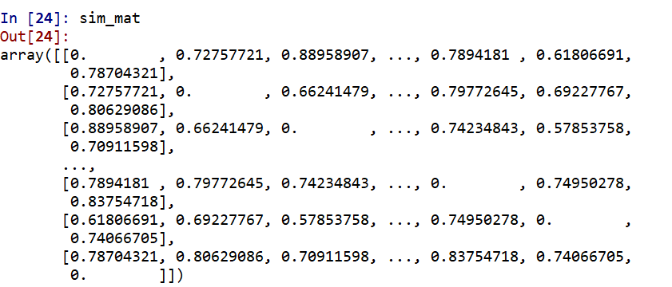
Similarity Matrix
Used cosine distance to make similarity matrix of S X S dim

Slide 11
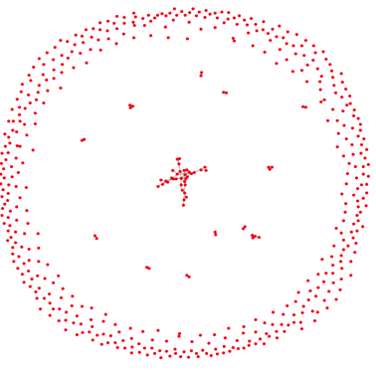
NetworkX Graph
Nodes represents the sentences in similarity matrix
Edge length represents the similarity weights of sentences.
Notes:
Then used Networkx to create a graph linking the sentences using similarity as weights for edges (edge length) then using weights above a certain cutoff to visualize the links. Closer the nodes more is the weight or similarity measure.

Slide 12
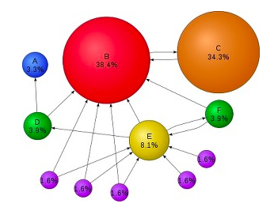

PageRank for Scoring Sentences
Used the PageRank (or Text Rank) algorithm to rank each nodes.
Notes:
[Citation] - Graph-based Ranking Algorithms for Sentence Extraction, Applied to Text Summarization Rada Mihalcea Department of Computer Science University of North Texas

Slide 13
To-Do List & Critical Items
To – Do List | Critical Items
Can/Could | Dates/Days
Do | must
recommend | should
want | strategy
help | immediate
update | important
primarily | wrong
Used simple regex rules using common vocab used in meetings.
Notes:
Going forward we can use DAN embedding/Word2Vec to find the similar context words and find the items using the embedding distance.

Slide 14
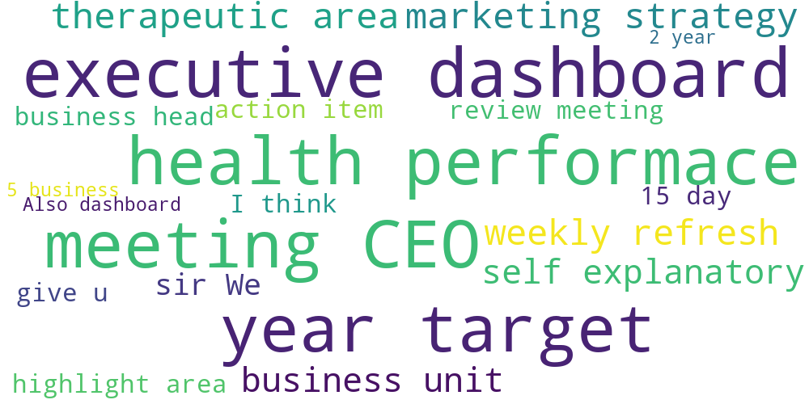
Word Cloud - Common Theme
2-gram word cloud based on most recurring combination
Docx to generate final output
Notes:
At last, we showed a 2-gram word cloud to show the most recurrent words just in case missed by above analysis and to have a high level view of the meeting discussion.

Slide 15

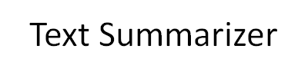

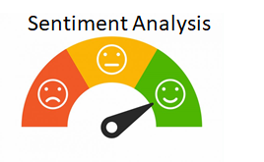

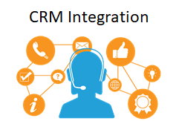

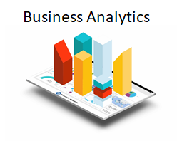

The business applications

Slide 16


