Slide 1
Part 1

Slide 2
Activity (5 minutes)
Using the next page, place up to 10 boxes on certain dogs
You may need to copy and paste to get more boxes
Pick two traits for the dogs according to your missing mechanism
If MCAR: Pick one trait that will have missing data
If MAR: two traits should have some observable relationship, but only one of them have missing values
Example: Fur color has missing information, when we condition on breed type (terrior)
If MNAR: one trait that is not related to observed values (of other traits)
Place semi-transparent boxes according to the missing mechanism you received

Slide 3
Dog ID | Breed | Length (in) | Speed (mph) | Social Score (1-10) | Energy Level (1-10) | Dominant Fur Color
1 | Affenpinscher | 11.2 | 14.5 | 6 | 7 | Black
2 | Affenpinscher | 10.5 | 13.2 | 5 | 6 | Gray
3 | Affenpinscher | 11.8 | 15.1 | 7 | 8 | Black
4 | Affenpinscher | 9.8 | 12.8 | 6 | 6 | Gray
5 | Affenpinscher | 10.9 | 14 | 4 | 7 | Black
6 | Bichon Frise | 10.1 | 11.5 | 9 | 5 | White
7 | Bichon Frise | 11.4 | 12.8 | 10 | 6 | White
8 | Bichon Frise | 9.5 | 10.2 | 8 | 5 | White
9 | Bichon Frise | 10.8 | 12.1 | 9 | 6 | White
10 | Bichon Frise | 11 | 11.9 | 10 | 5 | White
11 | Boston Terrier | 15.5 | 18.2 | 8 | 7 | Black
12 | Boston Terrier | 16.8 | 19.5 | 7 | 8 | Brown
13 | Boston Terrier | 14.2 | 16.9 | 9 | 6 | Black
14 | Boston Terrier | 15 | 17.5 | 8 | 7 | Black
15 | Boston Terrier | 16.1 | 18.8 | 8 | 8 | Brown
16 | Cavalier King Charles Spaniel | 12.5 | 15.4 | 9 | 5 | Brown
17 | Cavalier King Charles Spaniel | 13.2 | 16.2 | 10 | 6 | White
18 | Cavalier King Charles Spaniel | 11.9 | 14.8 | 9 | 5 | Black
19 | Cavalier King Charles Spaniel | 13 | 15.9 | 8 | 4 | Red
20 | Cavalier King Charles Spaniel | 12.3 | 15.1 | 10 | 5 | Brown
21 | Chihuahua | 7.5 | 11.2 | 4 | 6 | Tan
22 | Chihuahua | 8.2 | 12.5 | 5 | 7 | Brown
23 | Chihuahua | 6.8 | 10.1 | 3 | 5 | White
24 | Chihuahua | 7.9 | 11.8 | 5 | 6 | Black
25 | Chihuahua | 7.1 | 10.6 | 4 | 7 | Cream

Slide 4
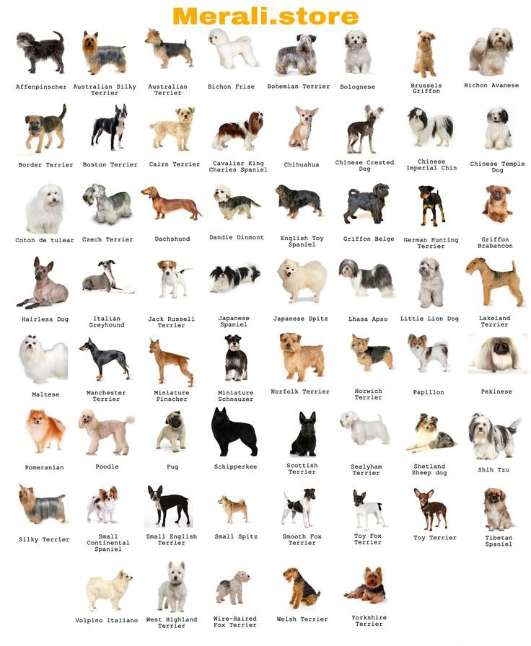
For reference of dogs!

Slide 5
Come together as a group (10 minutes)
Can your group figure out the mechanism of missing dogs?
You can use any qualities observed in the full picture
Can your group determine the trait (or if there is a trait) that you used to identify missing dogs?
If your dog data ignorable or non-ignorable?
Can you impute the missing dogs?
How would you approach these data?

Slide 6
Part 2

Slide 7
Reporting what you know (15 minutes)
Read the following page on reporting in the Van Buuren online textbook
5-10 minutes reading
Using the guidelines 1-3 and the template, construct a paragraph to report on missing data of the length of dogs!
Can do this as a group for each missing mechanism
Things you might include:
In total ____ out of 25 dogs (____%) were incomplete.
1-2 sentences for why missing data (you made need to make up a story)
We determined the data were _____ (missing mechanism and ignorability)
How would you handle the missing data?

