Slide 1
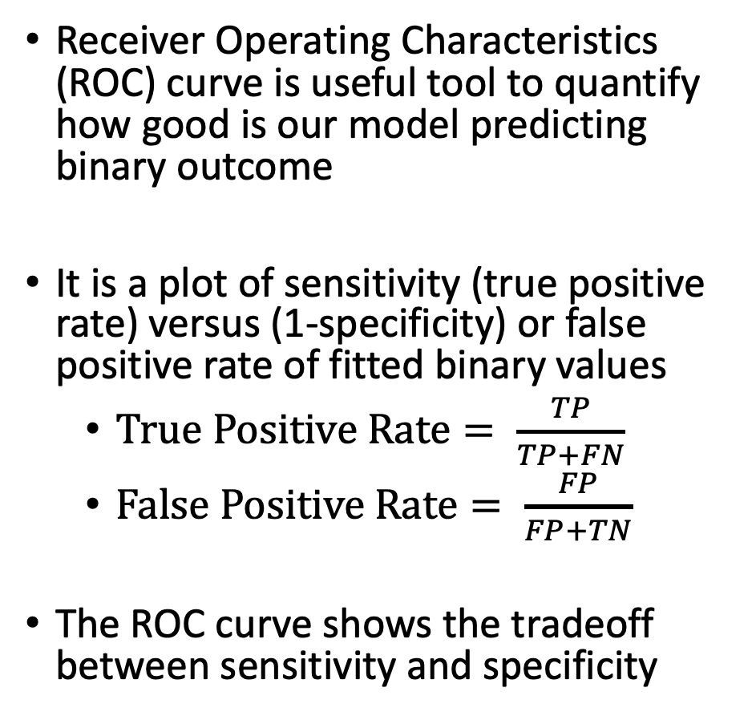
ROC Curve and AUC (I)
Receiver Operating Characteristics (ROC) curve is useful tool to quantify how good is our model predicting binary outcome
It is a plot of sensitivity (true positive rate) versus (1-specificity) or false positive rate of fitted binary values
$True Positive Rate= \frac{TP}{TP+FN}$
$False Positive Rate= \frac{FP}{FP+TN}$
The ROC curve shows the tradeoff between sensitivity and specificity
 |  | Observed outcome
 |  | 1 | 0
Predicted/fitted outcome | 1 | TP | FP
 | 0 | FN | TN
Image by Martin Thoma

Slide 2
ROC Curve and AUC (III)
Often only report the AUC
Textbook has some suggestions of how to interpret model fit through AUC values
AUC Values | Fit
0.5 | Uselesss
0.5-0.7 | Poor
0.7-0.8 | Acceptable
0.8-0.9 | Excellent
0.9-1 | Outstanding

Slide 3
Model 1
Model 2
Model 1
Model 3
Model 3
Model 2

