Slide 1
Lesson 17: Missing Data in Human Subjects Research
Nicky Wakim
June 2, 2025

Slide 2
Road Map for today
Motivation
Defining missing data
Handling missing data
Reporting missing data
Preventing missing data
Will quickly go through so you can revisit!
Missing data mechanisms most important takeaway!
Will spend more time here! Will need this for Lab 3!

Slide 3
Missing Data is unavoidable
Various reasons for missing data in human subjects research
  Respondents may skip any or all questions in a survey
  Loss of follow-up in longitudinal studies
  Missed appointments
Overall, medical research downplays missing data
  Rarely happens in a vacuum
  Can be linked to other variables or our outcome

Slide 4
Biggest issues with current practices
Missing data not mentioned in any results
Some imputation of missing data was performed but not discussed
  Imputation = filling in missing data
Research has different tables with different sample sizes
  No clear presentation of the sample size used in final analysis

Slide 5
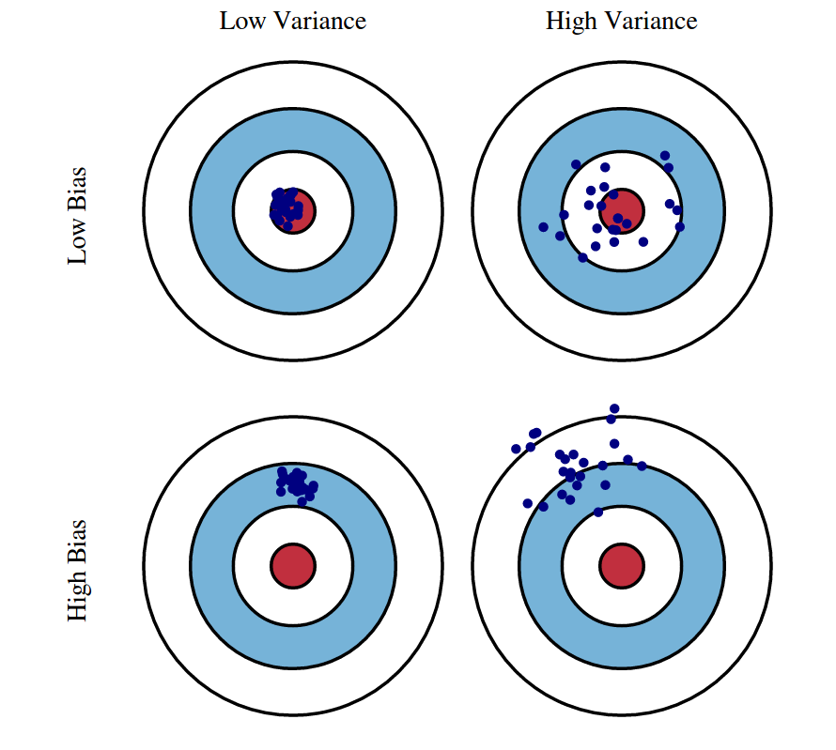
Consequences of missing data
Most researchers simply drop observations with any missing data
  Aka complete case analysis
Reduces the power of your analysis
  Smaller sample leads to less power
  Harder to prove differences
  Larger confidence intervals
Can lead to biased results
  Can overestimate or underestimate the
  true, underlying relationships

Slide 6
Hypothetical trial
See how missing data can decrease power and introduce bias
Let’s say we’re running a randomized control trial
  We have a treatment and control group
  We are measuring how many individuals develop a specific disease

Slide 7
Hypothetical trial
Treatment (n=120)
Placebo (n=120)

Slide 8
Hypothetical trial
Developed disease
Treatment (n=120)
Placebo (n=120)

Slide 9
Hypothetical trial
Scenario | Percent Missing | Treatment | Placebo | Estimated Risk Ratio
A (default) | 0%
B | 2%
C | 2%
D | 50%
E | 17%
https://academic.oup.com/ejendo/article/183/4/E7/6653760?login=false

Slide 10
Scenario A: default
Treatment (n=120)
Placebo (n=120)
24 individuals develop disease
40 individuals develop disease

Slide 11
Scenario A: default
Treatment (n=120)
Placebo (n=120)
24 individuals develop disease
40 individuals develop disease
Estimated risk of disease for treatment group is 0.6 times estimated risk of disease for placebo group (95% CI: 0.39, 0.93)

Slide 12
Hypothetical trial
Scenario | Percent Missing | Treatment | Placebo | Estimated Risk Ratio
A (default) | 0% | 24/120 | 40/120 | 0.60 (95% CI: 0.39, 0.93)
B | 2%
C | 2%
D | 50%
E | 17%

Slide 13
Scenario B (2% missing)
Treatment (n=115)
Placebo (n=120)
19 individuals develop disease
40 individuals develop disease

Slide 14
Scenario B (2% missing)
Treatment (n=115)
Placebo (n=120)
19 individuals develop disease
40 individuals develop disease
Estimated risk of disease for treatment group is 0.5 times estimated risk of disease for placebo group (95% CI: 0.31, 0.80)

Slide 15
Hypothetical trial
Scenario | Percent Missing | Treatment | Placebo | Estimated Risk Ratio
A (default) | 0% | 24/120 | 40/120 | 0.60 (95% CI: 0.39, 0.93)
B | 2% | 19/115 | 40/120 | 0.50 (95% CI: 0.31, 0.80)
C | 2%
D | 50%
E | 17%

Slide 16
Scenario C (2% missing)
Treatment (n=120)
Placebo (n=115)
24 individuals develop disease
35 individuals develop disease

Slide 17
Scenario C (2% missing)
Treatment (n=120)
Placebo (n=115)
24 individuals develop disease
35 individuals develop disease
Estimated risk of disease for treatment group is 0.66 times estimated risk of disease for placebo group (95% CI: 0.42, 1.03)

Slide 18
Hypothetical trial
Scenario | Percent Missing | Treatment | Placebo | Estimated Risk Ratio
A (default) | 0% | 24/120 | 40/120 | 0.60 (95% CI: 0.39, 0.93)
B | 2% | 19/115 | 40/120 | 0.50 (95% CI: 0.31, 0.80)
C | 2% | 24/120 | 35/120 | 0.66 (95% CI: 0.42; 1.03)
D | 50%
E | 17%

Slide 19
Scenario D (50% missing)
Treatment (n=60)
Placebo (n=60)
12 individuals develop disease
20 individuals develop disease

Slide 20
Scenario D (50% missing)
Treatment (n=60)
Placebo (n=60)
12 individuals develop disease
20 individuals develop disease
Estimated risk of disease for treatment group is 0.6 times estimated risk of disease for placebo group (95% CI: 0.32, 1.12)

Slide 21
Hypothetical trial
Scenario | Percent Missing | Treatment | Placebo | Estimated Risk Ratio
A (default) | 0% | 24/120 | 40/120 | 0.60 (95% CI: 0.39, 0.93)
B | 2% | 19/115 | 40/120 | 0.50 (95% CI: 0.31, 0.80)
C | 2% | 24/120 | 35/120 | 0.66 (95% CI: 0.42; 1.03)
D | 50% | 12/60 | 20/60 | 0.60 (95% CI: 0.32, 1.12)
E | 17%

Slide 22
Scenario E (17% missing)
Treatment (n=100)
Placebo (n=100)
15 individuals develop disease
25 individuals develop disease

Slide 23
Scenario E (17% missing)
Treatment (n=100)
Placebo (n=100)
15 individuals develop disease
25 individuals develop disease
Estimated risk of disease for treatment group is 0.6 times estimated risk of disease for placebo group (95% CI: 0.34, 1.07)

Slide 24
Hypothetical trial
Scenario | Percent Missing | Treatment | Placebo | Estimated Risk Ratio
A (default) | 0% | 24/120 | 40/120 | 0.60 (95% CI: 0.39, 0.93)
B | 2% | 19/115 | 40/120 | 0.50 (95% CI: 0.31, 0.80)
C | 2% | 24/120 | 35/120 | 0.66 (95% CI: 0.42; 1.03)
D | 50% | 12/60 | 20/60 | 0.60 (95% CI: 0.32, 1.12)
E | 17% | 15/199 | 25/100 | 0.60 (95% CI: 0.34, 1.07)

Slide 25
Hypothetical trial
Scenario | Percent Missing | Treatment | Placebo | Estimated Risk Ratio
A (default) | 0% | 24/120 | 40/120 | 0.60 (95% CI: 0.39, 0.93)
B | 2% | 19/115 | 40/120 | 0.50 (95% CI: 0.31, 0.80)
C | 2% | 24/120 | 35/120 | 0.66 (95% CI: 0.42; 1.03)
D | 50% | 12/60 | 20/60 | 0.60 (95% CI: 0.32, 1.12)
E | 17% | 15/199 | 25/100 | 0.60 (95% CI: 0.34, 1.07)
Biased estimate
Loss of Power (larger CIs)

Slide 26
Preventing Missing Data
Motivation
Defining missing data
Handling missing data
Reporting missing data
Preventing missing data

Slide 27
Preventing missing data
Missing data is unavoidable, but we can work to minimize the amount of missing data
We can do this through:
  Trial design: study population, outcome measurement, and way treatment is administered
  Trial conduct: limiting the burden on participants

Slide 28
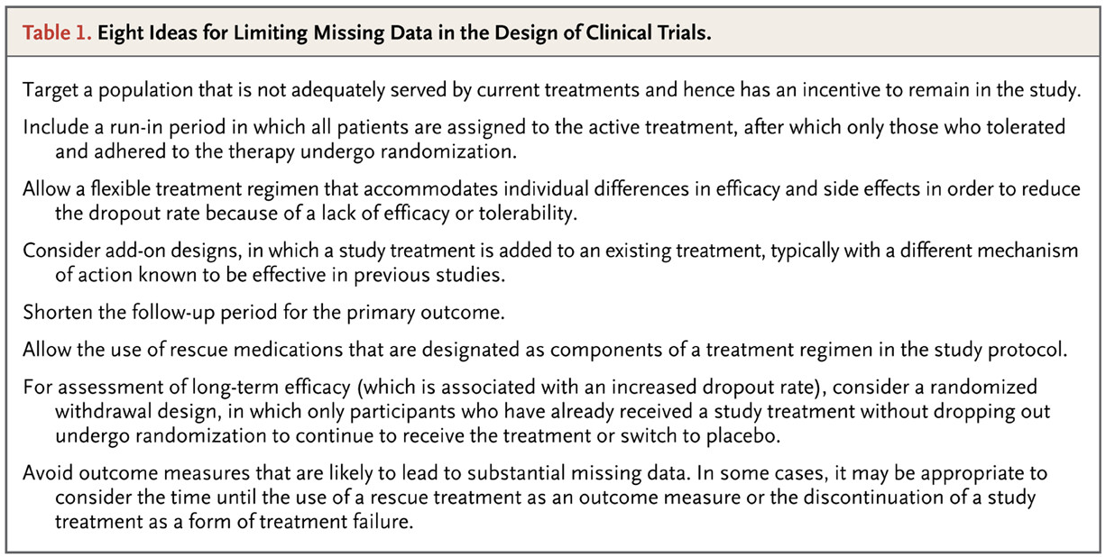
Trial design
https://www.nejm.org/doi/full/10.1056/NEJMsr1203730

Slide 29
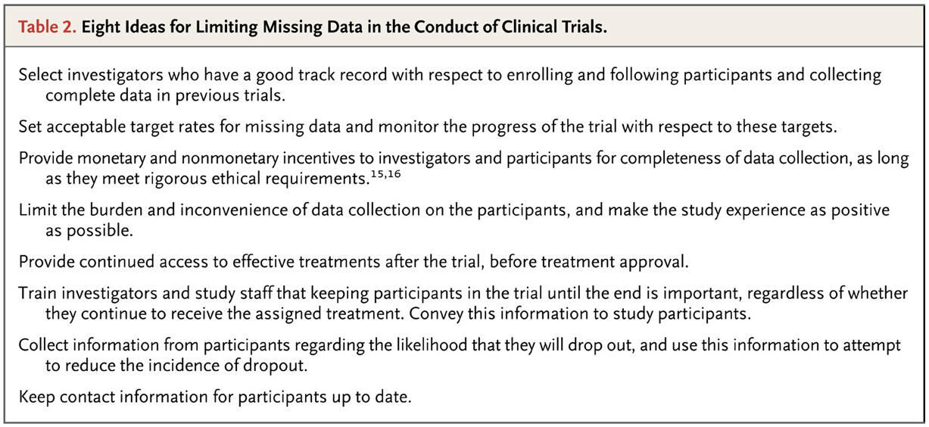
Trial conduct
https://www.nejm.org/doi/full/10.1056/NEJMsr1203730

Slide 30
Sample inflation is not prevention
Inflating the sample size to reach the originally desired sample size is NOT a good method!
  Does not account for why data is missing
Does not factor in that missing data may be fundamentally different than observed data
Will further strengthen any bias due to missing data
  Think back to Scenario B and C in hypothetical trial

Slide 31
Defining missing data
Motivation
Defining missing data
Handling missing data
Reporting missing data
Preventing missing data

Slide 32
Defining missing data
Three ways to define missing data
  Missing data patterns
  Missing data types/mechanisms
  Ignorability
Important definition
  Imputation: assigning a value to missing data

Slide 33
1. Missing data patterns
“Describes where the gaps in data are” (Koptur site)
Will help us determine what statistical methods are appropriate for imputing missing data

Slide 34
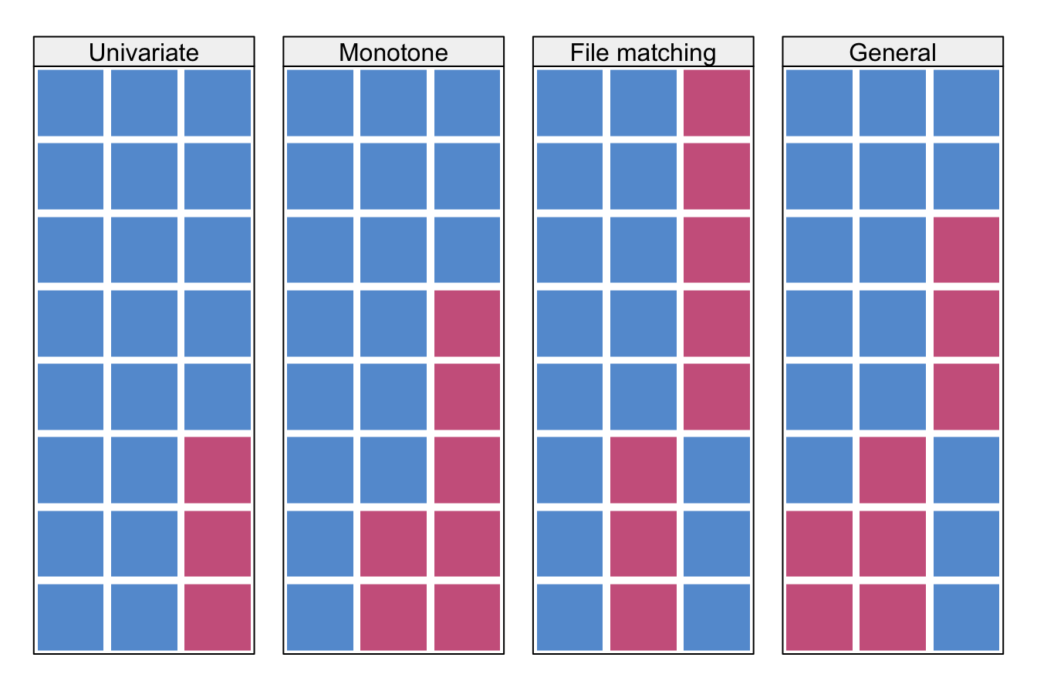
Missing data patterns
Univariate: only one variable has missing data
Monotone: drop out in longitudinal studies
File matching: variables are not observed together
General: multiple variables and at any time point
https://stefvanbuuren.name/fimd/missing-data-pattern.html

Slide 35
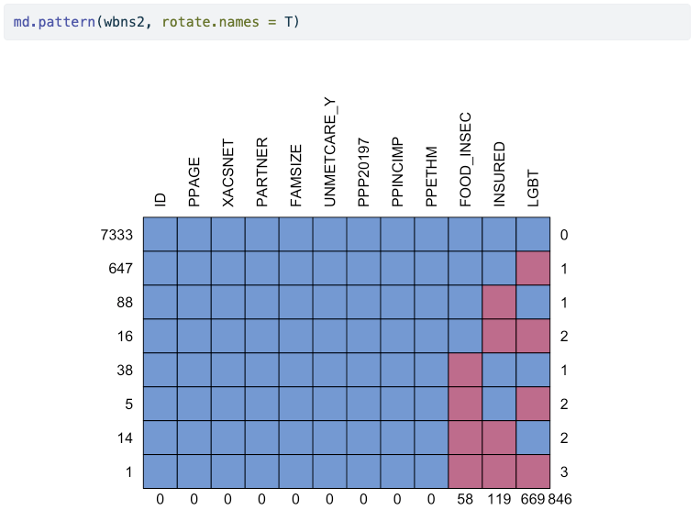
Missing data pattern

Slide 36
2. Missing data types/mechanisms
Missing completely at random (MCAR)
  Probability of missing data is independent of observed and unobserved data
  No reason why the data are missing
Missing at random (MAR)
  When we condition on the observed data, the probability of missing data is independent of unobserved data
  Reason for missingness can be determined from our observed data
Missing not at random (MNAR)
  Probability of missing data is NOT independent of unobserved data (whether we condition on the observed data or not)
  The thing that’s causing the missing data is also missing

Slide 37

I’m collecting data on the color of my cats…
Possible colors: white, black, brown, tan, light grey, dark grey, calico
white
light grey
brown
black
Missing completely at random
I randomly picked up whatever cats I could find, and recorded their color.
orange
black
dark grey
light grey
calico

Slide 38
I’m collecting data on the color of my cats…
Possible colors: white, black, brown, tan, light grey, dark grey, calico
white
white
tan
dark grey
light grey
brown
black
white
Missing at random
I also observed and recorded their eye colors, and (for some reason??) didn’t pick up cats with green eyes.
orange
white
dark grey
calico
dark grey
white
calico

Slide 39
I’m collecting data on the color of my cats…
Possible colors: white, black, brown, tan, light grey, dark grey, calico
white
light grey
tan
brown
black
Missing not at random
I picked up my favorite cats, but I’ll never record which ones are my favorite.
dark grey
black
dark grey
white
light grey

Slide 40
3. Ignorable vs. Non-ignorable
Type of missingness dictates (statistically) how we need to address the missing data
We often group the types into ignorable and non-ignorable missing data
Ignorable: Measures that are missing can be inferred from the observed data
Non-ignorable: Measures that are missing cannot be inferred from observed data
Note: ignorable does NOT mean we do not need to address the missing data
  We still need to address ignorable missing data
  Non-ignorable means we cannot proceed with analysis

Slide 41
Why is it important to determine the type?
For each type/mechanism, there is a specific way to address the missing data
MCAR (ignorable): we do not need to impute the missing data
MAR (ignorable): we can use the observed data to impute the missing data
MNAR (non-ignorable): we cannot use observed data to impute and we need to conduct further research on what we can measure to determine why data are missing

Slide 42
How to determine the missing mechanism
When in doubt between MCAR and MAR, just assume MAR
So I’d say the biggest decision is ignorable vs. non-ignorable
  And this is NOT something we can test for statistically
  So we need to use field knowledge
If ignorable (MCAR or MAR), we can use imputations
If non-ignorable, we need to incorporate more variables for more information

Slide 43
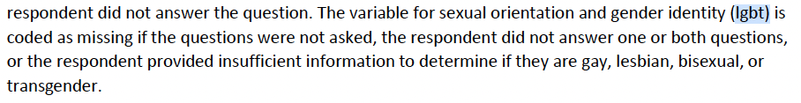
Example: LGBT variable
Why is it missing?
Look at the User Guide
This makes me think it might be MNAR
  Seems like options for sexual orientation and gender identity are lacking
  Missing LGBT observation may be linked to queer identities
  Are missing values more likely queer folks not answering?
Two options
  Assume MAR, impute, and then perform a sensitivity analysis
  Missing indicator method: missing values become their own category

Slide 44
Example: insurance
If MNAR: underlying insurance status may determine if missing
  Any other unobserved traits may determine
If MAR: then we can impute
  Maybe missing insurance is related to unmet care?
Three options
  Assume MAR, impute, and then perform a sensitivity analysis
  Missing indicator method: missing values become their own category
  Use the 5 imputed sets in the dataset
Check User Guide, and looks like they used additional info not available to us to generate 5 imputations (page 6 of User Guide)

Slide 45
5 min break + me giving your missing data mechanism
When you come back, you will receive a paper from me with your assignment for first activity
Notes:
2 1 1 2 3 2 3 2 3 1 3 1

Slide 46
Break for activity part 1
We will split into groups of 3-4. Each person in the group will be assigned a missing type (MCAR, MAR, or MNAR)
15 minutes

Slide 47
Handling missing data
Motivation
Defining missing data
Handling missing data
Reporting missing data
Preventing missing data

Slide 48
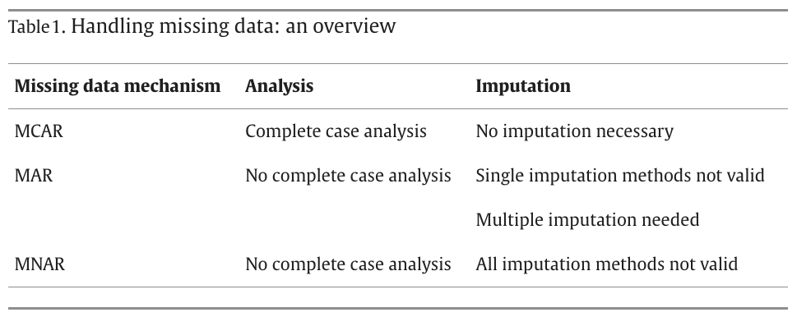
Handling missing data
https://www.sciencedirect.com/science/article/pii/S0895435622002189

Slide 49
Statistical methods to handle missing data
Leave data as is (analysis):
  Only works for MCAR (does not introduce bias)
  We use the observed data to perform our analysis
Generate observations for missing data (imputation):
  Works for MCAR or MAR
  We use the observed data to impute the missing data

Slide 50
If MCAR and proceeding with analysis
We use the observed data to perform our analysis
Two common approaches
  Complete case analysis (Listwise deletion)
    Use only the observations with complete information
  Pairwise deletion
    Use incomplete observations
    Missing variables within each incomplete obersvation will not be analyzed

Slide 51
If MCAR or MAR and proceeding with imputation
Works to fill in missing data with the best guess value
Structures to imputation: number of imputations performed on data
  Single imputation: One imputation, one analysis
    For methods with best guess that never changes
    Generally not advised
  Multiple imputation:
    More than one imputation with their own analyses
    Pool together the results from all the analyses
    Typically better because it includes the uncertainty around our best guess value

Slide 52
Methods of imputation: single imputation
Again, generally not advised
Mean imputation
  For number values, take the mean of the observed values
  Fill missing data with mean value
Last observation carried forward (LOCF)
  For longitudinal studies: replace missing data with previous observation
  Example: height in child’s growth trajectory
Baseline observation carried forward (BOCF)
  Similar to LOCF except you take the baseline value

Slide 53
Multiple imputation framework
Imputed dataset 1
Analyze dataset 1, find parameter estimate
Imputed dataset 2
Analyze dataset 2, find parameter estimate
Data with missing values
Imputed dataset 3
Analyze dataset 3, find parameter estimate
Pool results from imputations
Imputed dataset m
Analyze dataset m, find parameter estimate

Slide 54
Multiple imputation framework
How do we impute the data?
Imputed dataset 1
Analyze dataset 1, find parameter estimate
Imputed dataset 2
Analyze dataset 2, find parameter estimate
Data with missing values
Imputed dataset 3
Analyze dataset 3, find parameter estimate
Pool results from imputations
Imputed dataset m
Analyze dataset m, find parameter estimate

Slide 55
Methods of imputation: multiple imputation
Regression imputation/joint modeling
  Use observed data to construct model to predict another variable
  Then we use the prediction to impute data
Hot-deck
  Create a donor pool of observations that are similar to observation with missing data
  Randomly pick from donor pool
Each of the above can be used as a single imputation, but it does not capture to the uncertainty in the imputations!

Slide 56
How to pool results?
Rubin’s Rules!!
This applies to parameter estimates in regression
Use parameter estimate and sampling variance for parameter estimate

Slide 57
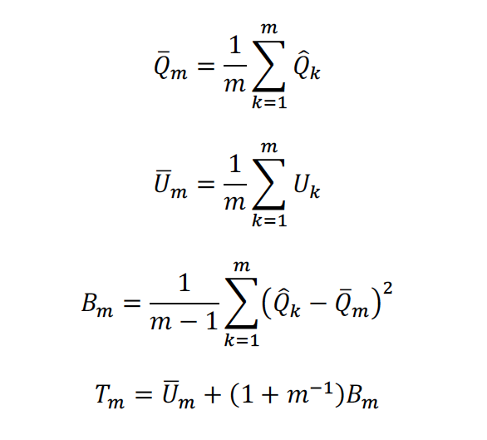
Rubin’s Rules
Number of imputations
Parameter estimate for imputation k
Sampling variance of parameter estimate for imputation k
Variance of combined parameter estimate
Combined variance
Butera et al, 2018

Slide 58
Reporting missing data
Motivation
Defining missing data
Handling missing data
Reporting missing data
Preventing missing data

Slide 59
Report information on missing data!!
It is important to be transparent about missing data
At the very least, make sure the following is presented on missing data:
  How much
    Percentage for each variable
    Percentage with incomplete data
  Why
  Potential consequences
  Method to handle (can be complete case only)

Slide 60
Reporting guidelines from Van Buuren textbook
Amount of missing data
Reasons for missingness
Consequences
Method to account of missing data
If imputing:
  Software
  Number of imputed datasets
  Derived variables
  Diagnostics
  Pooling
  Compare to complete case analysis
  Sensitivity analysis

Slide 61
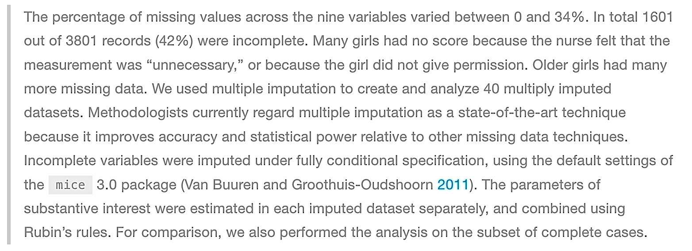
Example from Van Buuren textbook

Slide 62
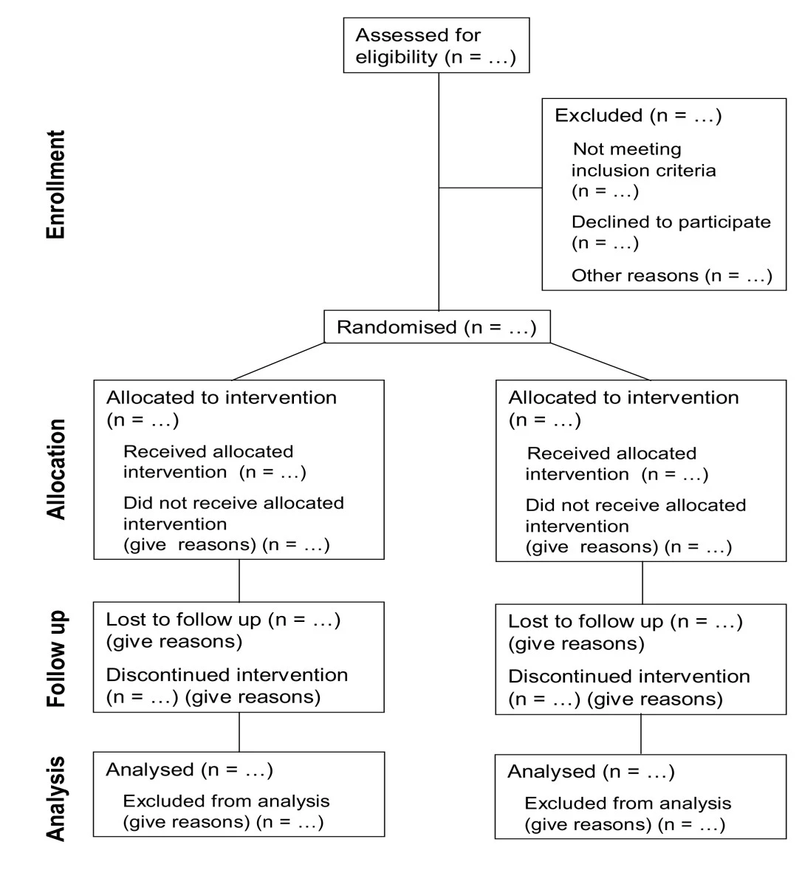
Presenting your sample size
Good way to report reasons and amount
Based on CONSORT (Consolidated Standards of Reporting Trials)
Present loss to follow-up or any other reasons that may result in smaller n for analysis
May need figure out the reasons
https://trialsjournal.biomedcentral.com/articles/10.1186/1745-6215-12-253

Slide 63
Break for activity part 2

Slide 64
Closing words
If you take one thing from today, I hope it is that missing data is complicated
If you’re not sure how to address missing data, at least be transparent about the data and your procedure!
Work with statisticians if you need help
  Design a study that limits missing data
  Address any missing data
Great online textbook: Flexible Imputation of Missing Data

