Slide 1
Explanatory Variable | Response Variable |  | Total
 | Failure/Control (0) | Success/Case (1)
Group 1 | 40 (n₁₀) | 40 (n₁₁) | 80 (n₁)
Group 2 | 160 (n₂₀) | 60 (n₂₁) | 220 (n₂)
Total | 200 (n_{F}) | 100 (n_{S}) | 300 (n)
Explanatory Variable | Response Variable |  | Total
 | Failure/Control (0) | Success/Case (1)
Group 1 | 4000 | 400 | 4400
Group 2 | 1600 | 600 | 1660
Total | 20000 | 1000 | 21000

Slide 2
Explanatory Variable | Response Variable |  | Total | Risk
 | Failure (0) | Success (1)
Group 1 | 9 | 9 | 18 | 0.5
Group 2 | 981 | 1 | 982 | 0.00102
Total | 990 | 10 | 1000 | 0.01010
Explanatory Variable | Response Variable |  | Total | Risk
 | Failure (0) | Success (1)
Group 1 | 100 | 9 | 109 | 0.0826
Group 2 | 981 | 1 | 982 | 0.00102
Total | 1081 | 10 | 1091 | 0.00925

Slide 4
Monday’s response | Wednesday’s response |  | Total
 | Good | Bad | Total
Good
Bad
Total

Slide 5
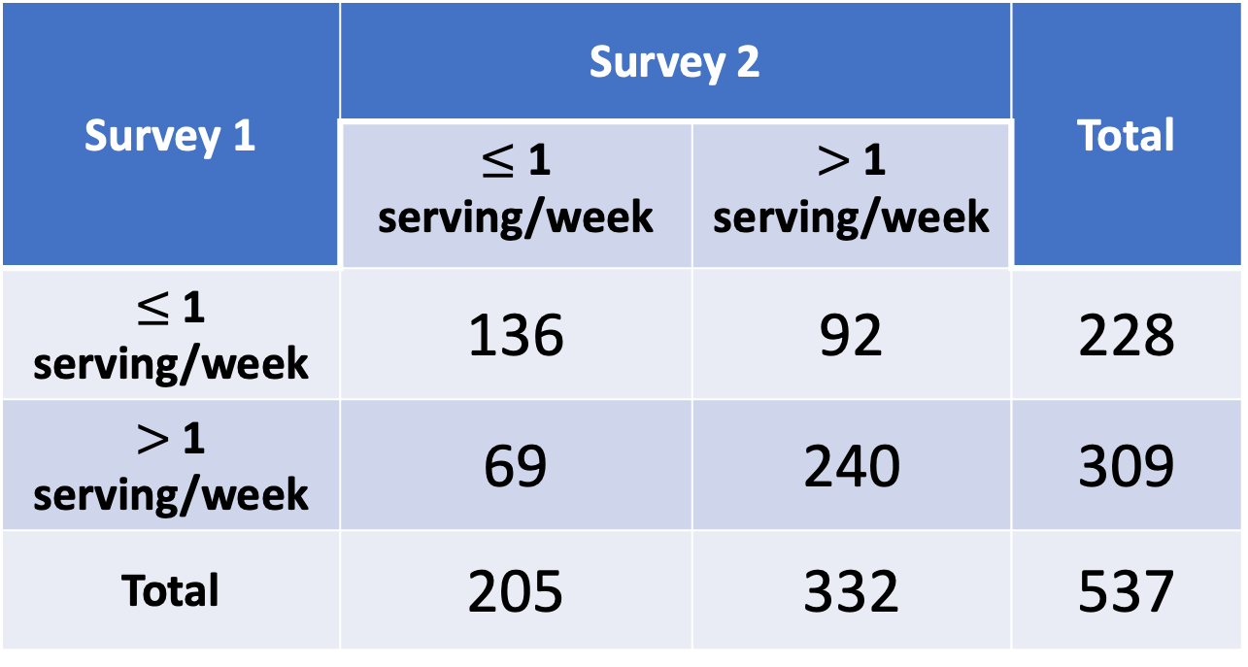
Survey 1 | Survey 2 |  | Total
 | $≤$ 1 serving/week | $>$ 1 serving/week | Total
$≤$ 1 serving/week | 136 | 92 | 228
$>$ 1 serving/week | 69 | 240 | 309
Total | 205 | 332 | 537

Slide 6
Measurement | Pros and Cons | Case-control study? | Cohort study? | RCT?
Risk difference | Can provide additional information, but can be misleading on its own Not the preferred measurement | 🚫 | ✅ | ✅
Risk ratio / prevalence ratio | Easy to interpret because is a ratio of probabilities Cannot use in retrospective, case-control studies | 🚫 | ✅ | ✅
Odds ratio | Good estimate of RR for rare diseases RR can be calculated for OR regardless of disease rate Not as easy to interpret or translate to clinical setting as RR Most preferred by statisticians because integrated into logistic regression | ✅ | ✅ | ✅

