Slide 1
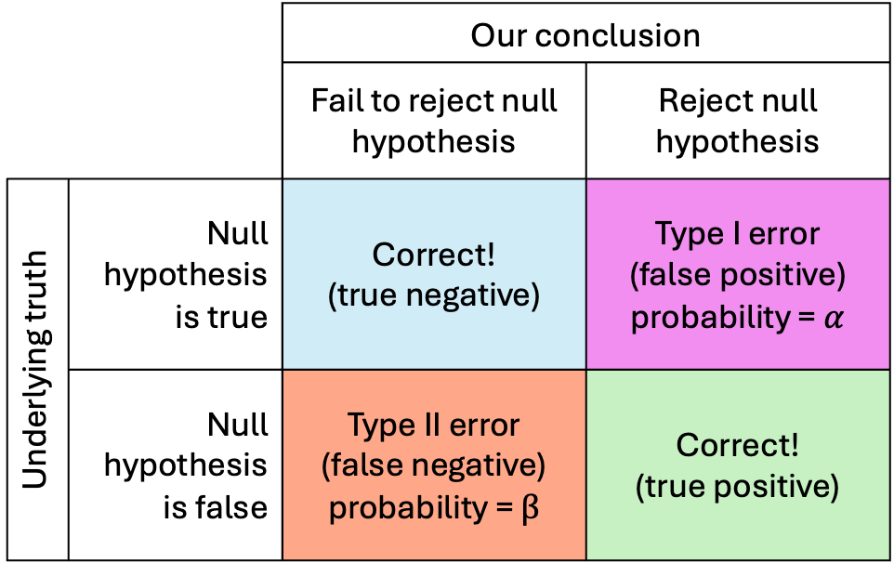
 |  | Our conclusion
 |  | Fail to reject null hypothesis | Reject null hypothesis
Underlying truth | Null hypothesis is true | Correct! (true negative) | Type I error (false positive) probability = $α$
 | Null hypothesis is false | Type II error (false negative) probability = $β$ | Correct! (true positive)

