Slide 1

Example to facilitate our thinking:
Population height

Slide 2

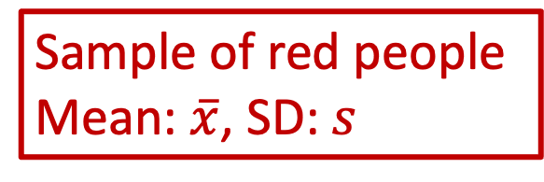
Sample of red people
Mean: $\overline{x}$, SD: $s$

Slide 3
Sample of red people
Mean: $\overline{x}$, SD: $s$
Heights of 10 people:
67 inches
57 inches
70 inches
61 inches
69 inches
68 inches
62 inches
75 inches
65 inches
59 inches

Slide 4
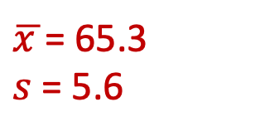
Sample of red people
Mean: $\overline{x}$, SD: $s$
$\overline{x }$= 65.3
$s$ = 5.6
From our red people sample, this is our best estimate of the population’s average height and standard deviation
When we are researching, this is usually the end of our data collection process!

Slide 5
Sample of red people
Mean: $\overline{x}$, SD: $s$
$\overline{x }$= 65.3
$s$ = 5.6
Even though this is the best estimate based on our sample, it may not truly capture the population.
Can we measure how well our sample captures the population?

Slide 6
Sample of red people
Mean: $\overline{x}$, SD: $s$
$\overline{x }$= 65.3
$s$ = 5.6
Even though this is the best estimate based on our sample, it may not truly capture the population.
Can we measure how well our sample captures the population?
BUILD A SAMPLING DISTRIBUTION

Slide 7

Sample of red people
Mean: $\overline{x}$, SD: $s$
$\overline{x }$= 65.3
$s$ = 5.6

Slide 8
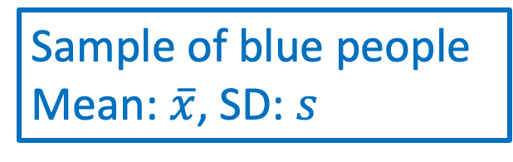
Sample of red people
Mean: $\overline{x}$, SD: $s$
$\overline{x }$= 65.3
$s$ = 5.6
Sample of blue people
Mean: $\overline{x}$, SD: $s$

Slide 9
Sample of red people
Mean: $\overline{x}$, SD: $s$
$\overline{x }$= 65.3
$s$ = 5.6
Sample of blue people
Mean: $\overline{x}$, SD: $s$
Heights of 10 people:
64 inches
67 inches
66 inches
61 inches
69 inches
68 inches
63 inches
71 inches
64 inches
68 inches
Notes:
Mean = 66. inches
Sd = 3.1 inches

Slide 10
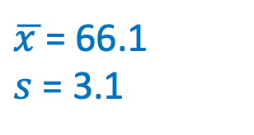
Sample of red people
Mean: $\overline{x}$, SD: $s$
$\overline{x }$= 65.3
$s$ = 5.6
Sample of blue people
Mean: $\overline{x}$, SD: $s$
$\overline{x }$= 66.1
$s$ = 3.1
Are these two sample means the same?
Notes:
Mean = 66. inches
Sd = 3.1 inches

Slide 11
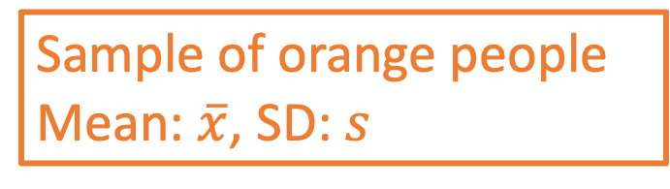
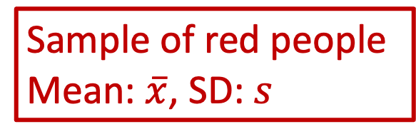
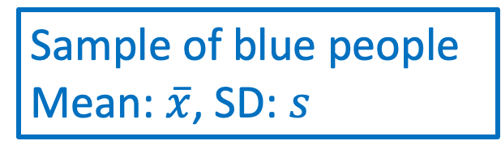
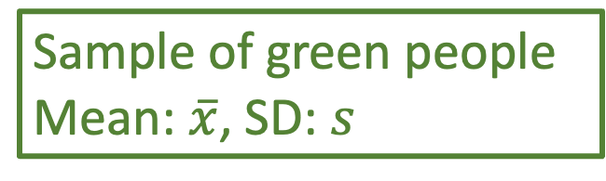
Sample of red people
Mean: $\overline{x}$, SD: $s$
Sample of blue people
Mean: $\overline{x}$, SD: $s$
Sample of orange people
Mean: $\overline{x}$, SD: $s$
Sample of green people
Mean: $\overline{x}$, SD: $s$

Slide 12
From our red sample alone, we don’t know how well it captures the population.
If we had access to many samples, we’d get a better picture of the population AND how the red sample relates to the population.

Slide 13
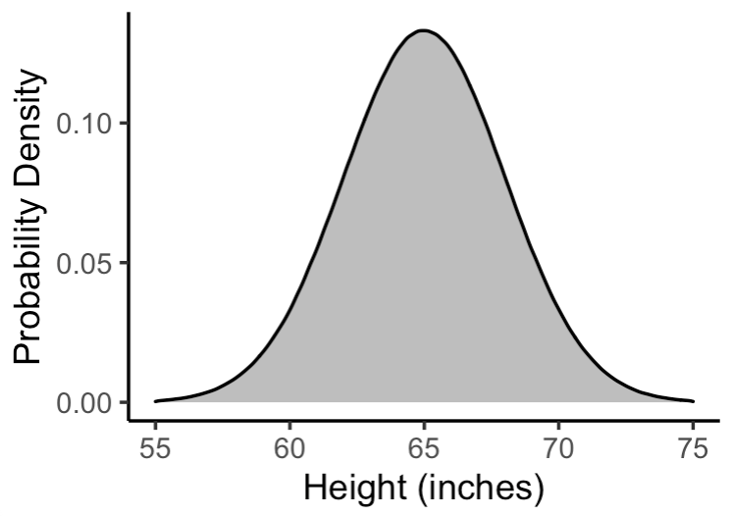
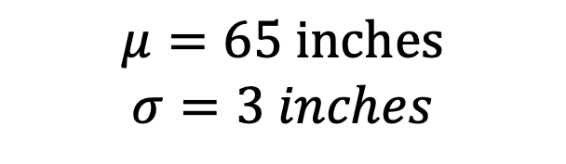
Let’s do a more concrete example with height
Population:
$$μ=65 inches$$
$$σ=3 inches$$

Slide 14
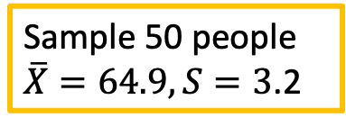
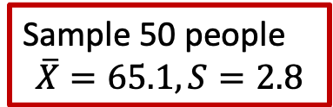
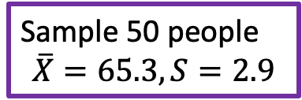
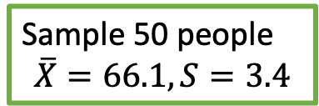
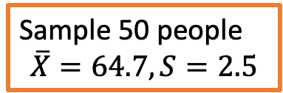
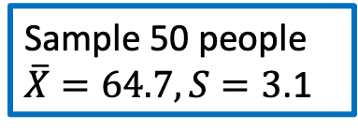
Let’s do a more concrete example with height
Sample 50 people
$$\overline{X}=65.1, S=2.8$$
1
Population:
Sample 50 people
$\overline{X}=64.7, S=3$.1
2
Sample 50 people
$$\overline{X}=64.7, S=2.5$$
3
Sample 50 people
$$\overline{X}=66.1, S=3.4$$
4
Sample 50 people
$$\overline{X}=65.3, S=2.9$$
5
$$μ=65 inches$$
$$σ=3 inches$$
…
Sample 50 people
$\overline{X}=64.9, S=3$.2
1000

Slide 15
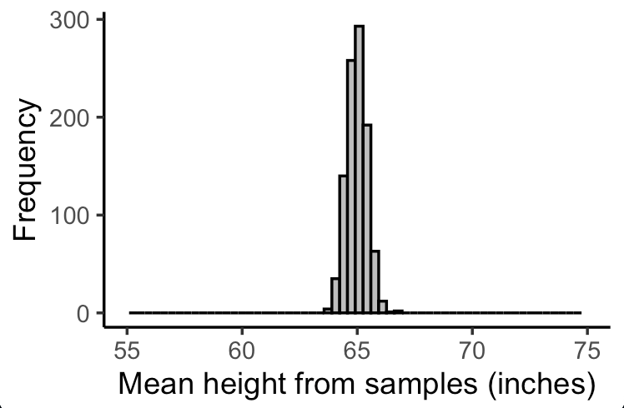
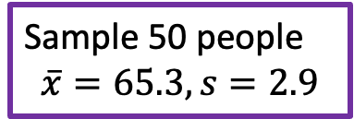
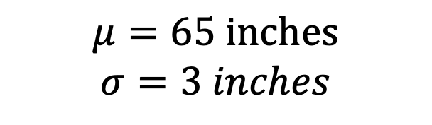
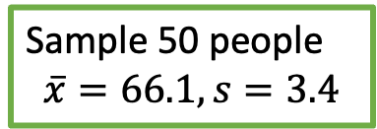

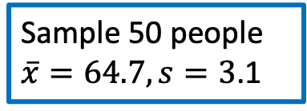
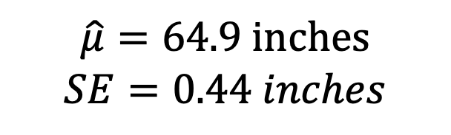
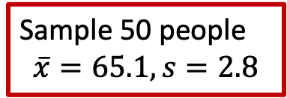
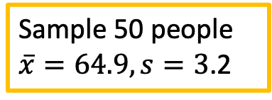
Let’s do a more concrete example with height
Sample 50 people
$$\overline{x}=65.1, s=2.8$$
Population:
1
Sampling Distribution:
Sample 50 people
$\overline{x}=64.7, s=3$.1
2
Sample 50 people
$$\overline{x}=64.7, s=2.5$$
3
Sample 50 people
$$\overline{x}=66.1, s=3.4$$
4
Sample 50 people
$$\overline{x}=65.3, s=2.9$$
5
$$μ=65 inches$$
$$σ=3 inches$$
…
$$\hat{μ}=64.9 inches$$
$$SE=0.44 inches$$
Sample 50 people
$\overline{x}=64.9, s=3$.2
1000
Notes:
While we go through the example, keep in mind that there are three standard deviations that I will refer to:
Variation (standard deviation) of the population (not observed)
Variation (standard deviation) within a sample (observed)
Variation (standard deviation) between samples

Slide 16
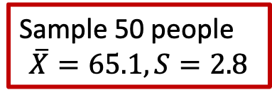

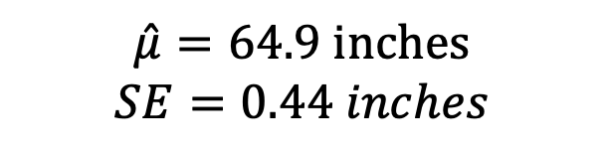
Different variabilities
Population:
$$μ=65 inches$$
$$σ=3 inches$$
Sample:
Sample 50 people
$$\overline{X}=65.1, S=2.8$$
1
Sampling Distribution:
$$\hat{μ}=64.9 inches$$
$$SE=0.44 inches$$
Notes:
While we go through the example, keep in mind that there are three standard deviations that I will refer to:
Variation (standard deviation) of the population (not observed)
Variation (standard deviation) within a sample (observed)
Variation (standard deviation) between samples

Slide 17
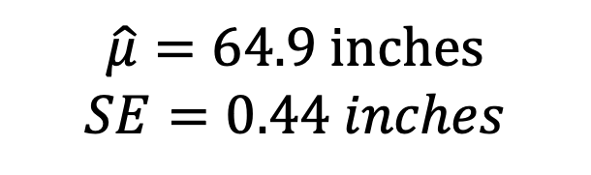
Sampling Distribution of Sample Means
We only know mean of the one sample we take
Sampling distribution is centered around the true population mean
Use properties of sampling distribution to see how our sample mean relates to the population mean
Sampling Distribution:
$$\hat{μ}=64.9 inches$$
$$SE=0.44 inches$$
Notes:
While we go through the example, keep in mind that there are three standard deviations that I will refer to:
Variation (standard deviation) of the population (not observed)
Variation (standard deviation) within a sample (observed)
Variation (standard deviation) between samples

Slide 18

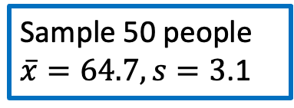
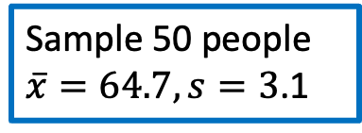
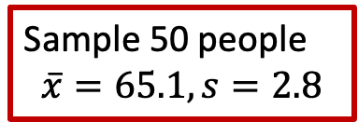

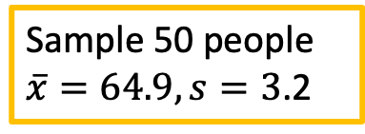

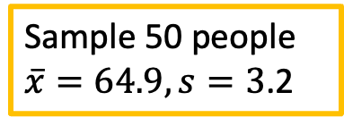
Sample 50 people
$\overline{x}=64.7, s=3$.1
Sample 50 people
$$\overline{x}=65.1, s=2.8$$
Sample 50 people
$\overline{x}=64.7, s=3$.1
Sample 50 people
$\overline{x}=64.9, s=3$.2
Sample 50 people
$$\overline{x}=66.1, s=3.4$$
Sample 50 people
$\overline{x}=64.9, s=3$.2
Sample 50 people
$$\overline{x}=65.1, s=2.8$$
Sample 50 people
$$\overline{x}=66.1, s=3.4$$

