Slide 1
Numerical Problems

Slide 2
Announcements
Really appreciate your feedback on ChatGPT
For those of you who expressed concerns about some students using it, I have given 0’s on problems where I identified its blatant use
Still looking through exams for any other signs
Unfortunately, we’re in an in-between phase while SPH works on developing school policies on ChatGPT’s use
One thing I want to say: whether you think it’s a good tool or not, there is certain expertise you should come out of this class with
In this class we are building nodes of knowledge and connecting those nodes
I’m playing catch up on all communication this week!

Slide 3
Project information
Education in screening data
Sorry for the back and forth on this
Please include education in your analysis
Missing data
Complete case analysis for our class
“drop_na()” in R should help
But make sure you drop NA’s in data frame that includes only your selected variables
Presentations
Given by the group
Ideally want each person to talk for some time
Will give more details and update project instructions

Slide 4
Midterm
Please come talk to me if you have questions
Or email!
There is still one student who has not taken the test, so we will not discuss answers in class
A couple questions that were challenging for majority of the class
Midterm feedback (mentioned in syllabus) will be sent out soon
Will help boost grades
Overall, very impressed with what you accomplished!

Slide 5
Homeworks
Homework 3
Redo due Friday, May 26, at 11pm
Homework 4
Graded and Released
Redo due Friday, June 2, at 11pm
Homework 5
Due Thursday, May 25, at 11pm

Slide 6
Numerical Problems

Slide 7
“Successful modeling of a complex data set is part science, part statistical methods, and part experience and common sense.”
Hosmer, Lemeshow, and Sturdivant Textbook, pg. 101

Slide 8
Class 13 Learning Objectives
Identify and troubleshoot logistic regression analysis when there are zero observations for the cross section of the outcome and a predictor
Identify and troubleshoot logistic regression analysis when there is complete separation between the two outcome groups
Identify and troubleshoot logistic regression analysis when there is collinearity between variables

Slide 9
Numerical Problems
Issues that may cause numerical problems:
Zero in a contingency table
Complete separation
Collinearity
All may cause large estimated coefficients and/or large estimated standard errors

Slide 10
Class 13 Learning Objectives
Identify and troubleshoot logistic regression analysis when there are zero observations for the cross section of the outcome and a predictor
Identify and troubleshoot logistic regression analysis when there is complete separation between the two outcome groups
Identify and troubleshoot logistic regression analysis when there is collinearity between variables

Slide 11
Zero cell in a contingency table
If no observations at any intersection of the covariate and outcome
Zero cell in a contingency table should be detected in descriptive statistical analysis stage
Example of one covariate with outcome:
Outcome | Covariate (x) |  |  | Total
 | 1 | 2 | 3
1 | 7 | 12 | 20 | 39
0 | 13 | 8 | 0 | 21
Total | 20 | 20 | 20 | 60

Slide 12
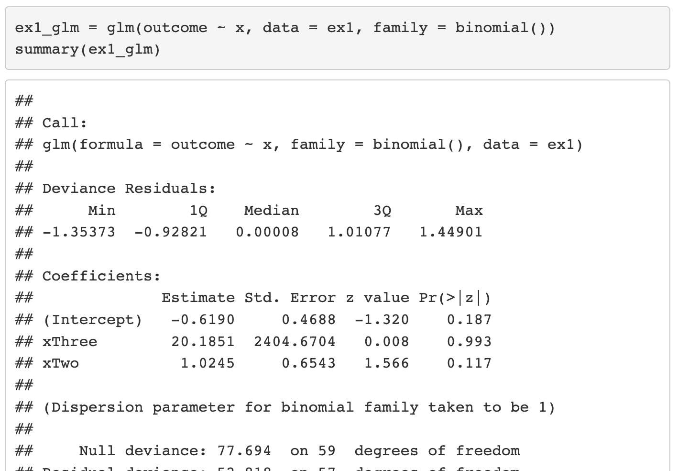
Zero cell in a contingency table
Example of one covariate with outcome:
Outcome | Covariate (x) |  |  | Total
 | 1 | 2 | 3
1 | 7 | 12 | 20 | 39
0 | 13 | 8 | 0 | 21
Total | 20 | 20 | 20 | 60

Slide 13
Zero cell in a contingency table
Example of one covariate with outcome:
Outcome | Covariate (x) |  |  | Total
 | 1 | 2 | 3
1 | 7 | 12 | 20 | 39
0 | 13 | 8 | 0 | 21
Total | 20 | 20 | 20 | 60
Coefficient estimate is large and standard error of coefficient is large!

Slide 14
Zero cell in a contingency table
Ways to address the issue (zero cell in a contingency table):
Add one-half to each of the cell counts
Technically works, but not the best option
May work for simple logistic regression
Rarely useful with a more complex analysis
Collapse the categories to remove the 0 cells
We could collapse groups 2 and 3 together if it makes clinical sense
Remove the category with 0 cells
This would mean we reduce the total sample size as well
If the variable is in ordinal scale, treat it as continuous
But check the linearity!!

Slide 15
Poll Everywhere Question 1

Slide 16
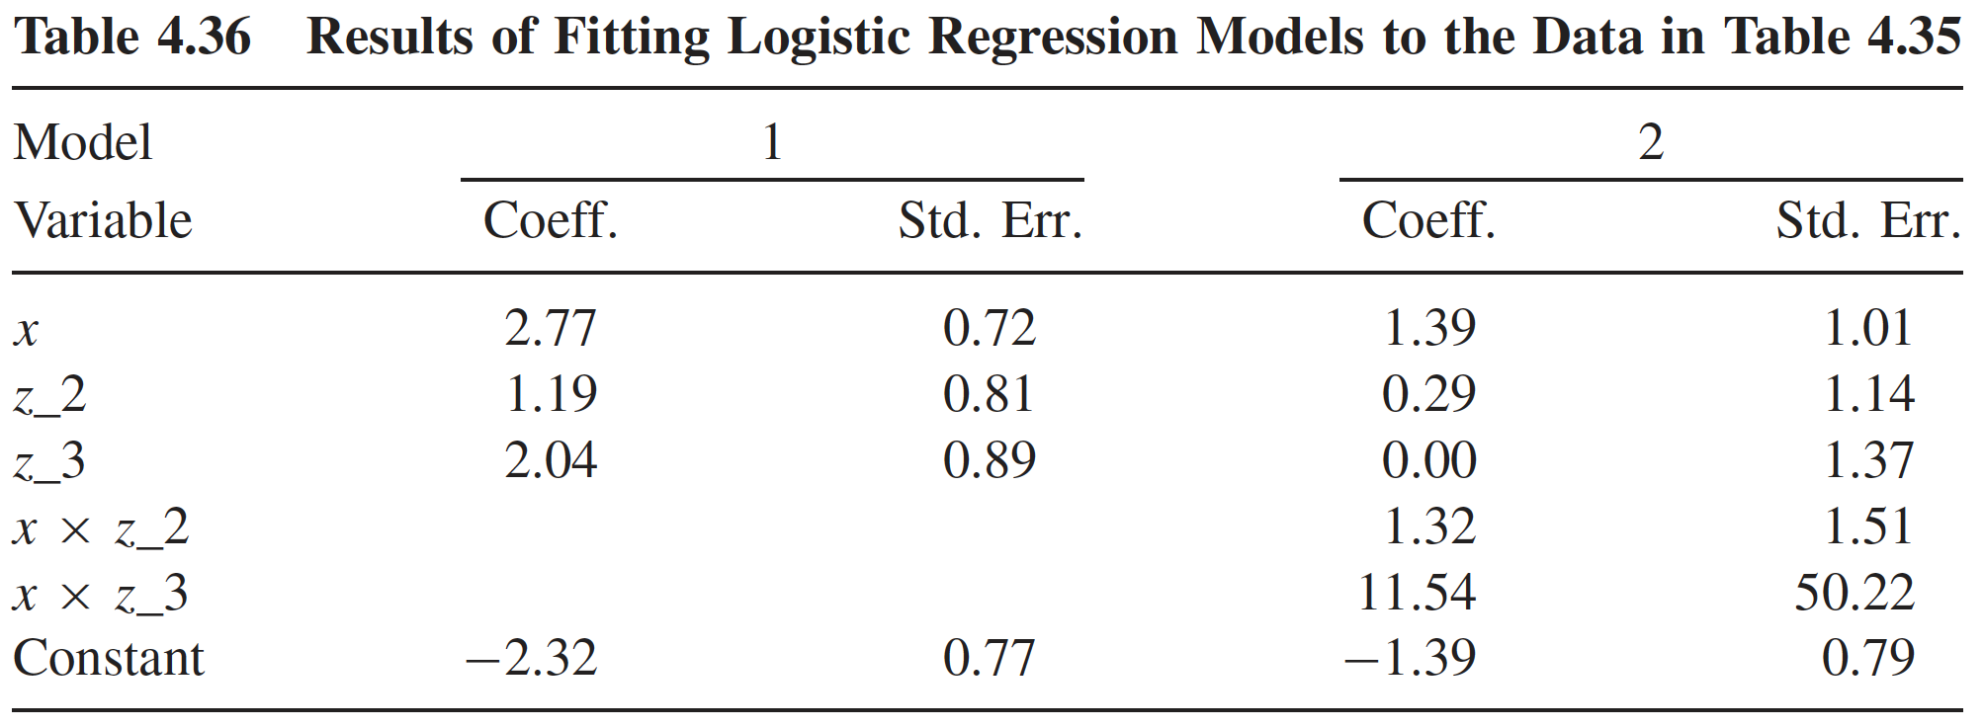
Zero cell in a contingency table: interaction
Often when we add in interactions, we don’t look at the contingency table first
We are looking at the results of a fit model with the interaction
Interaction term for x and third z group looks suspicious

Slide 17
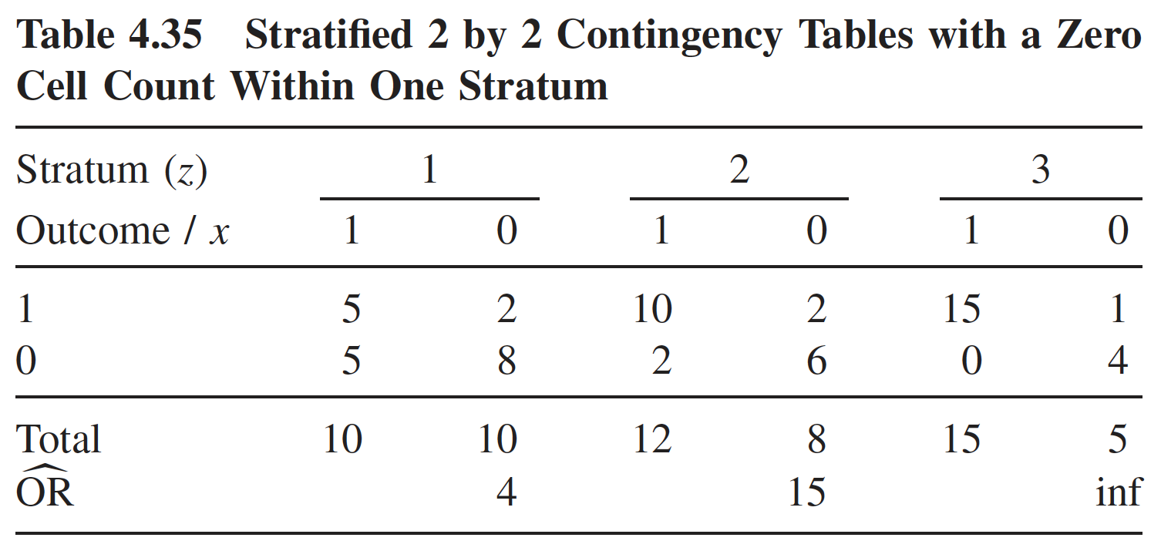
Zero cell in a contingency table: interaction
Contingency table used to detect zero cell issue when interaction term is included in the logistic regression model
Contingency table: interaction of z and x

Slide 18
Zero cell in a contingency table
Ways to address the issue (zero cell in a contingency table):
Add one-half to each of the cell counts
Collapse the categories to remove the 0 cells
We could collapse the second and third z groups
Not an option to collapse x
Remove the category with 0 cells
Remove z = 3, but then we lose 15 observations for x as well
If the variable is in ordinal scale, treat it as continuous
Could treat z as continuous

Slide 19
Class 13 Learning Objectives
Identify and troubleshoot logistic regression analysis when there are zero observations for the cross section of the outcome and a predictor
Identify and troubleshoot logistic regression analysis when there is complete separation between the two outcome groups
Identify and troubleshoot logistic regression analysis when there is collinearity between variables

Slide 20
Complete Separation
Complete separation: occurs when a collection of the covariates completely separates the outcome groups
Example: Outcome is “gets senior discount at iHop” and the only covariate you measure is age
Age will completely separate the outcome
No overlap in distribution of covariates between two outcome groups
Problem: the maximum likelihood estimates do not exist
Likelihood function is monotone
In order to have finite maximum likelihood estimates we must have some overlap in the distribution of the covariates in the model

Slide 21
Poll Everywhere Question 2

Slide 22
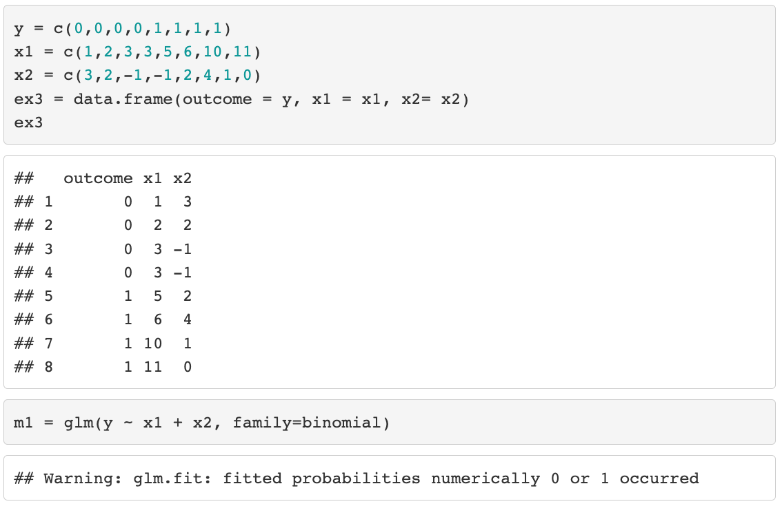
Complete Separation: example

Slide 23
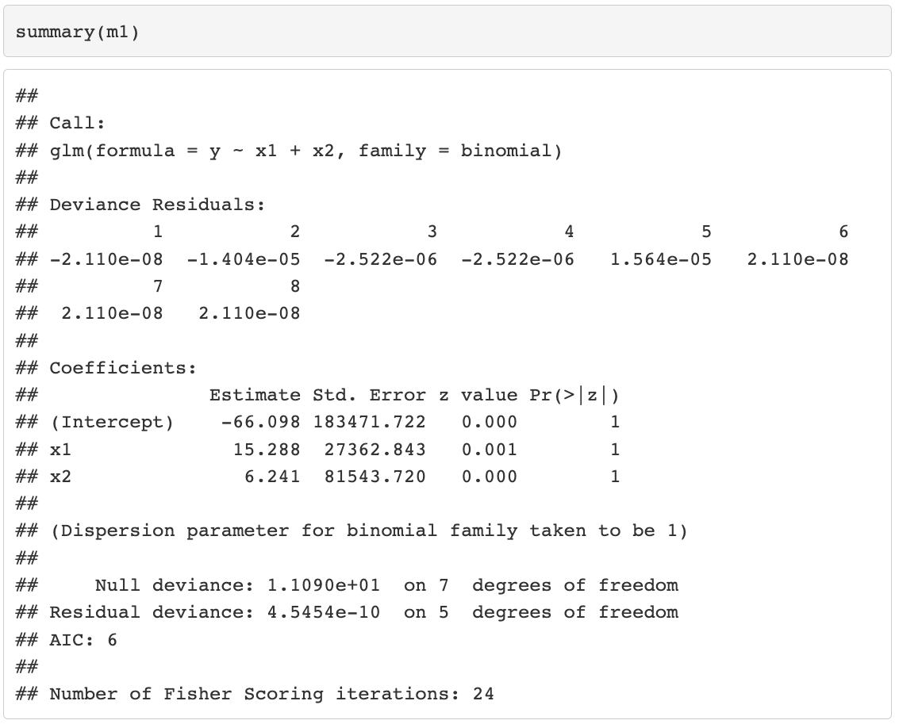
Complete Separation: example

Slide 24
Complete Separation: example
Coefficient estimate is large and standard error of coefficient is large!

Slide 25
Complete Separation
The occurrence of complete separation in practice depends on
Sample size
Number of subjects with the outcome present
Number of variables included in the model
Example: 25 observations and only 5 have “success” outcome
1 variable in model may not lead to complete separation
More variables = more dimensions that can completely separate the observations
In most cases, the occurrence of complete separation is not bad for clinical importance
But rather a numerical coincidence that causing problem for model fitting

Slide 26
Poll Everywhere Question 3

Slide 27

Complete Separation
Ways to address the issue:
Collapse categorical variables in a meaningful way
Easiest and best if stat methods are restricted (common for collaborations)
Exclude x1 from the model
Not ideal because this could lead to biased estimates for the other predicted variables in the model
Firth logistic regression
Uses penalized likelihood estimation method
Basically takes the likelihood (that has no maximum) and adds a penalty that makes the MLE estimatable

Slide 28
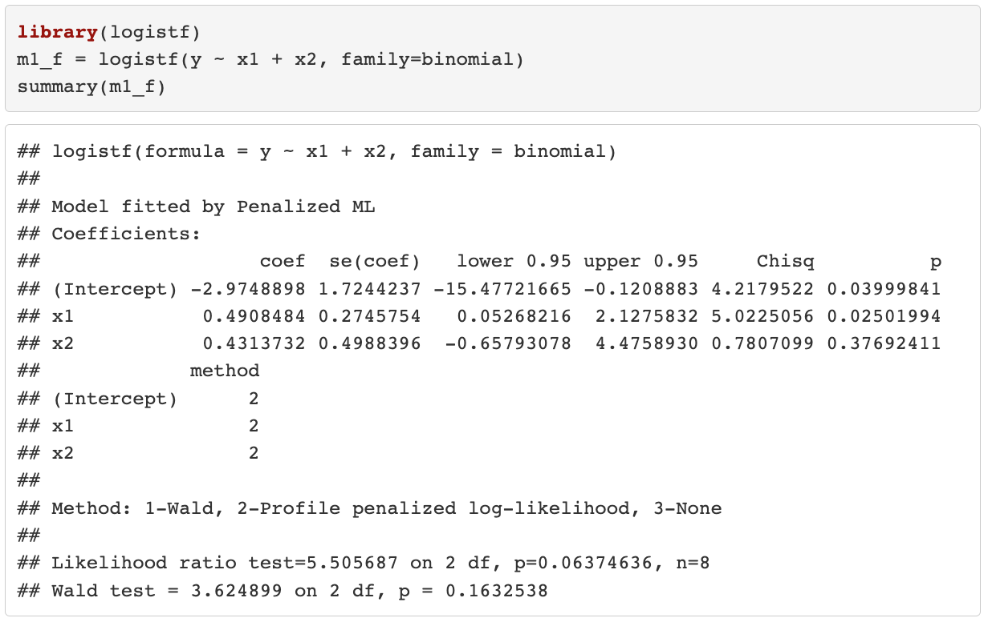
Complete Separation
Firth logistic regression

Slide 29
Class 13 Learning Objectives
Identify and troubleshoot logistic regression analysis when there are zero observations for the cross section of the outcome and a predictor
Identify and troubleshoot logistic regression analysis when there is complete separation between the two outcome groups
Identify and troubleshoot logistic regression analysis when there is collinearity between variables

Slide 30
Collinearity
Collinearity happens when one or more of the covariates in a model can be predicted from other covariates in the same model
This will cause unreliable coefficient estimates for some covariates in logistic regression, as in an ordinary linear regression
Looking at correlations among pairs of variables is helpful but not enough to identify collinearity problem
Because collinearity problems may involve relationships among more than two covariates

Slide 31
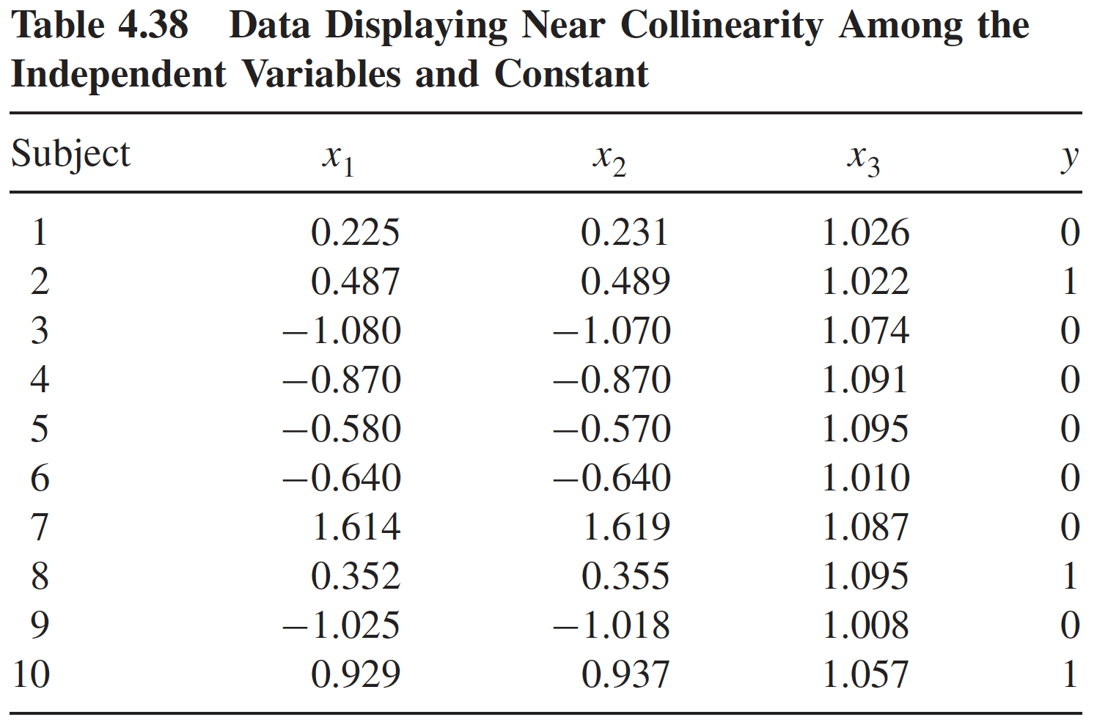

Collinearity
Table below is a simulated data with $x_{1}\sim N\left(0,1\right), x_{2}=x_{1}+U\left(0,0.1\right), { x}_{3}=1+U\left(0, 0.01\right)$
Therefore, $x_{1}$and $x_{2}$ are highly correlated, and $x_{3}$ is nearly collinear with the constant term.

Slide 32
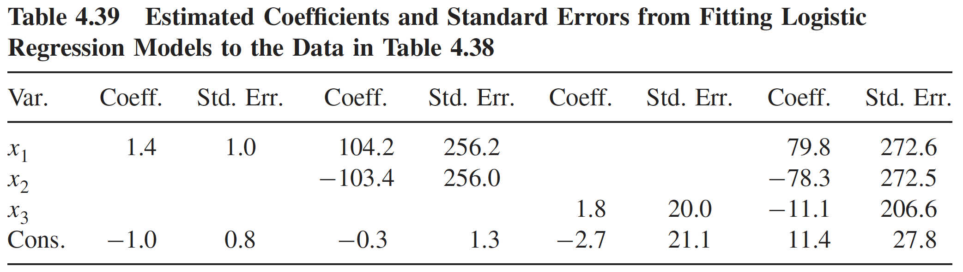
Collinearity
Four logistic regression models using data in the previous slide
Consequence of collinearity: large coefficient estimates and/or standard errors
Model 1: x1 only
Model 4: x1, x2, x3
Model 2: x1 and x2
Model 3: x3 only
Model 4: x1, x2, x3
Large coefficients and SE
Large SE
Large coefficients and SE

Slide 33
Collinearity
Four logistic regression models using data in the previous slide
Consequence of collinearity: large coefficient estimates and/or standard errors
Model 1: x1 only
Model 2: x1 and x2
Model 3: x3 only
Model 4: x1, x2, x3
Large coefficients and SE
Large SE
Large coefficients and SE

Slide 34
Collinearity
Four logistic regression models using data in the previous slide
Consequence of collinearity: large coefficient estimates and/or standard errors
Model 1: x1 only
Model 2: x1 and x2
Model 3: x3 only
Model 4: x1, x2, x3
Large coefficients and SE
Large SE
Large coefficients and SE

Slide 35
Collinearity
Collinearity only involves the covariates
No specific issues to logistic regression (vs. linear regression)
Techniques from 512/612 work well for logistic regression model
In more complicated dataset/analysis, we may not be able to detect collinearity using the coefficient estimates/SE
Variance inflation factor (VIF) approach: well-known approach to detect collinearity

Slide 36
https://statisticalhorizons.com/multicollinearity/

Slide 37
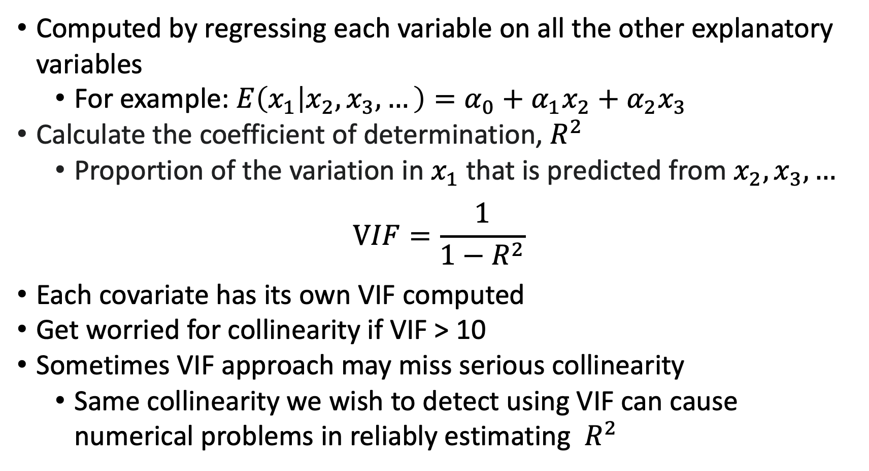
Variance Inflation Factor (VIF) Approach
Computed by regressing each variable on all the other explanatory variables
For example: $E\left(x_{1} | x_{2},x_{3},…\right)=α_{0}+α_{1}x_{2}+α_{2}x_{3}$
Calculate the coefficient of determination, $R^{2}$
Proportion of the variation in $x_{1}$that is predicted from $x_{2},x_{3},…$
$$VIF=\frac{1}{1−R^{2}}$$
Each covariate has its own VIF computed
Get worried for collinearity if VIF > 10
Sometimes VIF approach may miss serious collinearity
Same collinearity we wish to detect using VIF can cause numerical problems in reliably estimating $R^{2}$

Slide 38
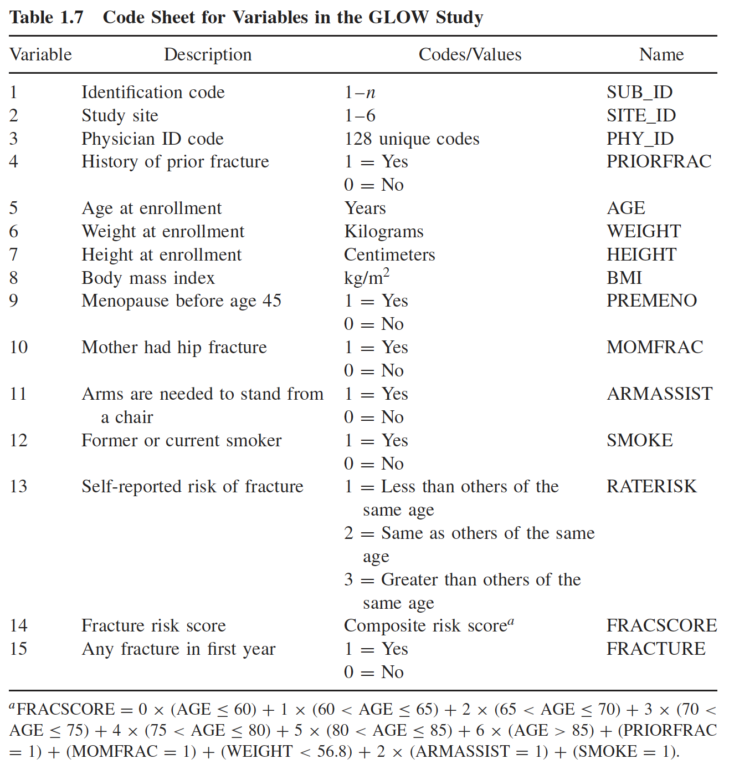
GLOW Study: Running example for class
Variables in the study
Fracture (last variable in table) is our outcome

Slide 39
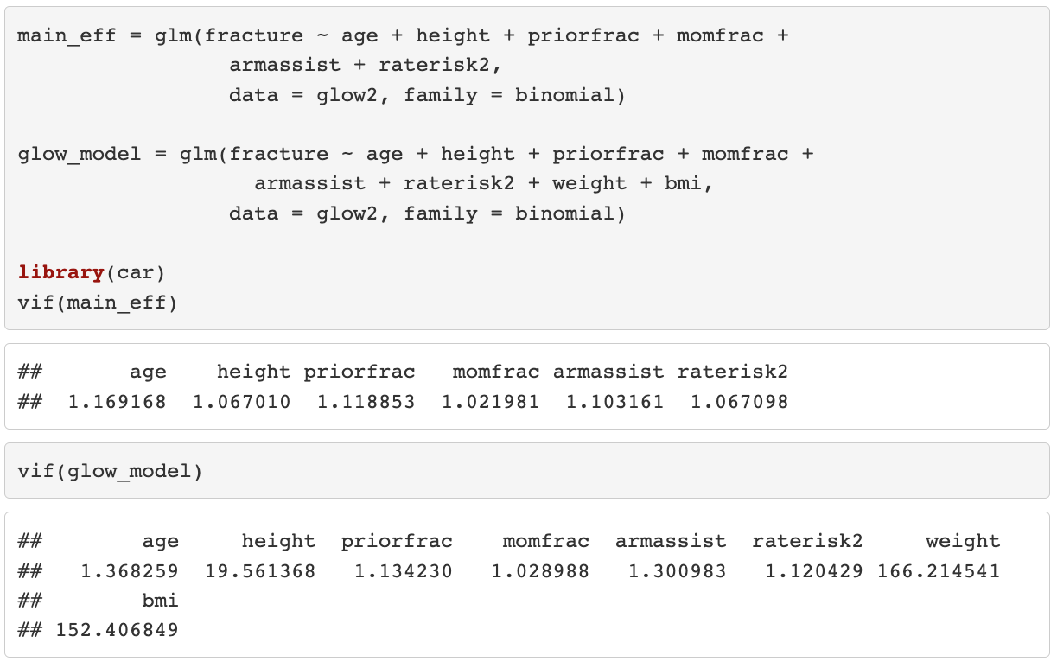
GLOW study: height, weight, BMI

Slide 40
Collinearity
Ways to address the issue:
Exclude the redundant variable from the model
In GLOW study, saw that height is okay without weight and BMI
Scaling and centering variables
When you have transformed a continuous variable
Other modeling approach (outside scope of this class)
Ridge regression
Principle component analysis

Slide 41
Poll Everywhere Question 4

Slide 42
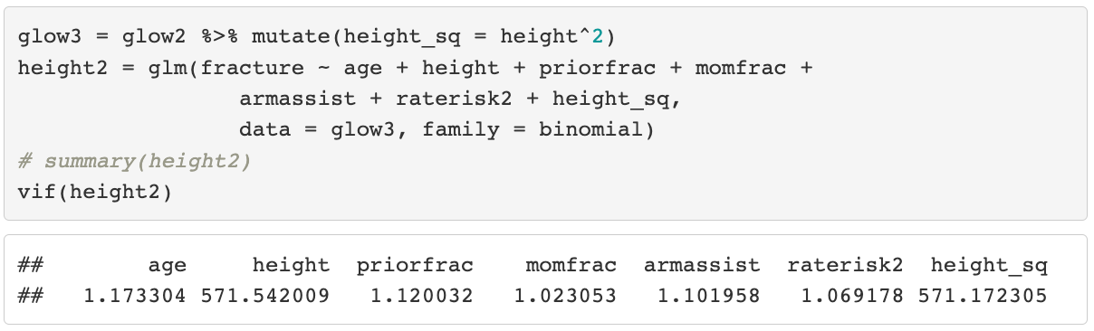
Collinearity
Scaling and centering variables
Let’s say we found that height is nonlinearly related to fracture, so include a squared height term

Slide 43
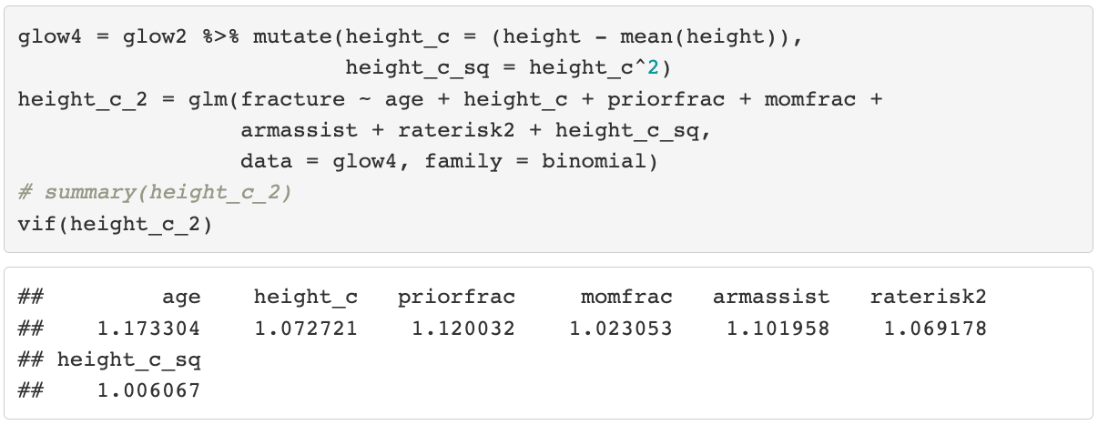
Collinearity
Scaling and centering variables
Centering height will reduce collinearity while still helping the nonlinear problem!

Slide 44
Class 13 Learning Objectives
Identify and troubleshoot logistic regression analysis when there are zero observations for the cross section of the outcome and a predictor
Identify and troubleshoot logistic regression analysis when there is complete separation between the two outcome groups
Identify and troubleshoot logistic regression analysis when there is collinearity between variables

Slide 45

Wrap-up
With experience and time, you won’t need to rely so heavily on the systematic approaches to model building and numerical problems
This is the experience part of the quote!
4-minute exit ticket
Next class
Assessing model fit
https://forms.office.com/r/kWwYz6cs5v

